Slide 1
(XVII.) PNEUMOGRAPHY
Dep. of Physiology, Fac. of Medicine, MU, 2015 © Mohamed Al-Kubati

Slide 2
Anatomy of respiratory system
Respiratory system
Airways
  Upper airways
  Lower airways
Lungs
Respiratory muscles
Inspiratory muscles
  Diaphragm
  External intercostal muscles
Accessory inspiratory muscles
  Scalene and sternocleidomastoid muscles
Expiratory muscles
  Internal intercostal muscles; abdominal muscles

Slide 3
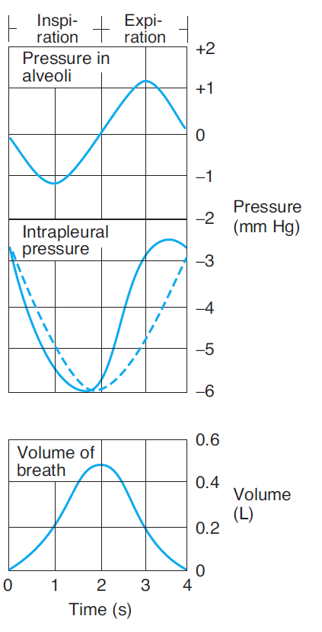
Changes of intrapleural and intraalveolar pressure (related to atmospheric pressure) during inspiration and expiration
Inspiration
Active process – contraction of respiratory muscles
Decrease of intrapleural pressure
Decrease of intraalveolar pressure
Due to pressure gradient, air flows into lungs
Expiration
Passive process (quiet expiration) – elasticity of thoracic wall and lungs
Increase of intrapleural and intraalveolar pressure
Air flows out of lungs

Slide 4
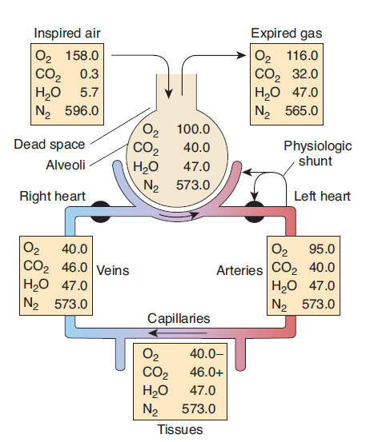
Partial pressures of gases (mm Hg) in various parts of the respiratory system and in the circulatory system

Slide 5
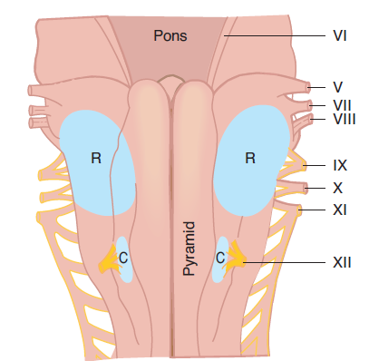
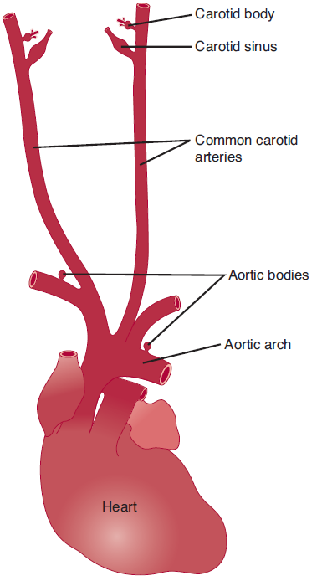
Chemical control of breathing
Chemoreceptors
- Peripheral
- Central

Slide 6
Equipment
- two respiratory belts for registration of respiratory movements
- nose clip
- sterile mouthpiece
- Krogh respirometer
- PowerLab system
Procedure
Record:
- Resting respiration (1 min)
- Respiration after a mild exertion (5 squats – 10 breathing cycles)
- Respiration after an intensive exertion (30 squats – 10 BC)
- Respiration after re-breathing of the expired air from Krogh respirometer (2-3 min + recovery)

Slide 7
Evaluation
Following parameters in 6 chosen breathing cycles in each recorded situation
T_{i} - duration of inspiration
T_{e} - duration of expiration
BI - duration of whole breathing cycle (breathing interval)
Ampl - amplitude of breathing movements
Create a table, calculate arithmetic means and standard deviations
Ampl
T_{i}
T_{e}
BI

Slide 8
Statistical analysis of obtained data
Choose two sets of data which will be analyzed
Follow the procedure in textbook

