Slide 1
Practical training
in Histology and Embryology

Slide 2
Organization issues
Beginning - strictly on time
Change your shoes - you will not be allowed to enter the hall w/o indoor shoes
Lockers – Jackets, coats, bags etc.
Cell phone – switched off or in silent mode
Microscopic hall = laboratory
– eating, drinking, smoking not allowed
– smoking strictly forbidden anywhere in LF
– students have to follow the instructions
– academic misconducts or inappropriate behavior result in excluding
from the lesson or course
Follow safety rules
You have dedicated working place
You are responsible for microscope, slide set, EM atlas

Slide 3
Practical lesson
Introduction; the images aree available through MedAtlas
your individual work = study of the slides, schematic but precise drawing of tissue architecture, careful description. You make your own „study atlas“
students come prepared for practices - schedules and syllables – pin-boards or dpt. webpage
your knowledge is verified during semester
break – 10 minutes
Attendance
100% attendance
substitution only in exceptional cases, after permissions from both the teacher of your group and the lesson where you plan to substitute
sign in to the list
make a protocol, let it check and signed by the lecturer

Slide 4
Registration of substitution:
Datum Jméno Ročník Skupina Č. praktika Č. místa Vyučující - podpis
Date Name Year Group Nr. of practice Nr. of place Teacher- signature

Slide 5
Protocols
you have to make paper protocols (no tablets, laptops)
A4 size, blank, without lines, according to the template (can be downloaded from www.med.muni.cz/histology - Education)
(color)pencil handdrawings (no pen)
complete set of signed protocols is required for getting the credits
the quality of the protocol is approved by your teacher’s signature at the end of practical lesson
incomplete or low-quality protocols cannot be approved and you have to substitute the respective practical lesson

Slide 6
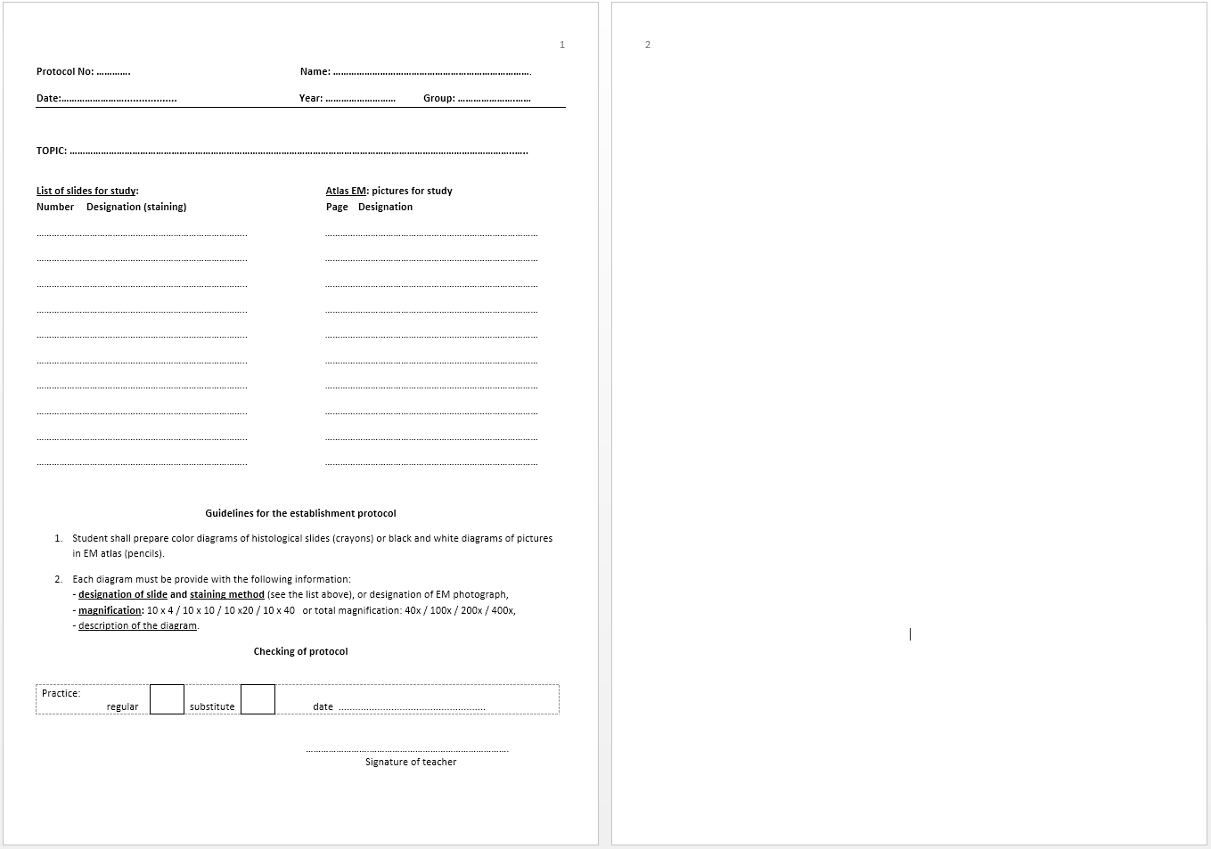

Slide 7
Testing your knowledge
every student is examined 4× per semester
testing the knowledge of structures of the previous practical lesson, including the theory (their English and Latin names, functions, development and biological context) AND the theory for the curent practical lesson
short written test with images or schemes, results: „Passed“ or „Failed“
all images and schemes are made public (MedAtlas, IS)
you have to successfully pass all 4 tests
if you fail in partial test, you can repeat it once per semester
failing in the partial tests result in the overal Credit test at the end of semester

Slide 8
Credits
100% attendance
complete set of signed protocols from all lessons
passed four tests
End of practical lesson:
the practice is closed by the lecturer
you are allowed to leave your working place only after checking the microscope and slides
if you leave before the check you may be responsible for any damages/losses recognized later

Slide 9
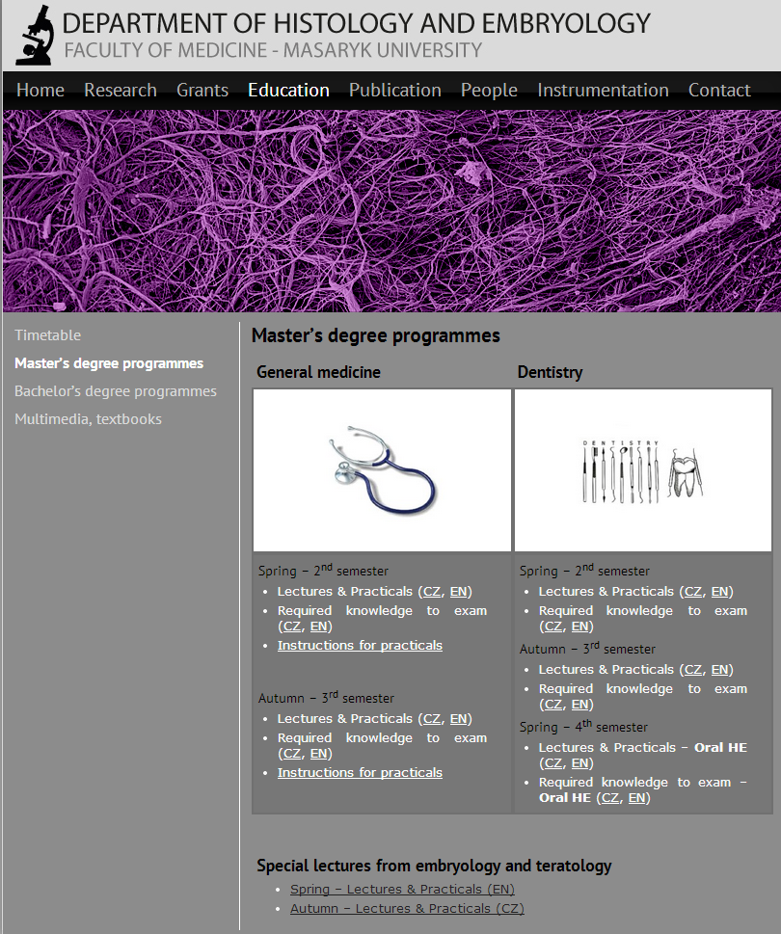
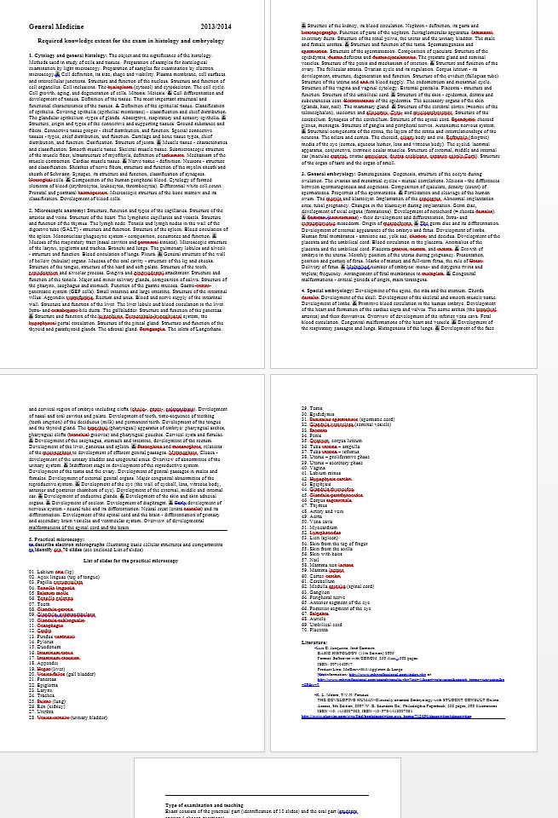
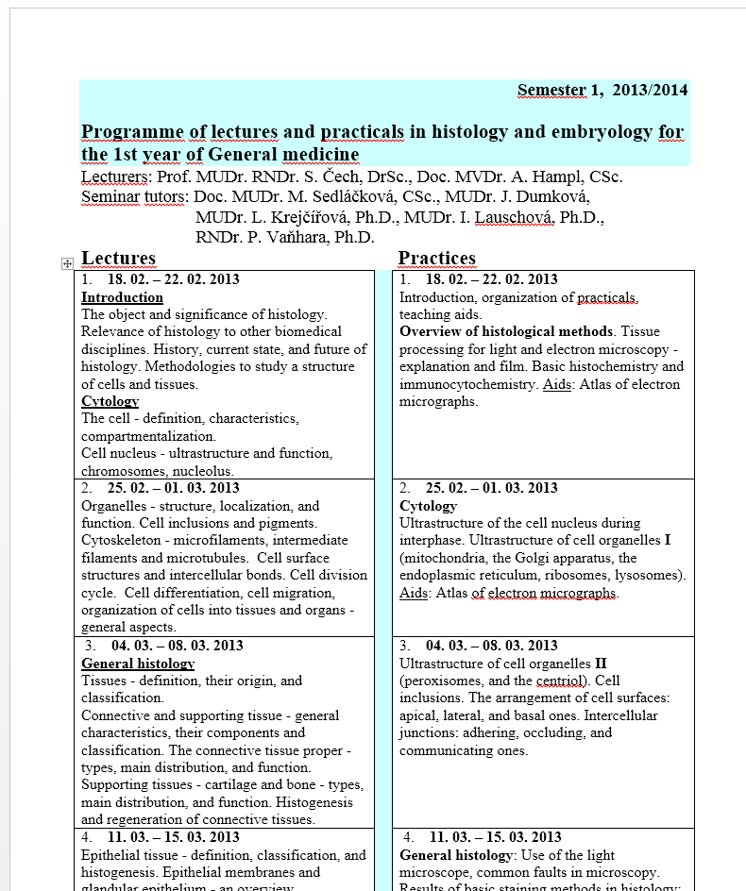
Department of Histology and Embryology
Faculty of Medicine MU
http://www.med.muni.cz/histology

Slide 10
RECOMMENDED LITERATURE
Čech, S. a D. Horký. Přehled obecné histologie. 1. vyd. Brno: Masarykova univerzita, 2005. 140 s. ISBN 8021038543.
Horký, D. a S. Čech. Mikroskopická anatomie. 2. nezm. vyd. Brno: Masarykova univerzita, 2005. 353 s. ISBN 802103775X.
Čech, S., D. Horký a M. Sedláčková. Přehled embryologie člověka. 1. vyd. Brno: Masarykova univerzita, 2011. 187 s. ISBN 978-80-210-5414-1.
Mescher, A.L. Junqueira's basic histology :text and atlas. 13th ed. New York: McGraw-Hill Medical, 2013. xi, 544. ISBN 9781259072321.
Moore, K.L., T.V.N. Persaud a M.G. Torchia. The developing human :clinically oriented embryology. 9th ed. Philadelphia, PA: Saunders/Elsevier, 2013. xix, 540. ISBN 9781437720020.
Vacek, Z. Embryologie :učebnice pro studenty lékařství a oborů všeobecná sestra a porodní aistentka. 1. vyd. Praha: Grada, 2006. 255 s. ISBN 9788024712673.
Sadler, T.W. Langmanova lékařská embryologie. 1. české vyd. Praha: Grada, 2011. xviii, 414. ISBN 9788024726403.
Kapeller, K. a V. Pospíšilová. Embryológia človeka: učebnica pre lekárske fakulty. Martin: Osveta, 2001. 370 s. ISBN 80-8063-072-0.
Lüllmann-Rauch, R. Histologie. Translated by Radomír Čihák. 1. české vyd. Praha: Grada, 2012. xx, 556. ISBN 9788024737294.
Ovalle, W.K., P.C. Nahirney a F.H. Netter. Netter's essential histology. 2nd ed. Philadelphia, PA: Elsevier/Saunders, 2013. xv, 517. ISBN 9781455706310.
Young, B. Wheater's functional histology :a text and colour atlas. 5th ed. [Oxford]: Churchill Livingstone, 2006. x, 437. ISBN 044306850X.
Sadler, T.W. a J. Langman. Langman's medical embryology. Illustrated by Jill Leland. 11th ed. Baltimore, Md.: Lippincott William & Wilkins, 2010. ix, 385. ISBN 9781605476568.
Lowe, J.S. a P.G. Anderson. Stevens and Lowe´s Human Histology. 4th. : Elsevier, 2015. ISBN 978-0-7234-3502-0.
+
Lectures
Protocols

Slide 11
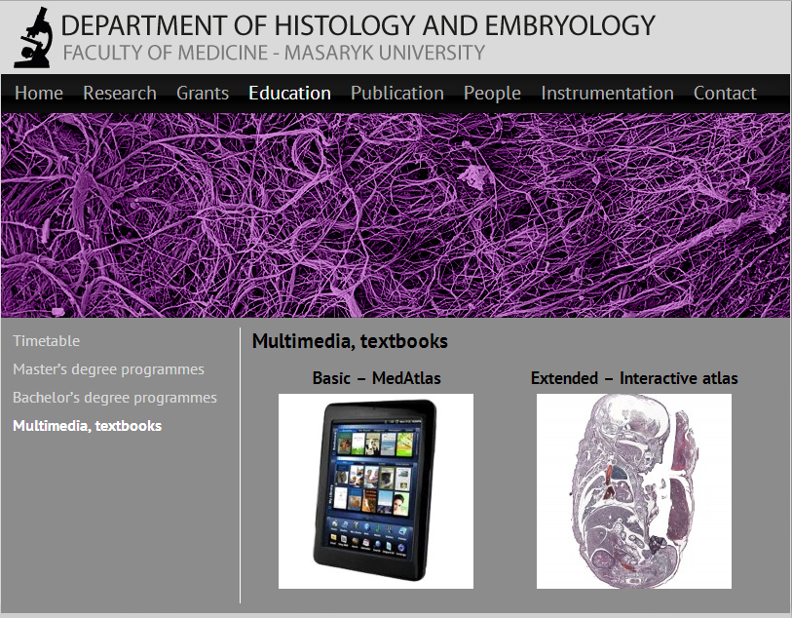
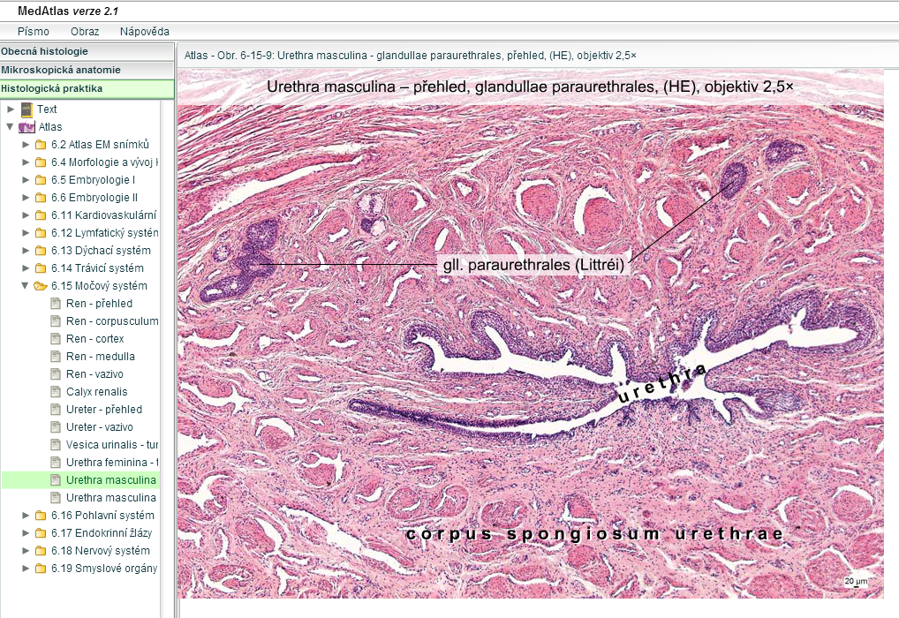
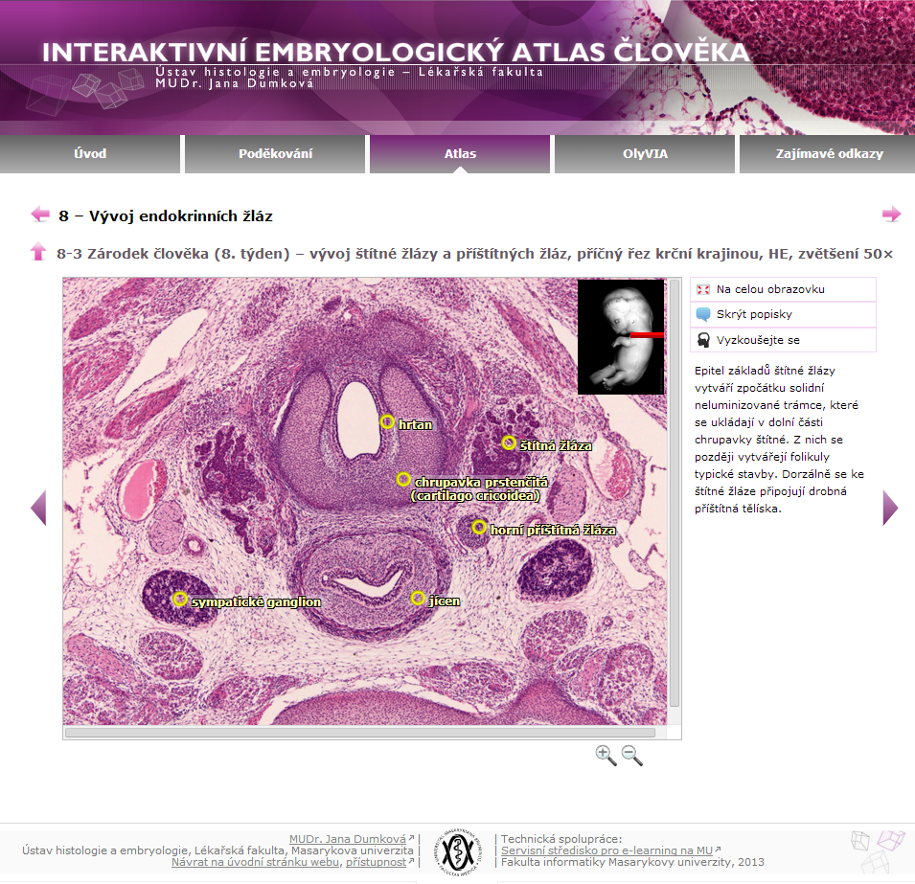
http://www.med.muni.cz/histology

Slide 12
HISTOLOGY
structure and ultrastructure of normal cells and tissues,
cytology and general histology
special histology = microscopic anatomy of individual organs
relevance: oncology, surgery, hematology, pathology, forensic,…

Slide 13
EMBRYOLOGY
– prenatal (intra uterine) development
General embryology (until 2nd month – EMBRYO )
gametogenesis and early embryonic development
Special embryology (since 3rd month to birth – FETUS )
organogenesis
Teratology – defects in organ development, malformations, anomalies; prenatal screening – ultrasonography, amniocentesis, genetic and karyotype screening
Relevance: gynecology and obstetrics, pediatrics, assisted reproduction

Slide 14
Understaning of the whole system
Personalized medicine
Regenerative medicne
Assisted reproduction
Gene therapy
Cancer therapy
Biomedical research
Gene, cell and tissue engineering
Physiology
Histology and ulstrastructural architecture
Molecular biology
Cell biology
Quantitative analyses of cells and tissues
Genomics
Transcriptomics
Proteomics
Metabolomics
…
Biochemistry
Histology cannot be put out of the biological and functional context

Slide 15
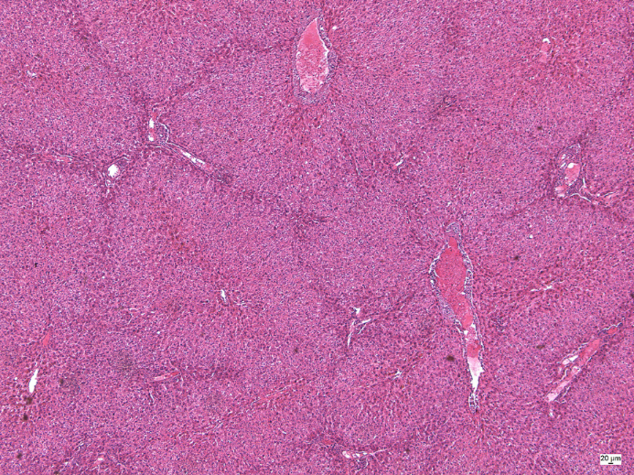
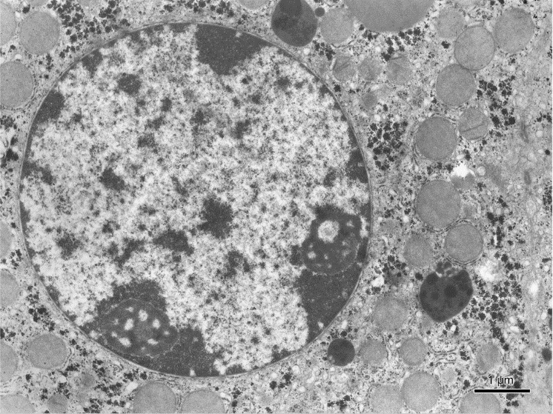
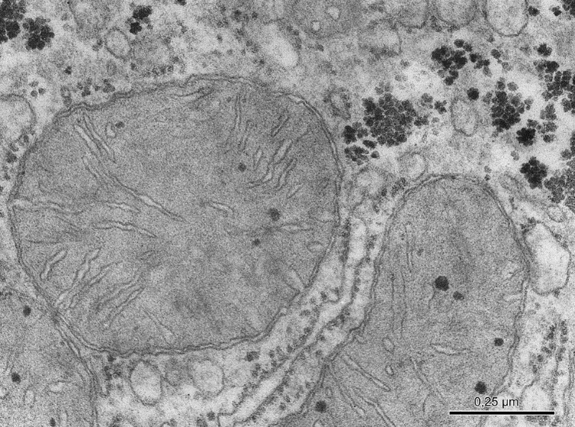
Histology
Resolution of naked eye – 0,1 mm
Resolution of light microscopy – 10 nm
Resolution of electron microscopy – 0,1 nm

Slide 16
Tissue processing for the light microscopy (LM) (making of permanent preparations – slides)
SAMPLING (obtaining of material – cells, tissue pieces)
FIXATION of samples (tissue blocks)
RINSING (washing) of samples
EMBEDDING of samples - embedded blocks
CUTTING of blocks - sections
AFFIXING of sections
STAINING of sections
MOUNTING of sections

Slide 17
SAMPLING
A small piece of organ (tissue) is sampled and quickly put into the fixative medium.
Biopsy during surgical dissection of organs in living organism
= excision
= puncture (liver or kidney parenchyma, bone marrow)
= curettage (uterine endometrium, adenoid vegetation)
Necropsy from dead individual (sections); in experiments laboratory animals are used and tissue have to be sampled as soon as possible after the break of blood circulation
The specimens shouldn't be more than 5 – 10 mm³ thick and fixation should follow immediately.

Slide 18
FIXATION
Definition: denaturation and stabilization of cell proteins with minimum artifacts
The reason of fixation: freshly removed tissues are chemically unstable – dry, shrink, undergo hypoxia, autolysis and bacteriological changes
To stop or prevent these changes and preserve the structure tissue samples have to be fixed. During the fixation, all tissue proteins are converted into inactive denaturized (stable) form.
3 main requirements on fixatives:
- good preservation of structure
- quick penetration into tissue block
- no negative effects on tissue staining

Slide 19
Fixatives: solutions of different chemicals
- organic fixatives – ALDEHYDES – formaldehyde (most frequently used for LM)
– glutaraldehyde (used for EM)
– ALCOHOLS – 96 – 100 % (absolute) ethylalcohol
– ORGANIC ACIDS – glacial acetic acid, picric acid,
trichloracetic acid
- inorganic fixatives – INORGANIC ACIDS – chromic acid, osmium tetraoxide (OsO4)
– SALTS OF HEAVY METALS – mercuric chloride HgC_{l2}
- compound fixatives – mixtures (two or more chemical components to offset
undesirable effects fo indiviual (simple) fixatives.
FLEMMING´s fluid – with OsO₄
ZENKER´s and HELLY´s fluid, SUSA fluid – with HgCl₂
BOUIN´s fluid – with picric acid
CARNOY´s fluid – with alcohol
Fixation is carried out at the room temperature, the time varies between 12 – 24 hours, specimen must be overlayed by 20 – 50 times fixative volume:
Ratio of tissue block volume to fixative volume 1 cm³ : 20 – 50 cm3

Slide 20
RINSING and EMBEDDING
All samples should be washed to remove the excess of fixative; the choice of rinsing medium is determined by type of fixative: running tap-water or 70-80% ethanol
Relevance of embedding: tissues and organs are brittle and unequal in density, they must be hardened before cutting

Slide 21
Embedding media
water soluble – gelatine, celodal, water soluble waxes
anhydrous – paraffin, celoidin

Slide 22
EMBEDDING into PARAFFIN
dehydration – to remove water from fixed samples by ascending series of ethanol is used (50%, 70%, 90%, 96%. each step - 2 – 6 hours
clearing – the ethanol must be replaced with organic solvatant that dissolves paraffin – benzene or xylene
infiltration – melted paraffin wax (56°C) is used; 3 x 6 hours.
casting (blocking out) – moulds (plastic, paper or metal chambers) are used for embedding.
The moulds are filled with melted paraffin, tissue samples are then placed inside and immediately immersed in cold water to cool paraffin quickly down.
These paraffin blocks are ready for trimming

Slide 23
Leica TP 1020
Automated device for tissue dehydration

Slide 24
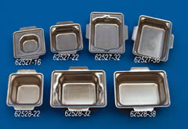
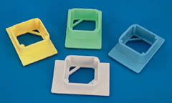
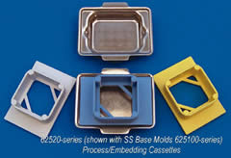
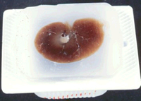
Paper chambers
- metal

Slide 25
CUTTING
Microtome – a machine with automatic regulation of section thickness: 5 – 10 μm is optimum.
sliding microtome – block is fixed in holder, knife or razor moves horizontally
rotary microtome – knife is fixed,
block holder moves vertically

Slide 26
Sliding microtome
Rotary microtome

Slide 27
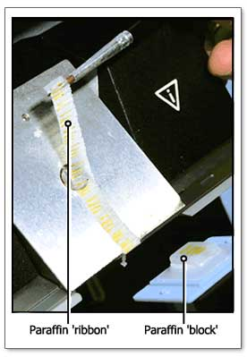
Freezing microtome (cryostat)
= rotary microtome housed in freezing box
(– 60º C)
Cutting of frozen tissue without the embedding

Slide 28
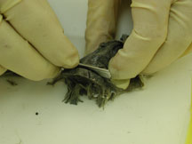
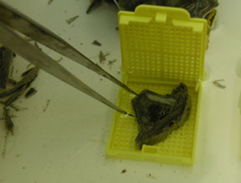
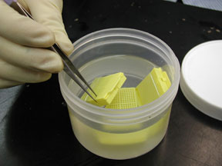
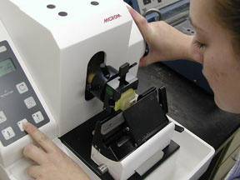
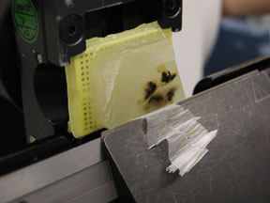
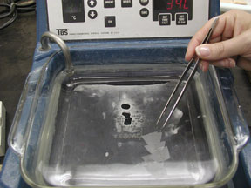
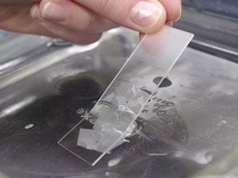
sampling
1
2
3
fixation
fixation
cutting
4
cutting
5
section affixing
6
section affixing
7

Slide 29
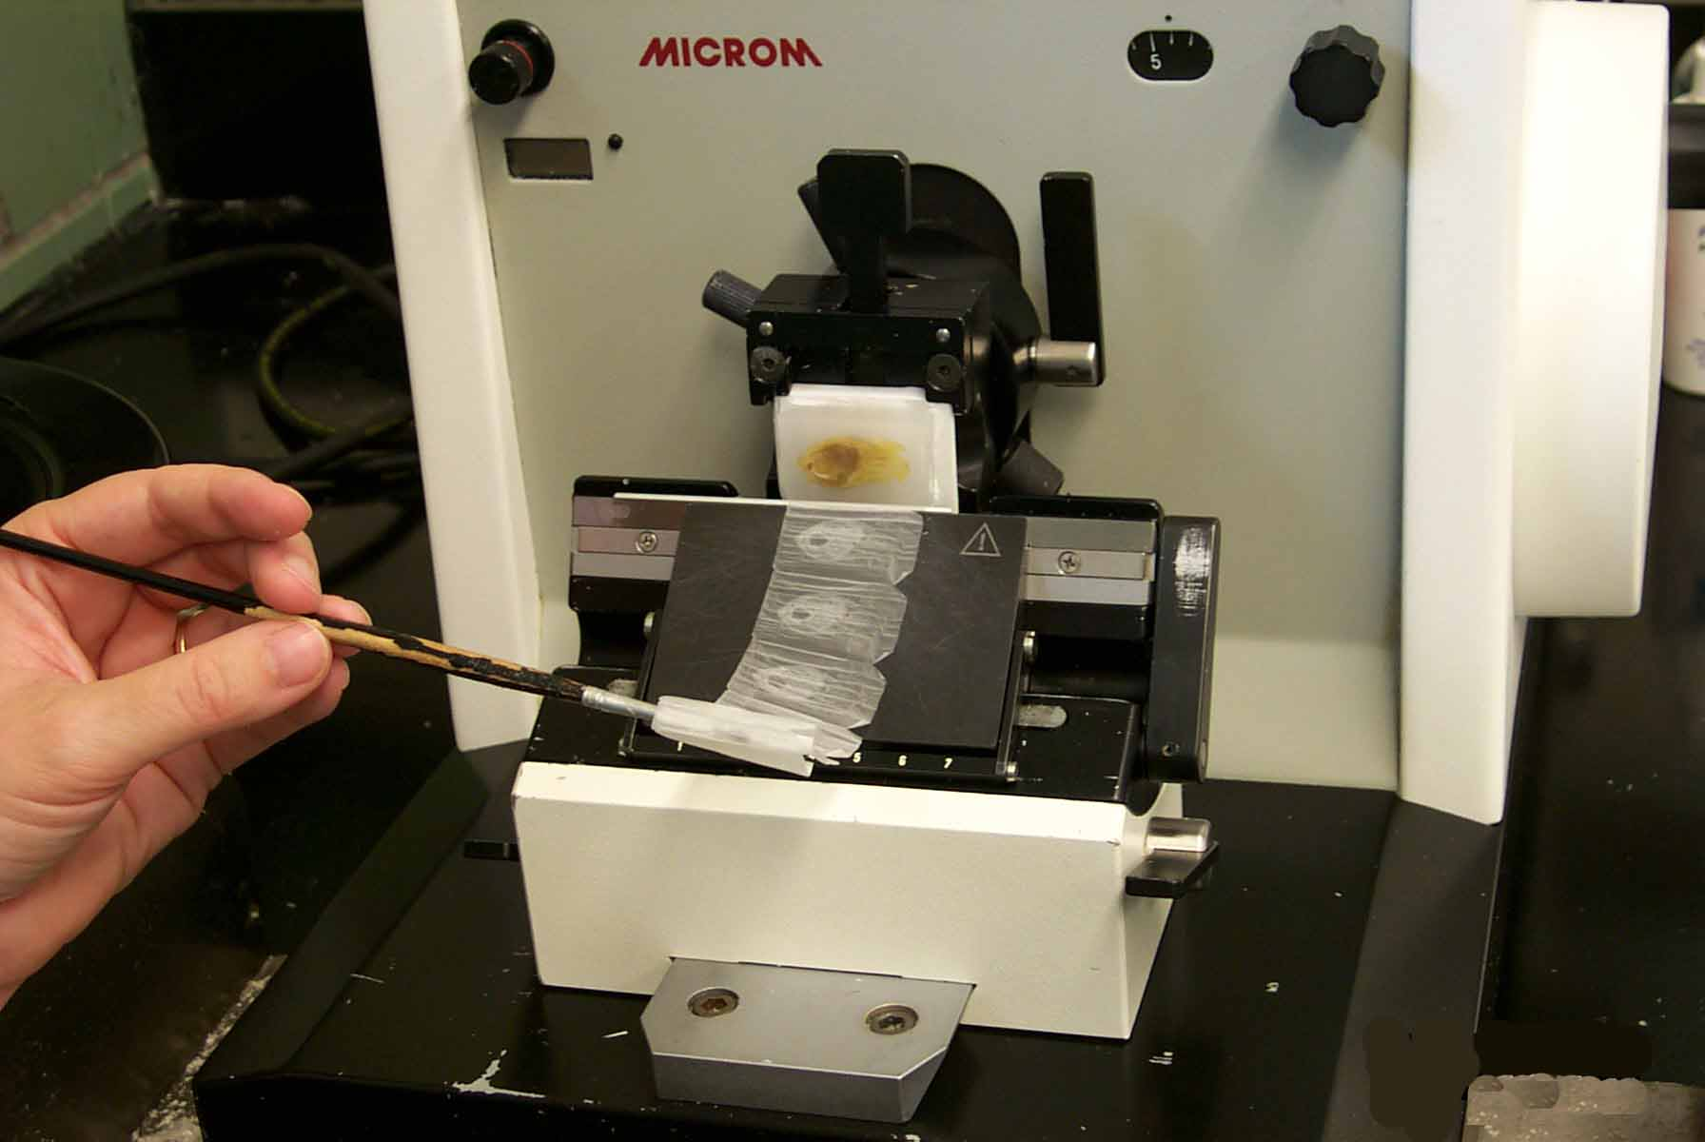

Slide 30
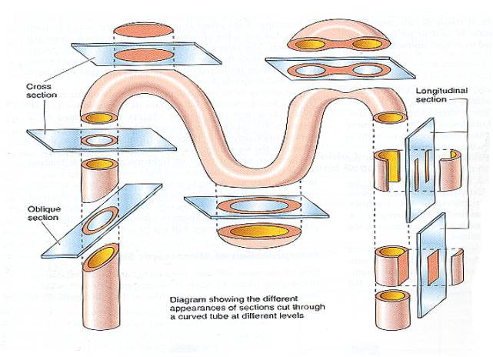
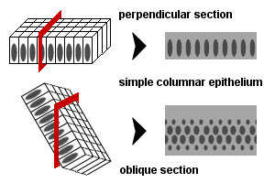

Slide 31
AFFIXING
Mixture of glycerin and egg albumin or gelatin
Section are transferred from microtome razor or knife on the level of warm water (45º C), where they are stretched; then they are put on slides coated with adhesive mixture; excess of water is drained and slides are put in incubator (thermostat, 37º C) over night to affixing of sections.

Slide 32
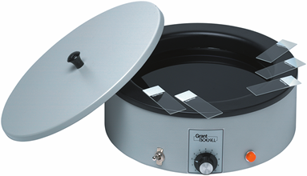
Stretching of sections on warm water
Stretching on a warm plate

Slide 33
STAINING
Different cell or tissue structures are not apparent without staining.
Cellular structures exhibit different affinity to staining dyes
alkaline dyes (basic or nuclear) – react with anionic groups of cell and tissue components
basophilia – basophilic structures in the cell
acid dyes (cytoplasmic) – react with cationic groups
acidophilia – acidophilic structures in the cell
neutrophilia – no reaction

Slide 34
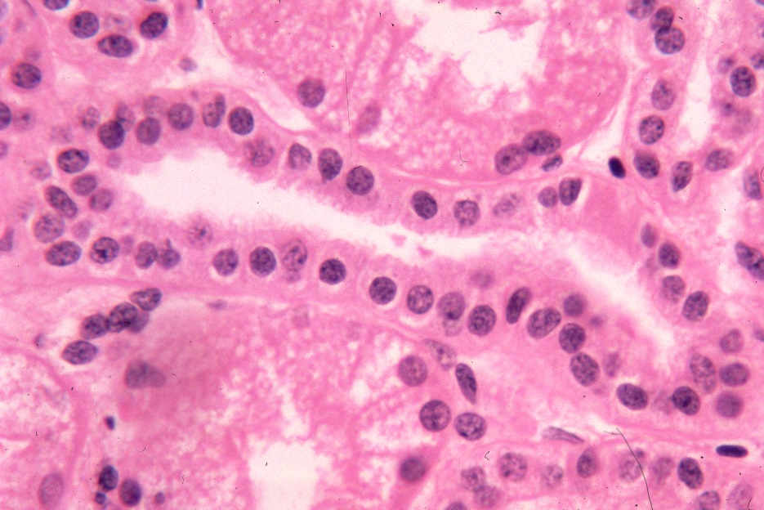
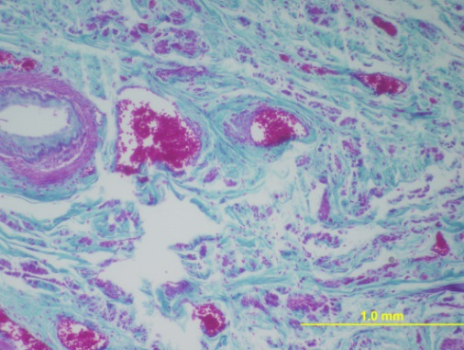
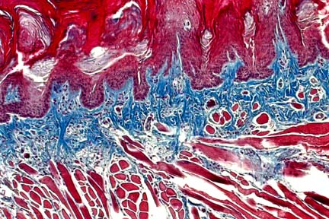
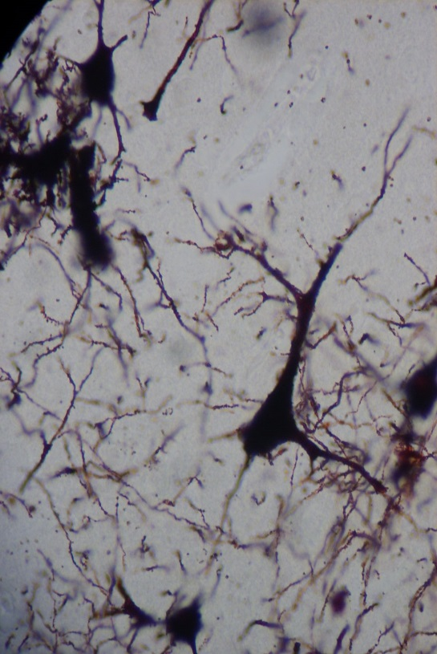
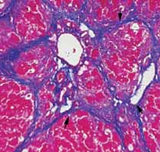
HE – the most frequent used method
Staining methods: routine – HE, AZAN
(demonstrate all components of tissue)
special
visualizes only special structures
impregnation
by silver salt for detection
of nerve or reticular fibers
Lipid droplets
detected by oil red

Slide 35
ROUTINE STAINING with HEMATOXYLINE – EOSIN (HE)
Hematoxyline – basic (nuclear) dye
Eosin – acid (cytoplasmic dye
Staining procedure:
paraffin must be removed (dissolved) by xylene
sections are rehydrated in descending series of ethanol (100% 96% 80%)
staining with hematoxyline
differentiation in acid ethanol and water (excess of dye is removed)
staining with eosin
rinsing in water (excess of dye is removed)
dehydration in graded ethanol series (80% 96% 100%)
clearing in xylene

Slide 36
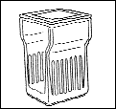
HEMATOXYLINE – EOSIN (HE)
Deparaffination Rehydration Washing Staining Differentiation
Xylen I XylenII 100% 96% H₂O hematoxyline acid
ethanol ethanol ethanol
Clearing Dehydration Washing Staining Washing
Xylen IV xylen III 100% 96% H₂O eosin H₂O
ethanol ethanol

Slide 37
Staining results:
HE = Hematoxyline – Eosin
nuclei – bright clear blue or dark violet
cytoplasm and collagen fibers – pink
muscle tissue – red
HES = Hematoxyline – Eosin – Safron
connective tissue – yellow
AZAN = AZocarmin – ANiline blue – orange G
nuclei – red
erythrocytes – orange
muscle – red
collagen fibers – blue

Slide 38
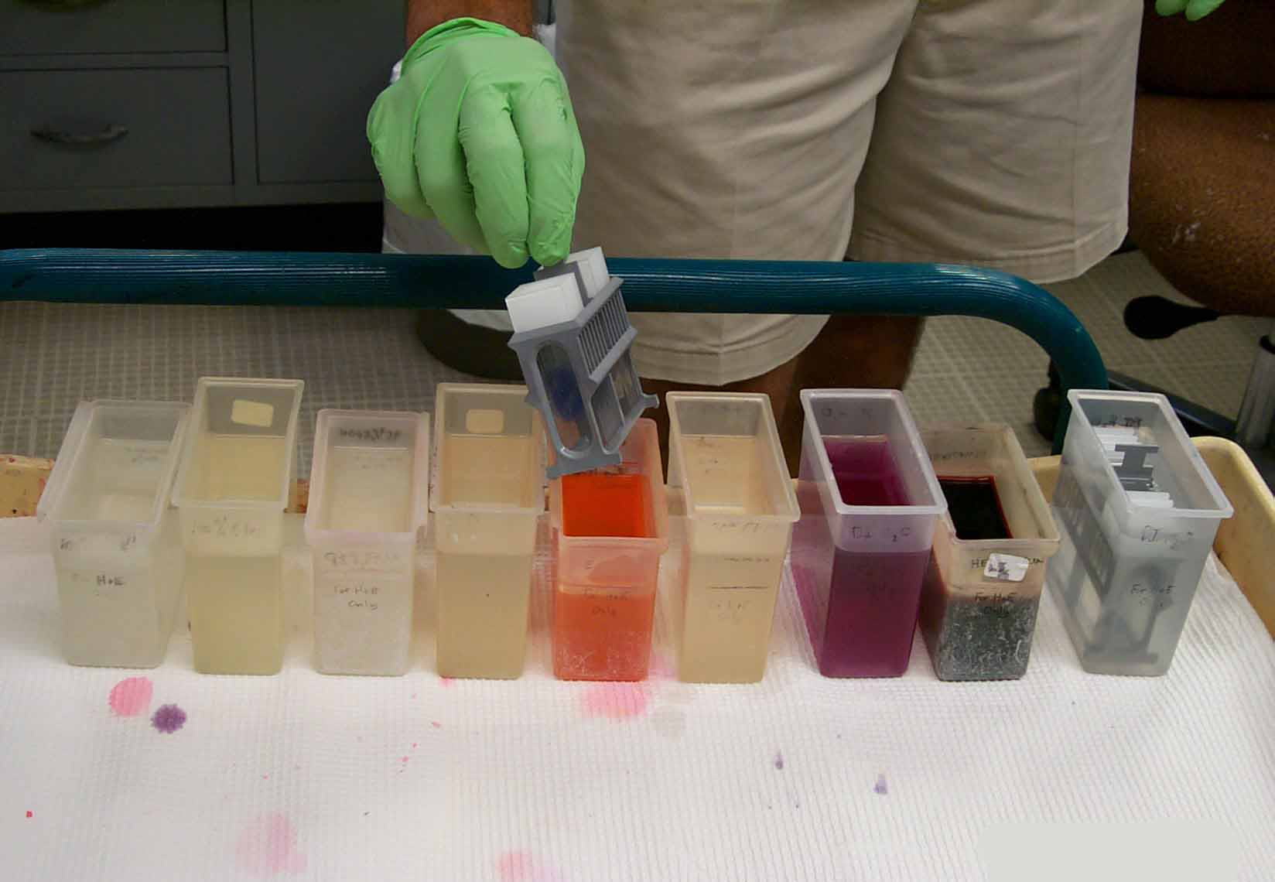
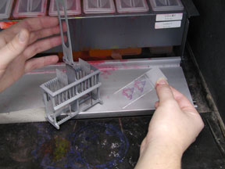
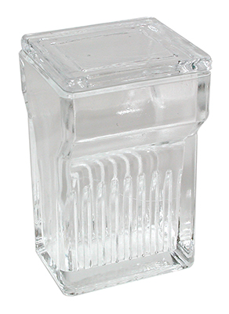
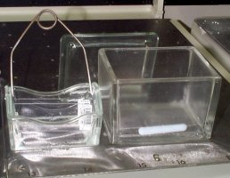
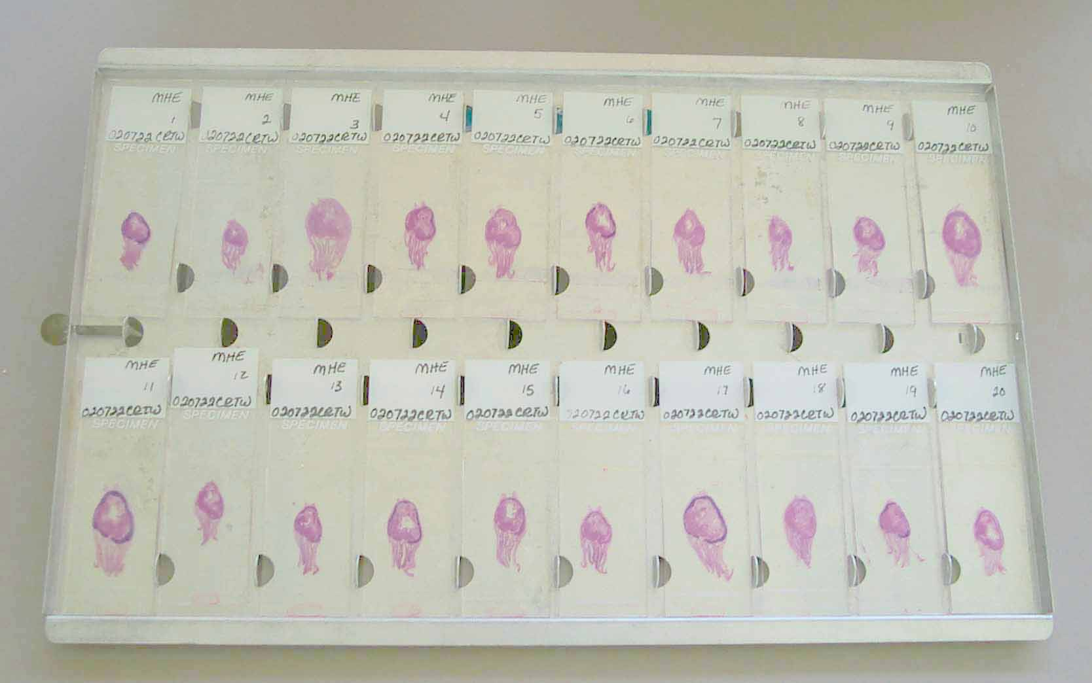
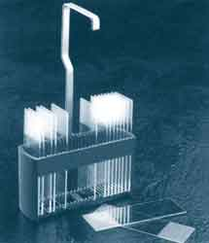
Staining tools:
cuvette
flask
slides holder
(basket)

Slide 39
Automatic slide stainer
staining set of boxes with media

Slide 40
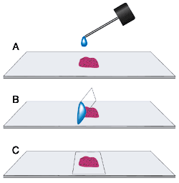
MOUNTING
Finally, preparates are closed with coverslip (coverglass) to form a permanent preparate. Small amount of mounting medium must be placed between stained section and the coverslip.
Mounting media: soluble in xylene – canada balsam soluble in water – glycerin-gelatine, arabic gum

Slide 41
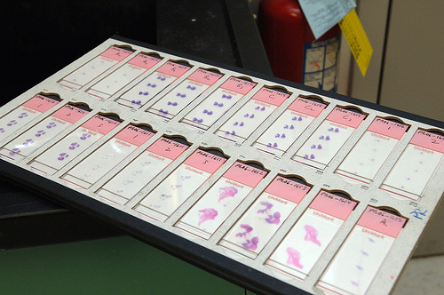
Permanent histological slides for study in the light microscope

Slide 42
Hematoxyline and eosin (HE)

Slide 43
Hematoxyline and eosin (HE)
cell cytoplasm
cell nuclei
collagenous
connective tissue

Slide 44
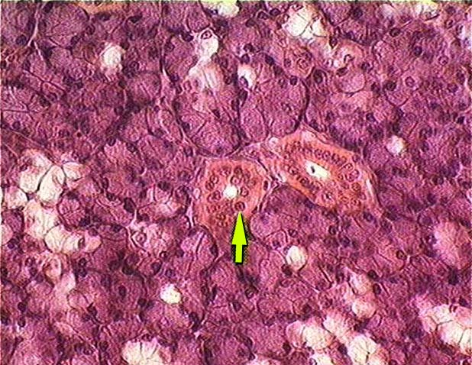
Hematoxyline and eosin (HE)
basophilic cytoplasm
of glandular cells
(contains ribosomes
with RNA)
acidophilic cytoplasm
of epithelial cells

Slide 45
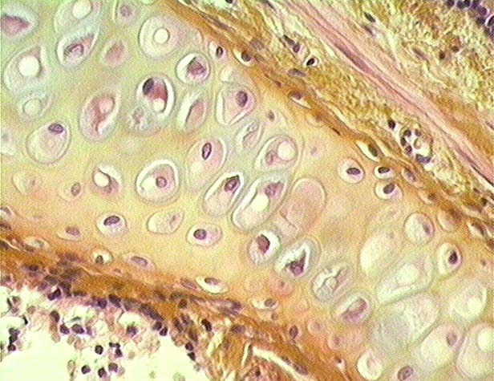
Hematoxyline, eosin and saffron (HES)
Collagenous fibers
of connective tissue
are yellow after staining
with saffron
cartillage

Slide 46
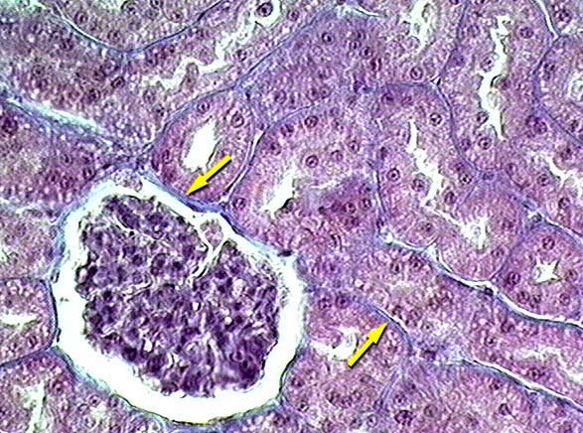
Azocarmine and aniline blue (AZAN)
Kidney – collagen connective tissue

Slide 47
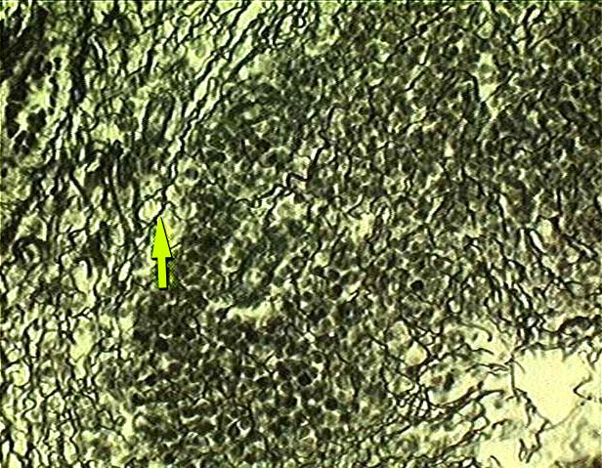
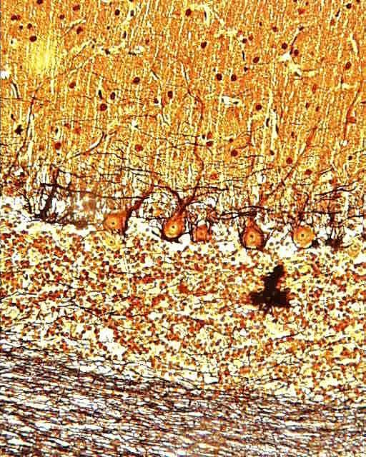
Impregnation of tissue with silver
Lien - reticular fibers
Cerebellum – nerve fibers

Slide 48
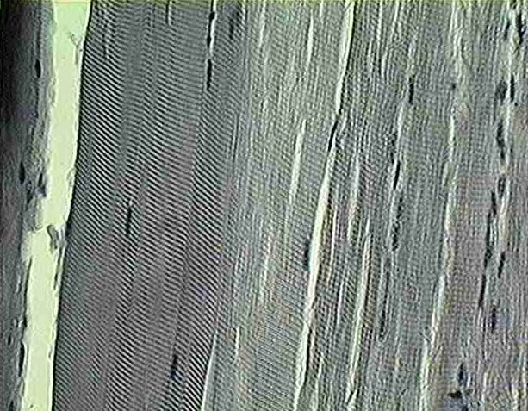
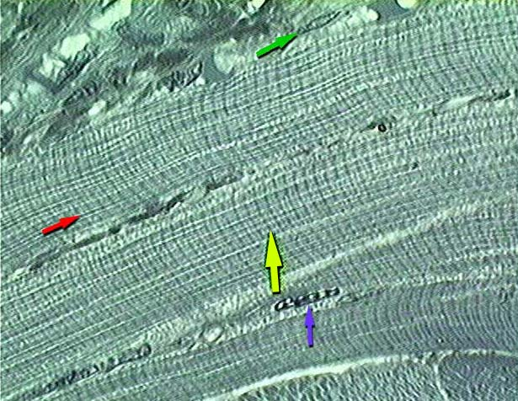
Iron hematoxyline
Skeletal muscle cells (fibers)

Slide 49
Iron hematoxyline
Mitochondria in hepatocytes

Slide 51
Histochemistry and Immunohistochemistry
Relevance:
various chemical compounds detected „in situ“ (proteins, AA, NA, saccharides, lipids, enzymes, pigments, inorganic substances – Fe, Ca, Zn)
Various epitopes detected by immunotechniques

Slide 52
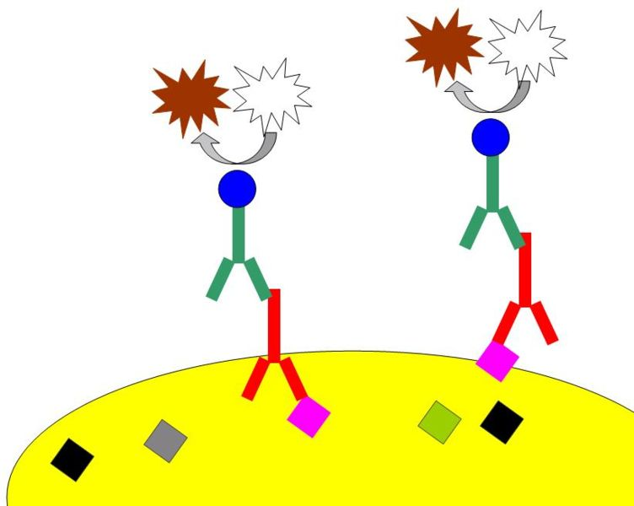
Enzyme conjugated with secondary Ab - visualization
Secondary Ab specific against primary Ab
Primary Ab specific against epitope of the particular antigen
Antigen

Slide 53
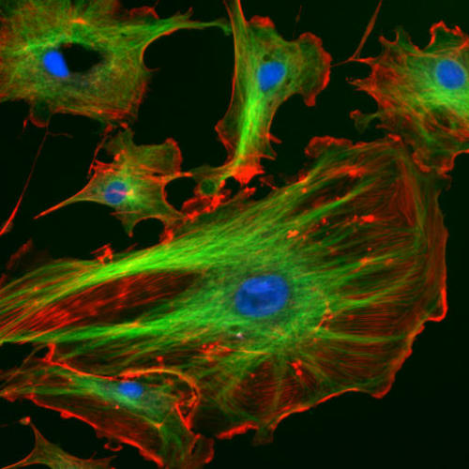
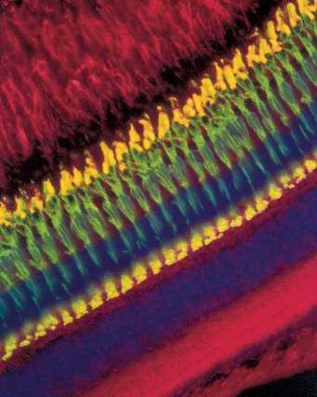
Actin (cytoskeleton)
DAPI (nucleus)
Microtubules (cytoskeleton)
KI-67

Slide 54
Tissue processing for the EM
pH of all solutions (media) must be buffered on 7.2 – 7.4 Cacodylate or phosphate buffer is frequently used.
Absolutely dustfree environment
Solutions (media) have to be precise (artifacts)

Slide 55
Tissue processing for the EM
SAMPLING – immediatelly after arresting of blood circulation, tissue block sized no more than 1mm³
FIXATION – glutaraldehyde (binds amine groups) + OsO₄ (binds lipids) are used as double fixation
RINSING – distilled water
DEHYDRATION - ethanol
EMBEDDING – gelatin capsule or plastic forms are filled with some medium (which can be polymerized from liquid to solid form) and pieces of fixed tissue are placed into this medium. Epoxyd resins (Epon, Durcupan, Araldite) are usually used as in water insoluble media.
CUTTING – ultrathin sections (in ultramictomes)
CONTRASTING ≈ staining

Slide 56
Embedding tools:
gelatin (1) or plastic (2) capsules
capsule holder (3)
embedding plates
(4, 5)
1
2
3
4,5
Embedded blocks
prepared for cutting

Slide 57
By trimming, using ultramicrotome, an excess of hard medium is removed and pyramide with minimal cut surface (0.1 mm2) is prepared.
Minimum of tissue (black) is in the top of pyramid

Slide 58
Cutting

Slide 59
Cutting
Ultrathin sections (70 – 100 nm) - ultramicrotomes.
Glass or diamond (b) knives with water reservoir are used
Sections slide flow on water in small container attached to the knive
Supporting grids

Slide 60
Ultramicrotom
knives:
glass
diamond

Slide 61
CONTRASTING (=STAINING)
principle of differentiation of structures – different dispersion of beam of electrons depending on atomic weight of elements. „electron dyes“ are thus mixtures of heavy metals: uranylacetate or lead citrate
stain droplet with floating grid
placed section-side down on the
droplet

Slide 62
Notes:
Golgiho aparát ve žlázové buňce
Cisterny
Granulární ER s transportními váčky
Nezralá sekreční granula
62

Slide 64
Differences between LM and EM
 | LM | EM
Sampling | < 1 cm³ minutes | < 1 mm³ seconds
Fixation | formaldehyde 12 – 24 hours | glutaraldehyde 1 – 3 hours
Embedding | paraffin | epoxid resins (Durcupan)
Cutting Thickness of sections | microtome 5 – 10 μm | Ultramicrotomes 50 – 100 nm
Staining (LM) contrasting (EM) | dyes (hematoxyline – eosin) | heavy metals (uranylacetate,lead citrate)
Mounting (only LM) |  | ---
Result | histological slide (preparate) | photograph of ultrathin section

Slide 65
Visit us at:
http://www.med.muni.cz/histology
Thank you for attention

