Slide 1
Revision

Slide 2
???
What are the typical features of particular declensions?
How do you decide on the declension of a noun?
What are the typical endings of particular cases?
How do neuters behave?
What is the function of Genitive?
What is Genitive stem and how do you recognize it?
How does a word behave after a preposition?
How do you treat numbers?

Slide 3
Adjectives
Latin adjective has to match the noun in...?
gender, case, number
thus the endings do NOT have to look the same!
diabetes mellitus, gen.: diabetae melliti
rete venosum, gen.: retis venosi
vulnus lacerum, gen.: vulneris laceri
manus dextra, gen.: manus dextrae
etc...

Slide 4
Give the noun which the underlined adjectives come from, its genitive singular form, gender, declension and meaning
term | nom. sg. | gen. sg. | gender | declension | meaning
os frontale
margo supraorbitalis
concha nasalis media
os parietale
os temporale
os occipitale

Slide 5
Identify common mistakes
genuae varae
fracturae ossium brevium multiplicium
abortus post traumam gravem
fractura luxationis ossum metacarpalis
collapsus pulmonum in graviditem
vulna scissa in regio abdominis
abruptio corpi vertebrae cervicalis secundi
in dente permanente
medicamentum pro usu externo
ulcus durus duodeni
musculi sphinctes
sub meato acustico
medulla ossium ruberum

Slide 6
Confusing words I
Tell the difference between the words and make up illustrative phrases:
dislocatio, onis, f. X dislocatus, a, um
fractura costae verae secundae l.sin. dislocata
dislocatio articulationis sacroiliacae l.dx.
ruptura, ae, f. X ruptus, rupta, ruptum
ruptura tendinum manus dextrae
sutura parietis vaginae ruptae post partum
perforatio, onis, f. X perforatus, a, um/perforans, ntis
perforatio parietis gastris propter ulcus
ulcus duodeni perforatum/perforans
suspicio, onis f. X suspectus, a, um
suspicio carcinomatis mammae l.sin.
Infractio partis distalis tibiae l.dx. suspecta

Slide 7
Confusing words II Match the nouns with the pictures
morsus
paries
pars
mors
facies
morbus
fascia

Slide 8
Confusing words II Match the nouns with the pictures
fascia, ae, f.
mors, tis, f.
paries, etis, m.
morsus, us, m.
facies, ei, f.
pars, tis, f.
morbus, i, m.
Notes:
ať studenti teď zkusí vytvořit nějaké fráze

Slide 9
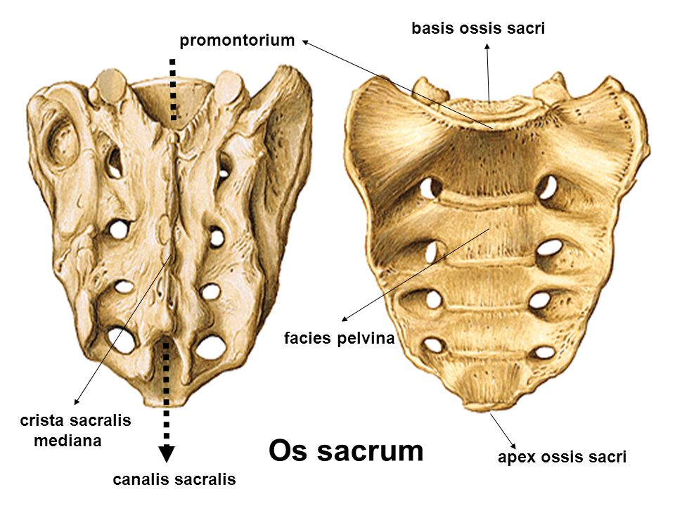
Translate
rupture of the wide fascia
ruptura fasciae latae
death after an animal bite
mors post morsum animalis
parts of a gall bladder
partes vesicae felleae
pelvic surface of sacral bone
facies pelvina ossis sacri
infectious diseases
morbi contagiosi
perforation of the wall of the stomach
perforatio parietis gastris

Slide 10
Translate
suprarenal glands
glandulae suprarenales
simple joints
articulationes simplices
lateral margin of the nail
margo lateralis unguis
hollow for the lacrimal gland (literally of the lacrimal gland)
fossa glandulae lacrimalis
nucleus of the abducent nerve
nucleus nervi abducentis
vein accompanying the hypoglossal nerve (literally the accompanying vein of the hypoglossal nerve)
vena comitans nervi hypoglossi

Slide 11
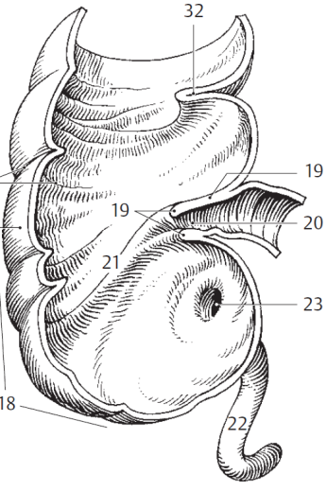
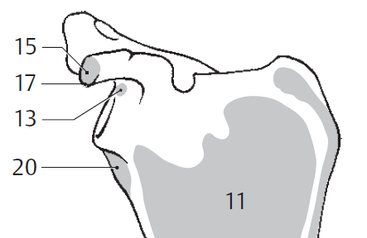
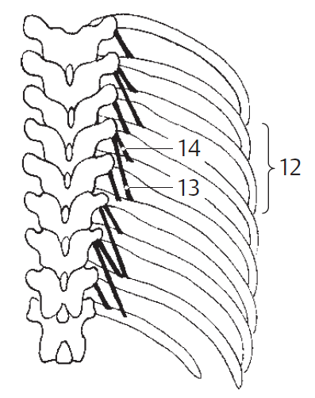
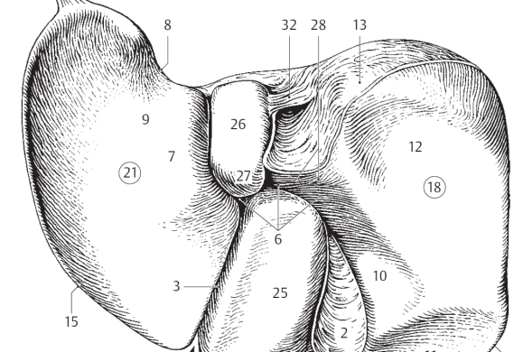
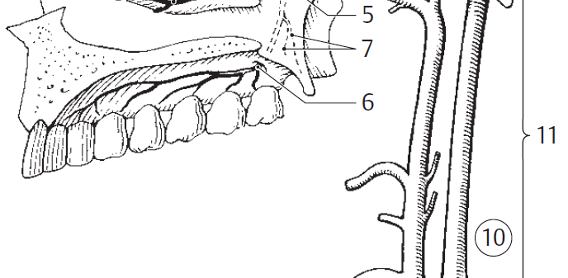
short levator muscles of ribs
internal carotid artery
fissure of the round ligament
long/short head of the biceps muscle of humerus
orifice of the vermiform appendix
mm. levatores costarum breves
arteria carotis interna
fissura ligamenti teretis
caput longum/breve musculi bicipitis humeri
ostium appendicis vermiformis

Slide 12
Form phrases from words in boxes and translate them into English
medicamenta contagiosum
morbum
contra
medicamenta contra morbum infectiosum
medicaments against infectious disease
acutus
pulmonis
dolor
dextri
dolor acutus pulmonis dextri
acute pain of right lung
symptomata
hepatitidis
acutae
symptomata hepatitidis acutae
symptoms of acute inflammation of the liver
collapsus
periculum
digestorii
systematis
periculum collapsus systematis digestorii
danger of a collapse of the digestive system

Slide 13
What are the correct LATIN terms?
paries perforatus
wallum perforatum
neonatus malignus
cancer testiculi
traumata bruisa
vulni sub tempibus
inflammatio cerebri
tea urologica
tumor malignus
cancer testis
vulnera contusa
vulnera sub temporibus
encephalitis
species urologicae

