Slide 1
REVISION: CONNECT
partes
processus
nervus
ruptura
carcinoma
sanatio
caries
bursa
inflammatio
lamina
fractura
therapia
operatio
remedium
columna vertebralis
vertebrae lumbales
brachium laterale
ligamentum teres
colon descendens
herpes simplex
dentes permanentes
musculus biceps brachii
appendix vermiformis
os ethmoidale
ossa nasalia
morbus exacerbans
trauma grave
febris recurrens
columnae vertebralis
vertebrarum lumbalium
brachii lateralis
ligamenti teretis
coli descendentis
herpetis simplicis
dentium permanentium
musculi bicipitis brachii
appendicis vermiformis
ossis ethmoidalis
ossium nasalium
morbi exacerbantis
traumatis gravis
febris recurrentis
Notes:
Which phrases are in Plural?

Slide 2
Comparison of adjectives
2nd week

Slide 3
Comparison of adjectives
Adjectives can express different levels of quality
  1st level – POSITIVE
    expresses quality on its own
    in English: good, small, easy
  2nd level – COMPARATIVE
    compare differences between the qualities of two nouns
    in English: better, smaller, easier
  3rd level – SUPERLATIVE
    describe the quality of a noun that is the highest (or lowest) in degree compared to the members of the noun’s group.
    in English: the best, the smallest, the easiest

Slide 4
Types of comparison
In Latin, as well as in English, there exist various ways of comparing adjectives:
  regular
    comparatives and adjectives are formed using suffixes
    in English: small, smaller, the smallest
  irregular
    comparatives and superlatives have irregular forms
    in English: good, better, the best
  periphrastic
    a multi-word expression has the same role as an inflection
    in English: intelligent, more intelligent, the most intelligent
  incomplete
    no positive form of adjective, only comparatives (and superlatives) exist

Slide 5
Regular comparison - comparative
Positive
  LONGUS, A, UM gen. LONG-I
  BREVIS, E gen. BREV-IS
Comparative
  take genitive stem of the adjective and add endings:
  -ior (m+f), -ius (n), genitive ending for all 3 genders: -ioris
  declined like the 3rd declension consonant stems
LONGIOR, LONGIUS, gen. LONGIORIS
BREVIOR, BREVIUS, gen. BREVIORIS

Slide 6
Declining of comparatives
 | singular |  | plural
nom. | brevior | brevius | breviores | breviora
gen. | brevioris |  | breviorum
acc. | breviorem | brevius | breviores | breviora
abl. | breviore |  | brevioribus
Comparative forms are declined according to paradigms DOLOR (M., F.) and CORPUS (N.)
Genitive ending is for all 3 genders: – IORIS.
simplex, simplicis -> simplicior (m., f.), simplicius (n.) -> g. sg.: simplicioris (m., f., n.)
latus, a, um -> latior (m., f.), latius (n.) -> g. sg.: latioris

Slide 7
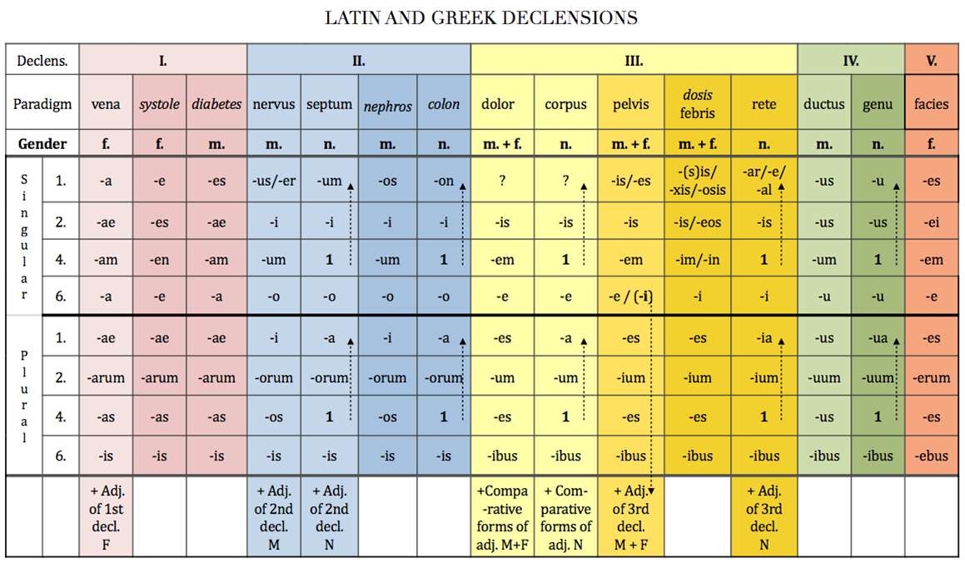

Slide 8
Regular comparison - superlative
Positive
  LONGUS, A, UM gen. LONG-I
  BREVIS, E gen. BREV-IS
Superlative
  take genitive stem of the adjective and add endings:
  -issimus (m), a (f), um (n) – declined like 1+2 decl. adjectives
  LONGISSIMUS, A, UM
  BREVISSIMUS, A, UM

Slide 9
Irregular and incomplete comparison
Irregular comparison
  magnus major, majus maximus, a, um
  parvus minor, minus minimus, a, um
Incomplete comparison
  forms used to describe positions on human body, derived from prepositions, having only comparative and superlative forms
    ante anterior, ius
    post posterior, ius postremus, a, um
    supra superior, ius supremus, a, um
    infra inferior, ius infimus/imus, a, um
    intra interior, ius intimus, a, um

Slide 10
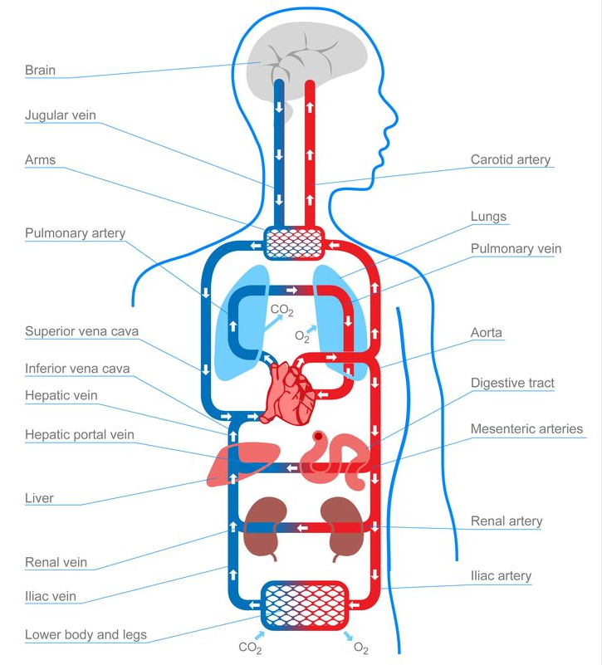
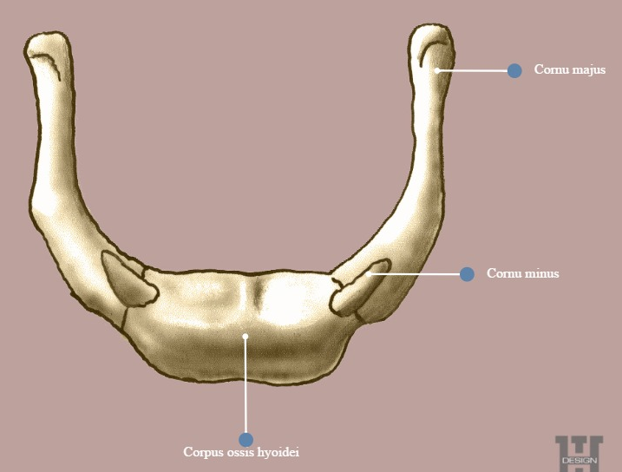
Use of Comparatives in Anatomical Terminology
Comparative forms are used in anatomical terminology when two phaenomena of the same kind occur or when we want to denote location:
  circulatio sanguinis major / minor
  cornu majus / minus ossis hyoidei

Slide 11
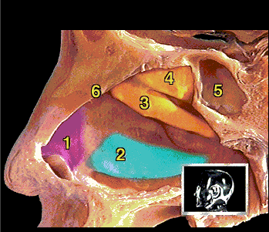
1 cartilago lateralis
2 concha nasalis inferior
3 concha nasalis media
concha nasalis superior
sinus sphenoidalis
septum nasi

Slide 12
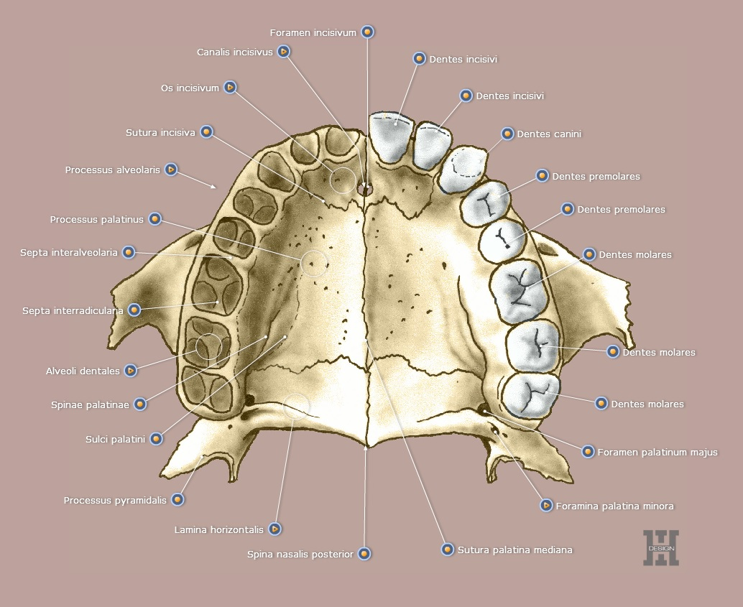

Slide 13
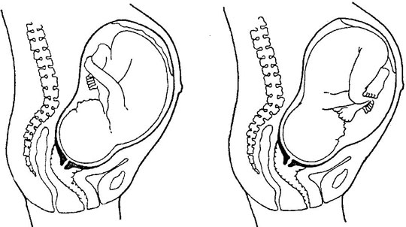
praesentatio occipitis
anterior posterior

Slide 14
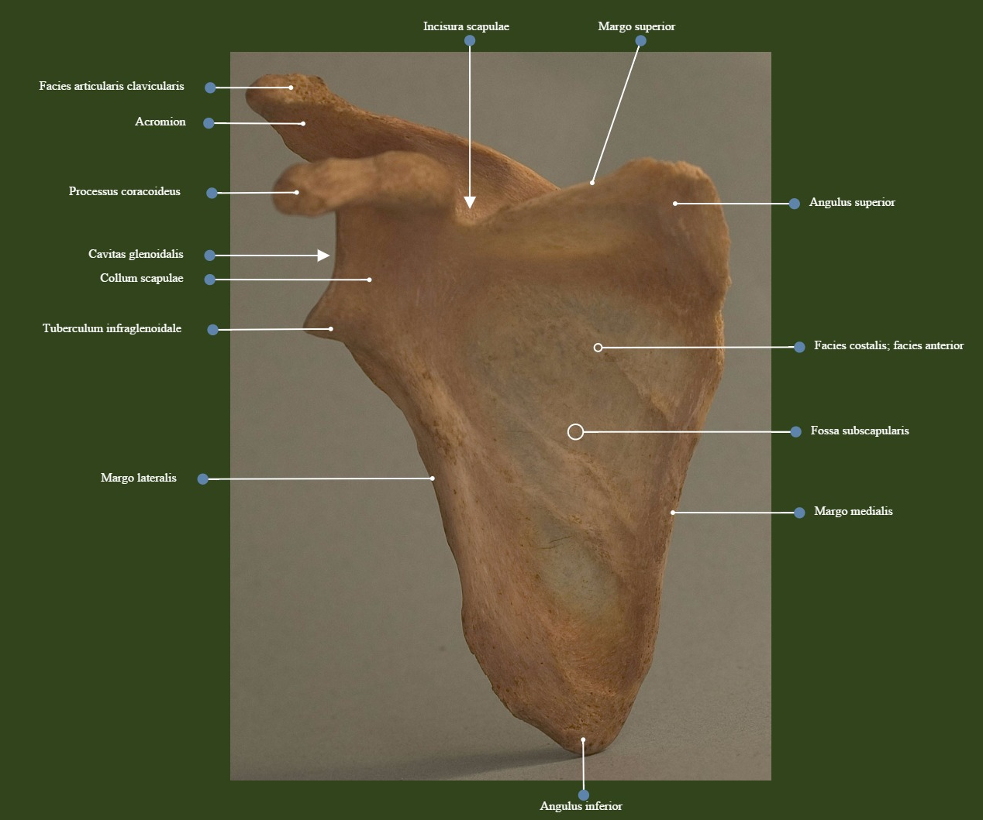

Slide 15
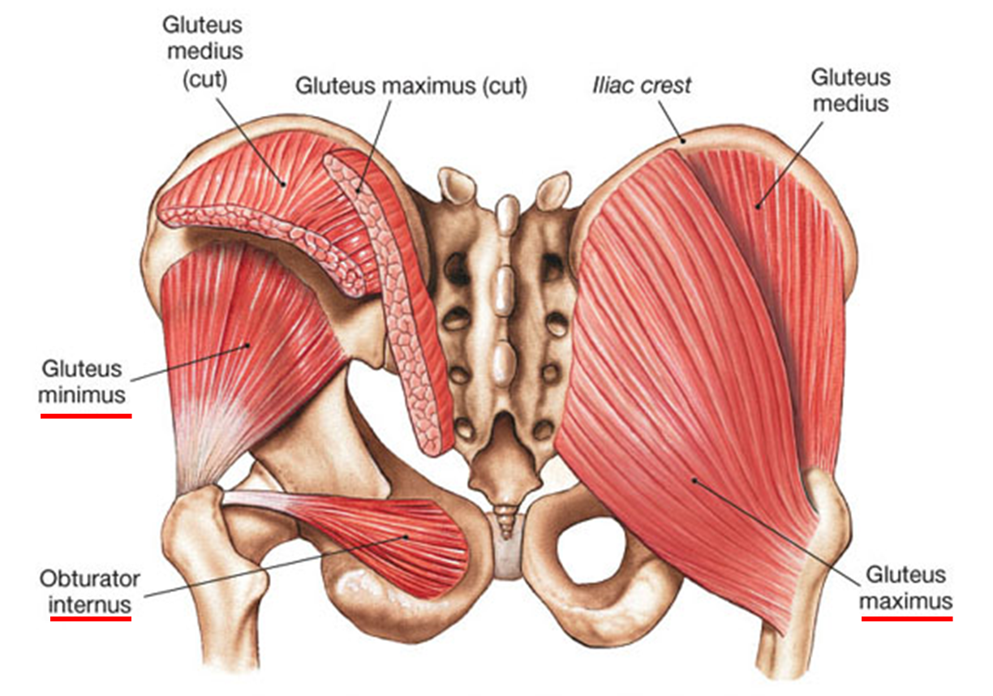
Use of Superlatives in Anatomical Terminology
Superlative forms are used when more than 2 phaenomena of the same kind occur to denote the highest quality of a phaenomenon
  e.g.: musculus gluteus maximus / medius /minimus

Slide 16
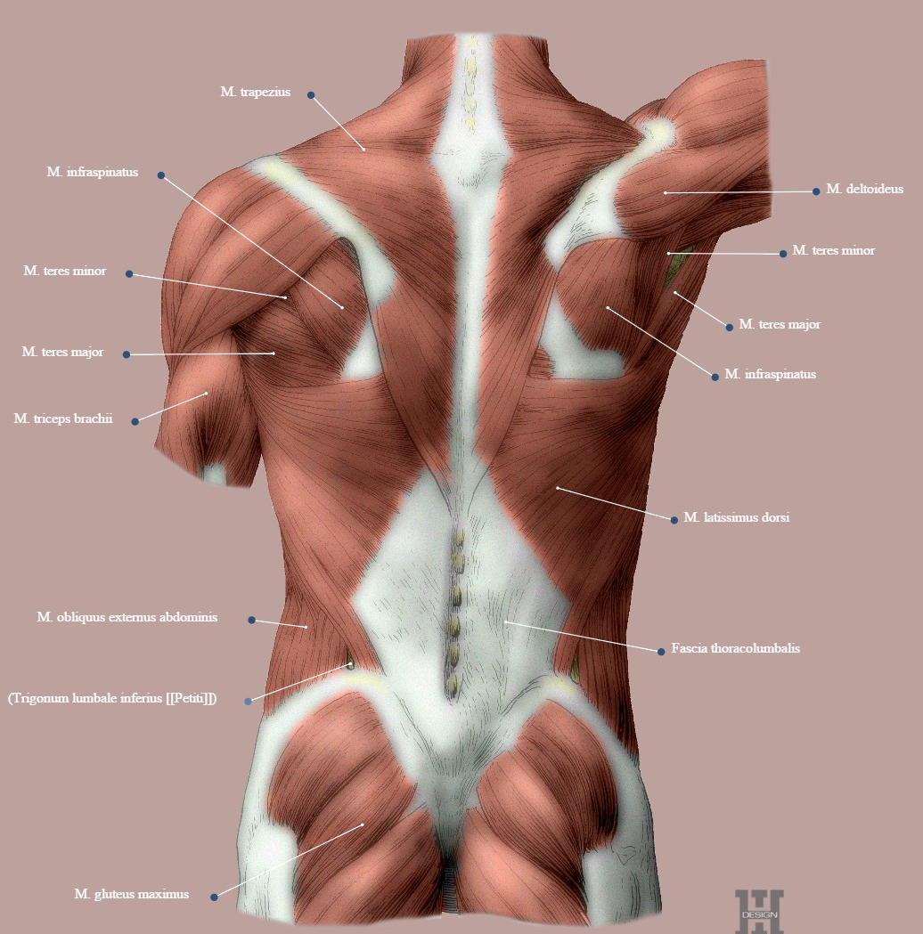

Slide 17
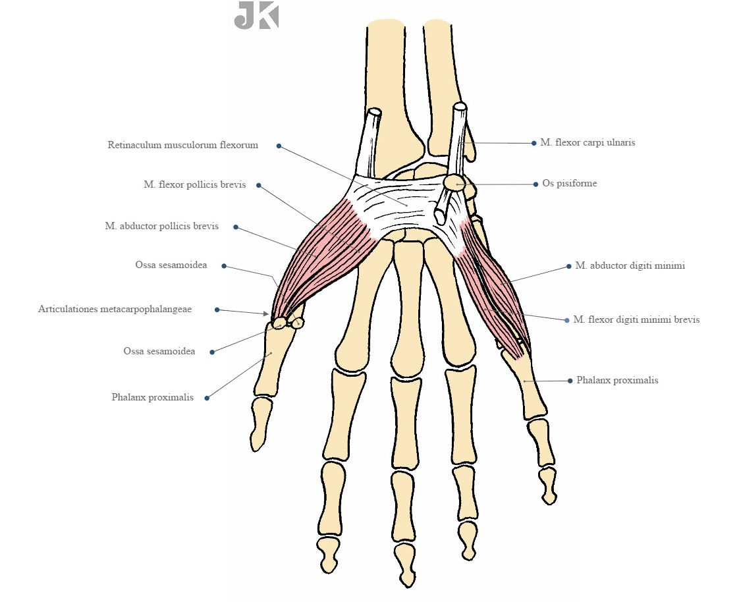
For more examples see handout called „Anatomical terms with superlatives“

Slide 18
Form comparatives and superlatives from given adjectives
POSITIVE | COMPARATIVE | SUPERLATIVE
parvus, a, um
brevis, e
fortis, e
acutus, a, um
magnus, a, um
longus, a,um
gravis, e
profundus, a, um
latus, a, um
minor, minus
minimus, a, um
brevior, ius
brevissimus, a, um
fortior, ius
fortissimus, a, um
acutior, ius
acutissimus, a um
maior, maius
maximus, a, um
longior, ius
longissimus, a, um
gravior, ius
gravissimus, a, um
profundior, ius
profundissimus, a, um
latior, ius
latissimus, a, um

Slide 19
FILL IN COMPARATIVES AND SUPERLATIVES IN CORRECT FORMS
minimi
minimus, a, um musculus abductor digiti __________
minor,minus cornu _______ ossis hyoidei
superior, ius defectus arcus dentalis____________
intimus,a,um musculi intercostales___________
inferior,ius amputatio membri ___________
imus, a,um arteriae lumbales __________
anterior, ius peritoneum parietale ___________
latissimus,a,um ruptura musculi ___________ dorsi
posterior, ius arteria temporalis profunda ________
minus
superioris
intimi
inferioris
imae
anterius
latissimi
posterior

Slide 20
CREATE MEANINGFUL DIAGNOSES
pro / dosis / infantibus / maxima
  dosis maxima pro infantibus
oris / chronicum / superioris / ulcus / labii
  ulcus chronicum labii superioris oris
sepsim / propter / lateris / amputatio / membri / sinistri / inferioris
  amputatio membri inferioris lateris sinistri propter sepsim
gastritidis / minoris / suspicio / gradus
  suspicio gastritidis gradus minoris
inferioris / dextri / rami / et / ossis / fractura / superioris / pubis / lateris
  fractura rami superioris et inferioris ossis pubis lateris dextri

Slide 21
TRANSLATE
shorter bone
  os brevius
more severe injury
  trauma gravius
bigger danger
  periculum majus
bigger sublingual duc
  ductus sublingualis major
in the upper hollow vein
  in vena cava superiore
the longest muscle of the upper limb
  musculus longissimus membri superioris
lesser curvature of ventricle of heart
  curvatura minor ventriculi cordis

Slide 22
TRANSLATE
posterior deep temporal artery
  arteria temporalis profunda posterior
fracture of the middle phalanx of the smallest finger
  fractura phalangis mediae digiti minimi
the most recent infarction
  infarctus recentissimus
the most frequent disease
  morbus frequentissimus
the innermost layer of oesophagus
  tunica intima oesophagi
amputation of the lower limb due to gangraena caused by diabetes mellitus
  amputatio extremitatis inferioris propter ganreaenam e diabeta mellito

Slide 23
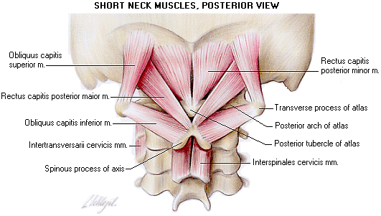
Put the correct Latin anatomical terms

Slide 24
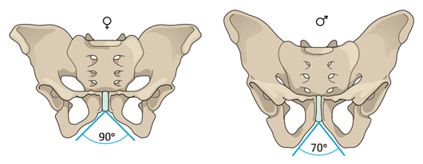
True False
1. Pelvis feminina levior est.
2. Pelvis masculina latior est.
3. Apertura superior pelvis femininae major est.
4. Cavitas pelvis femininae angustior est.
5. Os sacrum pelvis masculinae brevius est.
6. Os sacrum pelvis femininae latius est.
7. Foramina obturatoria pelvis femininae majora sunt.
8. Acetabula feminina majora sunt.
9. Coccyx feminina brevior est.
10. Angulus alarum ossis ilii masculini minor est.
11. Promontorium femininum minus est.
12. Symphysis pubica feminina longior est.
✓
✓
✓
✓
✓
✓
✓
✓
✓
✓
✓
✓

Slide 25
HOW DO WE DERIVE WORDS IN MEDICAL TERMINOLOGY
1) Derivation
  a) Prefix: ante-brachium; ana-lysis
  b) Sufix: brachi-alis; nephr-itis
  c) Prefix + sufix: ante-brachi-alis; para-nephr-itis
2) Composition: prim-i-para; pneum-o-thorax
3) Derivation + composition: nas-o-lacrim-alis; haemat-ur-ia
4) Abbreviation: DM; CT; HIV, AIDS
5) Borrowings: shock; stress

Slide 26
BASIC TERMINOLOGY
Medical words, like many other words consist of 3 basic component parts:
PREFIX
WORD ROOT
SUFFIX
 | PORT
RE | PORT
IM | PORT
SUP | PORT
EX | PORT
TRANS | PORT
 | PORT | ER
 | PORT | ABLE
TRANS | PORT | ABILITY

Slide 27
PREFIXES
ORIGIN: LATIN/GREEK prepositions and their phonological variants
ROLE: SPECIFY/RESTRICT/CHANGE/ALTER the meaning of the derived word
  Ad-ductor vs. Ab-ductor
POSITION: AT the BEGINNING of the word
MEANING:
  TIME/PLACE
  DEGREE
  DEVIATION/CORECTNESS

Slide 28
SUFFIXES
ROLE: SPECIFY/RESTRICT/CHANGE/ALTER the meaning of the derived word
  English example: teach vs. teacher
  e.g. adductio vs. adductor
  e.g. nephrosis, nephritis, nephroma
POSITION: AT the END of the word
MEANING:
  NOUN ENDINGS: STATE, QUALITY, FORM OF DISEASE,...
  ADJECTIVE ENDINGS: RELATION, POSSIBILITY, ABILITY, SHAPE,...

Slide 29
Diminutives
A diminutive creates a meaning of ‘small’ or ‘little’.
  English example: kittie, sweetie, Maggie,...
In Latin, the diminutive is formed from another noun by the addition of a suffix to its genitive stem:
  -(i)culus, a, um e.g. canaliculus (small canal)
  -ulus, a, um e.g. capitulum (small head)
  -olus, a, um e.g. alveolus (small cavity or pit)
  -illus, a, um e.g. pupilla (pupil; the dark circular aperture at the centre of the iris of the eye)
  -ellus, a, um e.g. cerebellum (posterior brain mass, lit. small brain)
Latin diminutives are always of the same gender like the nouns they are derived from.

Slide 30
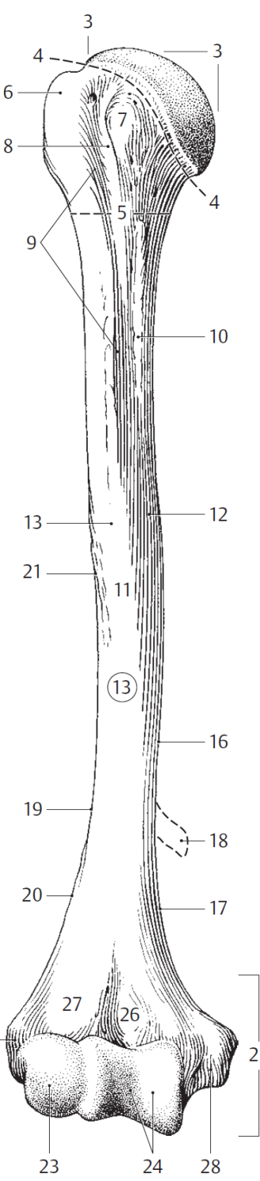
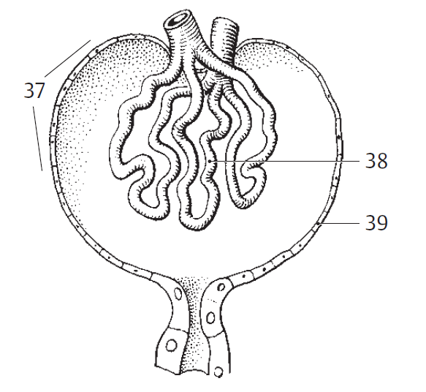
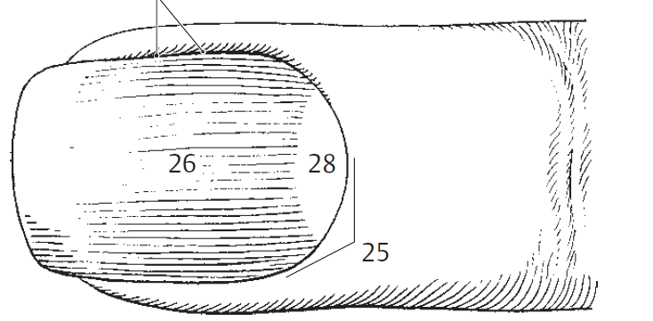
caput humeri
x
capitulum humeri
cuticula unguis
corpusculum renale
glomerulus
capsula glomerularis

Slide 31
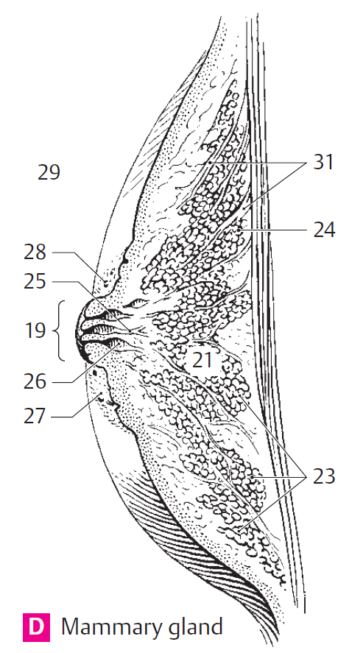
papilla mammae 19
lobi glandulae mammariae 23
lobuli glandulae mammariae 24
areola mammae 27
glandulae areolares 28
ligg. suspensoria mammaria 31

Slide 32
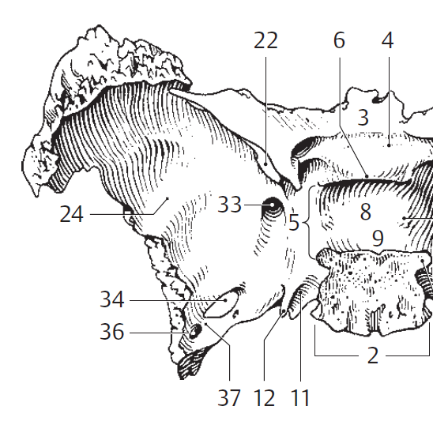
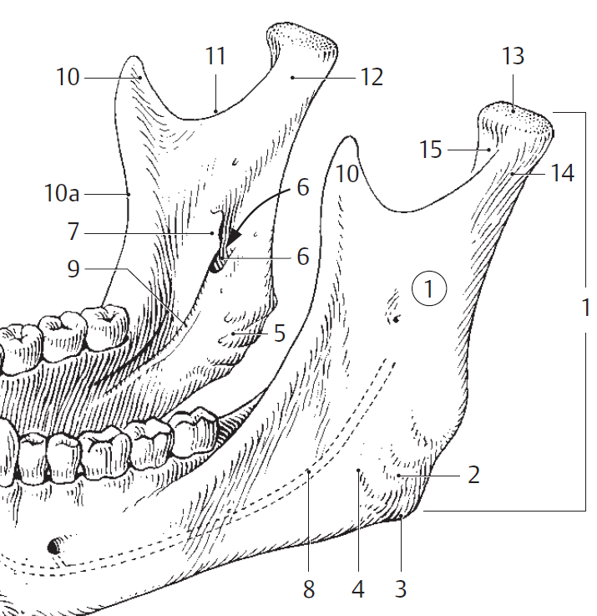
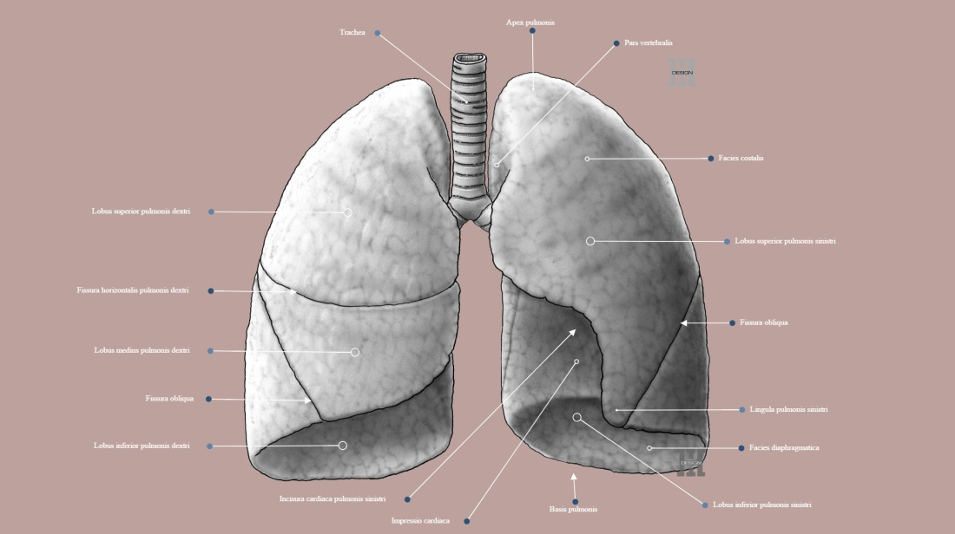
lingula (< lingua)
= little projection, process
E.g.:
sphenoidalis
pulmonis sinistri
mandibulae

Slide 33
Give nouns from which following diminutives are derived:
caput, itis, n.
os, ossis, n.
capitulum ........................
nodulus .......................
cerebellum ........................
lingula ........................
cuticula ......................
denticulus ....................
vasculum ....................
ossiculum ....................
venula........................
geniculum ........................
canaliculus........................
arteriola........................
areola ........................
nodus, i, m.
vena, ae, f.
cerebrum, i, n.
genu, us, n.
lingua, ae, f.
canalis, is, m.
cutis, is, f.
arteria, ae, f.
dens, dentis, m.
area, ae, f.
vas, vasis, n.

Slide 34
Form diminutives:
lobus ........................
ductus .......................
anus ........................
frenum ......................
valva .....................
mus ......................
venter.....................
vena....................
septum........................
fossa ........................
tuber ........................
corpus ........................
glans ........................
auris ........................
lobulus
venula
ductulus
septulum
anulus
fossula
frenulum
tuberculum
valvula
corpusculum
musculus
glandula
ventriculus
auricula

Slide 35
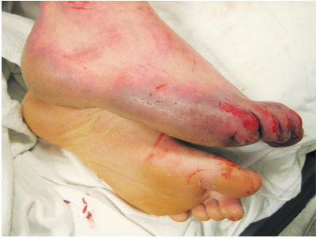
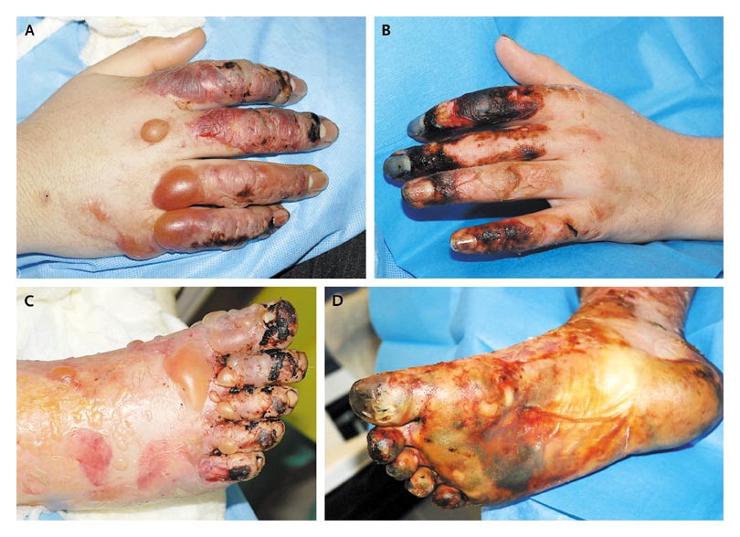
A 16-year-old boy was admitted to the hospital after being found unconscious in a snow bank at 6 a.m. on New Year's Day. He had been well until the night before admission, when he attended a party where alcohol was consumed. He was last seen at approximately 11 p.m. Approximately 2 hours later, his friends and family noticed his absence and notified police; a search was begun. At approximately 6 a.m., he was found unconscious in a snowbank by local firefighters and police officers. The ambient temperature was −15°C (5°F), with a wind-chill factor of approximately −29°C (−20°F). He was partially undressed
with his pants down and his right boot off;
his limbs were buried in the snow, and
a layer of ice surrounded his right foot.
Diagnosis:
Stage 3 hypothermia.
Stage 3 frostbite with diffuse distal
small-vessel thrombosis and impending
partial limb loss.
Notes:
Hypothermia gradus tertii.
Congelatio gradus tertii cum thrombosi vasculorum distali diffusa
Periculum amputationis partialis membri (extremitatis) / amputatio partialis imminens

