Slide 1
Fractures

Slide 2
Authentic medical reports
Décollement = severe damage of soft tissues

Slide 3
Fractura pathologica
Myeloma -The plasma membrane of a muscle fiber

Slide 4
Fractura traumatica

Slide 5
Fractura aperta/clausa

Slide 6
Fractura simplex/multiplex

Slide 7
Fractura comminutiva

Slide 8
Fractura transversa/obliqua

Slide 9
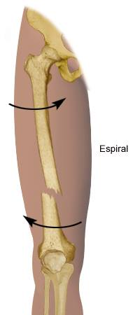
Fractura spiralis / longitudinalis

Slide 10
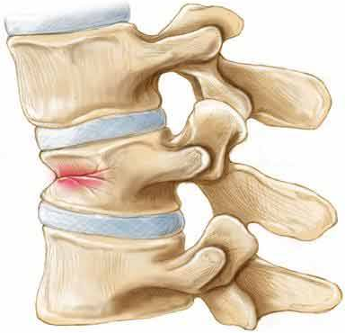
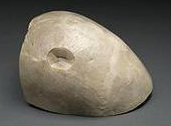
Fractura compressiva / impressiva

Slide 11
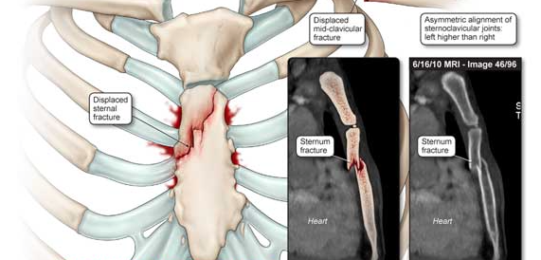
Fractura incuneata
Notes:
Toto by snáď mohlo byť ok?

Slide 12
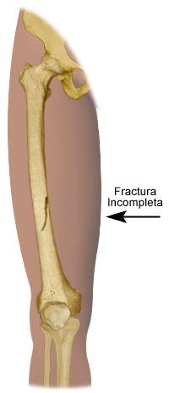
Infractio = f. partialis = f. incompleta

Slide 13
Fractura cum dislocatione
ad axim
ad latus
ad longitudinem cum contractione
ad longitudinem cum distractione

Slide 14
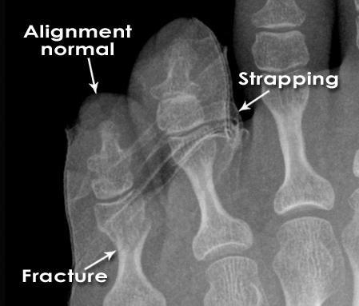
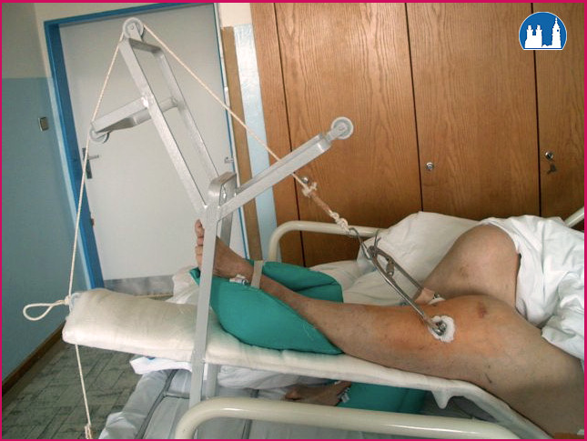
Fracture Healing: 1: REPOSITIO = REDUCTIO fragmentorum
CLOSED (short /long term)
Notes:
is a medical procedure to restore fracture or dislocation to the correct alignment. This sense of the term "reduction" does not imply any sort of removal or quantitative decrease but rather implies a restoration: re ("back [to normal]") + ducere ("lead"/"bring"), i.e., "bringing back to normal."
Use of plates, screws, and wires was first documented in the 1880s and 1890s. Early surgical fixation initially was complicated by many obstacles, such as infection, poorly conceived implants and techniques, metal allergy, and a limited understanding of the biology and mechanics of fracture healing.[1] During the 1950s, Danis and Muller began to define the principles and techniques of internal fixation.

Slide 15
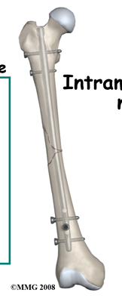
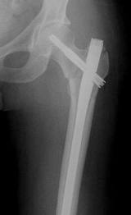
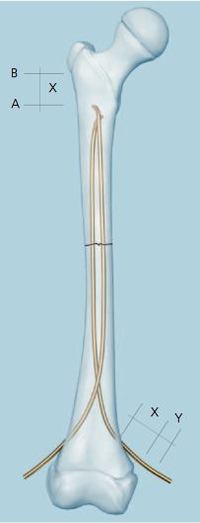
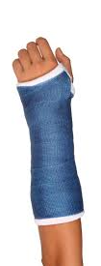
Fracture Healing: 2: FIXATIO = STABILISATIO fragmentorum
PLASTER CAST
INTERNAL FIXATION
Notes:
(mechanical stability) intramedullar rods/ Internal plates and screws
ESIN

Slide 16
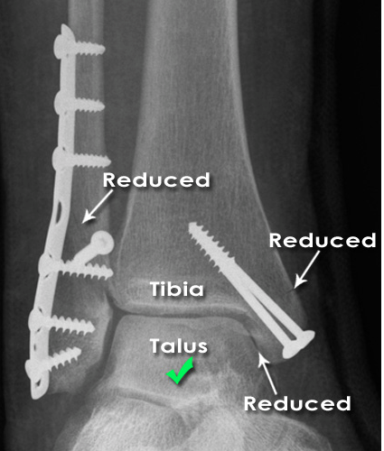
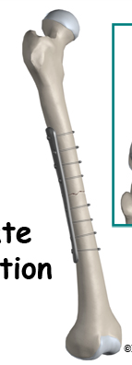
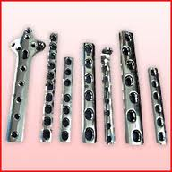
Fracture Healing: 2: FIXATIO = STABILISATIO fragmentorum
INTERNAL FIXATION

Slide 17
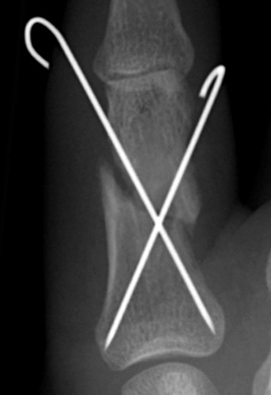
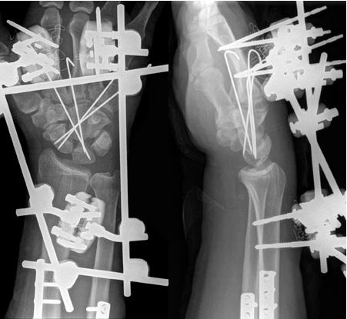
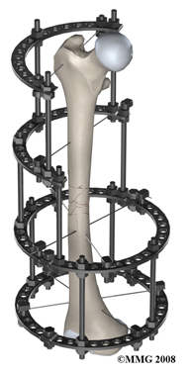
Fracture Healing: 2: FIXATIO = STABILISATIO fragmentorum
Notes:
Kirschner

Slide 18
Name the type of fracture
A
B
C
D
E
F
Notes:
A, pathologica
B, spiralis
C, infractio, incompleta
D, obliqua
E, aperta/complicata
F, comminutiva

Slide 19
A) Name different bones of the human body B) Write down different types of fractures of named bones
Notes:
Cvičení primárně slouží jako opakování názvú kostí lidského těla, (kosti pojmenovat, zařadit do deklinace, určit gen. základ slova, případně odvodit adj.
Sekundárně jej možno použít jako cvičení pro zopakování typu zlomenin, student si vybere, kterou kost a jak “zlomí” a pokusí se to zapsat

Slide 20
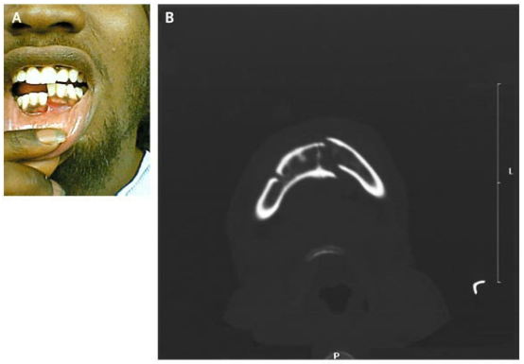
3
A 21-year-old man
presented after being
struck with a gun on
his right lower jaw.
Examination revealed
displacement of the
left half of his mandible with malocclusion on biting (Panel A). Computed tomography showed a fracture of the left mandible and a fracture of the right mandibular body and angle (Panel B). Given the U shape of the mandible, it is common for contralateral fractures to result from major injury. Intravenous analgesics and antibiotics were given; the patient underwent open reduction with internal fixation of his fractures.
Notes:
Fractura mandibulae lateris sinistri
Fractura corporis et anguli mandibulae
Reductio fragmentorum aperta cum fixatione interna

Slide 21
Literature
Mazánek, J.: Traumatologie orofaciální oblasti. Praha : Grada, p. 24
http://radiologymasterclass.co.uk
http://anthropology.si.edu
http://nejm.org (The New England Journal of Medicine)

