Slide 1
COLOURS IN MEDICAL TERMINOLOGY

Slide 2
General terms
color, oris, m. (Lat.)
chroma, chromatis, n. (Gr.) = colour

Slide 3
Adjectives denoting colours and demonstration of their medical use
albus, a, um (L.)
leuko- (G.) = white
e.g. vaselinum album; albinismus; leucocytus; leucorrhoea; leucoplacia; leucaemia

Slide 4
Pallidus, a, um (L.) = pale
e.g. facies pallida; febris pallida

Slide 5
Flavus/luteus, a, um (L.)
Xantho-/cirrho- (G.) = yellow
e.g. febris flava; corpus luteum; ligamenta flava; xanthoderma; cirrhosis

Slide 6
Ruber, a, um (L.)
erythro- (G.) = red
e.g. medulla ossium rubra; nucleus ruber; rubeola; erythrocytus; erythroderma

Slide 7
Roseus, a, um (L.) = pink
e.g. pithyriasis rosea; roseola

Slide 8
Caeruleus, a, um (L.)
cyano- (G.) = blue/blue-black
e.g. naevus caeruleus; cyanosis; cyanopsia; cyanoticus

Slide 9
Niger, a, um (L.)
melano-/anthraco- (G.) = black
e.g. lingua villosa nigra; substantia nigra; melanoma; melanosis; anthracosis

Slide 10
Griseus, a, um (L.)
polio- (G.) = grey
e.g. substantia grisea; poliomyelitis; poliovirus

Slide 11
Lividus, a, um (L.) = livid, discoloured, bluish
e.g. asphyxia livida

Slide 12
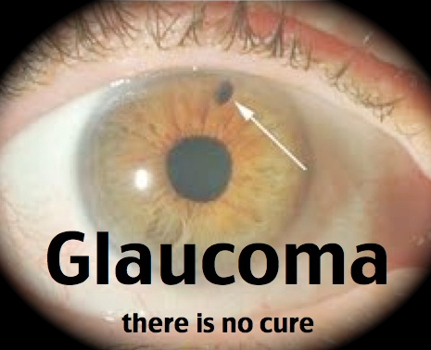
Glauco- (G. ~ chloro-) = green-blue
e.g. glaucoma

Slide 13
Fuscus, a, um = dark, brown
e.g. lagoena fusca

Slide 14
Versicolor, oris (L.)
poikilo- (G.) = vari-coloured
e.g. pithyriasis versicolor; poikiloderma

Slide 15
Thank you for your attention!

