Slide 1
Střevní mikrobiom ve zdraví a nemoci
VKP 27. 4. 2018

Slide 2
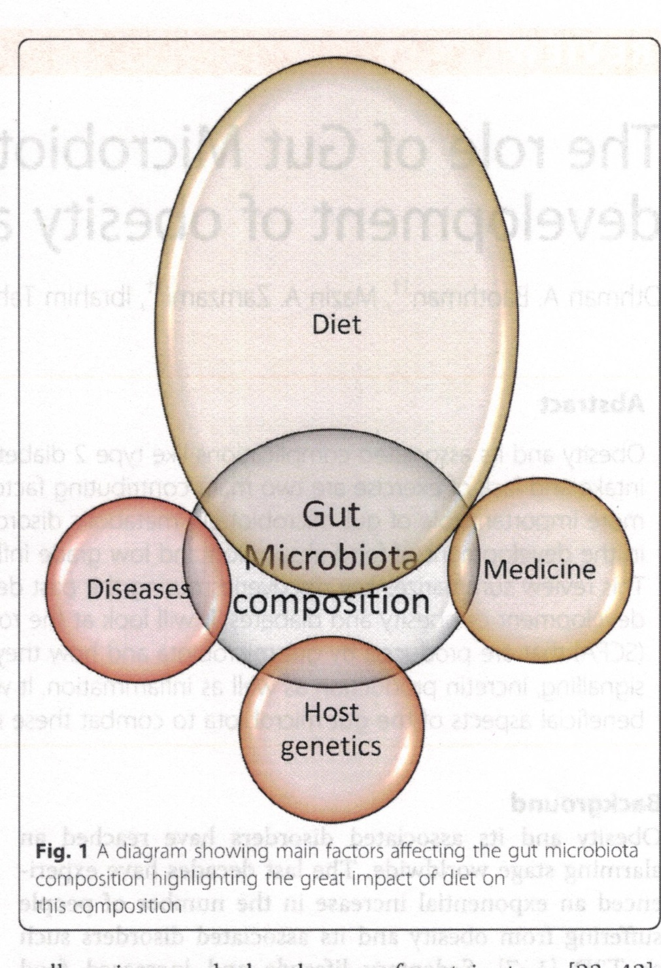

Slide 3
Evolution
Evidence suggests that human evolution, which has taken billions of years of continual interaction with our environment, played a major role in the way we have evolved. Among the environmental factors, intestinal microbes have conferred numerous metabolic and biological functions that we are unable to perform by our own cells.
Recent data estimate that humans are colonized by trillions of microbes, and the vast majority of them reside in our gut. This tremendous number of microbial cells represents a ratio of approximately 1:1 between human and microbial cells, or even 1:10 if we take into account only the number of human nucleated cells (i.e., excluding red blood cells).

Slide 4
Gut microbiota
Gut microbiota describes all organisms living in the gastrointestinal (GI) tract.
The majority of these organisms reside in the large intestine. These bacteria play important physiological role in vital processes such as digestion, vitamin synthesis and metabolism amongst others. Even though the exact mechanism linking gut microbiota to obesity is far from being very well understood, it’s well established that gut microbiota can increase energy production from diet, contribute to low-grade inflammation and regulate fatty acid tissue composition. These processes as well as others have been proposed as the link between obesity and gut microbiota.

Slide 5
Gut microbiota
The exact contribution of gut microbiota to the development of obesity and diabetes is not very clear due to many reasons including the complexity and diversity of gut microbes, ethnic variation in studied populations and large variations between individuals studied.
Modulation of gut microbiota holds a tremendous therapeutic potential to treat the growing obesity epidemic especially when combined with diet and exercise.

Slide 6
Mikroorganismy ve střevě
Gut microbiota harbors a vast number of genes that clearly outnumbers our own genome by at least 100‐fold. This vast catalog of genes encodes for specific metabolic activities, allowing microbes to adapt to their environment and eventually the energy sources available. Hence, the gut microbiota is considered a massive “organ” able to perform complex functions and thereby produce a myriad of different metabolites.
Numerous publications have found an association between the microbiota and many diseases (e.g., obesity, diabetes, liver diseases, altered immunity, digestive diseases, cancer, neurodegenerative disorders), but the exact role of the gut microbiota in the onset of diseases remains a matter of debate.

Slide 7
Mikroorganismy ve střevě
The microbial diversity (i.e., species richness of the microbiota) is another concept that has been linked with the metabolic functions of the gut bacteria. Indeed, low bacterial richness is consistently appearing in the literature as a risk factor for different diseases (e.g., obesity, low‐grade inflammation, intestinal inflammation).
Aside from the microbial diversity, evidence also suggests that we can classify subjects on the basis of the number of bacterial genes that they harbor in their gut (i.e., microbial gene richness). More precisely, Le Chatelier et al. identified a bimodal distribution of microbial genes leading to the clustering of subjects as either low gene count or high gene count according to the number of genes present in the microbiota. This also seems to be important for the susceptibility to respond to dietary intervention devoted to improving metabolic parameters, since dietary restriction in patients with overweight or obesity is less efficient in low gene count than in high gene count individuals in terms of improving insulin sensitivity and lowering cholesterol and inflammation.

Slide 8
Factors affecting gut microbiota composition
Composition of gut microbiota is affected by many factors such as diet, disease state, medications as well as host genetics to name a few. As a result, the composition of the gut microbiota is constantly changing affecting the health and well-being of the host such as disease state as well as the use of various medicines such as antibiotics .
The effect of antibiotics on gut microbiota is well documented showing a long term reduction in bacterial diversity after use of antibiotics.

Slide 9
Factors affecting gut microbiota composition
Link between antibiotics and weight gain is also well documented in infants as well as in adults.
Use of antibiotics will cause a decline in the bacterial diversity, stereotypic declines as well as increased abundances of certain taxa.
Recovery of normal microbiota from certain antibiotic treatment can be long depending on the type of antibiotic and its spectrum. Strong and broad spectrum antibiotics such as clindamycin can have longer affects persisting up to 4 years.
The stress caused by the disruption of normal flora after antibiotic treatment facilitates the transfer of antibiotic resistance genes to virulent species leading to increased drug resistance.
Finally, the main contributor to the diversity of the gut microbiota is diet.

Slide 10
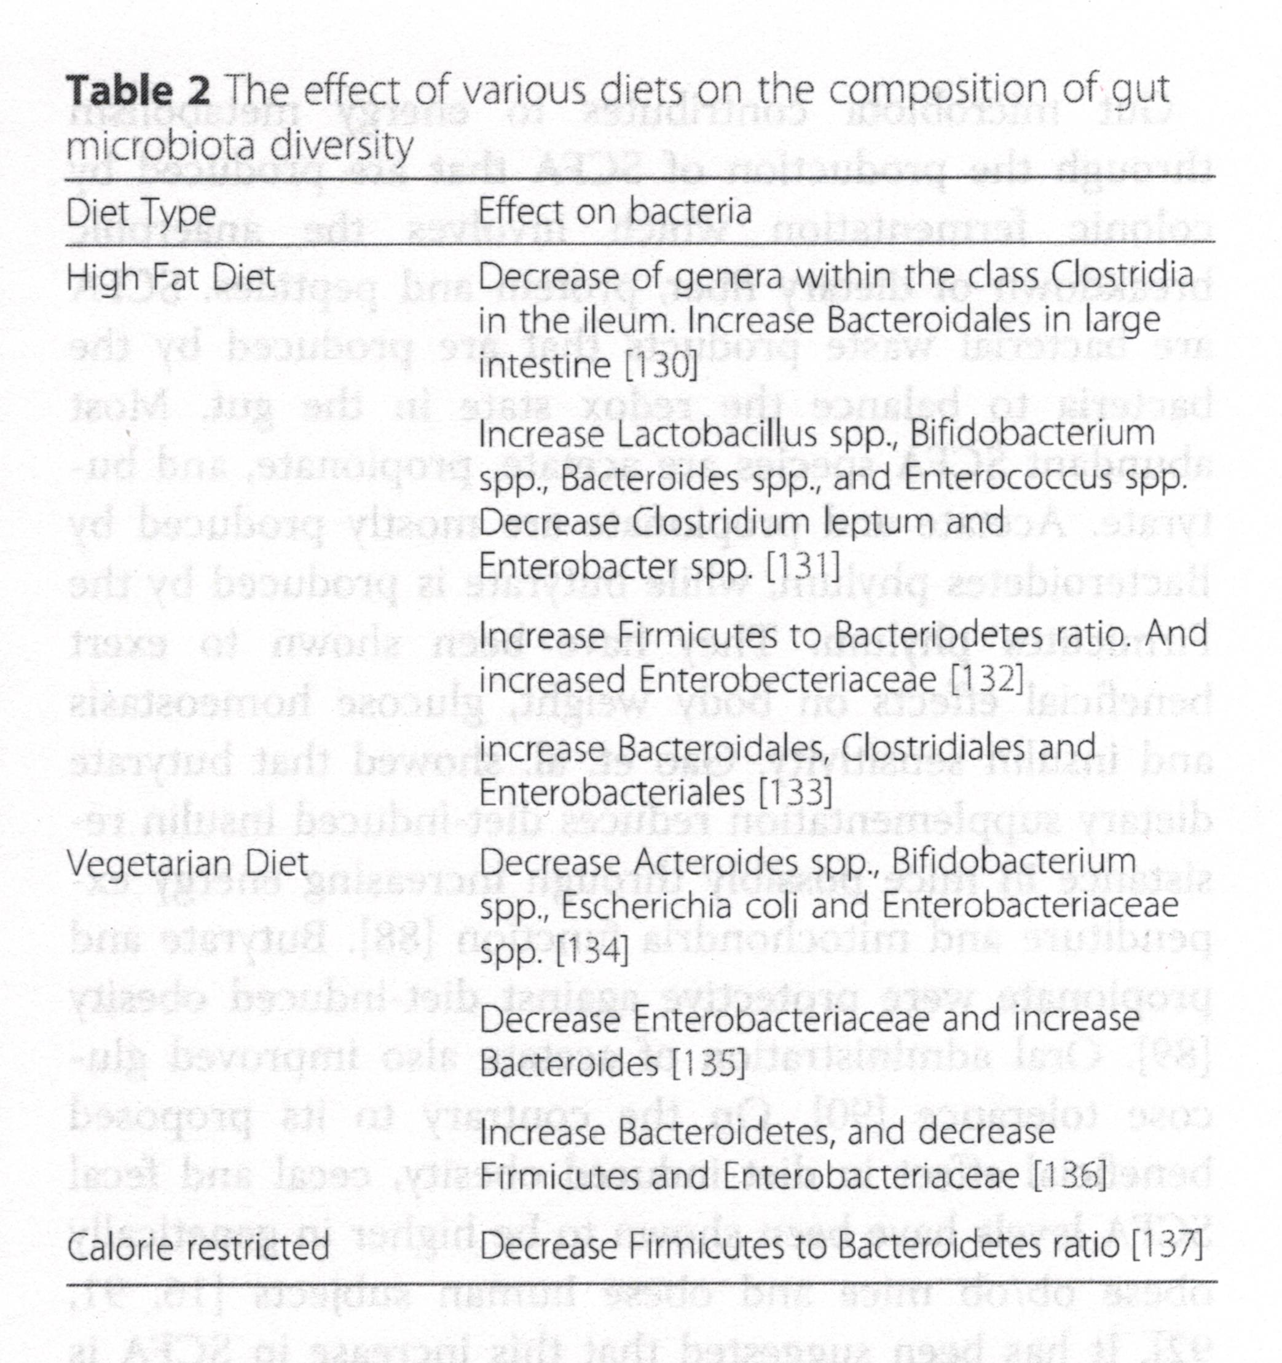

Slide 11
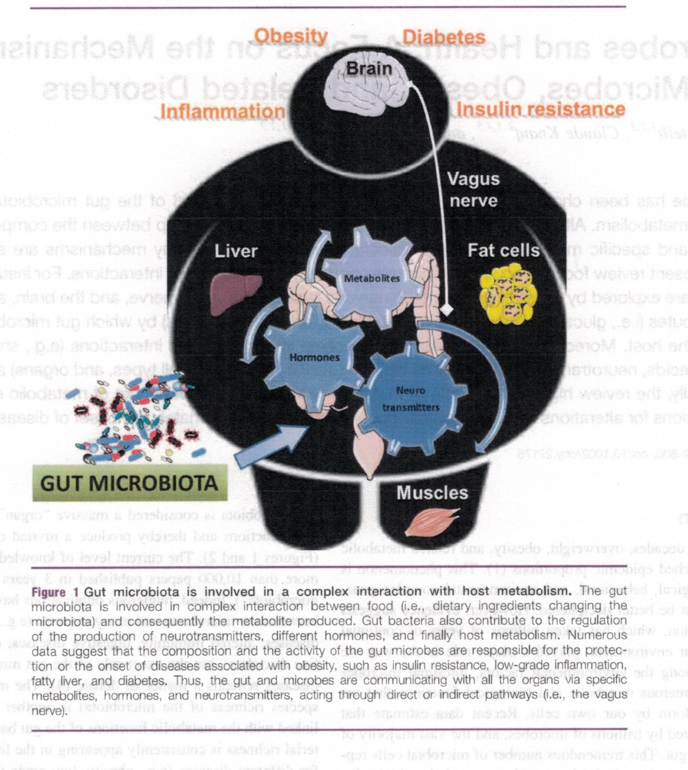

Slide 12
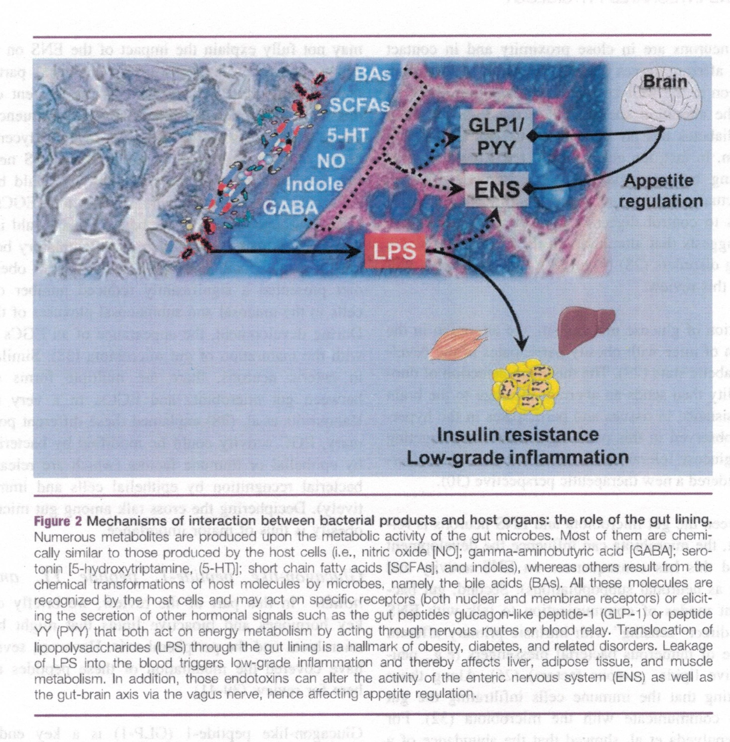

Slide 13
Inervace GIT
The gastrointestinal tract is densely innervated by intrinsic and extrinsic neurons: the differentiation relies on the localization of the soma of the neurons.
The enteric nervous system (ENS) is composed of various types of neurons, including intrinsic primary afferent neurons and inter‐ and motor neurons.
These neurons are in close proximity and in contact with spinal and vagal afferent nerves that send intestinal information to the brain. In addition to the well‐known nerve alteration observed in type 2 diabetes, the alteration specifically in the ENS observed during obesity and diabetes has an impact on the control of food intake and metabolism. In fact, the gut is considered a major partner that influences feeding behavior via the ENS.
Actual cross talk among gut hormones, the ENS, and microbial factors to control digestive motility and food intake, and evidence suggests that alterations in the gut‐brain axis are associated with eating disorders were decribed.

Slide 14
The relationship between the gut microbiota and ENS neurons is relatively complex.
First, the microbiota can influence the development of the ENS, and this has consequences on ENS activity and neurochemistry (such as neuronal subpopulations).
Second, gut bacteria can use different modes of communication to talk with ENS neurons, including a direct “sensing” with intrinsic primary afferent neurons or the release of numerous bacterial messengers (e.g., neurotransmitters, bioactive lipids, gaseous factors). Along those lines, it is worth noting that the immune cells infiltrating the gut epithelium may also communicate with the microbiota.

Slide 15
Is there a link between the gut microbiota, the ENS, and obesity?
A direct relationship between the gut microbiota, the ENS, and obesity has never been clearly demonstrated. Phenotypic characteristics (e.g., dysbiosis, alteration of gut motility, hyperglycemia) are exacerbated during aging.
Aging was associated with an increase in excitatory neuronal markers, which could explain intestinal hyper‐contractility.
Dysmotility of the colon during aging could also be explained by the development of fat deposition in the tunica muscularis of intestinal smooth muscle cells, which decreases the number of myenteric neurons that express the neuronal nitric oxide (NO) synthase enzyme.

Slide 16
Is there a link between the gut microbiota, the ENS, and obesity
The link between obesity and gut microbiota is well established, but researchers have to focus on the capacity of the gut microbiota and its releasing factors to target the ENS in order to propose novel approaches to treat obesity and its associated phenotypes: namely, increase in food intake, intestinal dysmotility, and type 2 diabetes. However, although the link between colonic gut microbiota and the ENS is easily plausible, one may not fully explain the impact of the ENS on glucose absorption or the arrival of nutrients in the duodenal part. For instance, in humans, numerous factors, such as the nutrient composition of the diet and the hormonal response, strongly influence the gastric emptying, which in turn can affect the overall glycemic profile as well as the appetite sensation. In addition to ENS neurons, the cellular link between gut microbiota and obesity could be the enteric glial cells (EGCs).

Slide 17
Is there a link between the gut microbiota, the ENS, and obesity
EGCs seem to exert pleiotropic effects throughout the whole body, which could imply various roles in numerous pathologies, such as inflammatory bowel diseases, Parkinson disease, and obesity.
EGC activity could be modified by bacterial metabolites and by epithelial or immune factors (which are released in response to bacterial recognition by epithelial cells and immune cells, respectively). Deciphering the cross talk among gut microbiota, EGCs, and obesity is thus of major importance.

Slide 18
Glucagon‐like peptide‐1 (GLP‐1) is
Glucagon‐like peptide‐1 (GLP‐1) is a key endocrine factor that could participate in the control of the gut‐brain axis by gut microbiota because of its location (i.e., released by intestinal L cells).
GLP‐1 could act on ENS neurons to modify the gut‐brain axis to control food intake and glucose metabolism.
GLP‐1 has a potential anorexigenic effect in humans with obesity after bariatric surgery. However, whether the appetite and the glycemic impact observed after bariatric surgery are mediated by only the hormone GLP‐1 remains a matter of discussion.

Slide 19
Endocannabinoid system (ECS)
In the context of energy homeostasis, the endocannabinoid system (ECS) plays a major role.
Endocannabinoids (eCBs) are bioactive lipids that are synthesized in and exert their action on several organs involved in metabolism and appetite regulation. Depending on the action exerted by eCBs on the intestinal mucosa, they can be clustered as a “gate opener” (anandamide) and “gate keeper” (palmitoylethanolamine, 2‐oleoylglycerol).
Gut microbiota can modulate intestinal eCB tone. An “obesity microbiota” is associated with an increased intestinal level of anandamide, thus increasing gut permeability.

Slide 20
Endocannabinoid system (ECS)
The daily administration of a key bacterium, Akkermansia muciniphila, was found to reverse diet‐induced obesity by a mechanism associated with increased intestinal levels of eCBs that control inflammation, the gut barrier, and gut peptide secretion.

Slide 21
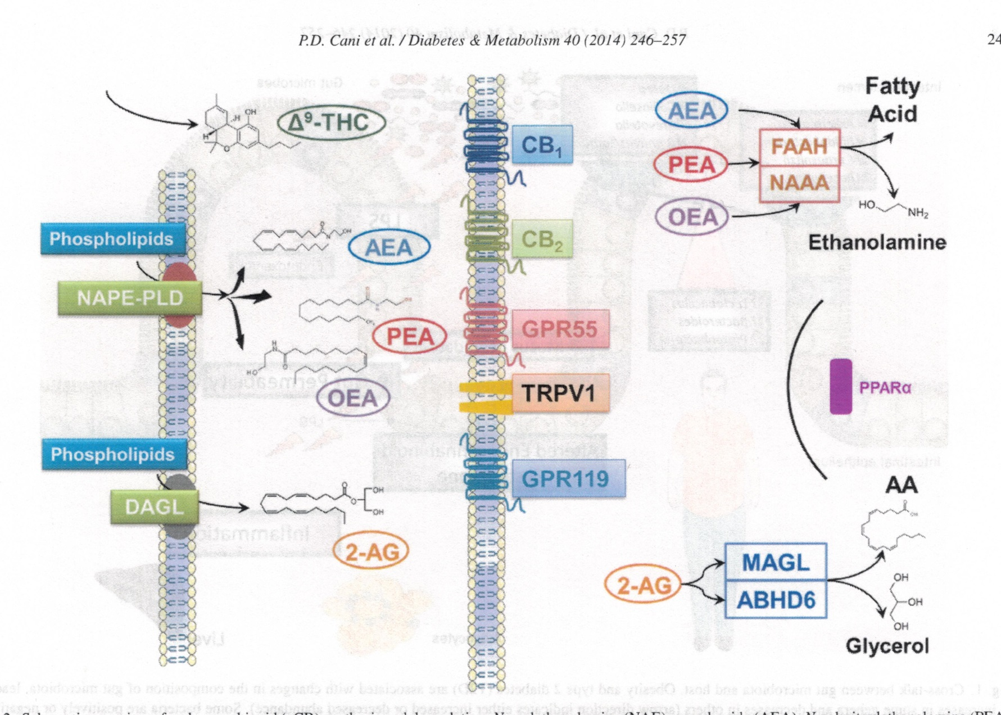

Slide 22
Endocannabinoid (eCB) synthesis
Schematic overview of endocannabinoid (eCB) synthesis and degradation. N-acylethanolamine (NAE), anandamide (AEA), N-palmitoylethanolamine (PEA)and N-oleoylethanolamine (OEA) are synthesized on demand from cell membrane phospholipids through N-acylphosphatidyl-ethanolamine-specific phospholipaseD (NAPE-PLD).
2-Arachidonoylglycerol (2-AG) is also produced from cell membrane phospholipids through the action of diacylglycerol lipase (DAGL). These bioactive lipids activate cannabinoid receptors 1 and 2 (CB1and CB2), also targeted by 9-tetrahydrocannabinol (9-THC), the principal active component of Cannabis sativa, or other non-cannabinoid receptors such as PPAR , GPR55, GPR119 and TRPV1. These lipids are hydrolyzed in the cell by several lipases. NAE is mainly hydrolyzed by fatty acid amide hydrolase (FAAH) and N-acylethanolamine-hydrolyzing acid amidase (NAAA) into ethanolamine and a fatty acid (dependingon the NAE hydrolyzed). 2-AG is hydrolyzed by two serine hydrolases, monoacylglycerol lipase (MAGL) and / -hydrolase domain 6 (ABHD6), into glycerol andarachidonic acid (AA).

Slide 23
Metabolites produced by gut microbiota and acting as signaling molecules
Short chain fatty acids
Short chain fatty acids (SCFAs) are organic fatty acids containing two to six atoms of carbon and are produced in the cecum and in the colon of the host by the microbiota following the fermentation of nondigestible dietary fibers, proteins, and glycoproteins. Acetate, propionate, and butyrate represent 95% of SCFAs.
Bacterial SCFAs locally modulate the physiology of the large intestine, but they can also be absorbed (only 5%‐10% are excreted in feces) and control the metabolism of other organs (such as adipose, liver, muscle, and brain tissue), thus influencing the energetic homeostasis of the host, including appetite regulation.
One of the primary roles of SCFAs is the modulation of the activity of histone deacetylase.

Slide 24
Metabolites produced by gut microbiota and acting as signaling molecules
Short chain fatty acids SCFAs induce colon motility.
SCFA administration increased the luminal release of serotonin (5‐HT). It has also been suggested that butyrate, but not acetate or propionate, has a colonic prokinetic effect by increasing the proportion of cholinergic (excitatory) myenteric neurons; it seems that the change in neuronal phenotype is associated with increased acetylation of histone 3.
SCFAs modulate colonic secretion in response to 5HT: the gut microbiota downregulates 5‐HT3 expression via acetate production, thus lowering the host secretory response.
SCFAs in the gut‐brain axis. The finding that the GPR41 receptor is expressed in sensory ganglia (afferent fibers) and in autonomic ganglia (efferent fibers) strongly supports the role played by SCFAs in the gut‐brain axis
Butyrate and propionate activated intestinal gluconeogenesis in the colon via complementary mechanisms. Butyrate increased the expression of intestinal gluconeogenesis enzymes through a cAMP‐dependent mechanism, while the same genes were activated by propionate via a gut‐brain axis involving GPR41 expressed on periportal neural afferents.

Slide 25
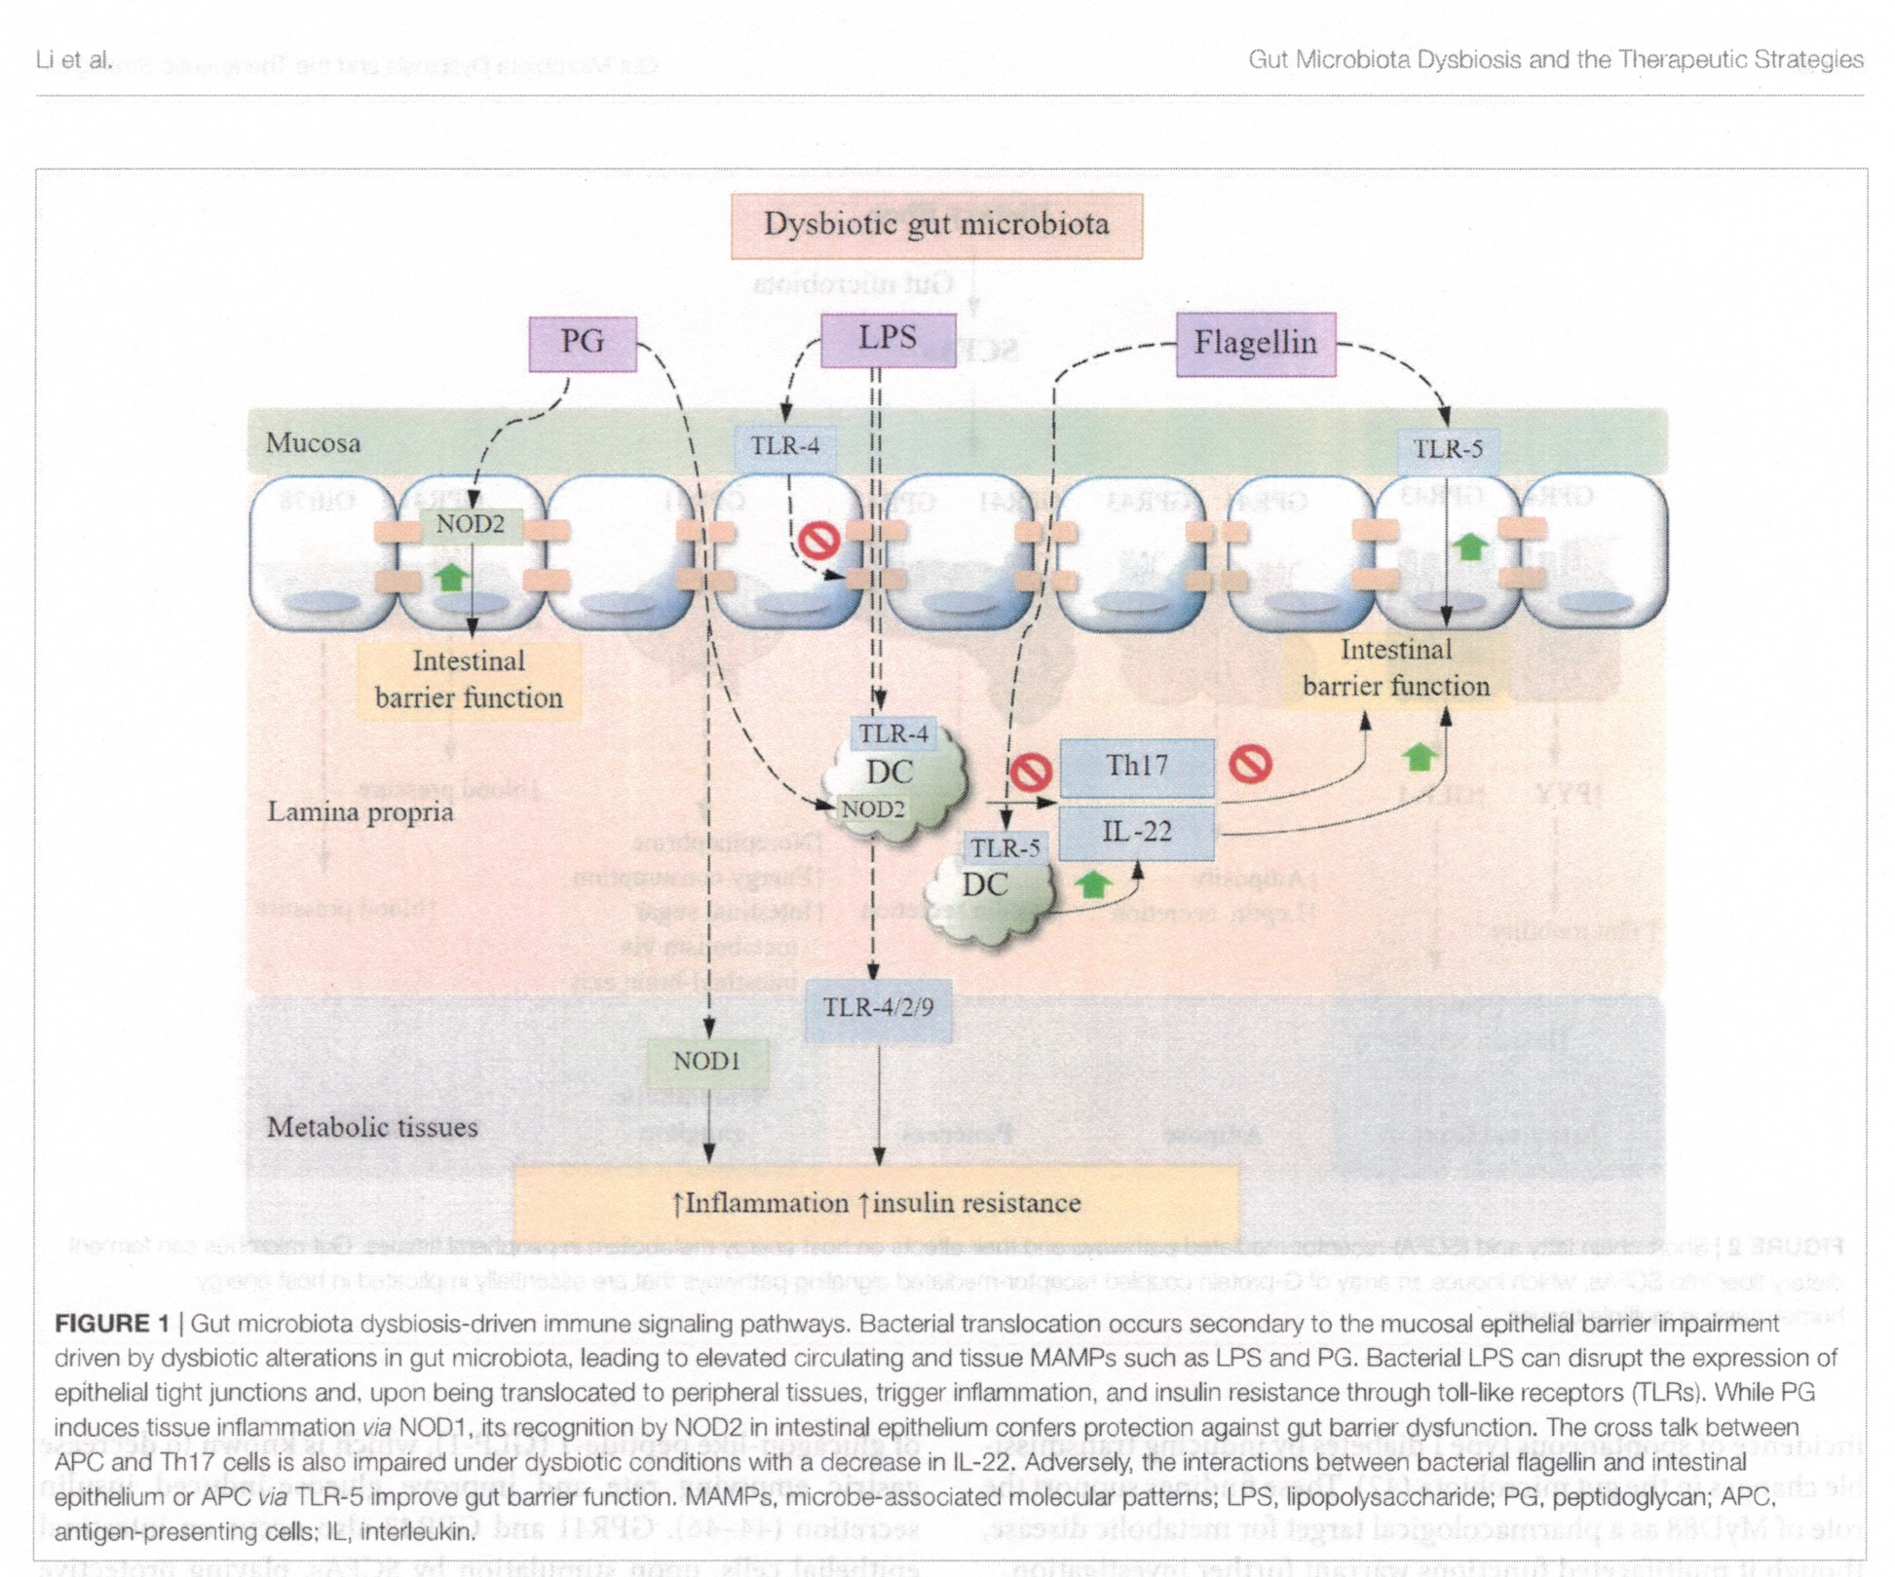

Slide 26
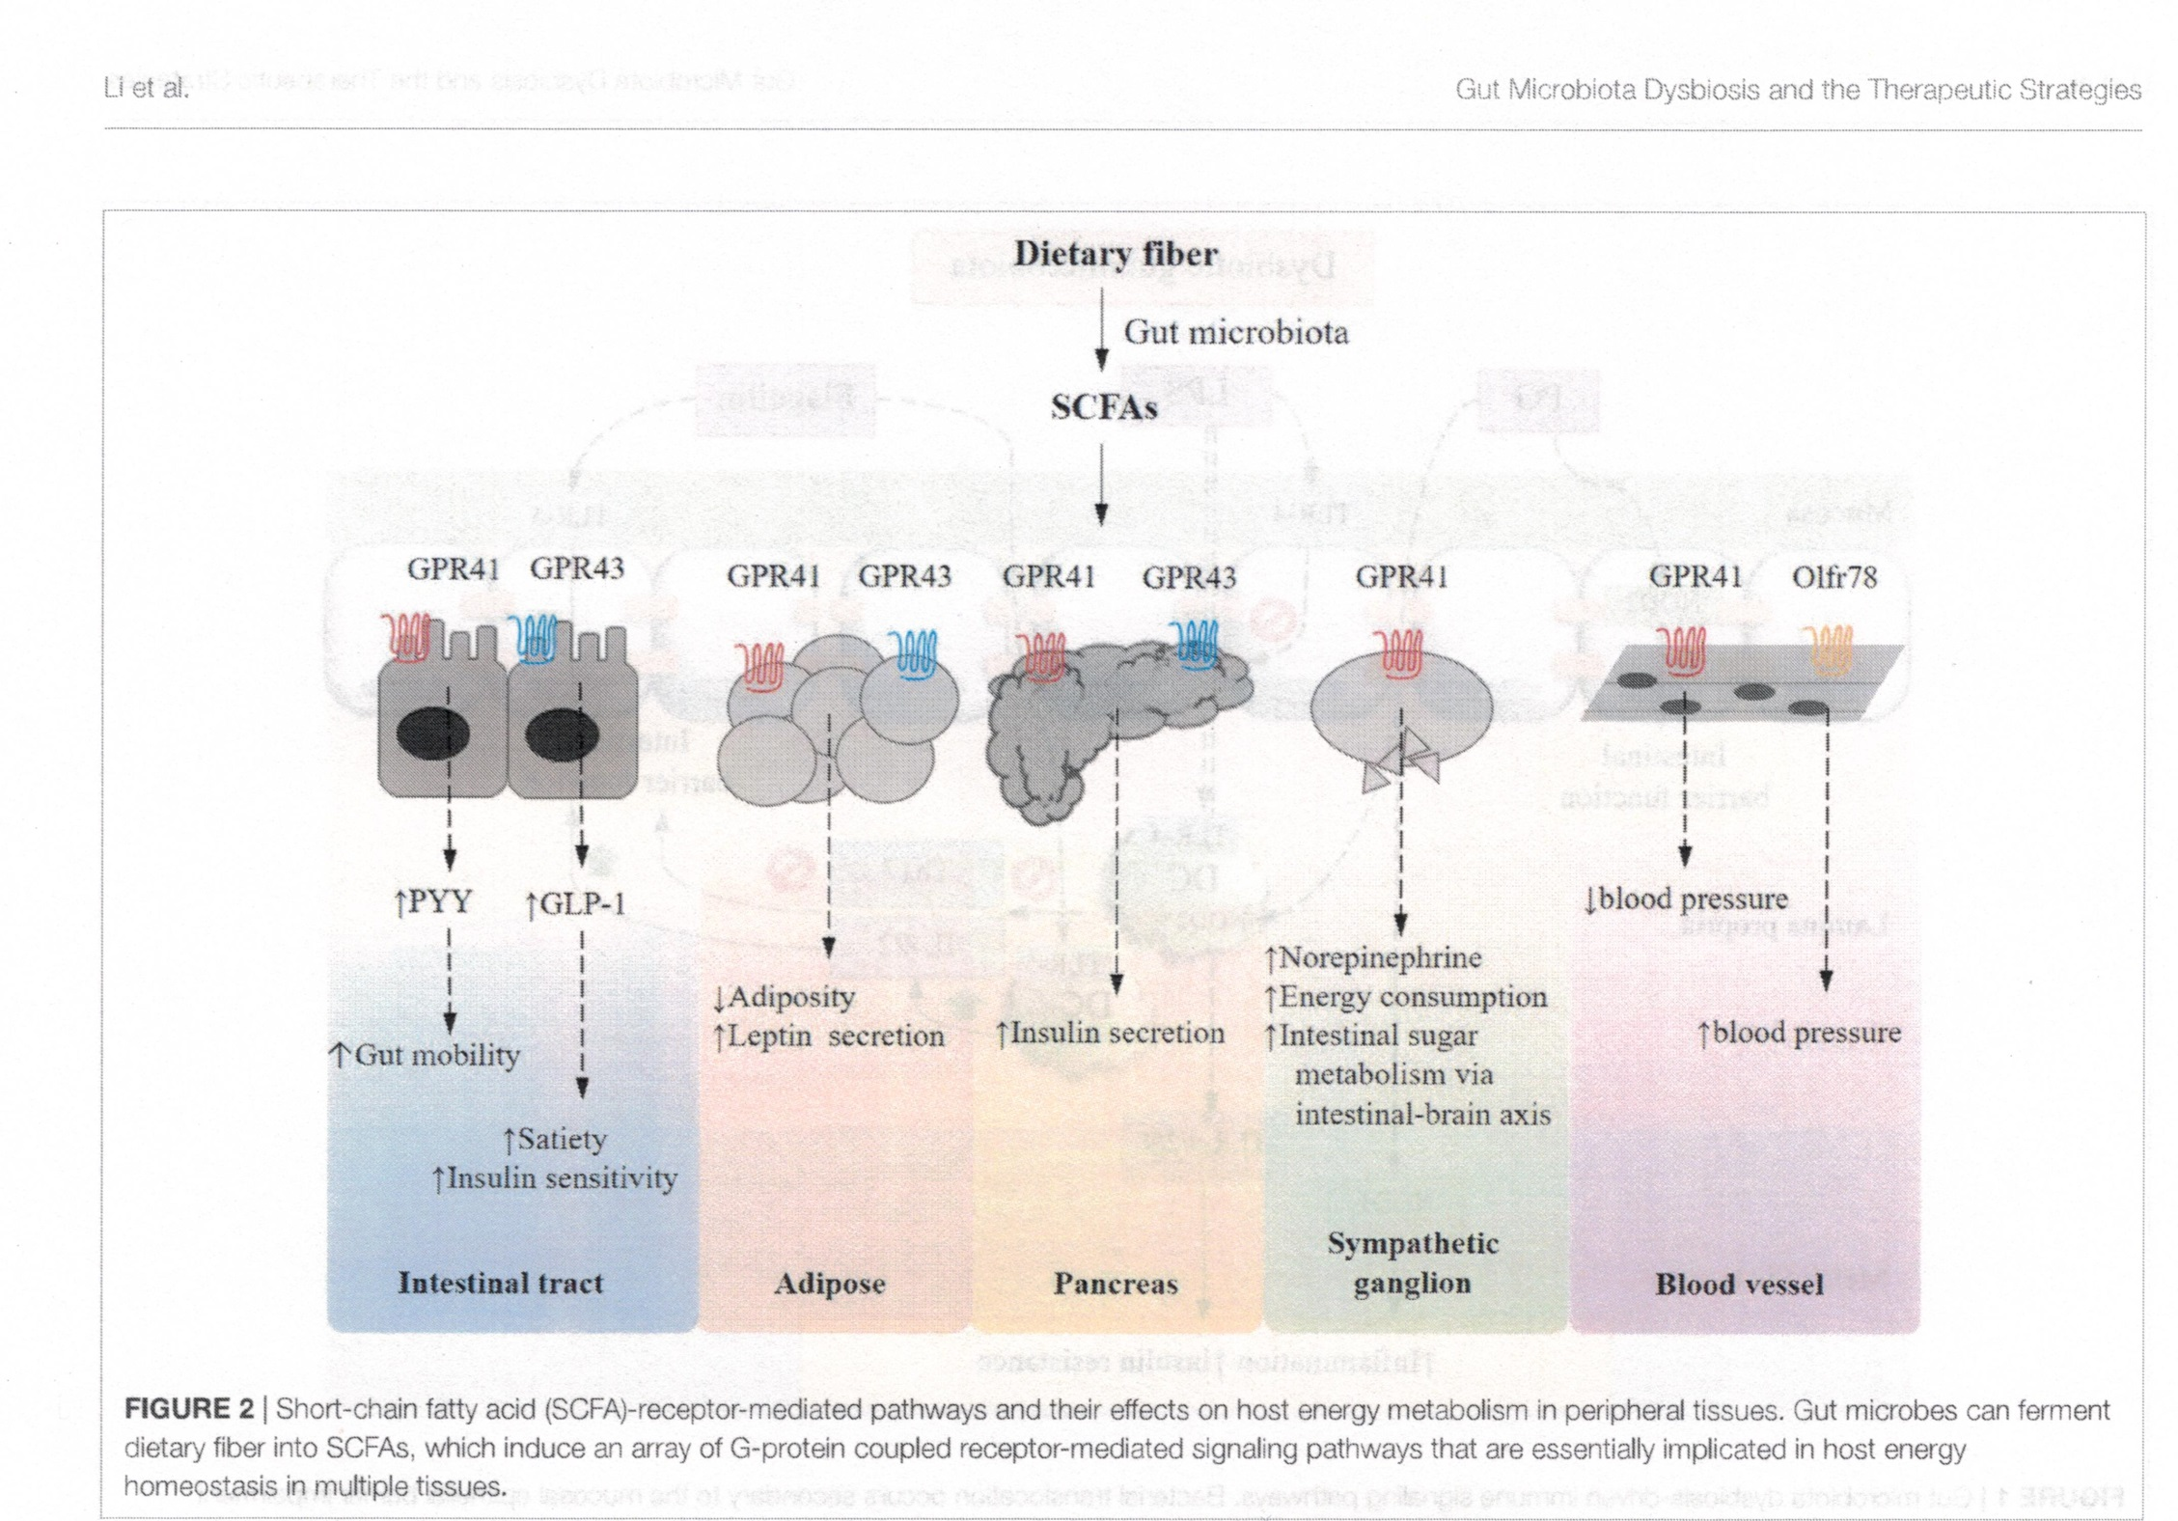

Slide 27
Metabolites produced by gut microbiota and acting as signaling molecules
Acetate can also influence metabolism via a gut‐brain axis. It was demonstrated that fermentable carbohydrates such as inulin altered hypothalamic neuronal activity specifically in the arcuate nucleus (ARC). Intraperitoneal administration of acetate or acetate directly produced by the gut microbiota through fermentation entered the hypothalamus and reduced appetite by increasing the expression of anorectic pro‐opiomelanocortin and suppressing agouti‐related peptide.
Acetate production from an altered gut microbiota increased glucose‐stimulated insulin secretion, ghrelin secretion, hyperphagia, and other alterations in the metabolism associated with obesity by activating parasympathetic neurons. But, it remains unclear whether the observed effects are attributable to the acetate itself or to other products of the cross feeding.

Slide 28
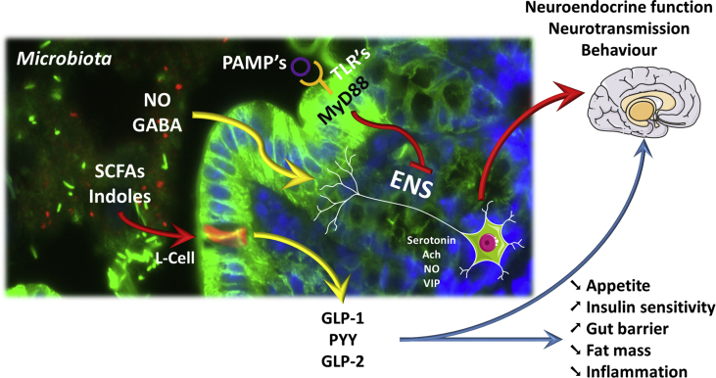

Slide 29
Overview of the different interactions existing between microbial metabolites, endocrine and nervous routes.
Gut microbes interact with host cells using different mechanisms. SCFAs (short chain fatty acids) are metabolites produced by the microbial fermentation of different nutrients; these SCFAs are recognized by specific G-protein coupled receptors expressed at the surface of enteroendocrine cells such as L-cells, producing GLP-1, GLP-2, and PYY. Indoles are also bacterial metabolites of tryptophan degradation involved in the control of GLP-1 release and appetite control. The secretion of such hormones control appetite, gut barrier, and glucose homeostasis (e.g., insulin sensitivity) via direct interactions with organs but also through nervous routes.

Slide 30
Overview of the different interactions existing between microbial metabolites, endocrine and nervous routes.
Similar to what is observed in the brain, different neurotransmitters or molecules (produced by intestinal microbes), such as nitric oxide (NO) as well as γ-aminobutyric acid (GABA), act through the enteric nervous system (ENS). Secondary messengers, including NO, serotonin, acetylcholine (Ach) or vasoactive intestinal polypeptide (VIP) release, are involved in the gut to peripheral organ and brain communication, leading to the control of different behaviors (e.g., food intake, anxiety, stress).
Pathogen-associated molecular patterns (PAMPs) are recognized by pathogen recognition receptors such as Toll-Like receptors (TLR's) that are for most of them signaling through the central adaptor molecule myeloid differentiation primary response gene 88 (MyD88). The intestinal abundance of PAMPs and the activation of different TLR's at the intestinal epithelial surface or at the level of the ENS regulate numerous metabolic functions such as for instance leptin sensitivity, gut hormones signaling to the brain, hence controlling whole-body energy homeostasis.

Slide 31
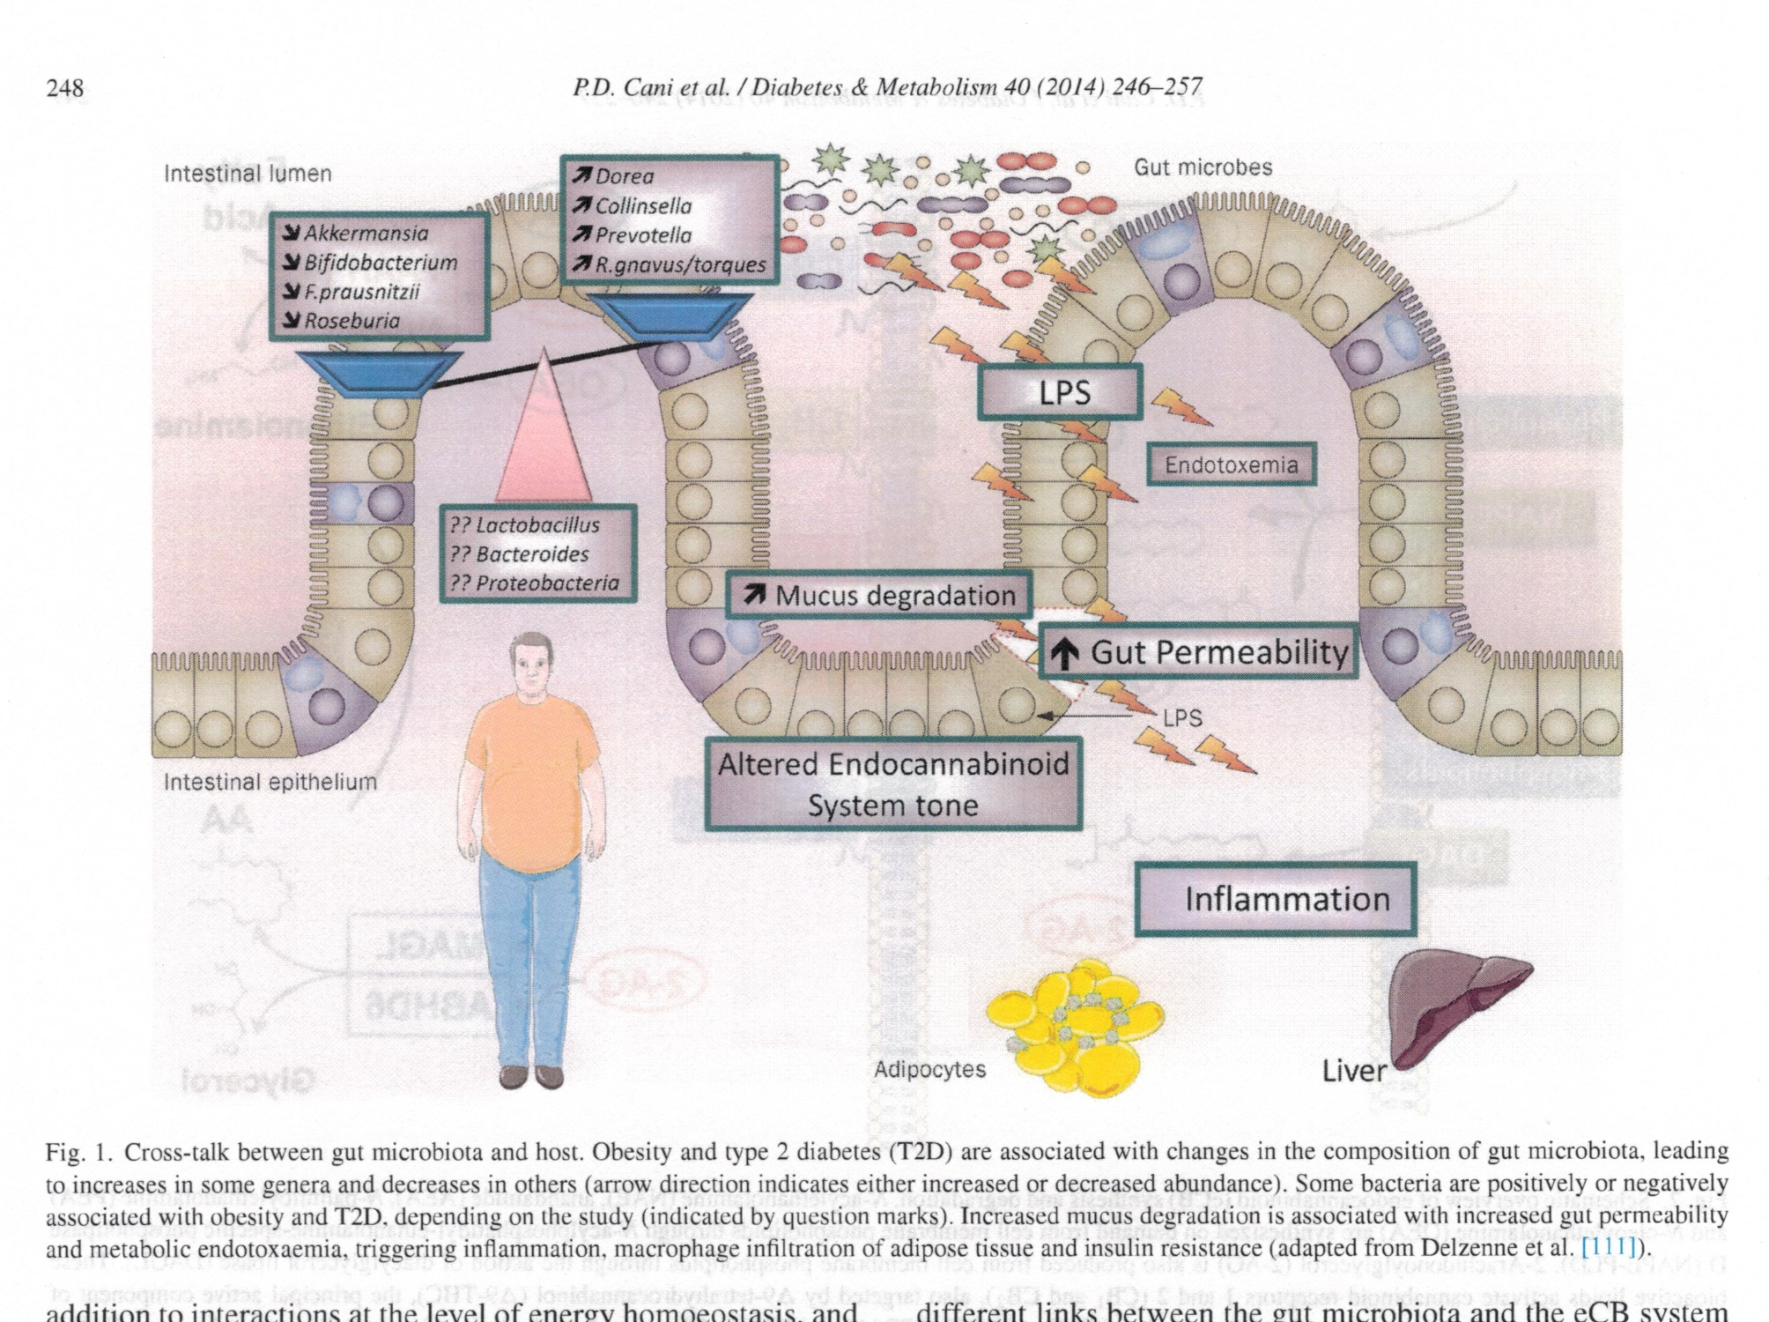

Slide 32
GUt microbiota and DM
In the Diabetes Prevention and Prediction (DIPP) study it was shown that new-onset T1D subjects had different gut microbiota composition than controls. They showed that in the control group, mucin synthesis was induced by lactate- and butyrate-producing bacteria to maintain gut integrity while mucin synthesis was prevented by the non-butyrate-producing lactate-utilizing bacteria leading to β-cell autoimmunity and T1D.
Many other studies confirmed the differences observed in gut microbiota composition between T1D and their matched health controls highlighting the need for better understanding of the role that these bacteria may play in the development of this disease.

Slide 33
GUt microbiota and DM
The effect of microbiota on T2D has been proposed to be mediated through mechanisms that involve modifications in the secretion butyrate and incretins.
T2D patients had moderate degree of gut microbial dysbiosis, a decrease in universal butyrate-producing bacteria and an increase in opportunistic pathogens.
Similar data were reported by other studies highlighting the role of these bacteria in regulating important T2D pathways such as insulin signaling, inflammation and glucose homeostasis.
On the other hand, gut microbiota has been shown to affect the production of key insulin signaling molecules such as GLP-1 and PYY through SCFA and its binding to FFAR2.

Slide 34
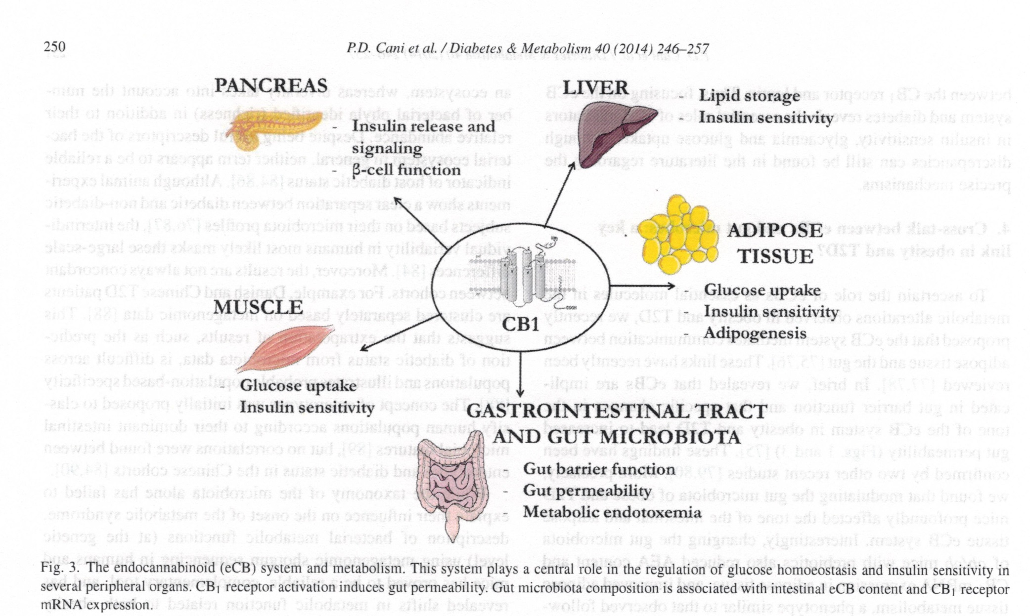

Slide 35
The Trialogue Between Nutritional Status, Gut Microbiota, and Immune System Reveals Novel Therapeutic Opportunities for Metabolic Diseases
Metabolic diseases are characterized by a state of chronic subclinical inflammation in metabolic tissues such as liver, adipose, muscles, and pancreatic islets.
The causative role of a dysbiotic gut microbiota in this inflammatory status by virtue of engaging diverse signaling transduction pathways and immune responses has been increasingly established in the past decade. In light of the increasingly unraveled trialogue between diet, gut microbiota, and the host immune system, a multitude of therapeutic approaches against metabolic diseases have emerged. One compelling set of mechanisms dictate the translocation of commensal bacteria and bacterial fragments toward metabolic tissues, where they trigger pro-inflammatory responses at the early onset of metabolic disorders.
Evidence suggests that this translocation is promoted by a diet/microbiota-driven gut barrier impairment in dysbiotic conditions, thereby continuously fueling the host immune machinery that orchestrates the innate and adaptive arms.

Slide 36
GUt microbiota and DM
It’s becoming increasingly evident that gut microbiota is contributing to many human diseases including diabetes both type 1 and type 2.
Type 1 diabetes (T1D) is an autoimmune disease that is caused by the destruction of pancreatic β-cells by the immune system. Even though T1D is mainly caused by genetic defect, epigenetic and environmental factors have been shown to play an important role in this disease. Higher rates of T1D incidence have been reported in recent years that are not explained by genetic factors and have been attributed to changes in our lifestyle such diet, hygiene, and antibiotic usage that can directly affect microbiota.
It has been shown that diabetes incidence in the germ free non-obese diabetic subjects or patients (NOD) was significantly increased which is in line with the observation that the rates of T1D is higher in countries with stringent hygiene practices. Similarly comparison of the gut microbiota composition between children with high genetic risk for T1D and their age matched healthy controls showed less diverse and less dynamic microbiota in the risk group.

Slide 37

Děkuji za pozornost

