Slide 1

Examination techniques in ophthalmology
E. Vlková et al.

Slide 2
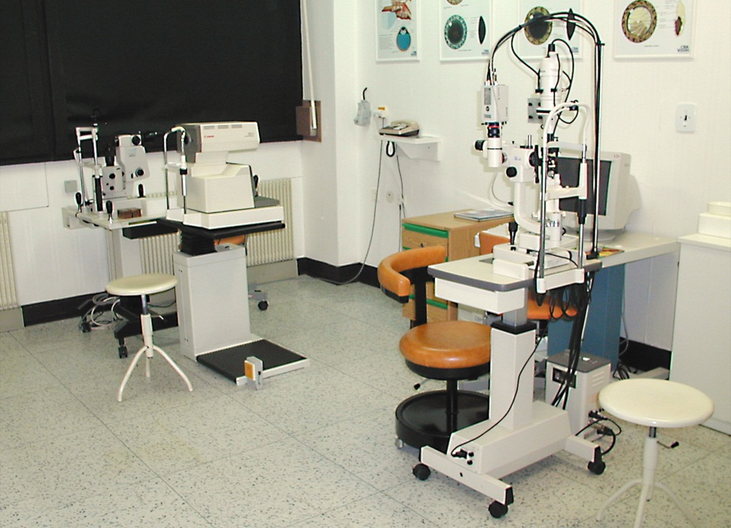
Basic examination techniques
Visual acuity (natural, best corrected)
Measurement of intraocular pressure
Slit lamp examination
Fundus examination

Slide 3
Visual acuity
Visual acuity (natural, best corrected)
Distance vision
Near vision
Charts
Snellen
Landolt ring
Pictures
ETDRS
Jaeger

Slide 4
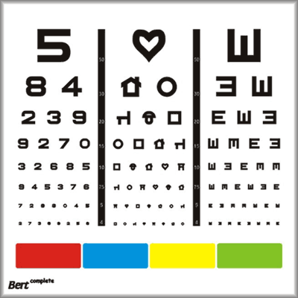
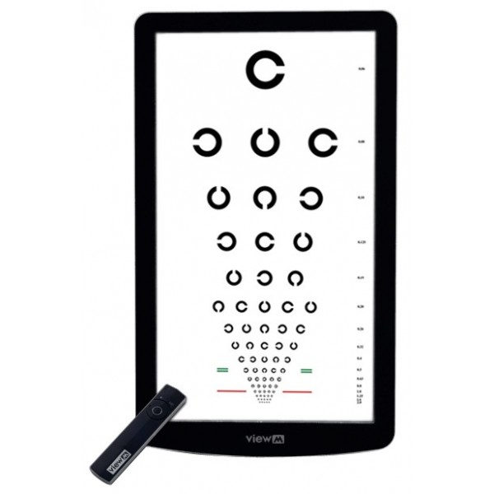
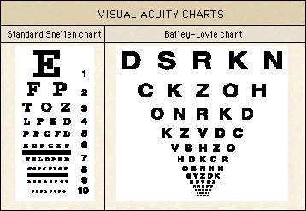
Charts

Slide 5

Near vision
Jaeger chart

Slide 6

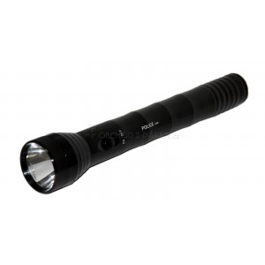
Visual acuity
Counting finger (metres )
Hand movement
Light perception

Slide 7
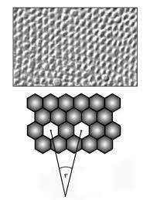
Visual Acuity
5/50 (metres, feet 20/200)
0,1
Minimum separabile – minimum angle of resolution

Slide 8
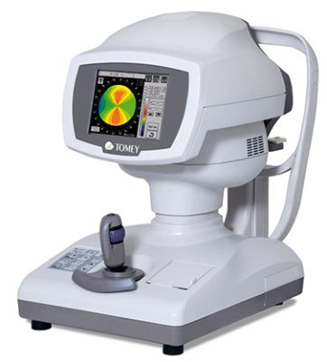
Refraction
Refractive error is an optical abnormality in which the shape of the eye fails to bring light into sharp focus on the retina, resulting in blurred or distorted vision.
In optometry, a "refraction" procedure is the measurement of refractive error
Autorefractor

Slide 9
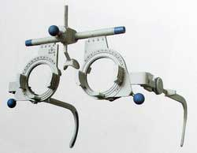
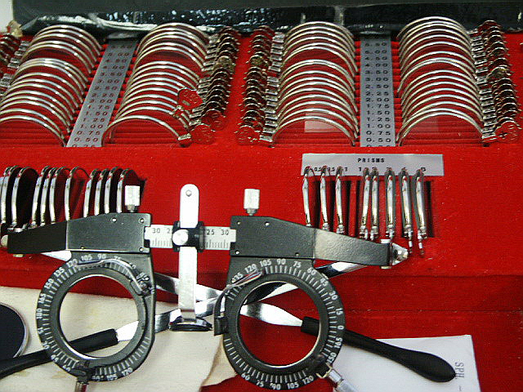
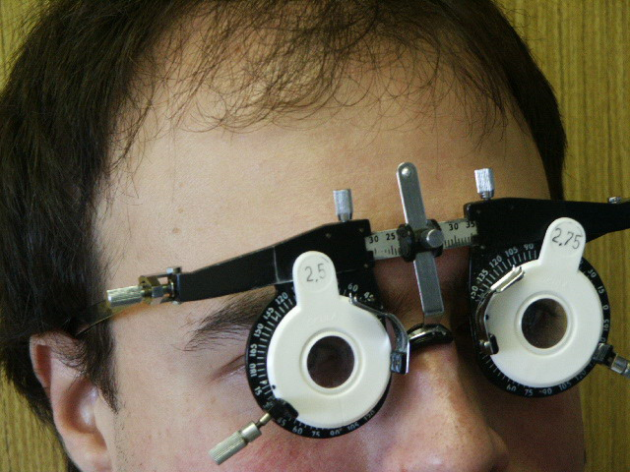
Visual acuity
Frame
Lenses

Slide 10
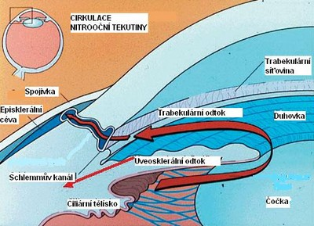
Tonometry
Contact techniques
Schiötz tonometry
Goldmann applanation tonometry
Non contact techniques
Jet air (air puff)

Slide 11
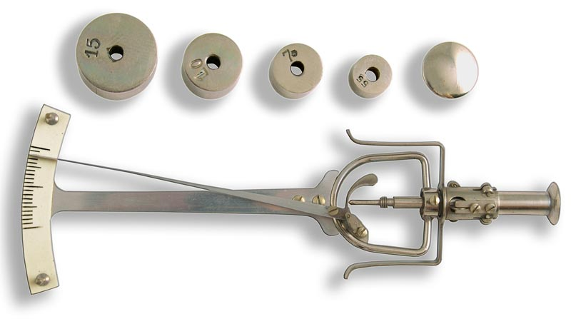
Schiötz tonometry
7/7,5
Topical anestesia

Slide 12
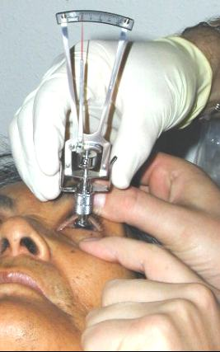
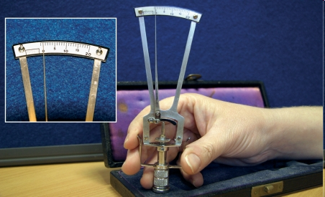
Schiötz tonometry

Slide 13

Goldmann tonometry
The normal range is 10-21 mmHg
Topical anestesia, fluorescein
Force required to flatten the cornae

Slide 14
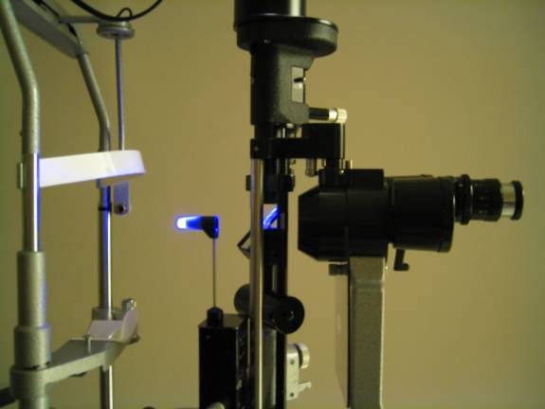
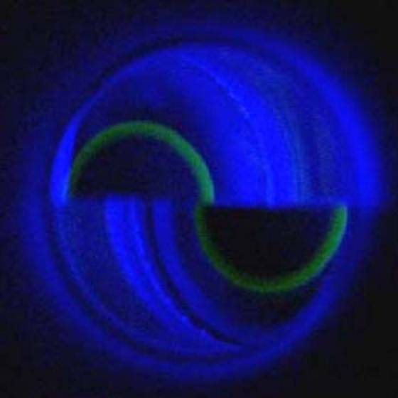
Goldmann tonometry

Slide 15
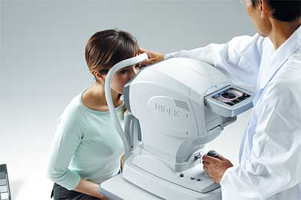
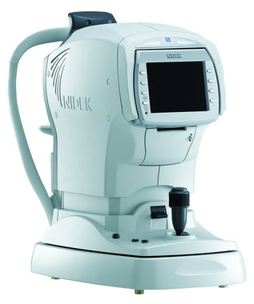
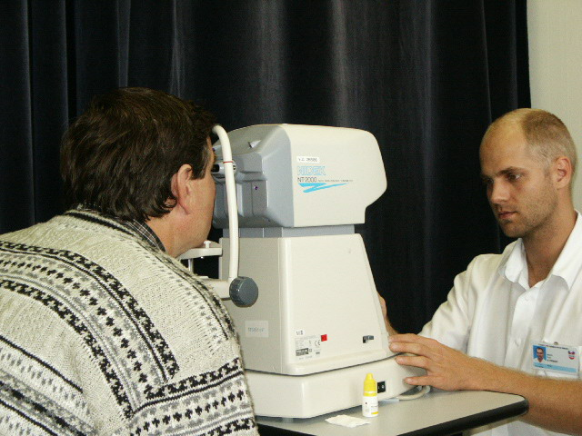
Non contact tonometry

Slide 16
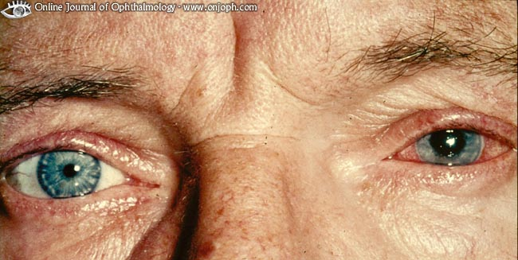
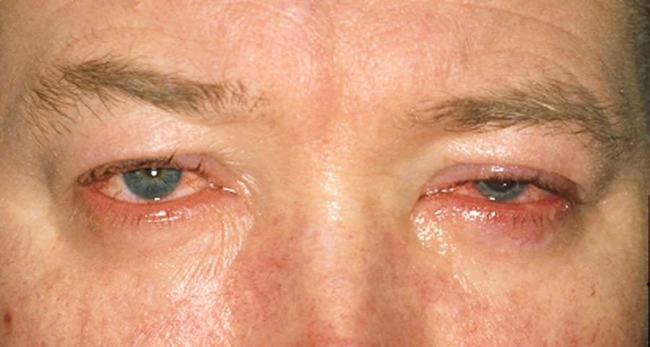
Examination of anterior segment
Aspection

Slide 17
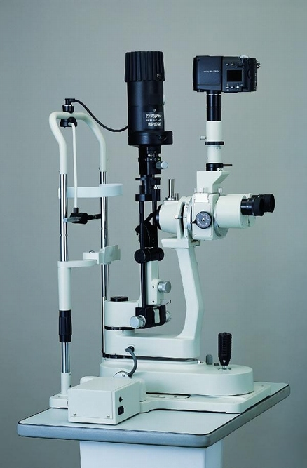
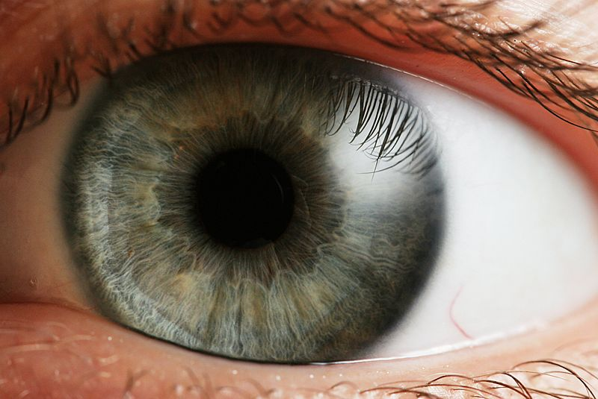
Slit lamp biomicroscopy
table mounted microscope with a special adjustable illumination source attached

Slide 18
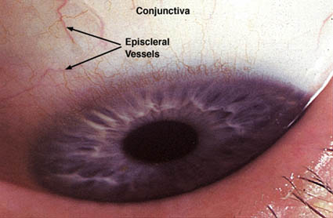
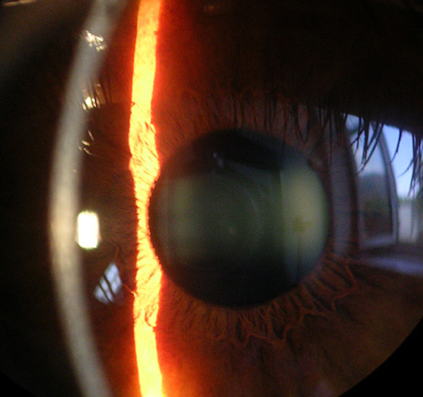
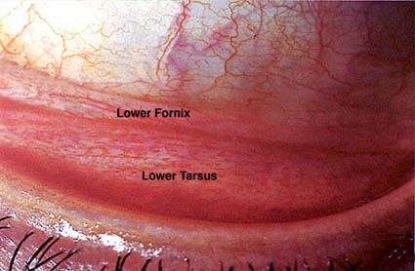
Slit lamp biomicroscopy
duhovka

Slide 19
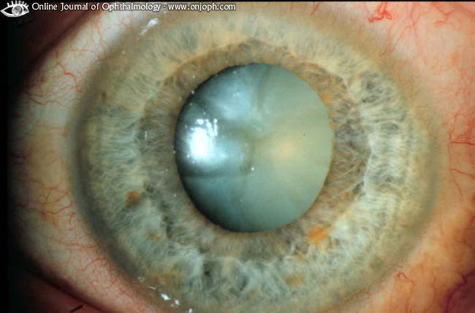
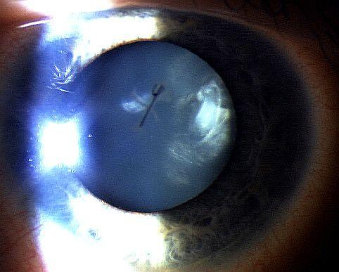
Slit lamp biomicroscopy
,

Slide 20
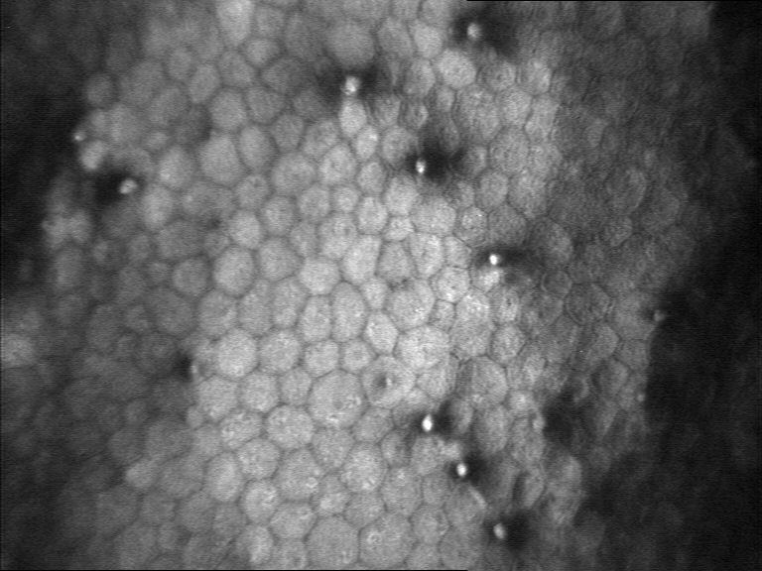
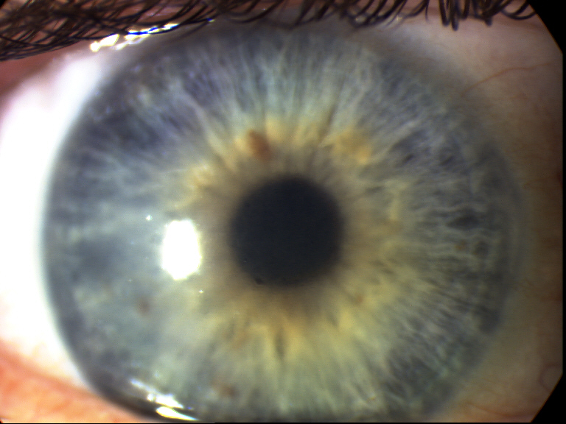
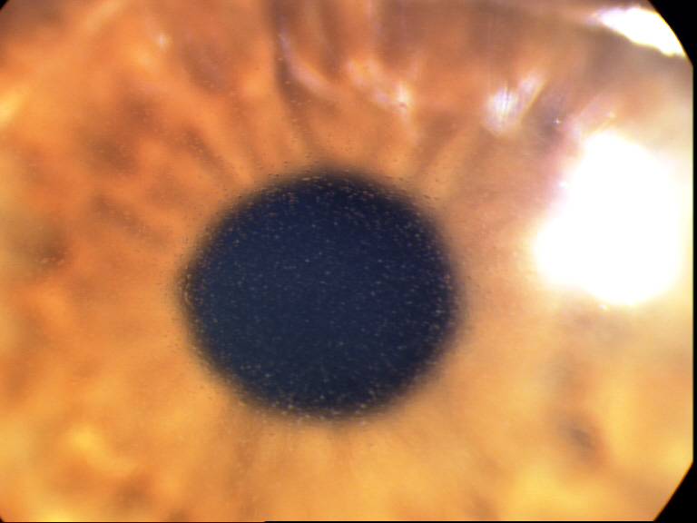

Fuchs endotelial dystrophy

Slide 21
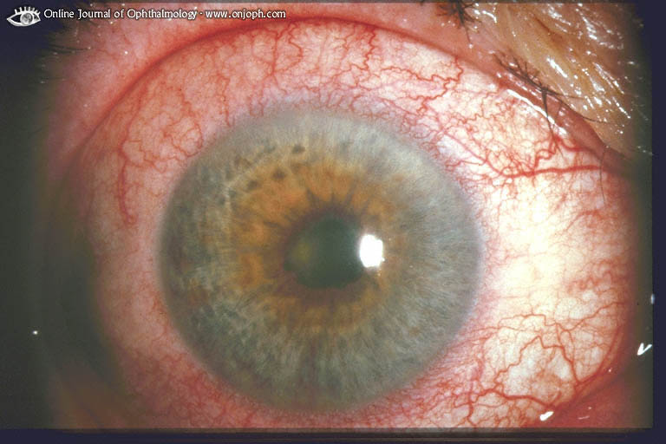
Synechiae posterior

Slide 22
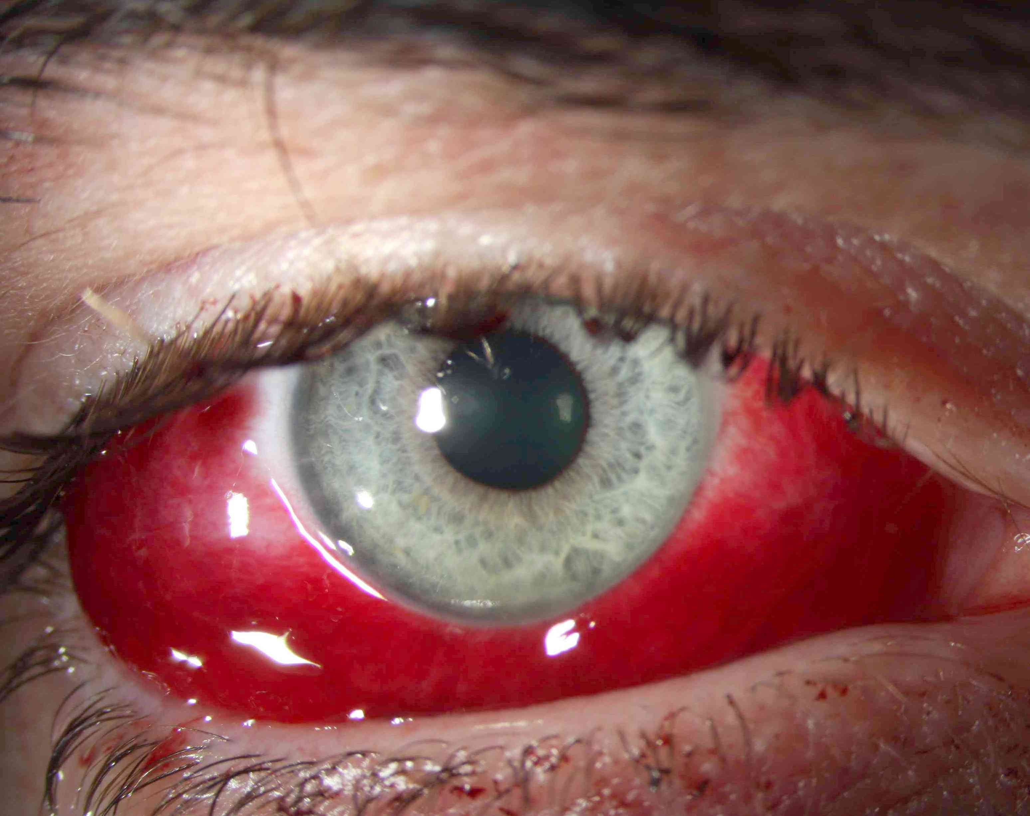
Sunconjunctival haemorrhage

Slide 23
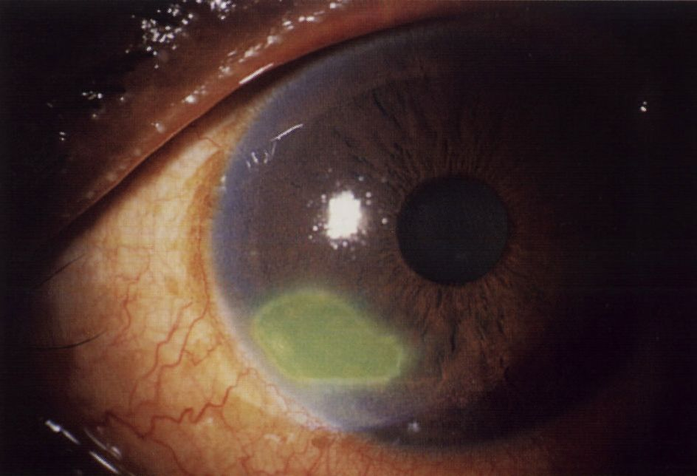
Corneal abrasion

Slide 24
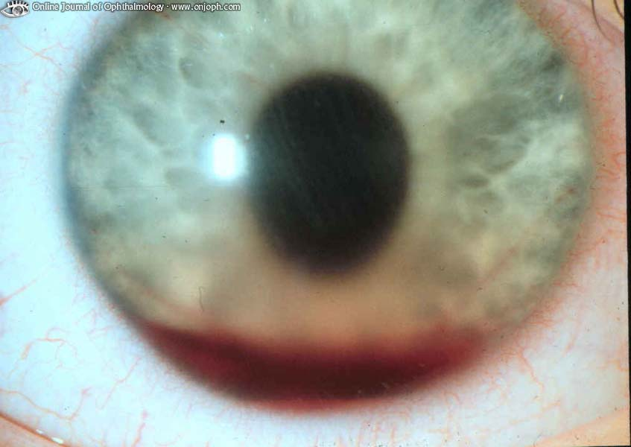
Hyphema

Slide 25
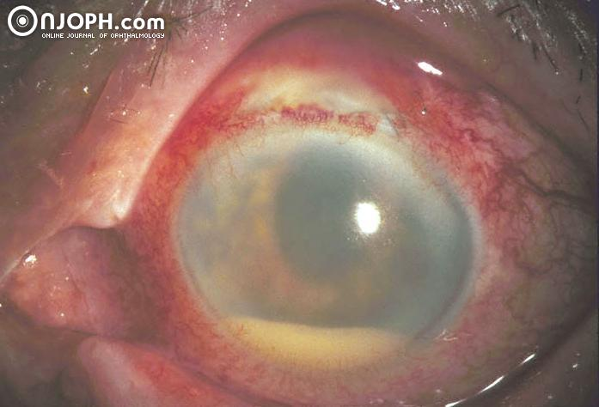
Hypopyon

Slide 26
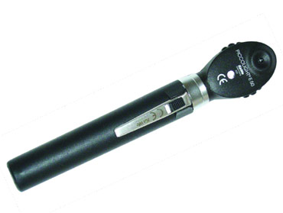
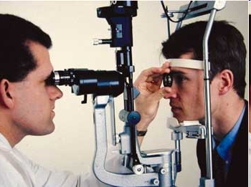
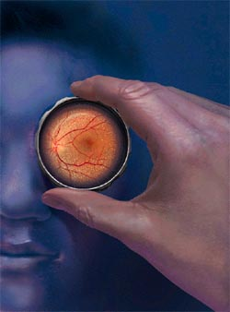
Examination of fundus
Ophthalmoscopy - direct
- indirect
Slit lamp biomicrocsopy
(high power convex lens, the image is vertically inverted
and laterally reversed)

Slide 27
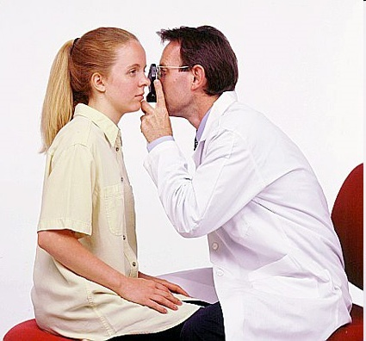
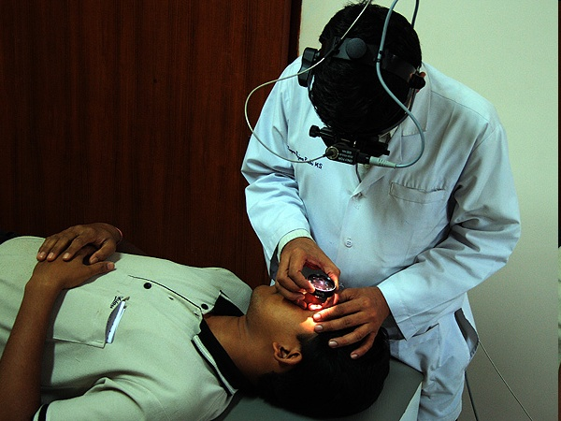
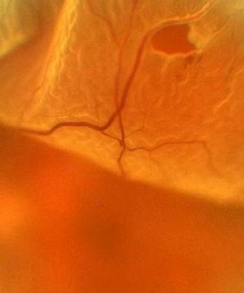
Notes:
27

Slide 28
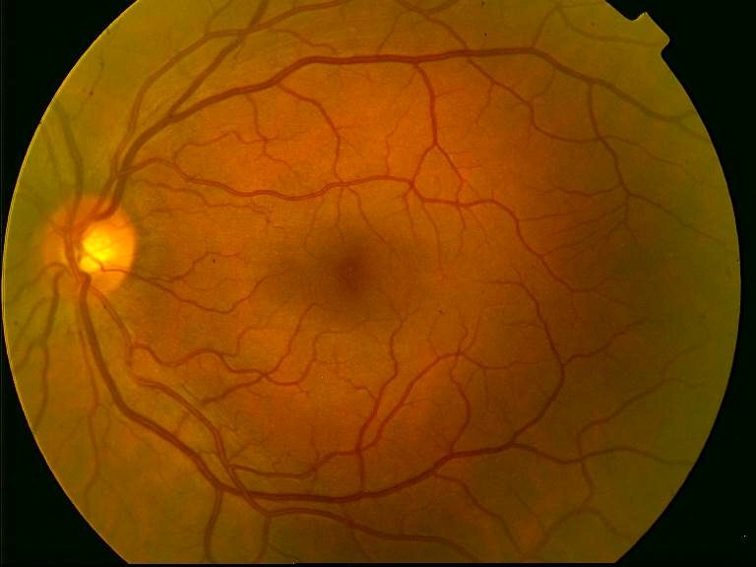
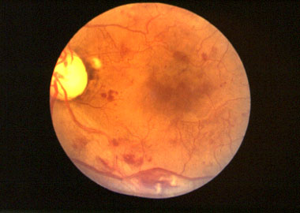
Ocular fundus

Slide 29
Special examination techniques

Slide 30
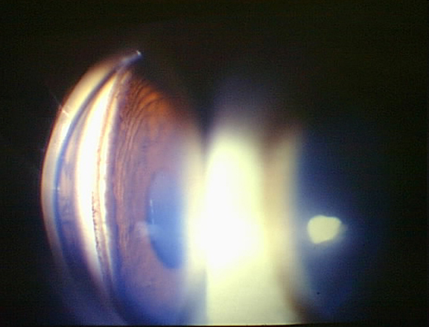
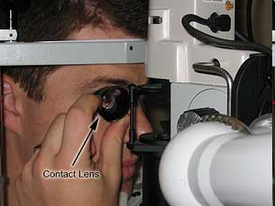
Gonioscopy
Gonio lens ( mirrors)
Angle structures
Fundus examination
Notes:
30

Slide 31
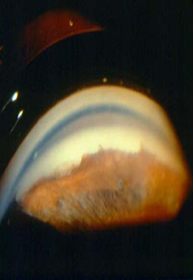
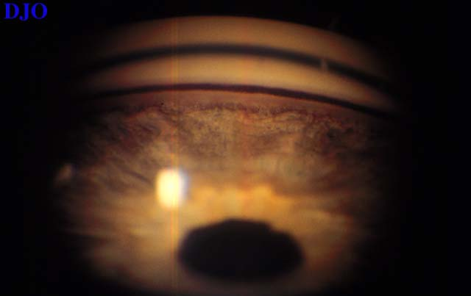
Notes:
31

Slide 32
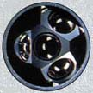
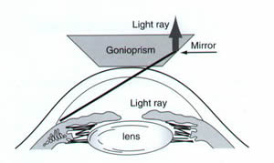


Slide 33
Electrophysical tests
ERG (electroretinography)
diagnosis of functional defects of retina
Record of an action potential produced by the retina when it is stimulated by light
VEP (visual evoked potential)
-diagnosis of functional defects of visual pathways
Record of electrical activity of the visual cortex created by stimulation of the retina

Slide 34


Electrophysical tests

Slide 35

Electrophysical tests

Slide 36



Ultrasound

Slide 37


Ultrasound
Non transparent optical media
UBM- high frequency ultrasound – imaging of anterior segment

Slide 38


A scan ( biometry)
B scan

Slide 39





Ultrasound

Slide 40


Color vision – HUE test

Slide 41




Hertl exoftalmometry

Slide 42

Děkuji za pozornost!

