Slide 1
Pathological fractures
Pazourek L., Rozkydal, Z.
I.orthopaedic dpt., St. Anna Hospital, Medical faculty, Brno

Slide 2
Features
Fracture in bone with pathological lesion decresing the stregth of bone
Without trauma
Minimal violence
Normal traumatic mechanism

Slide 3
Etiology
Metabolic diseases
osteoporosis
osteomalacia, HPT
Local lesions
bone metastasis, multiple myeloma
benign tumors
malignant tumors
Congenital anomalies
osteogenesis imperfecta,..
Other entities
Paget´s disease of bone, fibrous dysplasia
osteomyelitis
osteonecrosis

Slide 4
♂ 53 let
Fr. by opening a bottle
i.m. osteosynthesis
Increasing swelling and mass in upper arm
X- ray repeated no finding
back pain after 3 months

Slide 5
Metastasis of carcinoma
After 4 months referred to our clinic
Exulceration
Th 12 large osteolytic lesion
Risk o paraplegia
Metastasis of carcinoma from small
cells

Slide 6
♂ 26 let
Fr. by driving a car
AO plate osteosynthesis
Afterwards increasing mass
X ray after 3 months
OSTEOSARCOMA HIGH-GRADE

Slide 7
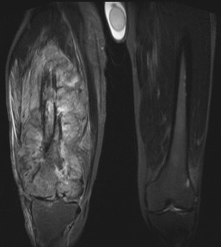
LEIOMYOSARCOMA G3
Fall on stairs
Supracondylar fr.
Osteosynthesis with a nail
Increasing pain and swelling
After 6 months removal of metal a biopsy
Fracture not healed
Referred to our clinic
♂ 42 let

Slide 8
Bone metastases of carcinoma
Breast, prostate, kidney, lung, thyreoid gland
Assessment of prognosis
Visceral or bone lesions, solitary or multiple lesions
Type of primary tumor, staging
Time of first occurrence
Sensitivity to other treatment
Comorbidities and general condition
Pathological fracture makes always the prognosis worse
Multidisciplinary access

Slide 9
Mirel´s score
points | 1 | 2 | 3
Localisation | Upper extr. | Lowe extr. | Pertrochant. region
Pain | low | medium | big
Type | Osteoplastic | mixed | Osteolytic
Size | <1/3 widht of bone | 1/3 – 2/3 widht of bone | >2/3 widht of bone
≤ 7 ponts | Risk 4% | Preventive ORIF no
8 points | Risk 15% | Indication for ORIF on border
≥ 9 points | Risk 33% and more | Indication for preventive ORIF

Slide 10
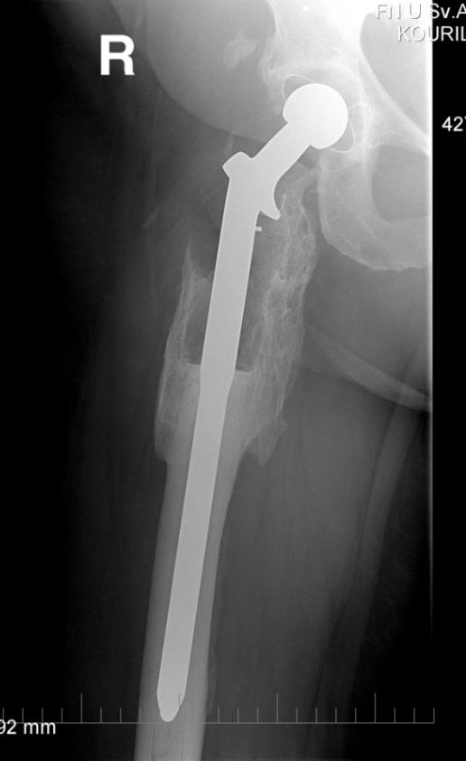
TU-THA optimal solution
Metastasis of clear cells renal carcinoma (angiography with embolisation)

Slide 11
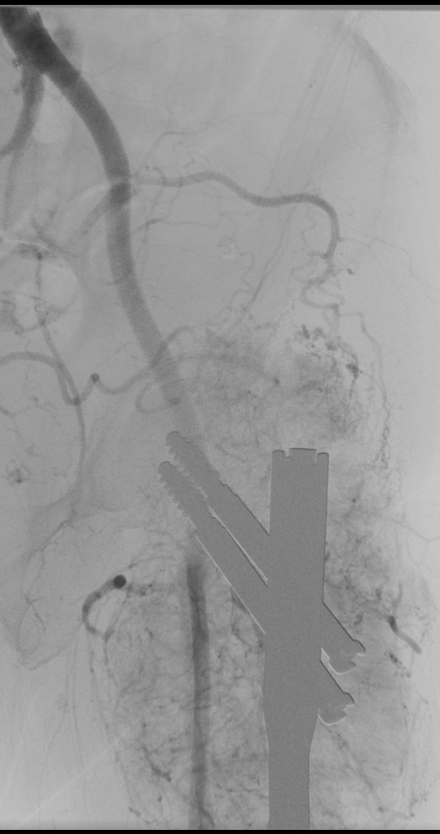
Condition after osteosynthesis for pathological fr. with metastasis of renal tumor, progresion of osteolytic lesion
No adjuvant chermotherapy
Angiography + embolisation, resection
TU THA

Slide 12
METASTASIS of thyroid carcinoma
♂ 58 let
Total thyroidectomia 7 years ago, radiotherapy and chemotherapy
X- ray osteosynthesis 2 years ago, no further treatment
No further treatment for humeral lesion
No radiotherapy
Disarticulation in shoulder

Slide 13
Total femur
Metastasis of breast carcinoma,
good prognosis

Slide 14
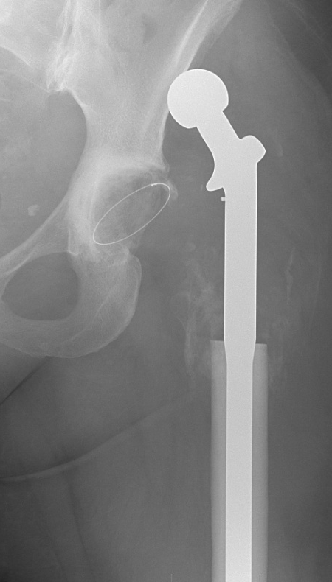
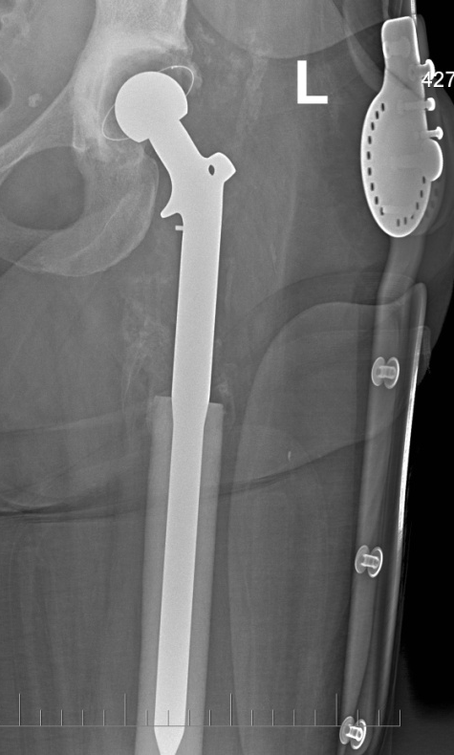
Dislocation of TU THA

Slide 15
Proximal humeru Head prosthesis Reverse total shoulder replacement

Slide 16
TU-TKA

Slide 17
Metastasis in diaphyseal region
Femur and humerus
Types
i.m. nail
Resection + cement a osteosynthesis
Resection + intercalary spacer
Resection + bone graft and osteosynthesis
Radiotherapy in a case of nonradical surgery

Slide 18
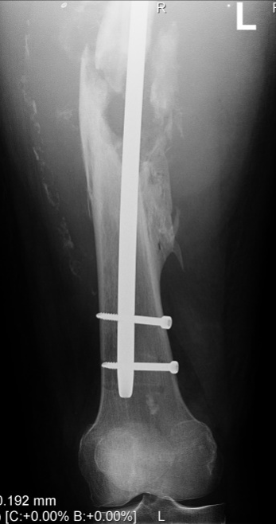
i.m. nail
Tumor in situ
paliative surgery
wrong prognosis
Adjuvant radiotherapy

Slide 19
Curretage + osteosynthesis + cement

Slide 20
Resection + i.m. nail and cement

Slide 21
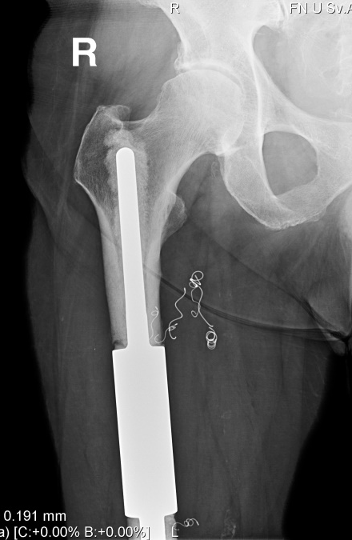
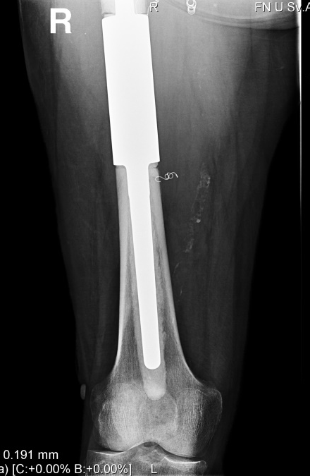
Diaphyseal spacer

Slide 22
Primary malignant bone tumors
Osteosarcoma, Ewing sa, chondrosarcoma
Pathological fracture
Worse prognosis
High risk of dissemination
Less chance for local control
Amputation ?

Slide 23
Orthesis
chemotherapy
Resection bone graft
plate
♂13 let boy
By throwing of a ball
High grade osteosarcoma

Slide 24
♀73 let, Dediferentiated chondrosa G3
Pathol. fracture
Amputation

