Slide 1
Regulation
in cardiovascular system

Slide 2
The role of nervous system
ANTICIPATION
Cortex
Potential input
Potential output
Cortex
Integration
Sensor
Input
Output
Effector
REGULATION

Slide 3
Types of regulation - general view
2 basic types:
Nervous regulation
Humoral regulation
Feedback control - negative
- positive
autoregulation – local regulation – system regulation

Slide 4
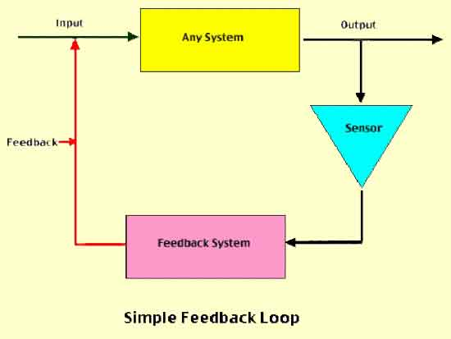
Feedback regulation
http://www.slideshare.net/drpsdeb/presentations

Slide 5
REGULATION IN CARDIOVASCULAR SYSTEM
Main function:
keep relatively constantaneous arterial blood pressure
Keep perfusion of tissues

Slide 6
Regulation of vessels tone
Tone of the vessels = basic tension of the smooth muscle inside of the wall
(vasoconstriction x vasodilatation)
Regulation - local autoregulation
- system regulation

Slide 7
Autoregulation
Autoregulation – the capacity of tissues to regulate their own blood flow
Myogenic theory – Bayliss phenomenon (as the pressure rises, the blood vessels are distended and the vascular smooth muscle fibres that surround the vessels contract; the wall tension is proportional to the distending pressure times the radius of the vessels – law of Laplace)

Slide 8
Autoregulation
Metabolic theory – vasodilator substances tend to accumulate in active tissue, and these metabolites also contribute to autoregulation
ending products of energetic metabolism – CO₂, lactate acid, K⁺
effect of hypoxia (circulation: vasodilatation x pulmonary circulation: vasoconstriction)
Adenosin – coronary circulation: vasodilatation

Slide 9
Autoregulation
by substances which releasing from:
endothelium
tissues

Slide 10
Substances secreted by the ENDOTHELIUM
Vasodilatation:
Nitric oxide (NO) from endothelial cells
(originally called: EDRF)
Prostacyclin is produced by endothelial cells
Thromboxane A2 promotes platelet aggregation
(important prostacyclin – thromboxan balance)
Vazoconstriction:
Endothelins (polypeptids – 21peptides)
three isopeptides: ET 1, ET 2 , ET 3

Slide 11
Substances secreted by the tissues:
Histamine – primarily tissue hormones.
General affect: vasodilatation - decrease periphery resistence, blood pressure
KININS: 2 related vasodilated peptides
Bradykinin + lysylbradykinin (kallidin).
Sweat glands, salivary glands
10x strongers than histamine
Relaxation of smooth muscle, decrease blood pressure

Slide 12
Systemic regulation
By hormones
Catecholamines – epinephrine, norepinephrine - effect as activation of sympathetic system
RAAS - stress situation
ADH - general vasoconstriction
Natriuretic hormones - vasodilatation

Slide 13
Neural regulatory mechanism
Autonomic nervous system
Sympathetic: vasoconstriction
All blood vessels except capillaries and venules contain smooth muscle and receive motor nerve fibers from sympathetic division of ANS (noradrenergic fibers)
Regulation of tissue blood flow
Regulation of blood pressure
Parasympathetic part: vasodilatation
Only sacral parasympathetic cholinergic fibres (Ach) inervated arteriols from external sex organs

Slide 14
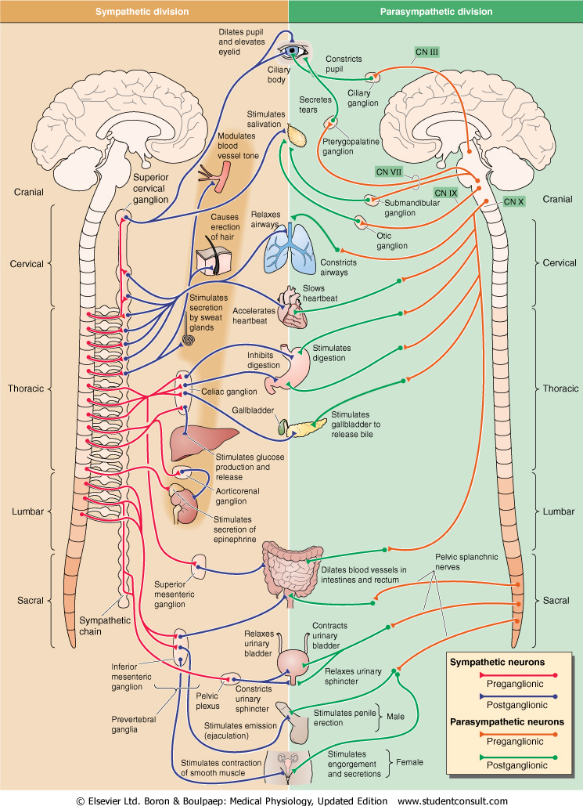
Sympathetic nervous system
Fight or flight response
Energy/store consumption
Preganglionic neuron
– Spinal cord
-Thoraco - lumbar system
Ganglia Paravertebral
Truncus sympathicus
Majority
Prevertebral
-Plexus aorticus
Mostly diffuse effect
Parasympathetic nervous system
Rest and digest response
Energy conservation/en. store production
Preganglionic neuron
– Brain stem and spinal cord
– cranio-sacral system
Ganglia
Close to target organs or intramurally
Mostly local effect

Slide 15
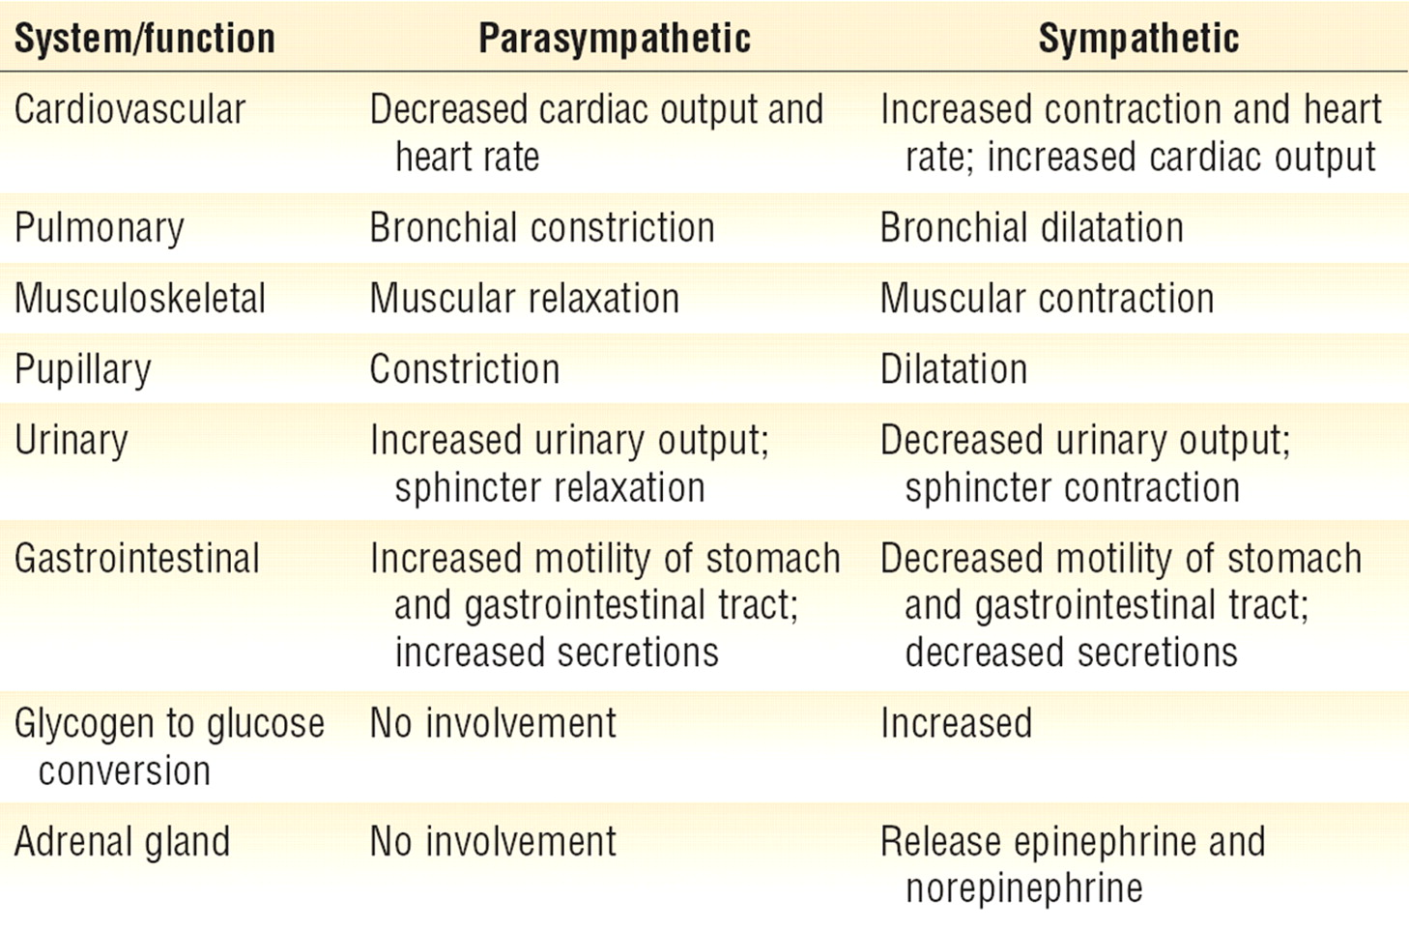
Sympatthetic nervous system
Fight or flight response
Energy/store consumption
Preganglionic neuron
– Spinal cord
-Thoraco - lumbar system
Ganglia Paravertebral
Truncus sympathicus
Majority
Prevertebral
-Plexus aorticus
Mostly diffuse effect
Parasympathetic nervous system
Rest and digest response
Energy conservation/energy store production
Preganglionic neuron
– Brain stem and spinal cord
– cranio-sacral system
Ganglia
Close to target organs or intramurally
Mostly local effect

Slide 16
Mediators of somatic and autonomic nervous system
https://www.google.cz/url?sa=i&rct=j&q=&esrc=s&source=imgres&cd=&ved=0ahUKEwjujdLGieLPAhVJOhQKHay0BnUQjBwIBA&url=http%3A%2F%2Fimg.docstoccdn.com%2Fthumb%2Forig%2F105365259.png&psig=AFQjCNFxrUy63llCAlny-Vhlyse4FHDMaw&ust=1476801796194278

Slide 17
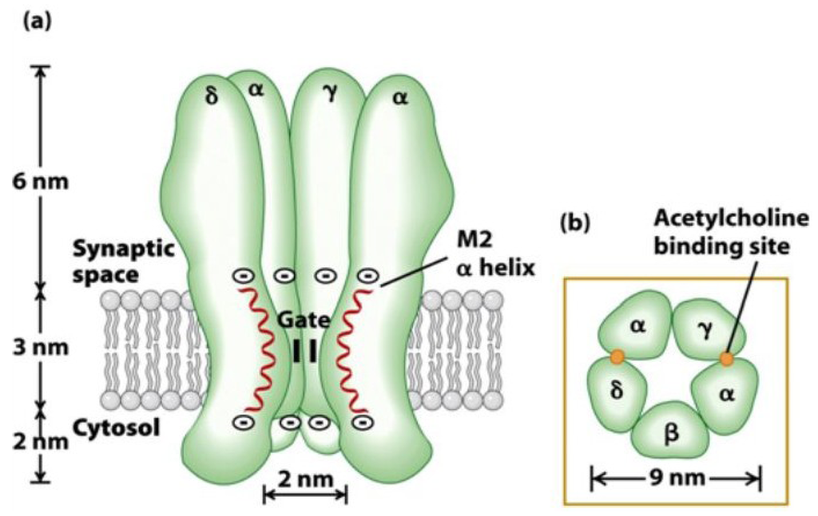
Acetylcholine
Preganglionic fibers
Postganglionic fibers
Sympathetic
Parasympathetic
Nicotinic receptor
Ligand-gated ion channels
Na+, K+, Ca2+
Neuronal (N_{N}) and muscle (N_{M}) type
Excitatory
Parasympathetic
Muscarinic receptor
G-coupled
Excitatory
M1, M3, M5
Inhibitory
M2, M4
http://www.mdpi.com/marinedrugs/marinedrugs-12-02970/article_deploy/html/images/marinedrugs-12-02970-g013-1024.png
https://s-media-cache-ak0.pinimg.com/originals/ea/6c/3e/ea6c3e44afe638dca65fb4a3014bc095.jpg

Slide 18
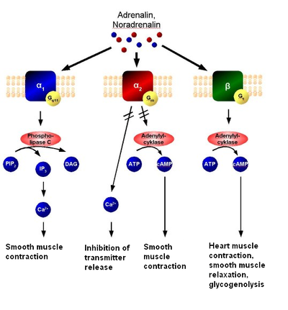
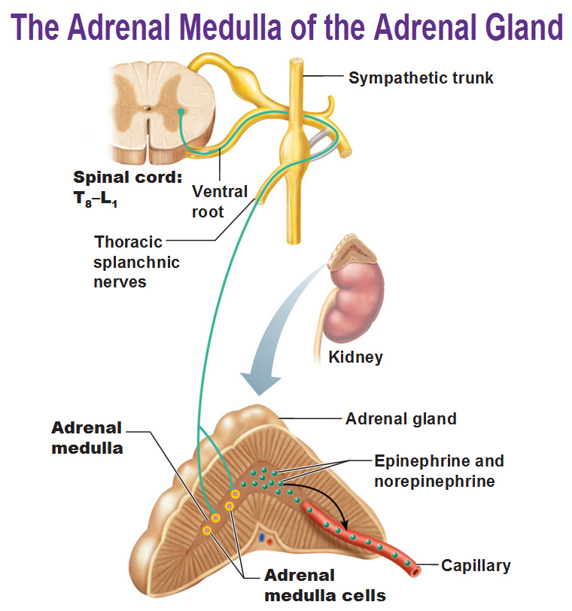
Norepinephrine
Postganglionic sympathetic fibers
Adrenergic receptor
G-coupled
α type– generally excitatory (contraction)
β type – generally inhibitory (relaxation) with an exception of !!! heart !!!
Adrenal medulla
Modified sympathetic ganglion
„Transmitters“ (stress hormones)
secreted into the blood stream
Norepinephrine
Epinephrine
Dřeň nadledvin
Modifikované sympatické ganglion
„Transmitery“ (stresové hormony) vylučuje do krve
Noradrenalin
Adrenalin
http://antranik.org/wp-content/uploads/2011/11/the-adrenal-medulla-of-the-adrenal-gland-epinephrine-norepinephrine-splanchic-nerves.jpg
http://antranik.org/wp-content/uploads/2011/11/the-adrenal-medulla-of-the-adrenal-gland-epinephrine-norepinephrine-splanchic-nerves.jpg
https://en.wikipedia.org/wiki/Adrenergic_receptor

Slide 19
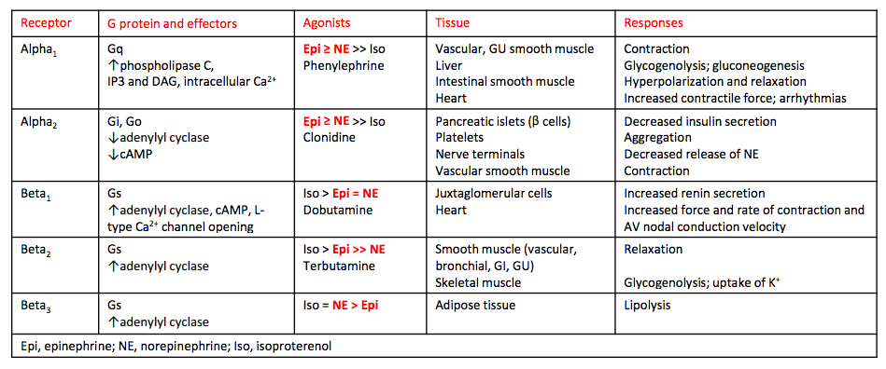
Norepinephrine
Postganglionic sympathetic fibers
Adrenergic receptor
G-coupled
α type– generally excitatory (contraction)
β type – generally inhibitory (relaxation) with an exception of !!! heart !!!
Adrenal medulla
Modified sympathetic ganglion
„Transmitters“ (stress hormones)
secreted into the blood stream
Norepinephrine
Epinephrine
Dřeň nadledvin
Modifikované sympatické ganglion
„Transmitery“ (stresové hormony) vylučuje do krve
Noradrenalin
Adrenalin
http://antranik.org/wp-content/uploads/2011/11/the-adrenal-medulla-of-the-adrenal-gland-epinephrine-norepinephrine-splanchic-nerves.jpg
http://antranik.org/wp-content/uploads/2011/11/the-adrenal-medulla-of-the-adrenal-gland-epinephrine-norepinephrine-splanchic-nerves.jpg
https://en.wikipedia.org/wiki/Adrenergic_receptor
https://s3.amazonaws.com/classconnection/769/flashcards/5928769/png/screen_shot_2014-11-04_at_92935_am-1497B7358A4552ACB39.png

Slide 20
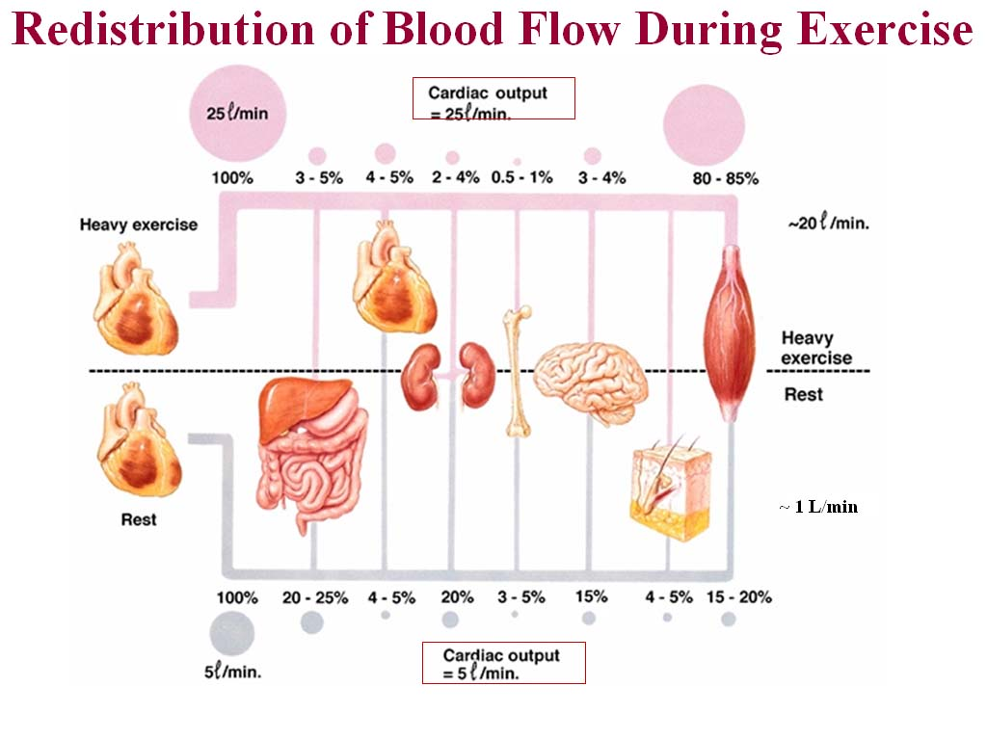
http://2.bp.blogspot.com/_MJ0CEYnSB4U/S99IJTUruOI/AAAAAAAAACs/NPzsh8ydzjQ/s1600/redistributionofbloodflow.jpg

Slide 21
Autonomic nervous system regulates the activity of individual organs and mutually coordinates the activities of all the organs systems.
http://2.bp.blogspot.com/_MJ0CEYnSB4U/S99IJTUruOI/AAAAAAAAACs/NPzsh8ydzjQ/s1600/redistributionofbloodflow.jpg

