Slide 1
Prescription Revision
Week 11

Slide 2
???
What information is usually found in the individually prepared prescription?
What are the formulae used?
What cases are included in the ready-made prescriptions? Why?
Which part of prescription is not in Latin? Why?
What are the introductory and the concluding formulae in a prescription?

Slide 3
MATCH THE PROBLEMS WITH THE APPROPRIATE MEDICATION GROUPS:
OBSTIPATIO
THROMBOSIS
ONYCHOMYCOSIS
CANCER
DILATATIO VASORUM
OLIGURIA
INTOXICATIO
DOLORES PERMAGNI
DIURETICA
ANTICOAGULANTIA
VASOCONSTRINGENTIA
NARCOTICA
EMETICA / ANTIDOTUM
CHEMOTHERAPEUTICA
LAXATIVA
ANTIMYCOTICA

Slide 4
FILL IN MISSING TERMS Antidepressivum
________
Asentra 50 tbl. p. o. 28 x 50 mg
________ orig. _______ IV (quattuor)
D. ________ 2 tablety denně.

Slide 5
GIVE FULL FORMS OF THE UNDERLINED ABBREVIATED TERMS: analgeticum + antipyreticum
Rp.
Acidi acetylsalicylici
Paracetamoli aa 0,3
Codeinii dihydrogenphosphorici 0,02
Coffeini cum natrio benzoico 0,1
Magnesii oxydati 0,05
M. f. pulv.
D. t. d. No. XX (viginti) ad caps.
S. 3krát denně 1 prášek.

Slide 6
INTERPRET diureticum
Rp.
Aminophyllini 1,8
Olei cacao q. s. ut f. supp.
D. t. d. No. VI (sex)
S. 2krát denně zavést 1 čípek do konečníku.

Slide 7
CHANGE TO PLURAL
tuba originalis
remedium expectorans
dosis pro adulto
flos tiliae
solutio physiologica
pars aequalis
suppositorium rectale
pulvis adspersorius
tubae originales
remedia expectorantia
doses pro adultis
flores tiliae
solutiones physiologicae
partes aequales
suppositoria rectalia
pulveres adspersorii

Slide 8
MAKE A PRESCRIPTION
a) A fifty-year old woman suffers from chronic bad headache with no reason identified. Prescribe her capsules made of 0,005 g of Diazepamum; 0,02 g of Phenobarbitalum; 0,1 g of coffeinum; and 0,2 g of paracetamolum. The vehicle is lactose (lactosum) up to 0,5 grams. The pharmacist should make a powder. Make 50 doses in the form of gelatine capsules (gelatinosus, a, um). The patient should take one capsule if needed, max. twice a day. The medication should be marked as poison.
b) A hard smoker suffers from chronic bronchitis and needs to expectorate the mucus from his bronchial tubes. Prescribe him mucolytics: one package of Mucosolvan drops. The patient should take 30 drops every three hours.
1

Slide 9
a) Rp.
Ergotamini tartratis 0,001
Diazepami 0,005
Phenobarbitali 0,020
Coffeini 0,100
Paracetamoli 0,200
Lactosi ad 0,5
M.f. plv.
D. t. d. No. L (quinquaginta)
D. ad caps. gelat.
D. S. One capsule if needed, max. twice a day. S. s. v.
b) Rp.
Mucosolvan gtt.
Exp. orig. No. I (unam)
D. S. 30 drops every 3 hours.

Slide 10
MAKE A PRESCRIPTION
a) A five-year old child has been received at the hospital with very high fever caused by acute inflammation of urinary bladder. One of the best ways how to lower the fever of children is via paracetamol suppositories (Suppositoria paracetamoli). These should be made by pharmacist of 10 grams of paracetamol + 30 grams of Adipis solidi as adjuvant remedy. 20 of them should be made in equal doses. The instructions for the patient are to take one suppository every 6 hours if the fever reaches 38,5⁰C.
b) The patient suffers from acute pnemonia, but is allergic to penicilline antibiotics. Therefore, two original packages of klaritromycine antibiotics Klacid 500 mg have to be prescribed in the form of coated tablets. The patient should take one tablet every 12 hours for two-three weeks.
2

Slide 11
a) Rp.
Paracetamoli 10,0
Adipis solidi 30,0
M. f. supp.
Div. in d. aeq. No. XX (viginti)
D. S. One suppository every 6 hours if the fever reaches 38,5⁰C.
b) Rp.
Klacid 500 mg tbl. obd.
Exp. orig. No. II (duas)
D. S. One tablet every 12 hours for 2-3 weeks.

Slide 12
Dissection Protocol
Week 11

Slide 13
STRUCTURE
Pathological-anatomical diagnosis consists of four parts:
I. Morbus principalis
II. Complicationes
III. Causa mortis
IV. Inventus accesorius

Slide 14
ANALYZE THE DISSECTION PROTOCOL

Slide 15
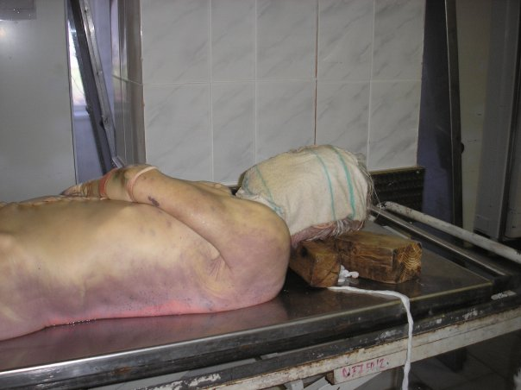
LIVORES MORTIS
Hypostasis; a settling of blood in the lower parts of body post mortem, which causes a purplish red discoloration of the skin
start 20-30 min after death, visible 2 hours after death, maximum extent 8-12 hours after death

Slide 16
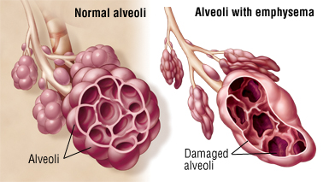
Emphysema pulmonale
a type of COPD (chronic obstructive pulmonary disease) together with e.g. bronchitis;
a dilatation of pulmonary ways and destruction of intraalveolar septa, permanent excessive amount of air in lungs
Symptoms: shortness of breath, cough, sputum, gets worse over time
Causes: smoking, air pollution, chronic bronchitis

Slide 17
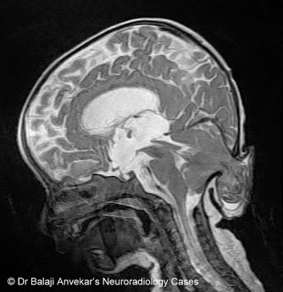
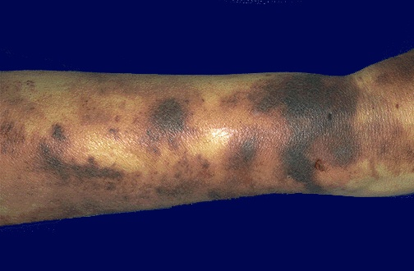
conus occipitalis
herniation/compression of the life important brain structures into foramen occipitale magnum; fatal
ecchymoses
subcutaneous spots of blood similar to haematoma; however, not caused by trauma but a pathophysiology of cells / vessels

Slide 18
hypertrophia trabecularis
pathological overgrowth of the trabeculae of heart muscle
cor pulmonale
pulmonary heart disease; enlargement and failure of the right ventricle due to high blood pressure in lungs or pulmonary stenosis

Slide 19
MATCH THE TERMS WITH APPROPRIATE ADJECTIVES AND CONNECT WITH „CUM“:
emphysema – fractura – decubitus – pneumothorax
conus – ebrietas – hemosinus
alcoholicus, a, um |  | cum
superficialis, e
pulmonalis, e
traumaticus, a, um
sphenoidalis, e
comminutivus, a, um
temporalis, e
Notes:
cum ebrietate alcoholica; cum decubitibus superficialis; cum emphysemate pulmonali; cum pneumothorace traumatico; cum hemosinu sphenoidali;
cum fractura comminutiva; cum cono temporali

Slide 20
Melanoblastoma dorsi reg. subscapularis l. dx.
Metastases multiplices cerebri lat. utr., cerebelli lat utr., et ad pulmones.
Oedema cerebri.
Decubitus reg. sacralis superficialis parvus. Hypertrophia lienis.
Arteriosclerosis universalis. Bronchopneumonia hypostatica microfocalis l.dx.
Thromboembolia ramorum arteriae pulmonalis l. dx. multifocalis. Dilatatio ventriculi cordis dextri acuta.
Defectus dentium partialis reg. mandibulae l. sin. Atrophia fusca myocardii et hepatis.
Adenoma lobi sinistri glandulae thyroideae. Stp. HYE et adnexectomiam bilateralem. Striae cutis reg. abdominis. Degeneratio cuspidum valvae mitralis. Cystes serosae corticis renum. Urocystitis catarrhalis.
Notes:
Odpovědi jsou v poznámce pod následujícím slidem
Co je příčinou smrti?
Jak se nazývají jednotlivé části epikrízy (shrnutí pitvy)?
Jedná se o muže, či ženu?
Co znamená zkratka HYE?
Najděte všechny záněty.

Slide 21
MAN / WOMAN ?
CAUSE OF DEATH ?
INFLAMMATIONS ?
TUMOURS ?

