Slide 1
Basic medical terminology 6
IIIrd DECLENSION

Slide 2
Write down the stem and guess the paradigm word
os, ossis, n.
cutis, is, f.
mors, tis, f.
pulmo, onis, f.
trauma, atis, n.
dens, dentis, m.
animal, alis, n.
latus, eris, n.
cochlear, aris, n.
pubes, is, f.
oss-
cut-
mort-
pulmon-
traumat-
dent-
animal-
later-
cochlear-
pub-
corpus
pelvis
pelvis
dolor
corpus
pelvis
rete
corpus
rete
pelvis

Slide 3
Change into nominative plural:
Femur
Mater
Flos
Foramen
Oedema
Apex
Caput
Melanoma
Cartilago
Injectio
Femora
Matres
Flores
Foramina
Oedemata
Apices
Capita
Melanomata
Cartilagines
Injectiones

Slide 4
Form phrases
Cortex + ren, lien, cerebellum, ovarium
Carcinoma + ureter, uterus, urethra, tuba uterina, vesica urinaria
Fractura + occiput, femur dextrum, caput femoris, thorax, costae verae
Apex + cor, pulmo, prostata, vesica urinaria, lingua
Basis + cor, pulmo dexter, cranium, phalanges digitorum
Caput + femur sinistrum, costa spuria, humerus, pancreas, fibula dextra, os metacarpi

Slide 5
1. Find correct form of adjective, 2. Change phrases into gen. sg.
margo (dexter, a, um)
pars (uterinus, a, um)
femur (sinister, a, um)
regio (thoracicus, a, um)
os (longus, a, um)
cirrhosis (chronicus, a, um)
pelvis (masculinus, a, um)
canalis (nutricius, a, um)
rete (venosus, a, um)
marginis dextri
partis uterinae
femoris sinistri
regionis thoracicae
ossis longi
cirrhosis chronicae
pelvis masculinae
canalis nutricii
retis venosi

Slide 6
Match and form phrases

Slide 7
Add loose attributes, TASK 5
Cavitas + septum nasi
Operatio + cervix uteri
Corpus + vertebra thoracica
Fractura + os sacrum
Luxatio + crus
Morbus infectiosus + abdomen
Dolor acutus + caput
Cavitas septi nasi
Operatio cervicis uteri
Corpus vertebrae thoracicae
Fractura ossis sacri
Luxatio cruris
Morbus infectiosus abdominis
Dolor acutus capitis

Slide 8
Change for nominative plural, TASK 7
sphincter
foramen nutricium
dolor chronicus
vas longum
musculus adductor
femur fractum
cartilago thyreoidea
vulnus punctum
sphincteres
foramina nutricia
dolores chronici
vasa longa
musculi adductores
femora fracta
cartilagines thyreoideae
vulnera puncta

Slide 9
Connect with the preposition to form the phrase, TASK 6
inter
post
sub (position)
propter
ad
pro
per
cum
contra
phalanges digitorum
operationem carcinomatis
lobo dextro pulmonis
dolorem acutum cordis
cavitatem nasi
injectione subcutanea
os
vulnere secto
ulcus ventriculi

Slide 10
Fill in the missing ending, TASK 9
um
is
Vitium acquisit_____ ren_____
Operatio tumor____ benign____ in cavitat____ or____
Fractura complicat_____ femor_____ sinistr_____
Luxatio articulation_____
Injectio contra dolor_____ acut_____
Periculum carcinomat_____ cervic_____ uter_____
Oculus post operation_____ irid_____
Medicamentum bon_____ contra encephalitid_____ adult_____
Excisio tumor_____ benign_____
Medicamentum bon_____ contra colitid____ acut_____
is
i
e
is
a
is
i
is
em
um
is
is
i
em
is
um
em
orum
is
i
um
em
am

Slide 11
Form phrases with different types of injuries
Vulnus + sclopetarius, a, um + dorsum
Sutura + vulnus + lacer, a, um + caput
Oedema + propter + vulnus + contusus, a, um + femur
Infectio + in + vulnus + scissus, a, um + digitus + II
Vulnus (pl.) + sectus, a, um + antebrachium
Sepsis + post + vulnus (pl.) + morsus, a, um + caput
Corpus (pl.) + alienus, a, um + in + vulnus (pl.) + punctus, a, um + abdomen
Vulnus sclopetarium dorsi
Sutura vulneris laceri capitis
Oedema propter vulnus contusum femoris
Infectio in vulnere scisso digiti secundi
Vulnera secta antebrachii
Sepsis post vulnera morsa capitis
Corpora aliena in vulneribus punctis abdominis

Slide 12
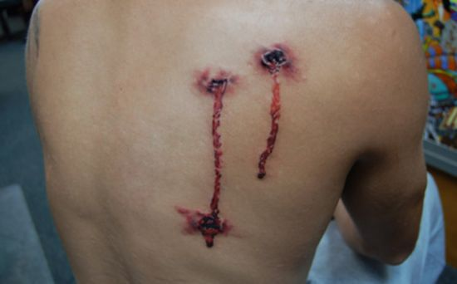
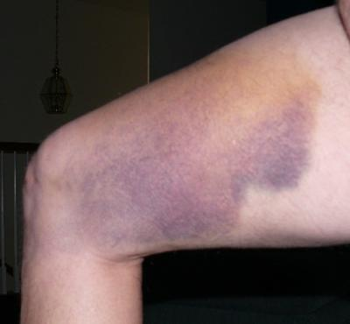
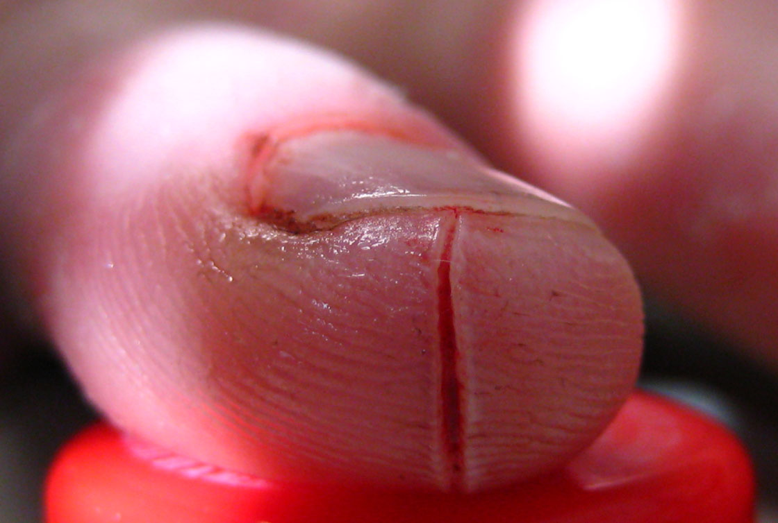
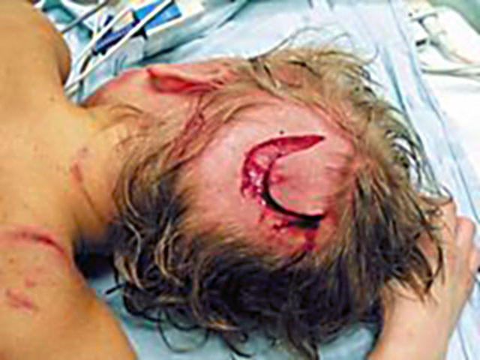
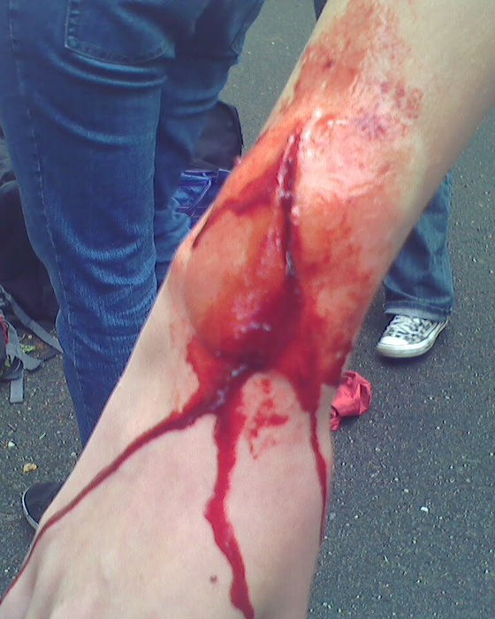
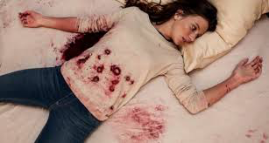
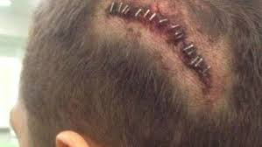
A
C
F
B
D
G
E
Notes:
A vulnus sclopetarium dorsi/ B vulnera secta antebrachii, (vidno len jednu ranu!)/ C oedema propter vulnus contusum femoris/ D corpora aliena in vulneribus punctis abdominis (často sa dostanu do rany kúsky látky z odevu) /E sutura vulneris laceri capitis / F Infectio in vulnere scisso digiti secundi / G sepsis post vulnera morsa capitis (vidno len jednu ranu!)

Slide 13
Reading authentic records 2 - read and translate the diagnosis, re-write it without abbreviations

Slide 14
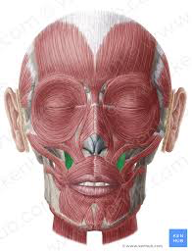
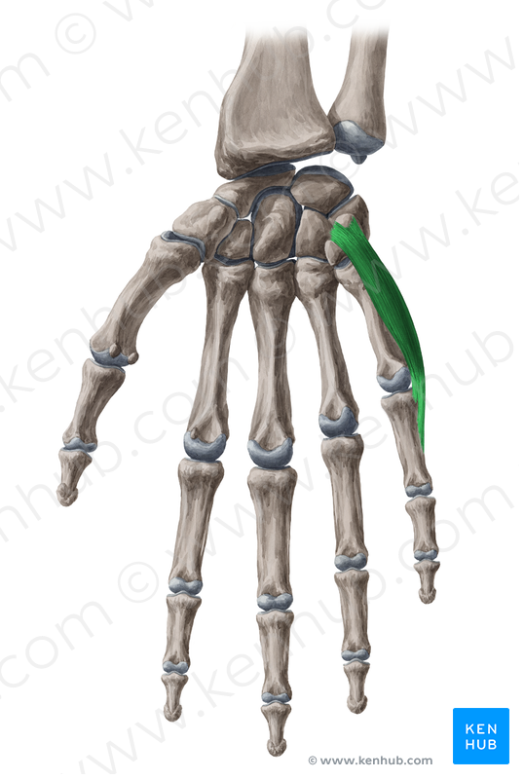
The muscle(s) that…
…moves the little finger away from other fingers is…
…helps the face to form a smile because it elevates the angles of the mouth at each corner is…
…stretches the wide band that encloses the thigh muscles is…
Notes:
Musculus abductor digiti minimi
Musculus levator anguli oris
Musculus tensor fasciae latae

Slide 15
Name the action performed by the given muscle
Musculus abductor pollicis longus >> abductio, onis, f.
Adductio, onis, f.
Musculus adductor hallucis longus
Musculus compressor urethrae
Musculus constrictor pharyngis medius
Musculus depressor anguli oris
Musculus dilatator pupillae
Musculus extensor carpi
Musculus flexor digitorum profundus
Musculus levator glandulae thyr(e)oideae
Musculi rotatores thoracis
Musculus tensor fasciae latae
Compressio, onis, f.
Constrictio, onis, f.
Depressio, onis, f.
Dilatatio, onis, f.
Extensio, onis, f.
Flexio, onis, f.
Levatio, onis, f.
Rotatio, onis, f.
Tensio, onis, f.

Slide 16
Translate
Death on the operating table
Deep part of the parotid gland
Internal ear
Network of carpus
Canine teeth
Venous network of the eyeball
Symptoms of inflammation of liver
Mors in tabula
Pars profunda (glandulae) parotidis
Auris interna
Rete carpi
Dentes canini
Rete venosum bulbi oculi
Symptomata hepatitidis

Slide 17
Give the full form of abbreviated words
Vulnus reg. coxae l. sin.
Varices extremitatum l. utr.
Ulcus chron. cruris l. dx. Posttraumaticum
Vv. lacera reg. pedis
V. contusum regionis femoris l. dx.
Oedema pedis et cruris l. utr. post vulnus morsum
Amputatio phalangis digiti III. et IV. pedis l. sin.
Status post luxationem colli femoris l. dx.
Fractura baseos phalangis digiti V.

Slide 18
Find Greek and Latin synonyms
English Latin Greek
_____________ ___________ soma
_____________ os, oris _____________
kidney _____________ _____________
_____________ _____________ colon
brain _____________ _____________
_____________ organum _____________
_____________ _____________ hepar
stitch _____________ _____________
_____________ vulnus __________
body
corpus
mouth
stoma
ren
nephros
large intestine
intestinum crassum
cerebrum
encephalon
organ
organon
liver
iecur
sutura
r(h)aphe
injury, wound
trauma

Slide 19
DOSIS
Only feminine nouns decline according to paradigm dosis
These words are mostly of Greek origin
in nominative singular they end in -sis, -xis, -osis
and the genitive singular is the same
 | Sg. | Pl.
nom. | dosis | dos-es
gen. | dos-is / -eos | dos-ium
ak. | dos-im / -in | dos-es
abl. | dos-i | dos-ibus
Some Latin words are declined according to dosis, but they do not have Greek endings:
febris, is, f, tussis, is, f., pertussis, is, f., sitis, is, f., tuberculosis, is, f.

