Slide 1
I. Disinfection and sterilization
MUDr. Bohdana Rezková, Ph.D.
Doc. Ing. Martin Krsek, Ph.D., MSc.
Department of Public Health

Slide 2
Terms
Decontamination - disinfection procedures to eliminate contamination, ie pollution of the environment with substances with infectivity, radioactivity etc. Comes before mechanical cleaning.
Mechanical Cleaning - is a set of procedures that remove dirt and reduce the number of micro-organisms.
Disinfection - is a set of measures that lead to the destruction of some microorganisms by physical, chemical, or combined processes to interrupt the route of transmission from the source to the susceptible individual.
- Normal protective disinfection - part of routine procedures
- Special protective disinfection - at the outbreak/source of disease (continuous, final)
Sterilization - a process that leads to the killing of all micro-organisms capable of reproduction, including their spores, leads to the irreversible inactivation of viruses and the killing of worms and their eggs.

Slide 3
Legislative requirements
I
(Decree No. 306/2012 Coll.)
in patient care, health workers must use barrier care techniques at all workplaces
only decontaminated aids should be used
work surfaces at all workplaces of healthcare facilities must be allocated according to the nature of the activity being carried out
barrier care techniques must also be used for handling and transporting patients and for performing in joint/common examination and treatment departments.

Slide 4
Legislative requirements
I I
(Decree No. 306/2012 Coll.)
For parenteral procedures including drainage of wound and body cavities, urinary catheter insertion (!), health care workers must only use sterile medical devices and observe the aseptic principle during each parenteral procedure
when changing collecting bags, they must use a closed drainage and collecting system to ensure against a possible backflow

Slide 5
Legislative requirements
III
(Decree No. 306/2012 Coll.)
in endoscopes and other optical devices inserted into sterile body cavities, at least higher degree of disinfection must be ensured; for digestive flexible and rigid endoscopes (except surgical) and laryngoscopes, two-stage disinfection must be ensured;
sterile fluids must be used when investigating sterile body cavities when their use is indicated;
pad pliers for sterile material handling are stored in a preservative or disinfectant solution intended for this purpose and exchanged for a maximum of 24 hours;

Slide 6
Legislative requirements
I V
(Decree No. 306/2012 Coll.)
reusable medical devices are disinfected, cleaned and sterilized according to the manufacturer's instructions
disposable aids must not be repeatedly used even after sterilization
used tools and aids contaminated with biological material must not be hand-cleansed by health workers without prior decontamination by disinfectants with virucidal effect!

Slide 7
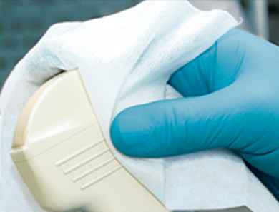
DISINFECTION
an essential part of the anti-epidemic regime in healthcare facilities and in areas where epidemiologically significant activity is being carried out (food industry, massage, …)

Slide 8
Microbes and
Environment
Environmental factors
External environment factors
- temperature
radiation
lack of water
lack of nutrients
inappropriate pH
chemical substance

Slide 9
Microbes and
Environment
Effect on microbial survival
I
Effect on microorganisms
all micro-organisms are not killed at the same time, there is a gradual dying
the number of microbes killed at a certain time depends on:
- factor intensity
- time of action (logarithmic relationship)
- the starting count!
- the type of microbe
- environmental protection
- for chemicals - temperature

Slide 10
Microbes and
Environment
Effect on microbial survival
II
- Factor intensity (physical effect, chemical concentration)
- the higher, the more efficient
- does not always apply !!!
- Exposure time
- the longer, the better
- reliable result: exposure time that decreases probability of survival to 10-6
- Starting count (contamination level)
- the more, the longer
- the amount of the microbial biomass can bind the active ingredient of the antimicrobial agents! .....necessary pre-cleaning!

Slide 11
Microbes and
Environment
Effect on microbial survival
III
Type and condition of microbes
- spors
- genus Mycobacterium
- naked x enveloped viruses
The protective effect of the environment
- influence of organic substances (especially fats)
- pH (microbes are more sensitive in acidic environment)
- the physical nature of the environment (porosity and hydrophobicity of surfaces ...)
- chemical effect (silver, copper)
Temperature at exposure to the chemical substance
- higher temperature increases the effectiveness of antimicrobials
(but also accelerates their deactivation !!!)

Slide 12
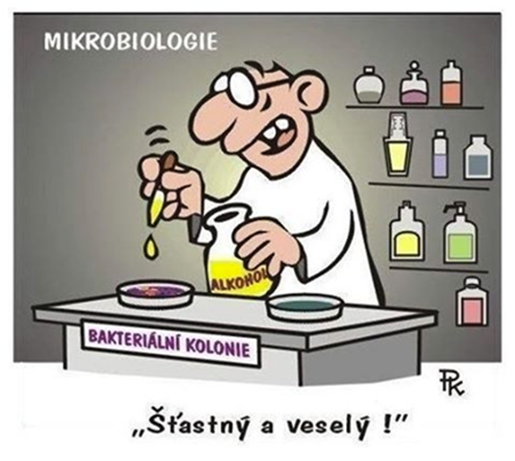
Methods of disinfection
Physical
Chemical
Physico – chemical
Biological protection
Happy New Year !

Slide 13
Spectrum of disinfection efficiency and labeling on the packaging
Bactericidal – A
Virucidal - B:
- partially - enveloped viruses
- fully – non-enveloped (naked) viruses
Sporicidní – C
Fungicidal - V (microscopic fibrous/mycelial fungi), Levurocidal - C.albicans (V)
Tuberculocidal - T (M.tuberculosis complex)
Mycobactericidal - M (atypical mycobacteria)
Protozoa – P
Helminths – H
        Efficiency is tested according to standards!

Slide 14
Disinfection efficiency spectrum
Examples

Slide 15
Procedure
Mechanical cleansing
Disinfection itself
Can be combined using disinfectants with washing and cleaning properties.

Slide 16
Mechanical Cleansing
(Decree No. 306/2012 Coll.)
Mechanical cleansing is one of the decontamination procedures that remove dirt and reduce the number of micro-organisms. If contamination with biological material has occurred, it is necessary to include the disinfection process prior to mechanical cleaning.
Cleaning agents with disinfectant effect are applied either manually or by means of washing and cleaning machines, pressure guns, ultrasonic devices etc.
All instruments and devices are kept clean.
Cleaning machines and other equipment are used according to the manufacturer's instructions, including the control of cleaning process.

Slide 17
Physical disinfection
Disinfection in instruments at a temperature controlled/governed by parameter A0. Devices must guarantee - at a given temperature - a reduction in the number of viable microorganisms on a disinfected item to a predetermined level that is suitable for items further use.
Ultra violet radiation.
Filtration, flame sterilization, combustion.
Pasteurization (heating at 62.5 ° C for 30 minutes).
Boiling at atmospheric pressure for at least 30 minutes.
Boiling in overpressure vessels for at least 20 minutes.

Slide 18
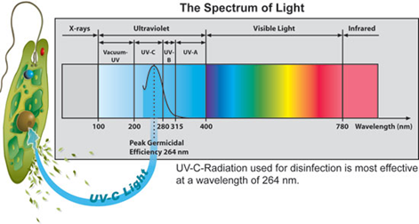
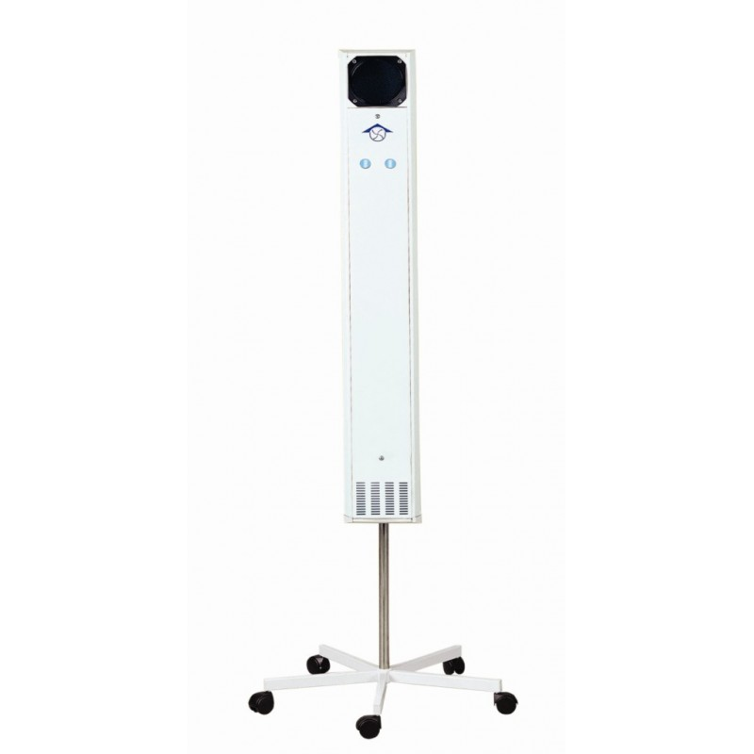
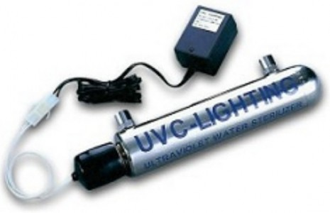
Disinfection by
UV radiation
              Effect:
Germicidal fluorescent lamps with a wavelength of 253.7 - 264 nm (DNA)
It acts (is effective) on nucleic acids of microorganisms
Limited efficiency !:
Sensitive - streptococci, staphylococci, influenza virus, polio virus
Resistant - microbes sporulating and forming pigments, VHB,
HCV, HIV
Range of microbicidal effect in air - 30 - 50 cm
It does not penetrate the solid matter, it does not act on the shaded side
efficient only on clean surfaces (dust!)
Usage (as an additional disinfection!):
1. Surface disinfection (eg laboratories)
2. Air disinfection
3. Disinfection of water

Slide 19
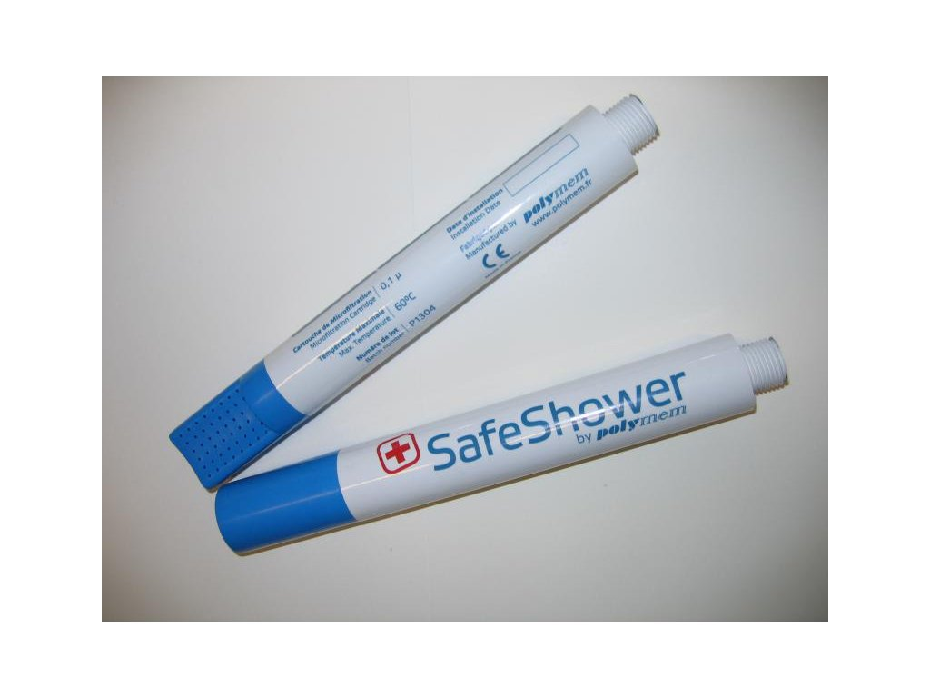
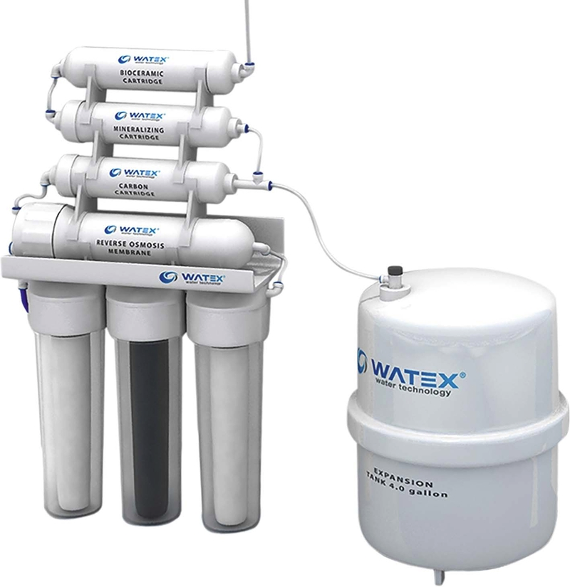
Filtration
Health applications:
- water disinfection - membrane filters (inlet water of dishwashing and disinfection equipment, shower filters to prevent legionella, ..)
shower head
- air disinfection - facial masks, respirators, HEPA filters

Slide 20
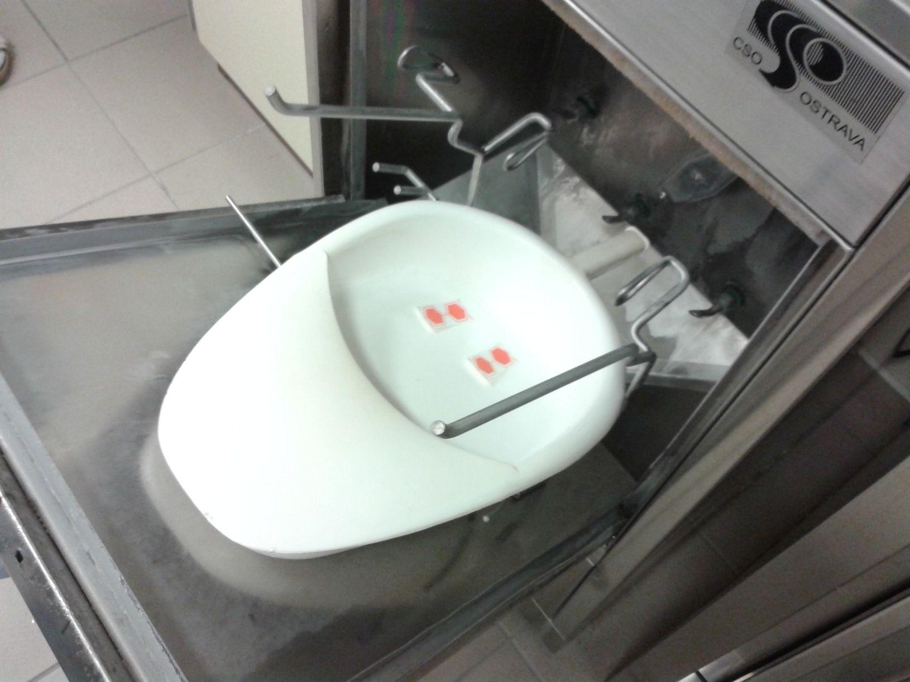
Parameter A0?
The parameters governing disinfection with moist heat (in washer-disinfectors etc.)
”A” here denotes the time equivalent in seconds at 80 °C which generates a
certain disinfection action against microorganisms with a defined z value.
The z value is a measurement (in °C) of the temperature relationship to the
killing process.
A0 = 600 is considered the minimum standard for non-critical medical devices, ie for those who come into contact only with intact skin (e.g. a bed basin). Another condition is that there is only slight microbial contamination and there are no heat-resistant pathogens.
A0 = 600 can be achieved by maintaining a temperature of 80 ° C for 10 minutes or 90 ° C for 1 minute or even 70 ° C for 100 minutes.
In the case of medical devices contaminated by heat-resistant viruses such as hepatitis B, the lowest required value is A0 = 3000.
This can be achieved by maintaining a temperature of 90 ° C for 5 minutes.

Slide 21
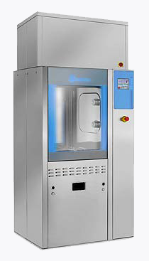
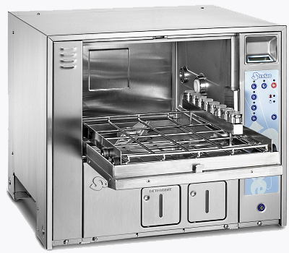
Physical-chemical disinfection
Formaldehyde steam chamber - serves for disinfection of textile, plastic products, wool, leather and fur at a temperature of 45 to 75 ° C.
Washing and cleaning machines - disinfection takes place at temperatures up to 60 ° C with the addition of chemical disinfectants. The time parameter is governed by the manufacturer's instructions.

Slide 22
Chemical disinfection
Hydroxides and other alkalis
Acids and some of their salts (inorganic, organic, acid esters, peroxyacids)
Oxidizing agents (ozone, hydrogen peroxide, ...)
Halogens (chlorine, chlorates, chloramines, bromine, iodine, ...)
Heavy metal compounds (silver, copper, ...)
Alcohols and ethers (ethyl alcohol, propanol, ...)
Aldehydes (formaldehyde, glutaraldehyde, ...)
Cyclic compounds (phenol, cresol, ...)
Surfactants – tensides
Combined
New substances (octenidine dihydrochloride)

Slide 23
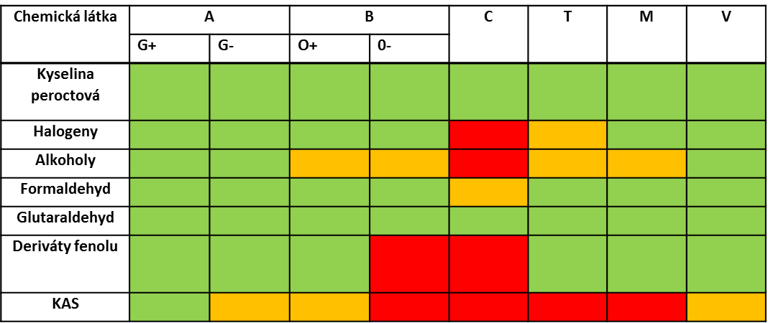
Spectrum of
Disinfection Efficiency of
Chemicals
Overview
Chemical compound
Peracetic acid
Halogens
Alcohols
Formaldehyde
Glutaraldehyde
phenol derivative
Quaternary
ammonium
compounds

Slide 24
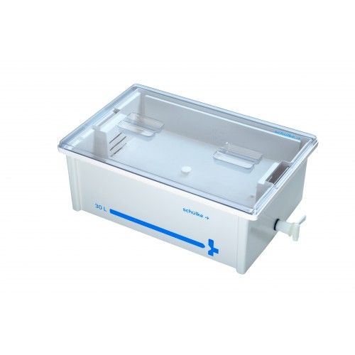
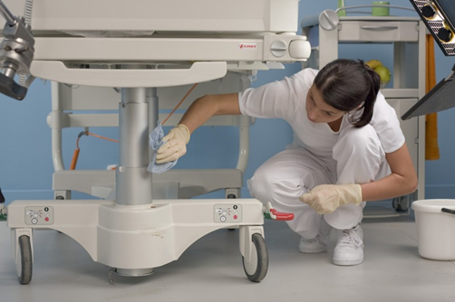
Methods of performing the disinfection
Immersion
Wiping
Spraying
Disinfectant aerosols
By gassing
Evaporation
Foam

Slide 25
Check of disinfection
The following methods are used to control disinfection:
chemical - qualitative and quantitative method for determination of active substances and their content in disinfecting solutions,
microbiological - detection of the effectiveness of disinfecting solutions or microbial contamination of disinfected surfaces (smears, imprint, rinses, etc.).

Slide 26
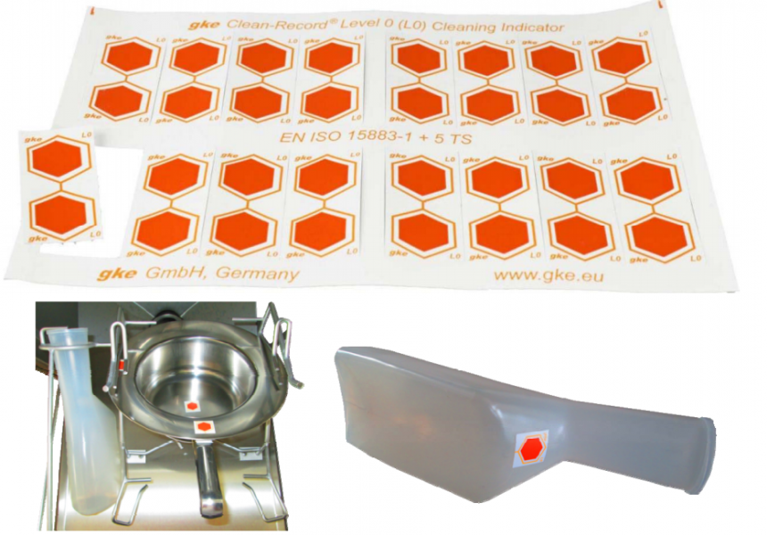
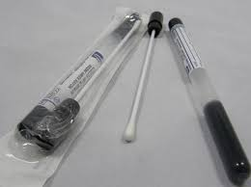
Checking the effectiveness of washing and disinfection equipment
(Decree No. 306/2012 Coll.)
Continuous monitoring of parameters and verification of the effectiveness of the washing and disinfection process in washing and disinfection facilities shall be carried out and documented on a continuous basis, at least once every 3 months, by means of a device record or physical or chemical indicators or bioindicators.

Slide 27
Disinfection documentation
Documentation of the process of instrumental disinfection of invasive and noninvasive medical devices is documented/proved by an automatic statement of instrument values or a physical or chemical indicator or bioindicator.
Documentation of the pasteurization process is documented by listing or recording of physical parameters.
Written, or the electronic documentation of the washing and disinfection equipment is archived at least 5 years after the process control.

Slide 28
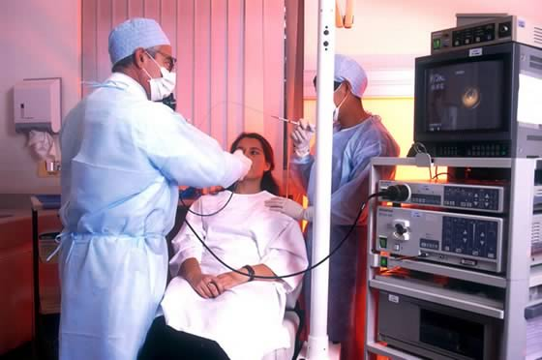
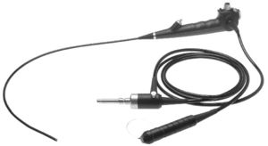
Higher degree of disinfection
Designed for medical devices that can not be sterilized by available methods and are used to perform and investigate microbially physiologically uninhabited body cavities (eg surgical and investigative endoscopes other than digestive ).
1st stage - disinfection and mechanical cleaning in disinfection solution No. 1 - bactericidal and virucidal effect
2nd stage - disinfectant solution No. 2 - bactericidal, virucidal, fungicidal, tuberculocidal and sporicidal effect
After a higher degree of disinfection, it is necessary to rinse objects with sterile water to remove residual chemicals.

Slide 29
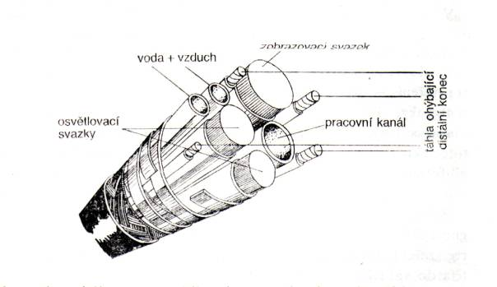
Two-stage disinfection
For medical devices that are used to perform activity in physiologically microbial inhabited areas of the body (digestive flexible and rigid endoscopes) and which can not be sterilized, two-stage disinfection is intended.
The first stage of disinfection of the device or aid is done immediately after using it with a bactericidal and virucidal effect, followed by mechanical cleaning
Using disinfectants with a broader range of disinfectant efficiency (at least bactericidal, virucidal and on microscopic fiber fungi) in the second stage
With subsequent rinsing
a) by drinking water, the quality of which will be evidenced at least twice a year at the outlet of the healthcare provider under another legal regulation for drinking water , or
b) by purified water (Aqua purificata).

Slide 30
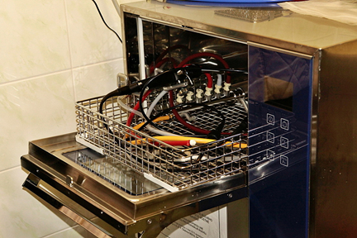
Endoscope treatment procedure
1) Decontamination of the surface of an endoscope – eg. a napkin (virucidal efficacy!).
2) Treatment of hollow parts of the endoscope - by sucking the disinfectant solution into the endoscope cavity.
3) Disinfection and washing of endoscope in solution (No. 1) with bactericidal and virucidal activity (stage I) - immersion in a disinfection bath with disinfectant solution, rinsing with potable water and drying.
4) stage II or higher degree of disinfection - manually or in devices, disinfectant solution (No. 2) with efficiency according to the type of process.

Slide 31
Storage of endoscopes
Storage for 8 hours - covered with a sterile drape (only for example during pre-performance preparation - there is a risk of contamination of the drape), in closed and labeled disinfected cassettes or cabinets under aseptic conditions,
after 8 hours, the last disinfection step in solution No. 2 (or instrument disinfection) must be repeated.
Storage for more than 8 hours - in special cabinets with HEPA filters - as instructed by the cabinet manufacturer.

Slide 32
Documentation
The success of a higher level of disinfection is documented by a diary/logbook of a higher degree of disinfection for each medical device, which can not be sterilized by the classical method. In the diary of a higher degree of disinfection, the date of preparation of the disinfectant solution, the whole patient's name, the name of the disinfectant used, the concentration, the exposure, the name and signature of the medical practitioner, the identification number of the used medical device.
Disinfection preparations used for two-stage disinfection shall be recorded in the diary/logbook with the date of preparation of the working solution, name of the worker, concentration and exposure, the identification number of the medical device used.
Written or electronic documentation is archived for at least 5 years after the higher level of disinfection.

Slide 33
Principles of the use of disinfectants
I
Disinfectants with different effective chemical substances alternate regularly.
When changing the active substance, the surfaces must first be wiped with detergent water to avoid chemical reaction (stickiness, odor).
When using disinfectants, follow the instructions of the disinfectant manufacturer.
Work disinfection solutions are prepared by dissolving the right amount of disinfectant in water. Prepared for each shift (12 hours) fresh - depending on the degree of loading with biological material can be prepared even more often.

Slide 34
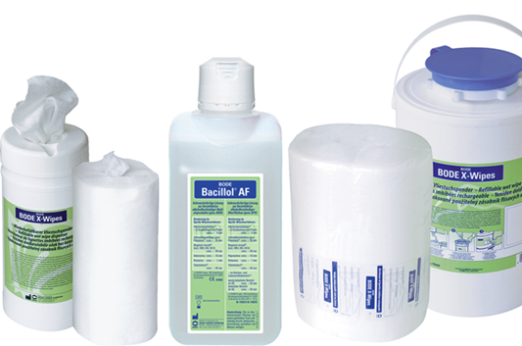
Principles of the use of disinfectants
II
Disinfectants are diluted with cold water, unless otherwise specified by the manufacturer, to reduce the evaporation of chemicals into the air and their irritant effects. This applies especially to disinfectants containing aldehydes and chlorine.
In the preparation of working disinfectant solutions, the supplied liquid disinfectant is considered a 100% solution.
The prescribed exposure time for the disinfectant must be observed.
Containers with diluted solutions of disinfectants shall be labeled with the name of the disinfectant, the concentration, the time of exposure, the date and the hour of dilution and the signature of the worker who diluted the solution.

Slide 35
Principles of the use of disinfectants
III
Without the manufacturer's recommendations, disinfectants should not be mixed with other chemicals (other disinfectants or cleaning agents).
Disinfectants and procedures of disinfection are chosen not to damage the disinfected material.
Disinfected items, that come into contact with food, should be thoroughly rinsed with potable water after disinfection.
Disinfectants are stored in original sealed containers, in dry and clean warehouses, separately from food or other chemicals

Slide 36
Disinfection of skin and mucous membranes
Hand disinfection - alcohols.
Decontamination during splashing with biological material (eg eye flushing, etc.).
Before any damage to the skin (mucous membranes):
1. tattoos, earrings, piercing,
2. prior to injection, vaccination, blood collection
3. prior to surgery (disinfection of skin or mucous membranes).
To disinfect mucous membranes or wounds - antiseptic (not to damage living tissues!)
Color solutions (for visual inspection of the disinfected area) or colorless solutions (when assessing expected skin color changes) are used.
When using electric appliances - it is necessary to dry alcoholic disinfectants!

Slide 37
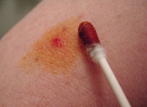
Examples of disinfectants for skin or mucous membranes
Skin disinfection - active ingredient:
1. alcohols (e.g., Cutasept)
2. Iodine preparations:
- polyvinylpyrrolidone (PVP)-iodine - aqueous solution without alcohol (eg Braunol)
- PVP - Iodine containing alcohol (eg Braunoderm dyed/
uncoloured)
mucosal disinfection - active substance:
- Chlorhexidine (can not be used in newborns!)
- PVP - iodine (eg Braunol),
- Octenidine dihydrochloride (eg Octenisept)
- some preparations are only used after dilution. Always follow the manufacturer's instructions!

Slide 38
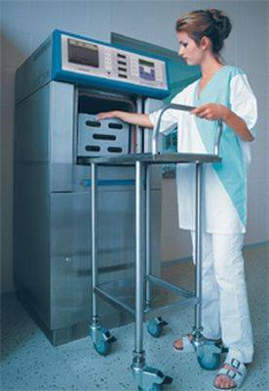
STERILIZATION

Slide 39
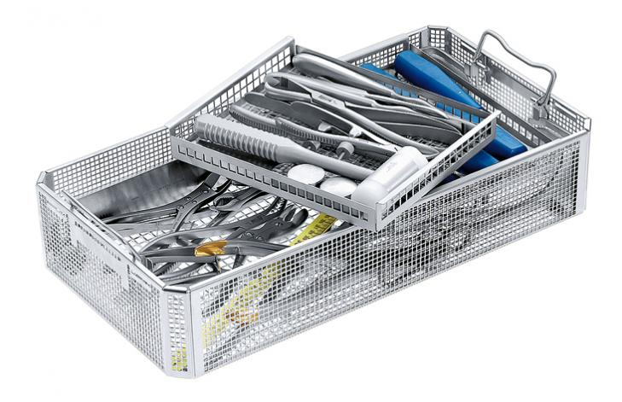
Definition
The process that leads to the killing of all microorganisms capable of reproduction, including spores, leads to the irreversible inactivation of viruses and the killing of worms and their eggs.

Slide 40
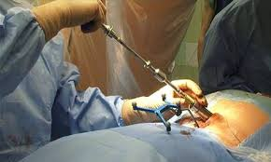
Requirements for sterility
All tools and aids that break the integrity of the skin and mucous membranes.

Slide 41
Methods of sterilization and use
Physical:
1. Hot air - metal, porcelain, glass, ceramics
2. Steam - metal, porcelain, glass, ceramics, textiles, rubber, plastics, ...
3. Plasma - for most materials, other than paper, textiles (temperature up to 60 ° C)
4. Radiation - for new products, only for industrial use
Chemical:
1. Formaldehyde - thermolabile materials (temperature up to 80 ° C)
2. Ethylene oxide - thermolabile materials including porous (temperature up to 55 ° C)

Slide 42
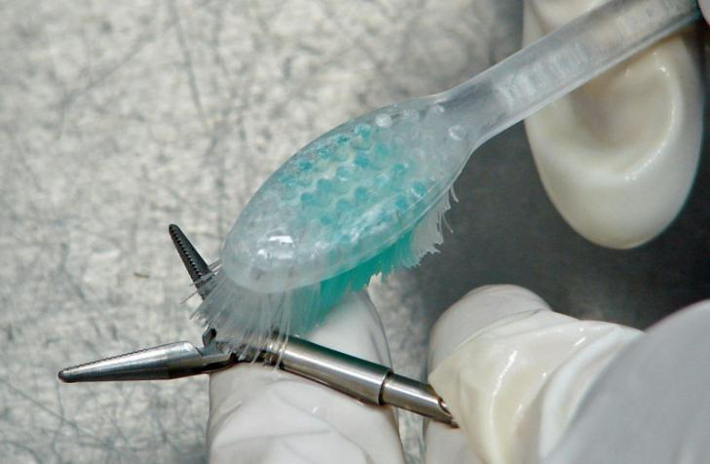

Pre-sterilization preparation of aids/tools
Disinfection with a virucidal agent
Mechanical cleansing
- manual (formation of infectious aerosol !!!)
- in dishwashing and disinfection facilities
1. Rinse with drinking water
2. Drying
3. Packaging
4. Marking

Slide 43
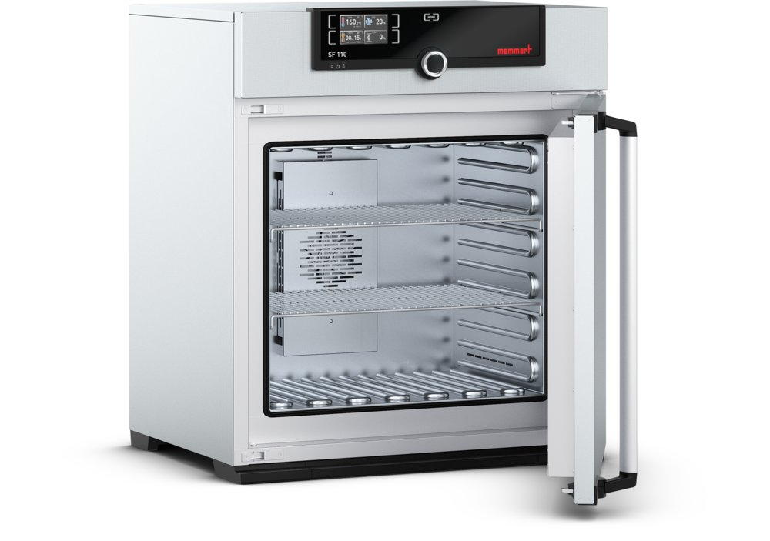
Sterilization
It is performed mostly in sterilizing devices in several stages:
- heating up the material and possibly evacuate the air
- temperature equilizing in the material and in the space of the sterilizer
- killing of micro-organisms
- chamber cooling, material drying, cooling, pressure equalization
Sterilization and pre-sterilization must always be carried out according to the manufacturer's instructions!
The sterilizing chamber is filled up to ¾ volume!

Slide 44
PHYSICAL STERILIZATION
Wet Heat Sterilization (Steam Autoclave)
Suitable for items from: metal, glass, porcelain, ceramics, rubber, plastic and textiles, solutions, media
There must be gaps between the embedded material so that steam can pass through!
Sterilization parameters:
Temperature
of saturated
steam
Pressure
Overpressure
Sterilization
exposure

Slide 45
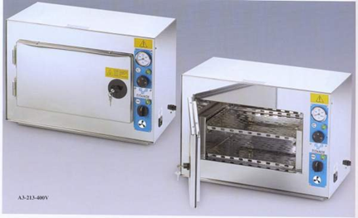
PHYSICAL sterilization
Sterilization with circulating hot air
Suitable for items from: metal, glass, porcelain, ceramics, stoneware.
Circulating air delivers thermal energy directly or on the principle of conductivity and radiation.
Sterilization parameters:
160 ºC for 60 minutes
170 ºC for 30 minutes
180 ºC for 20 minutes.
The hot air sterilizer opens at the end of the sterilization cycle after cooling to at least 80ºC.

Slide 46
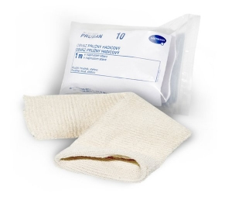
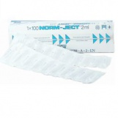
PHYSICAL
Sterilization
Sterilization by radiation
It is used only for the industrial production of sterile disposable material (a controversial effect on HBV, HIV, ...).
Suitable materials - some types of plastics, textiles, pulp, rubber, sewing material, medicaments, some transplants, ....
It is carried out in the irradiation centers.
The effect is caused by gamma rays at a rate of 25 kGy with high penetration through the material; the already packed materials stored in the cartons is irradiated

Slide 47
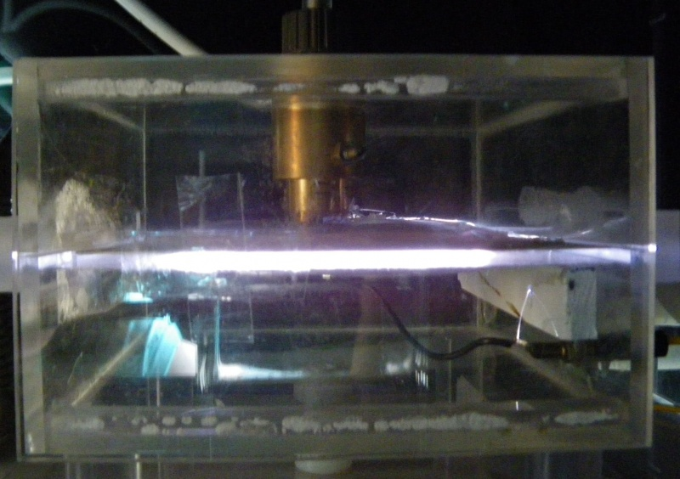
PHYSICAL
Sterilization
Sterilization by plasma
Suitable for metal, rubber, plastic, optical instruments.
You can not sterilize wet and porous materials and textiles.
Plasma is generated by the action of a high frequency electromagnetic field in a high vacuum on hydrogen peroxide vapor at a temperature of 50-60 ºC. Free reactive particles react with live matter to deactivate them.
This is a dry process.

Slide 48
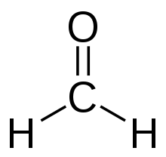
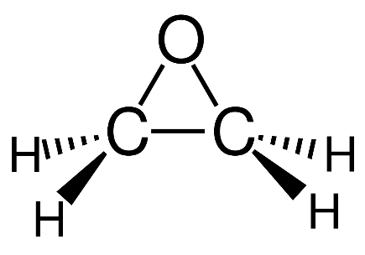
CHEMICAL
Designed for medical devices that can not be sterilized by physical methods.
1. Formaldehyde:
- for thermolabile material, metal sharp objects, optics.
- not suitable for textiles and paper.
- works by the action of a gaseous mixture of formaldehyde with water vapor at a temperature of 60-80 ºC.
- only in rooms with controlled air conditioning.
2. Ethylene oxide:
- colorless, volatile liquid, vapors are flammable, explosive, toxic, carcinogenic!
- after sterilization, materials must be vented in special cabinets or rooms.

Slide 49
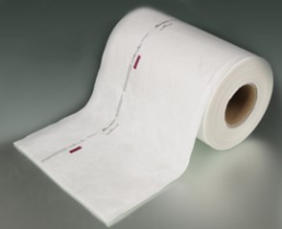
Sterilization packages/wraps
serves to protect sterilized objects from secondary contamination until their use
are different for each method of sterilization
must always be marked by a process test! (color change indicates, that the item underwent a sterilization process)

Slide 50
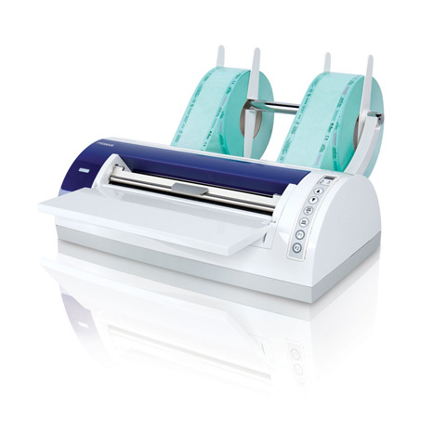
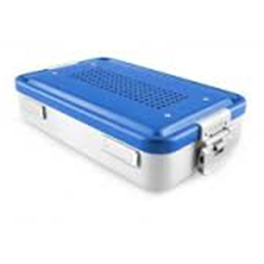
Types of sterilization packages/wraps
Disposable packaging/wraps
- paper, polyamide, combined paper - foil and other (nonwoven textiles, crepe packaging, ...),
- always provided with a process test,
- sealed by welding or gluing,
- different according to the method of sterilization
Solid, reusable packaging
- cassettes (stainless steel and only for hot air sterilization!)
- containers (stainless steel or aluminum) - with Thermo-lock system, which closes the container by heat during sterilization.

Slide 51
Labeling of sterilization packages
Primary sterilization packaging (unit) - a sealed or closed packaging system that forms a microbial barrier closing the medical device.
Secondary sterilization packaging - a packing system containing one or more medical devices, each packed in its primary packaging.

Slide 52
Method of sterilization Expiration for material
freely stored protected
Kind of packing
Cassettes
Container
Paper
Paper – foil
Polyamid
Polypropylene
Tyvek
nonwoven textiles
Double packing
Double packing
and storage packing

Slide 53
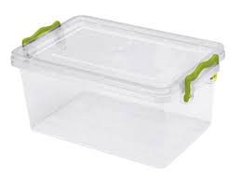
Storage and transportation of sterilized material
It is necessary to protect it from dust, direct sunlight, moisture and mechanical damage.
Best to store in closed cabinets, storage container, drawer or other packaging.
Transport to a place of use only in a special locked closed crates or cabinets!

Slide 54
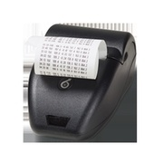
CONTROL
OF STERILIZATION
Sterilization cycle monitoring (monitoring of measuring devices, eventually printing of values and their evaluation in sterilization diary/logbook)
Checking the effectiveness of sterilizing devices (see below)
Control of sterility of sterilized material (part of validation).

Slide 55
Check the sterilization device's performance
The operator is responsible for checking the effectiveness of the sterilizing instruments.
Combining the evaluation of physical parameters of sterilization, chemical indicators and biological indicators.
If any parameter is outside the set limit, sterilization is judged to be unsatisfactory!
The sterilization check is recorded in the sterilization diary/logbook.

Slide 56
Sterilization documentation
The sterilization diary/logbook documents:
- type of sterilized material,
- sterilization parameters,
- date
- the name and surname of the person who performed the sterilization
- written evaluation of non-biological tests (passed / failed),
(archiving for 5 years).

Slide 57
Checking the effectiveness of the sterilization device
Methods
The check is carried out by:
1. Biological systems
(eg. Geobacillus stearothermophilus for steam sterilization, ...)
2. Non-biological systems
(Bowie-Dick test, Chemical Process Tests, Chemical Tests
of sterilization)
3. Physical Systems – part of instrument (Vacuum Test, Apparatus displaying or recording measured temperature)

Slide 58

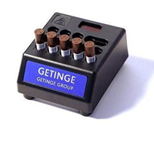
Biological control systems
The biological indicator contains a selected microorganism (Geobacillus stearothermophilus) with high resistance to the sterilizing medium. If it is killed by sterilization sterilization cycle has passed, it has been effective.
the procedure and method of use are governed by applicable standards.
Frequency of use:
  for new instruments, after repair, after relocation,
  always if in doubt,
  once a month on central sterilization, operating theaters.
  for sterilisers older than 10 years, after 100 cycles and at least once every six months; if younger than 10 years - after 200 cycles and at least once a year.

Slide 59
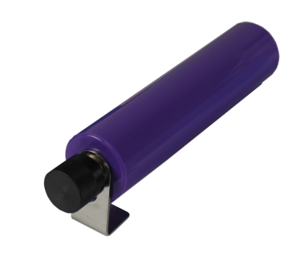
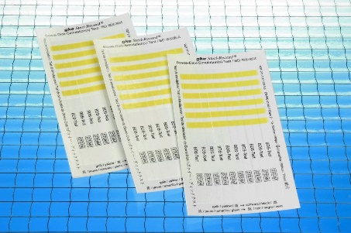
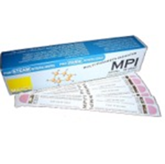
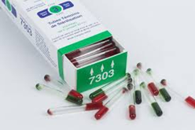
Non-biological systems
Bowie - Dick's Test:
- a test of correct venting and penetration of steam,
- performed before the first sterilization cycle of the day without batch.
Chemical Process Tests:
- they react to the presence of the sterilizing medium by color change
- it is part of each unit package.
Chemical sterilization tests:
- to demonstrate/prove all cycle parameters (eg temperature, pressure, ...)
- respond to conditions in the sterilization chamber by color change
- they are added to each batch and evaluated immediately after the end of the cycle.

Slide 60
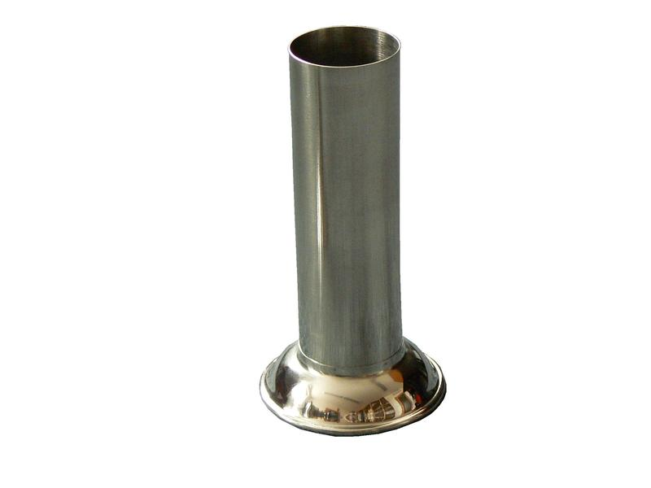
Manipulation with sterile medical supplies
It is necessary to ensure the shortest way of sterile material to the patient without the risk of contamination:
- non-delivery system (without touching)
- single use of sterilized tweezers and material, sterile gloves,
- if not possible, then by means of pliers daily sterilized and stored in daily sterilized wenches filled up to 2/3 with some of the appropriate disinfectant solutions for tools.

Slide 61
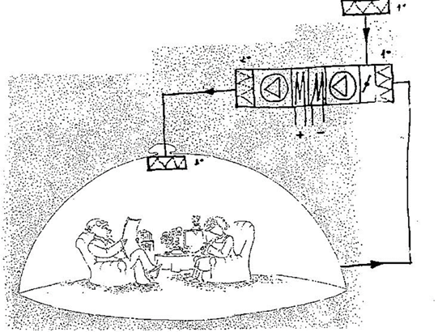
II. Clean rooms

Slide 62
Clean rooms
Definitions
It is a confined space, in which the concentration of dust particles and microorganisms is controlled.
It is designed and used in such a way as to minimize the input, formation and settling of particles inside the space and in which other relevant parameters such as temperature, humidity and pressure are controlled.

Slide 63
Classification of clean rooms.
- It is given by the amount of dust particles of a certain size / m³
- it divides clean rooms into so-called cleanliness classes
Specification:
EN ISO 14644-1
Clean spaces and appropriate managed environments
(ISO Class 1 - 9)
Parameters of microbial contamination are supplemented by:
- International Regulation PIC PH 1/97:
Pharmaceutical Inspection Concention
(Class A, B, C, D)

Slide 64
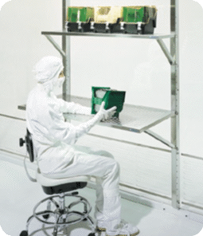
Use of clean rooms
1. GROUP
Micromechanisms
microhydraulics, gyroscopes, compact discs
Cars
car paint rooms
Electronics
processors, IO, TV screens,
magnetic tapes
Optics
lenses, photographic films, laser devices

Slide 65
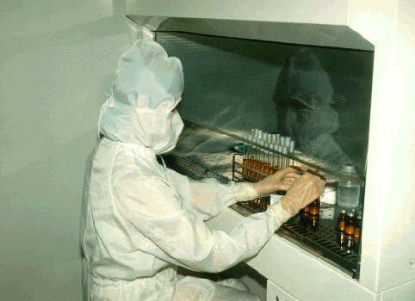
Use of clean rooms
2. GROUP
Biotechnology
antibiotics, genetic engineering
Medical equipment
pacemakers, artificial blood vessels, syringes, implants
Pharmacy
sterile production, protection of some critical steps
HOSPITAL
operating theatres, central sterilization, isolation of infectious patients
Food and beverages
beer production, non-sterile food and beverage

Slide 66
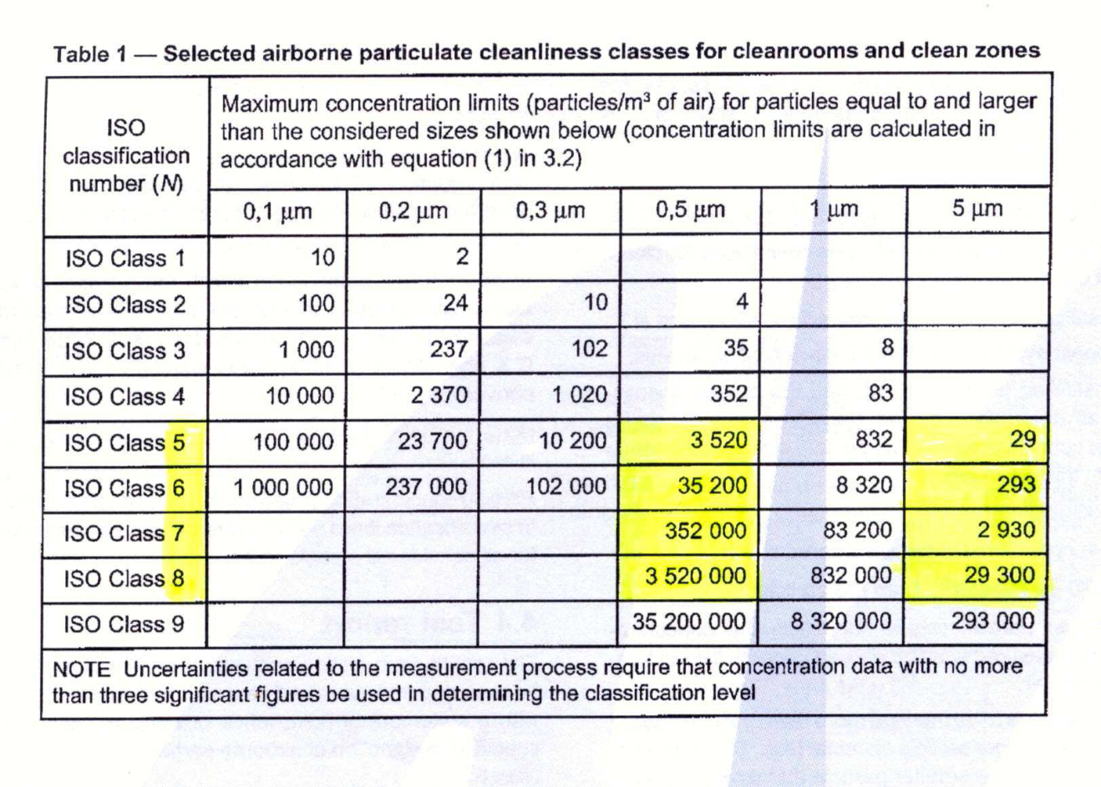
CLASSES OF CLEANING
Norm 14644-1

Slide 67
Clean rooms in legislation of
Czech Republic
Legislation defining cleanroom requirements in the Czech Republic is focused only on production facilities and treatment of pharmaceuticals.
The only legally binding regulation in this area is Decree No. 84/2008 Coll. on good pharmacy practice.
For the healthcare facilities, therefore, the classifications of purity classes given for pharmacy practice are used:
SÚKL (State Institute for Drug Control ) Instruction:
- VYR 36 Clean rooms (2009)
- LEK-17 Preparation of sterile medicinal products in
pharmacies and medical facilities (2016)

Slide 68
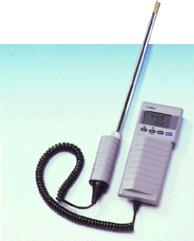
Microclimatic parameters in
Czech legislation
Decree No. 6/2003 Coll., laying down hygienic limits of chemical, physical and biological parameters for indoor living quarters of some buildings:
- does not apply to operating theaters and other areas
requiring increased demands on cleanliness
- environmental cleanliness: bacterial limit - 500 cfu / m³
mold limit - 500 cfu / m³
(detected by aeroscopic measurement)
- temperature limits - summer: 24 ° C ± 2 ° C
- winter: 22 ° C ± 2 ° C

Slide 69
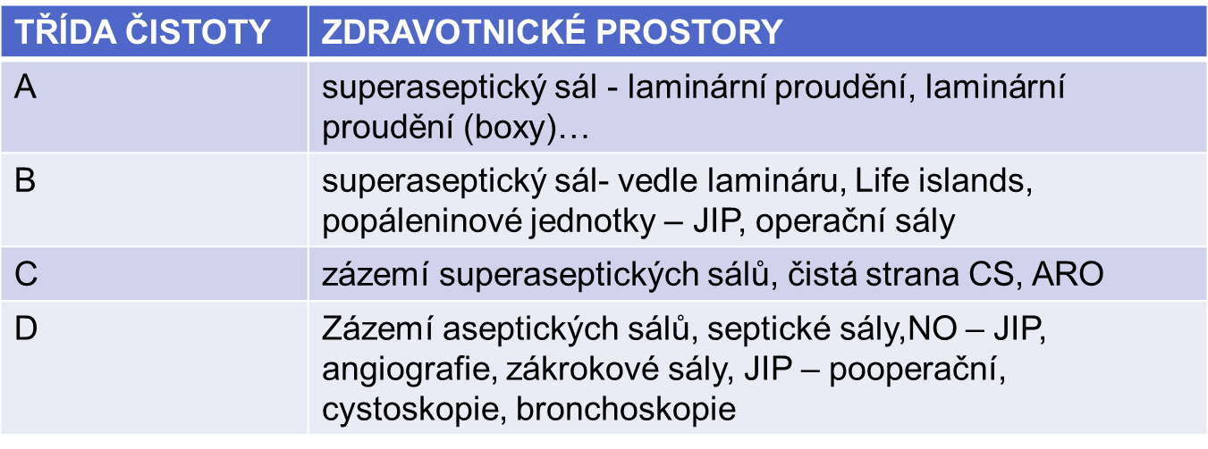
The inclusion of
"clean rooms" in the healthcare sector of the
Czech Republic
Established by agreement between Public health authorities, designers and users
class of
cleanliness
medical facilities
superaseptic hall
superaseptic hall
utility rooms
utility rooms

Slide 70
Annex No. 1 to the Decree No. 553/2007 Coll.,
The highest possible concentrations of dust particles and microbial factors in clean areas of the facility
Slovakia
Třída čistoty ISO | Zdravotnické pracoviště | Počet prachových částic/m³ |  | Počet mikroorganismů KTJ/m³
Třída čistoty vyhláška |  | ≥ 0,5 µm | ≥ 5,0 µm | nepatogenní | patogenní
5 (A) | Superaseptický operační sál/operační pole, Transplantační a popáleninová jednotka. | 3 520 | 29 | --- | < 1
M 3,5 |  | 3 530 | 0 | < 1
6 (B) | Aseptický operační sál/operační pole, Superaseptický operační sál/prostor sálu. | 35 200 | 293 | ---
4,5 |  | 35 300 | 247 | 5
7 (C) | Aseptický operační sál/prostor sálu, Čistá a aseptická strana CS, Angiografické sály, JIP patologických novorozenců a onkologie. ARO | 352 000 | 2 930 | ---
5,5 |  | 353 000 | 2 470 | 100
8 (D) | Zázemí aseptických sálů, JIP chirurgické, novorozeneckéí Dospávací pokoje, Zákrokové sálky, Endoskopické vyšetřovny. | 3 520 000 | 29 300 | ---
6,5 |  | 3 530 000 | 24 700 | 500
9 | Standardní lůžkové oddělení/pokoje pacientů | 35 200 000 | 293 000 | ---
- |  | --- | --- | 1 000

Slide 71
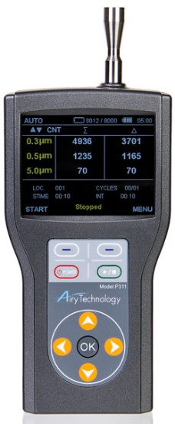

CLASSES OF CLEANING
Dust particles according to VYR 36 (SÚKL instruction)

Slide 72


Classes of cleanliness
Number of viable microorganisms / m³ of air according to VYR 36 (Instruction SÚKL)
Measurement during operation !!!
Class Recommended limits for microbiological contamination
air petri dish contact dish glove imprint

Slide 73
Aeroscopic measurement
it serves to quantify microbial contamination of the environment.
air of a certain volume (most often 100 l) is sucked in and directed to a standard Petri dish with culture medium.
air samples (Petri dishes) are further cultivated according to accredited procedures for colony numbers.
the results are rated according to VYR 36.

Slide 74
Clean rooms in the healthcare
Air conditioning
For clean rooms in the health care sector, air conditioning units with three-stage filtration (coarse filter, fine filter, end HEPA filter - high efficiency particulate arrestance) are delivered.
Unidirectional air flow must be maintained by maintaining constant overpressure (15 kPa).
The pressure must be highest in the area of the highest purity class.
They allow filtration, heating, dampening, air cooling, and transport of conditioned air.
Panels or boxes for laminar flow are used to protect the surgical wound, product or staff.

Slide 75

Definition of
HEPA filter from
IES
HEPA - High efficiency particulate arrestance
Disposable filter medium of dry type in a solid frame-having a minimum particle capture efficiency of 99.97% for thermally generated 0.3 μm diketophthalate (DOP) particles (or for a specified alternative method).

Slide 76

HEPA filters
Division of HEPA filters into classes according to ČSN EN 779, 1822
Penetration/efficacy

Slide 77



Laminar flow

Slide 78

Employee Mode
(Lek 17)
For personnel and material movement and room cleaning, there must be precisely defined rules that minimize particulate and microbial contamination.
Workers' access should be limited and personnel and material must enter the cleanroom according to a defined procedure (changing clothes and cleaning of workers, cleaning and disinfecting the material). The range and procedures are to be determined depending on the defined purity class.
Workers should wear special clothing depending on the cleanliness class.
Does she have a white coat? She has! So calm down!

Slide 79
Working clothes and dressing
(according to Lek 17)
Class A / B: The headgear (the balaclava) has perfectly maske the hair and where it is needed also the beard and is to be inserted under the collar of the overalls. A mask should be deployed across the face to prevent droplet release. On the hands, workers should have a sterilized, non-dusted rubber or plastic gloves, on legs there should be sterilized or disinfected footwear or sleeves. The lower ends of the trousers should be inserted into the shoe or sleeves, and the sleeves of the overalls should be inserted into the gloves. The protective suit is practically free of any loose fibers and particles and is supposed to trap particle detached from the surface of the body.
Class C: Hair and wherever needed also the beard should be covered. Clothes should consist of a short coat and trousers or overalls, the sleeves should be tightened on the wrist, the coat should have a high collar, and the feet should have suitable shoes or sleeves. No fibers or particles should be released from the clothing.
Class D: Hair and wherever needed also beard should be covered. Protective clothing and appropriate footwear or sleeves should be used. Appropriate measures should be taken to prevent the introduction of contamination into clean rooms.

Slide 80

OPERATION THEATRE
=
CLEAN ROOM
Mode
Statute of the closed department.
Separation of the operation of the barrier (septic) hall, separation of the operation of the super-aseptic hall from the regular aseptic rooms (rooms, tools, devices, laundry, personnel in one operational shift).
Compliance with the rules for the individual classes of purity of the operating tract (use of lips, staff regime, laundry mode, waste disposal, ...).
Hygienic hand disinfection already in a hygienic filter.
Modes of patient and material transportation, employee entrance (own transport vehicles, dedicated access roads, hygienic filters, ...)
Professional behavior of medical professionals (protection of operating theater air by closing the door, without excessive movement and speaking during operations, ...)
Ensure air quality with appropriate air conditioning (see Clean rooms).
Preoperative patient preparation.

