Slide 1
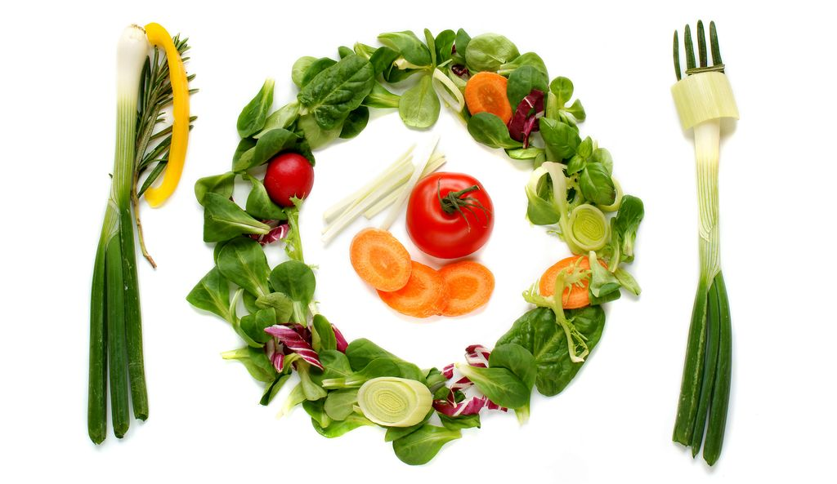
“Alternative nutrition”
Mgr. Zlata Kapounová, Ph. D., Mgr. Aleksandra Nikolić, Bc. Iuliia Pavlovská, Bc. Petra Ferenčuhová
Notes:
Or Alternative eating/dietary lifestyles

Slide 2
“Alternative nutrition”
General term
Types of diets, that differ from the nutritional habits of the majority of society and conventional recommendations from dietitians.
Usually based on the restriction of certain food groups, most often food of animal origin

Slide 3
Why alternative nutrition?
Health reasons
  the need for change of lifestyle- obesity, gout, dyslipidemia, zoonosis
Moral and ethical reasons
  compassion for animals
Ecological aspect
Economic reasons
Religion
Social factors
  peer pressure, fashion,...
Taste preference
Notes:
Dotaz:
Alternativnim stravovaním se maskuje PPP

Slide 4
Types of alternative nutrition
Vegetarianism
Macrobiotic diet
Marginal types:
  Divided food diet
  Diet by blood group (Adamo’s Diet)
  Paleo Diet (Paleolithic diet)
  Diet based on pH (alkaline diet)
  Detox diet
Organic food

Slide 5
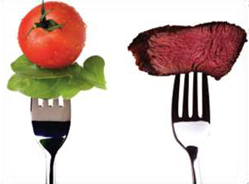
Vegetarianism
The most widespread alternative way of eating in Czechia (about 2 % of the population - 200,000 people)
Vegetarian - generally not consuming meat
Types depending on restricted consumption of food of animal origin
  semivegetarians (pulo-, pesco-) or flexitarians
  lactoovovegetarians
  lactovegetarians
  vegans
  fruitarians
  vitarians - RAW fod

Slide 6
Vegetarianism
Origin in the Eastern religions of Buddhism and Hinduism
The term dates back to the 19th century
The Vegetarian societies:
  The Vegetarian Society (1847 England)
  IVU - International Vegetarian Union (1908 Dresden)
  EVU - European Vegetarian Union
  Czech Society for Nutrition and Vegetarianism
  Czech Vegetarian Society
Lifestyle - temperance, non-smoking, alcohol avoidance, regular physical activity
Vegetarian pyramid, rainbow

Slide 7



Logos of vegetarian assotiations
Czech Society for Nutrition and Vegetarianism
(Česká společnost pro výživu a vegetariánství)
International Vegetarian Union
European Vegetarian Union
Notes:
Loga graficky upravit- aby nebyly rozmazane

Slide 8
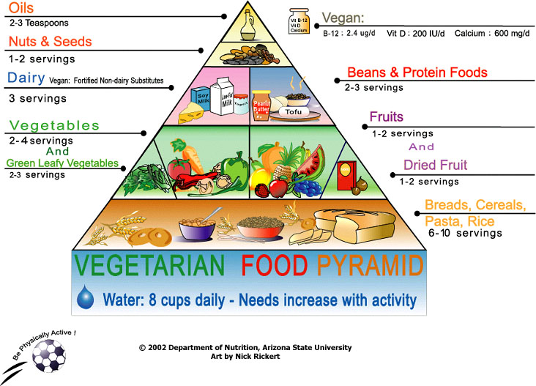

Slide 9
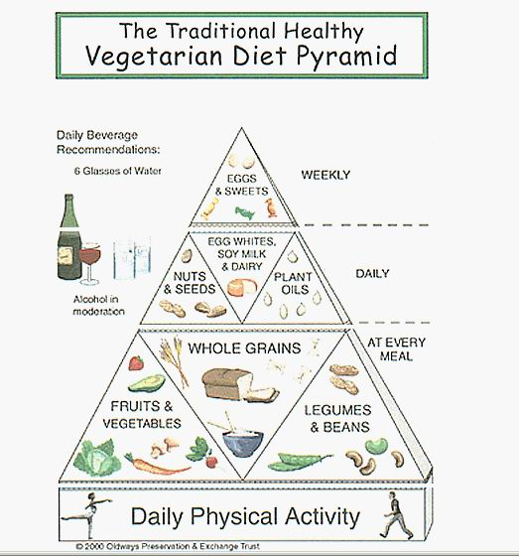

Slide 10
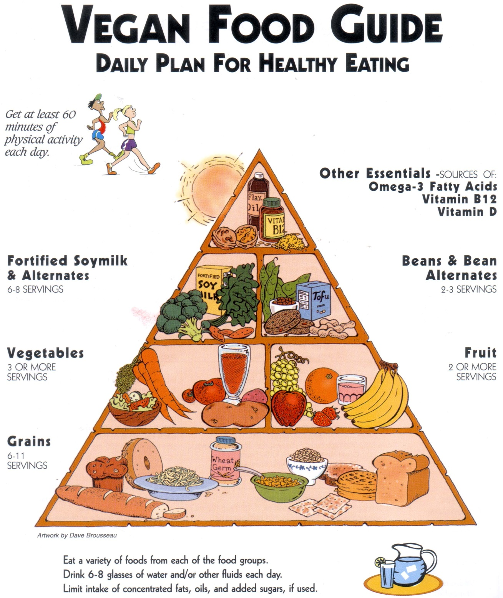

Slide 11
Expert opinion on vegetarianism
Opinion of the Academy of Nutrition and Dietetics from 2016
A properly planned vegetarian diet is:
  Healthy, nutritionally balanced and has some health benefits in prevention and treatment of certain diseases
  Appropriate for all stages of the life cycle
    childhood including infancy
    adolescence
    pregnancy and lactation
    old age (elderly)
  Plant-based diets are more environmentally sustainable than diets rich in animal products because they use fewer natural resources and are associated with much less environmental damage.
The Journal of the academy of nutrition and dietetics, Dec 2016, Vol 116, No. 12, pg. 1970-1980, http://jandonline.org/article/S2212-2672(16)31192-3/pdf

Slide 12

The benefits of vegetarianism
More frequent consumption of fruits, vegetables, cereals, sprouts, legumes, nuts, seeds, vegetable oils
Lower intake of saturated fat, cholesterol, animal proteins
Lower energy intake
Lifestyle
Diet based on food of plant origin predominant consumption may reduce the risk of developing certain diseases
It should be stressed out, that the risk of the disease affected by dietary intake is generally low if the person has a balanced diet, regardless of whether meat is consumed or not.
Notes:
Diet based on predominant food consumption of plant origin may reduce the risk of developing certain diseases

Slide 13
The risks of vegetarianism
Incorrect food composition (poor awareness)
Some nutritients may be missing or in reduced quanity in a plant based diet.
There are certain substances in diet from plants which may reduce absorption of certain vitamins and minerals.
Others
Inadequate intake of certain nutrients and the risks involved
Notes:
Dotaz na rizika a na špatně postavení jídelníčku

Slide 14
Rules for balanced diet
Keep the variety and balance in the diet
Food groups that should not be missing in your diet:
  cereals and pseudocereals
  vegetables and fruits
  legumes and products thereof
  milk, dairy products
  eggs
  nuts, seeds
  vegetable oils
  seaweed

Slide 15
Rules for balanced diet
A balanced meal should consist of various sources of proteins during different meals of the day.
  cereals with legumes (bean stew with bread, leguminous soup with cereal, cholent, etc.)
  legumes with potatoes
  plant protein sources with animal (cereal with dairy products - milk cereal slurry, etc.)
Do not replace meat dishes with sweet and fried dishes.

Slide 16
Example of daily meal plan
B: oatmeal with nuts and grapes
S: bread with radish spread
L: chickpeas cream soup, lasagna with spinach and mozzarella
S: Banana cocktail
D: baked cauliflower with eggs, potatoes, tomato salad

Slide 17
Examples of daily meal plan
B: bread with egg spread, paprika
S: apple
L: vegetable soup with yeast dumplings, Mexican beans in tortilla with yoghurt dressing
S: Pudding with fruit
D: buckwheat risotto with vegetables, cheese

Slide 18
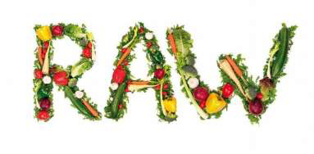
Raw food diet
Vitarianism, consumption of raw food
In Czechia, It’s on the rise
Eating food without heat treatment, in the most natural form
Heat treatment of food at max. 42-45 ° C (107.6- 113 ° F )
According to the supporters, there is no reduction in the nutritional value of the diet, destruction of enzymes, vitamins, etc.

Slide 19
Raw food diet
The main ingredients of the diet are raw fruits and vegetables, raw nuts and seeds, legumes, various cereals, sprouts, seaweeds and it is predominantly supported by vegans.
There are also subgroups of raw food diet that allow consumption of raw meat, eggs, unpasteurized milk.
Types of food processing - dipping, mixing, drying, juicing

Slide 20
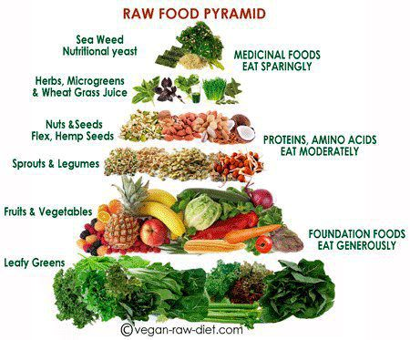

Slide 21
Example of meals
Banana oatmeal with walnuts
Miso soup with mushrooms
Cucumber soup with basil
Butter pumpkin noodles with sage sauce
Vegetable rolls
Guacamole with curry and vegetables
Chia pudink
Juices, cocktails, smoothie

Slide 22
The benefits and risks of raw food diet
+ There is no reduction in nutritional value by heat treatment
+ Lower intake of fat, sodium, cholesterol
+ Higher intake of fiber (sometimes too much), potassium and other substances
- Lack of some essential nutritional substances, energy (except for raw desserts)
  there is a risk of deficiency in long-term aspect: B12, protein, iron, calcium, omega-3 use of dietary supplements
- Poor digestibility of raw food
- Lower absorption
- Microbial risk

Slide 23
Dietary Conclusion
For diversifying our diet
However it can’t be recommended for long-term way of lifestyle

Slide 24
Macrobiotics
A widespread lifestyle that is closely related to nutrition
“The art of long life“
Origins in Zen Buddhism, Taoism elements
Effort to return to a natural way of life
Founder George Ohsawa (1893-1966, Japan, Concept of Macrobiotic Learning)
Macrobiotic teachings were further developed by Ohsaw's pupils

Slide 25
Macrobiotic diet
According to macrobiotics, food differs from the content of YIN and YANG
The yin / yang ratio is the "value" of each food
Harmonic food - yin and yang in balance
The most energy-balanced – cereals
Ohsawa divided nutrition into ten degrees (-3 to +7)

Slide 26
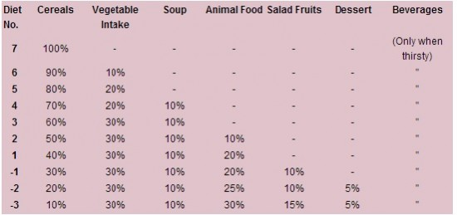

Slide 27
Macrobiotic diet
The basic rule of macrobiotic nutrition is to consume the food slowly, to chew it very well.
The theory of so-called biological transmutation
Emphasis is also put on:
  Natural food from local sources or at least from the same climatic zone that corresponds to the season
  Avoid eating meat, milk, dairy products, tropical fruit, refined sugar, eggs, potatoes, white flour,
  Rejection of consumption of preserved, chemically treated, artificially colored, frozen or irradiated food,
  Denial of drug use, alcohol and drug consumption,
  Modesty, moderation, positive attitude

Slide 28
Macrobiotic diet by Michio Kushi
It is mainly based on cereals, vegetables, legumes, fermented foods
The smaller ratio is represented by seaweed, seeds, nuts, temperate berries and fish
Macrobiotic plate
Important Policy:
  Eat only in case of hunger
  Thoroughly chew (50 times or more one bite)
  Eat seated, calmed and relaxed
  Eat regularly 2-3 times a day, as much as needed, leaving satisfied, but not full
Drink liquids sparingly, only when thirsty
Last meal of the day should be at least 3 hours before sleeping

Slide 29
Macrobiotic diet by Michio Kushi
50-60% Wholegrain cereals and products of wholegrain flour
  Daily - brown rice, barley, millet, wheat, oats, rye, corn, buckwheat
  Occasionally wholegrain pasta, wholegrain sliced bread, wholegrain rye bread, bulgur, couscous, polenta
25-30% vegetables - in each meal
2/3 Cooked, fried on a small amount of vegetable oil, 1/3 raw salads, pickles (fermented)
  Daily - cabbage, Chinese cabbage, leek, broccoli, cauliflower, carrots, onions, pumpkins, radishes, kohlrabi, cress, parsley, dandelion ...
  2-3 times a week - cucumbers, celery, mushrooms, herbs
  Not suitable - potatoes, spinach, red beet, peppers, tomatoes
5-10% Legume (not more than once a day), seaweed
5-10% (1-2 cups a day) soup

Slide 30
Macrobiotic diet by Michio Kushi
Occasionally:
  2-3 times per week: fish, fresh or dried seasonal fruit
  1-2 cups per week: seeds (sesame, pumpkin, sunflower) and nuts (almonds, walnuts, pecans, chestnuts, peanuts, coconut);
  sweetening - rice syrup, barley malt;
  oil, preferably unrefined, corn or sesame
Types of drinks: clean water, some types of tea
Avoid:
  meat, animal fat, eggs, milk and dairy products,
  refined sugar, honey, molasses, chocolate, simple sugars and sweetened foods, tropical fruits,
  artificial drinks, aromatic and stimulating teas,
  technology processed grains, white flour and products of them
  hot spices, aromatic stimulating foods, artificial vinegar, hard alcohol
  all artificially colored, preserved, chemically treated, frozen, irradiated foods.

Slide 31
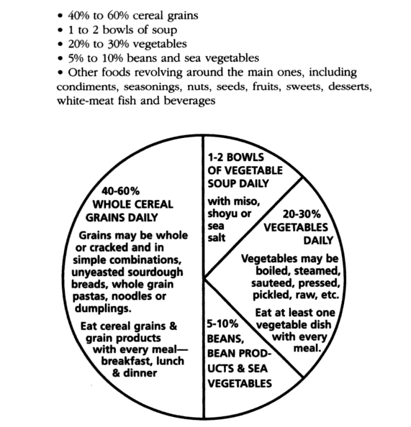
Macrobiotic plate

Slide 32
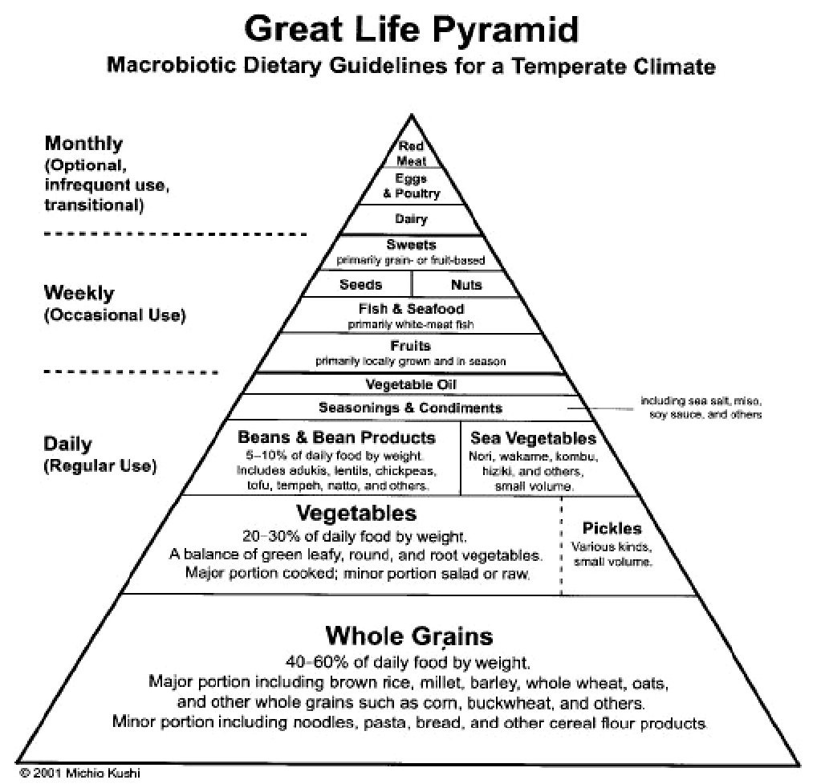

Slide 33
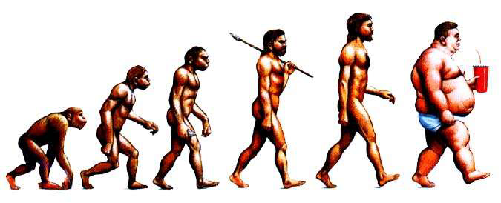
Paleo Diet
Attempt to get closer to the diet from the Paleolithic period (Stone Age), choosing the resources from the current food
Basis
  Lean meat, fish, seafood
  Eggs
  Fruit, berries
  Vegetables, especially root crops
  Nuts
Restricted
  Cereals
  Legumes
  Potatoes
  Refined oils
  Sugar, salt
  Milk and dairy products
Notes:
There is no typical and original paleo diet.
Geograficke podminky

Slide 34
  Diet based on pH
Principle - keeping the balance between acids and bases in the human body
Acidification - the basis for the occurrence of disorders and illnesses
Alkali versus acidifying foods
Foods that increase pH and cause alkalinity (from the most effective to less):
  baking soda,
  raisins, dried figs, cucumbers, spinach, ginger, celery, broccoli, cabbage, parsley,
  carrots, dandelions, vegetable bowl, kohlrabi, black currant, lemon,
  pure lecithin, mushrooms, cauliflower, melon, mango,
  beet, radish, garlic,
  lettuce, black molasses, olives, apple vinegar, tomatoes,
  soya beans, oranges, onions, green beans (pods),
  bananas, pears, apples, raspberries, apricots, cherries, other fruits, hazelnuts,
  potatoes, green and herbal tea, kefir

Slide 35
Diet based on pH
Foods that reduce pH and cause acidity (in the order of those most acidifying to less):
  pork, veal, dark rice, rabbit, sea crayfish, beef, oysters, sausages, soft drinks
  fish, other meat, eggs, liqueurs, chocolate, hard and stuffed cheese, turkey, chicken,
  oats, black tea, sparkling beverages,
  bread, margarine, walnuts, walnuts and cashews, other cereals, pasta, white rice
  drinking water at or below the lower limit of the standard (6.5-9.5 pH)
  curd and fresh soft cheese, coconut, almonds, butter and cream,
  whey, cow & goat milk, beans, lentils, wine, coffee, beer

Slide 36
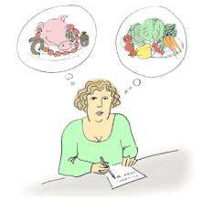
Divided food diet
Founder William Howard Hay - a physician from New York
Main principle - separate consumption of protein-rich foods and carbohydrate-rich foods
Neutral foods - fats, sour milk products, fresh cheeses, curd, some vegetables, herbs, nuts and seeds
Later attached policies
  Do not combine protein with fruit
  Fruits do not combine with vegetables
  Keep drinking (2-3 liters daily)
  Eat at rest
  Consume three meals a day with a break of 3-4 hours
Notes:
Je na odstupu.

Slide 37
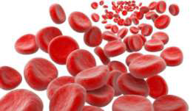
Diet by blood group (Adamo’s Diet)
Book Nutrition and Blood Groups by Peter J.D. Adam
Individual diets by type of blood group
The list of foods for each blood group
3 food categories:
  Very beneficial
  Neutral
  Forbidden
The reason for this diet is, according to the author, the presence of lectins in food and the human body's immune response to these substances that is affected by the blood group.

Slide 38
Diet by Ayurveda
Ayurveda is a traditional Indian medicine for over 5,000 years
The aim is to achieve a balance between the body, soul, senses of man and the environment
The main principle is the ratio of the 3 basic types of energy Vata, Pitta and Kapha - different for each person
  Body constitution type
  The activity of the human organism
  Choosing the right food for each type
Other recommendations
  Prefer the plant diet as fresh as possible
  Avoiding foods containing preservatives and other additives
  Adaptation of diet to the season, climate, region
  Do not eat between meals, breaks for 3-5 hours for perfect digestion

Slide 39
Detox Diets
One of Fad diet
Claim to facilitate toxin elimination and weight loss promoting health and well-being
Recommended consumption of “alkaline foods”
  such as: vegetables, fruits, nuts, seeds and herbs
Forbidden consumption of acidifying foods
  such as: meat, fish, dairy products, bakery products (products made from white flour) and refined sugar
Lobby of pharmaceutical firms, pharmacies, apprentices of alternative medicine
Notes:
Fad diet- Atkin’s diet,…

Slide 40
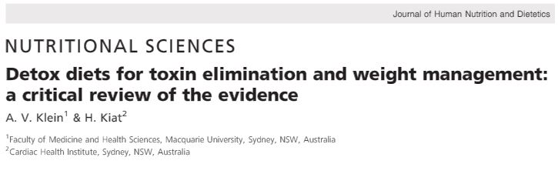
Detox Diets
Some clinical studies have shown that commercial detox diets enhance liver detoxification, BUT they have flawed methodologies and small sample sizes!
NO randomised controlled trials have been conducted to assess the effectiveness of commercial detox diets in humans!!!
http://onlinelibrary.wiley.com/doi/10.1111/jhn.12286/epdf viewed 26.1.2018

Slide 41
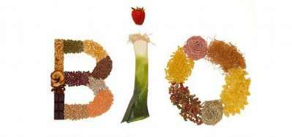
Organic food
Sometimes it’s also classified under alternative nutrition
Consumption of foods, that have been produced by methods that don’t use pesticides, herbicides, fertilisers and which haven’t been industrially processed
Transformed into a lifestyle
More friendly approach to nature and animals

Slide 42
Nutritional and health aspects

Slide 43
Nutritional and health aspects
It’s depending on the degree of restriction of food of animal origin and on the composition of consumed food
Risks of alternative nutrition
  Poor awareness
  Improper diet composition
  Some nutritients may be missing or in reduced quanity in a plant based diet.
  The presence of inhibitors of the absorption of certain nutrients
  Others
Benefits of alternative nutrition
  Higher consumption of fruit, vegetables, cereals, sprouts, legumes, nuts, seeds, vegetable oils
  Lower intake of saturated fat, cholesterol, animal protein
  Lower energy density
  Lifestyle

Slide 44
General assessment
The vast majority of epidemiological studies revolves around vegetarianism and its subgroups.
Vegetarians partially consuming food of animal origin
  With the right combination of foods, nutritional deficiency problems usually do not occur
  Potential risks most often result from bad diet plan
Vegans
  Compliance with many rules
  Your diet must be enriched with the missing ingredients in the form of dietary supplements or fortified foods - vitamins B12, B2, D, Ca, I
Vitarians
  Certain positive aspects
  Negative - higher content of natural toxic and antinutritive substances, hygienic quality, digestibility
  Not enough of all essential nutrients can be provided to the extent necessary
Fructarians
  Completely inappropriate diet

Slide 45
General assessment
Macrobiotics
  Lower levels can meet the nutritional needs of adult
  Higher restrictive levels - inadequate from both nutritional and energy generation point of view
  Lack of valuable proteins, Ca, Fe, PUFA, vitamins A, C, D and B12
Divided food diet
  While adhering to its diversity and regularity, it can provide sufficient nutrients
  The principles of separate consumption of carbohydrate and protein foods are unjustified and scientifically unsubstantiated
Diet by blood group
  The theoretical assumptions of this diet are not serious
  By strict adherence to recommended guidelines, some blood groups may have a deficiency in vital nutrients
Ayurveda
  Recommendation of vegetarian diet
  Restriction of food choices restriction of diversity

Slide 46
Selected dietary components that are at risk
Proteins
Unsaturated fatty acids
Iron
Calcium
Zinc
Iodine
Vitamin B12
Vitamin D
Carnitine
Toxic metals – cadmium
Advanced protein glycation end products (AGEs)
Others - mycotoxins, nitrates

Slide 47
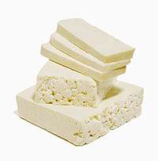
Proteins
Lower biological value of plant proteins
Lack of essential AAs (methionine and lysine)
Reduced total percentage of essential AAs
Worse digestibility
To receive all essential AAs, it is necessary to consume multiple sources of vegetable protein during the day
The quality of plant proteins is increased when combined with one another, or combined with milk, dairy products or eggs
It is best to combine legumes with cereals and potatoes

Slide 48
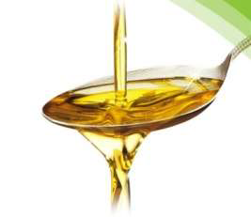
PUFA
Vegetarian, especially vegan diet is characterized by
  Low intake of unsaturated long chain fatty acids - EPA, DHA, AA
  High intakes of linoleic acid
Vegetarians and vegans are reliant on the formation of EPA and DHA from alpha-linolenic acid
  However, this conversion is not very effective: <5-10% EPA and 2-5% DHA
  The conversion also inhibits high levels of PUFA ω-6 in the diet (up to 40%), lack of energy, protein, deficiency of pyridoxine, biotin, calcium, copper, magnesium and zinc, and excessive ingestion of transunsaturated fatty acids
  Iron deficiency also has a negative effect
Increase intake of α-linolenic acid by incorporating sources with a low ω-6: ω-3 ratio such as crushed linseed, linseed oil (flaxseed), rapeseed oil, soybean oil and walnuts
Notes:
Zeptat What are EPA,DHA,

Slide 49
Iron Fe
In plants present in non-haem form, absorption is about 3-5%, mostly depends on the overall composition of the diet
Absorption is negatively affected by
  absorption inhibitors - phytic acid, polyphenols, oxalic acid (?), Fiber
  simultaneous high intake of calcium, zinc, magnesium and potassium
  plant proteins in soybean and nuts
Absorption is improved by
  Vitamin C and organic acids in fruits and vegetables
  presence of AAs
  Soaking and germination of seeds, fermentation processes
The adaptation to low iron intake through increased absorption
Adult vegetarians have lower iron stores compared to consumers of meat, serum ferritin values are usually normal
Iron deficiency affects the metabolism of PUFA ω-3 with long-chain by influencing the activity of δ-6-desaturase.

Slide 50
Calcium Ca
In foods of plant origin, availability is reduced
  The presence of phytates, oxalic acid and larger content of fiber
Properly planned vegetarian diet can provide sufficient calcium intake, although in the case of vegans it is sometimes easier to use fortified foods or supplements.
Zinc Zn
Absorption is adversely affected by absorption inhibitors, as is the case with iron - phytic acid
Soya, soy products, other legumes, grains, nuts, cheeses
When comparing cereals and legumes, legumes are a better source of zinc
Absorption is increased by seed soaking and germination, fermentation processes (disruption of zinc and phytic acid bonding), presence of organic acids

Slide 51
Iodine I
The content of iodine in food of plant origin in Czechia is low, because of its low concentration in soil
Vegetarians (↑ vegans) are at increased risk of iodine deficiency
Increased risk of mental, psychomotor and growth abnormalities
Most sensitive to iodine deficiency are newborns, infants, adolescent girls, pregnant and lactating women
The risk of deficiency is increased by the so-called goitrogens, which are found in cruciferous vegetables, soybeans and sweet potatoes
Consumption of seaweed, mineral water containing iodine, use of iodinated table salt

Slide 52
Vitamin B12
Plant sources of foods do not contain vitamin B12, unless they are contaminated with microorganisms that produce this vitamin
The main food sources - meat, fish, eggs, dairy products, yeast, fortified foods (some soy drink substitutes, breakfast cereals)
Soy products like miso, tempeh, tamari, shoy and some algae products contain only corinoids, vitamin B12 analogues, which do not normally have physiological effects comparable to those of vitamin B12
Vitamin B12 deficiency in adults is most likely to occur after a long-term limitation of consumption of food of animal origin rich endogenous stock up to 3 mg, unlike newborn infants only about 25 μg
Deficit - megaloblastic anemia, metabolic and neurological disorders
Negative effects on brain development in children
Risk of the accumulation of homocysteine

Slide 53

Vitamin D
Vitamin D3 - cholecalciferol → in foods of animal origin
Vitamin D2 - ergocalciferol – in foods of plant origin, according to some studies absorption is less effective (?)
Absorption is negatively affected by high phytate content in the diet
Fortification of food, supplements
Most at risk are individuals consuming only foods of plant origin, refusing the intake of supplements and fortified foods, particularly in the winter months
Children and the elderly are more prone to risks where the synthesis of vitamin D is less effective
Infants fed according to macrobiotic believes- a higher prevalence of rickets
Notes:
Phytate?

Slide 54
Carnitine
Essential for the metabolism of long-chain fatty acid
The amount of carnitine in the blood is partly dependent on food intake, about one-third of daily needs are due to endogenous synthesis.
High carnitine content is found in meat, lower in dairy products, foods of plant origin contain very little or no carnitine.
Individuals limiting the consumption of meat or all food of animal origin may be at risk of carnitine deficiency
  in terms of its insufficient amount of food
  possible reduction of endogenous carnitine because of low income essential AAs methionine and lysine, and the possible occurrence of iron deficiency

Slide 55
Cadmium Cd
Toxic metal ( kidney, liver) with a long biological half-life
Accumulation in plants
Higher content in cereals (grains, germ), seeds, legumes and leafy vegetables
Increased levels of cadmium in vegetarians, especially vegans, correlation with length of practice
Toxic effect - the presence of selenium, a high saturation of the organism with iron, calcium, zinc
The role in detoxification - Glutathione

Slide 56
Advanced protein glycation end products AGEs
The non-enzymatic reaction of reducing sugars with a free amino group.
Formed during heat treatment of food
Negatively affect the functional properties of proteins, lipids, DNA
They play an important role in the process of atherosclerosis, complications of diabetes, aging and chronic renal insufficiency.
For vegetarians measured higher values - cause higher intake of foods with a predominance of fructose compared to glucose which is more reactive due to a higher proportion of acyclic forms.
AGEs may pose a certain risk, but the protective effect of eating enough fruit and vegetables is dominant from a nutritional point of view.

Slide 57
Health aspects
Nutrition along with health style play an important role in protecting health and preventing chronic degenerative diseases and metabolic disorders.
Mortality - for vegetarians, lower mortality rates from ICHS
Cardiovascular disease
Blood pressure values 5-10 mmHg, occurrence of hypertension
Weight, BMI 1-2kg / m2 lower
Lower total cholesterol, LDL and TAG, TNMK, higher HDL
Type 2 diabetes mellitus
Cancer - colorectal, prostate and breast cancer (?)
Other disease - prevention of constipation, diverticulosis, developing gallstones

Slide 58
Risk population groups
Children
Adolescents
Pregnant and lactating women
Athletes
Seniors
Notes:
Dotaz: Which population group can be in risk?

Slide 59
Thank you for attention

