Slide 1

CHILDHOOD HYGIENE breastfeeding support • infant and toddler nutrition • growth charts • social pediatrics
Mgr. Martin Krobot
Mgr. Kamila Jančeková
Mgr. Sylva Šmídová
Department of Public Health
Public Health II – spring 2018

Slide 2

Breastfeeding support

Slide 3


Slide 4
Not only milk drinking!
exclusive breastfeeding:
  childhood and adolescence obesity prevention
  decrease in infant mortality
  lower incidence – atopic dermatitis, otitis media, URT infection, GIT infection
mothers – lower risk of postpartum depression, mammal and ovarial tu, T2DM, osteoporosis, rheumatoid arthritis
contraceptional effect
relationship between child and mother
Breastfeeding support

Slide 5
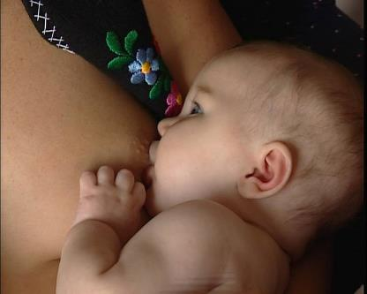
Stimuli for child‘s brain
Mutual look
The child listens
to mother‘s voice
The child smells the mother
The child moves with
its mother
The child tastes the milk
The child feels mother‘s touch on its back
The child touches mother‘s skin
Mother provides warmth
Skin-to-skin contact
Author: Nils Bergman
Breastfeeding support

Slide 6
Breast milk composition
specific for animal species
appropriate with lifestyle, genetics and individual needs
  milk of bats low in water, milk of sea mammals higher in fat, milk of primates higher in carbohydrates
composition variable in time due to change in needs
transfer of information about child‘s needs during BF
standard sample of BM doesn‘t exist due to variability
Breastfeeding support

Slide 7
Breast milk composition
colostrum
  yellowish liquid
   protein (Ig),  minerals (Mg – peristalsis)
   carbohydrates, fats
transient milk
mature milk
composition isn‘t constant – according to child‘s needs
Breastfeeding support

Slide 8
Breast milk composition
energy: 280–290 kJ/100 ml
  P : F : CH = 7–10 : 50 : 40
protein: 0,9–1,3 g/100 ml
  whey/casein ratio – digestibility
fats: 4 g/100 ml
  lipase – easier digestion, rich in PUFA (DHA), cholesterole
carbohydrates: 7 g/100 ml
  Lac (absorption of Ca, Fe), Fru, Gal (galactolipids for CNS development)
  oligosaccharides – microbiota support
Breastfeeding support

Slide 9
Breast milk composition
minerals
  less then in cow‘s milk (kidneys), suitable proportion
  Ca:P = 2:1
  Fe absorbable up to 70 %, Zn, Cu, Co, Se well absorbed
  low content of Fe and Zn – antenatal stores
protective factors
  Ig, lactoferrin, lysozyme, macrophages, complement, interferons aj.
harmful substances
  weight reduction during BF – lipophilic xenobiotics (PCB etc.)
  medicaments, alcohol, drug etc.
Breastfeeding support

Slide 10
Proteins in breast milk
67 % Whey
Breast milk Cow‘s milk
67 % Whey 8 %
8 % Casein 90 %
25 % np-N 2 %
8 %
90 % Casein
8 %
25 %
np-N
2 %
Breastfeeding support

Slide 11
Fats in breast milk
mature milk – small droplets
milk contains lipase – better digestion
SFA : UFA = 42–48 : 52–57
rich in PUFA (linolic acid, linolenic acid, arachidonic acid,
DHA – CNS and retina growth and development)
cholesterole (5x the amount in cow‘s milk, cell membrane development)
Breastfeeding support

Slide 12
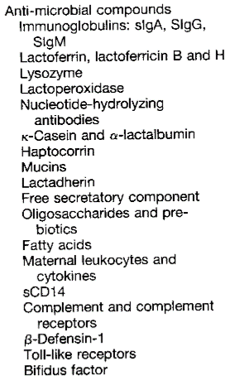
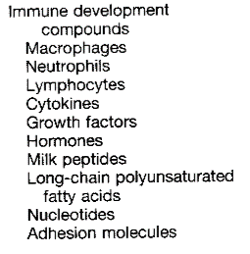
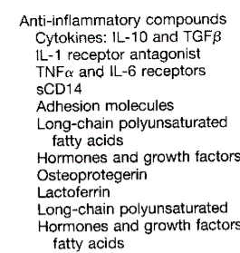

Imunologically active compounds
Breastfeeding support

Slide 13
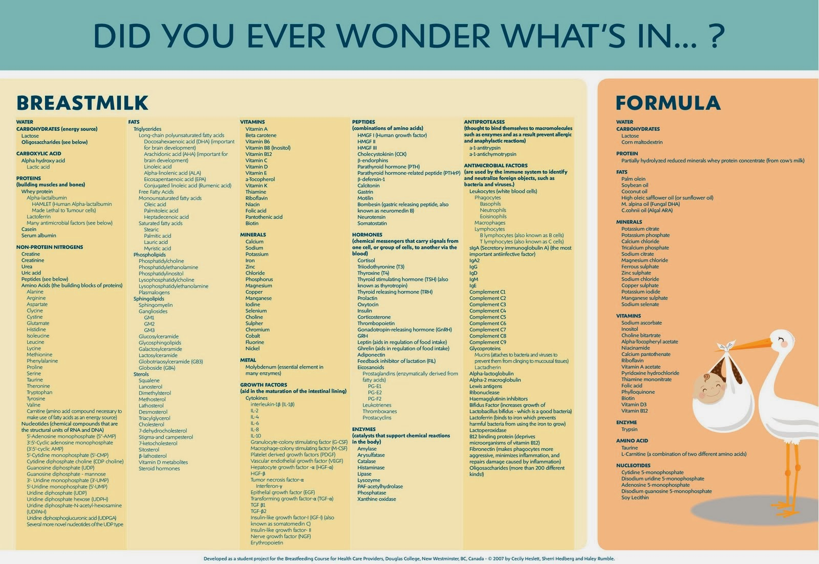
DHA
cholesterole
substances supporting
microbiota

Slide 14
WHO recommendation
up to term. 6th month of age
exclusive breastfeeding
up to 2 years of age and beyond
introducing local nutritious food
while breastfeeding
Breastfeeding support

Slide 16

Other recommendations
European Code Against Cancer (2014)
  Breastfeeding lowers the risk of cancer in
  mothers. Breastfeed your child, if possible.
WHO
  Breastfeeding is the most effective way for
  child health protection and support.
opinion of alergologists*
  The most effective prevention of food allergies
  is exclusive breastfeeding for 4–6 months.
*Pracovní skupina dětské gastroenterologie a výživy. Doporučení pracovní skupiny gastroenterologie a výživy ČPS
pro výživu kojenců a batolat. Česko-slovenská pediatrie. 2014, roč. 69, č. S1, s. 12-13. ISSN 0069-2328.
Breastfeeding support

Slide 17
Risks rise when not breastfeeding
mother
  postpartum depression
  T2 diabetes mellitus
  mammal and ovarial tu
child
  otitis media
  gastroenteritis
  atopic dermatitis
  severe infection of LRT
  necrotic enterocolitis
  SIDS
  obesity
  T1 and T2 diabetes mellitus
  asthma
  leukaemia
Source: International Code of Marketing of Breast-Milk Substitutes
Breastfeeding support

Slide 18

higher expenses for healthcare
negative environmental impact
Source: International Code of Marketing of Breast-Milk Substitutes

Slide 19
Official breastfeeding support
WHO, UNICEF:
1981 – International Code of Marketing of BM Substitutes
1991 – Baby-friendly Hospital Initiative
1991 – Ten Steps to Successful Breastfeeding (WHO, UNICEF)
CZ:
2007 – Standard practical instructions for BF in CZ (upgr. 2015)
Breastfeeding support

Slide 20
International Code of Marketing of BM Substitutes
„(…) first choice, closest to natural breastfeeding.“
„(...) if you decide to feed from the bottle, you will have two main advantages against breastfeeding mothers. First, you don‘t have to feed the child alone (…) second, you will know how much milk has your child drunk.“
„(…) bottle for breastfed children. Preserves natural way of suckling as in breastfeeding (…) facilitates switching from the breast to the bottle and back (…)“
Breastfeeding support

Slide 21
Situation before the Code
children were always BF – those who weren‘t didn‘t survive for long
if the mother couldn‘t breastfeed, she hired a wet nurse
for children, who couldn‘t be breastfed, the substitute was other mammal‘s milk
1867 – Henri Nestlé – „Farine Lactée“ – artificial nutrition for children who couldn‘t be breastfed (expansion until 1970s)
in developed countries breastfeeding started to rise thanks to support
artificial nutrition producers – developing countries, aggressive marketing (presents for healthcare workers, promotion aimed to mothers, samples)
Breastfeeding support

Slide 22
International Code of Marketing of BM Substitutes
1979 – congress of WHO, UNICEF, government delegates and producers of BM substitutes – approved 1981
recommended to incorporate into legislation
aim – to contribute to adequate and safe infant nutrition through support and protection of BF against inappropriate marketing of BM substitutes, bottles and pacifiers
in CZ it‘s not a part of legislation (not obligatory)
Breastfeeding support

Slide 23
Arrangements of the Code
No public promotion of these products
No free samples for mothers
No promotion in healthcare facilities
No consultants employed by the producers consulting mothers
No presents or free samples for healthcare providers
No text or images idealizing artificial nutrition, including images of children on the packaging
Breastfeeding support

Slide 24
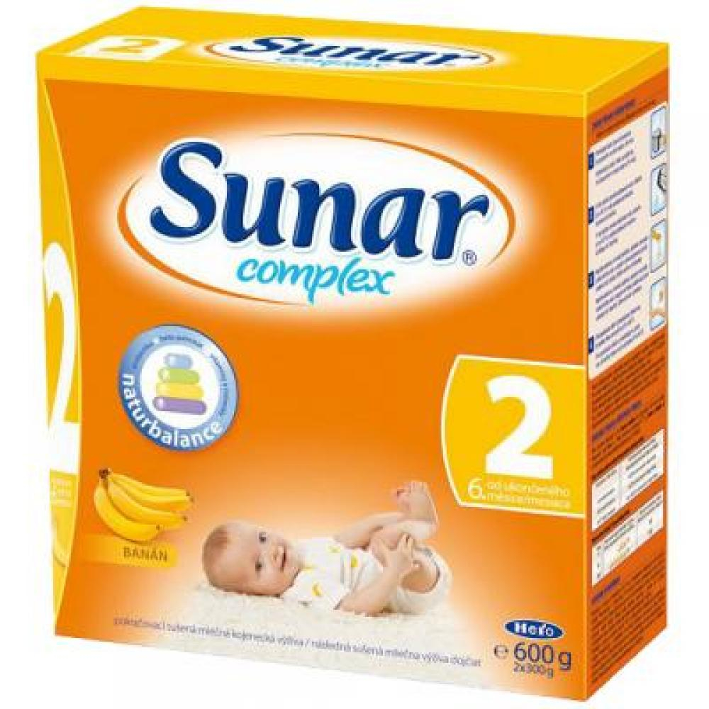

Slide 25
Arrangements of the Code
Information for healthcare providers should be evidence-based and true
All information about infant formula including labels, should point to the benefits of breastfeeding, the cost of infant formula and its risks
Inappropriate products, eg. sweetened condensed milk, should not be promoted as appropriate for children
All products should be in high quality and take into account climatic and storage conditions of the country
Breastfeeding support

Slide 26
Remember:
Breast milk substitutes
should always be used as the
last alternative!
Optimally in indicated cases only.
Breastfeeding support

Slide 27
Baby-friendly Hospital Initiative (BFHI)
initiative of WHO and UNICEF (1991)
worldwide effort to protect, support
and promote breastfeeding
in CZ 65 out of 96 maternity hospitals
recertification every 5 years
facility has to meet the criteria:
  „10 steps to successful breastfeeding“
! rev. 2017 !
Seznam BFHI nemocnic v ČR: http://www.kojeni.cz/maminkam/bfh/seznam-bfh-nemocnic/
Breastfeeding support

Slide 28
The developement of the percentage of exclusively breastfed newborns after maternity hospital discharge (BFH and other maternity hospitals),
Czech Republic

Slide 29
The developement of the percentage of exclusively breastfed newborns and breastfed with formula supplementation after discharge by the type of hospital (BFH and other maternity hospitals), Czech Republic

Slide 30
Breastfeeding until 6 months
Long-term breastfeeding in CZ 2013 (in %)
6 weeks | 80,3
3 months | 63,7
6 months | 38,6
Exclusive breastfeeding
6 weeks | 27,5
3 months | 15,3
6 months | Not observed
Breastfeeding support

Slide 31
10 steps to successful breastfeeding
?
Breastfeeding support

Slide 32


Slide 33


Slide 34
10 steps to successful BF – 2017
key clinical practices
  Where facilities provide antenatal care, pregnant women and their families should be counselled about the benefits and management of breastfeeding.
  Early and uninterrupted skin-to-skin contact between mothers and infants should be facilitated and encouraged as soon as possible after birth, and all mothers should be supported to initiate breastfeeding as soon as possible after birth, within the first hour after delivery.
  Mothers should receive practical support to enable them to initiate and maintain breastfeeding and manage common breastfeeding difficulties.
  Mothers should be discouraged from giving any food or fluids other than breast milk, unless medically indicated.
  Facilities providing maternity and newborn services should enable mothers and their infants to remain together and to practise rooming-in throughout the day and night.
  As part of protecting, promoting and supporting breastfeeding, discharge from facilities providing maternity and newborn services should be planned for and coordinated, so that parents and their infants receive the appropriate care and have access to supportive resources.
Breastfeeding support

Slide 35
10 steps to successful BF – 2017
critical management procedures
  Facilities providing maternity and newborn services should have a clearly written breastfeeding policy that is routinely communicated to staff and parents.
  Facilities providing maternity and newborn services should fully comply with the International Code of Marketing of Breast-milk Substitutes and relevant World Health Assembly resolutions.
  Health-facility staff who provide infant feeding services, including breastfeeding, should have sufficient knowledge, competence and skills to support women to breastfeed.
  Facilities providing maternity and newborn services should establish ongoing monitoring and data-management systems to monitor compliance with the clinical practices above.
Breastfeeding support

Slide 36
Skin-to-skin
immediately after the birth skin-to-skin contact of the child and its mother for at least one hour
for all mothers after vaginal labour or section without anaesthesia (except medicaly argued cases)
give enough time to the mother and child
support mothers to learn the signals of their child showing to be ready to be breastfed and offer help to mothers in case of need.
not force the child to the breast but help when the child is ready
Breastfeeding support

Slide 37

Skin-to-skin
relationship between mother and child
  it‘s not the result of nursing – its an instinctive system of the behaviour, expected by the child
it needs:
  a closenes of the mother
  carying by the mother
  breastfeeding
  expected mother‘s reaction to baby‘s crying
Breastfeeding support

Slide 38
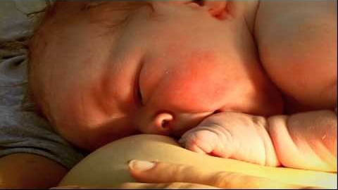

Slide 39
You could see…
the newborn can start sucking optimally on its own, if it has enough time (in the 55th minute on average)
the newborn is situated on the mother‘s belly only wiped dry
the hands aren‘t dried and no cap is given to the child
most of the newborn examinations can be carried out on the mother‘s body
skin-to-skin contact is ideal for managing normal body temperature, it controls breathing and heart rate, the child is calm and usually doesn‘t cry
uniterrupted contact between the mother and the child, rooming-in, begins right at the delivery room
Breastfeeding support

Slide 40
You could see…
mothers after the section or total anesthesia can be skin-to-skin immediately after waking up
meanwhile, the child can be skin-to-skin e.g. with the father
children in need of special care should also have the possibility of skin-to-skin contact (otherwise the medical reason should be explained)
mother‘s body is better than an incubator
children after strenuous deliveries need more time (if the sucking couldn‘t start right after delivery, it can be compensated when possible)
Breastfeeding support

Slide 41
Support of the mothers
pay attention to the mothers, who faced breastfeeding problems in the past
teach the mothers:
  breastfeeding positions
  how to latch on the child (describe it, demonstrate it)
  how to express the milk
help with the breastfeeding during first 6 hours after the labour (position, latching on, drinking...)
it‘s necessary to breastfeed or express the milk at least 8 times within 24 hours for good milk production
Breastfeeding support

Slide 42
Support of the mothers
teach the mothers how to identify their child is showing its will to be breastfed
the mothers should know at least 2 signals (turning head, opening mouths, the effort to suck the hand od finger etc. , sucking movements, dissatisfaction, the face pointing to crying...
advise mothers to breastfeed as often and as long as the child wishes
Breastfeeding support

Slide 43
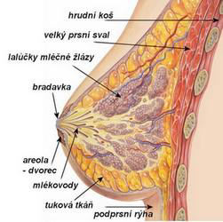
Lactation physiology
The essential unit of glandular tissue is lobulus – racemous structure comprising of secretory cells (alveoli) and milk ducts.
Alveols create milk from the nutrients coming through mother‘s blood. One breast contains cca 7–10 lobuli.
Secretory cells are surrounded by myoepithelial cells. These cells, with their ability to contract, enable the milk to move from the alveolus to branched outlet system towards the nipple, where the nipple can suck it. Myoepithelial cells are present also in the walls of the ducts.
Breastfeeding support

Slide 44
Lactation physiology
Hypophysis stimulation
Stimulation of nerves in
the nipple and areola by effective suckling
Posterior pituitary
oxytocin
Anterior pituitary
prolactin
Myoepithelial cells
milk expression
Alveolar cells
milk creation
Engorged breasts
Hypothalamus – prolactin inhibiting hormone (PIH)
Lactation inhibition
Breastfeeding support

Slide 45
It follows that…
Milk creation is affected by the amount of milk taken away by the child!
If the milk isn‘t taken away, it‘s production decreases.
It is necessary to:
1. Effective suckling – monitoring and adjustment of suckling (position and swallowing,
pause in the chin)
2. Unlimited access to the breast (length and frequency of breastfeeding = breastfeeding according to child‘s needs)
→ effective stimulation and emptying of the breast→ milk creation
→ the more milk is taken away from the breast, the more milk is created
Every child has different capability of effective suckling and every mother produces and expresses the milk differently. Thus, every child needs different length and frequency of breastfeeding!
Breastfeeding support

Slide 46
Four points for breastfeeding support
right position
right suckling
pause in the chin
breast pressing
Breastfeeding support

Slide 47
Right position
Mother is pulling the child towards the breast with the whole forearm
Mother should feel comfortable – no back or
shoulder pains
Transversal position (position of the dancer) is the
easiest for most mothers and it provides the child
with most milk
Breastfeeding support

Slide 48
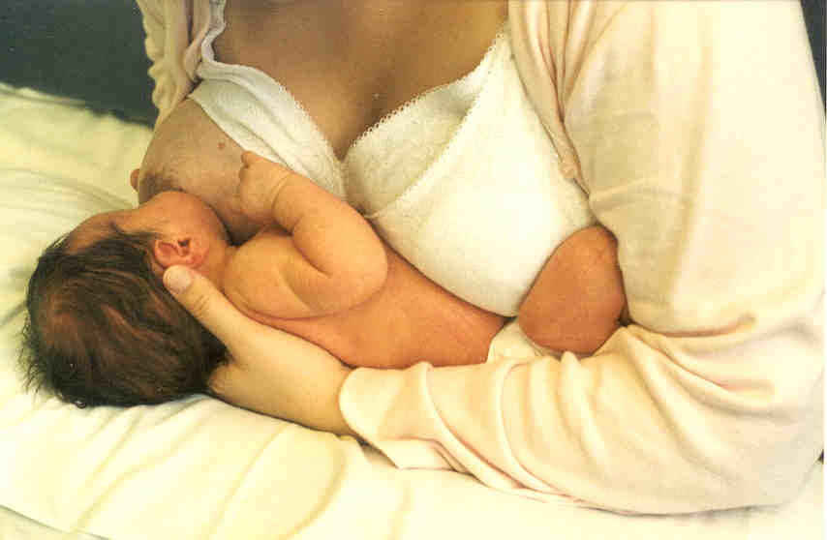
Right position
Breastfeeding support

Slide 49
Right position
mother pushes the child with her forearm (the child is on the forearm)
palm of the hand is under the cheek of the child
mother touches the upper lip of the child with her nipple, from one side of the mouth to the other
she waits for the child opening its mouth wide and pulls
it right to the breast
she encloses the child with the whole arm
elbow pushes the buttocks, wrist pushes between the
scapulae – the child slightly tilts the head back (chin touches
the breast, the nose not)
there is no obstacle between mother and child
Breastfeeding support

Slide 50
Right position
sedentary position
  mother should be comfortable
  she shouldn‘t sit at the edge of hospital bed – it‘s too high without a chance to rest neither the legs, arms, nor the back
  seat with well-supported straight back
  trunk is directed slightly forward, pelvis is flat
Breastfeeding support

Slide 51
Right position
child‘s head and body are very close to mother‘s body
child‘s whole body is supported and legs are winded around mother‘s body
child‘s buttocks are pushed to mother‘s body by her forearm –
the nipple will be automatically directed towards the child‘s
upper lip
it‘s not a belly-to-belly position, but the child is facing the
breast from below and there is an eye contact
child‘s body keeps a line (ear, shoulder, hip)
Breastfeeding support

Slide 52
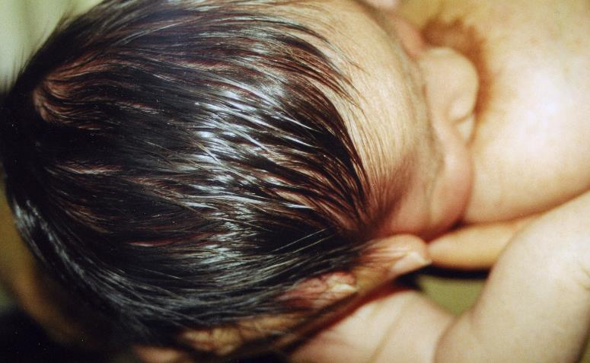
Right position
palm of the hand under the child‘s cheek
Breastfeeding support

Slide 53
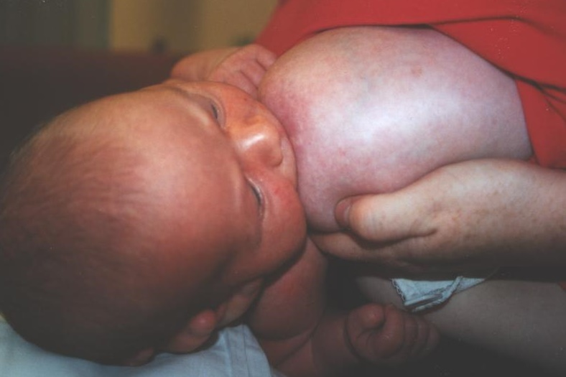
Right position
tilting upwards
Breastfeeding support

Slide 54
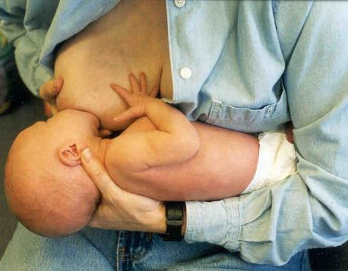
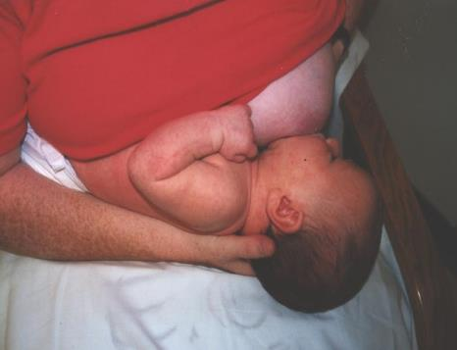
Right transversal position
- child is on the forearm
- child is tilted upwards
- body keeps a line
- mother‘s fingers are under the child‘s cheek
- mother pushes the child‘s buttocks with
her elbow
- mother pushes the child‘s scapulae with
her wrist
Breastfeeding support

Slide 55


Wrong positions
Breastfeeding support

Slide 56
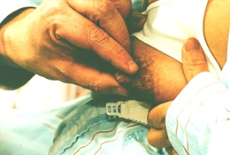
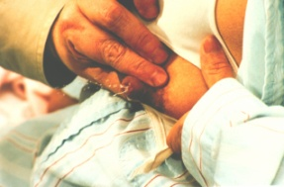
Right suckling
the child only holds the nipple with its lips
the child is suckling right
Breastfeeding support

Slide 57
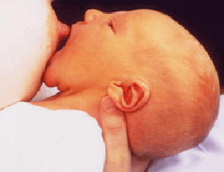
Right suckling
mouth is open wide
tongue reaches at least the lower lip
chin is touching the breast
nose isn‘t touching the breast
child covers more of the areola with its
lower lip than with the upper – areola is more visible above the upper lip
cheeks don‘t collapse inside while breastfeeding
Breastfeeding support

Slide 58
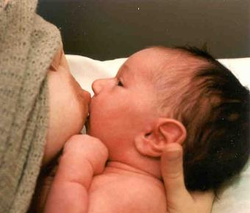
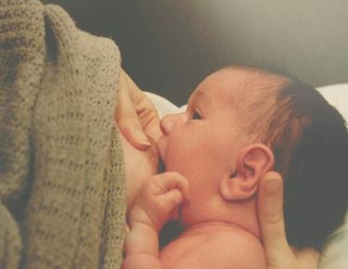
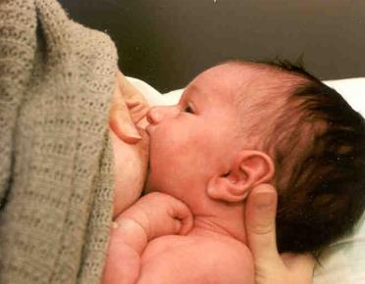
Right suckling
Breastfeeding support

Slide 59


Wrong suckling
Breastfeeding support

Slide 60
Pause in the chin
monitoring of the suckling
checking if the child gets the milk
nutritive and non-nutritive suckling
https://www.youtube.com/watch?v=-erpc0vLbm4
Breastfeeding support

Slide 61
How big is baby‘s stomach?
Breastfeeding support

Slide 62

Breast pressing
prevents the baby from falling asleep by getting the milk to it – the milk is pouring faster
Breastfeeding support

Slide 63
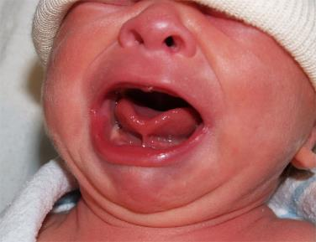
Why is it important
for the mother – prevention of sore nipples
breastfeeding doesn‘t hurt – if so, then it has to be treated
in case of problems
  check the „four points“
  check the frenulum
  don‘t use nipple shields
  contact lactation counsellor
Breastfeeding support

Slide 64
Only breast milk
exclusive breastfeeding or feeding with breast milk (from the mother or bank) since delivery until dismissal
mother‘s shouldn‘t be provided with brochures promoting substitutes of breast milk
Breastfeeding support

Slide 65
Reminder – arrangements of the Code
No public promotion of these products
No free samples for mothers
No promotion in healthcare facilities
No consultants employed by the producers consulting mothers
No presents or free samples for healthcare providers
No text or images idealizing artificial nutrition, including images of children on the packaging
Breastfeeding support

Slide 66
Reminder – arrangements of the Code
Information for healthcare providers should be evidence-based and true
All information about infant formula including labels, should point to the benefits of breastfeeding, the cost of infant formula and its risks
Inappropriate products, eg. sweetened condensed milk, should not be promoted as appropriate for children
All products should be in high quality and take into account climatic and storage conditions of the country
Breastfeeding support

Slide 67
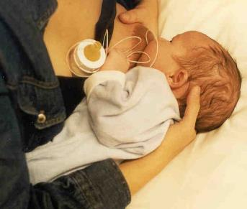
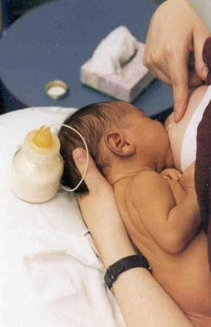
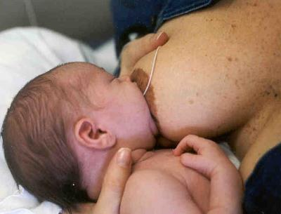
What if the child has to be fed?
The child is still breastfed.
The child learns to be BF by being BF.
Mothers learn to BF by BF.
The child won‘t refuse the breast.
For the child, breastfeeding is more than milk intake!
Breastfeeding support

Slide 68
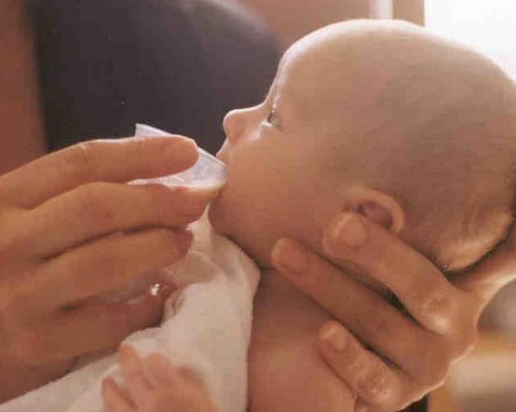
What if the child has to be fed?
if the child can‘t start suckling
pokud se dítě nepřisává na prs, krmíme pohárkem
stačí obyčejná léková odměrka nebo malá sklenička
Breastfeeding support

Slide 69
Rooming-in
The child is in the same room and bed with its mother
No separation (only from excusable reason)
„Mother needs to rest after the labour.“ yes, but with her child
If there is not a medicaly indicated reason, start with rooming-in immediatelly after the labout
Breastfeeding support

Slide 70
The care after the labour
Before the discharge from the hospital the mother should be given information, where to find help (pressed info, contact for lactation consultants, supporting groups etc.)
The hospital should support and coordinate the
estabilishment of such supporting groups
The staff suport mothers and enable acces
of a person who is well experienced in breastfeeding
support and can judge the qualitty of breastfeeding
technique and provide help soon after the labour
Breastfeeding support

Slide 71

According to the Code
do not give the children substitutes, bottles, comforters
the mother must be informed of the risks involved
"Baby confused by a pacifier„
Children learn to breastfeed by breastfeeding. "
" Give the baby artificial substitution of the breast
is not physiological! This is the intervention technique!
Dr. Jack Newman
Breastfeeding support

Slide 72
Contraindications of breastfeeding
health conditions
  galactosemia
  children of mothers with HTLV I and HTLV II (human T-lymphotropic virus)
  children of mothers with HIV/AIDS
  children with PKU can be partially breastfed
temporary contraindications (solution: regular squirting)
  squirted milk can be given to child, e.g. active TBC
  radioactive isotope treatment – interruption of BF for 5 times the t_{1/2} of the isotope
incorrect contraindications
  hepatitis B and C of the mother, allergies of the child, diarrhoea of the child, fever and cold of the mother, diarrhoea of the mother
medicaments – almost everything can be treated with drugs compatible with breastfeeding
Breastfeeding support

Slide 73
The view of lay people and professionals on lactation counselling
(Pokorná, Kameníková, Dvořáková, 2016)
three groups
  management of BFH
  hospitalized women 3rd day postpartum
  medical staff of BFH
Breastfeeding support

Slide 74
The view of mothers and medical staff on information about BF (Likert‘s scale: 5 – most important, 1 – least important)
mothers (241 mother in total)
4,75 – the importance of breastfeeding
4,6 – effective suckling recognition
4,5 – treatment of sore breasts, sore nipples, position during breastfeeding
4,4 – frequency and length of breastfeeding
4,0 – pause in the chin observing (20 women didn‘t mark)
16,2 % of mothers weren‘t educated about the breastfeeding effectivity recognition
25,3 % weren‘t allowed for postpartum skin-to-skin contact
medical staff (141 workers)
4,8 – treatment of sore nipples
4,7 – BF frequency, treatment of sore breasts
4,4 – breastfeeding length
lowest value – pause in the chin observing (20 workers didn‘t mark)
Most addressed issues:
65,8 % start of suckling
43,9 % effective suckling
24,6 % sore breasts
21,9 % sore nipples
Recommendations
68,4 % BF frequency according to child‘s needs
46,5 % BF length accorfing to child‘s needs
Source: Pediatrie pro praxi, 2016, 17(5) - http://www.pediatriepropraxi.cz/artkey/ped-201605-0009_Moznosti_podpory_kojeni_laktacniho_poradenstvi_z_pohledu_laicke_i_odborne_verejnosti.php
Breastfeeding support

Slide 75
What you as doctors should know
(suitable for self-study)
How to treat aching nipples?
How to treat failure to thrive?
How to treat mastitis or blocked milk ducts?
How to treat candidosis?
How to treat failure to thrive following after previous thrift?
How to treat milk refusal in a child?
Breastfeeding support

Slide 76
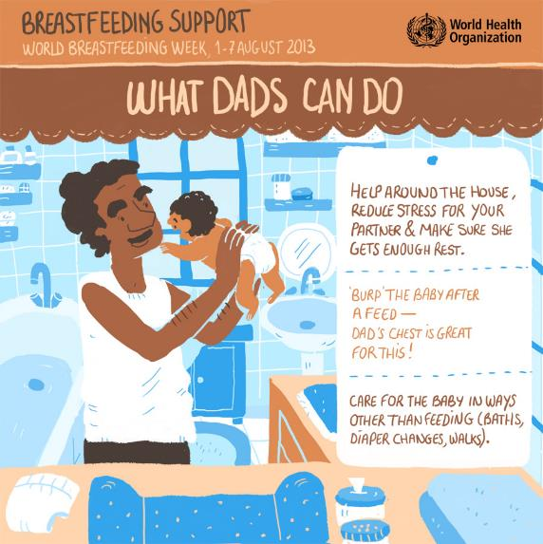

Slide 77



Slide 78
PAUSE
5 min

Slide 79

Infant and toddler nutrition

Slide 80

Complementary food
When to start with complementary feeding?
Is it necessary to terminate breastfeeding?
Infant and toddler nutrition

Slide 81
WHO recommendation
up to term. 6th month of age
exclusive breastfeeding
up to 2 years of age and beyond
introducing local nutritious food
while breastfeeding
Infant and toddler nutrition

Slide 82
When to start?
the child is mature enough to eat
breast milk is no longer sufficient to cover the child‘s needs
WHO recommendation is always the priority.
if the child fails to thrive before compl. 6th month – lactation support  non-milk complementary food  breast milk substitute
  not before completed 4th month
children born prematurely (before 35th week)
  not before completed 3rd month of adjusted age
Infant and toddler nutrition

Slide 83
Introduction of complementary food
diversity – gradually add new tastes
let the child use its hands, feed „on its own“, but w/o force
gradually soft bites – rather cut than mashed
deeper heavier bowl, working with a spoon
after 10th month liquids in a cup
regular dietary regimen
autonomy, but not without supervision
collective dining – habits
Infant and toddler nutrition

Slide 84
Potential allergens introduction (MZ ČR)
in children with high risk of allergy only one new type of food at a time
  gradual introduction, observing the reaction
  together with breastfeeding, higher antigen tolerance
  not before compl. 6th month – early contact with the allergen doesn‘t overcome the benefits of exclusive breastfeeding
concerning allergies, gluten no later than in 7th month together with BF
  ESPGHAN – timing has no effect on the incidence of coeliac disease
Ministry of Health recommendation vs. opinion of allergologists
  The most effective prevention of food allergies is exclusive breastfeeding for 4–6 months.
Infant and toddler nutrition

Slide 85
Beware
insoluble small bits of food
milk shouldn‘t be given as a drink, proteins shouldn‘t be covered only from dairy sources (Fe)
low-fat products shouldn‘t be given – the child needs food of high energy density and low volume (fats make 45 % of energy)
sweets, snacks
not to add sugar or salt
Infant and toddler nutrition

Slide 86
Role of the parents
feed the child slowly and patiently
react to the signs of hunger and satiety
various combinations, tastes, textures
help the child to learn – beware of negative examples
feeding – relationship
Infant and toddler nutrition

Slide 87
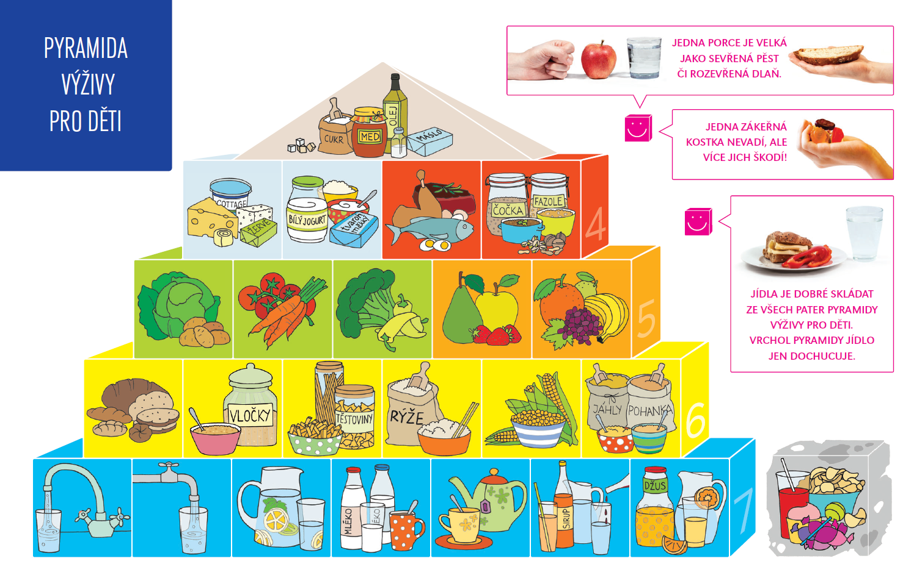
Nutrition after 2 years of age
Infant and toddler nutrition

Slide 88
Risk nutrient – iron
often insufficient intake
other sources of protein than dairy products shouldn‘t be omitted
iron in different food groups
  cereals – e.g. porridge (mainly oats)
  meat – red meat, intestines (liver) – meat factor
  seeds, legumes (appropriately processed)
  fruits and vegetables – vitamin C
Infant and toddler nutrition

Slide 89
Recommendation on complementary food introduction in toddlers (Ministry of Health, CZ)
It is necessary to consider exclusive breastfeeding until completed 6th month followed by breastfeeding with complementary food according to child‘s needs until 2 years and beyond an optimal nutrition standard for the child, which corresponds with the recommendations of World Health Organization (WHO), European Society for Peadiatric Gastroenterology, Hepatology and Nutrition (ESPGHAN) and Scientific Advisory Committee on Nutrition (SCAN).
Complementary food should be introduced in both breastfed and not breastfed children no later than after completed 6th month of age, 180 days (in 26th week), but not before completed 4th month of age (17 weeks).
Infant and toddler nutrition

Slide 90
Recommendation on complementary food introduction in toddlers (Ministry of Health, CZ)
Complementary food is introduced when breast milk or milk substitute no longer covers the nutrient requirements of the child. If the breastfed child fails to thrive, it is recommended tu support the mother in breastfeeding and introduce a non-milk complementary food. If the lactation doesn‘t improve, breast milk substitute is introduced.
The process of introducing the complementary food in prematurely born children (born before the 37th week) is as follows: In children born after completed 35th week, it is recommended to act as in children born in term. In children born before completed 35th week, complementary food can be introduced 5–8 months since birth date, but not before completed 3rd month of adjusted age (calculated delivery date). Complementary food introduction is always assessed individually according to clinical state of the child (health, psychomotoric maturity, thrift etc.)
Infant and toddler nutrition

Slide 91
Recommendation on complementary food introduction in toddlers (Ministry of Health, CZ)
Developmental maturity is important when introducing complementary food, i.e. keeping the head in a stable position, coordinating eyes, hands and mouth when looking for food, holding it and putting it into mouth, swallowing and tolerance of solid food.
In both breastfed and not breastfed children the complementary food is introduced in accordance with present recommendations. Food containing gluten should be introduced until completed 7th of the child‘s life at the latest, optimally together with breastfeeding.
Infant and toddler nutrition

Slide 92
Recommendation on complementary food introduction in toddlers (Ministry of Health, CZ)
In children with high risk of allergies, the process of complementary food introduction is similar to other children, but only one new type of food is introduced at a time, while potential reaction is observed. By introducing complementary food together with breastfeeding, the imunoprotective tolerance of the organism of the infant towards the antigens in food rises.
So far, decrease of incidence of allergies or coeliac disease by early sensibilization with allergens in food hasn‘t been proven . There is no reason to recommend contact with food allergens and food containing gluten before completed 6th month to thriving children.
Infant and toddler nutrition

Slide 93
Further information
Recommendation on complementary food introduction in toddlers (Ministry of Health, Czech rep.)
  http://www.mzcr.cz/Odbornik/dokumenty/doporuceni-k-zavadeni-komplementarni-vyzivyprikrmu-u-kojencu_7542_1154_3.html
Dietary guidelines for the inhabitants of Czech rep. (SPV, 2012)
  http://www.vyzivaspol.cz/rubrika-dokumenty/konecne-zneni-vyzivovych-doporuceni.html
diploma thesis:
  Jana Kráľová: Iron deficiency anemia in infants and toddlers
Infant and toddler nutrition

Slide 94
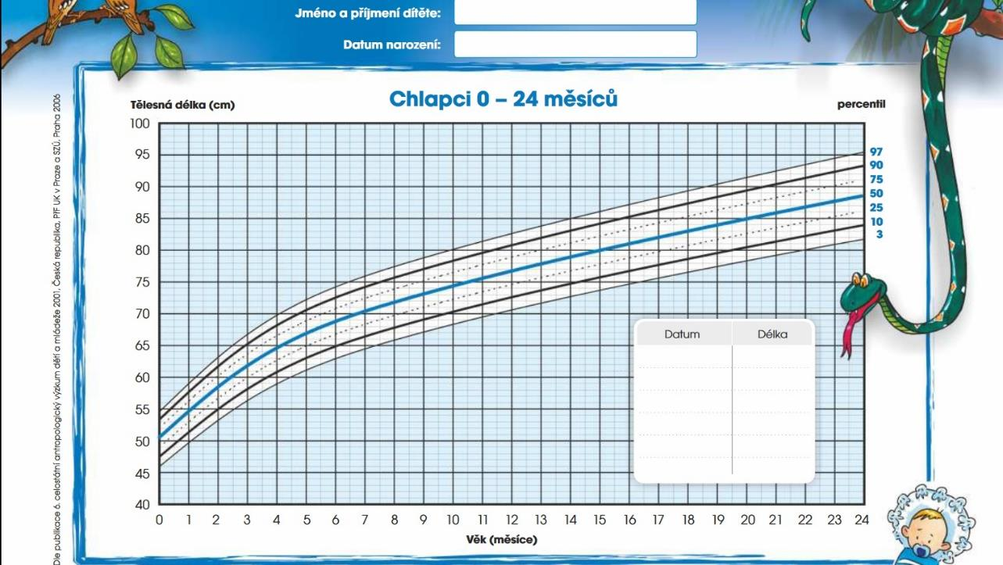
Growth charts

Slide 95
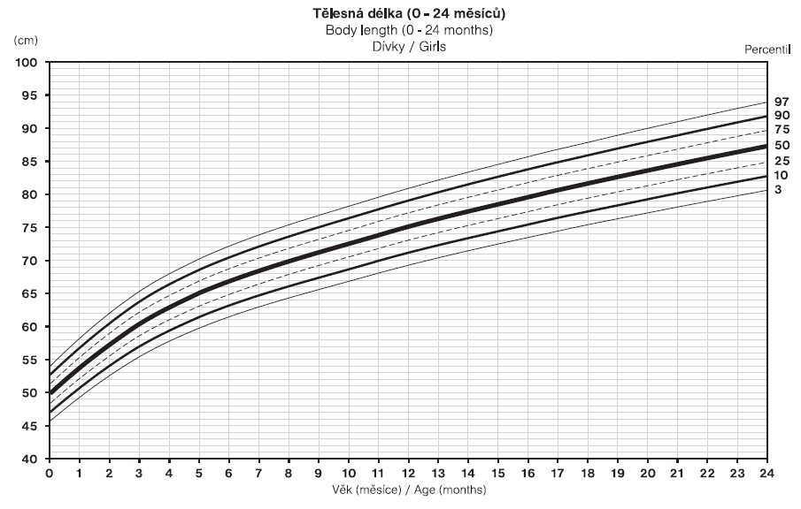

Slide 96
What are they for?
growth examination by GP
underweight/overweight classification in children
alert that „something is happening“
charts available in CZ
  height, weight, weight/height ratio, BMI
  circumferences – hips, waist, head, arm
  skinfolds – biceps, triceps, thigh, subscapular, suprailiacal, 2-skinfold sum, 4-skinfold sum
Growth charts

Slide 97

How are they made?
nationwide anthropometric survey (CAV)
  CAV 2001 – most up-to-date data
  CAV 1991 – charts regarding weight
Why do we use weight and BMI charts from 1991?
Growth charts

Slide 98
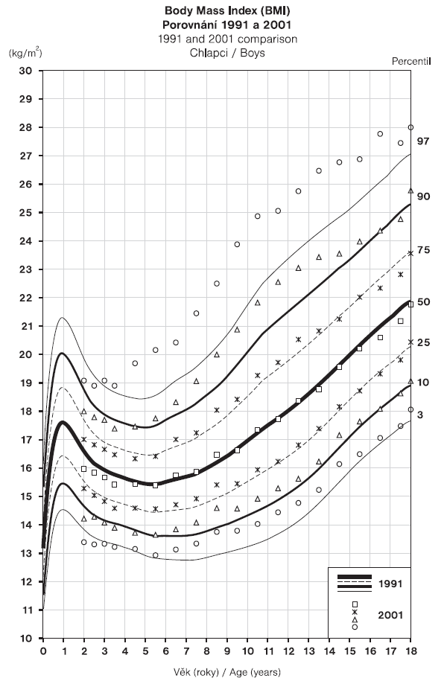
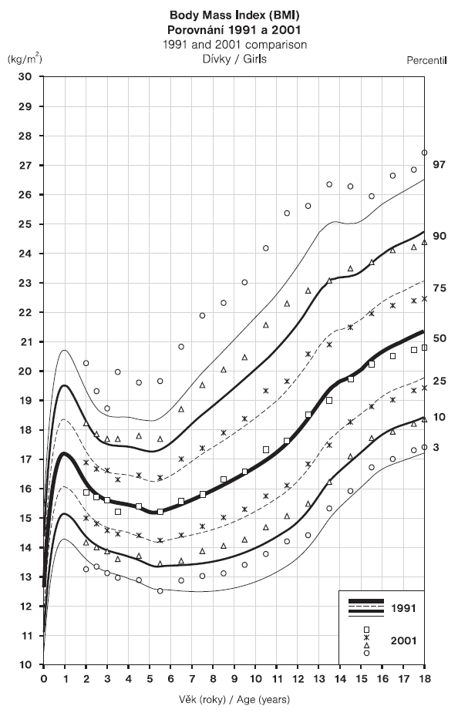

Slide 99
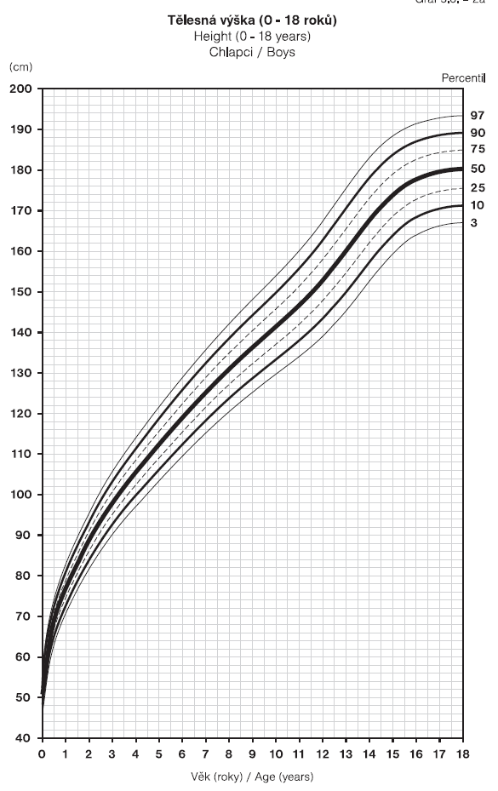
malnutrition
celiac disease
endocrine disorders
cancer
…
familial low stature
constitutional delay of
growth and puberty (CDGP)
other minor disorders

Slide 100

Good utility, not a pattern!
think when you use the charts
a child high for his age – weight will be higher
  assess rather weight/height or BMI (in older children)
a child with family history of low statures – will be smaller
  keep other factors in mind
What do we know from only one point on the chart?
Growth charts

Slide 101
Exclusively breastfed children
exclusively BF children slightly „delayed“ in Czech charts
physiologically slower growth and weight gain
  graphs created according to the data of breastfed children + children fed breast milk substitutes
Complementary food or substitutes shouldn‘t be given only because of slight delay of exclusively breastfed children against the growth chart!
Growth charts

Slide 102
Assessment of the weight of a child
Percentile area | Assessment
> 97 | obese
90–97 | overweight
75–90 | stocky
25–75 | proportional
10–25 | lean
< 10 | underweight
Growth charts

Slide 103

Exercise
boy, 12 y.o., 156 cm
girl, 10 y.o., 140 cm, 44 kg
girl, 10 y.o., 156 cm, 44 kg
boy, 13 m.o., 73 cm, 9 kg
boy, 13 m.o., 79 cm, 10 kg
In CZ, does GP have to monitor weight and height of a child?
In CZ, does GP have to use growth charts for this monitoring?
If the child is proportional, does it mean its nutrition is alright?
Growth charts

Slide 104
Further information
webpage of National Health Institue + RustCZ
  http://www.szu.cz/publikace/data/program-rustove-grafy-ke-stazeni
growth charts for download
  http://www.szu.cz/publikace/data/seznam-rustovych-grafu-ke-stazeni
Growth charts

Slide 105

Introduction to social pediatrics

Slide 106
Social pediatrics
social aspects of health
healthy development, child‘s needs
promoting the best interests and right of the child
Declaration of the Rights of the Child (1989)
World Declaration on the Survival, Protection and Development of Children (1990)
Social pediatrics

Slide 107
Focus of social pediatrics
chronically ill children
children with a handicap
family environment quality and its impact on child‘s health
abandoned, orphaned children, spare family care
toxicomania, childhood criminality, socially maladaptive children
social impacts of illness and health impairment for the child, family and society
threatened children, CAN sy, criminal acts commited on children
Social pediatrics

Slide 108
Risk groups of children
?
Social pediatrics

Slide 109
Risk groups of children
children born prematurely, with inborn errors of development, with complications
unwanted children – lack of interest, negligence, abuse, killing
dispensarized children – sense impairment, chronic illness
adolescents – mainly behavioral problems
children from socially/culturally disadvantaged environment
  environment preventing the child from full development of its potential, capabilities and skills
Social pediatrics

Slide 110
Risk groups of children
socially/culturally disadvantaged environment
  parents too young (mainly underage mother)
  incomplete primary education of one of the parents
  chronic or psychiatric illness of one of the parents
  insufficient social integration of the parents (language etc.)
  home violence
  addictive substances in the family
  legitimate investigation of the child protection authority
Social pediatrics

Slide 111
Why are they at risk?
factors with an impact on health:
  genetics
  environment
  healthcare system
  lifestyle
  social aspects
    social differences and inequalities in health
    social disadvantage and cultural differences
    unemployment, poverty
Social aspects can have a huge impact on child‘s health!
Social pediatrics

Slide 112

Think about it…
what is the role of a pediatrician in social pediatrics?
Social pediatrics

Slide 113

Mgr. Martin Krobot Mgr. Kamila Jančeková krobot@med.muni.cz jancekova@med.muni.cz
Contact for a case of need:

