Slide 1

Nutritional Status Assessment
Assoc. Prof. Jindřich Fiala
Department of Public Health
Faculty of Medicine, Masaryk University

Slide 2
Outline, main points
Background, basics, definitions, objectives, indications
Malnutrition
Techniques (in assessing nutritional status):
History
Anthropometry
Physical (clinical) examination - general appearance
Biochemical and immunological examinations
Dynamometry tests (muscle strength)
Validated screening tools
Children (specifics)
2
Notes:
2

Slide 3
Definitions, scope
Nutritional status:
- The resulting status of health and nutrition given and influenced by diet, dietary intake and uptake, factors influencing uptake (including malfunctions and diseases), energy output, heredity, environmental factors, lifestyle (physical activity, smoking, alcohol…)
Nutritional assessment – differentiate:
- Dietary assessment, (Food consumption, Dietary habits …)
v.s.
- Nutritional status assessment
Malnutrition
- Nutritional status, which is characterized by a deficit or excess of energy or individual nutrients
- This imbalance results in measurable changes in the tissues, the body's form, the functions of the organism, and the clinical condition of the individual
3
Notes:
3

Slide 4
Malnutrition
Malnutrition by deficiency - undernutrition
Energy, energy-protein deficiency malnutritions:
Underweight
Cachexia
Marasmus
Kwashiorkor
Marasmic kwashiorkor
Specific deficiencies
Iodine deficiency - endemic goitre (Struma)
Vit. A deficiency - xeroftalmia
Nutritional anaemia
Nutritional osteopenia
B1 (Thiamine) deficiency - Beri beri
B2 (Riboflavin) deficiency
B3 (Niacin, vit. PP) - Pellagra
Vit C deficiency) - Scurvy
Sarcopenia
Malnutritions by excess, overnutrition
Overweight
Obesity
Micronutrient excess
4
Notes:
4

Slide 5
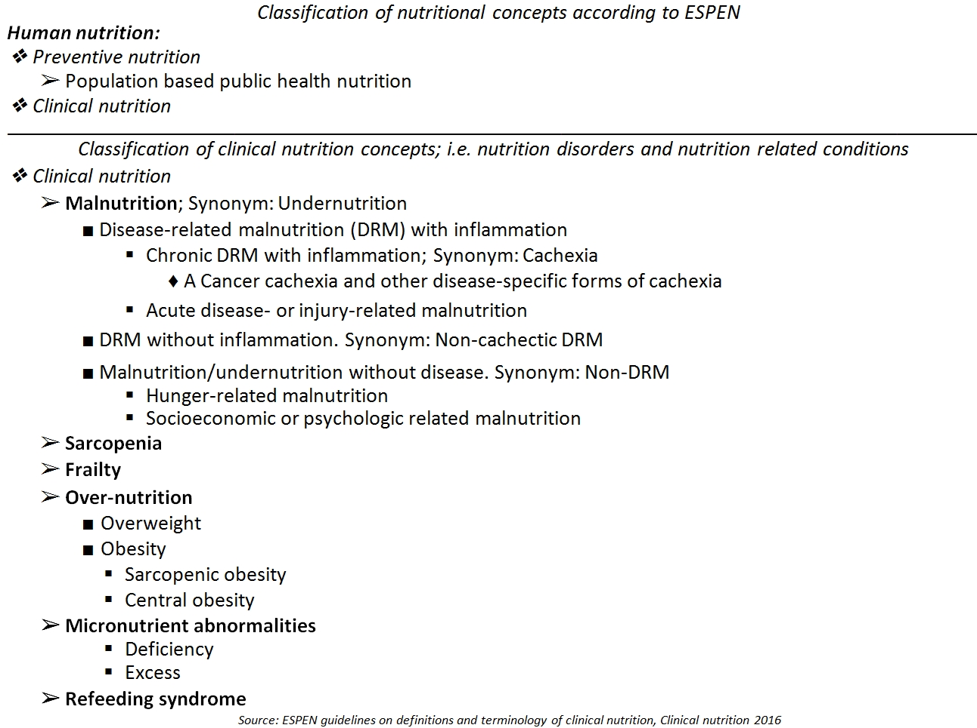
5
Notes:
5

Slide 6
Burden of malnutrition
Malnutrition affects people in every country.
Around 1.9 billion adults worldwide are overweight, while 462 million are underweight.
An estimated 41 million children under the age of 5 years are overweight or obese, while some 159 million are stunted and 50 million are wasted.
Adding to this burden are the 528 million or 29% of women of reproductive age around the world affected by anaemia, for which approximately half would be amenable to iron supplementation.
Many families cannot afford or access enough nutritious foods like fresh fruit and vegetables, legumes, meat and milk, while foods and drinks high in fat, sugar and salt are cheaper and more readily available, leading to a rapid rise in the number of children and adults who are overweight and obese, in poor as well as rich countries.
It is quite common to find undernutrition and overweight within the same community, household or even individual – it is possible to be both overweight and micronutrient deficient, for example.
6
Notes:
6

Slide 7
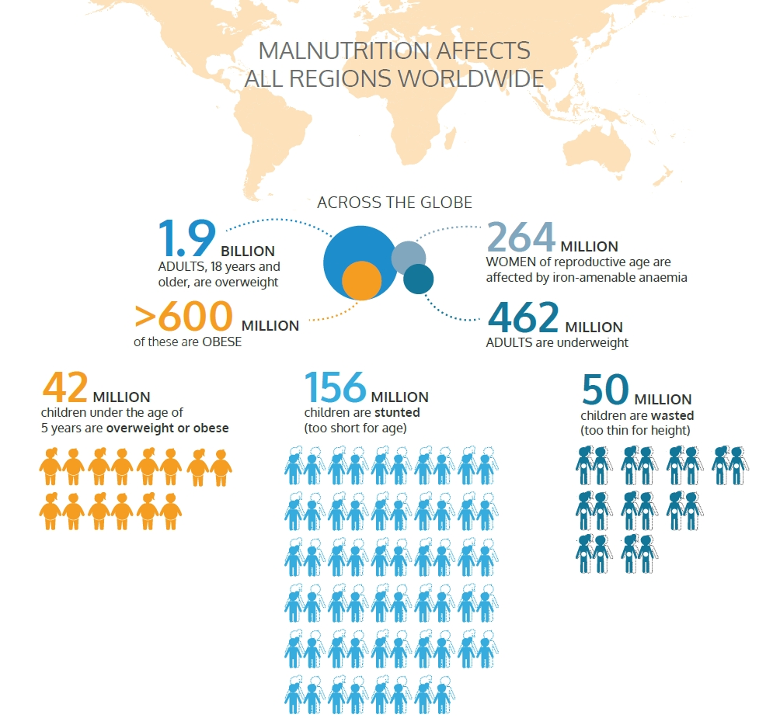
7
Notes:
7

Slide 8
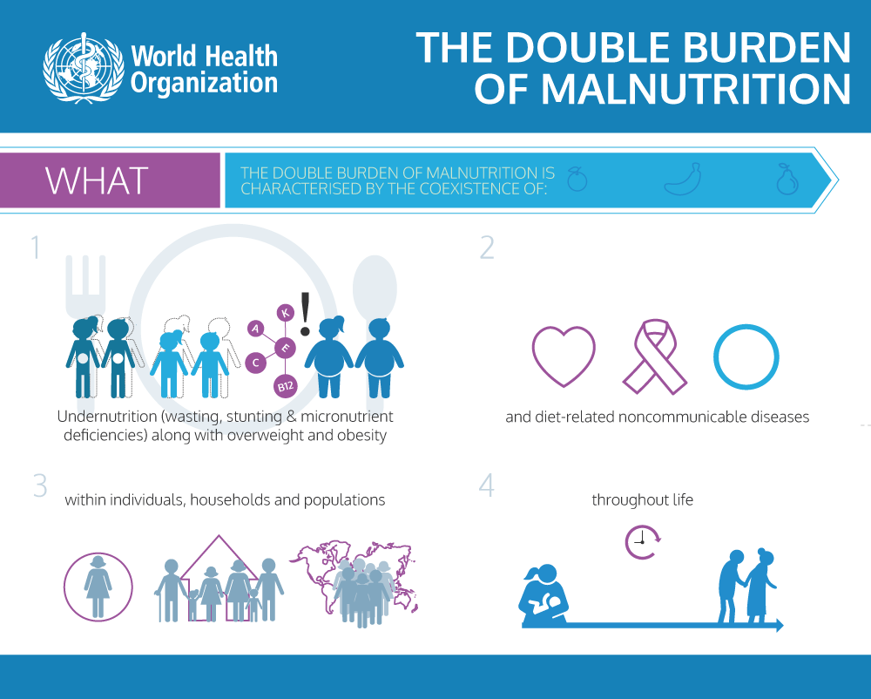
8
Notes:
8

Slide 9
Types of Protein-Energy Malnutrition (PEM)
Underweight - adults low BMI, children low weight for age
Starvation – pure caloric deficiency, conserve lean mass, increase fat metabolism
Wasting – gradual loss of body mass (getting thinner). In children: Low weight for height.
Stunting – low height for age
Kwashiorkor – edematous PEM by protein deficiency
Marasmus – severe wasting due to energy deficiency
Marasmic kwashiorkor
Cachexia –associated with inflammatory or neoplastic condition
Sarcopenia - skeletal muscle wasting by ageing
The most common:
For infants – Marasmus , for older infants: Kwashiorkor
For elderly: Sarcopenia and cachexia (regarding undernutrition)
9
Notes:
9

Slide 10
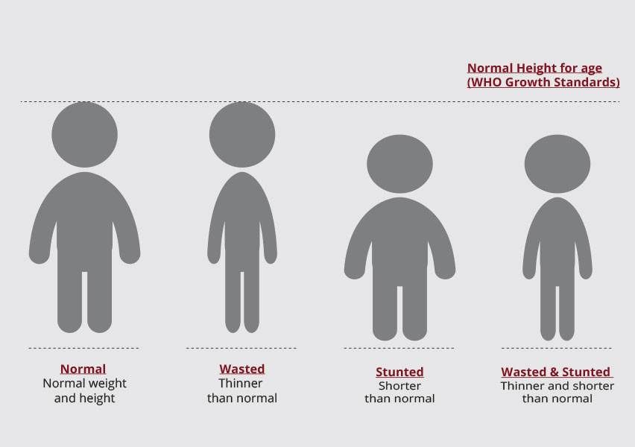
10
Notes:
10

Slide 11
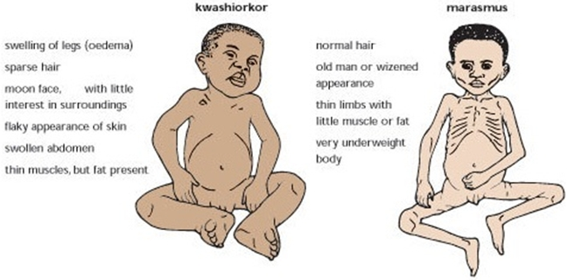
Marasmus vs Kwashiorkor
Marasmus
Marasmus is caused by a severe deficiency of nearly all nutrients, especially protein, carbohydrates, and lipids.
Kwashiorkor
Sufficient calorie intake, but with insufficient protein consumption.
11
Notes:
11

Slide 12
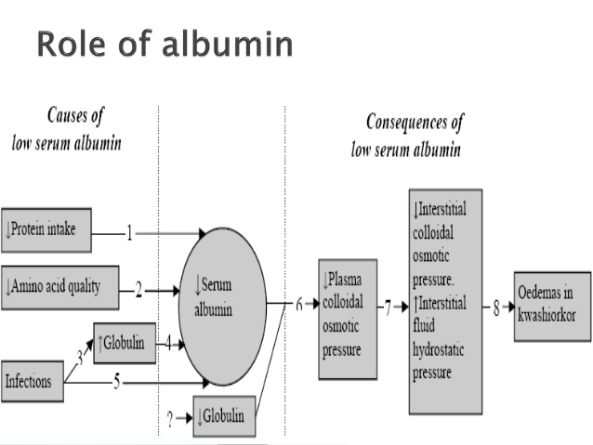
12
Notes:
12

Slide 13
Malnutrition - symptoms
Lack of appetite or interest in food or drink
Tiredness and irritability
Inability to concentrate
Always feeling cold
Loss of fat, muscle mass, and body tissue
Higher risk of getting sick and taking longer to heal
Longer healing time for wounds
Higher risk of complications after surgery
Depression
Reduced sex drive and problems with fertility
Breathing becomes difficult
Skin may become thin, dry, inelastic, pale, and cold
The cheeks appear hollow and the eyes sunken, as fat disappears from the face
Hair becomes dry and sparse, falling out easily
13
Notes:
13

Slide 14
Malnutrition - causes
Low intake of food
This may be caused by symptoms of an illness, for example, dysphagia, when it is difficult to swallow. Badly fitting dentures may contribute.
Mental health problems
Conditions such as depression, dementia, schizophrenia, anorexia nervosa, and bulimia can lead to malnutrition
Social and mobility problems
Some people cannot leave the house to buy food or find it physically difficult to prepare meals. Those who live alone and are isolated are more at risk. Some people do not have enough money to spend on food, and others have limited cooking skills.
Digestive disorders and stomach conditions
If the body does not absorb nutrients efficiently, even a healthful diet may not prevent malnutrition. People with Crohn's disease or ulcerative colitis may need to have part of the small intestine removed to enable them to absorb nutrients. Celiac disease may result in damage to the lining of the intestines and poor food absorption. Persistent diarrhea, vomiting, or both can lead to a loss of vital nutrients
Alcoholism
Alcohol can lead to gastritis or damage to the pancreas. These can make it hard to digest food, absorb certain vitamins, and produce hormones that regulate metabolism. Alcohol contains calories, so the person may not feel hungry. They may not eat enough proper food to supply the body with essential nutrients.
Lack of breastfeeding
14
Not breastfeeding, especially in the developing world, can lead to malnutrition in infants and children.
Notes:
14

Slide 15
Worldwide most frequent micronutrient deficiencies
Iron deficiency
The world's most widespread micronutrient deficit (2 billion people)
Anaemia, reduced mental and physical performance, susceptibility to infections
Vitamin A deficiency
In adult individual pool for 2 years
In developing countries, babies are born with small supplies and do not receive vitamin A by breastfeeding either
First, reversible night blindness
Later, irreversible blindness (annually 1.5 million children)
Decrease in immune functions, pneumonias, infectious diarrhea, death
Iodine
The second most common deficit, very serious manifestations for the population
The world’s most prevalent, yet easily preventable, cause of brain damage
"Iodine Deficiency Disorders" (IDD) - goiter, hypothyroidism, retardation of psychomotor development, cretinism
The best prevention: iodised salt
Natural content in food outside marine products depends on the geological basement - mountain deficiency
The urinary excretion shows the saturation (<100 ug / l = deficiency)
15
Notes:
15

Slide 16
The spectrum of iodine deficiency disorders, IDD
Fetus | Miscarriage Stillbirths Congenital anomalies Increased perinatal morbidity and mortality Endemic cretinism
Neonate | Neonatal goiter Neonatal hypothyroidism Endemic neurocognitive impairment Increased susceptibility of the thyroid gland to nuclear radiation
Child and adolescent | Goiter (Subclinical) hypothyroidism Impaired mental function Retarded physical development Increased susceptibility of the thyroid gland to nuclear radiation
Adult | Goiter with its complications Hypothyroidism Impaired mental function Spontaneous hyperthyroidism in the elderly Iodine-induced hyperthyroidism Increased susceptibility of the thyroid gland to nuclear radiation
16
Notes:
16

Slide 17
METHODS
17
Notes:
17

Slide 18
Methods, techniques
History
Physical, (clinical) examination – general appearance
Anthropometry
Laboratory – biochemical and immunological examinations
Dynamometry tests (muscle strength)*
*Rather rare use
Validated screening tests
Children
18
Notes:
18

Slide 19
History and Physical Examination
Comprehensive nutritional assessment begins with a history and physical examination. History should consist of medical diagnoses, hospitalizations, changes in appetite, availability and preparation of food, medications, and details regarding weight change. Weight loss is perhaps the most validated parameter of nutritional status.
Following the history, a thorough physical examination may be performed. Attention should be directed toward findings of soft-tissue wasting, hydration status, evidence of vitamin and mineral deficiencies, height, weight, and body mass index (BMI). See table for a description of physical examination findings and related nutrient deficiencies.
19
Notes:
19

Slide 20
History
To a large extent, it overlaps with the „Dietary assessment" , or "Nutritional history". Directly within the Nutritional Status assessment,we focus especially on the factors that can influence the nutritional status:
Dietary habits, possible alternative diets, social status..
Lifestyle – physical activity, alcohol…
Chronic and current diseases of the examined person
Focus on gastrointestinal problems
Using drugs that can interact with the digestion and uptake of nutrients
20
Notes:
20

Slide 21
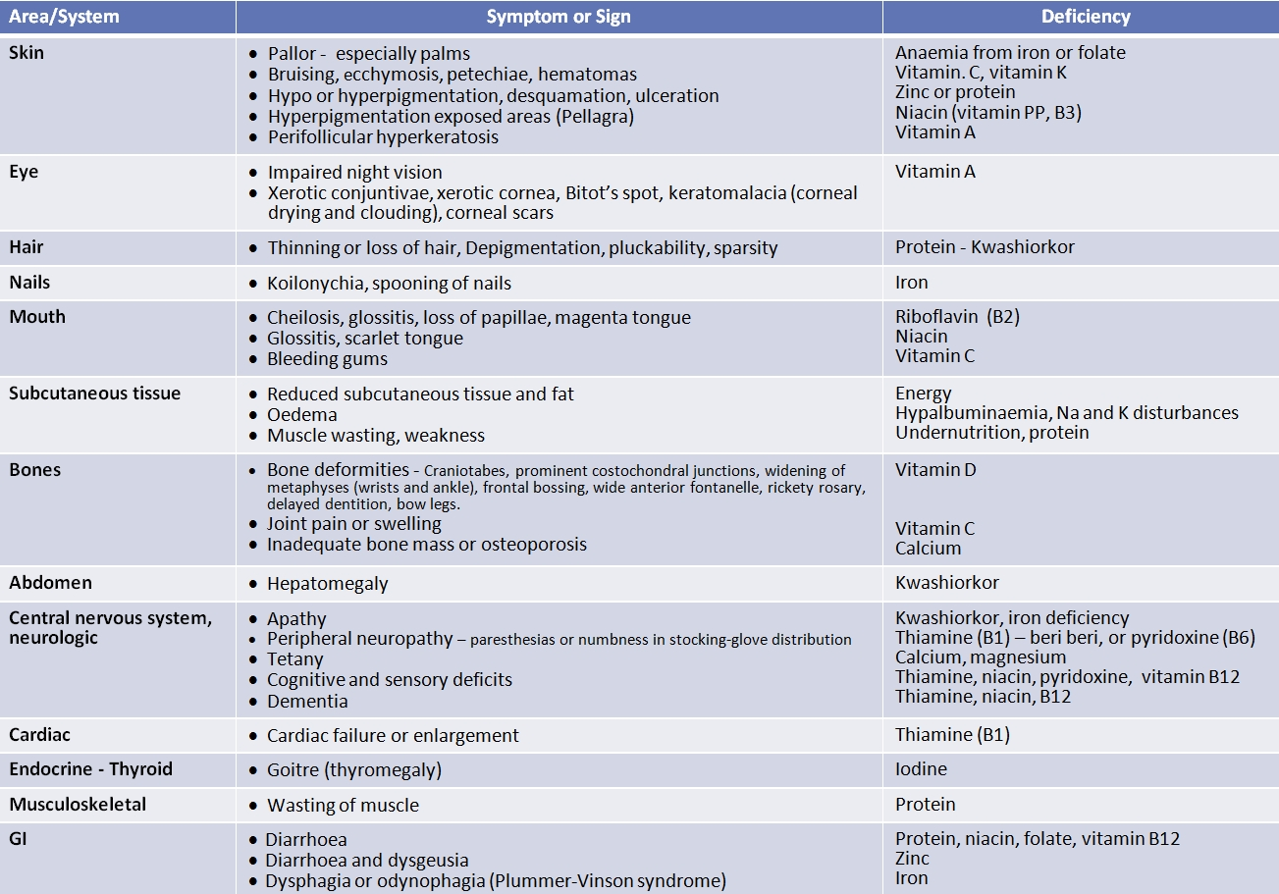
Symptoms and signs of undernutrition and micronutrient deficiency
21
Notes:
21

Slide 22
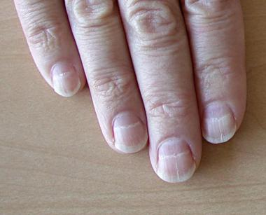
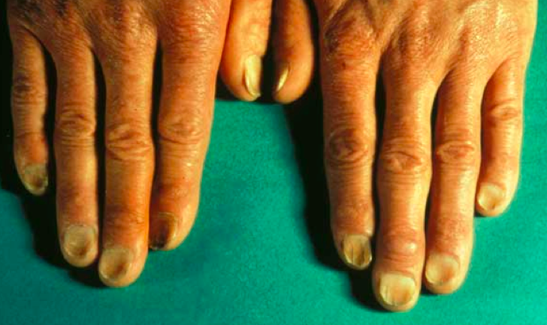
Nails
Nails
  Anémie z nedostatku železa – suché, lomivé, ploché až lžičkovitého tvaru (koilonychie)
  Nedostatek bílkovin – příčné bílé proužky
https://classconnection.s3.amazonaws.com/639/flashcards/1040639/png/screen_shot_2012-09-29_at_73928_pm1348962057890.png
https://img.medscapestatic.com/pi/meds/ckb/41/28841tn.jpg

Slide 23
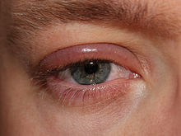
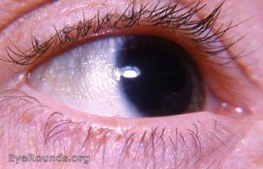
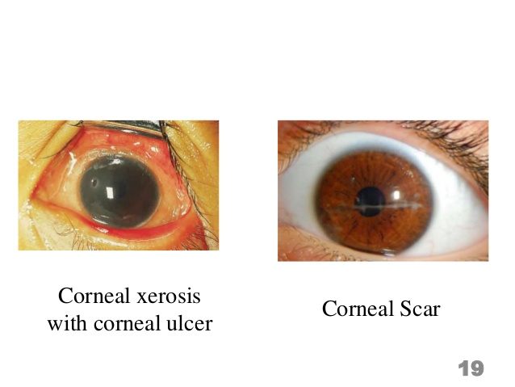
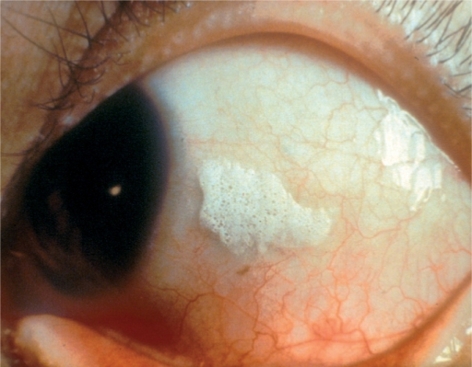
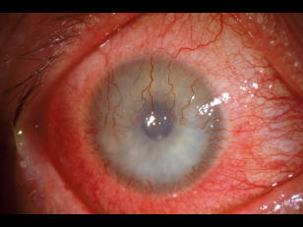
Eyes
Oči
  Blefaritis – nedostatek riboflavinu, příp. vitamínu A
  Xeróza spojivek – nedostatek vitamínu A
  Korneální skleróza, keratomalacie – nedostatek vitamínu A
  Bitotovy skvrny – nedostatek vitamínu A
  Korneální vaskularizace – nedostatek riboflavinu nebo vitamínu A
  Angulární palpebritis – nedostatek riboflavinu, pyridoxinu, železa
  Šeroslepost – nedostatek vitaminu A, retinolu a β-karotenu
https://upload.wikimedia.org/wikipedia/commons/thumb/3/34/Blepharitis.JPG/220px-Blepharitis.JPG
https://webeye.ophth.uiowa.edu/eyeforum/atlas/photos-earlier/xerosis-conjunctivae.jpg
https://image.slidesharecdn.com/problemsolvingexercise-vita-copy-160505054605/95/vitamin-a-and-its-deficiency-19-638.jpg?cb=1462427304
https://openi.nlm.nih.gov/imgs/512/100/2873666/PMC2873666_jceh_23_72_004_f18.png?keywords=vitamin+a+deficiencies,bitot%27s+spots
http://3.bp.blogspot.com/-xl6WLqTk1uI/TriLOUllM6I/AAAAAAAAAJw/rU2PltJiqsc/s1600/corneal_neovascularization.jpg

Slide 24
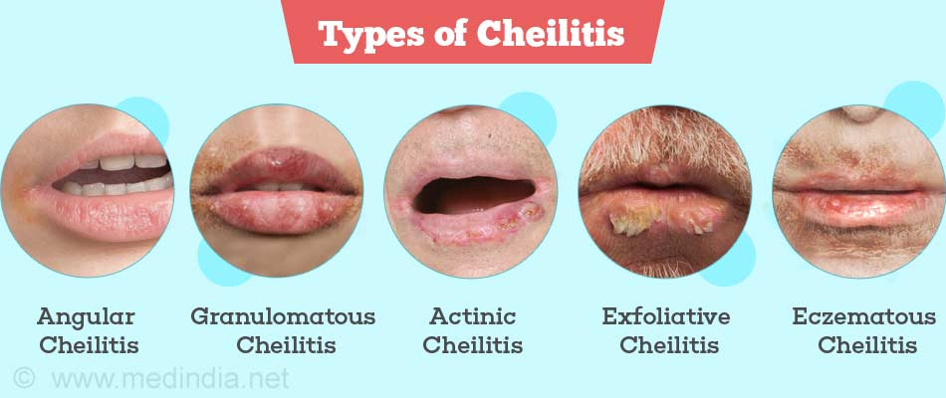
Mouth, lips
Rty
  Angulární stomatitis – nedostatek riboflavinu, pyridoxinu, železa
  Angulární jizvy – nedostatek riboflavinu, pyridoxinu
  Cheilitis – nedostatek riboflavinu
http://healthlifemedia.com/healthy/wp-content/uploads/2017/09/types-of-cheilitis.jpg

Slide 25
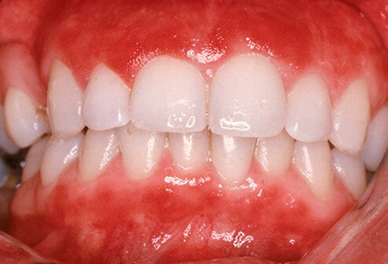
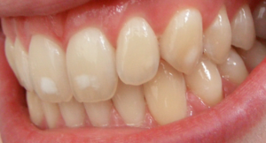
Teeth, gums
Dásně
  Gingivitis – nedostatek vitamínu C
Jazyk
  Nedostatek riboflavinu, k. nikotinové, pyridoxinu, kobalaminu, k. listové a železa – akutní zánět, glossodynie, pukliny, vyhlazení povrchu jazyka
Zuby
  Zubní kaz
    Nedostatek fluoru – zvýšená kazivost
  Skvrnitá sklovina
    Nadbytek fluoru
https://images.onhealth.com/images/slideshow/dental-problems-s6-gingivitis.jpg
https://upload.wikimedia.org/wikipedia/commons/thumb/4/4e/Dental_fluorosis_%28mild%29.png/300px-Dental_fluorosis_%28mild%29.png

Slide 26
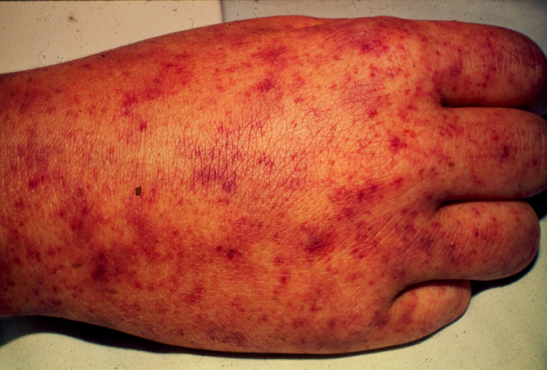
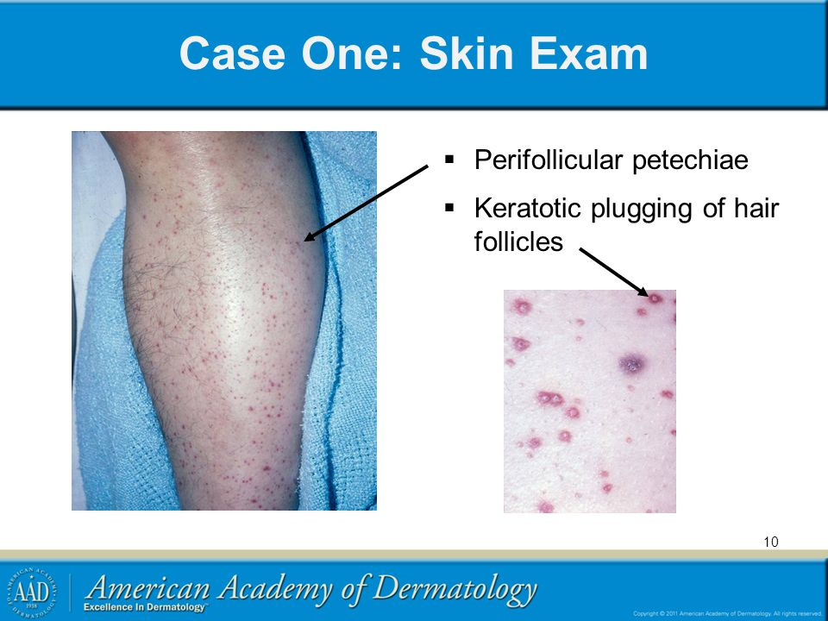
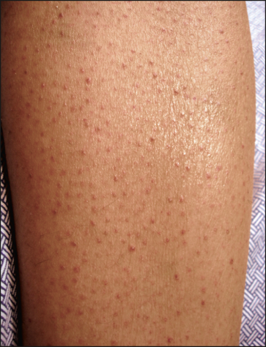
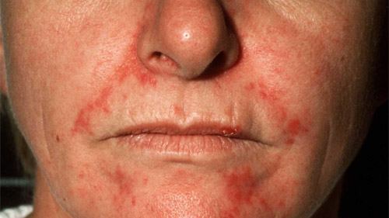
Skin
Kůže
  Folikulární hyperkeratóza – nedostatek vitamínu A, nedostatek esenciálních mastných kyselin, nedostatek pyridoxinu
  Xeroderma – nedostatek vitamínu A
  Nasolabiální seborrhoea – nedostatek riboflavinu
  Folikulární petechie – avitaminóza C
  Petechiální hemorrhagie – avitaminózy C, K
http://www.uaz.edu.mx/histo/pathology/ed/ch_7/c7_rmsf_hand.jpg
https://jamanetwork.com/data/Journals/DERM/4687/dsk50017f2.png
https://noskinproblems.com/wp-content/uploads/2015/06/seborrheic-dermatitis-face.jpg
http://slideplayer.com/1718407/7/images/10/Case+One%3A+Skin+Exam+Perifollicular+petechiae.jpg

Slide 27
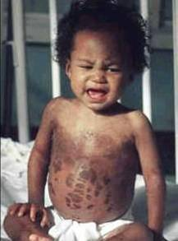
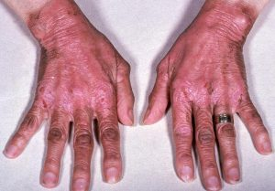
Skin
Kůže
  Změny pigmentace
    Špinavě hnědé skvrny – chronická podvýživa
    Depigmentace – kwashiorkor
    Erytém, svědění, pálení – puchýřky – hrubnutí kůže – pelagra
    Bledá kůže - chudokrevnost
https://www.med.uottawa.ca/sim/data/Images/Kwashiorkor.jpg
https://niacinreviews.com/wp-content/uploads/2016/10/Pellagra-300x209.jpg

Slide 28
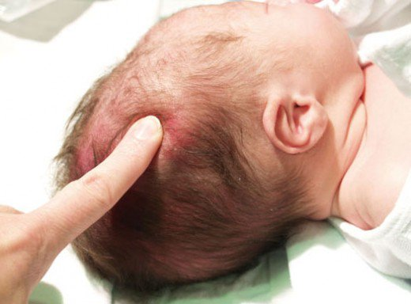
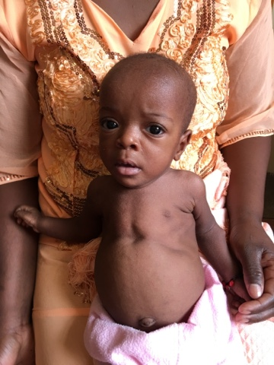
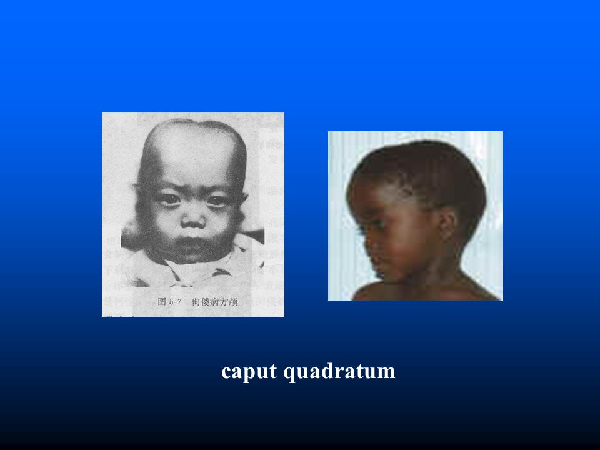
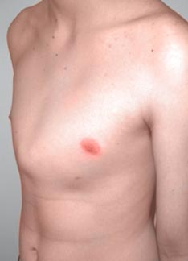
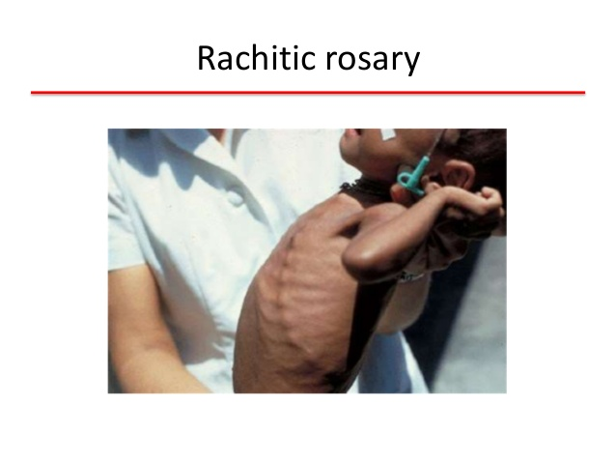
Bones, skeleton
Kostra – nedostatek vitamínu D
  Craniotabes
  Caput quadratum
  Pozdní uzávěr velké fontanely
  Rachitický růženec
  Pectus carinatum
  Harrisonova rýha
  Deformace dlouhých kostí
  Nohy do „X“ nebo do „O“
https://usercontent2.hubstatic.com/8761643_f520.jpg
https://lh3.googleusercontent.com/-j4DAMWNSi1E/VyuFmVjt3BI/AAAAAAAABis/ww3CnqYmfno/s640/blogger-image-2107067516.jpg
http://www.orthokids.com.au/static/uploads/images/pectus-carinatum-patient-wfwwhgzwmqop.jpg
http://slideplayer.com/10592260/36/images/20/caput+quadratum.jpg
https://image.slidesharecdn.com/bonedemineralizationpblariff-150108110339-conversion-gate02/95/bone-demineralization-10-638.jpg?cb=1420720388

Slide 29
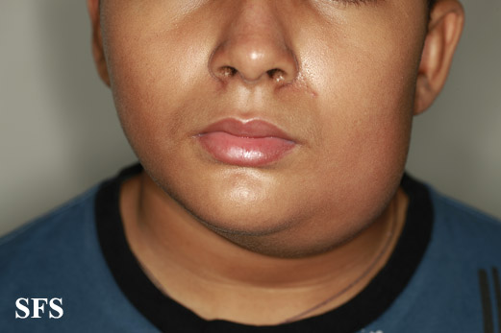
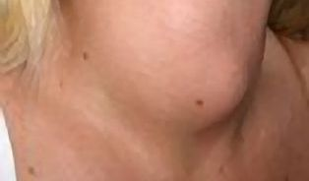
Thyroid - goitre
Žlázy
  Zvětšení příušních žláz – nedostatek kvalitních bílkovin
  Struma – nedostatek jódu
https://www.wikidoc.org/images/a/aa/Parotitis01.jpg
https://i.iinfo.cz/images/414/struma-vole-zvetsena-stitna-zlaza-2-thumb.jpg

Slide 30
ANTHROPOMETRY
30
Notes:
30

Slide 31
Anthropometric (somatometric) measurements used in nutritional status assessment
Directly measured simple parameters:
Height
Weight
Waist
Hip
Arm (MUAC)
Skinfolds
Anthropometric indexes:
BMI
WHR
Body composition analysis:
BIA
Hydrodensitometry (hydrostatic weighing)
DEXA
MRI
Plethysmography (BodPod) (whole body air displacement plethysmography)
3D-scanning
31
Notes:
31

Slide 32
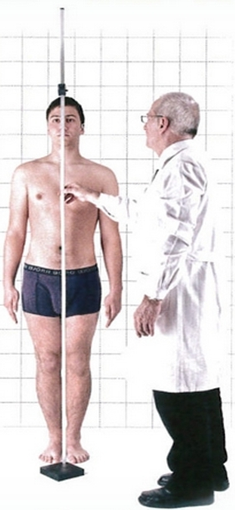
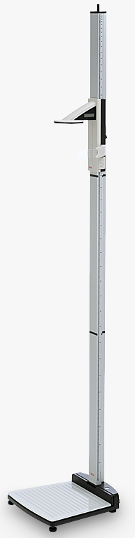
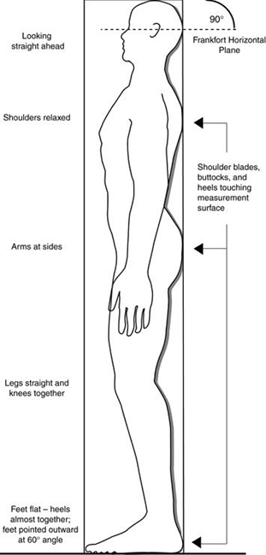
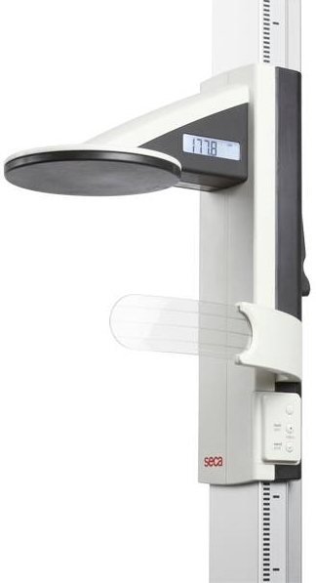
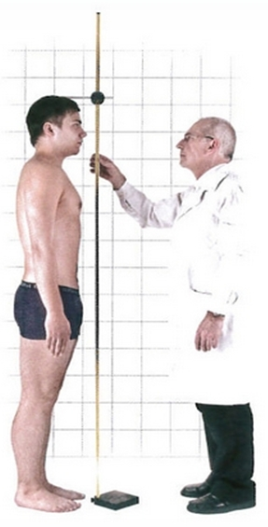
Height
32
Notes:
32

Slide 33
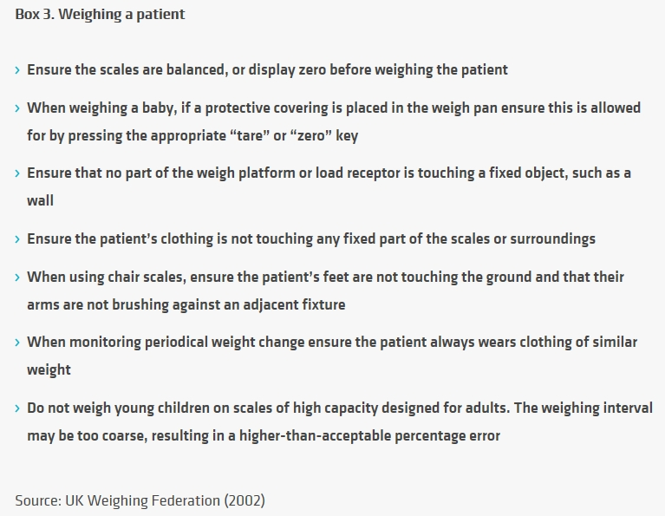
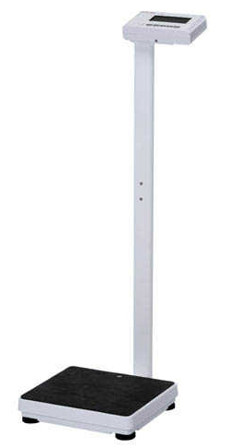
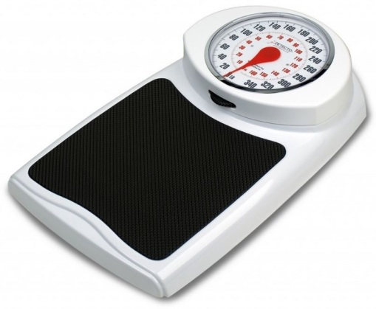
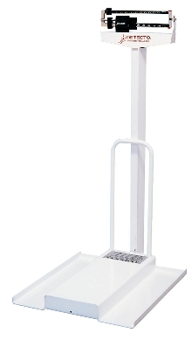
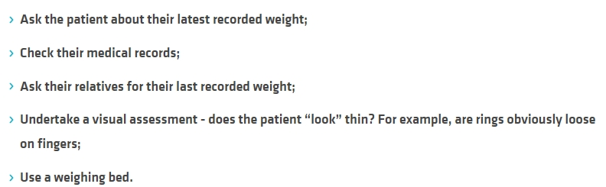
Weight
Alternatives to weighing patients:
33
Notes:
33

Slide 34
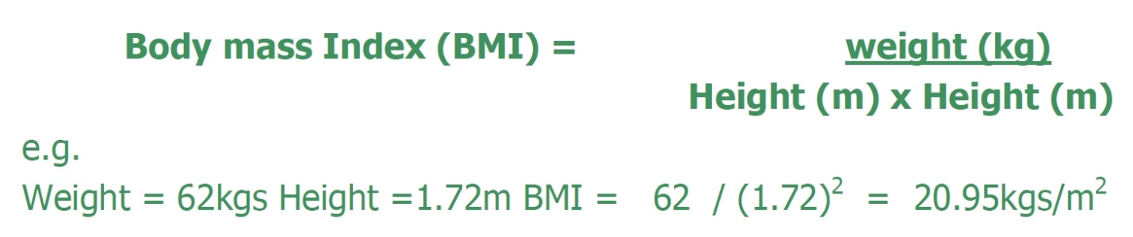
BMI
BMI = weight (kg) / height² (m²)
Classification: | Underweight | Normal range | Overweight | Obesity
BMI | < 18.5 | 18.5 – 24.9 | 25.0 -29.9 | ≥ 30.0
34
Notes:
34

Slide 35
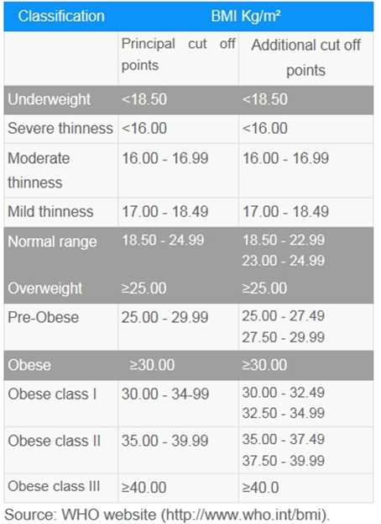
BMI – Diagnostic criteria (cut-offs)
35
Notes:
35

Slide 36
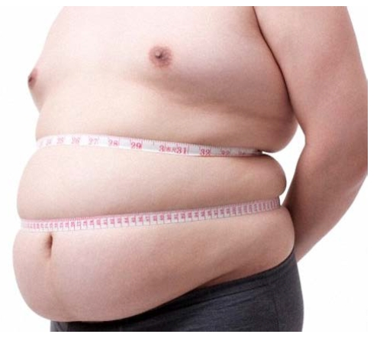
Circumferences
Possible circumferences in nutritional status assessment:
Waist
Hip
Arm
Calf
36
Notes:
36

Slide 37
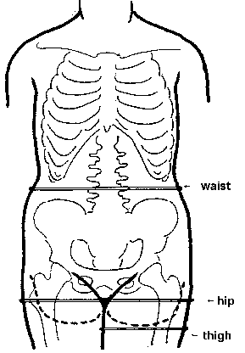
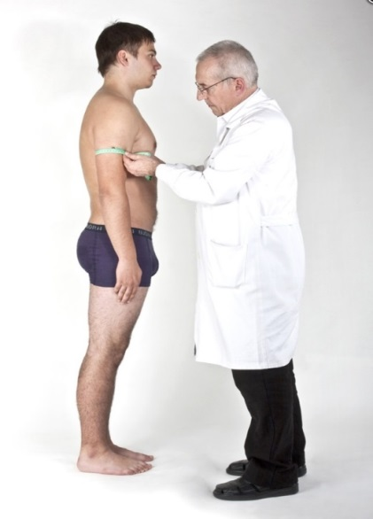
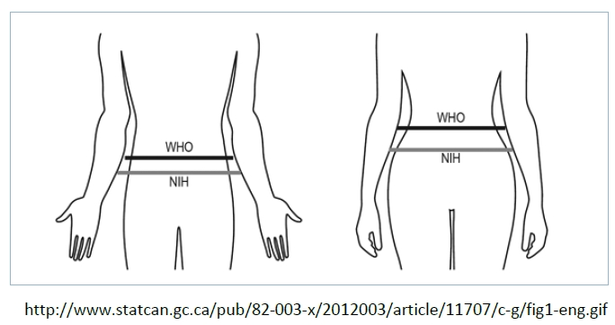
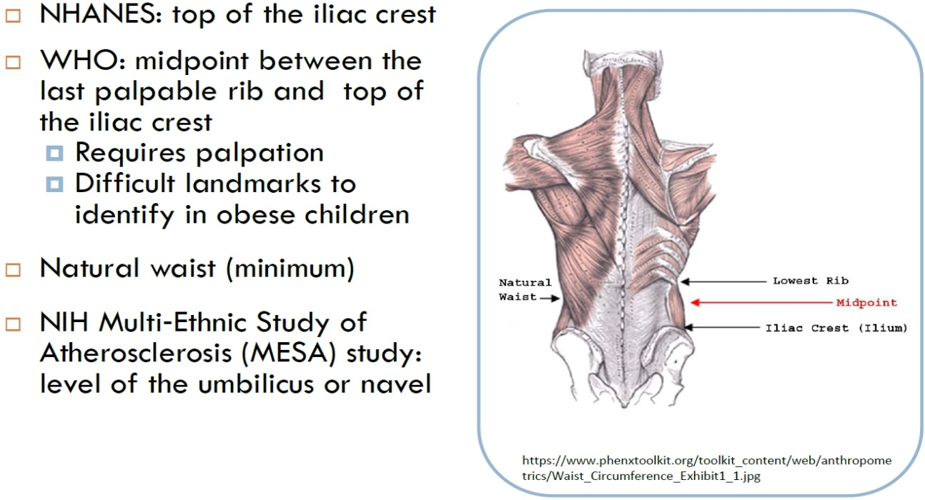
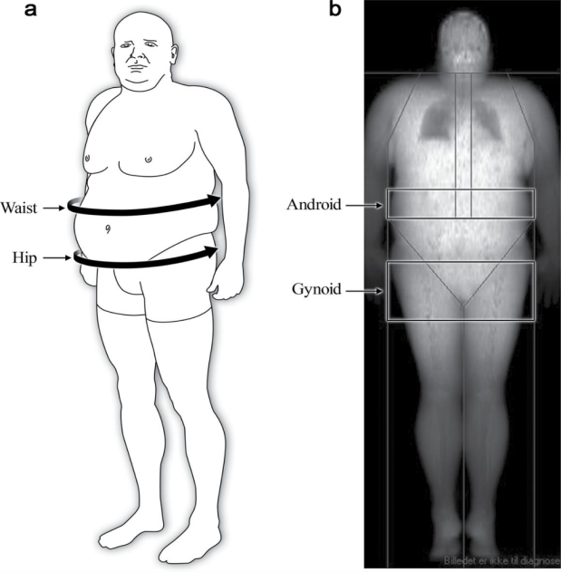
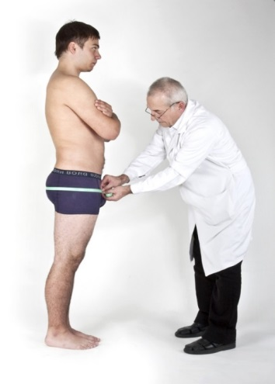
Circumferences – measuring sites:
Waist – taken in level of the umbilicus (navel)
Hip - measurement is taken at the widest lateral extension of the hips
Arm – mid upper arm, relaxed
37
Notes:
37

Slide 38
Waist circumference – diagnostic criteria
WHO – risk of metabolic complications:
 | OK | Risk increased | Substantially increased
Men | < 94 | 94.1 - 102 | > 102
Women | < 80 | 80.1 - 88 | > 88
38
Notes:
38

Slide 39
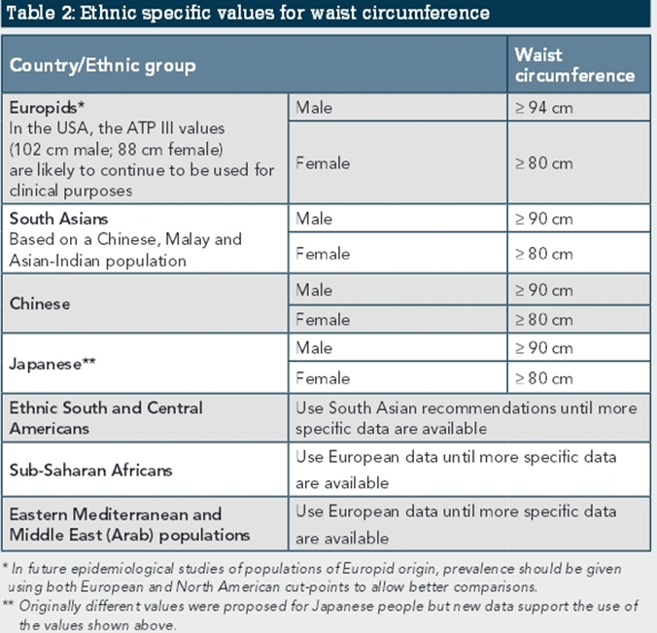
39
Notes:
39

Slide 40

Waist circumference – correlation with abdominal fat
40
Després J P, Lemieux I, Prud'homme D: Treatment of obesity: need to focus on high risk abdominally obese patients. BMJ. 2001 Mar 24;322(7288):716-20.
Notes:
40

Slide 41




WHR – Waist to Hip Ratio
41
Notes:
41

Slide 42

WHR – diagnostic criteria
 | Low risk | Moderate risk | High risk
Men | < 0.95 | 0.95 - 1.00 | > 1.00
Women | < 0.80 | 0.81 - 0.85 | > 0.85
Ideal value (health and fertility): Men 0.9, Women 0.7
42
Notes:
42

Slide 43

WHR interpretation pitfalls
Després J P, Lemieux I, Prud'homme D: Treatment of obesity: need to focus on high risk abdominally obese patients.
BMJ. 2001 Mar 24;322(7288):716-20.
43
Notes:
43

Slide 44




WHR
The most desirable between 0.6 – 0.75
44
Notes:
44

Slide 45

Diagnostická kritéria - WHR
45
Notes:
45

Slide 46

Classification of obesity developed by the National Heart, Lung and Blood Institute task force, along with the associated disease risk with increasing BMI, waist circumference and waist to hip ratio.
46
Oliveros E, Somers V, Sochor O, Goel K, Lopez-Jimenez F: The concept of normal weight obesity. Progress in cardiovascular diseases, 2014, 56, 426-433
Notes:
46

Slide 47
METABOLIC SYNDROM
47
Notes:
47

Slide 48
Metabolic syndrome
Metabolic syndrome, sometimes known by other names, is a clustering of at least three of the five following medical conditions: abdominal obesity, high blood pressure, high blood sugar, high serum triglycerides and low high-density lipoprotein (HDL) levels.
Metabolic syndrome is associated with the risk of developing cardiovascular disease and type 2 diabetes.
Insulin resistance, metabolic syndrome, and prediabetes are closely related to one another and have overlapping aspects.
The syndrome is thought to be caused by an underlying disorder of energy utilization and storage.
48
Notes:
48

Slide 49

49
Notes:
49

Slide 50

50
Notes:
50

Slide 51
BODY FAT AND BODY COMPOSITION MAEASUREMENT
51
Notes:
51

Slide 52
SKINFOLDS
52
Notes:
52

Slide 53




Skinfolds measurement
Several types od calipers
Best:
Harpenden:
53
Notes:
53

Slide 54




Skinfolds measurement
Measuring with Best caliper:
Triceps
Supraspinal
Subscapular
54
Notes:
54

Slide 55
BIA - Bioelectrical impedance analysis
55
Notes:
55

Slide 56







BIA – Bioelectrical impedance analysis
BIA actually determines the electrical impedance, or opposition to the flow of an electric current through body tissues which can then be used to estimate total body water (TBW), which can be used to estimate fat-free body mass and, by difference with body weight, body fat.
56
Notes:
56

Slide 57


Inbody S10
57
Notes:
57

Slide 58

Inbody S10
58
Notes:
58

Slide 59


59
Notes:
59

Slide 60

Body Composition Analysis
Muscle-Fat Analysis
Segmental Lean Analysis
Research Items
60
Notes:
60

Slide 61



Inbody S10
61
Notes:
61

Slide 62

62
Notes:
62

Slide 63
OTHER TECHNIQUES
63
Notes:
63

Slide 64

Underwater weighing - hydrodensitometry
64
Notes:
64

Slide 65


DEXA – Dual Energy X-ray Absorptiometry
65
Notes:
65

Slide 66

DEXA – Dual Energy X-ray Absorptiometry - principle
66
Notes:
66

Slide 67

DEXA – Dual Energy X-ray Absorptiometry
67
Notes:
67

Slide 68


BodPod –Air displacement plethysmography
68
Notes:
68

Slide 69


Body fat - diagnostic criteria
 | Men | Women
Normal | < 20 | < 30
Overfat | 20 - 25 | 30 - 35
Obesity | > 25 | > 35
Oliveros E, Somers V, Sochor O, Goel K, Lopez-Jimenez F: The concept of normal weight obesity. Progress in cardiovascular diseases, 2014, 56, 426-433
Biospace: Standard body fat percent is 15 % (range 10 - 20) for men and 23 % (range 18 - 28) for women
Measured PBF corresponding to BMI cut-offs: (Galagher et al.)
Category | OK | Overweight | Obesity
BMI | < 25 | 25 – 30 | > 30
PBF males | < 20 % | 20 – 25 % | > 25 %
PBF females | < 32 % | 32 – 38 % | > 38 %
69
Notes:
69

Slide 70
The health impact of obesity, NWO
Condition „fit fat“ is better (healthier) than „unfit unfat“
The most important is the ratio between fat and muscle tissue
NWO (Normal Weight Obesity) – increased fat in normal BMI, it poses metabolic and health risk. Diagnosis is often missed!
70
Notes:
70

Slide 71
LABORATORY
71
Notes:
71

Slide 72

Hxx
72
Notes:
72

Slide 73
Biochemical examinations – serum proteins
 | Normal [g/l] | Heavy deficiency [g/l] | Halftime
Albumin | > 32 | < 21 | 20 days
Transferin | > 2 | < 1 | 8-10 days
Prealbumin | > 0.2 | < 0.1 | 2 days
73
Notes:
73

Slide 74

74
Notes:
74

Slide 75

Pros and cons of serum nutritional markers
75
Notes:
75

Slide 76

ccc
76
Notes:
76

Slide 77

Nitrogen balance/
77
Notes:
77

Slide 78
CHILDREN
78
Notes:
78

Slide 79
Children types of malnutrition
Stunting – low height for age
Wasting – low weight for height
Marasmus – severe deficiency in almost all nutrients
Kwashiorkor – low proteins intake, adequate calories ⇒ oedemas
Overweight
79
Notes:
79

Slide 80
80
Notes:
80

Slide 81

Definitions
81
Notes:
81

Slide 82


Nutritional status assessment in children – BMI percentiles
82
Notes:
82

Slide 83

Hodnocení výživového stav dětí
83
Notes:
83

Slide 84

Application Rust.cz
84
Notes:
84

Slide 85

Hodnocení výživového stav dětí
85
Notes:
85

Slide 86
Z - score
The difference between the measured value and the 50. percentile, expressed in units of SD.
86
Notes:
86

Slide 87
Z - score (WHO)
There are three different systems by which a child or a group of children can be compared to the reference population: Z-scores (standard deviation scores), percentiles, and percent of median. For population-based assessment—including surveys and nutritional surveillance—the Z-score is widely recognized as the best system for analysis and presentation of anthropometric data because of its advantages compared to the other methods (5). At the individual level, however, although there is substantial recognition that Z-score is the most appropriate descriptor of malnutrition, health and nutrition centers (e.g. supplementary feeding programmes in refugee camps) have been in practice reluctant to adopt its use for individual assessment. A detailed description of the three systems, including a discussion of their strengths and weaknesses, can be found elsewhere (5, 14).
In this database, weight-for-height, height-for-age and weight-for-age are interpreted by using the Z-score classification system. The Z-score system expresses the anthropometric value as a number of standard deviations or Z-scores below or above the reference mean or median value. A fixed Z-score interval implies a fixed height or weight difference for children of a given age. For population-based uses, a major advantage is that a group of Z-scores can be subjected to summary statistics such as the mean and standard deviation. The formula for calculating the Z-score is (5):
Z-score (or SD-score) = (observed value - median value of the reference population) / standard deviation value of reference population
Interpreting the results in terms of Z-scores has several advantages:
The Z-score scale is linear and therefore a fixed interval of Z-scores has a fixed height difference in cm, or weight difference in kg, for all children of the same age. For example, on the height-for-age distribution for a 36-month-old boy, the distance from a Z-score of -2 to a Z-score of -1 is 3.8 cm. The same difference is found between a Z-score of 0 and a Z-score of +1 on the same distribution. In other words, Z-scores have the same statistical relation to the distribution of the reference around the mean at all ages, which makes results comparable across ages groups and indicators.
Z-scores are also sex-independent, thus permitting the evaluation of children's growth status by combining sex and age groups.
These characteristics of Z-scores allow further computation of summary statistics such as means, standard deviations, and standard error to classify a population's growth status.
87
Notes:
87

Slide 88

MID-UPPER ARM CIRCUMFERENCE (MUAC) MEASURING TAPES
An accurate way to measure fat-free mass is to measure the Mid Upper Arm Circumference (MUAC). The MUAC is the circumference of the upper arm at the midway between the shoulder tip and the elbow tip on the left arm. A low reading indicates a loss of muscle mass.
MUAC is a good screening tool in determining the risk of mortality among children, and people living with HIV/AIDS. MUAC is the only anthropometric measure for assessing nutritional status among pregnant women. It is also very simple for use in screening a large number of people, especially during community level screening for community-based nutrition interventions or during emergency situations.
MUAC is therefore used as a screening tool for community based nutrition programmes. MUAC is also used for screening target children and pregnant women for severe acute malnutrition (SAM) and moderate acute malnutrition (MAM).
88
Notes:
88

Slide 89

MID-UPPER ARM CIRCUMFERENCE (MUAC) MEASURING TAPES
89
Notes:
89

Slide 90

MUAC in children
90
Notes:
90

Slide 91
Arm and Calf circumferences cut-offs
Arm (AC, MAC, MUAC):
Children:
<11.5 cm – severe malnutrition (severe wasting)
11.5 – 12.5 – yelow range
Adults:
LOW MAC = < 24
UNICEF:
< 21 cm – red
21 – 23 – yelow
Calf (CC):
< 31 cm – manutrition
> 31 - OK
Mid-arm and calf circumferences (MAC and CC) are better than body mass index (BMI) in predicting health status and mortality risk in institutionalized elderly Taiwanese.
Arch Gerontol Geriatr. 2012 May-Jun;54(3):443-7.
Mid-arm and calf circumferences are stronger mortality predictors than body mass index for patients with chronic obstructive pulmonary diseaseInt J Chron Obstruct Pulmon Dis. 2016; 11: 2075–2080.
91
Notes:
91

Slide 92
Screening tests
92
Notes:
92

Slide 93
Validated screening test
MNA – Mini Nutritional Assessment
MNA-SF (Short Form)
SGA – Subjective Global Assessment
PG-SGA (Patient Generated)
NRS – Nutritional Risk Screening
MUST – Malnutrition Universal Screening Tool
Nottingham questionnaire
93
Notes:
93

Slide 94

Validated screening test
94
Notes:
94

Slide 95
MNA – Mini Nutritional assessment
Sensitivity: 98.9 %
Specifity: 94.3 %
Diagnostic accuracy: 97.2 %
95
Notes:
95

Slide 96

96
Notes:
96

Slide 97



97
Notes:
97

Slide 98

98
Notes:
98

Slide 99
MNA – Mini Nutritional Assessment
Screening:
Food intake decline over the past 3 months due to loss of appetite, digestive problems
Weight loss during the last 3 months
Mobility
Psychological stress or acute disease in the past 3 months
Neuropsychological problems (dementia or depression)
BMI (<19, 19-20.9, 21-22.9, ≥23)
------------------------------------------------------------------------------------------------------------------------------
Assessment:
Generally:
Self-sufficiency – lives independently?
Drugs – more than 3 prescription drugs per day
Skin defects – pressure sores or skin ulcers
Diet:
How many full meals daily
Markers for protein intake
Fruits or vegetable – two or more servings per day?
How much fluid per day?
Mode of feeding – self-sufficiency?)
Self view:
Self view of nutritional status
Self view of his/her nutritional status in comparison with other people
Anthropometry – 2 circumference:
Arm circumferences (<21, 21-21.9, ≥22)
Calf circumference (<31, ≥31)
Screening score:
0-7: Malnourished
8-11: At risk of malnutrition
12-14: Normal nutritional status
Total assessment – Malnutrition Indicator Score (Screening score + Assessment score):
<17: Malnourished
17-23.5: At risk of malnutrition
24-30: Normal nutritional status
99
Notes:
99

Slide 100

MNA - SF
100
Notes:
100

Slide 101

MNA - SF
101
Notes:
101

Slide 102

102
Notes:
102

Slide 103
SGA – Subjective Global Assessment
It covers 3 areas:
Medical History
Weight change
Dietary intake change
Gastrointestinal symptoms
Functional capacity
Physical examination
Loss of subcutaneous fat
Loss of muscle mass
Presence of oedema, ascites
Subjective global assessment
A – Well nourished
B - Mildly/Moderately Malnourished
C - Severely Malnourished
The individual items are not point scored as the assessment is subjective. The results of the medical history and physical examination are summarized in the „Subjective Global Assessment“
103
Notes:
103

Slide 104

104
Notes:
104

Slide 105


SGA – Subjective Global Assessment Guidance for Body Composition
Subcutaneous fat
Muscle wasting
105
Notes:
105

Slide 106

SGA – Subjective Global Assessment
Fluid retention
Subjective Global Assessment
A - Well-nourished | B - Mildly/moderately malnourished | C- Severely malnourished
No decrease in food/nutrient intake; < 5% weight loss; No/minimal symptoms affecting food intake; No deficit in function; No deficit in fat or muscle mass | Definite decrease in food/nutrient intake; 5% - 10% weight loss without stabilization or gain; Mild/some symptoms affecting food intake; Moderate functional deficit or recent deterioration; Mild/moderate loss of fat and/or muscle mass | Severe deficit in food/nutrient intake; > 10% weight loss which is ongoing; Significant symptoms affecting food/ nutrient intake; Severe functional deficit OR *recent significant deterioration obvious signs of fat and/or muscle loss
106
Notes:
106

Slide 107



NRS 2002 - Nutritional Risk Screening
107
Notes:
107

Slide 108

MUST – Malnutrition Universal Screening Tool
108
Notes:
108

Slide 109

109
Notes:
109

