Slide 1

Smoking
Ochrana a podpora zdraví II. – cvičení (aVLOZ0642c)
Mgr. Jana Fialová, Ph.D.
Doc. Ing. Martin Krsek, CSc., MSc.
Ústav ochrany a podpory zdraví
Lékařská fakulta
Masarykova univerzita

Slide 2
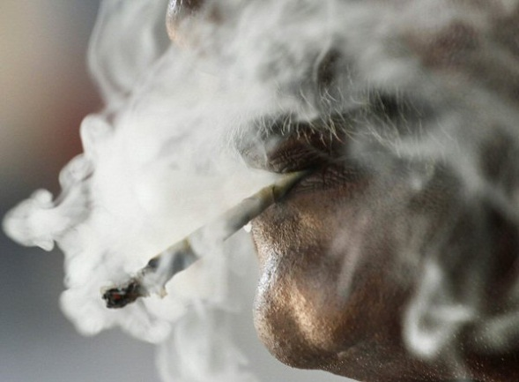

Smoking
Inhalation of tobacco smoke, most effective way for intoxication by nicotine
1 cigarette 1 - 3 mg of nicotine, 1 cigar cca 10 mg of nicotine
Inhaling into mouth only - absorbs 5% of nicotine, deep inhalation – absorbs 70%, very deep inhalation with holding breath - 95% of nicotine
Tobacco products for smoking (with nicotine-rich leaves of a tobacco plant) :
cigarette,
cigar and cigarillos,
pipe tobacco,
water pipe tobacco
Notes:
Obrázek - zdroj: ČTK/AP http://magazin.ceskenoviny.cz/zpravy/koureni-a-rakovina-aneb-nejde-jen-o-plice/1165944

Slide 3
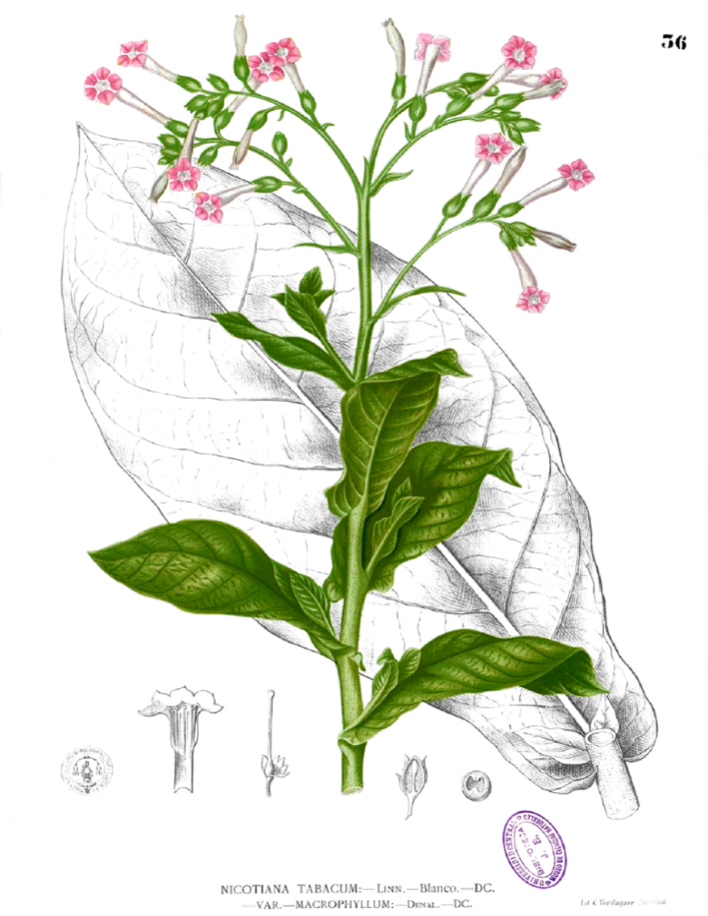
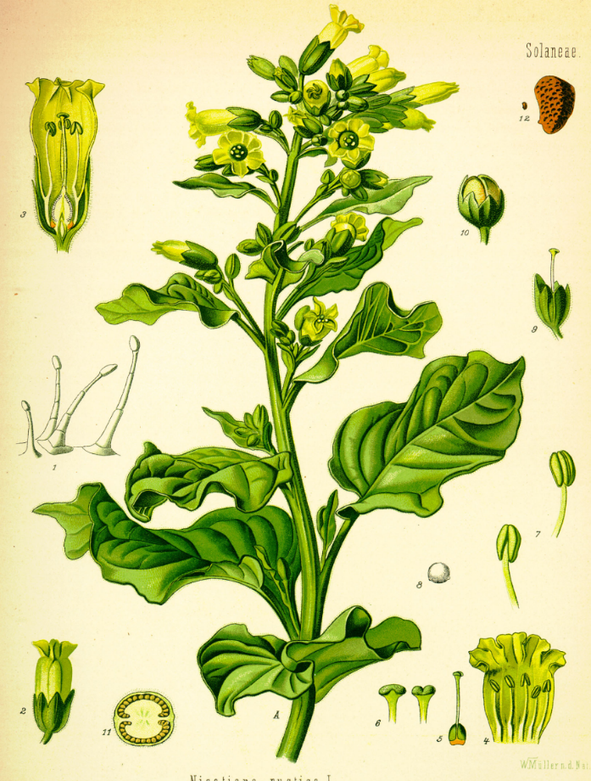
Tobacco plants
Nicotiana tabacum
Nicotiana rustica L.
French ambassador in Portugal, Jean Nicot de Villemain sent tobacco and seeds to Paris in 1560
Notes:
Nicotiana tabacum – tabák viržinský; původ Mexiko, pravděpodobně kříženec planých druhů N. sylvestris a N. tomentosa.
Nicotiana rustica L. – tabák selský – lidově Machorka, jeden z původních botanických druhů.

Slide 4
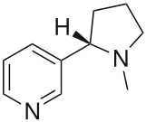
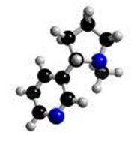
Nicotine
Plant alkaloid (from plant family Solanaceae)
Human lethal dose - cca 60 mg
Stimulating effects in nervous system
Increase digestive tract activity, increase blood pressure, cardiac acceleration, vasoconstrictor effects, related tissue and organ hypoxia
It is not a carcinogen itself
Its metabolites do
E.g. NNK - nicotine-nitrosamine ketone: a strong mutagen and a carcinogen present in tobacco smoke, naturally occurring in tobacco leaves of industrially treated tobacco crops in the presence of light
C₁₀H₁₄N₂
Notes:
Solanaceae: potatoes, eggplant, tomatoes, peppers… , but rich of nicotine is tobacco only

Slide 5
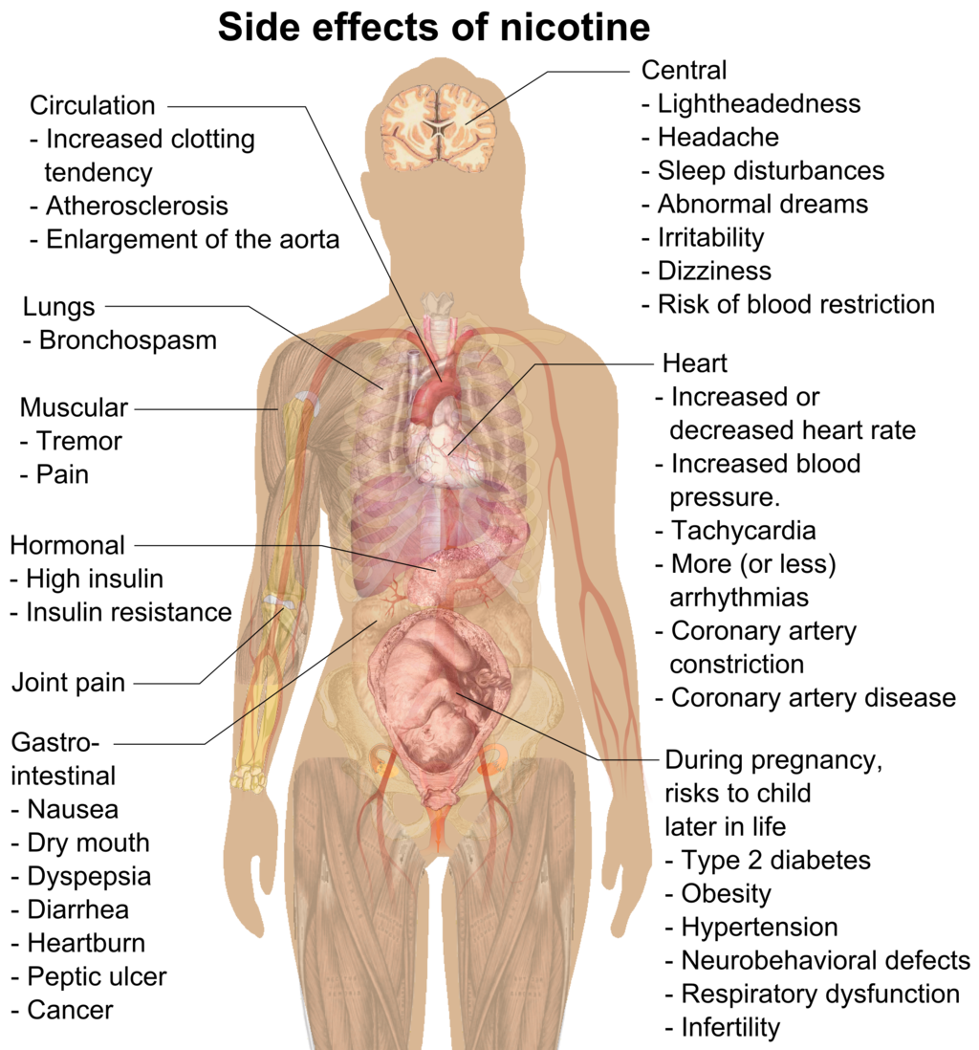
Side effects of nicotine

Slide 6
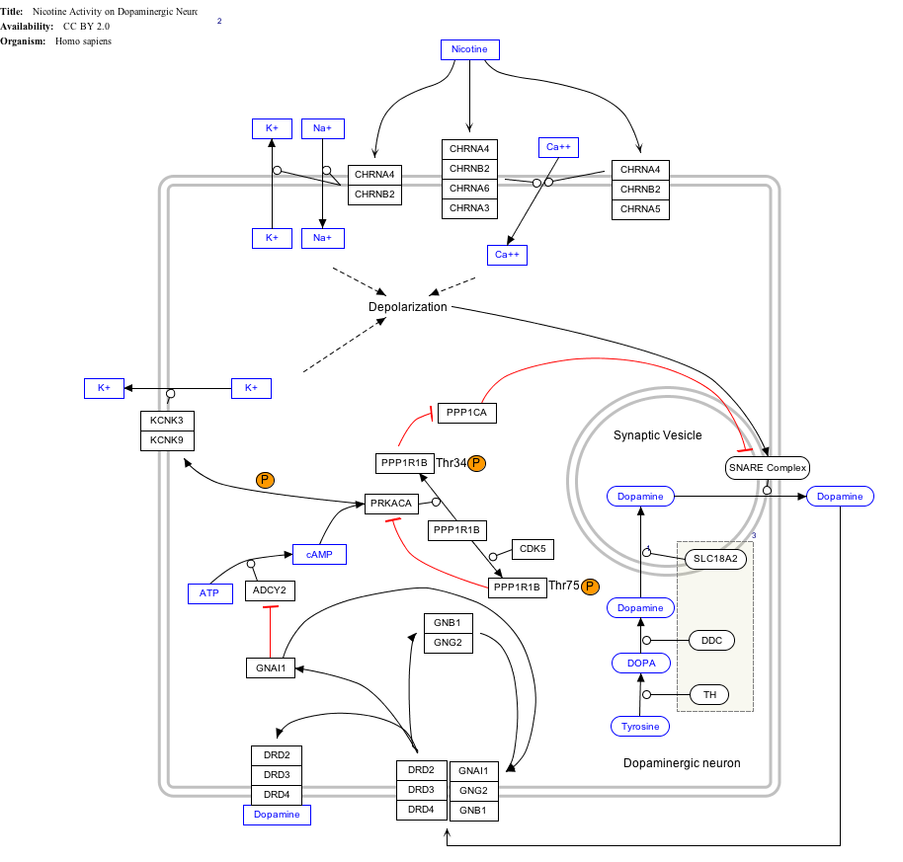
Effect of nicotine on dopaminergic neurons

Slide 7
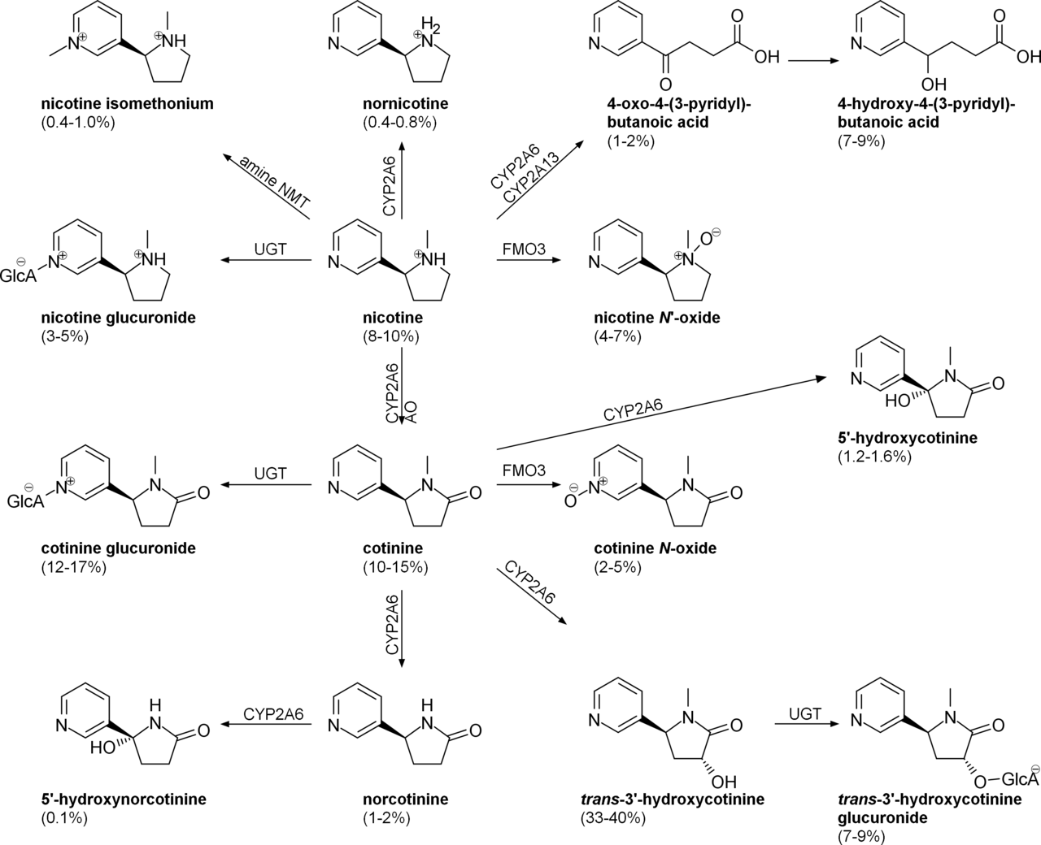
Urinary metabolites of nicotine, quantified as average percentage of total urinary nicotine

Slide 8
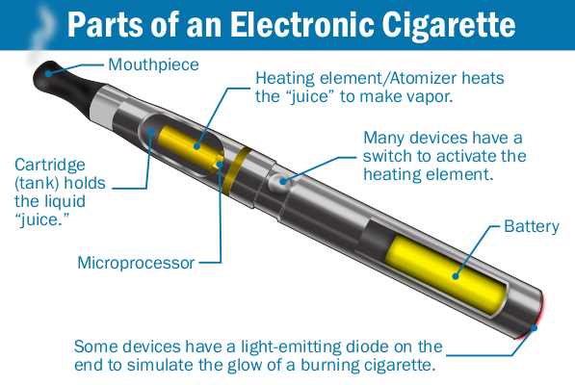
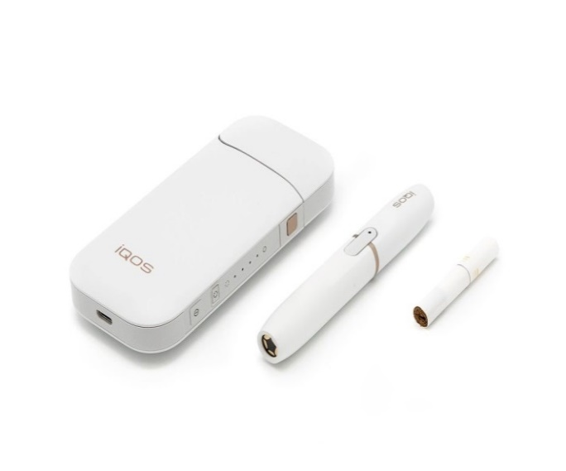
Smokeless use of nicotine
Electronic cigarettes, electronic pipe (nikotin liquid)
- IQOS + Heets (Marlboro)
(tobbaco inside)
Smokeless tobbaco products:
oral, chewing, snuff tobacco
(like a Snus or dipping tobacco)
Notes:
Obrázek - zdroj: https://en.wikipedia.org/wiki/Heat-not-burn_tobacco_product

Slide 9
Tobacco smoke
Approximately 1500 different chemicals are detected in the smoke of pipe and cigar tobacco, in cigarette smoke even more than 5000, of which:
Over 30 of them are contaminants of polluted air
Approximately 70 of these are considered as human carcinogens
WHO: Tobacco smoke is human carcinogenic mixture
A - arsenic - a toxic element, used since ancient times as a rat poison (soil, pesticides)
B - Benzene - carcinogenic, naturally occurring in oil, benzopyrene - a highly carcinogenic and mutagenic substance, a typical product of incomplete combustion (1/2 of exposure from cig.)
D - dioxins (a group of the strongest known poisons), DDT (a very effective insecticide, used to kill harmful insects until the late 1960s , then banned in most countries) - both highly persistent
F - Formaldehyde - formerly used as an insecticide to kill moths, as a disinfectant and sterilizing agent, as a part of chipboard adhesives or in the manufacture of carpets
K - cadmium - heavy metal, strongly cumulative mainly in kidneys, chemically similar to Zn - blockages and changes in biochemistry cycles (insulin cycle)
- hydrogen cyanide - one of the most poisonous gases (used in gas chambers during WW II, as
well as a mouse poison)
N - nickel - a highly toxic element, highly teratogenic
O - Lead - a toxic element, especially dangerous for children - causes slowing of mental development and behavioral disorders
TSNA - Tobacco-specific nitrosamines - a group of highly cancer-causing substances that are present only in tobacco products, are involved in many types of cancer, can damage reproductive organs (nitrite + AA)

Slide 10
The most famous components of tobacco smoke
Carbon monoxide (CO) - toxic gas; preferential binding to hemoglobin molecules - decreases the amount of oxygen transferred by blood, significantly lower overall oxygenation of the organism. The main component of exhaust gases.
Nitrogen dioxide (NO₂) - highly toxic gas, airway inflammation - from light forms to lung edema. Involved in the formation of acid rains and the formation of photochemical smog.
Nitric oxide (NO) - toxic gas, corrosive in the presence of moisture. In the human body it is formed in the cardiovascular and nervous system, it affects the vasodilatation, the signal molecules, the neurotransmitter function; in medicine, use in the release of smooth muscle cramps, during asthma. At higher doses - heart weakness. Releases in exhaust gases and co-operate in acid rain.
Tar - a mixture of chemicals (predominantly toxic and cancer-causing) such as polycyclic aromatic hydrocarbons (PAHs) or aromatic amines; has a dense oily or greasy consistency. In tobacco smoke it is dispersed in the form of an aerosol, 90% of which is deposited in the lungs of the smoker, 10% returns with exhaled smoke back to the atmosphere in its immediate vicinity.

Slide 11
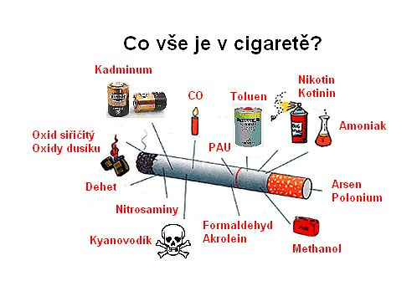
The most famous components of tobacco smoke

Slide 12
Health consequences of inhalation of tobacco smoke
It is involved in origin of about 25 diseases
Increased morbidity
Premature mortality
50% of smokers die as a result of smoking
Half of them, ie 25% die prematurely
Differences in mortality among smokers and non-smokers are statistically significant after 20 years of smoking
WHO: SMOKING IS THE MOST IMPORTANT PREVENTABLE (!) CAUSE OF DEATH IN THE WORLD

Slide 13
The British Doctors' Study 1951 - 2001
The longest prospective study - addressed more than 34,000 British doctors (more than 2/3 get involved). Basic hypothesis - "Smoking is a major cause of lung cancer". In 1951-1971, the difference in life span of smokers and non-smokers was 5 years, after another 20 years 8 years, and the latest study found a 10-year loss of life for British doctors-smokers as compared to lifetime non-smokers.

Slide 14
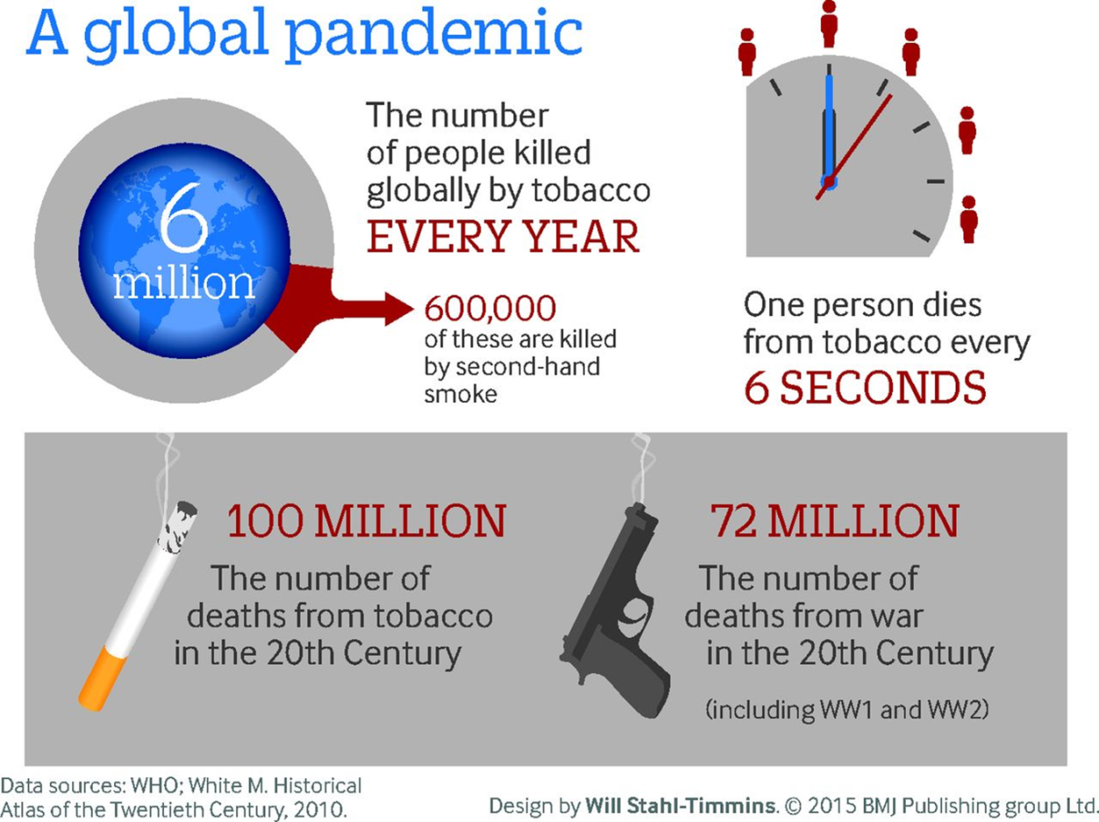
WHO: Global pandemic
Smokers mortality:
CVD (cardiovascular d.) 1,69 mil/rok
CHOPD (Chronic Obstructive Pulmonary Disease) 970 tisíc/rok
Lung cancer
850 tisíc/rok

Slide 15
Another smoking-related illness
Ca of throat, mouth and larynx, Ca of intestines and rectum, Ca of urinary tract, Ca of breast and cervix
Reproductive health
Dental health
Ulcer disease of the stomach and duodenum
Intestinal polyps, Crohn's disease
Immune disorders
Macular degeneration of the retina and cataracts
Hyposmia, earlier presbyakusia
Psychiatric disorders
Worsening of healing of wounds and skin lesions, increased wrinkle formation
Psoriasis
Tremor

Slide 16
Smoking during pregnancy and prenatal exposure to tobacco smoke
Intrauterine retardation (lower birth weight and length, smaller head and chest circumference)
More common birth defects
The withdrawal symptoms of children after childbirth
Sudden Infant Death Syndrome - SIDS
Behavioral Disorders, Socialization, Learning difficulties - ADHD
CVD programming (obesity, irreversible changes in serum lipid spectrum)

Slide 17
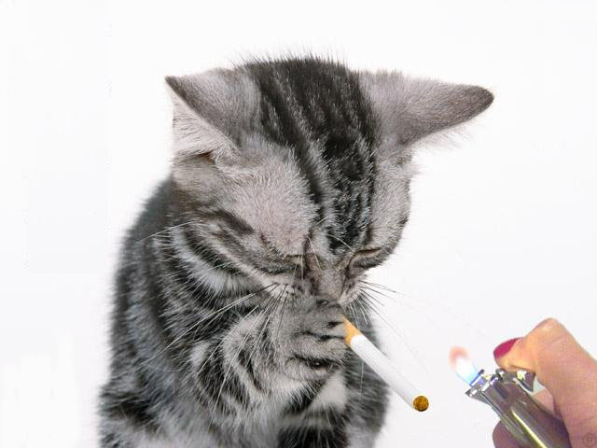
Active and passive smoking
Active - "Voluntarily"
First-hand smoke
Main stream
Temperature 800-900 ° C
O₂ content around 16%
Passively - involuntarily
Second-hand smoke (environmental tobacco smoke)
Side stream
Temperature 600 ° C
The content of O₂ about 2%
Higher content of some chemicals (acetone, acrolein, formaldehyde, ammonia, cadmium, CO, naphthalene, toluene, polonium 210 ...)
Notes:
Obrázek: Zdroj: http://allfunnyiffo.blogspot.cz/2013/02/funny-animals-smoking-best-photos-and.html

Slide 18
Residual smoke: Third-hand smoke
The form of passive smoking - "third-hand"
Specific smoking product: residues of nicotine and other chemicals from smoke and products of their interaction with other substances in the (polluted) environment (ozone, nitric acid) + fine dust (from the environment, from combustion of cigarettes)
Persistent toxic and carcinogenic substances - nitrosamines
Contamination of surfaces in interiors
Furniture, textiles, objects in houses and cars
The most vulnerable group – children (immature biological structures, faster breathing frequency, lower breath zone, specific habits - climbing on four, licking hands ...)

Slide 19
Prevalence of tobacco smoking
In the Czech Republic:
The overall prevalence of cigarette smoking over the past 15 years: about 30%
By gender male 36%, women 26%
By age - under 15: up to 33%, 15-24 years: 43%, 25-44 years: 33%, 45-64 years: 28%, over 65: 20%
Use of tobacco products other than cigarettes around 2 - 2.5%; e-cigarettes 1.7%
Source: SZÚ 2013: Use of tobacco and alcohol in the Czech Republic in 2012
In the world:
http://www.who.int/gho/tobacco/use/en/

Slide 20
Definition of smoking by WHO
Regular smoker - at least 1 cigarette / day
Occasional smoker - less than 1 cigarette / day
Former smoker - at the time of the study he/she has not smoked for at least 6 months, smoked more than 100 cigarettes during his/her life / was a regular smoker for more than 6 months
Non-smoker - He has not smoked more than 100 cigarettes in his lifetime
Defined by the International Union Against Cancer (UICC) in Lyon 1976

Slide 21
Tobacco abuse and addiction
Nicotine addiction - Dg. F17 according to the International Classification List of Diseases: "Mental and behavioral disorders caused by the use of tobacco"
In children and adolescents - rapid development of physical dependence (brain development not complete: limbic structures = emotional component of behavior, frontal cortex = cognitive component, proven cognitive deficit in adulthood)
Consequences at the age of 30-60: Reduction of audio-verbal learning, reduction of visual spatial memory, reduction of cognitive abilities, reduction of physical performance, reduction of general intelligence, reduction of postural stability and motor dexterity.
Notes:
Durazzo TC et al., Drug Alcohol Depend 2011;doi:10.1016/j.drugalcdep.2011.09.019

Slide 22
The origin and development of the disease
Three stages of disease development:
- Psychosocial stimuli
- Strengthening "psychic addiction„
- Syndrome of addiction - in 60-80% of smokers
Addiction syndrome - a set of behavioral, cognitive and physiological phenomena that develops after repeated use of the substance, and which typically includes i.c. so-called withdrawal symptoms.

Slide 23
Withdrawal symptoms
craving - craving, urge, desire
bad mood, depression, irritability to aggression, anger, frustration, anxiety
insomnia, fatigue, headaches
increased appetite
nausea, constipation, flatulence
decrease in blood pressure, dizziness
less ability to concentrate and manage stressful situations
Notes:
První za 2h, maximum po 24-48h, doba trvání 3 týdny – 3 měsíce, ve vlnách, nejčastější příčina relapsu. Minnesotská škála abstinenčních příznaků – 15 bodů, podle intenzity výběr léčby.

Slide 24
Diagnosis of addiction
In the Czech Republic, it is underestimated - in hospitalized patients only 1.5% diagnosed with Dg. F17
In general, the diagnosis of tobacism is also mentioned in the Czech legislation: Act No. 65/2017 Coll.
Diagnosis in practice: the procedure is not well defined, recommended combination of assessment of typical addiction traits (eg by the American Psychiatric Society using tobacco more than a year + min. 2 positive responses for typical dependencies) and assessment of the degree of addiction - Fagerström test and Minnesota's school of withdrawal symptoms (https://www.ncbi.nlm.nih.gov/pmc/articles/PMC2527730/)

Slide 25
Fagerstrom Test of Nicotine Dependence
1. How soon after you wake up do you smoke your first cigarette?
After 60 minutes 0
31-60 minutes 1
6-30 minutes 2
Within 5 minutes 3
2. Do you find it difficult to refrain from smoking in places where it is forbidden?
No 0
Yes 1
3. Which cigarette would you hate most to give up?
The first in the morning 1
Any other 0
4. How many cigarettes per day do you smoke?
10 or less 0
11-20 1
21-30 2
31 or more 3
5. Do you smoke more frequently during the first hours after awakening than during the rest of the day?
No 0
Yes 1
6. Do you smoke even if you are so ill that you are in bed most of the day?
No 0
Yes 1

Slide 26

Program of 5 A‘s for Smoking Cessation
Ask
Advice
Assess (Assess the willingness to stop, or to motivate)
Assist (Help – NRT - nicotine replacement therapy, centre)
Arrange follow up (Schedule checks)
Notes:
Mimořádně důležitá – týká se všech lékařů i ostatního zdravotnického personálu – autorita, důvěra pacienta, znalosti, příležitost ovlivnit pacienta! Program 5A – u nás někdy zjednodušován na 4A – vynechání prostředního bodu
První tři body – každý!!! Lékař, další dva – specialisté v centrech
ASK – odběr kuřácké anamnézy – vždy se ptát, vždy vyjádřit nesouhlas s kouřením, ne až při klinické manifestaci následků kouření
ADVICE – personifikovat riziko – na základě zdravotního stavu, rodinné anamnézy, sociálního postavení
ASSESS – zvážit, co dál, zda pacient chce odvykat, jestli je schopen sám, zda půjde do specializovaného centra…
ASSIST – stanovení intenzity závislosti, volba vhodné metody a doplňkové terapie, příprava na den D, …
ARRANGE… - sledování nejméně po dobu 1 roku, zpočátku časté kontroly (2 týdny) – podpora motivace, překonání nejkrizovějšího období, příprava na život bez cigarety

Slide 27
Treatment of the physical component of the addiction: minimizing withdrawal symptoms
Substitutional - Nicotine replacement therapy (NNT) Pharmacotherapeutical - Bupropion, Varenicline
Behavioral (psychotherapy)
Alternative (lack of evidence of efficacy, according to EBM can not be recommended as an effective treatment option)

Slide 28
Nicotine replacement therapy NRT
minimizes withdrawal symptoms
CI (relative): CV disease, pregnancy, childhood - even in these cases always healthier than smoking
NE: throat burns, hiccups, indigestion, nausea, palpitations, headache
Dosage: Individual setting, about 3 months to stay at the starting dose, further 3 months - of gradual dose reduction after 2 weeks
Notes:
Problematika podávání NNT v těhotenství: N prochází placentou – neuroteratogen, narušení vývoje dopaminergního a serotonergního systému = ADHD, poruchy chování, pozornosti, nižší porodní hmotnost,…
Dlouhodobě – N se metablizuje na NNK (nitrosamin..) – nejpotentnější plicní karcinogen, promotor karcinogeneze i ostatních (dětských!) nádorů

Slide 29
Forms of NRT
Chewing gums 2 mg, 4 mg (260, -) the right technique !!!
Nicorette plaster 5, 10, 15 mg, 16h (570, -)
Niquitin CQ 7, 14, 21mg, 24h (460, -)
Inhaler 10, 15 mg (360 - 400, -)
Sublingual tablets: 2 mg
Oral spray 1 dose 1 mg of nicotine, pack of 150 mg of solution (370, -)
Pastilles 1.5 mg, 4 mg
Orodispersible film
They differ in pharmacokinetics, the possibility of combining of continuously acting patches/plasters with other forms influencing peaks.
Notes:
Žvýkačky – nejstarší forma NNT – od 60. let američtí námořníci v ponorkách. Vstřebávání v alkalickém ph dutiny ústní – rozžvýkat, 2-3min nechat, nepolykat, celk. doba 30-45min
Náplasti – i nejslabší pro kuřáky od 10 cig./den!

Slide 30
Farmakotherapy
It reduces the intensity of withdrawal symptoms similar to NRT, but without nicotine
The need for long-term treatment: at least 3-6 months, individually and much longer
Mostly good tolerance, beware of interaction with drugs used in psychiatry
Bupropion
Vareniclin
Cytisin
Combination options with NRT

Slide 31
Combined treatment
NRT - different forms combined among themselves
Bupropion + NRT
Varenicline + NRT
All the above mentioned ideally combine with behavioral psychotherapy

Slide 32
Treatment of behavioral addiction
An integral and necessary part of the curing/cessation process !!!
Psychosocial complex approach
Advice - should be provided by an expert - trained specialist
Not yet so available in the Czech Republic
Network of available services:
Smoking cessation counseling
Smoking cessation centers

Slide 33
Harm reduction
Efforts to reduce the health risks of smoking
Can not talk about "healthier" smoking, it's just a reduction of toxicity
Apply this approach only after failure of verified methods
Principle: Permanent reduction of the number of smoked cigarettes (most commonly NRT or pharmacotherapy)
E-cigarettes, vaporizers: Recommended as harm reduction products or for smoking cessation, but many experts disagree
Current lifestyle change (nutrition, movement, etc.)
It is absolutely necessary to reject the hookah/water pipe as a means of HR, the harmfulness for active and passive smokers similar to the cigarette

Slide 34
Prevention of smoking
Comprehensive approach:
Changing attitudes and viewing the society on smoking
Education, information, enlightenment
availability of tobacco for children and teenagers
(legislation and its enforceability, economic
instruments, ...)
Beware of the opposite effect, especially among young people !!!
Solving problem of smoking with other forms of risky behavior
Necessary part of prevention - helping to quit smoking

Slide 35
Legislation in prevention
Smoking restriction
Restrictions of advertisement
Terms and rules of production and distribution
of tobacco products
- Conditions of labelling and warning
- Act No. 65/2017 Coll., On the protection of health against harmful effects of addictive substances
- Decree No. 37/2017 Coll., On e-cigarettes ...
- Differences between countries, including within the EU

Slide 36
Economic and social aspects of smoking
High spending on health care
Receipt of finance from the taxation of tobacco products into the state budget
Problems: strong tobacco lobbies (?), Non-transparent transfers of funds (?) - no clear arguments
The tendency of smoking in the socially weaker groups, getting poorer, the vicious circle, the economic and social interdependence - the connection to the social and health system

Slide 37
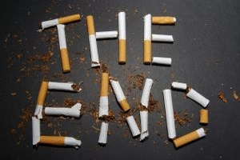
Thanks for your attention!

