Slide 1
Therapeutic Diets in School Food Service,
Most Common Therapeutic Diets
2018
Mgr. Zlata Kapounová, Ph. D., Mgr. Aleksandra Nikolić, Mgr. Veronika Volavá, Bc. Iuliia Pavlovská, Bc. Petra Ferenčuhová

Slide 2
Outline of the seminar:
School Food Service - School meals
Legislation
Therapeutic diets
Vegetarian and other unconventional diets (2nd Seminar)

Slide 3
SCHOOL FOOD SERVICE IMPORTANCE AND PURPOSE
The main purpose of School Food Service is to ensure high-quality meals for children during the time they spend at school:
Traditional satiating role (35 % daily energy requirements, 60 % for kindergarden)
Health supporting role (norms – recommended consumer basket for school meals, hygienic standards - food safety – nutritional value of meals served corresponding to dietary guidelines)
Educational role - encouraging children to eat a healthy and varied diet (dining etiquette, new meals, good example of a healthy lifestyle)
We must teach children to eat well so that they could keep that pattern in their further life and be protected from “lifestyle“ diseases.

Slide 4
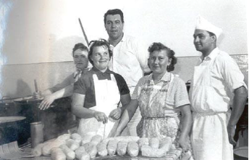
HISTORY OF SCHOOL FOOD SERVICE
IN THE CZECH REPUBLIC
There is a longtime tradition of School Food Service in the Czech Republic. Their roots go back to the year 1946.
At that time the inhabitants of most European countries, devastated by the World War II, tried to rectify the war consequences – rebuild homes, renew industry, revive school system, culture, healthcare… to make people’s lives easier and meaningful again.

Slide 5
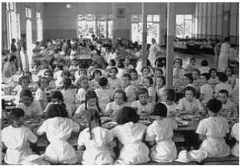
HISTORY OF SCHOOL FOOD SERVICE
IN THE CZECH REPUBLIC
Later, as more and more women - mothers - went to work, the institution of School Food Service (school meals) gained in importance.
At the beginning it was just an initiative of a few schools. Later the responsibility was taken over by municipalities and in 1960 a government resolution charged the Ministry of Education to supervise School Food Service.
The popularity of School Food Service increased dramatically and in the 1970s it was able to procure school meals to all children interested, which represented a large majority.

Slide 6
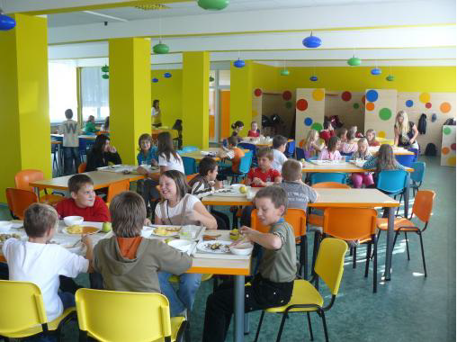
SCHOOL FOOD SERVICE IN NUMBERS (2015)
About 1 733 686 school meals are served daily:
1 379 778 meals for children
194 590 meals for school employees
159 318 meals for outsiders
Meals are daily made:
in 8 454 school lunchrooms
by 6 678 school lunchrooms managers
by 26 893 cooks and other employees in the kitchen
by 33 759 people in total

Slide 7

LEGISLATION
Education Act no. 561/2004
Decree on School Food Service no. 107/2005
Hygiene and food safety regulations
the Labour code

Slide 8
Decree no.107/2005.,on School Food Service, as amended by Decree no.107/2008 . and Decree no. 17/2015, takes the following wording:
“(4) The boarders whose health condition requires a special restricted diet as confirmed by a registered child/adolescent medical practitioner⁸⁾ may be provided with special diet meals. In case of School Food Service this must be under conditions given by their internal rules. In case of a third party provider this must be in accordance with agreements on School Food Service procurement.
(5) The choice of foods, recipes, cooking methods and the menu planning for meals under a therapeutic diet must be done by a dietitian⁹⁾.“

Slide 9
DECREE OF MINISTRY OF EDUCATION ON SCHOOL FOOD SERVICE – UPDATE
DECREE no. 210/2017 Coll .
dated from 26 June 2017,
which changes the Decree no. 107/2005 Coll., on School Food Service, as subsequently amended
According to § 35 section 2, § 121 section 1 and § 123 section 5 of the Act no. 561/2004 Coll., on Pre-school, Primary, Secondary, Higher Professional and Other Education (Education Act), and in agreement with the Ministry of Health according to § 121 section 2 of the Education Act, the Ministry of Education defines:

Slide 10
Article. I
Decree no. 107/2005 Coll., on School Food Service, as amended by the decree no. 107/2008 Coll., decree no. 463/2011 Coll. and decree no. 17/2015 Coll., takes the following wording:
§ 2 section 5 including footnotes no. 9 and 10 says:„(5) When providing therapeutic diet meals the food service provider uses recipes approved by a:
a) dietitian⁹,
b) medical practitioner with specialization (in)¹⁰:
1. general practitioner for children and adolescents
2. pediatry,
3. internal medicine,
4. general practitioner,
5. endocrinology and diabetology, or
6. gastroenterology, or
c) medical practitioner with specific qualification in¹⁰:
1. hygiene of children and adolescents,
2. hygiene of nutrition and articles of daily use,
3. endocrinology and diabetology for children, or
4. gastroenterology and hepatology for children”

Slide 11
THE FUTURE
SCHOOL FOOD SERVICEACTIONS
Despite all obstacles:
the School Food Service continuously tries to raise public awareness of healthy nutrition
a lot of conferences and lectures for school lunchrooms employees take place in Brno and other Czech cities
a largely publicized contest for the Best school lunch is organized every year
children in the whole country are encouraged to taste new healthy meals in a modern and attractive way - the school lunchrooms organize thematic days such as Days of Thai, Norwegian or Spanish cuisine.

Slide 12
THERAPEUTIC DIETS

Slide 13
THERAPEUTIC DIETS IN SCHOOL FOOD SERVICE
  Colaboration with a registered dietitian or, newly, with a medical practitioner with specialized qualification or with specific specialized qualification
  Diets which will be prepared.
  Recipes and technical procedures for those diets.
  Menus.
  Personal, technical, spatial equipment.
  Medical certificate from the boarder.
  Staff training.
  Therapeutic diets introduction.

Slide 14
THERAPEUTIC DIETS FOR CHILDREN
  Most common therapeutic diets in childhood:
    Gluten-free diet
    Dairy-free or milk-free diet
      Diets in other food allergies and intolerances
    Bland diet
    Diabetic diet

Slide 15
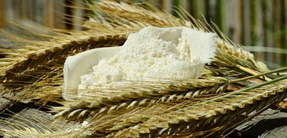
GLUTEN-FREE DIET

Slide 16
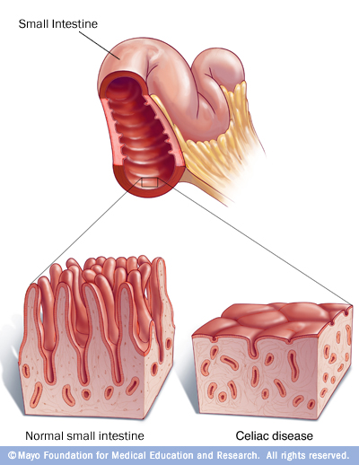
Diseases caused by gluten pathogenesis
Autoimmune
  Celiac disease
    Symptomatic
    Silent
    Latent
  Dermatitis herpetiformis (Duhring)
  Gluten ataxia
Allergic
  Wheat allergy
    WDEIA (Wheat-dependent exercise-induced anaphylaxis)
    Food allergy
    Respiratory allergy
    Contact urtcaria
    Baker΄s asthma – occupational asthma afflicting bakers, caused by breathing in wheat flour
Non-autoimmune non-allergic
  Non-celiac gluten sensitivity

Slide 17
CELIAC DISEASE = CELIAC SPRUE = GLUTEN ENTEROPATHY
Impaired tolerance of the protein gliadin
Subtotal villus atrophy accompanied by enzyme deficiency
20-30 % active clinical form, other in adulthood
Diagnosis
  1. enterobiopsy of small intestine
  2. positive autoantibodies – against gliadin, endomysium and tissue transglutaminase
Gluten-free diet

Slide 18
GLUTEN-FREE DIET
Goal:
to reduce the amount of gluten in the diet as much as possible
 elimination of all food containg gluten from the diet
Adherence to gluten-free diet is imperative:
  for people with celiac disease
  for people with gluten (wheat) allergy

Slide 19
CELIAC DISEASE x GLUTEN (WHEAT) ALLERGY
Celiac disease - lifelong disease caused by gluten intolerance
 lifelong adherence to gluten-free diet
  people with celiac disease may commonly tolerate approx. 20 mg of gluten - vary significantly from person to person
    people with celiac disease should not exceed the total of 20-50 mg gluten daily. However, in most sensitive individuals histologic changes were observed after consumption of only 10 mg gluten / day.

Slide 20
CELIAC DISEASE x GLUTEN (WHEAT) ALLERGY
Gluten (wheat) allergy
disease caused by an excessive immune system reaction
symptoms may appear even after consumption of traces of gluten
risk of meal contamination

Slide 21
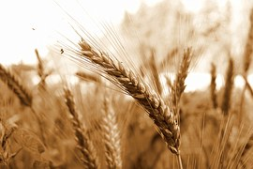
WHAT IS GLUTEN ?
protein fraction
appears in the inner part of the grain of some cereals
   wheat and its cultivars, rye, triticale, barley, oats
significant for bakery products structure (crumb)

Slide 22
GLUTEN
gluten – protein fraction
mixture of water-insoluble proteins
  glutenins + prolamins (40-50 %) – different toxicity
swells in water, is responsible for dough elasticity and extensibility, gives structure to baked goods. Products made with high-gluten flour have bigger volume and keep their shape better.
Prolamins – responsible for development of celiac disease
wheat  gliadins, rye  secalins, barley  hordeins
  contain high amount of glutamine and proline, ß-helix
oats  avenins
  contain moderate amount of glutamine and low amount of proline
regarding the celiac disease the following amino acids sequences are described as significant - toxic
  proline-serine-proline-glutamine
  glutamine-glutamine-glutamine-proline

Slide 23
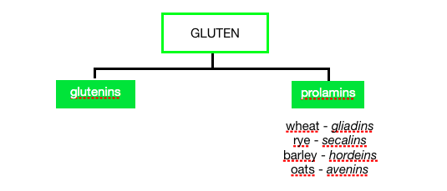
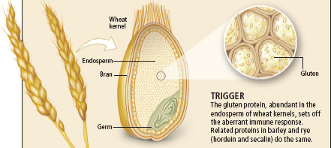
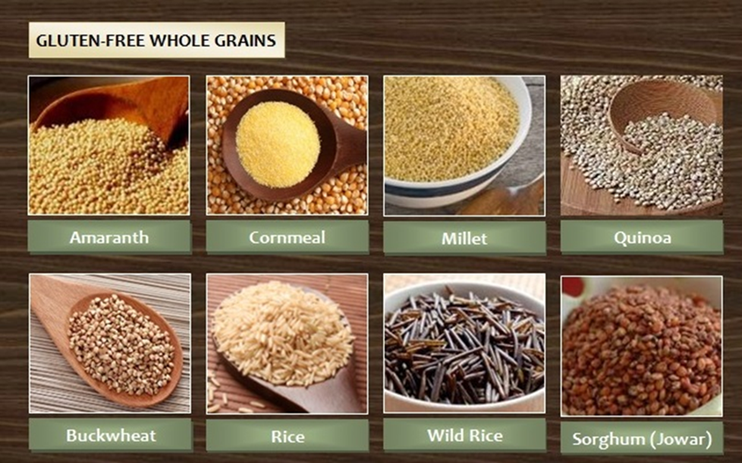
GLUTEN
wheat, rye, barley, oats (?)
Gluten-free
Cereals: rice, corn, millet, sorghum
Pseudocereals: buckwheat, amaranth, quinoa,
Canihua, teff

Slide 24
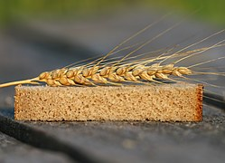
GLUTEN-FREE DIET
   elimination of wheat, rye, triticale, barley, oats
  and any products made from these cereals from the diet

Slide 25
GLUTEN-FREE DIET
   elimination of wheat, rye, triticale, barley, oats (?)
  and any products made from these cereals from diet
  Most people with gluten intolerance can eat oats without experiencing negative effects on their health. However, there is a high risk of contamination with wheat, rye or barley!!!
  According to Canadian Celiac Association the safe dose of oats is 70 g for adults and 25 g for children.

Slide 26

MAIN GLUTEN SOURCES
flour, starch
bread, baked products, breadcrumbs, crackers, biscuits, wafers
pasta, dumplings
hulled barley, pearl barley, oats, muesli, breakfast cereals, puffed grains
products containing malt

Slide 27
POSSIBLE GLUTEN RESOURCES
products where flour or starch made of gluten-containing cereals may be added
      instant products
      meat products
      dairy products
      ketchup, mustard, mayo, tartar sauce
      soya sauce
      sweets
      ice-cream
      fruit and vegetable spreads
      mixed spices
      baking powder …

Slide 28
GLUTEN CEREALS SUBSTITUTES
Common
  rice, corn,
  millet, buckwheat,
  quinoa, amaranth
Less known
  sorghum,
  teff (eragrostis tef),
  manioc,
  chestnut flour, hemp flour, pumpkin flour, flaxseed flour etc…
Notes:
Cvičení – poznávání vzorků obilovin

Slide 29
PRINCIPLES OF A THERAPEUTIC DIET PREPARATION
is not different from other meals, only gluten-free ingredients are used,
all cooking methods are usually allowed,
preparation separated in time or spatially,
it is necessary to clean all surfaces, cutting boards and utensils after gluten-containing foods have been handled, especially if flour has been used. There may be special set of dishes reserved for GF diet,
gluten-free side dishes must be prepared separately,
never fry gluten-free foods in oil where gluten foods have been previously prepared,
for common foods such as jam, butter, mustard etc. clean utensils (spoons, knives) must always be used

Slide 30
GLUTEN ON FOOD LABELS
Regulation (EC) No. 41/2009 defines:
  products may bear the term ‘GLUTEN-FREE’ if the gluten content does not exceed 20 mg/kg of the food as sold to the final consumer.
  products shall bear the term „VERY LOW GLUTEN“ if they do not contain a level of gluten exceeding 100 mg/kg of the food as sold to the final consumer.
  Labelling „GLUTEN-FREE“ or „VERY LOW GLUTEN“:
  shall appear in proximity to the name under which the food is sold.
  the use of ‘no gluten containing ingredients’ (NGCI) and similar factual statements other than the ones mentioned in the Regulation, cannot be used in any food labelling.

Slide 31
GLUTEN ON FOOD LABELS
  Regulation (EC) No. 41/2009 of 20 January 2009 concerning the composition and labelling of foodstuffs suitable for people intolerant to gluten.
    valid since 1/1/2012
    since 1/1/2012 only foodstuffs that comply with the provisions of the Regulation may be placed on the market
    the Regulation makes the gluten labelling unified
    it defines unified European rules for the composition and labelling regarding gluten
    it replaces previous national requirements defined by the Decree of Ministry of Health No. 54/2004 Coll. on Foodstuffs Intended for Particular Nutritional Uses and on the Method of Their Use
    it aims to classify foods on the market according to their gluten content so that consumers can choose products corresponding to their needs and sensitivity.

Slide 32

GLUTEN ON FOOD LABELS
…gluten-free diet and OATS
  toxic sequences of amino acids in oats were found to be much less frequent
   low or no toxicity
  studies did not confirm any significant alterations in gut mucosa in patients after longterm oats consumption
  some studies point at higher incidence of antibodies against avenin in some patients
  (5 % of celiacs is oat-sensitive)
  the main danger lies in the risk of possible contamination with wheat, rye or barley
  Codex Comittee on Nutrition and Foods for Special Dietary Uses
    suggestion of final standard for gluten-free foodstuffs
    oats is not globally forbidden for people with celiac disease, however it might be forbidden by national legislation
  According to the Regulation EC No. 41/2009
    Oats contained in foodstuffs for people intolerant to gluten must have been specially produced, prepared and/or processed in a way to avoid contamination by wheat, rye, barley, or their crossbred varieties and the gluten content of such oats must not exceed 20 mg/kg.

Slide 33
…gluten-free diet and OATS
Most people with intolerance to gluten can include oats in their diet without adverse effect on their health. This is an issue of ongoing study and investigation by the scientific community. However, a major concern is the contamination of oats with wheat, rye or barley that can occur during grain harvesting, transport, storage and processing. Therefore, the risk of gluten contamination in products containing oats should be taken into consideration with regard to the relevant information provided on those food products by food business operators.

Slide 34

GLUTEN ON FOOD LABELS
Other statements - voluntary labelling
  May be used provided they do not mislead consumers and they must always be accompanied by the terms defined in the Regulation (EC) No. 41/2009, i.e. ”gluten-free“ or “very low gluten.“
  Statement „suitable for people intolerant to gluten’ or ‘suitable for celiacs’
  the Crossed Grain symbol
So called advisory statement - „may contain traces of gluten“
  the allergenic part was not used in the product but it might be present in the foodstuff due to unintentional contamination during processing
  the use of advisory statement has to be well-grounded, e.g. based on risks analysis, production devices screening or final inspection

Slide 35
Foodstuffs for specific nutritional uses
Certain foods have been specially produced, prepared and/or processed to reduce the gluten content of one or more gluten-containing ingredients or to substitute the gluten-containing ingredients with other ingredients naturally free of gluten. Other foods are made exclusively from ingredients that are naturally free of gluten.
The removal of gluten from gluten-containing grains presents considerable technical difficulties and economic constraints and therefore the manufacture of totally gluten-free food when using such grains is difficult. Consequently, many foods especially processed to reduce the gluten content of one or more gluten-containing ingredients on the market may contain low residual amounts of gluten.

Slide 36
GLUTEN FREE
In collaboration with the European Food Safety Authority (EFSA), the European Commission has developed a list of ingredients that do not have to be labelled as being from a gluten containing cereal. In this case, the grain has been processed to remove gluten and it has been proved there are no more allergenic residues. In case of cereals, these ingredients are defined in the Decree No. 113/2005 Coll.:
glucose syrups derived from wheat or barley including dextrose
wheat based maltodextrins
distilled ingredients made from cereals that contain gluten e.g. alcoholic spirits

Slide 37
Regulation No. 828/2014 on the Requirements for the Provision of Information to Consumers on the Absence or Reduced Presence of Gluten in Food
In case the allergen was not added to a food intentionally as an ingredient and the package bears the advisory statement „May contain traces of…“, then the amount of the allergen should not be detectable by a certified laboratory method (the given foodstuff will be considered as allergen free).
Tolerance is not defined by any legal regulation. If the amount of the allergen in a food is at borderline of detection or lightly higher (e.g. for inspection purpose SZPI considers as lightly higher values higher at most 10 times), it can be accounted as trace amount and the statement is convenient..
The advisory statement „May contain traces of…“ cannot be used freely. The producer must verify the HACCP record, analyses, tests for allergens etc. in the enterprise where the food is produced.

Slide 38

Application

Slide 39
MENU gluten-free (GF) diet - practical exercise
TASK:
Highlight those foods in the meal plan that are not suitable for a GF diet
Modify the meal plan, substitute unsuitable foods with foods for a GF diet.
B: Wholewheat roll, vegetable margarine, ham,
tomato, coffee substitute with milk
Snack: Fruit yogurt with puffs
L: Soup with couscous,
Spaghetti with chicken, cream and broccoli
Snack: Spelt roll with butter, salmon, cheese and rucola salad
D: Scrambled cauliflower with eggs, bread

Slide 40
MENU gluten-free (GF) diet - practical exercise
B: Wholewheat roll, vegetable margarine, ham slice, tomato, coffee substitute with milk
Snack: Fruit yogurt with puffs
L: Soup with couscous, Spaghetti with chicken, cream and broccoli
Snack: Spelt roll with butter, salmon, cheese and rucola salad
D: Scrambled cauliflower with eggs, bread
B: Wholewheat roll, vegetable margarine, ham, tomato, coffee substitute with milk
Snack: Fruit yogurt with puffs
L: Soup with couscous, Spaghetti with chicken, cream and broccoli
Snack: Spelt roll with butter, salmon, cheese and rucola salad
D: Scrambled cauliflower with eggs, bread

Slide 41
MENU gluten-free (GF) diet - practical exercise
B: Wholewheat roll, vegetable margarine, ham, tomato, coffee substitute with milk
Snack: Fruit yogurt with puffs
L: Soup with couscous, Spaghetti with chicken, cream and broccoli
Snack: Spelt roll with butter, salmon, cheese and rucola salad
D: Scrambled cauliflower with eggs, bread
B: Gluten-free roll, vegetable margarine, ham, tomato, tea or milk
Snack: Plain yogurt with fruit and GF muesli
L: Soup with millet, Corn spaghetti with chicken, cream and broccoli
Snack: GF rollwith butter, salmon, cheese and rucola salad
D: Scrambled cauliflower with eggs, GF bread

Slide 42
FOOD ALLERGY AND INTOLERANCE

Slide 43
FOOD ALLERGY AND INTOLERANCE
Food allergy
  is an abnormal immune response to food  the immune system excessively reacts to food allergens, which would not represent any danger for an individual under normal conditions
  more frequent in children
  in central Europe the typical allergies are to milk, eggs, fruits of temperate zone, nuts, poppy seeds and root vegetables
Food intolerance
  Might be caused by partial or complete deficiency of certain enzyme.

Slide 44
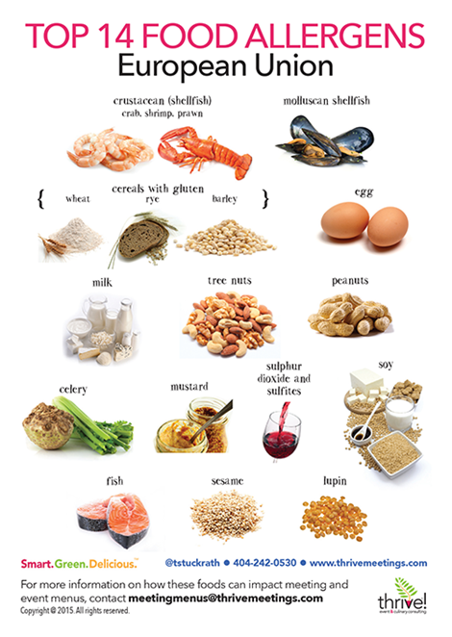
aLLERGENS 1
Food ingredients that must be declared as allergens in the EU
1. Cereals containing gluten, namely: wheat (such as spelt and
khorasan wheat), rye, barley, oats or their hybridised strains,
and products thereof, except:
(a) wheat based glucose syrups including dextrose
(b) wheat based maltodextrins
(c) glucose syrups based on barley
(d) cereals used for making alcoholic distillates including ethyl
alcohol of agricultural origin
2. Crustaceans and products thereof
3. Eggs and products thereof
4. Fish and products thereof, except:
(a) fish gelatine used as carrier for vitamin or carotenoid preparations
(b) fish gelatine or Isinglass used as fining agent in beer and wine

Slide 45
aLLERGENS 2
5. P5. Peanuts and products thereof
6. Soybeans and products thereof, except:
(a) fully refined soybean oil and fat
(b) natural mixed tocopherols (E306), natural D-alpha tocopherol, natural
D-alpha tocopherol acetate, and natural D-alpha tocopherol succinate
from soybean sources
(c) vegetable oils derived phytosterols and phytosterol esters from
soybean sources
(d) plant stanol ester produced from vegetable oil sterols from
soybean sources
7. Milk and products thereof (including lactose), except:
(a) whey used for making alcoholic distillates including ethyl
alcohol of agricultural origin
(b) lactitol

Slide 46
aLLERGENS 3
8. Nuts, namely: almonds (Amygdalus communis L.), hazelnuts
(Corylus avellana), walnuts (Juglans regia), cashews (Anacardium
occidentale), pecan nuts (Carya illinoinensis (Wangenh.) K. Koch),
Brazil nuts (Bertholletia excelsa), pistachio nuts (Pistacia vera),
macadamia or Queensland nuts (Macadamia ternifolia), and products
thereof, except for nuts used for making alcoholic distillates including
ethyl alcohol of agricultural origin
9. Celery and products thereof
10. Mustard and products thereof
11. Sesame seeds and products thereof
12. Sulphur dioxide and sulphites at concentrations of more than
10 mg/kg or 10 mg/litre in terms of the total SO2 which are to be
calculated for products as proposed ready for consumption or as
reconstituted according to the instructions of the manufacturers
13. Lupin and products thereof
14. Molluscs and products thereof

Slide 47
FOOD ALLERGY AND INTOLERANCE
Diets for people with food allergies are very individual.
They depend on the allergic reaction trigger - the allergen.
A narrow colaboration with the parents of the child with a food allergy is necessary.
Elimination diets are used to treat food allergies and intolerances
Main principles for meal preparation:
Meals must be prepared separately, and only with cookware and utensils designated for the given diet
Attention must be paid to possible contamination during preparation, cooking and storing.

Slide 48
COW’S MILK PROTEIN ALLERGY
reaction to one of proteins contained in cow’s milk
3-5 % of children in the Czech Republic , mainly under 3 years of age
GI symptoms in about 60% of children, 50-60% skin reactions, 1/3 respiratory symptoms
more than 80 % of allergic infants can tolerate cow’s milk before 3 years of age
Notes:
atopický ekzém, chronickými gastrointestinálními obtížemi a neprospíváním
děti s alergií na kravské mléko zprostředkovanou IgE protilátkami mají větší riziko vývoje dalších potravinových alergií, průduškového astmatu, alergické rýmy a zánětu spojivek do věku 10 let

Slide 49
COW’S MILK PROTEIN ALLERGY
abnormal immune response to milk and products that contain milk
allergy is linked to the proteins lactoglobulin, lactalbumin and casein
symptoms: dyspnoea, vomiting, urticaria, GI problems, anaphylaxis (serious, life-threatening reaction)
treatment: dairy-free diet
Notes:
atopický ekzém, chronickými gastrointestinálními obtížemi a neprospíváním
děti s alergií na kravské mléko zprostředkovanou IgE protilátkami mají větší riziko vývoje dalších potravinových alergií, průduškového astmatu, alergické rýmy a zánětu spojivek do věku 10 let

Slide 50
COW’S MILK PROTEIN ALLERGY
Whey proteins
  alfa-lactalbumin, beta-laktoglobulin, milk serum albumin
whey protein allergy is the most common in children under 3 years of age
  Casein
  allergy to casein is less common in young children
  caseins often resist to heat and proteolytic enzymes in GIT
  it is often a sign of a coming allergy later in age, usually a respiratory allergy
  Other proteins
  gamaglobulins, lactoferin
  in adults, allergy to serum proteins is more common, e.g. to bovine serum albumin,
  crossed allergies - the patient may react not only to cow’s milk but also to beef
Notes:
Alergen – spouštěč alergické reakce.
atopický ekzém, chronickými gastrointestinálními obtížemi a neprospíváním
děti s alergií na kravské mléko zprostředkovanou IgE protilátkami mají větší riziko vývoje dalších potravinových alergií, průduškového astmatu, alergické rýmy a zánětu spojivek do věku 10 let

Slide 51
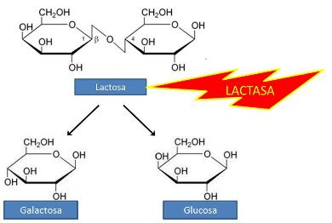
LACTOSE INTOLERANCE
(hypolactasia, non-persistent lactose intolerance)
!
Primary lactose intolerance is a genetically given reduction of gut lactase
lactose tolerance = mutation of the gene for lactase (a variable gene)
Secondary lactose intolerance may develop as a consequence of a small intestine infection, inflammatory gut disease or malnutrition
Symptoms: abdominal bloating, flatulence, cramps, diarrhea after consumption of lactose
Treatment: Lactose-free or Low-lactose diet
ASIANS | 98 %
AFRICANS | 78 %
CZECHS | 6–20 %
SCANDINAVIANS | 10 %
Notes:
Alergen – spouštěč alergické reakce.
atopický ekzém, chronickými gastrointestinálními obtížemi a neprospíváním
děti s alergií na kravské mléko zprostředkovanou IgE protilátkami mají větší riziko vývoje dalších potravinových alergií, průduškového astmatu, alergické rýmy a zánětu spojivek do věku 10 let

Slide 52
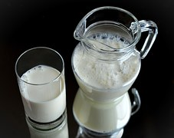
COW’S MILK PROTEIN ALLERGY
Treatment:
  elimination of milk and dairy from the diet
  elimination of any foods containing milk and dairy
  elimination of foods containing milk proteins
But what about butter?

Slide 53
COW’S MILK PROTEIN ALLERGY
Milk protein, where you may not expect it…
  Sweet and savoury bakery products
  Wafers with filling
  Chocolate, frostings
  Energy bars
  Smoked meats
  Margarines („with butter aroma“)
  Instant foods

Slide 54

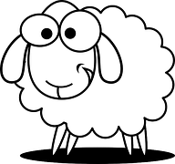


COW’S MILK PROTEIN ALLERGY
Crossed reactions to goat and sheep milk are quite common.
Crossed reaction between casein and soy protein may also happen.
Notes:
atopický ekzém, chronickými gastrointestinálními obtížemi a neprospíváním
děti s alergií na kravské mléko zprostředkovanou IgE protilátkami mají větší riziko vývoje dalších potravinových alergií, průduškového astmatu, alergické rýmy a zánětu spojivek do věku 10 let

Slide 55

COW’S MILK PROTEIN ALLERGY
And what about heat-treated milk?
It does not have any significant effect and may not reduce the allergenic potential!
Casein is heat resistant.

Slide 56
COW’S MILK PROTEIN ALLERGY
Milk substitutes:
  Plant-based drinks
Dairy substitutes:
  Butter substitutes – vegetable oils, some margarines
  Cream substitutes – plant-based substitutes of cream, rice drink thickened with rice flour or starch
  Yogurt substitutes – plant-based desserts (rice, oat, alternatively soy)
  Proccessed cheese substitutes – vegetable and legumes spreads (tofu)
It is necessary to watch sufficient calcium intake !
Notes:
sójové ● rýžové ● ovesné ● špaldové ● mandlové ● kokosové a další

Slide 57
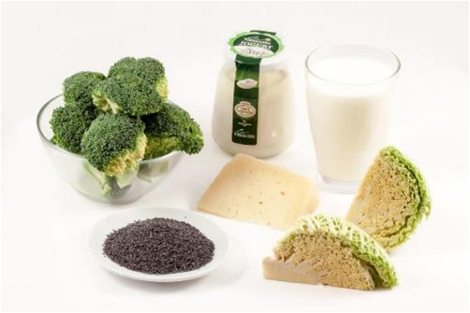
COW’S MILK PROTEIN ALLERGY – and calcium absorption
  calcium absorption from vegetables such as broccoli, cauliflower and kale is higher than from milk and diary products
Notes:
sójové ● rýžové ● ovesné ● špaldové ● mandlové ● kokosové a další

Slide 58
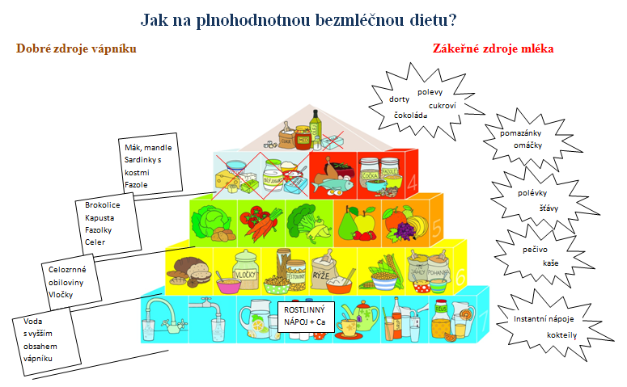
DAIRY-FREE DIET AT SCHOOL FOOD SERVICE
Eating a balanced diet without dairy?
Good calcium sources
Hidden milk in foods !
Food pyramid for children
taken from the project called Physical Activity and Nutrition. Highlighted are rich, non-dairy resources of calcium (left) as well as hidden sources of milk (right), which must be watched out for in dairy-free diet
cakes
frostings
chocolate
sweets
spreads
Poppy seeds, Almonds, Sardines with bones, Beans
sauces
soups
Broccoli
Wild cabbage
Green beans
Celery root
juice
bakery products
Whole grains
Oats
porridge
PLANT-BASED DRINK + Ca
instant drinks
Water with higher calcium content
smoothies

Slide 59
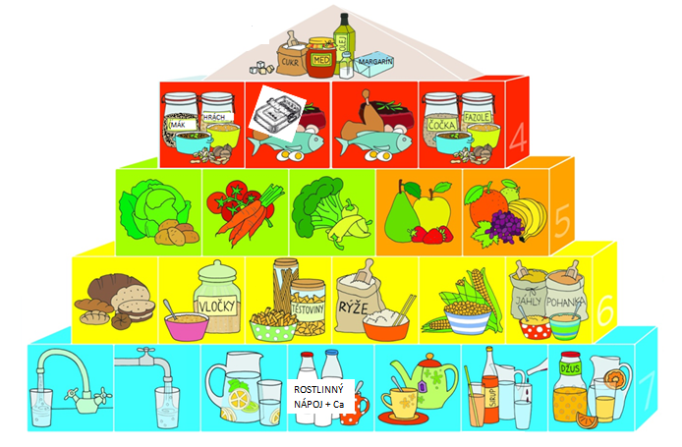
DAIRY-FREE DIET AT SCHOOL FOOD SERVICE
Food pyramid for children
taken from the project called Physical Activity and Nutrition and modified for a dairy-free diet

Slide 60
GUIDELINES FOR DAIRY-FREE AND LOW-LACTOSE DIET
General guidelines for individuals with low lactose diet: | General guidelines for a dairy-free diet:
remove all sources of lactose from the diet (completely in galaktosemia, small amounts may be tolerated in lactose intolerance) individual tolerance observation, alternatively lactose intake may be spread into smaller portions throughout the day emphasis on adequate protein intake (sufficient consumption of varied rich protein sources = meat, eggs, pulses, nuts, seeds) emphasis on adequate calcium intake (sufficient consumption of varied rich calcium sources = brassicaceous vegetables. poppy seeds, almonds, pulses) | remove all sources of milk and dairy from the diet (incl. hidden sources) check ingredients on food packages emphasis on adequate protein intake (sufficient consumption of varied rich protein sources = meat, eggs, pulses, nuts, seeds) emphasis on adequate calcium intake (sufficient consumption of varied rich calcium sources = brassicaceous vegetables. poppy seeds, almonds, pulses) with regard to their bioavailability
General guidelines for individuals with low lactose diet: | General guidelines for a dairy-free diet:
emphasis on adequate iodine intake (use of iodised salt, consumption of fish and seefood) in lactose intolerance dairy may be substituted with specially modified lactose-free products (for preserving high nutrient content), low-lactose dairy are highly recommended if tolerated (individual tolerance must be obeserved) effort to avoid unnecessary elimination of low lactose products (butter, hard cheese) | emphasis on adequate iodine intake (use of iodised salt, consumption of fish and seefood) if dairy are substituted with plant-based foods, foods enriched with calcium and vitamin D are prefered (frequent consumption of soy products by children is not recommended) supplementation with calcium (ideally together with vitamin D) if intake from natural sources is not adequate

Slide 61
DAIRY-FREE DIET IN SCHOOL FOOD SERVICE
Dairy-free elevenses in the kindergarden
Recipe | Ingredients | Quantity (g) | Instructions | Protein (g) | Calcium (mg)
Wholemeal roll with radish spread | wholemeal roll redishes, egg, potato, margarine, mustard, onion, orange juice | 25 15 14 30 14 3 3 100 | Cook the potatoes and the eggs, peel, mix together and mash. Mix in the remaining ingredients putting some radishes aside for decoration. Serve with orange juice | 5 | 31
Sweet bread with poppy seed spread and banana | sweet bread (vanocka)* poppy seeds honey apple banana | 25 18 4 30 25 | Cook the ground poppy seeds in water. Mix with honey and grated apples. Spread on slices of sweet bread and serve with banana round slices | 6 | 271
Mixed vegetable salad with sunflower seeds and a roll | Chinese cabbage Tomato Cucumber bell pepper sunflower oil apple cider vinegar Sugar sunflower seeds salt roll | 20 40 40 30 4 5 3 10 30 | Cut the vegetables, mix with sunflower seeds and dressing made with the oil, vinegar, sugar, salt and some water. Serve with a roll. | 5,6 | 43
Examples of “elevenses” for preschool children

Slide 62
DAIRY-FREE DIET IN SCHOOL FOOD SERVICE
Dairy-free elevenses in the kindergarden
Recipe | Ingredients | Quantity (g) | Instructions | Protein (g) | Calcium (mg)
Vanilla cream with currant jam and sesame seeds | Hraska with vanilla (special mixture based on pea flour) rice drink sunflower oil currant jam sesame seeds | 15 100 5 12 5 | Mix “Hraska” with rice drink and cook for about 20 min. Pour into bowls, decorate with jam and sesame seeds | 3,7 | 174
Roll with red lentils spread and cherry tomatoes | Roll red lentils olive oil garlic onion Carrot lemon juice cherry tomatoes salt marjoram | 40 25 6 5 7 20 5 40 | Heat the oil, add onions and garlic and cook and stir shortly. Add red lentils and finely chopped carrots, pour on some hot water, add salt and marjoram and cook until soft. Season with lemon juice, spread on the roll and serve with cherry tomtaoes | 7 | 57
Examples of “elevenses” for preschool children

Slide 63
Application

Slide 64
MENU dairy-free (DF) diet - practical exercise
TASK:
Highlight those foods in the meal plan that are not suitable for a DF diet
Modify the meal plan, substitute unsuitable foods with foods for a DF diet.
B: Wheat bread, butter, cheese, radish, cocoa milk drink
Snack: Fruit yogurt with puffs, apple
L: Tomato soup with rice,
Beef, dill cream sauce, potatoes
Snack: Whole wheat bread, sardine spread with cottage cheese, cucumber
D: Oat milk porridge with nuts and fruit

Slide 65
MENU dairy-free (DF) diet - practical exercise
B: Wheat bread, butter, cheese, radish, cocoa milk drink
Snack: Fruit yogurt with puffs, apple
L: Tomato soup with rice,
Beef, dill cream sauce, potatoes
Snack: Whole wheat bread, sardine spread with cottage cheese, cucumber
D: Oat porridge with milk, nuts and fruit
B: Wheat bread, butter, cheese, radish, cocoa milk drink
Snack: Fruit yogurt with puffs, apple
L: Tomato soup with rice,
Beef, dill cream sauce, potatoes
Snack: Whole wheat bread, sardine spread with cottage cheese, cucumber
D: Oat „milk“ porridge with nuts and fruit

Slide 66
MENU dairy-free (DF) diet - practical exercise
B: Wheat bread, butter, cheese, radish, cocoa milk drink
Snack: Fruit yogurt with puffs, apple
L: Tomato soup with rice,
Beef, dill cream sauce, potatoes
Snack: Whole wheat bread, sardine spread with cottage cheese, cucumber
D: Oat milk porridge with nuts and fruit
B: Wheat bread, avocado spread with boiled eggs, radish, cocoa plant-based drink
Snack: Soya dessert with puffs, apple
L: Tomato soup with rice,
Beef with spinach and potatoes
Snack: Whole wheat bread, sardine spread with DF margarine, cucumber
D: Oat porridge made of plant-based drink with nuts and fruit

Slide 67
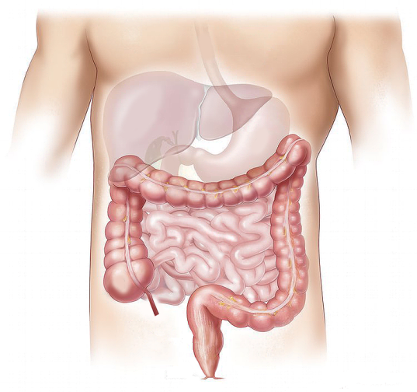

BLAND DIET

Slide 68
BLAND DIET
during recovery period after an acute hepatitis
during remissions in chronic bowel diseases
usually a temporary restriction, progressive loosening of the diet
the diet is varied, balanced, easy to digest and does not cause flatulence; without hot and irritating spices
is GIT-friendly, eliminates chemical and mechanical irritants

Slide 69
BLAND DIET
Mechanical irritants elimination
  Fruits and vegetables with tough peels, seeds and woody parts are not served.
  Foods with whole seeds and grains are not served.
  Meals are cooked until soft, without hard crusts and burnt edges.
Chemical irritants elimination
  Hot irritating spices are not used.
  Any form of frying or roasting is not applied - only fresh forms of fat may be added to a finished meal

Slide 70
Practical examples follow…

Slide 71
BLAND DIET
TASK:
Highlight those foods in the meal paln that are not suitable for bland diet
Modify the meal plan, substitute unsuitable foods with foods for the bland diet.
B: Bread with sunflower seeds, carrot spread with garlic, bell peppers, strong black tea
Snack: Yogurt smoothie with strawberries
L: Potato soup with mushrooms
Turkey roll, wild rice, coleslaw
Snack: Whole grain bread, cream cheese spread, pear
D: Lentils with cream, root vegetable and fried eggs, bread

Slide 72
BLAND DIET
B: Bread with sunflower seeds, carrot spread with garlic, bell peppers, strong black tea
Snack: Yogurt smoothie with strawberries
L: Potato soup with mushrooms
Turkey roll, wild rice, coleslaw
Snack: Whole gran bread, cream cheese spread, pear
D: Lentils with cream, root vegetable and fried eggs, bread
B: Bread with sunflower seeds, carrot spread with garlic, bell peppers, strong black tea
Snack: Yogurt smoothie with strawberries
L: Potato soup with mushrooms
Turkey roll, wild rice, coleslaw
Snack: Wholegrain bread, cream cheese spread, pear
D: Lentils with cream, root vegetable and fried eggs, bread

Slide 73
BLAND DIET
B: Bread with sunflower seeds, carrot spread with garlic, bell peppers, strong black tea
Snack: Yogurt smoothie with strawberries
L: Potato soup with mushrooms
Turkey roll, wild rice, coleslaw
Snack: Wholegrain bread, cream cheese spread, pear
D: Lentils with cream, root vegetable and fried eggs, bread
B: Toast bread, carrot spread with parsley, weak black tea
Snack: Yogurt smoothie with banana
L: Potato soup with mushroom stock
Turkey roll, stewed rice, Chinese cabbage salad with dill
Snack: Plain roll (no seeds), cream cheese spread, apple (grated)
D: Red lentils with cream, root vegetables and boiled eggs, French white bread

Slide 74
SUITABLE AND UNSUITABLE MEALS
Buckwheat porridge with pumpkin seeds, honey and raspberries
Multigrain bread with avocado-garlic spread and tomato
Chicken curry thighs, homemade tartar sauce, mashed potatoes with green onions
Potato soup with boletes (wild mushrooms)
Stuffed beef roll, basmati rice
Rabbit stew with garlic, sweet and sour red cabbage, bread dumplings
Alaska pollock in cheese batter, potatoes, tomato salad

Slide 75
SUITABLE AND UNSUITABLE MEALS
Buckwheat porridge with pumpkin seeds, honey and raspberries
➞ Buckwheat porridge with corn flakes, honey and apricots – SUITABLE meal
Multigrain bread with avocado-garlic spread and tomato
Chicken curry thighs, homemade tartar sauce, mashed potatoes with green onions
Potato soup with boletes (wild mushrooms)
Stuffed beef roll, basmati rice
Rabbit stew with garlic, sweet and sour red cabbage, bread dumplings
Alaska pollock in cheese batter, potatoes, tomato salad

Slide 76
SUITABLE AND UNSUITABLE MEALS
Buckwheat porridge with pumpkin seeds, honey and raspberries
➞ Buckwheat porridge with corn flakes, honey and apricots – SUITABLE meal
Multigrain bread with avocado-garlic spread and tomato
➞ Toast bread with avocado spread and carrot - – SUITABLE meal
Chicken curry thighs, homemade tartar sauce, mashed potatoes with green onions
Potato soup with boletes (wild mushrooms)
Stuffed beef roll, basmati rice
Rabbit stew with garlic, sweet and sour red cabbage, bread dumplings
Alaska pollock in cheese batter, potatoes, tomato salad

Slide 77
SUITABLE AND UNSUITABLE MEALS
Buckwheat porridge with pumpkin seeds, honey and raspberries
➞ Buckwheat porridge with corn flakes, honey and apricots – SUITABLE meal
Multigrain bread with avocado-garlic spread and tomato
➞ Toast bread with avocado spread and carrot – SUITABLE meal
Chicken curry thighs, homemade tartar sauce, mashed potatoes with green onions
➞ Chicken thighs with herbs, yogurt dip, mashed potatoes with chives - – SUITABLE meal
Potato soup with boletes (wild mushrooms)
Stuffed beef roll, basmati rice
Rabbit stew with garlic, sweet and sour red cabbage, bread dumplings
Alaska pollock in cheese batter, potatoes, tomato salad

Slide 78
SUITABLE AND UNSUITABLE MEALS
Buckwheat porridge with pumpkin seeds, honey and raspberries
➞ Buckwheat porridge with corn flakes, honey and apricots – SUITABLE meal
Multigrain bread with avocado-garlic spread and tomato
➞ Toast bread with avocado spread and carrot – SUITABLE meal
Chicken curry thighs, homemade tartar sauce, mashed potatoes with green onions
➞ Chicken thighs with herbs, yogurt dip, mashed potatoes with chives – SUITABLE meal
Potato soup with boletes (wild mushrooms)
➞ Potato soup with button mushrooms - SUITABLE meal
Stuffed beef roll, basmati rice
Rabbit stew with garlic, sweet and sour red cabbage, bread dumplings
Alaska pollock in cheese batter, potatoes, tomato salad

Slide 79
SUITABLE AND UNSUITABLE MEALS
Buckwheat porridge with pumpkin seeds, honey and raspberries
➞ Buckwheat porridge with corn flakes, honey and apricots - SUITABLE meal
Multigrain bread with avocado-garlic spread and tomato
➞ Toast bread with avocado spread and carrot - SUITABLE meal
Chicken curry thighs, homemade tartar sauce, mashed potatoes with green onions
➞ Chicken thighs with herbs, yogurt dip, mashed potatoes with chives - SUITABLE meal
Potato soup with boletes (wild mushrooms)
➞ Potato soup with button mushrooms - SUITABLE meal
Stuffed beef roll, basmati rice
➞ Beef roll with ham and cheese, basmati rice - SUITABLE meal
Rabbit stew with garlic, sweet and sour red cabbage, bread dumplings
Alaska pollock in cheese batter, potatoes, tomato salad

Slide 80
SUITABLE AND UNSUITABLE MEALS
Buckwheat porridge with pumpkin seeds, honey and raspberries
➞ Buckwheat porridge with corn flakes, honey and apricots - SUITABLE meal
Multigrain bread with avocado-garlic spread and tomato
➞ Toast bread with avocado spread and carrot - SUITABLE meal
Chicken curry thighs, homemade tartar sauce, mashed potatoes with green onions
➞ Chicken thighs with herbs, yogurt dip, mashed potatoes with chives - SUITABLE meal
Potato soup with boletes (wild mushrooms)
➞ Potato soup with button mushrooms - SUITABLE meal
Stuffed beef roll, basmati rice
➞ Beef roll with ham and cheese, basmati rice - SUITABLE meal
Rabbit stew with garlic, sweet and sour red cabbage, bread dumplings
➞ Rabbit stew, kohlrabis à la sweet and sour cabbage, Carlsbad dumplings - SUITABLE meal
Alaska pollock in cheese batter, potatoes, tomato salad

Slide 81
SUITABLE AND UNSUITABLE MEALS
Buckwheat porridge with pumpkin seeds, honey and raspberries - UNSUITABLE meal
➞ Buckwheat porridge with corn flakes, honey and apricots - SUITABLE meal
Multigrain bread with avocado-garlic spread and tomato - UNSUITABLE meal
➞ Toast bread with avocado spread and carrot - SUITABLE meal
Chicken curry thighs, homemade tartar sauce, mashed potatoes with green onions - UNSUITABLE meal
➞ Chicken thighs with herbs, yogurt dip, mashed potatoes with chives - SUITABLE meal
Potato soup with boletes (wild mushrooms) - UNSUITABLE meal
➞ Potato soup - SUITABLE meal
Stuffed beef roll, basmati rice - UNSUITABLE meal
➞ Beef roll with ham and cheese, basmati rice - SUITABLE meal
Rabbit stew with garlic, sweet and sour red cabbage, bread dumplings - UNSUITABLE meal
➞ Rabbit stew, kohlrabis à la sweet and sour cabbage, Carlsbad dumplings
Alaska pollock in cheese batter, potatoes, tomato salad - UNSUITABLE meal
➞ Alaska pollock with cheese, potatoes, carrot salad - SUITABLE meal

Slide 82
TYPE 1 DIABETES DIET

Slide 83
DIABETES DIET AND SCHOOL FOOD SERVICE
Regulation of food quantity, specially of foods rich in carbohydrates.
Limitation of simple carbohydrates in both meals and drinks.
Colaboration between the stuff and the boarder and his/her parents is very important
Older children are able to regulate the food quantity by themselves, in respect to insulin application, physical activity etc.

Slide 84
HOMEWORK ASSIGNMENT
School Lunches You've Probably Never Heard About...
https://www.youtube.com/watch?v=-7YBTX7vnVc
Write a brief summary, on 1 page A4, about School Food System in your country. Did you have it in your school? How are the situations where a child must comply with any dietary restrictions or diet dealt with? Did your school offer the possibility of preparing dietary foods for these children or not? Describe how this issue is addressed in your country.
Your homework should be added in Homework Vaults by the next week’s seminar
Bring your summaries for the next class and someone will present us their situation of School Food Service and diets in their country

Slide 85
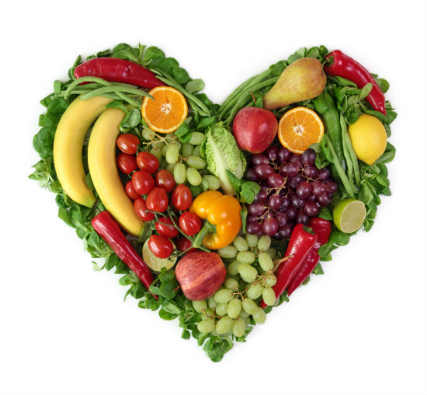
THANK YOU FOR ATTENTION

