Slide 1
Water and health
RNDr. Danuše Lefnerová, Ph.D.
Doc.Ing. Martin Krsek, CSc.

Slide 2
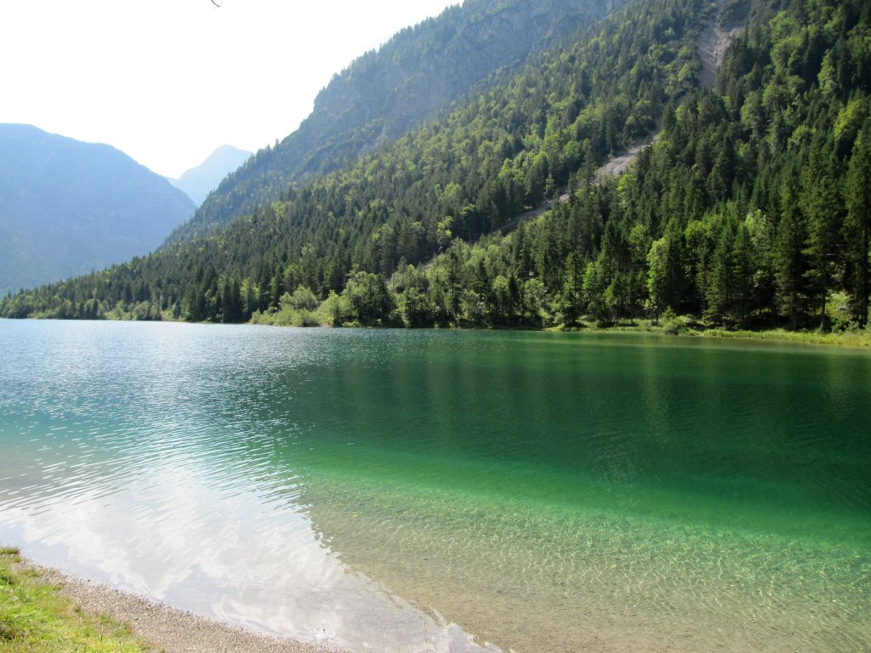
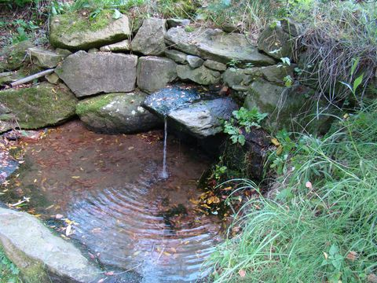
Water and health
Act No. 258/2000 Coll.
on public health protection:
„Drinking water is all water in its original state or after treatment intended for drinking, cooking, preparation of food and drinks, water used in the food industry, water intended for body care, cleaning of objects , which by their intended purpose come into contact with food or human body and for other purposes of human consumption, irrespective of its origin, state and mode of delivery. „

Slide 3
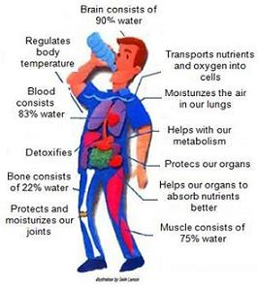
Water and health
Function of water in body:
- transport (transmission of nutrients, waste products, heat,
electrolytes, hormones)
- assistance in thermoregulation
- acts as a solvent and a suitable environment for chemical reactions taking place
in the body
- protects the surroundings of joints, spinal cord and brain
- surrounds the fetus like amniotic fluid
- involved in maintaining homeostasis, ensuring a physically and chemically
stable internal environment of the body

Slide 4
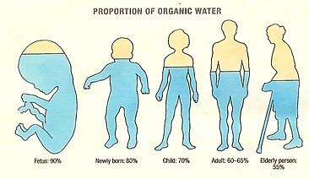
Water and health
Water requirement:
Very individual, can not be standardized.
It depends on many factors - age, sex, weight, ambient temperature and air humidity,
health, diet, physical activity
After birth, water is 75% of body weight, in adults 60% and in old age 50% of body weight
The need for water is partly covered by its natural content in foods ranging from 20-30%
(very fatty products) and very often between 80-90% (fruits, vegetables, soups, sauces).

Slide 5
Water and health
By the oxidative metabolism of organic macronutrients, 300 ml of water per day is
produced in the human body.
Necessary water intake is average 2.5 l per day for an average adult (1.5 liters in the form
of beverages and 1 l from regular food).
Literature - 22 ml - 50 ml per kg of body weight, regardless of climatic conditions
Children are dehydrated faster, so they should drink more - schoolchildren by half more
than adult of the same weight.
Water delivery and intake should always be in equilibrium

Slide 6
Water and health
Lack of water in the body (dehydration) - headaches, fatigue, malaise, decrease
in physical and mental performance, including decreased concentration
- children - decreased ability to concentrate
Long-term fluid deficiency - renal impairment, kidney and urinary stones,
risk of urinary tract infection,…

Slide 7
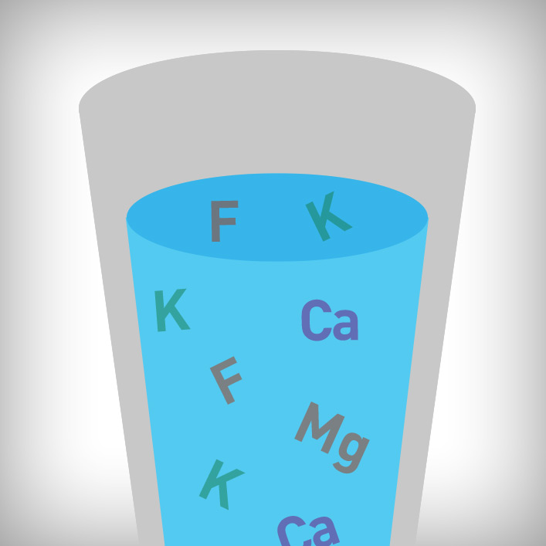
Biological (biogenic) value of drinking water
Drinking water must be health-conscious with a satisfactory biological value.
Mineral substances contained in drinking water are usually in ion form, perfectly dissolved, and are therefore easily resorbable and more usable for the organism.
Water is an important source of all required minerals
(fluorine in the form of fluoride anions, iodine, sodium,
potassium, the calcium / magnesium ratio, selenium,
zinc and other macro and micro elements).

Slide 8

Drinking water sources - their protection
Czech Republic - surface sources: underground source = 1: 1
2016 - 2.305 water treatment plants - 600 million m³ (Prague 100 million)
Brno dam - 7.6 - 10.8 million m³
When determining the range of hygiene protection, account shall be taken of:
- geological composition of soil, its permeability (sand x clay)
- slope of the land around the source
- yield of water source
- industrial activity
- agricultural activity
- transportation around the source

Slide 9
Drinking water sources - a multi-barrier approach to their protection
To ensure that water is microbiologically safe, it is necessary to apply:
1. barrier - consistent protection of water source (functional protection zone)
2. barrier - the use of such water treatment technology, which corresponds to
the quality of raw water
3. barrier - water protection against secondary contamination during distribution
to the consumer
4. barrier - internal water supply (domestic water supply) - design of hygienically
safe materials

Slide 10
Drinking water sources - water treatment
Category according to Decree of the Ministry of Health No. 428/2001 Coll., As amended by Decree No. 146/2004 Coll. Resources % Resources %
surface underground
A 1 - Simple physical treatment and disinfection, for example fast
filtration and disinfection, or simple sand filtration, chemical
deacidification or mechanical deacidification or removal
gaseous components by aeration. 7.1 76.5
A 2 - common physical treatment, chemical treatment and disinfection,
coagulation filtration, infiltration, slow biological filtration,
flocculation, sedimentation, filtration, disinfection (final behavior),
single- or two-stage jamming and demagnetization. 54 9
A 3 - intensive physical and chemical treatment, extended treatment
and disinfection, for example chlorination to break point, coagulation,
flocculation, sedimentation, filtration, adsorption (activated carbon),
disinfection (ozone, final chlorination). Combination physically
chemical and microbiological and biological treatment 38,9 14,5

Slide 11
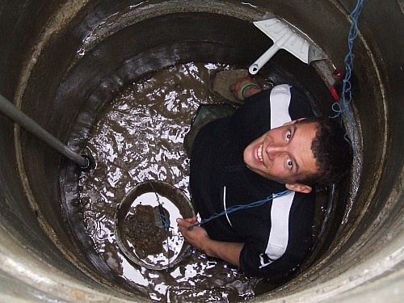
Drinking water sources and their protection
Suspicion or finding that the water in the source is contaminated:
The source of the pollution is removed, building modifications are carried out, the hygienic protection zone is restored
Wells - the inner walls of the well are mechanically cleaned, the water is drained, the bottom is cleaned from sludge
One-off disinfection is carried out

Slide 12
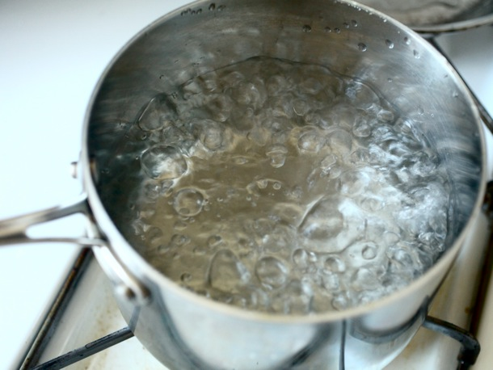
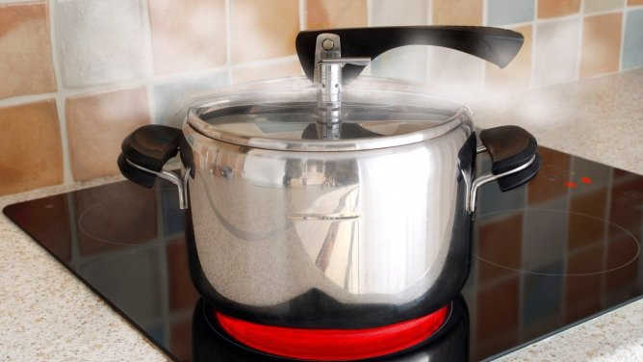
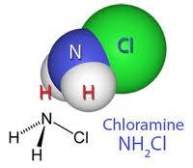
Disinfection of drinking water
Chloramine - 2-3 g / m³ of water, Sagen (Ag), Savo, Chlorine, Ozone, UV, filtration
Boiling : bubbles on the whole surface of water (100 ° C), leave for 10 minutes stand and naturally cool down - do not put ice in it. Water is not sterile !!! (sterility only ensures sterilization in the autoclave).

Slide 13
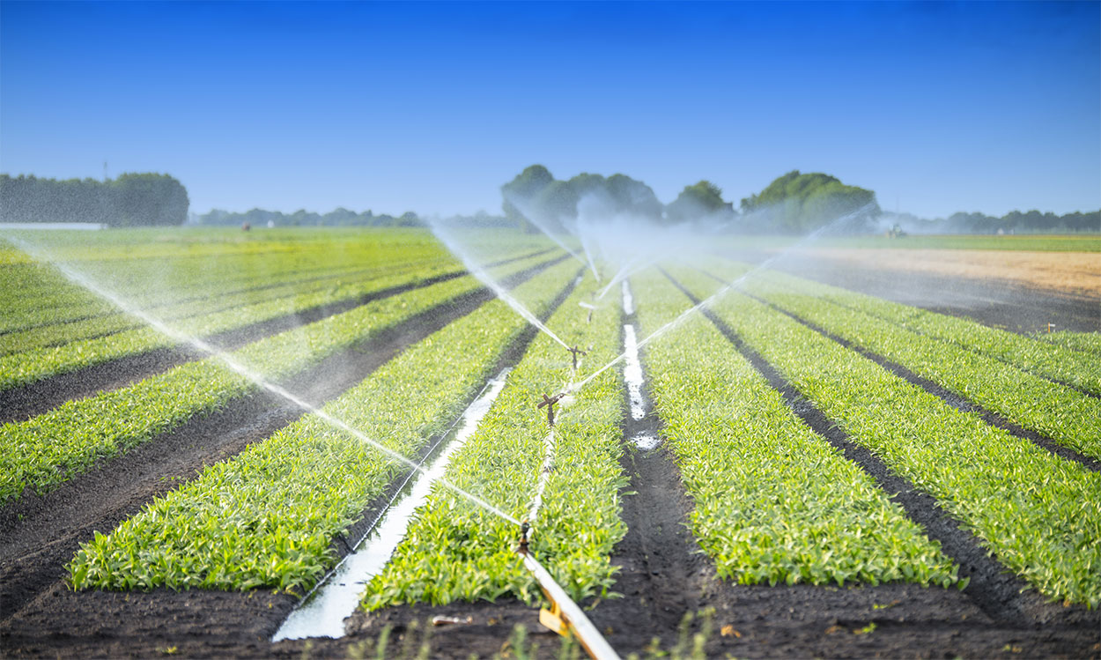
Non-potable/running water
It is hygienically safe water which is not used as drinking water and for cooking but only for washing, bathing and for production purposes.
Domestic hot water is produced from drinking water under the Public Health Act but is not considered drinking water.
Industrial water
Technological water
Water for irrigation

Slide 14
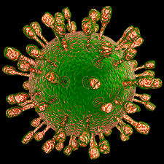
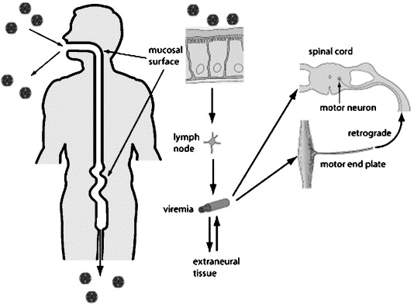
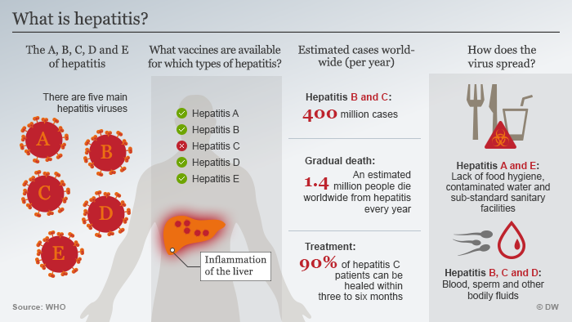
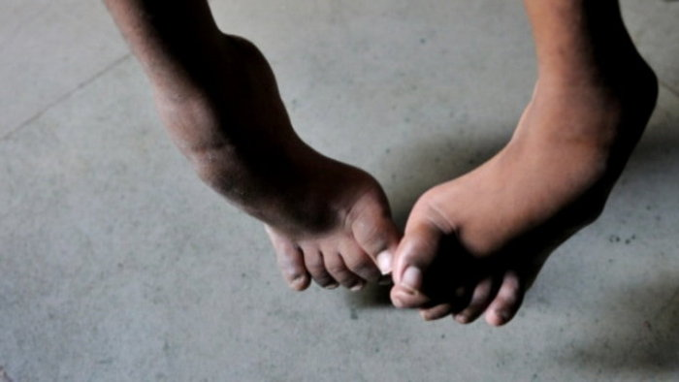
Microbes transmitted by water
Condition: excretion of agent by excrement (humans and animals) and possibility of new food infections
Viruses:
Rotaviruses - diarrhoeal diseases
Polioviruses - agents of poliomyelitis
RNA viruses – hepatitis A, E, (F)

Slide 15
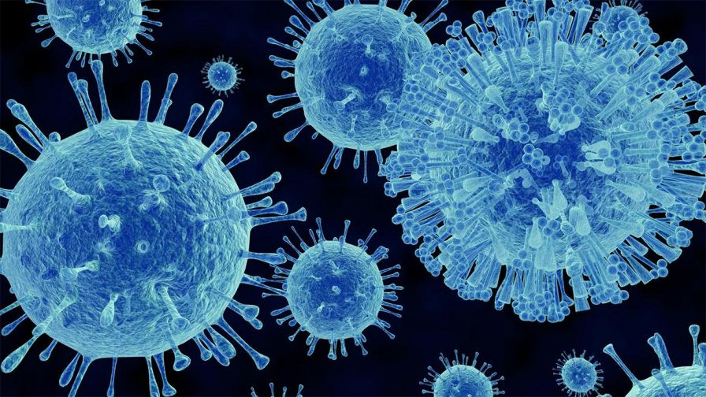
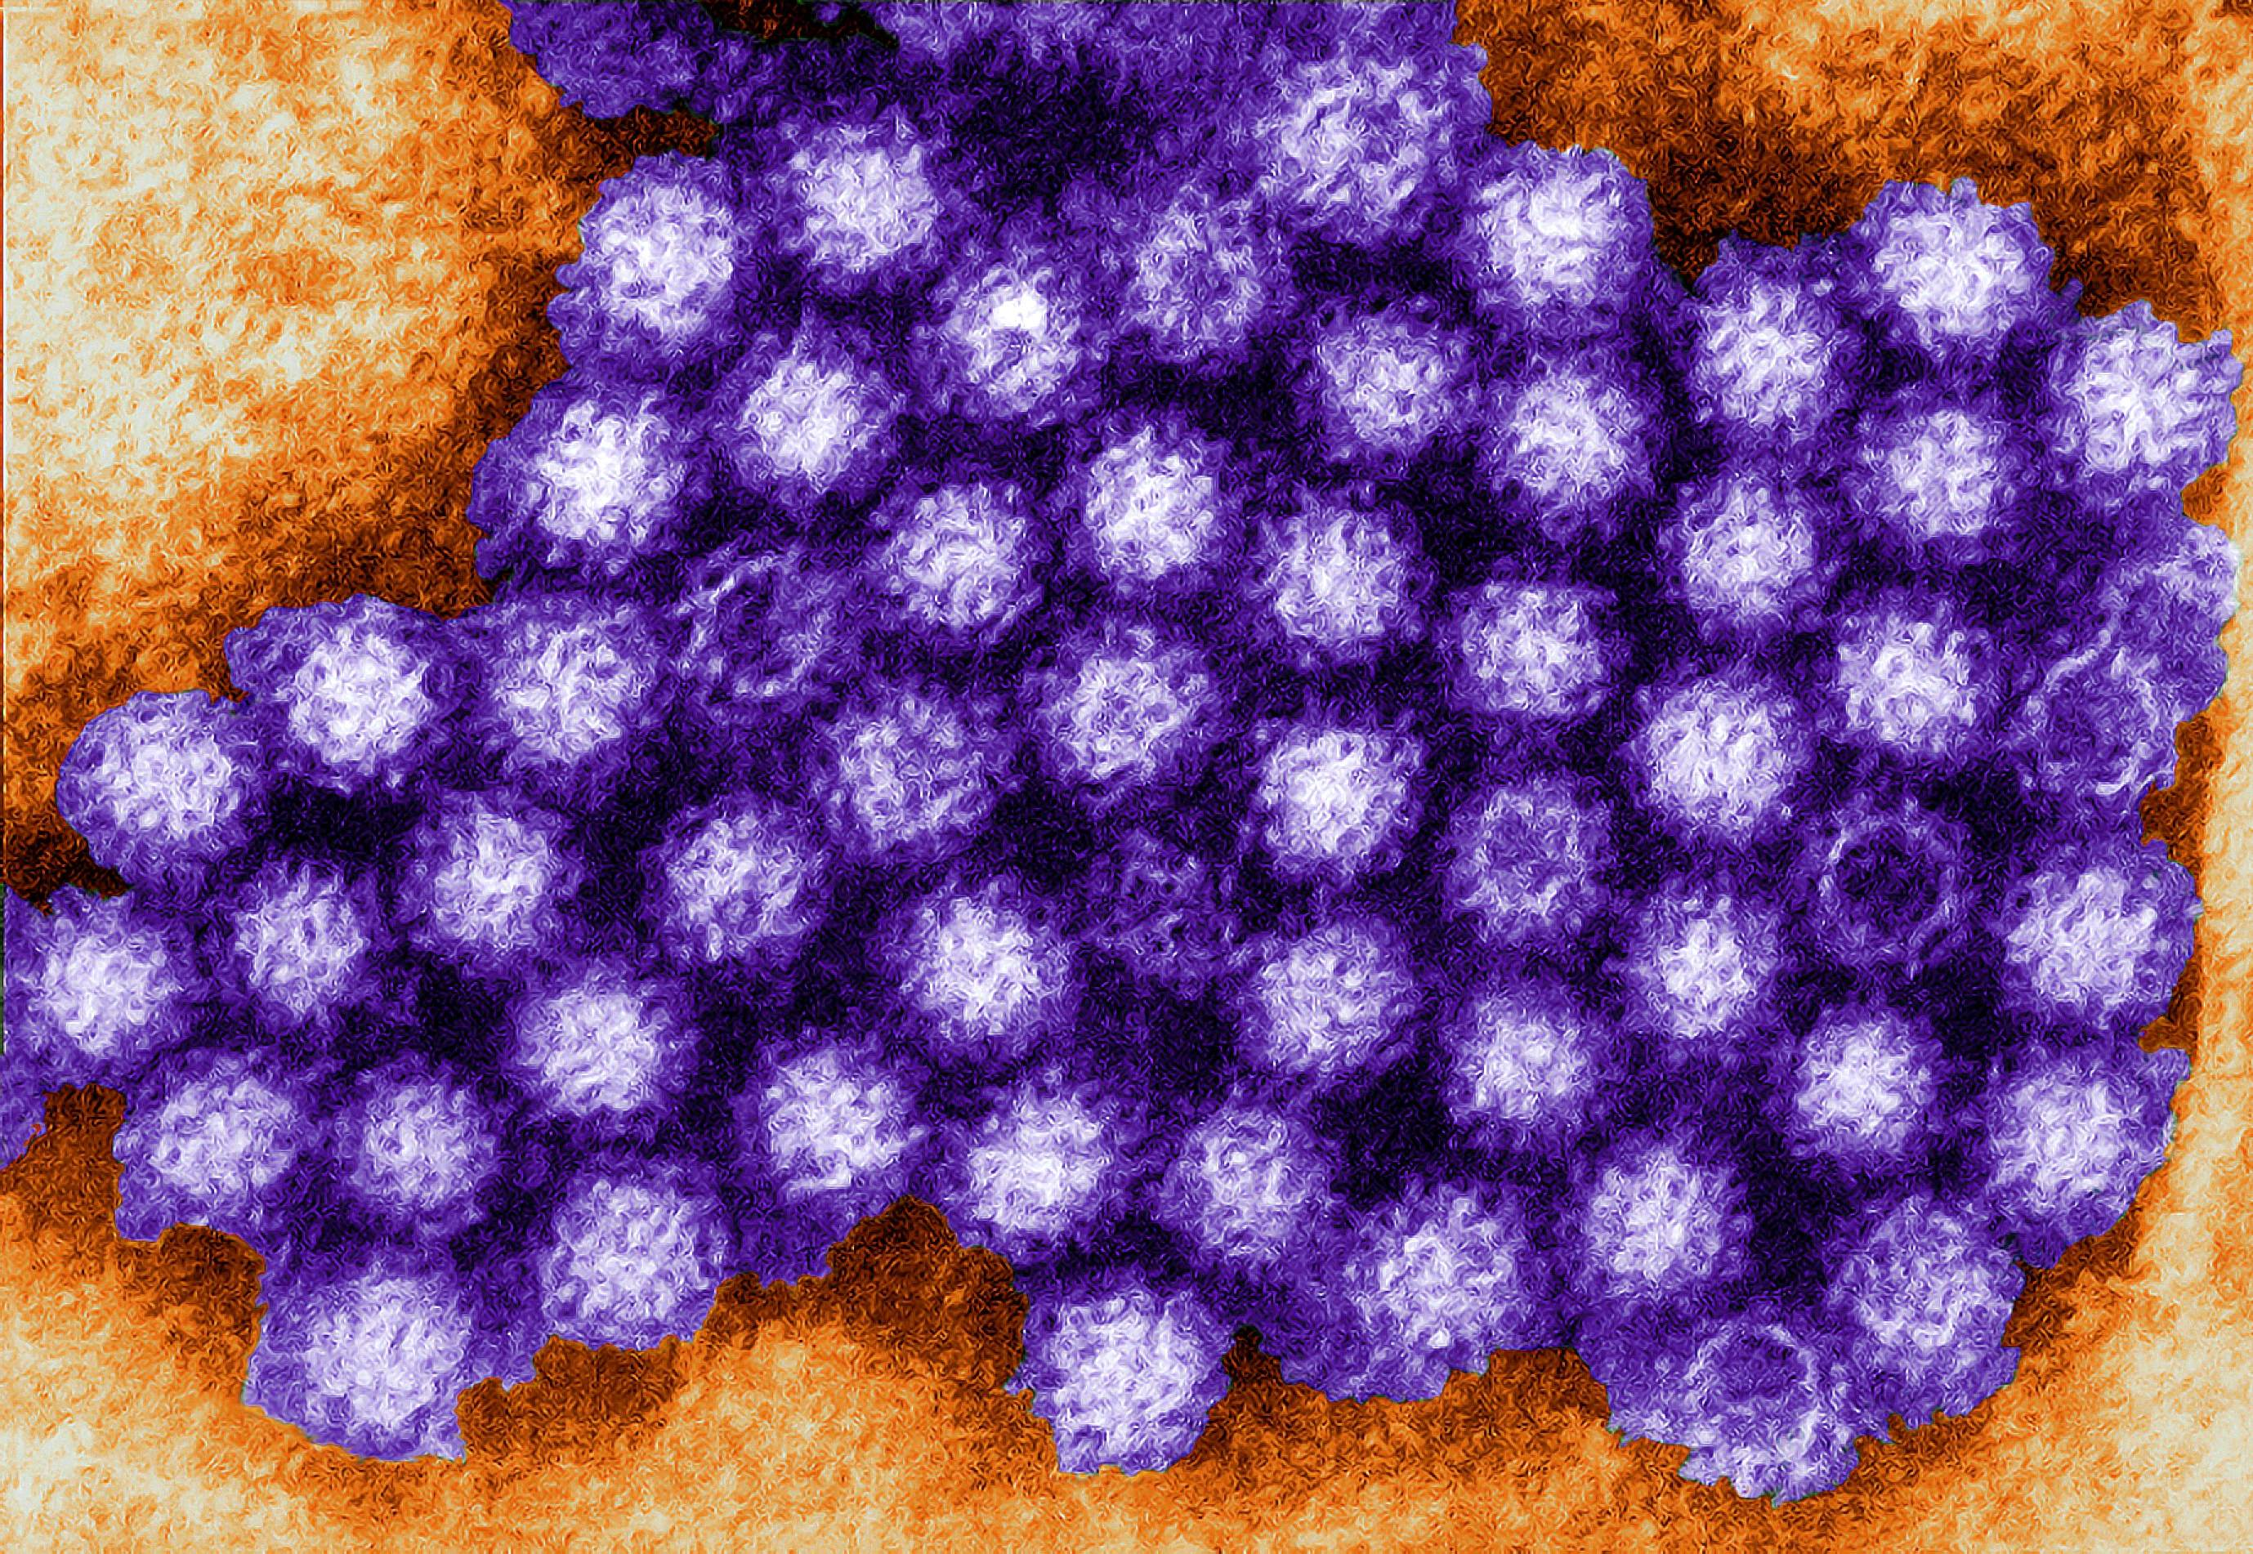
Microbes transmitted by water
Viruses – cont.:
Norovirus - originally called the Norwalk virus
- RNA virus
- it causes an epidemic acute gastroenteritis
- diseases from water (Prague), food, but also through direct contact
- symptoms of the disease - nausea, vomiting, diarrhea and abdominal cramps, mild fever, fever, pain of muscles and headache, fatigue
- it is also transmitted via a faecal oral route

Slide 16
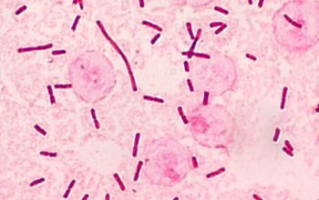
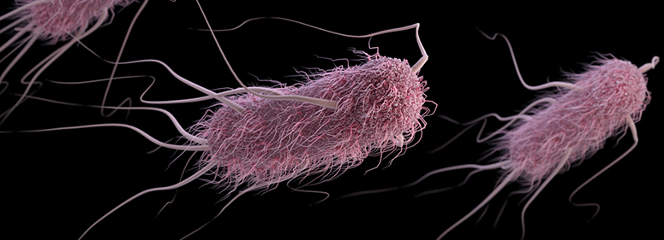
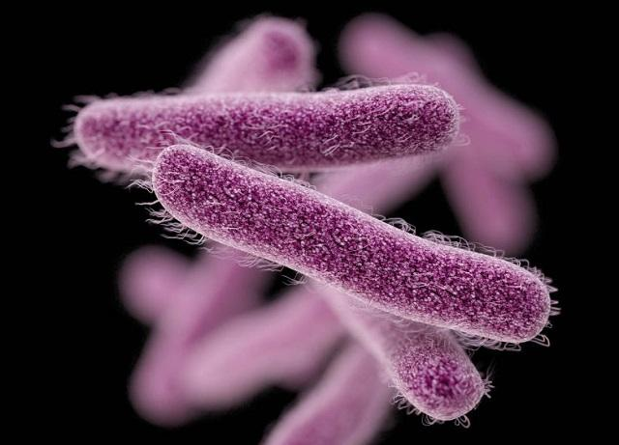
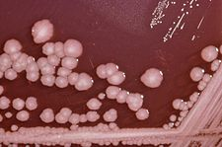
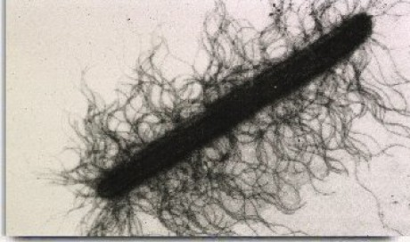
Microbes transmitted by water
Gram negative facultative anaerobic rods:
Escherichia coli, Klebsiella spp., Citrobacter spp., Salmonella typhi, Salmonella paratyphi - frequent water transfer
Shigella sonei, Shigella flexneri - bacillary dysentery
Yersinia entrocolitica - diarrheal diseases in children
Serratia marcescens - infection of the urogenital and respiratory tract
Proteus mirabilis, Proteus vulgaris – urogenital tract, gastroenteritis in infants

Slide 17
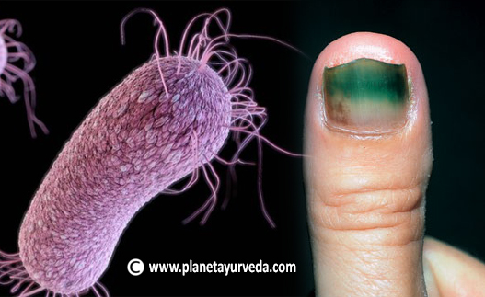
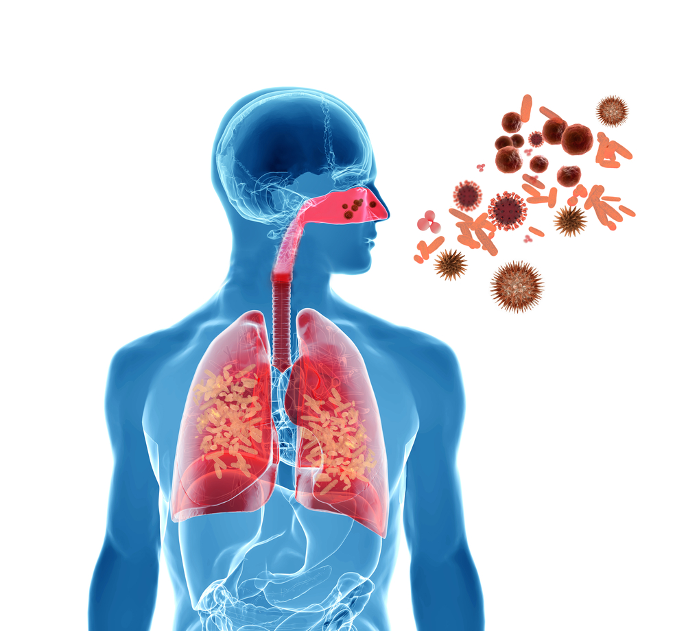
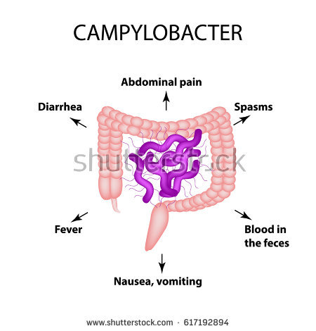
Microbes transmitted by water
Gram negative aerobic rods and cocci:
Klebsiella pneumoniae, Pseudomonas aeruginosa
via aerosols
inflammation of the upper respiratory tract, lung,
urogenital tract
Neisseria gonorhoea, Treponema pallidum
- they do not survive in the waters, transmission is unlikely
Campylobacter spp. - diarrheal diseases

Slide 18
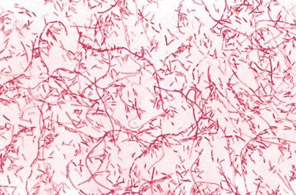
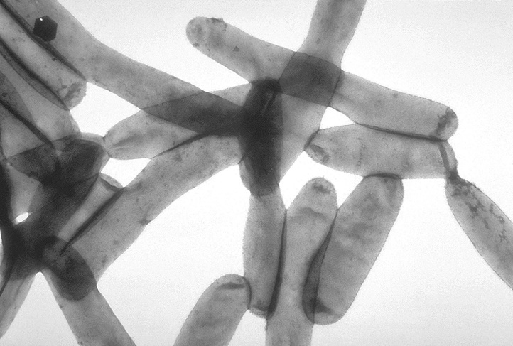
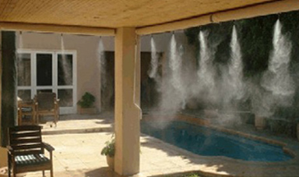
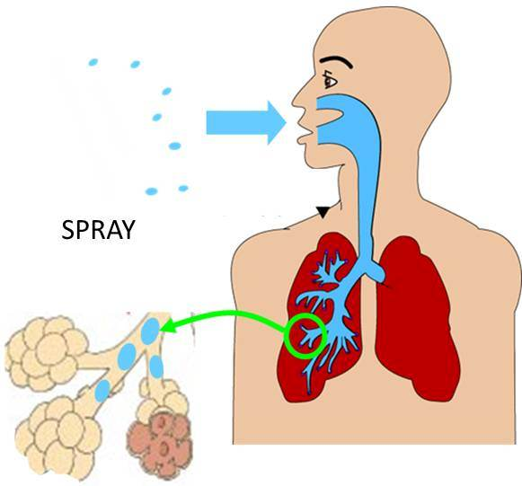
Microbes transmitted by water
Legionella pneumophila (Legionella) – G- aerobic rod
Occurrence:
hot and cold water, surface water, water courses as part of biofilms, filters, refrigeration circuits of air conditioners.
Survives in humid environments
It lives and multiplies at 25-50 ºC.
Spread with air - inhalation of aerosol contaminated water
Respiratory tract infections, pneumonia (Legionnaires' disease)

Slide 19
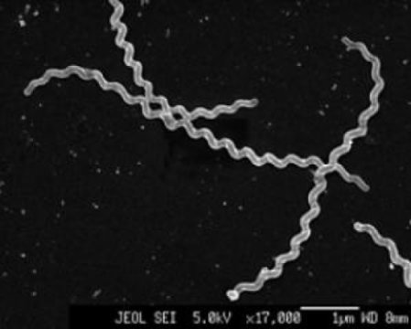
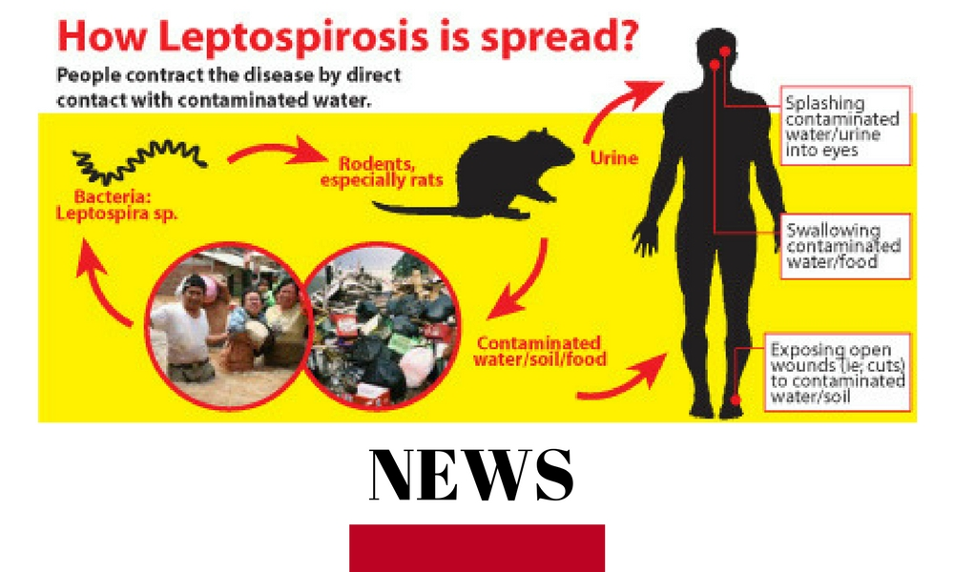
Microbes transmitted by water
Leptospirosis – G- spirochete
Febrile bacterial disease, a zoonotic disease caused by genera Leptospira
The way of infecting people is contacting damaged skin, eyes or mucous membranes with water contaminated by the urine of the infected animal
This is an antropozoonosis – transfer from animal (rats, mice, cattle) to humans
Symptoms - high fever, chills, tremor, severe headache
and muscle aches, abdominal pain, nausea, vomiting

Slide 20
Microbes transmitted by water
Fungi and yeasts – water mains, air washers, air conditioning

Slide 21
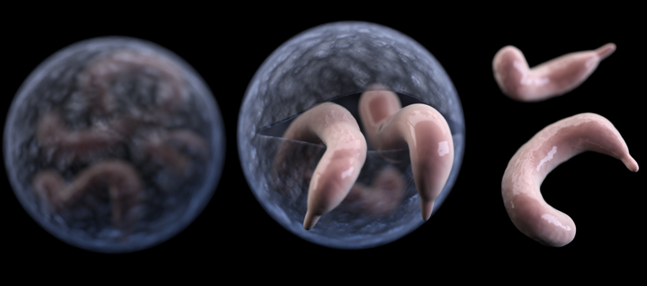
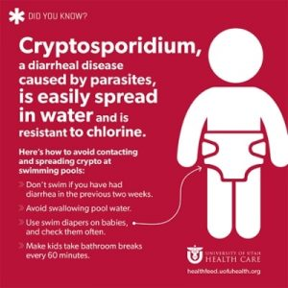
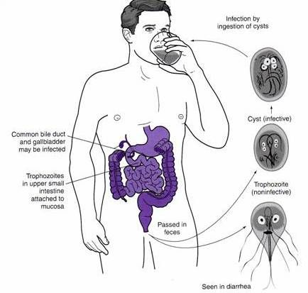
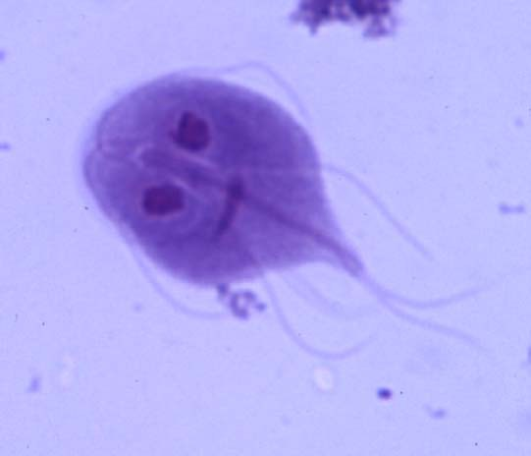
Protozoa
Cryprosporidium - protozoa - occurrence in surface waters.
- it can also penetrate into drinking water - chemical disinfection
against oocysts is ineffective.
causes diarrheal disease - cryptosporidiosis.
1993 Milwaukee Cryptosporidiosis outbreak - 400,000 patients
104 death
Giardia intestinalis - human lamblia - it causes diarrheal disease – giardiasis
Infective germ can enter the body
and cause the disease not only
by the digestive tract, but also
by the airways, skin abrasions
and injuries.

Slide 22
Health aspect
The route of inhalation and dermal - may be more risky than the oral route
substances after entry into the body can affect the target organs before liver
biotransformation.
- doses received by inhalation and dermal route are, in their sum, at least equal
to the dose obtained by ingestion of 2 liters of water.
Extra-intestinal and intestinal disease - extra-intestinal and intestinal infections

Slide 23
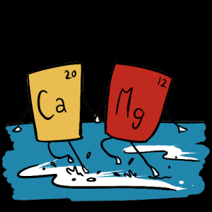
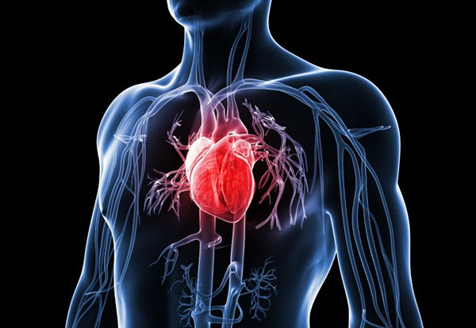
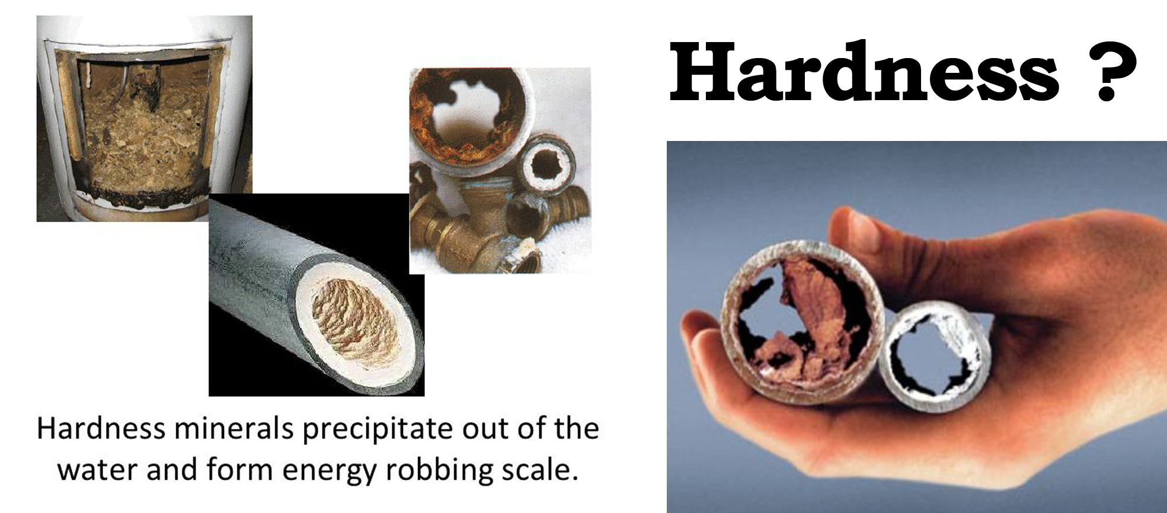
Water hardness and cardiovascular diseases
Water hardness - mainly composed of calcium and magnesium carbonate
History: The 50s of the last century - Japanese chemist Kobayashi pointed out that mortality on the cerebral vascular disease of the population is higher in the vicinity of the Japanese rivers, where the water is more acidic (softer) than the rivers with water harder (more basic) - from where the water was used for drinking purposes.
The relationship between drinking water hardness and mortality in cardiovascular disease - demonstrated
in many further studies.

Slide 24
Water hardness and cardiovascular disease
Calcium: necessary for the proper functioning of the heart's transfer system, for blood clotting and neuromuscular irritation
Magnesium: an important role as a cofactor and activator of over 300 enzymatic reactions including glycolysis, ATP metabolism, transport of elements such as Na, K, Ca through membranes.
It is also important for protein and nucleic acid synthesis.
Magnesium deficiency increases the risk of vascular spasms and promotes cardiac arrhythmias.
Protective effect of calcium and magnesium against the development of tooth decay

Slide 25
Water hardness and cardiovascular disease
Calcium and magnesium - beneficial antitoxic function
Ca and Mg also prevent the absorption of some toxic metals such as lead and cadmium.
Utilization of magnesium from the water is also higher than that from food.
Cooking in soft water causes considerable loss of elements from food, while cooking in hard water minimizes losses.

Slide 26
Drinking water and cancer
Water disinfection with chlorination – chlorine can react with higher level of organic substances in water – production of low-molecular substances (chloroform, chlorobenzene, heptachlor and other chlorinated compounds) - genotoxic activity.
Studies show a connection between drinking chlorinated drinking water and the occurrence of bladder, rectum, kidney tumors. Negative effects on reproduction have also been demonstrated.
Arsenic in drinking water - exposure is associated with the occurrence of various skin lesions (pigmentation, keratoses, skin tumors and malignant tumors).
Arsenites show high embryotoxicity.

Slide 27
Drinking water and cancer
Nitrates - no clear epidemiological evidence that people who consume drinking water with increased nitrate content are at increased risk of cancer (reaction with amino acids to produce nitrosamines).
Only one of three UK studies has revealed a relationship between stomach cancer mortality and nitrate content in water. So far, the results are inconsistent.
Methemoglobinemia may be more significant – especially in infants
Radionuclides – mainly natural radionuclides are important for drinking water.
It is generally assumed that the ingestion of radon in drinking water is not associated with any significant risk of cancer.

Slide 28
Drinking water and cancer
Fluorides - fluorization of drinking water to prevent tooth decay has been reversed in the Czech Republic.
Environmental studies have not confirmed the effect of fluorides on cancer.
Industrially produced organic substances (chlorophenols, trichlorethylene, volatile organic compounds) - besides impairment of the immune system, there was an increased incidence of bladder cancer.

Slide 29
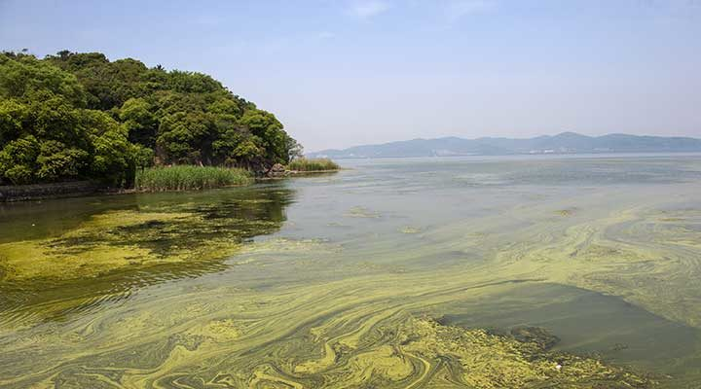
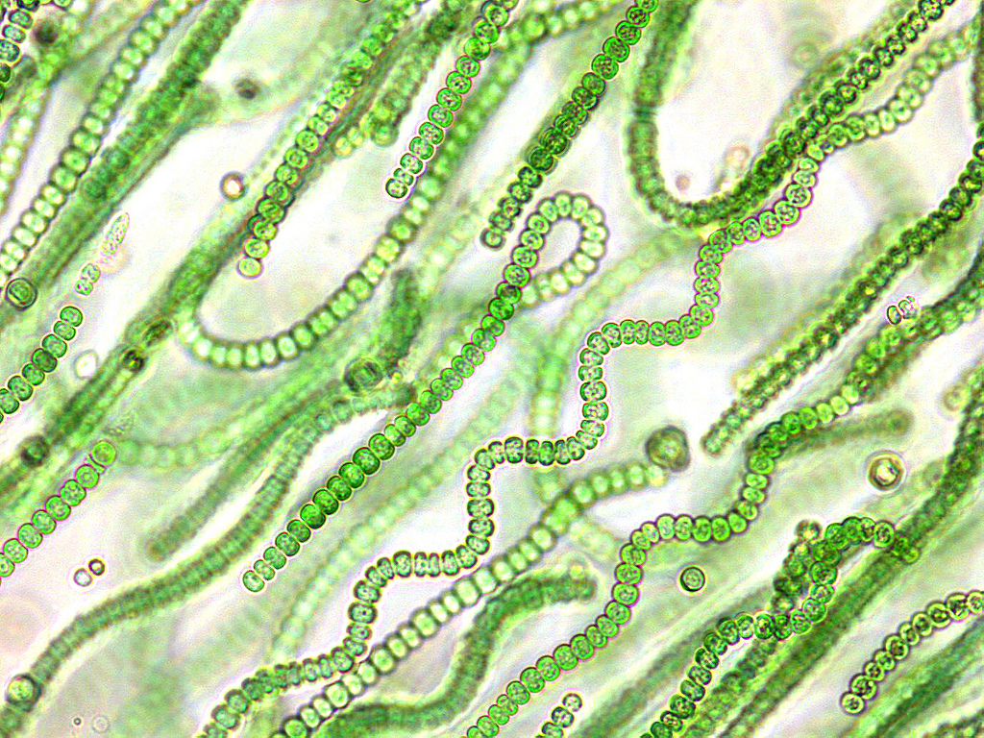
Drinking water and cancer
Cyanobacterial toxins (cyanotoxins)
Cyanobacteria - in warmer waters with higher nutrient
content (especially phosphorus - agriculture,
detergents)
They can cause digestive tract disorders, allergic reactions, liver disease, immune system weakness, respiratory and contact dermatitis…
They have embryotoxic and genotoxic effects

Slide 30
Drinking water and cancer
Drinking water can theoretically contribute to the annual increase in the probability of developing cancers in the Czech Republic by only 1-2 cases to the total number of over 60,000 new cases of newly reported cancer.

Slide 31
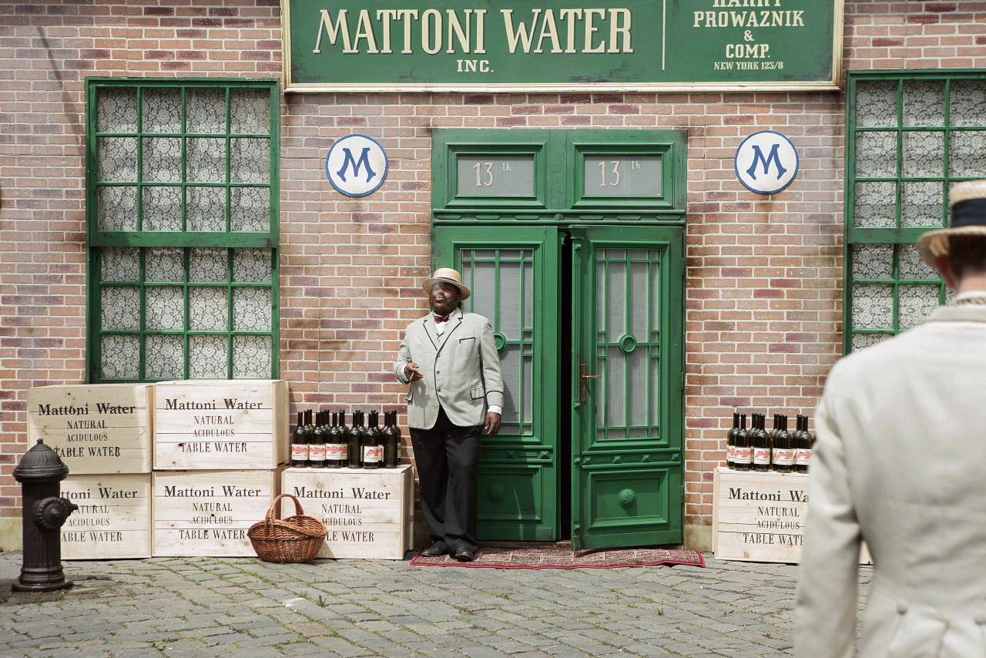
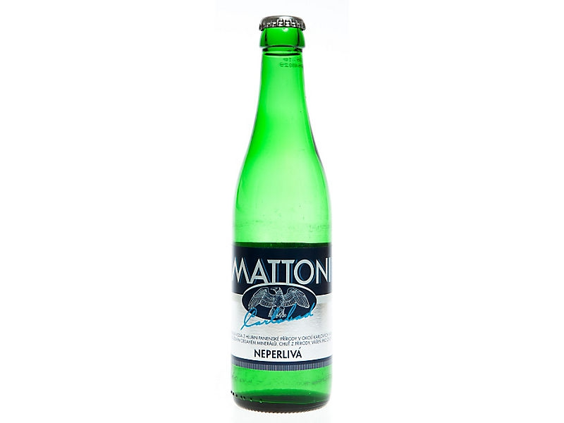
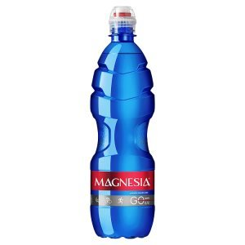
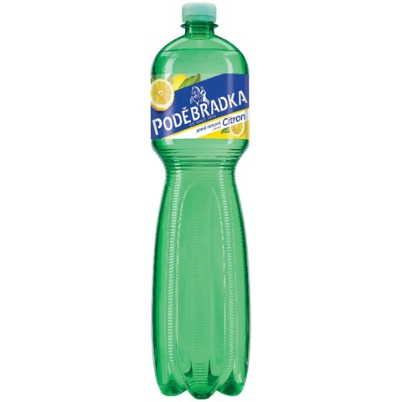
Bottled water
Natural mineral water
Spring water
Infant water
Drinking water
Natural mineral water: extracted from an underground resource that must be approved and regularly inspected by the Ministry of Health
Mattoni, Magnesia, Podebrady

Slide 32
Bottled water
Spring water (table): from a protected underground resource that does not need to be approved by the Department of Health.
It must not be modified in any way that would alter the characteristic composition
Toma natura, Bonaqua
Infant water: from a protected underground resource, and more stringent requirements apply to it
Mountain spring (Horský pramen)
Drinking water: It does not have to come from an underground resource, it can be tapped from the public water supply, the quality is comparable to drinking water quality from the water supply

Slide 33
Mineral bottled water
If you would drink only mineral water, you would get too much salt into your body, especially sodium.
The mineral waters - benefit mainly in heat, during heavy work and intense sports
Pregnant and lactating women should choose those with higher potassium and calcium levels
The sodium content should be mainly watched by the cardiac
Dyspnoeic people, people who suffer from swelling, who tend to develop kidney stones – no mineral water at all
Artificially supplied carbon dioxide does not bring anything to the body to benefit. It contributes to bloating and burying. Carbon dioxide is the waste product that our body must actually constantly get rid of.

Slide 34
Health risks - demineralized water
Demineralized water - it does not have the character of drinking water and its regular consumption or one-off consumption in large quantities must be considered as a health risk
Devices based on distillation or deionization must be rejected as the final stage of drinking water treatment:
- virtually zero intake of calcium and magnesium with water
- reduced intake of some essential elements and microelements
- high losses of calcium, magnesium and other essential elements from foods cooked
in demineralized water

Slide 35
Water enriched with oxygen
Water artificially enriched with pure oxygen - a food supplement
Manufacturers claim: increased oxygen concentration in blood, increased vitality and performance, blood pressure regulation, improved metabolism, increased immunity, increased resistance to stress, improved concentration and memory
A safe concentration of oxygen in drinking water can be considered to be up to 25 mg per liter.
Increased oxygen saturation - the risk of oxidative stress and its cytotoxic effects
An increase in chromosome aberrations was observed in rats

Slide 36
Water enriched with oxygen
Oxygen-enriched water manufacturers have not yet submitted any scientific study that would confirm the safety of higher oxygen values in water (when consumed)
Further work is needed to confirm or eliminate the potential physiological and toxic effect of oxygen enriched water
No international recommendations (WHO, FAO, etc.) on the safe maximum concentration of oxygen in drinking water
Natural pure water has a maximum of about 10 mg of oxygen per liter

Slide 37
Water and health - Microbiological analysis of water
DECREE No. 83 of 30 April 2014 amending Decree No. 252/2004 Coll., laying down
the sanitary requirements for drinking and warm water and the frequency and scope
of drinking water control, as amended
Limit value (MH): Exceeding does not usually present an acute health risk.
Unless otherwise indicated, this is the upper limit of the allowable range.
Highest limit value (NMH): The value of a health-related indicator of the quality
of drinking water as a result of which the use of water as a drinking water is excluded,
unless the public health authority decides otherwise under the law.

Slide 38
Microbiological analysis of water
Indicator (groups of) bacteria
Psychrophilic bacteria (22ºC) - indicators of general contamination
Mesophilic bacteria (36ºC) - indicators of general contamination
Faecal contamination
Coliform bacteria - indicators of faecal contamination
(Escherichia spp., Salmonella spp., Shigella spp., Yersinia spp.)
Enterococci - indicators of faecal contamination
Clostridium perfringens
Escherichia coli

Slide 39
Sampling procedure for microbiological analysis
If the well has not been used for a long period of time (eg in the winter season), it is necessary to drain the well prior to sampling (at least rinse well pipes from the well to the sampling point). If the well is drained, the water is allowed to rise and then sample of water is taken.
• A sample of water is taken from the point where water is normally used (from the distribution line, from the tap, from the pump, etc.). The sample can not be taken over the hoses used for watering and sprinkling.
• Prior to sampling, the water is drained for 1 to 5 minutes evenly (according to the length of the pipeline) and then sampling bottle is filled with the sample as described below. The sample bottle is held in such a way that any impurity from the hands does not get into the sampler.
• Samples should be stored in a refrigerator and taken to the laboratory within 48 hours after sampling, sample for bacteriological analysis within 24 hours!
Sampling for chemical analysis:
 The sample is taken up in polyethylene sample bottles (bottles). When sampling, the sample bottle, including the closure, is rinsed three times with tap water.
 The sample bottle is filled to the edge.
Sample collection for bacteriological analysis:
 The sample is to be taken only into glass bottles with aluminum foil.
 The sample bottle is opened just before sampling. The sample bottle is not flushed and it is filled so that between the surface and the plug there is about 2 cm of air.
 After closure of the bottle, the socket plug is again covered with aluminum foil.

Slide 40
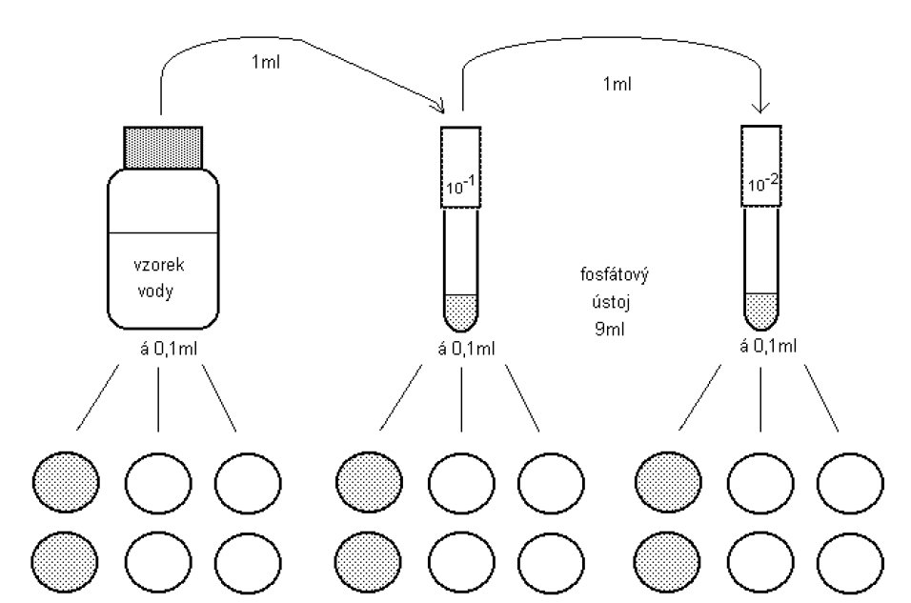
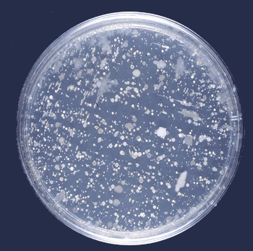
Microbiological analysis of water
Determination of general contamination indicators
1 ml of water plus 15 ml of TYEA agar
Cultivation
at 22ºC – psychrophilic bacteria
at 36ºC – mesophilic bacteria
1 ml
1 ml
1 ml
Drinking water surface water

Slide 41
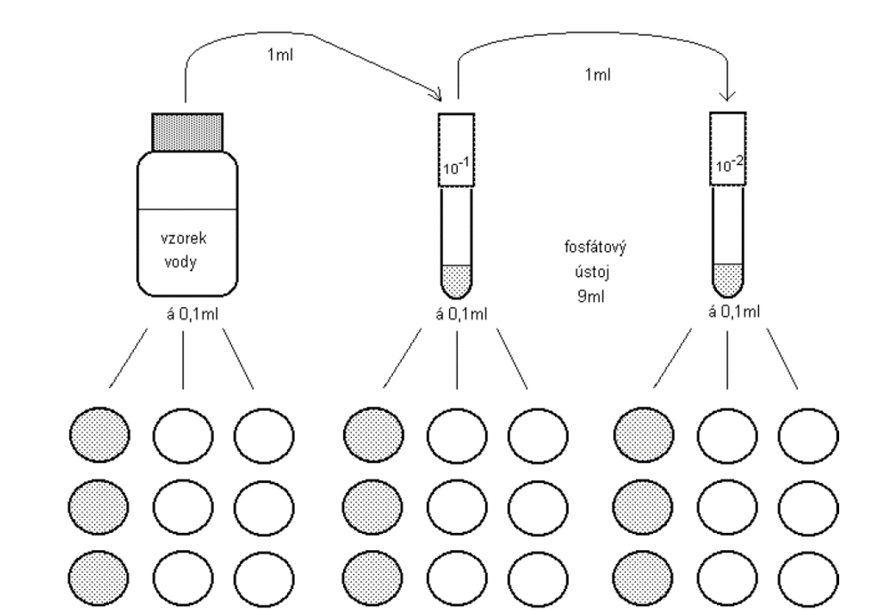
Microbiological analysis of water
Determination of general contamination indicators
Endo 37ºC
coliform bacteria
mFC 44ºC
termotolerant coliform
SB 37ºC
enterococci

Slide 42
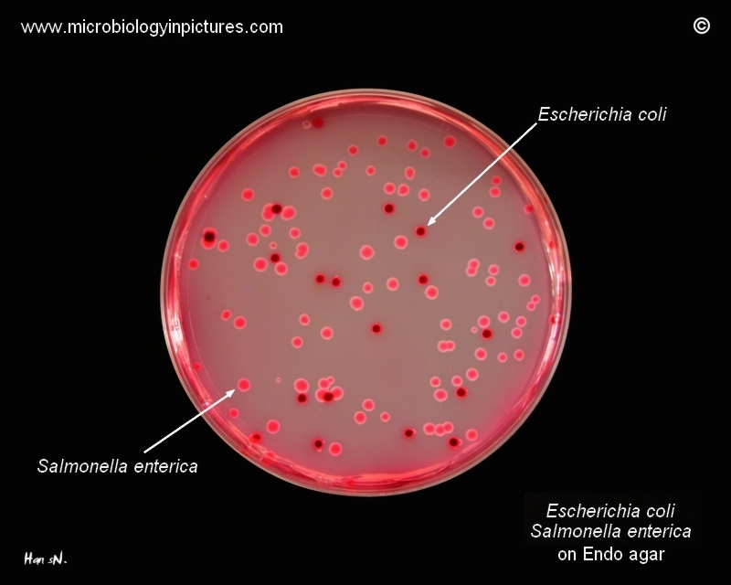
Coliform bacteria

Slide 43
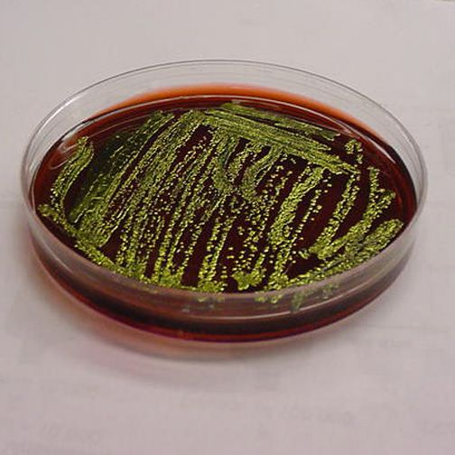

Escherichia coli

Slide 44
HiCrome Chromogenic Coliform Agar (CCA)
HiChromogenic Coliform Agar is a selective medium recommended for the simultaneous detection of Escherichia coli and total coliforms in water samples (1).
The medium contains three chromogenic substrates.
The enzyme ß-D-galactosidase produced by coliforms cleaves 6-chloro-3-indoxyl-β-D-galactopyranoside to form pink to red coloured colonies (3).
The enzyme ß-D-glucuronidase produced by E.coli, cleaves 5-bromo-4chloro-3-indoxyl-β-D-glucuronic acid (2).
Colonies of E.coli give dark blue to violet coloured colonies due to cleavage of both the chromogens.
The presence of the third chromogen IPTG enhances the colour reaction. Addition of L-Tryptophan improves the indole reaction thereby increasing the detection reliability.

Slide 45
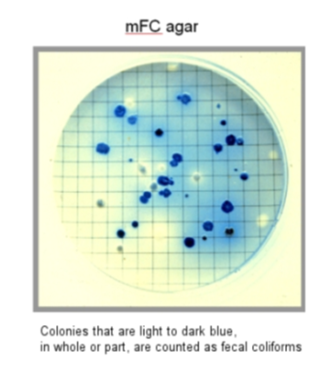
Termotolerant coliform bacteria

Slide 46
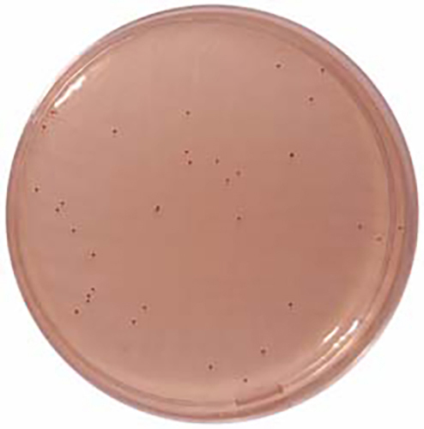

Enterococci
Slanetz & Bartley Medium
Originally intended as a medium for the enumeration of enterococci in water using
Membrane Filtration, this medium has become more popular in many other areas such
as food bacteriology.
The medium contains Tetrazolium Chloride, which is reduced by enterococci
to the insoluble red dye Formazan resulting in dark red colonies of enterococci on the agar.
It should be noted that this reaction is not exclusive to enterococci and colonies should
be confirmed by additional testing e.g. aesculin hydrolysis.

Slide 47
Physico-chemical properties
pH
Alkalite
Total hardness
Nitrates
Nitrites
Chlorides
Sulfates
Phosphates
Oxidability
Ammonia
Calcium
Magnesium
Iron
Cadmium
Trihalomethanes
PAH - polyaromatic hydrocarbons
Organoleptic evaluation - temperature, color, turbidity, taste, smell

Slide 48
Accredited water analysis in Brno
Water management services of the Czech Republic
Basic analysis of water with mikrobiology - 1290, - CZK
pH
overall hardness
COD-Mn (Chemical Oxygen Demand)
nitrates
nitrites
iron
manganese
sulphates
chlorides
ammonium ions
coliform bacteria - cfu
Escherichia coli - cfu

Slide 49



Slide 50



Slide 51

Waste water
• Ancient Greece, Rome - the first sewer system, sewage drawn into rivers, or soak up.
• The Middle Ages - a great decline.
• 18th century - construction of sewerage systems (drainage of army objects,
later church and public buildings).
• The end of the 19th century - sewer systems in most European cities.
• 1865 - England - The creation of the "Royal Commission on River Pollution".
• 1860 - First sewage WWTP - sewage farms.
• 1880 - First sedimentary treatment plant.
• 1900 - First intermittent biofilters.
• 1910 - USA - experimental aeration of sewage
• 1912 - England - Invention of the activation system

Slide 52
Waste water
• The protection of watercourses is primarily aimed at ensuring the required quality
of effluent on runoff from WWTP.
• Typical symptoms of waste water content in streams (odor, sludge, oxygen deficiency)
caused by organic substances - in European proportions are virtually eliminated.
• New cleaning issues: nitrogen, phosphorus, microfibers, pharmaceuticals.
• Act No. 254/2001 Coll. on water - defines the concept of wastewater.
• Act No. 274/2001 Coll. about public water supply systems and sewers as amended by
Act No. 76/2006 Coll.
• Government Decree No. 61/2003 Coll. in the act 229/2007 Coll. A 23/2011 Coll. about
indicators and values of permissible surface water pollution, discharging requirements
of sewage into surface water and sewage waters and about sensitive areas.
• Act No. 185/2001 Coll. on waste - determines the treatment of waste from WWTPs
(sludge, shrubs, sand, soil from root fields, etc.)

Slide 53
Waste water
Basic methods of wastewater treatment
• Mechanical
• Physical-chemical
• Biological
• In practice, combination of the three procedures are used
Sewage sorting
• Wastewater sewage
• Waste water industrial
• Wastewater rainfall (rainfall)

Slide 54

Waste water – WWTP scheme
Settling tank Activation tank Secondary settling tank
Ramp Sand trap
Inflow
Outflow
Primary sludge Activated sludge

Slide 55
Waste water – WWTP
The waste water first goes to the gravel trap.
The next level is ramp
- removal of rough floating dirt
(protection of other parts of the
treatment plant)
- landfill, composting, combustion.
A sand trap is next
The last device for mechanical cleaning
- the settling tank is a gravitational separation
of suspended substances
Primary sludge is formed
- processed in the sludge management.

Slide 56
Waste water – WWTP
BIOLOGICAL CLEANING (SECONDARY)
- activation line
- secondary settling tank
Activation tank - microorganisms in aerobic conditions decompose organics
biological oxidation of organic substrate, ammoniacal nitrogen, nitrification,
denitrification, biological decomposition of phosphorus, or its chemical precipitation.
Secondary settling tank
separation of activated sludge from purified water

Slide 57
Waste water – WWTP
Sludge processing technology
1. Concentration
2. Stabilization
3. Drainage
4. Hygiene
• Stabilization of sludge - reduction of degradable organic matter (microbes in aerobic
or anaerobic conditions) and the destruction of pathogenic microorganisms
• Total decomposition and other sludge stabilization methods:
- drying at low temperatures,
- drying at high temperatures (105 ° C),
- total decomposition with oxygen at 160 ° C,
- combustion of sludge with other fuels in power stations or cement plants

Slide 58
Waste water – WWTP
Sludge hygiene
- heat treatment of sludge at high temperatures
- pasteurization of sludge
- chemical treatment of sludge - liming
- anaerobic thermophilic processing methods
- composting
- special methods: ionizing radiation, ozone, decomposition

Slide 59

Waste water – WWTP
Category I - sludges can generally be applied to land used in agriculture
Category II - sludge can be applied to agricultural land intended for the cultivation of technical crops, and land that will not grow for at least 3 years after the use of sewage sludge field vegetables and intensely fruit-bearing fruit planting

Slide 60

Waste water – WWTP
Limit values of concentrations of selected hazardous substances and elements in slurries for their use on agricultural land

Slide 61
Waste and health
Waste is every movable thing the person discards, or has the intention or duty to discard it, and it belongs into one of the categories of waste listed in the catalog waste
(Act No. 185/2001 Coll.)
Types by production:
Communal-mixed - occurring in the activity of natural persons, dangerous drugs, cans from paints and thinners, etc. - it is the largest amount of all wastes
Agricultural - wastes from plant and livestock production (urine, manure),
agrochemicals (fertilizers)
Industrial - from industrial activities

Slide 62
Waste and health
According to the composition:
Inert - not subject to biodegradation - does not decompose/rot
Construction waste, glass, has no dangerous properties
Biological - is capable of aerobic and anaerobic digestion.
Food, paper, green mater
Toxic, radioactive - nuclear waste, old batteries, drugs, oils
Hospital - parts of human bodies, infectious waste, needles, plasma, cytostatics

Slide 63
Waste and health
Categories of waste from medical facilities
Specific waste
Sharp objects
Pathological and biologically contaminated waste
Discarded chemicals, drugs
Non-specific waste
Other wastes not requiring protection against the spread of infections

Slide 64
Waste and health
Exposure:
Dust
Contact
Mediated (contamination of water, soil, food chains, insects, rodents

Slide 65
Waste and health
Effects:
Irritation, toxic smoke
Parasitic infections - helminthoses, amoebae, cercariae (maggot stage, the evolutionary stage of the motolic, leaving the guts and looking for the host - the human)
Zoonoses
Hepatitis, AIDS
Poisoning

Slide 66
Waste and health
Action:
Minimizing quantity (recycling, use of one – off packaging)
Selection of suitable sites and landfill security
Separation of toxic, infectious, radioactive waste
Education of the population

Slide 67
Waste and health
Waste disposal:
Landfills
Composting
Combustion
Chemical destruction
Storage
Feeding to animals
Recycling of sorted waste (glass, paper, plastics, metals)

Slide 68


Slide 69


Slide 70


Slide 71


