Slide 1
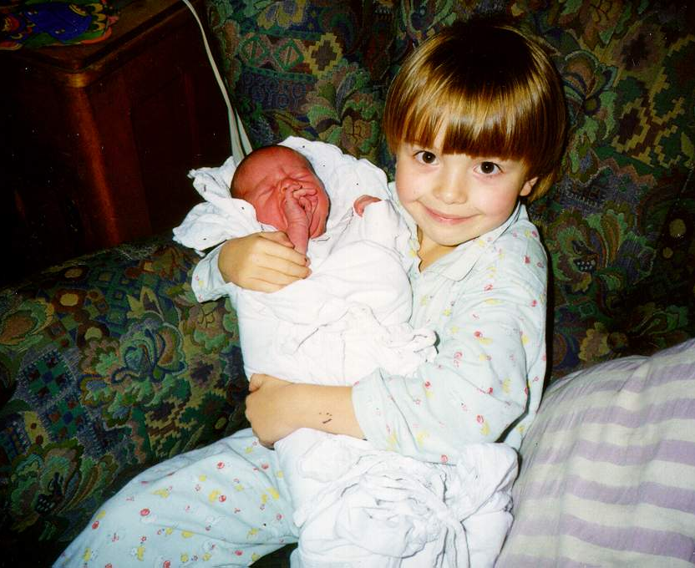
Allergy in childhood:
Need for early detection and treatment
Ondřej Rybníček
Allergy unit, Paediatric Dept., FN BRNO

Slide 2
INCREASE IN ALLERGY PREVALENCE
60th 90th
3 - 10 times
Sensitization
  allergic rhinitis
  atopic eczema
  bronchial asthma
Allergy drug consumption increase

Slide 3
ATOPIC SENSITIZATION
Sequential and progressive occurrence of atopy symptoms
in childhood
  Food allergy
  Atopic dermatitis
  Bronchial asthma
  Allergic rhinitis
„Atopic march“

Slide 4
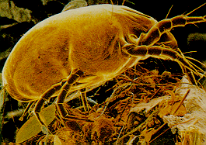
PREVENTION OF ALLERGY
AND ASTHMA
No contact with tobacco smoke both
pre- and postnatally
Encouragement of spontanneous delivery
(contact with vaginal microflora)
Encouragement of breastfeeding (also
other reasons than allergy prevention)
Avoiding broad-spectrum antibiotics
and paracetamol prenatally and during
the first year of life when possible
GINA2014

Slide 5
ALLERGIC DISEASES:
DIAGNOSIS
History, physical examination
Skin tests
Laboratory evaluation
Functional evaluation
Elimination-exposition tests (provocation tests)
Involvement of different specialists

Slide 6
ALLERGY THERAPY - APPROACH
COMPLEX APPROACH
Environmental adjustments
    In- and outdoor allergens, pollutants,
    dietary alterations
Specific allergen immunotherapy
Pharmacotherapy
Permanent patient education
Adjuvant methods
  Physiotherapy, climato/balneotherapy,
  diet, psychotherapy, vaccination….

Slide 7
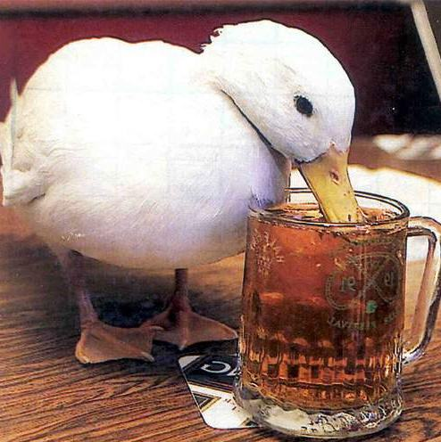
ALLERGEN IMMUNOTHERAPY (AIT)
Treatment approach where
defined doses of therapeutic
allergen are being administered
to the allergic person in regular
intervals.
The therapeutic allergen must
be a cause of allergic problems
+ IgE mediated hypersensitivity
(Ist type) must be confirmed.

Slide 8
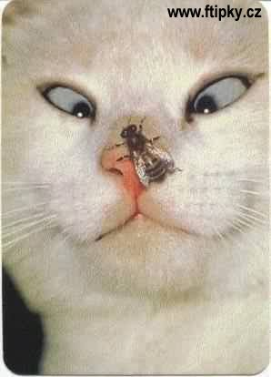
WHEN AIT IS INDICATED?
Allergic rhinitis and asthma caused by known aeroallergens
History of severe systemic reaction caused by Hymenoptera venom allergy.
AIT in urticaria, angioedema, atopic dermatitis and food allergy is up to now considered experimental and is not recommended for daily practice.

Slide 9

ALLERGENS SUITABLE FOR AIT
A/ Aeroallergens
  pollen allergens
  house dust mites
  cockroaches
  pet allergens
  moulds
B/ Hymenoptera venom

Slide 10
ANTIALLERGIC DRUGS
ANTIINFLAMMATORY DRUGS
systemic and topical GCS
antileukotriens
antihistamines
  suppressed adverse effects
  broader spectrum of effects:
    antihistaminic
    antiinflammatory
    antiallergic
theophylline
cromons

Slide 11

FOOD ALLERGY

Slide 12
FOOD ALLERGY:
DIAGNOSTIC APPROACH
History, physical exam
Skin testing
  prick tests, i.d. tests
  atopy patch test
Specific IgE antibodies
Component diagnostics
Elimination-exposition tests

Slide 13
FOOD ALLERGY:
MANAGEMENT
Elimination of causal allergens from diet, incl. cross-reacting allergens
Nalcrom
Epipen
(Antihistamines)

Slide 14
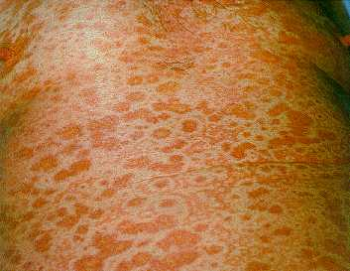
SKIN ALLERGY

Slide 15
ATOPIC DERMATITIS
Delayed hypersensitivity
Basic therapy: topical treatment
regimen adjustment
pruritus antihistamines

Slide 16
MECHANISMS OF URTICARIA
Degranulation of skin mastocytes
Effects of histamine on tissue receptors
Diverse etiology: allergy (food, drugs...)
physical factors (cold, pressure...)
focal infections
other diseases (hepatitis,
diabetes, haemophilia...)
C1-esterase inhibitor defect
comprehensive evaluation is necessary

Slide 17
CHRONIC URTICARIA THERAPY
Drugs of the choice
– non-sedating antihistamines
Symptom control (itching)
Higher doses usually necessary
  increase the dose of non-sedating antihistamine
  add first generation antihistamine
Continue 2-3 weeks after symptoms disappear (relaps prevention)
Plus: Regimen adjustment
Additional drugs according to clinical course (GCS, adrenaline)

Slide 18
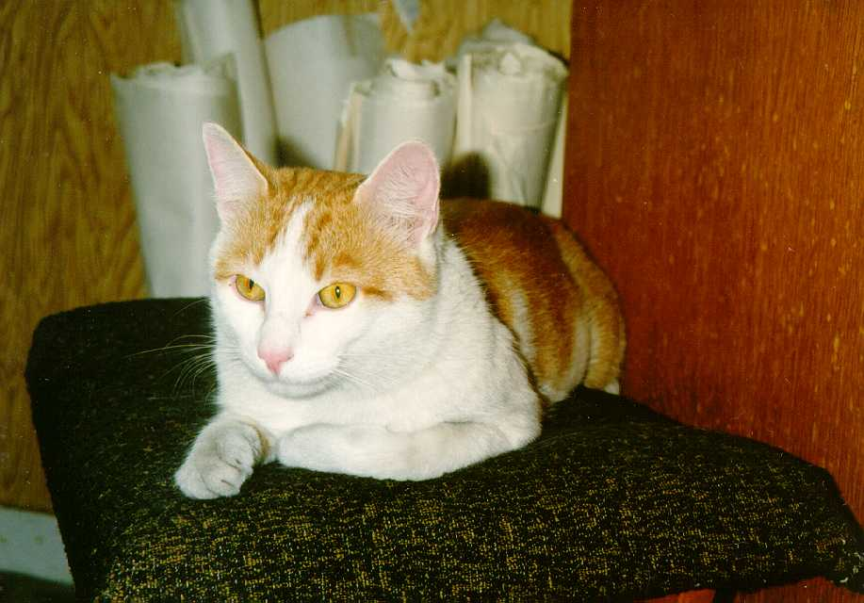
BRONCHIAL ASTHMA

Slide 19
2018 UPDATE OF GLOBAL STRATEGY FOR ASTHMA MANAGEMENT AND PREVENTION (GINA):
http://ginasthma.org/2018-gina-report-global-strategy-for-asthma-management-and-prevention
free download (pdf)
GINA 2018

Slide 20

Early childhood asthma
Childhood asthma: whole life importance
  2/3 of all asthma cases start in the first 3 years of life
  majority of severe asthma cases start in the first 3 years of life
  hypothesis that the severity of asthma in children decreases with age has not been proofed correct
Fernando D. Martinez

Slide 21
A clinical index to define risk of asthma in young children
Major criteria:
parental asthma
atopic eczema
Minor criteria:
allergic rhinitis
wheezing apart from colds
eosinophilia (>4%)
Early wheezer
+
at least 1 major criteria
or at least 2 minor criteria
Castro-Rodriguez et al., Am J Respir Crit Care Med, Vol 162. pp 1403–1406, 2000

Slide 22
CLINICAL COURSE OF ASTHMA
Zone for rescue drugs effect:
inhaled beta-2 agonists
inhaled anticholinergics
Acute exacerbation
clinical
manifestation
Chronic inflammation
Structural changes
Time

Slide 23
FULL ASTHMA CONTROL
No chronic symptoms incl. nocturnal problems
No asthma exacerbations
No need for ED visits
No need for rescue beta-2 agonists use
No limitation of daily activities including
physical activities and sport
Physiological circadian PEF variability
Normal lung function
No adverse effects of medication

Slide 24
ASTHMA PHARMACOTHERAPY
Two key parts of asthma therapy:
Preventive (antiinflammatory) medication
Rescue medication (SABA)
Stepwise treatment approach
GINA 2014

Slide 25
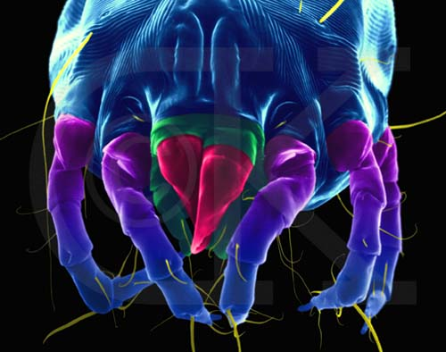
ALLERGIC RHINITIS

Slide 26
ALLERGIC RHINITIS CLASSIFICATION with regard to the quality of life
intermittent persistent
symptoms symptoms
<4 days/week >4 days/week
or <4 consecutive weeks and >4 consecutive weeks
mild moderate/severe
(all of the following) (one or more items)
normal sleep sleep disturbed
no impairment of daily activities, impairment of daily activities, sport, leisure sport, leisure
no impairment of work and school impairment of school or work
symptoms present, not troublesome troublesome symptoms

Slide 27
ALLERGIC RHINOCONJUNCTIVITIS: DIAGNOSTIC APPROACH
History, physical exam
Skin testing, specific IgE
Component diagnostics
Functional tests (flow-volume)
ENT, sinus X-ray (diff. dg.)
Ophthalmology (diff. dg.)
GINA 2014

Slide 28
ALLERGIC CONJUNCTIVITIS
Ist type allergic reaction
(immediate reaction)
Symptoms: itchy eyes
conjunctival injection
lacrimation
conjunctival oedema
usually together with AR

Slide 29
ALLERGIC RHINITIS PHARMACOTHERAPY
TREATMENT GOAL
block of pathophysiological mechanisms that induce chronic inflammation
prophylaxis of allergy symptoms
Allergy 1998:53(suppl 41)7-31
Rachelefsky GS. J Allergy Clin Immunol 1998;101:2, part 2, 367-69

Slide 30
RHINITIS – PRINCIPLES OF PHARMACOTHERAPY
When choosing a suitable and effective
medication, consider:
aetiology
pathophysiology
main symptoms
safety (side effects, drug interactions)
age
other specific conditions (pregnancy, athletes…)
coexisting airway disease (sinusitis, asthma)
patient preference and compliance

Slide 31
PHARMACOTHERAPY
Glucocorticosteroids (GCS)
  Intranasal GCS are considered drugs of choice when nasal congestion is the leading symptome (persistent rhinitis)
Decongestive drugs
  Topical
  Systemic
Antihistamines
Decongestant/antihistamine combination
Mast cell stabilizers
Leukotriene receptor antagonists
Corey et al. Ear Nose Throat J. 2000;79:690.
American Academy of Allergy, Asthma and Immunology. The Allergy Report. Volume 2: Diseases of the Atopic Diathesis.
Milwaukee, WI: American Academy of Allergy, Asthma and Immunology; 2000:13–50.

Slide 32
CLINICAL FEATURES OF RHINITIS
symptoms
„sneezers/secretors“
„blocked nose“
Sneezing
Rhinorrhoea
Itching
Blocked nose
Intensity variation during the day
Conjunctivitis
Paroxysmal
Watery secretion
Anterior + posterior
Yes
Sometimes
Daytime worsening,
nighttime improvement
Often
Not common
Thick mucus
Mainly posterior
No
Common, intense Permanent problems
often worse at night
Not common
Preferred therapy: antihistamines topical nasal steroids

Slide 33
UNITED AIRWAY DISEASE
rhinitis
asthma
* changes almost always detectable on the other organ
* intensity of nasal and bronchial symptoms correlate
* bronchial reaction after nasal provocation
* primary worsening usually on nasal mucosa

Slide 34
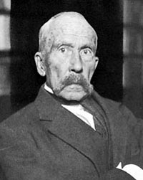
DEFINITION OF ANAPHYLAXIS
PATHOPHYSIOLOGY
Anaphylaxis is an acute allergic reaction based
on Ist type, IgE mediated immunopathologic reaction
CLINICAL DEFINITION
- Multiorgan involvement
- No generally accepted
clinical definition exists
Ch. Richet, 1850-1935

Slide 35
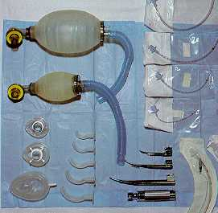
MANAGEMENT OF ANAPHYLACTIC REACTON
check vital functions
adrenaline i.m. 0,1 ml/10 kg
oxygen, maintain adequate oxygenation, relieve bronchospasm, intubate
I.V. fluids, maintain adequate blood pressure (noradrenaline, dopamine)
antihistamine
systemic GCS
Holgate ST, Church MK 1993

Slide 36
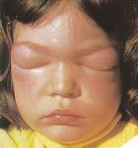
MANAGEMENT OF ANAPHYLACTIC REACTON
Adrenaline - effective in the early phase of anaphylactic reaction. Administer if in doubts, do not wait!
In fully developed anaphylactic reaction administration of I.V. fluids is necessary (up to 50% of vessel content can become extravasated within 10 minutes)
Sampson et al., JACI, 2005, Lieberman et al., JACI, 2005

Slide 37
ALLERGIC PATIENT - CARE
ENT, DERM., OPHTHAL. SPECIALIST
ALLERGIST
GENERAL PRACTITIONER
OTHER SPECIALISTS
PULMOLOGIST

Slide 38
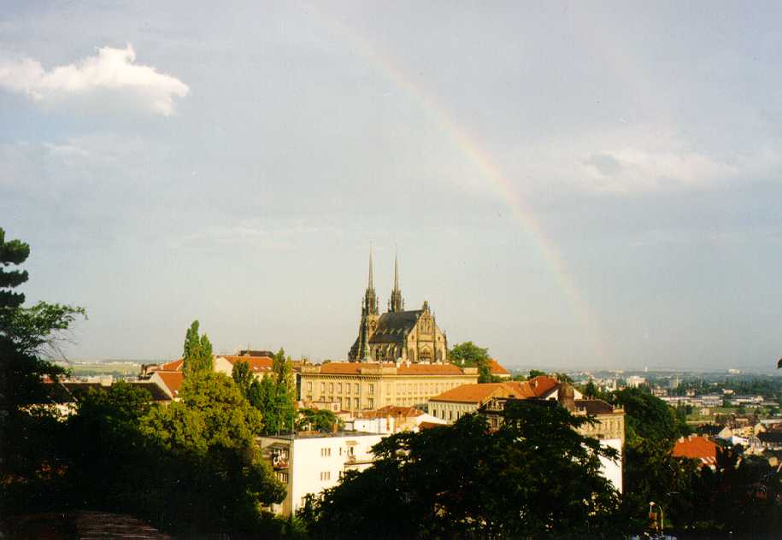
Thank you for
your attention!

