Slide 1
Pathogenesis of autoimmune diseases
Jiří Litzman

Slide 2
Immmune tolerance

Slide 3
Clonal selection theory - Forbidden clones F.M. Burnet, 1957
During (mainly fetal) development immunocompetent cells of the immune system develop. Each cell is characterized by its own antigen specific receptor. Each cell reacts only with one concrete specific antigen.
After exposure to autoantigen during fetal life autoreactive clones are eliminated ( „forbidden clones“).
If a concrete cell recognizes its specific antigen, it is stimulated, proliferates and forms a clone = clonal selection.
After repeated divisions the cell becomes a terminally differentiated cell, that does not proliferate and after some time dies.
The cells of the clone that do not differentiate into the terminal stage become a memory cells which will quickly react after the second exposure to the antigen.

Slide 4
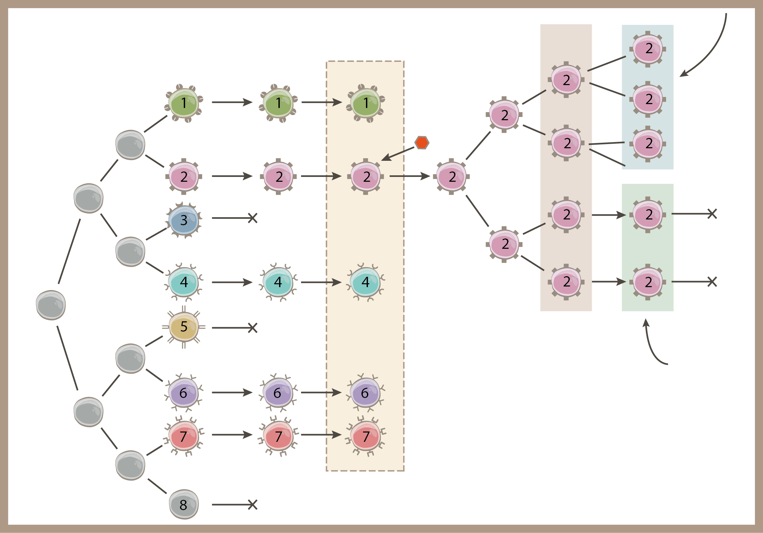
Clonal selection theory
Memory cells
Elimination of autoreactive clones
Blood and periperal lymphatic organs
expansion
antigen
death
death
Effector cells

Slide 5
Immune tolerance
Central
Peripheral

Slide 6
Central immune tolerance = clonal deletion
Negative selection during the thymic education proces.
Deletion of autoreactive B-lymphocytes in the bone marrow

Slide 7
Development of lymphocytes in the thymus

Slide 8
Thymic education
Positive selection: survival of cells reacting with low affinity to HLA antigens expressed on antigen-presenting cells in the thymus. Only those cells that recognize HLA antigen of the concrete person survive. The non-reacting cells die by neglect.
Negative selection – those thymocytes that react with high affinity with complexes of HLA-autoantigens in thymus die by apoptosis.
It is supposed that more than 90-95% of thymocytes die during these processes.

Slide 9
Negative selection during thymic education
Negative selection – in the subcortical and mainly medullary areas of the thymus. Thymic epithelial cells in the subcortical and medullary areas of the thymus express a variety of somatic antigens on their HLA.
This expression is controlled by the gene AIRE. Apoptosis is induced in the thymocytes with high affinity with complexes of HLA-autoantigen.
It is estimated that during the processes of positive and negative selection up to 98% of the thymocytes are eliminated.

Slide 10
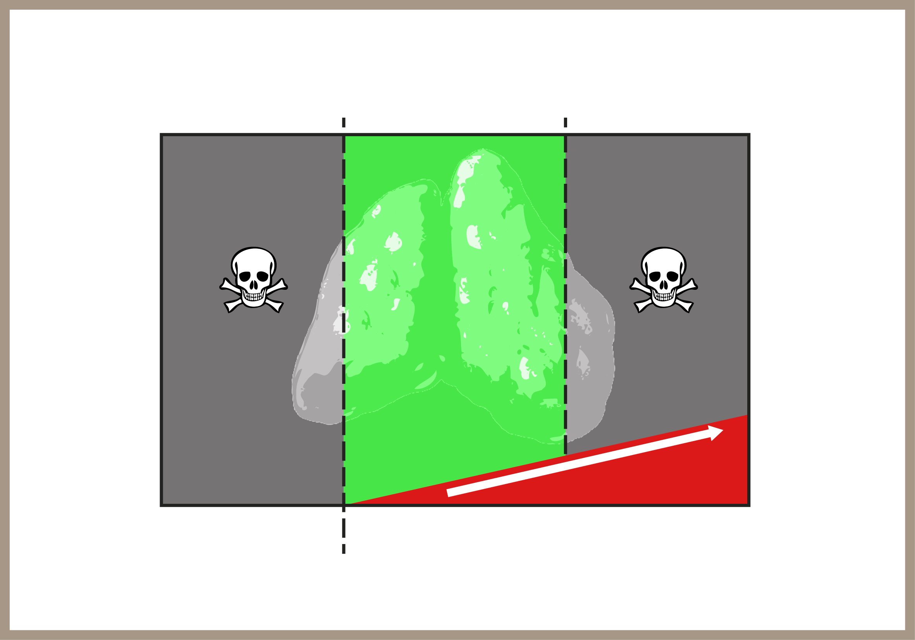
Strength of interaction between TCR and HLA-(antigen) complexes determines the fate of thymocytes
Neglected cells
Positive selectoion
Negative selection
Stength of interaction
Cell death

Slide 11
AIRE gene deficiency
Results is a rare disease APECED (Autoimmune polyendocrinopathy-candidiasis-ectodermal dystrophy)
Autoimune manifestations: autoimmune polyendokrinopathy (most importantly hypoparathyroidism, Addison's disease), autoimmune hepatitis, vitiligo, alopecia....
Mucocutaneous kandidiasis is caused by autoantibodies against IL-17.

Slide 12
Innate defects of apoptosis
A number of genes may be affected.
The most frequent disease – autoimmune lymphoproliferative syndrome (ALPS).
Lymphadenopathy, hepatosplenomegaly, autoimmune anaemia, thrombocytopenia, other autoimmune diseases.
A significant increase of CD4-CD8-T-lymphocyte in the blood.

Slide 13
Immune tolerance
Peripheral:
Clonal deletion - elimination of autoreactive cells by apoptosis
Clonal anergy - costimulatory signals are lacking
Clonal ignorance - to low concentration of antigen does not stimulate immune response
Suppression - autoreactivity is blocked by regulatory cells

Slide 14
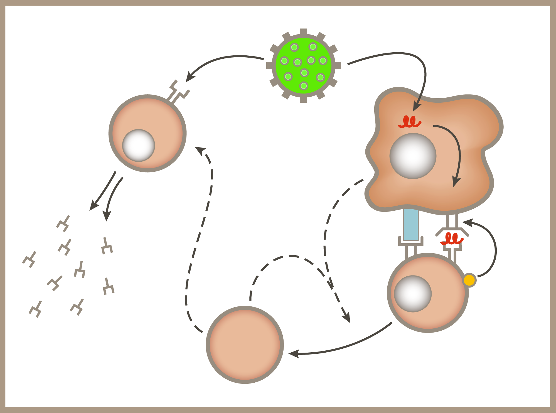
Activation of immune system by antigen
B-cell receptor
B cell
Antigen
peptide
Antigen
presenting cell
DC80/86
MHCII
Interleukin 4,5,6
B-cell activation
Interleukin 4
CD28
Interleukin 4
Th0
T Cell
Antibodies
Th2
T Cell

Slide 15
T_{reg} lymphocytes
Thymic development, but can be induced also in periphery.
FOX-P3 is a crucial transcription factor
In flow cytometry CD4+CD25+ (FOX-P3+)
Involved in tolerance of autoantigens
Direct effect on other T cells by CTLA-4 molecule and also by soluble or membrane bound TGF-β.
Suppress function of antigen-presenting cells.
However also involved in „autotoleration“ of tumor cells
Comprise approximately 5-10% of peripheral CD4+ lymphocytes.

Slide 16
FOX-P3 transcription factor deficiency
Results is a serious rare disease - IPEX syndrome (Immune by the dysregulation, Polyendocrinopathy, Enteropathy, X-linked)
Severe autoimmune enteritis, diabetes mellitus, eczema, hypothyroidism...
The gene is on X-chromosome.
Lethal if haematopoietic cells are not transplanted.

Slide 17
Genetic aspects of autoimmune diseases
The accumulation of autoimmune diseases in families.
Inbred strains of animals which develop a defined autoimmune disease.
Association of autoimmune diseases with HLA antigens.
The significance of various polymorphism of cytokine/ cytokine receptors and other regulatory genes.
Failure of apoptosis leads to autoimmune diseases.
Majority of autoimmune diseases are more frequent in women.

Slide 18
Environmental factors in the development of autoimmune diseases
Infection
"Bystander" effect in the ongoing inflammation.
Molecular mimicry.
Polyclonal stimulation.
Abnormal response to the physiological flora (IBD).
Effect of UV light on the development and exacerbation of SLE
The effect of stress is considered
Several autoimmune diseases are more frequent in vaious geographical areas (the north-south gradient in multiple cerebrospinal sclerosis)
Increased intake of iodine is associated with more frequent occurrence of Hashiomoto thyroiditis.

Slide 19
Development of autoimmune disease after pregnancy
Suspected are hormonal changes after delivery and the termination of "immunosuppression" present during pregnancy.

Slide 20
Frequency of autimmune diseases (Mackay IR, BMJ 2000; 321: 93-96)
It is estimated that approximately 5% (other estimations > 10%) of the population suffer from any autoimune disease.
Autoimmune impairment of the thyroid gland: approximately 3% of females.
Rheumatoid arthritis: 1% of the population.
Primary Sjogren's syndrome: 0.6-3% of women.
SLE: 0,12% of the population.
Multiple sclerosis: 0.1% of the population.

Slide 21
Autoreactitity and autoimmunity
Autoreactivity is a physiological process in which the immune system recognizes its own structure and respond to them.
It is involved during the growth, differentiation, removal of old cells.
Autoimmunity is a pathological condition, if there are clinical signs we speak about an autoimmune disease.

Slide 22
Pathogenesis of Autoimmune Diseases
Autoantibodies cause opsonization, activate the complement system, block/stimulate the receptors, may be involved in ADCC phenomenon.
Complexes with autoantigens cause immunocomplex diseases.
Autoreactive T-lymphocytes: cytotoxic but also Th lymphocytes are involved . The best-known example is multiple sclerosis, DM-I.
Non-specific mechanisms: chemotaxis of leukocytes to the site of inflammation.

Slide 23
Autoantibodies in pathogenesis of autoimmune diseases
The presence of various of autoantibodies in low titre can be observed quite frequently in many people not suffering from autoimmune diseases.
This incidence increases with age.
Quite often we encounter situation when diagnostically used autoantibodies are different from the autoantibodies of pathogenetic importance or cellular immunity plays a crucial role.
The finding of certain autoantibodies may precede autoimmune disease by many years ( antimitochondrial, anti-cyclic citrulinated peptides).
Autoimmune disease must have clinical symptoms, the presence of autoantibodies never provides a diagnosis of a disease!

Slide 24
Mechanisms leading to autoimmune diseases
Visualization of hidden antigens
Cross-reactivity of exo - and endoantigens (molecular mimicry)
"Bystander" activation
Abnormal expression of HLA-II antigens
Polyclonal stimulation of T-and B – lymphocytes
Impaired function of regulatory T-lymphocytes.
The formation of neoantigens (e.g. the effect of drugs, infections.

Slide 25
Hashimoto thyroiditis
Autoimmune thyroiditis
Lymphacytic infiltration of the gland
The presence of antibodies against thyroglobulin (TG) and microsomal peroxidase (MPO).

Slide 26
Hashimoto thyroiditis
Symptoms of hyperthyroidism can be observed at the beginning of the disease – perhaps as a result of release of hormones from the colloid due to the necrosis of follicular cells.
Sometimes, it is possible to demonstrate antibodies against TSHR, but they have usually a blocking effect.
On the contrary, in some patients with Graves - Basedow disease antibodies against TG and the MPO can be demonstrated.

Slide 27
Autoimmunity in Hashimoto thyroiditis
Antibodies against thyroglobulin and microsomal peroxidase - some fix complement, i.e. they can have a cytolytic effect, in another patients complement fixation cannot be demonstrated.
Some patients have antibodies against TSH – they have usually a blocking effect.
Pathogenetically, T-lymphocytes are probably the most important: Cytotoxic CD8 lymphocytes, Th1 lymphocytes stimulate both CD8 lymphocytes ( IL-2, IFN-gamma), macrophages Th2 lymphocytes stimulate formation of antibodies

Slide 28
Possible mechanisms leading to autoimmune thyroiditis
Molecular mimicry – the triggering antigen was not documented.
Now considered the possibility of cross-reactivity of HSP proteins.
Bystander effect of abnormal expression of HLA-II on the cells of the thyroid gland.
Induction of apoptosis – increased expression of FAS on thyreocytes under the influence of IL-1beta (product of Th1 cells)

Slide 29
Triggering factors of Hashimoto thyroiditis
Infection – quite frequently and infection precedes the disease, however a concrete triggering microbe has never been demonstrated.
Stress – can be documented in some patients
Sex – ratio of women: men - 25:1
A period after giving birth
A large intake of iodine radiation (mainly studies after the Chernobyl disaster)

