Slide 1
Primary and Secondary Immunodeficiencies
Jiří Litzman
Dept. Clin. Immunol. Allergol, Faculty of Medicine, Masaryk University, Brno

Slide 2
Immunopathological states
IMMUNO-
DEFICIENCY
ALERGY
AUTOIMMUNITY

Slide 3
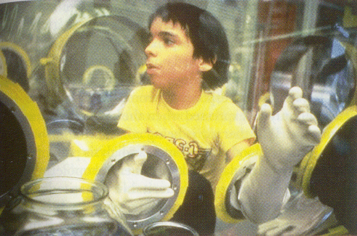
Bubble boy - David Phillip Vetter (1971 – 1984)

Slide 4
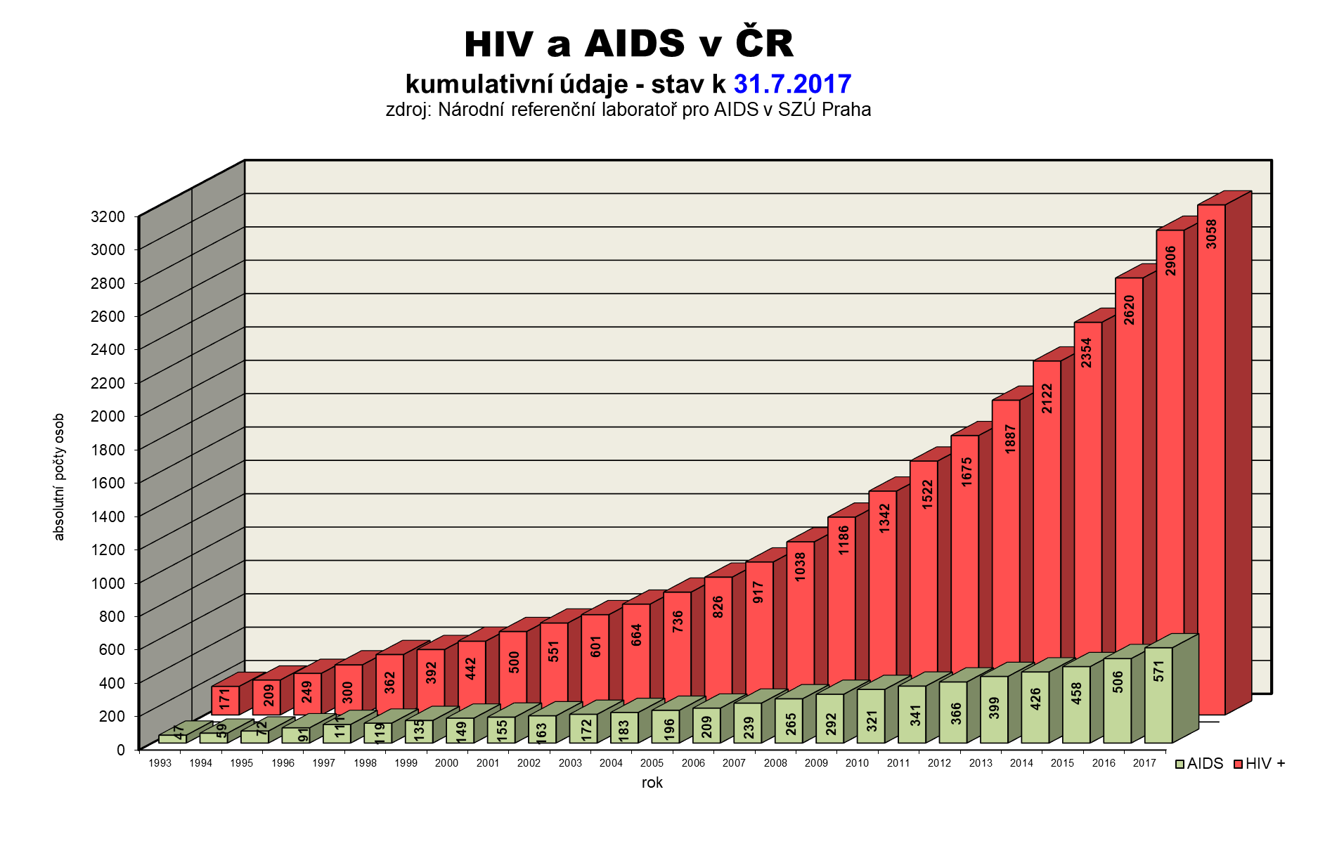
HIV and AIDS in the Czech Republic

Slide 5
Imunodeficiency states
Primary
  Caused by defined genetic defect
  Usually rare, but severe (exception: IgA deficiency)
Secondary
  Consequence of some other disease, treatment, environmental factors…
  Usually frequent, but usually clinically mild

Slide 6
Causes of secondary immunodeficiency
Metabolic - uremia, diabetes, malnutrition
Iatrogenic – cytostatics, immunosuppressive treatment
Malignat tumors
Viral infections - HIV, CMV, measles, infectious mononucleosis
Splenectomy
Stress
Injuries, operations, general anestesia

Slide 7
Complications of immunodeficiency
Tendency to infectious complications, mainly serious infectious complications.
Infections may be caused by usual or opportunistic pathogens.
The response to antibiotic treatment is insufficient.
In primary immune deficiencies we frequently observe other complications caused by dysregulation of the immune system - autoimmunity, allergic diseases, inflammatory diseases.
The incidence of malignancies is increased. This increase is extreme in primary immune deficiencies associated with increased chromosomal instability.

Slide 8
Typical infectious complications of immunodeficiencies
Antibody deficiencies: encapsulated bacteria
Complement system disturbances: meningococcal infections, other encapsulated bacteria
T-lymphocyte deficiencies: herpesviral infections (the most important is cytomegalovirus), Pneumocystis jiroveci, mycobacterial infections, deep fungal infections
Phagocytic disorders: fungal infections, several bacterial infections.

Slide 9
Frequency of immunodeficiency diseases
Severe combine immunodeficiency ( SCID) - 1:50 000 newborns (Czech Republic, much higher in countries with high degree of consanguinity)
Common variable immunodeficiency - prevalence 1:20 000
Di George syndrome - 1:4 000 newborns
HIV - 36.7 millions infected 2015 (estimation)
Malnutrition: 22,9 % of population ( UNICEF 2016)

Slide 10
Types of immunodeficiencies in dependence of the affected component of the immune system
Antibody production deficiencies
Abnormalities of number or function of T-lymphocytes
Complement system disturbances
Abnormalities in number or function of myeloid cells
Combined immunodeficiencies

Slide 11
Biological functions of immunoglobulin molecules
Activation of complement system (IgG, IgM)
Opsonization (IgG)
Neutralization of antigens (IgG, IgA, IgM)
Adherence interference (IgA, IgG)
Antibody dependent cellular cytotoxicity (ADCC)
Agglutination, precipitation (IgG, IgM)
Mast cells degranulation (IgE)
Transport through placenta (IgG)
Imunoregulation (mainly IgG)

Slide 12
Antibody Deficiencies
IgG deficiency is clinically the most significant. Disorders of IgA and IgM disturbed production do not lead to significant clinical complications.
The most commonly affected system is the respiratory tract. Typical complications are bronchitis, pneumonia, sinusitis, otitis in adulthood. Recurrent infections lead to bronchiectasis development.
Encapsulated bacteria - Haemophilus sp., Pneumococcus, Staphylococcus, or others are the predominant pathogens.
The frequency of viral infections is not significantly increased. An exception is enteroviral encephalitis in patients with severe antibody production disorders.

Slide 13
Diagnosis of Antibody Deficiency
Serum levels of IgG, IgA, IgM
Enumeration of B-lymphocytes (in many diseases may be normal!).
Investigation of antibody levels against tetanus toxoid, pneumococcal polysaccharide (PCP).
Monitoring of specific antibody response after vaccination with protein (tetanus anatoxin) and polysaccharide (eg. Pnemococcal non-conjugated vaccine, Salmonella typhi vaccine) antigens. Examination before vaccination and one month after the vaccination.

Slide 14
The most important primary antibody immunodeficiencies
X-linked agammaglobulinaemia: only boys affected, manifestations after 6 months of age. Caused by Bruton tyrosine kinase mutation
Common variable immunodeficiency (CVID). Both sexes are affected. The beginning of clinical manifestation at any age. Autoimmune (ITP, pernicious anemia) and inflammatory (granulomatous) complications are common. The disease may be caused by mutations of many different genes.
Selective IgA deficiency - prevalence approximately 1: 500. Often clinically silent. Cave: anti-IgA antibodies when IgD administered in blood derivatives. Possibility of progression to CVID.

Slide 15
Secomndary hypogammaglobulinemia
Disturbed antibody production
Chronic lymphatic leukemia (CLL)
Lymphomas
Myeloma
Drug-induced hypogammaglobulinaemia
Increased immunoglobulin losses
Nephrotic syndrome
Exductive enteropathy - IBD, celiac disease, intestinal lymphangiectasis
Severe atopic eczema
Peritoneal dialysis

Slide 16
Hypogamaglobulinaemia in Patients with Chronic Lymphatic Leukaemia
Hypogammaglobulinaemia is present in approximately 8% of patients in the time of diagnosis.
Present in approximately 70% of the patients seven years after diagnosis.
It is not affected by ongoing oncology treatment.
Many studies have shown the relationship between the number of infections and the level of immunoglobulins.
Prophylactic antibiotic therapy or substitution immunoglobulin therapy is indicated in patients with clinical manifestation of immunodeficiency.

Slide 17
Immunodeficiency in myeloma
The presence of paraprotein may lead to hypergammaglobulinaemia.
However, the levels of specific antibodies (including antimicrobial) are reduced.
This results in symptomatic humoral immune deficiency - especially frequent and complicated respiratory infections.
Granulocytopenia and T-cell deficiency may contribute to immunodeficiency.
Substitution immunoglobulin therapy is indicated in patients with severe immunodeficiency manifestation.

Slide 18
Hypogamaglobulinamia in Nephrotic Syndrome
A marked decrease in IgG levels can be observed, whereas IgA and IgM levels are minimally altered.
The production of specific postvaccination antibodies is not affected.
Due to the loss character of hypogammaglobulinaemia, immunoglobulin replacement therapy is not used.
Immune deficiency may be due to deficiency of vitamin D deficiency as well.
Patients may suffer from repeated bacterial respiratory or urinary infections, sepsis may develop.

Slide 19
Drug-induced hypogammaglobulinaemia
Anti CD20 monoclonal antbodeis (rituximab)
Glucocorticoid treatment
Other „classical“ immunosuppressive agents – metotrexate, azathioprine….
Other drugs interfering with B-cell development (Ibrutimib…)
Sulfasalazin (rheumatology, gastroenterology)
Antiepileptic drugs (Karbamazepin, Fenytoin)
Penicilamin (gastroentrology)
Kaptopril (antihypertinic drugs)
And many others

Slide 20
Neutrophil granulocytes
The most important cells involved in non-specific cellular immunity directed against microbes:
  They are the most numerous peripheral blood leukocytes
  They have excellent ability to penetrate the affected tissues
  They have a number of mechanisms capable of killing bacteria and fungi
  They are also significant proinflammatory cytokine producers in the early stages of inflammation.

Slide 21
Clinical Manifestion of Disturbances of Number and Function of Granulocytes.
Granulocytopaenia - Necrotizing inflammation of mucous membranes. The most common are disorder in the oral cavity (gingivitis, tonsillitis), rectum, genitals. Frequently accompanied by fever.
(Secondary) functional disorders of granulocytes - staphylococcal pyoderma, phlegmons. Infections with encapsulated bacteria.
Primary disorders of granulocyte function - tendency to abscess formation, bacterial and fungal infections.

Slide 22
Classification of neutropaenia
Light neutropenia <1500 and> 1000 cells / ml
Moderate neutropenia > 500 and <1000 cells / ml
Severe neutropenia <500 cells / ml
Agranulocytosis is usually defined by a decrease in the number of granulocytes below <200 cells / ml (but there are other definitions!)
Chronic neutropenia - lasts> 3 months.

Slide 23
Secondary neutropaenia
Chemicals (DDT)
Diseases affecting the bone marrow (eg malignancy)
Severe infections
Radiation
Autoimmune Disease (SLE)
Nutritional insufficiency - B-12, folate,
Cytostatic drugs
A number of other drugs

Slide 24
Drug-induced neutropaenia
Idosynkratic – unpredictable, independent of the dose.
  The immunological mechanism ( II or IV type hypersensitivity) is the most frequent.
  Toxic effect of metabolites in enzymatic disorders.
  Can be very severe (type B side effect).
Toxic – predictable for a particular drug, relatively frequent, relatively light (type A side effect).

Slide 25
Secondary neutropaenia
A study from 1996 found that about 70% of cases of acquired agranulocytosis are linked to medications. Drugs that can cause agranulocytosis include:
  Anti-thyroid medications, such as carbimazole
  Anti-inflammatory medications, such as sulafasalazine, and nonsteroidal anti-inflammatory drugs (NSAIDs)
  And many others

Slide 26
Primary granulocytopaenia
Kostmann syndrome
Cyclic granulocytopaenia
Many other inborn diseases associated with granulocytopaenia

Slide 27
Kostmann Syndrome
Severe congenital agranulocytosis
Defect of maturation at the level of promyelocytes and myelocytes
<200 neutrophils/ml in peripheral blood
Necrotizing inflammation of the skin and mucous membranes
Genetic cause: most commonly mutation of the leukocyte elastase gene

Slide 28
Cyclic granulocytopaenia
Necrotizing and ulcerative inflammation of mucous membranes and skin accompanied by fever.
Recurrent attacks after approximately 3 weeks.
The mutation of the granulocyte elastase gene is a frequent cause.

Slide 29
Primary defects of granulocyte function
Chronic granulomatous disease - impaired formation of reactive oxygen metabolites, mutation of NADPH oxidase components. Formation of abscesses (liver, periproctal and other parts of the body), granuloma formation.
Leukocyte adhesion deficiency (LAD) syndrome - CD11 / CD18 adhesion molecule expression disorder. Disturbance of granulocyte adhesion to endothelium. Consequent phlegmons with only serous (not purulent) content, but there is a marked granulocytosis in the blood. Disturbed umbilical separation and healing.

Slide 30
T-lymfocytes - function
Helper function (especially CD4 + lymphocytes)
  Activation of macrophages (Th1)
  Assistance in making antibodies (Th2)
  Pro-inflammatory effect (Th17)
Control functions (CD4 +)
  T-reg lymphocytes
Auxiliary and regulatory functions are primarily mediated by cytokine production.
Cytotoxic effect (CD8 + lymphocytes)

Slide 31
T lymfocyte - central regulator of the immune response
APC
Antigen-presenting cell
Ag
Ag
Ag
Th
cell
B cell
Cytokines
Tc
cell
NK
Granulocyte
Macrophage
NK cell
Cytokines

Slide 32
Abnormalities in Function and Number of T-lymphocytes
Increased susceptibility to viral infections, especially herpesvirus infections. The most important is the susceptibility to CMV complications. Activation of EBV can lead to EBV lymphoproliferative syndrome.
Mycobacterial infections
Severe disorders: opportunistic pathogens: Pneumocystis jiroveci, deep mycosis, cerebral toxoplasmosis (typical for HIV+ patients).

Slide 33
Complement system Deficiencies
C1-C4: frequent development of systemic immunocomplex diseases (SLE-like), susceptibility to pyogenic infections.
C3-C9: susceptibility to pyogenic infections. C9 deficiency is characterized by repeated meningococcal meningitis.
C1 INH: hereditary angioedema.

Slide 34
Imunodeficiency after Splenectomy or in Hyposplenism
Pathogenesis: decrease of antibodies against polysaccharide antigens.
Phagocytosis is disturbed because of tuftsin deficiency.
Failure of phagocytosis of polysaccharide antigens by splenic macrophages.
Presence of Howell-Jolly bodies in erythrocytes (residuals of erythrocyte nuclei) san be observed in patients with splenic dysfunction. However the sensitivity and specificity of the test are not sufficient.

Slide 35
Immunodeficiency after splenectomy
Caused by a phagocytosis disorder in the spleen and periphery (tuftsin deficiency), decreased production of antipolysaccharide antibodies.
The most serious complication is the development of hyperacute pneumococcal sepsis.
Prevention: pneumococcal vaccination, Haemophilus influenzae B and meningococcal disease, prophylactic PNC administration.

Slide 36
OPSI syndrom
(overwhelming postsplenectomy infection)
Almost exclusively in splenectomized patients
Hyperacute sepsis, most commonly caused by pneumococcus, or other encapsulated microbes.
It occurs in 3-5% of patients after splenectomy.
Described also in adequately vaccinated patients.
The risk is lifelong, the largest being in the first 5 years after splenectomy.
Letality 50-80%.

Slide 37
Hyposlenismus
Systemic Diseases
Amyloidosis
Coelic disease
Sarcoidosis
Long-term parenteral nutrition
AIDS
Age under 2 years

Slide 38
Imunodeficiency after trauma or after burns
Associated with the activation of the immune system and the formation of pro-inflammatory cytokines (IL-1, TNF-alpha) and subsequent activation of monocytomacrophage cells with the development of systemic inflammatory response (SIRS) and a subsequent compensatory anti-inflammatory reaction (CARS).

Slide 39
Immunodeficiency in pregnancy
Th1 cell suppression and increased activity of Treg lymphocytes
Alteration of NK cell function, dendritic, decreased HLA-antigen expression ...
Increased occurrence of bacterial and viral infections
Increased incidence of infections also involves anatomical changes during pregnancy (uroinfections)

Slide 40
Imunodeficiency caused by stress
Acute stress: increased frequency of viral infections, particularly exacerbations of herpesvirus infections or respiratory infections.
Chronic stress is also associated with increased susceptibility to malignancies.
Changes in the number and function of NK cells and T-lymphocytes were observed.

Slide 41
Imunodefiency caused by infections
Viruses: HIV, but also measles, herpesviruses
Bacteria - less important, especially bacteria producing superantigens (Staphylococci, streptococci)

Slide 42
Immunodeficiency after biological treatment
Monoclonal antibodies targeting B-lymphocytes (eg Rituximab) - the risk of unclear hypogammaglobulinaemia. Granulocytopaenia may also develop. In severe causes, substitution immunoglobulin therapy should be initiated.
Monoclonal antibodies interfering with granulocytic migration (eg natalizumab - alpha-4-integrin antibodies) - the risk of developing progressive multifocal panencephalitis (JC virosis).
Anticytokine therapy (eg anti-TNF alfa - infliximab, adalimumab) - risk of TB reactivation, bacterial sepsis, invasive fungal infections. These complications are rare in IL-1 biologic therapy.

Slide 43
Immunity in seniors
Complex immune deficiency and dysregulation in the elderly is referred to as immunosenescence.
Primary immune response is compromised, while secondary immune responses are generally not affected.
The decrease in the number of lymphocytes, especially CD4 +, immunoglobulin levels are frequently increased.
In general, reduced immune reactivity results in mild clinical symptoms of infections but also in relative secondary immunodeficiency.
Immune dysregulation is manifested by frequent occurrence of autoantibodies and paraproteins, but these do not usually lead to clinical illness.

Slide 44
Immunodeficiency in chronic renal failure
Pathogenesis:
  Phagocytosis disorders and cellular immunity due to vitamin D3 deficiency
  Effects of uremic factors
  Phagocytosis disorder due to activation on dialysis membranes
  Secondary antibody immunodeficiency due to T-cell deficiency
Clinical picture: increased incidence of TB, staphylococcal infections, chronic HBsAg

Slide 45
Immunodeficiency in diabetes
Complex impairment of immune functions, the most significantly disturbed is phagocytosis (chemotaxis, killing ability), due to impaired glucose metabolism in granulocytes.
T-lymphocyte abnormalities can also be detected.
Microangipathy leads to disturbed blood circulation in the tissues. This results is insufficient penetration of granulocytes into the site of inflammation.
Clinical consequences are pyoderma, poor wound healing, phlegmons, peripheral necrosis, fungal skin infections.

Slide 46
Immunodeficiency in chronic liver failure
Low levels of complement system components, impaired function and number of neutrophils due to hypersplenism.
In patients with a portal shunt, the filtrating function of the Kupfer cells is missing, leading to the fact that particles (including bacteria) or toxins ( including endotoxin) from the portal vein enters the systemic circulation.
Leads to phlegmons, pyoderma, pulmonary complications
Severe hepatic failure - tendency to sepsis and bacterial peritonitis.

Slide 47
Immundeficincy caused by malnutrition
Protein-calorie malnutrition, hypovitaminosis, lack of trace elements can be used.
The specific immune system affects how much of the food is inadequate.
It is estimated that severe malnutrition exacerbates the increase in mortality of pneumonia 10x, gastroenteritis 30x.
The cause may be malnutrition, but also anoraxia nervosa, alcoholism, digestive tract diseases.
Clinically, patients have an increased incidence of infections, including parasitic and mycobacterial infections.

Slide 48
Non-immunodeficiency diseases that can manifest like immunodeficiencies
Allergic diseases of the respiratory tract
Adenoids
Gastroesophageal reflux
Anatomical abnormalities
Cystic fibrosis
Ciliary dyskinesis

Slide 49
Gentic abnormalities of the immune system that usually do not lead to immunodeficiency symptoms
Selective IgA deficiency (prevalence of about 1: 500)-
Deficiency of mannan-binding lectin (MBL – activator of the third complement pathway) homozygous deficiency 5%, 25% hetrozygous deficiency.
Deficiency CCR5 Δ32 (in Europe about 1% of homozygos, 5-10% of heterozygotes) - perhaps aggravating complications in flavivirus infections (tick encephalitis), protect against HIV, perhaps plague.
However, we can also meet with patients with marked hypogammaglobulinaemia without symptoms of immunodeficiency.

Slide 50
Therapy of primary immunodefciemncies
The most severe conditions (SCID, LAD syndrome, Wiskott-Aldrich syndrome) - hematopoietic cell transplantation.
Antibody immunodeficiency: substitution immunoglobulin therapy + antibiotic prophylaxis if necessary.
In most other cases, only antibiotic prophylaxis is possible.
Vaccination with live vaccines should always be avoided.
In patients with T-cell and combined immunodeficiency, only irradiated blood derivatives may be administered - the risk of transfusion-induced GVHR.

Slide 51
Gene therapy of primary immunodeficiencies
The principle is the transduction of the missing gene into the target cells (in primary immunodeficiencies, preferably CD34 +) cells.
Retroviral vectors, in which the gag, env, pol genes have been replaced with the desired gene, are used. LTR sequences allow the insertion of DNA into the genome of the cell.
Also reverse transcriptase is included in the vector allowing transcription from RNA to c-DNA.
Experimentally used in some types of SCID (if not a suitable donor of hematopoietic cells).
Anecdotal cases of chronic granulomatous disease, Wiskott-Aldrich syndrome.

