Slide 1
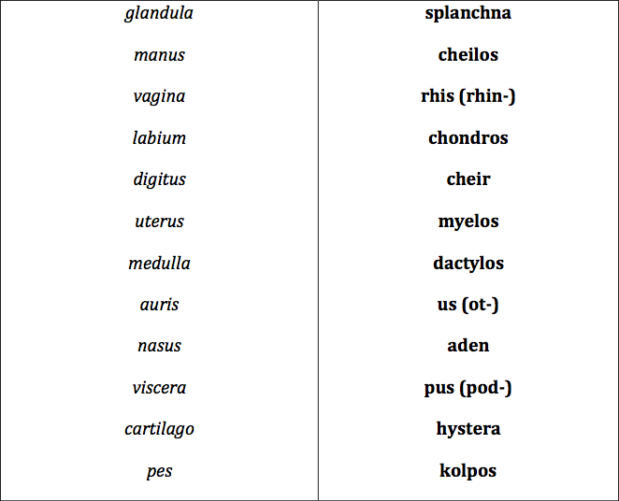
MATCH GREEK ELEMENTS WITH LATIN EQUIVALENTS

Slide 2
MATCH THE ITEMS IN THE TWO COLUMNS
Chrom-o-, chromat-o-
Blue
Chlor-o-
Color
Cyan-o-
Black, dark
Erythr-o-
Green
Leuc-o-
Grey
Xanth-o-
Red
Poli-o-
White, colorless
Melan-o
Yellow

Slide 3
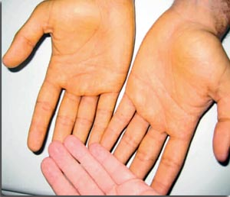
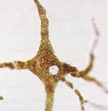
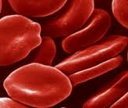
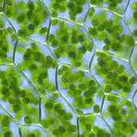
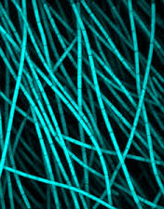
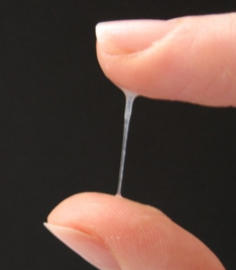
FORM COMPOUND WORDS WITH NAMES OF COLOURS
1. A yellowish discoloration of the skin is known as .…….…….derma
2. A cell producing the dark pigment (…………...) is called ……………………cytus
3. A decreased number of red blood cells is ………………..penia
4. The green pigment of plant leaves and algae is ………………phyllum
5. A group of photosynthetic bacteria containing a blue pigment is ………….bacteria
6. An excessive discharge of white (or sometimes yellowish) mucus from the vagina is ………………..rrhoea
Notes:
Xanthoderma – melanocytus – erythrocytopenia – chlorophyllum (on) - cyanobácteria - leucorrhoea

Slide 4
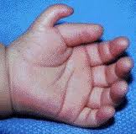
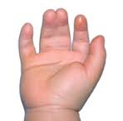
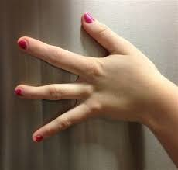
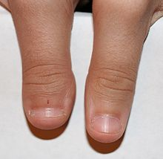
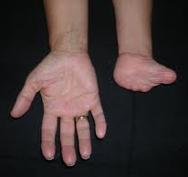
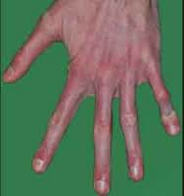
NAME WHAT KIND OF “-DACTYLIA” IS ON THE PICTURE
1
2
3
4
5
6
7
SYNDACTYLIA POLYDACTYLIA MACRODACTYLIA ARACHNODACTYLIA ADACTYLIA
BRACHYDACTYLIA OLIGODACTYLIA

Slide 5
Latin origin | Greek origin | Hybrids (both compound and derived terms)
⇨ usually 2-root expressions ⇨ connecting vowels: o/i/Ø ⇨ a noun/adjective/ numeral on the first place examples: nas-o-lacrim-alis secund-i-grav-ida uni-later-alis mult-angulus cerebr-o-spin-alis (noun) mult-i-cellul-aris (adj.) prim-i-para (numeral) | ⇨multi-root expressions ⇨ connecting vowels: o/Ø ⇨ a noun/adjective/ numeral on the first place examples: thromb-o-cyt-o-penia (3 roots) pan-hyster-o-salping-o-oophor-ec-tom-ia (5 roots) haemat-o-log-ia haemat-ur-ia tri-pleg-ia py-ur-ia (noun) macr-o-cephal-ia (adj.) mon-o-pleg-ia (numeral) haematuria x uraemia | ⇨multi-root expressions examples: ap-pendic-itis L L G hepat-o- ren-alis G L L ovari-ec-tom-ia L G G G cheil-o-gnath-o-palat-o-schisis G G L G

Slide 6
Obesitas permagna
ROOT SUFFIX PREFIX ROOT
St. p. cholecystectomiam laparoscopicam
ROOT 1 ROOT2 PREFIX ROOT 3 SUFFIX
ROOT 1 ROOT SUFFIX

Slide 7
PATHOLOGICAL STATES AND DISEASES
MEDICAL INTERVENTIONS AND EXAMINATIONS

Slide 8
FORM COMPOUND TERMS WITH THE GIVEN GREEK ELEMENT
-ALGIA: “pain, ache, suffering” of the body part or organ
e. g. dorsalgia – back pain
Pain in the JOINT(S)
Arthr-algia
STOMACH pain
Gastr-algia
Pain along the course of NERVE(S)
Neur-algia
TOOTHache
Odont-algia
Pain in the HIP JOINT
Cox-algia
HEADache
Cephal-algia
Pain in the UTERUS
Metr-algia
Pain in the BREAST
Mast-algia/Mamm-algia
Pain in the SMALL INTESTINE
Enter-algia
Notes:
+ ODYNIA is synonymic!!!!

Slide 9
EXPLAIN THE MEANING OF COMPOUND and DERIVED WORDS
-LYSIS : 1) Biochemistry: dissolution, destruction of cells
2) Medicine: gradual subsiding of the symptoms of an acute disease
Pyretolysis
Reduction of fever
Haemolysis
Disintegration of red blood cells
Spondylolysis
Defect in the connection between vertebrae
Spasmolysis
Relaxation of muscle spasms
Dialysis
Separation of smaller and larger molecules
Osteolysis
Dissolution or degeneration of bone tissue
Necrolysis
Disintegration and dissolution of dead tissue
Bacteriolysis
Dissolution or destruction of bacteria

Slide 10
EXPLAIN THE MEANING OR DERIVE THE COMPOUND WORD
-PATHIA : pathology of sth
-PTOSIS : prolapse of sth
Psychopathia
Prolapse of the uterus
Disease of the heart
Gastroptosis
Neuropathia
Prolapse of the Fallopian tube(s)
Disease of the cartilage
Colonoptosis
Angiopathia
Prolapse of the kidney
Disorder of a cell
Blepharoptosis
Rhinopathia
Disease of the tongue
Myopathia

Slide 11
FORM COMPOUND TERMS WITH GREEK ELEMENT
-ECTOMIA : excision, surgical removal of a part of or a whole organ
e. g. appendectomia – removal of vermiform appendix
Removal of FINGER -
Dactyl-ec-tomia
Removal of STOMACH -
Gastr-ec-tomia
Removal of LIVER -
Hepat-ec-tomia
Removal of LARYNX -
Laryng-ec-tomia
Removal of LOBE -
Lob-ec-tomia
Removal of BREAST -
Mast-ec-tomia
Removal of PANCREAS -
Pancreat-ec-tomia
Removal of PROSTATE -
Prostat-ec-tomia
Removal of UTERUS-
Hyster-ec-tomia

Slide 12
EXPLAIN MEANING OF THE COMPOUND WORDS
-GRAPHIA : recording, imaging of sth
e. g. hysterographia – graphic recording of the strenght of uterine contractions
Mamm-o-graphia
A breast examination with imaging technology
Angi-o-graphia
A vessels examination with some type of viewing/recording device
Radi-o-graphia
Internal organs examination by taking X-ray photographs
Electr-o-cardi-o-graphia
The process of recording electrical impulses of the heart

Slide 13
EXPLAIN MEANING OF THE COMPOUND WORDS
-METRIA : measurement of sth
e. g. pupillometria – measurement of the diameter of the eye pupil
Crani-o-metria
Measurement of SKULL
Pelvi-metria
Measurement of PELVIS
Cephal-o-metria
Measurement of HEAD
Odont-o-metria
Measurement of TEETH
Oste-o-metria
Measurement of BONES
Cyst-o-metria
Measurement of BLADDER

Slide 14
FORM COMPOUND TERMS WITH GREEK ELEMENT
-SCOPIA : visual examination of the interior of a body organ, broadly also any inspection of a body part
e. g. endoscopia : examination of the inside of the body
Inspection of FETUS-
Fet-o-scopia
Inspection of PHARYNX-
Pharyng-o-scopia
Inspection of ANUS-
An-o-scopia
Inspection of ABDOMINAL CAVITY-
Lapar-o-scopia
Inspection of LARGE INTESTINE-
Col-o(no)-scopia
Inspection of THORACIC CAVITY-
Thorac-o-scopia
Inspection of VAGINA-
Colp-o-scopia
Inspection of EYE-
Ophthalm-o-scopia

Slide 15
FORM COMPOUND TERMS WITH GREEK ELEMENT
-TOMIA : cutting, incision to sth
e. g. herniotomia – a surgical incision to fix hernia
Incision to ARTERY-
Arteri-o-tomia
Incision to BRONCHUS -
Bronch-o-tomia
Incision to SKULL -
Crani-o-tomia
Incision to LOBE -
Lob-o-tomia
Incision to MUSCLE -
My-o-tomia
Incision to PERICARDIUM -
Pericardi-o-tomia
Incision to PERINEUM (PUBIC REGION) -
Episi-o-tomia
Incision to VEIN -
Phleb-o-tomia
Incision toTYMPANUM -
Tympan-o-tomia

Slide 16
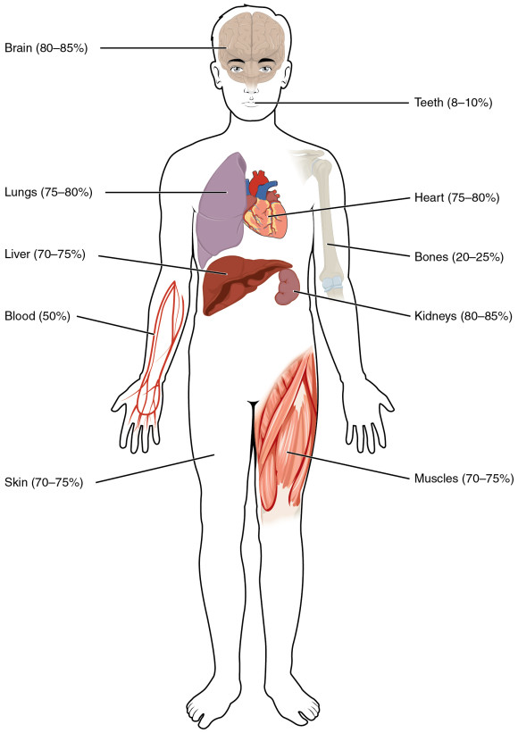
DECIDE WHETHER THE COMPOUND WORD CONTAINS GREEK
ELEMENT CORRESPONDING WITH THE LABELLED BODY PART:
Encephalopathia
Somatologia
Thoracographia
Phlebotomia
Cholecystitis
Otoscopia
Adenocarcinoma
Nephrostomia
Podarthritis
Myeloneuritis

Slide 17
MATCH DEFINITIONS WITH GREEK ROOTS
The benign tumor made up of newly formed blood vessels is ?
Py-
The burning sensation caused by the return of acidic stomach contents into the oesophagus is called heartburn or ?
Pyr-
Lith-
Condition in which excess cerebrospinal fluid accumulates in the ventricles of the brain is ?
Haem-angi-
The surgical removal of fat beneath the skin is ?
Hydr-
An accumulation of pus in the Fallopian tube is ?
The surgical removal of a kidney stone through an incision into the kidney is ?
Lip-
Ur-
A toxic condition resulting from renal failure in which kidney function is compromised and urea is retained in the blood is ?
Notes:
Haemangioma – pyrosis - hydrocephalus – lipectomia - Pyosalpinx – Nephrolithectomia – Uraemia -

Slide 18
ANALYZE THE MEDICAL TERMS INCL. GREEK ODÓUS, ODONTOS:
toothache
inflammation of the tissues surrounding teeth
hypersensitivity of teeth
the field of medicine dealing with teeth
benign tumour of tooth-tissue origin
tooth development
pathological fear of dental care, dentistry
visual examination of oral cavity
surgical removal of tooth
ODONTALGIA
PERIODONTITIS
ODONTOHYPERAESTHESIA
ODONTOLOGIA
ODONTOMA
ODONTOGENESIS
ODONTOPHOBIA
ODONTOSCOPIA
ODONTECTOMIA
Notes:
Handout 5 – time to prepare

Slide 19
FORM MEDICAL TERMS BASED ON DEFINITIONS:
Use the root my-o-/s/- (muscle)
Benign tumor in a smooth muscle
Inflammation of a muscle
Formation of multiple tumors in a smooth muscle
Heart muscle
Muscular tissue in the uterus
(adj.) Referring to the heart muscle
Recording the strength of a muscle contraction
Medical field studying muscles
Removal of a muscular tissue tumour
Surgical incision to a muscle
Plastic surgery to repair a muscle
MYOMA
MYOSITIS
MYOMATOSIS
MYOCARDIUM
MYOMETRIUM
MYOCARDIACUS
MYOGRAPHIA
MYOLOGIA
MYOMECTOMIA
MYOTOMIA
MYOPLASTICA
Notes:
Handout 6

Slide 20
CREATE COMPOUND MEDICAL TERMS FROM
THE GIVEN COMPONENTS AND FIGURE OUT THEIR MEANING:
hystera – salpinx – graphia
pan – hystera – salpinx – oophoron – ectome
oligos – erythros – kytos – haima
thrombos – kytos – penia
pneumon – haima – pericardium
kystis – ureter – pyelos – nephros - itis
hepaticus – duodenum – anastomosis
hysterosalpingographia
panhysterosalpingoophorectomia
oligoerythrocytaemia
thrombocytopenia
pneumohaemopericardium
cystoureteropyelonephritis
hepaticoduodenoanastomosis
Notes:
Time to prepare

Slide 21
FILL IN THE MEDICAL TERMS:
Plastic surgery to repair a blood vessel (e.g. a narrowed artery) is…
An X-ray examination of a vessel using radio-opaque dye so the vessel shows up is…
(Adjective) referring to the heart and the chest region …
An abbreviation C-PG stands for examination of the heart function and breathing, in Latin it is called…
Surgical operation to make a permanent opening into the pelvis of kidney from the surface is…
Surgery to make an opening between the bladder and the abdominal wall is…
Surgical removal of tongue is...
Plastic surgery of breasts is…
Replacement of the damaged skin by skin taken from a donor is…
Notes:
Time to prepare: Angioplastica; Angiographia; Cardiacus; Cardiopneumographia; Nephrostomia; Cystostomia; Glossectomia; Mastoplastica; Dermatoplastica

Slide 22
READ THE DIAGNOSES, PUT THE FULL FORMS OF ABBREVIATIONS
secundum (prep.!) = according to

