Slide 1
Colors in Medical Terminology
Garrick LaBriola & Alan Ostadi

Slide 2
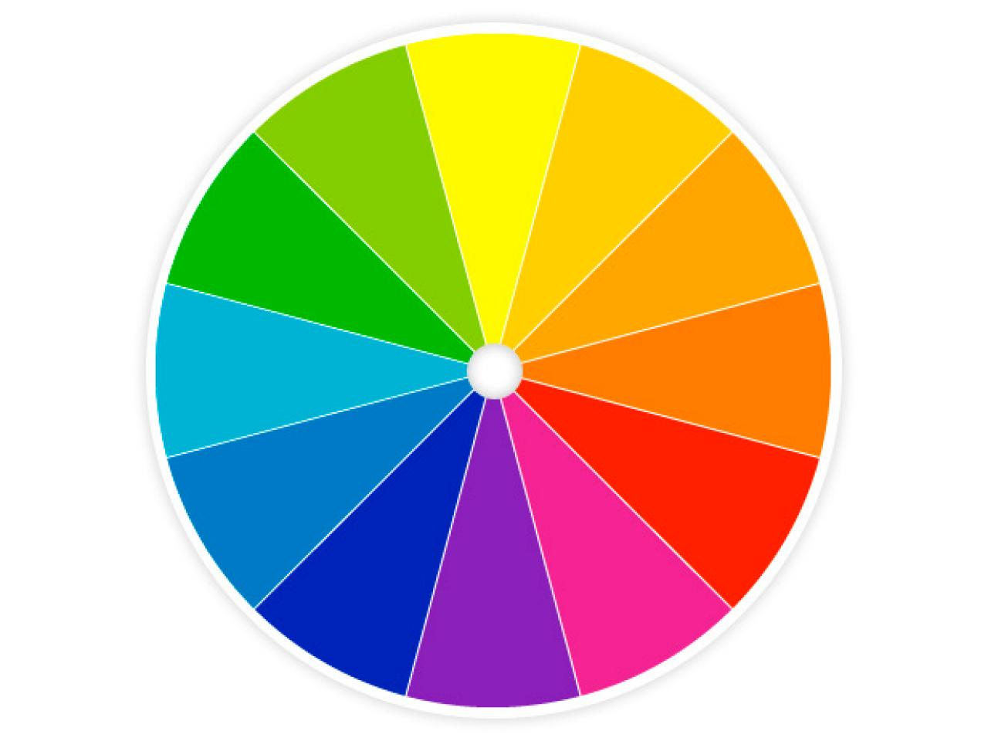
General Terminology
Color, oris, M (Latin)
Chroma, chromatis N (Greek)
Notes:
Color is Latin Chroma is Greek

Slide 3
Colors
Albus, a, um (L) Leuko (G) – White
Pallidus, a, um – Pale
Flavus/leteus, a, um (L) Xantho/Cirrho (G) - Yellow
Ruber, a, um (L) erythro (G) - Red
Roseus, a, um (L) – Pink
Caeruleus, a, um (L) Cyano (G) - Blue/Black
Niger, a, um (L) Melano/anthraco (G) - Black
Griseus, a, um (L) Polio (G) - Grey

Slide 4
Colors cont.
Lividus, a, um (L) – discolored
Glauco (G) – Green/blue
Fuscus, a, um – dark/brown
Versicolor, oris (L) Poikilo (G) - multicolored

Slide 5
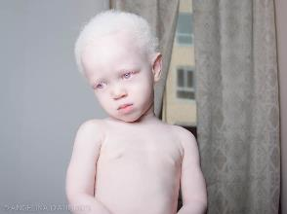
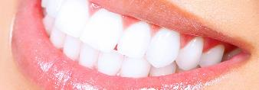
Albus/Leuko
Albus, a, um
Leuko/Leuco- leucocytus

Slide 6
Pallidus
Pallidus, a, um- Pale
Facies pallida

Slide 7
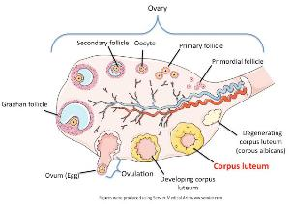
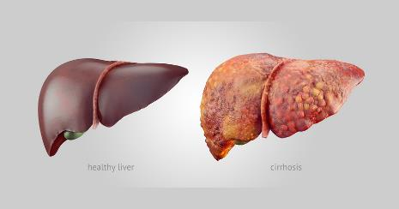
Luteus/Xantho/Cirrho-
Luteus, a, um
Xandtho- Xanthoderma
Cirrho
Notes:
Corpus luteum hormone-secreting structure that develops in an ovary after an ovum has been discharged but degenerates after a few days unless pregnancy has begun.
Color because of Carotenoids (organic pigment)
Liver disease which involves loss of liver cells and irreversible scarring – Typical alcohol

Slide 8
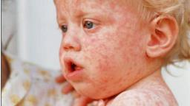
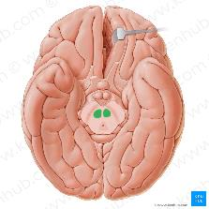
Ruber/Erythro-
Ruber, a, um- Red gums Gingiva rubra
Rubeola
Nucleus ruber
Erythro- Erythrocyte
Notes:
Rubeola – Measels : Viral rash of the skin. Last ca 10 days
nucleus ruber - In midbrain involved in motor coordination ( crawling baby, swinging arms in typical walking)

Slide 9
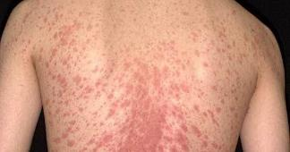
Roseus
Roseus, a, um – Pink
Pithyriasis rosea
Notes:
Pink rash- common and dissipear in 5-6 weeks
Roseola - viral illness affects kids, fever few days before the rash

Slide 10
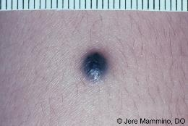
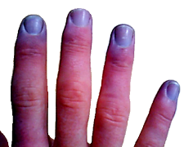
Caeruleus/Cyano
Caeruleus, a, um- Blue/Blue-black
Naevus caeruleus
Cyano- Cyanobacteria Cyanosis
Notes:
Blueish mole – Its melonocytes is deeper tha normal brown mole
Low oxygen saturation to the tissue near the skin surface

Slide 11
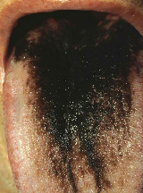
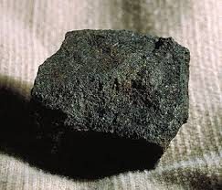
Niger/Melano/Anthraco-
Niger, a, um- Black
Lingua Villosa Nigra
Melano- Melanoma
Anthracosis
Notes:
Lingua villosa Nigra – Black hairy tongue; Bad hygiene, smoking, dehydration
Anthrac – Coal ; Black Lunge disease

Slide 12
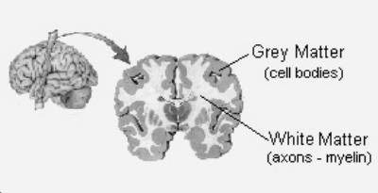
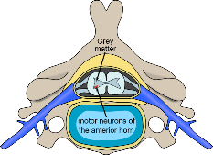
Griseus/Polio-
Griseus, a, um- Grey
Substantia grisea
Polio- poliomyelitis Poliovirus
Notes:
Polio – Grey Myelon – Marrow – leading to spinal cord

Slide 13
Lividus
Lividus, a, um – Discolored
Asphyxia livida
Notes:
abnormal condition in which a newborn appears pale and limp, shows signs of apnea

Slide 14
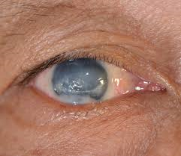
Glauco-
Glauco- green/blue
Glaucoma
Notes:
eye diseases which result in damage to the optic nerve and vision loss

Slide 15
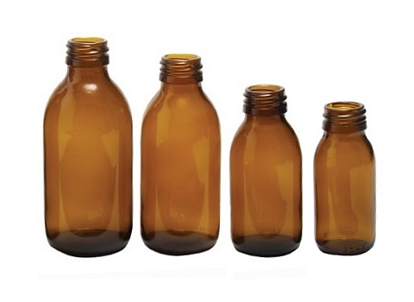
Fuscus
Fuscus, a, um- Dark, brown
Logoena Fusca

Slide 16
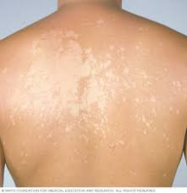
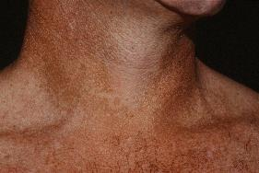
Versicolor/Poikilo
Versicolor, oris- multicolored
Pithyriasis versicolor
Poikilo Poikiloderma
Notes:
Pithyriasis versicolor is a fungal infection of the skin. caused by a type of yeast that naturally lives on your skin
Poikiloderma is most frequently seen on the chest or the neck and refers to a change in the skin where there is thinning, increased pigmentation and dilation of the fine blood vessels

Slide 17
Quiz!
What color are healthy teeth?
What color are veins?
What color are moles usually?

