Slide 1
DEATH
General terms
Terms derived from mors
Quiz

Slide 2
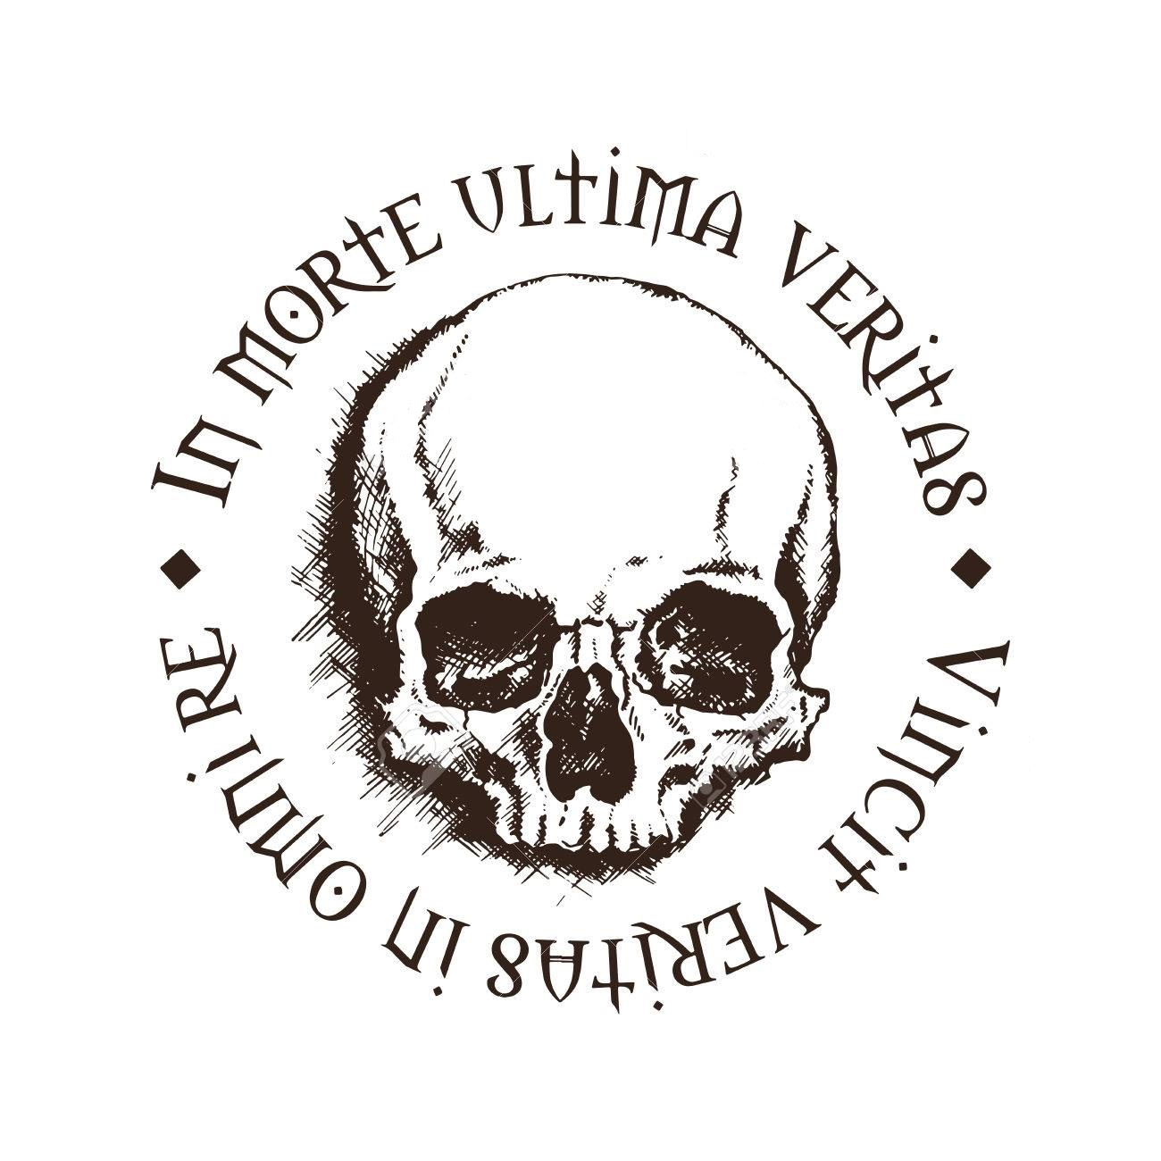
Death
In death lies the final truth.
Truth conquers in all matters.
Notes:
the permanent ending of vital processes in a cell or tissue.
A patient is considered dead when there is irreversible cessation of cardiopulmonary function
Or when there is irreversible cessation of brain function
Signs of death- no pulse, no breathing, algor mortis, pallor mortis, and livor mortis

Slide 3
General terms

Slide 4
DEATH
Latin
Exitus, us, m.
Mors, tis, f.
Finis, is, m.
Letalis, e
Mortalis, e
Greek
Thanat- (θάνατος)
Necr- (νεκρός)
Notes:
Exitus- Path to death, exit, figuratively, clinical- exitus lethalis (natural death)
Mors- pathological anatomy- Mors auxilium vitae (
Finis- end or death
Necros- dead body
Thanatos- god of peaceful death
Letalis- fatal
Mortalis- subjective to death

Slide 5
Terms derived from mors

Slide 6

Mors biologica
A permanent cellular damage resulting from lack of oxygen, which is irreversible

Slide 7
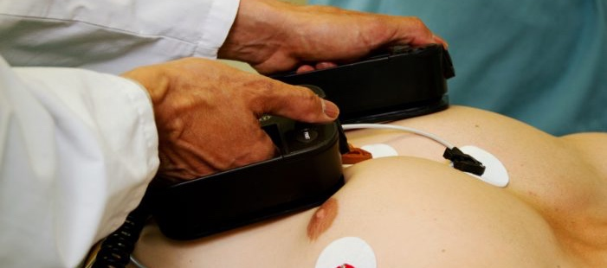
Mors clinica
a cessation of blood circulation and breathing, which is reversible by resuscitation methods
Notes:
The paitent should be able to be revived through CPR, or Defibration paddles.

Slide 8
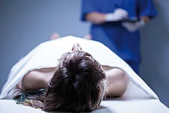
Mors in tabula
Death on the operation table
Notes:
Uncontrollable bloodloss, stroke or heart attack, weak patient that cannot withstand stress of surgery

Slide 9

Mors subita
Sudden death
Notes:
Arrhythmia
Acute Myocardial Infarction (AMI)
Intracranial Emergencies
Pulmonary Embolism (PE)
Aortic Catastrophe

Slide 10

Mors lentissima
Very slow death
Notes:
Alzheimers disease or AIDS

Slide 11
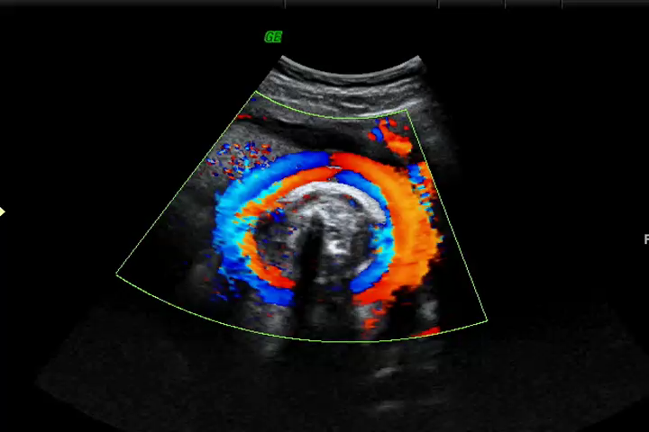
Mors praenatalis
Death of fetus before it starts breathing independently
Notes:
Lupus, trauma, hypoxia due to umbilical cord strangulation, true umbilical knot- resulting in suffocation, rh factor of mother, autoimmune diseases.

Slide 12
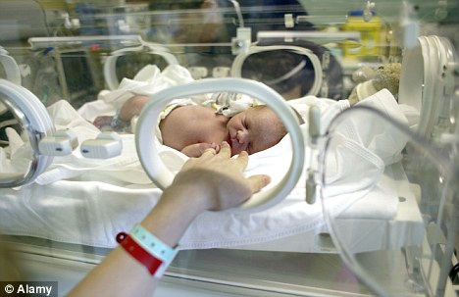
Mors neonatalis
Death of a new-born up to 10 days after birth
Notes:
Infections, especially blood infections
Complications of preterm birth
Lower respiratory infections (such as flu and pneumonia)
Diarrheal diseases

Slide 13
As we approach death

Slide 14
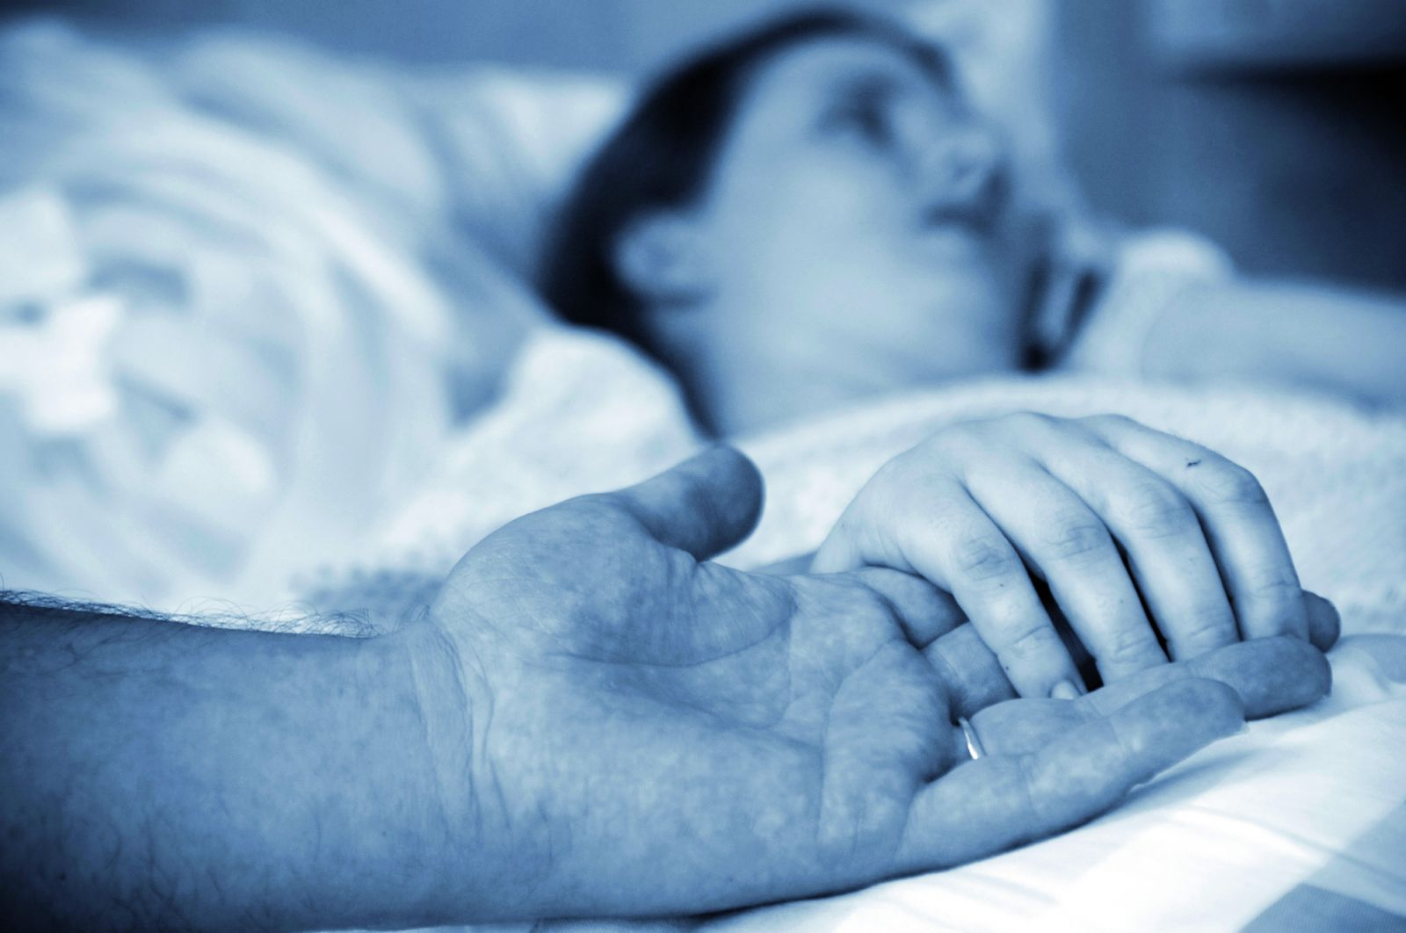
Moribundus, a, um
The one who is going to die, dying man

Slide 15
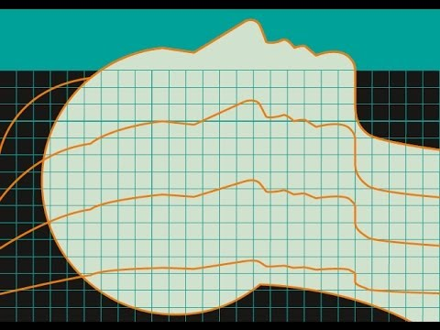
Vita minima
weak signs of the life
Notes:
Weak signs of life, organs not working in unison, vitals are weak along with body giving signs of death

Slide 16
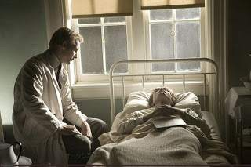
In ultimis/ in extremis
in the last moments of life

Slide 17
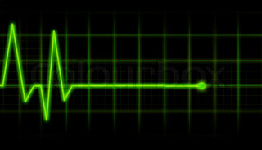
In articulo mortis
in the moment of the death

Slide 18

Mortuus, a, um
Dead

Slide 19
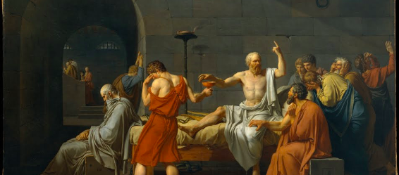
The stages of death
Pallor mortis
Algor mortis
Rigor mortis
Livor mortis
Putrefaction
Decomposition
Skeletonization Fossilization

Slide 20

Pallor mortis
Paleness post mortem
Notes:
Pallor = paleness
It occures almost immediately( 15-25 min.) post mortem
It results from the cessation of capillary circulation throughout the body. → Livor mortis

Slide 21

Algor mortis
The change of the body temperature post mortem until ambient temperature is matched

Slide 22
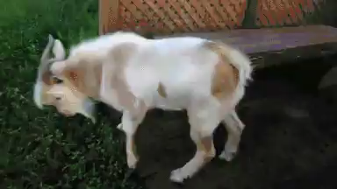
Rigor mortis
Post mortem stiffness caused by chemical changes in muscles, it subsides after 24h
Notes:
Muscles actualy need work to relax/extend by pumping calcium ions out of the cells and "rewinding" the fibers to default postition. Letting calcium ions in the cell again then in fact triggers the fibers to spring into flexed position. Also ATP is required to break the actin and myosin bridges, when the organism dies, ATP is not produced anymore.
After the cells die, they can't keep the ions outside anymore and they eventually get inside and flex the muscles. It’s uncoordinated and doesn't work properly but it sufficiently locks the muscles in place.
As these protein muscle fibers decompose the rigor subdues.

Slide 23
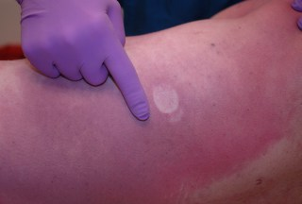
Livor mortis
A settling of the blood in the lower (dependent) portion of the body after death causing a purplish red discolouration of the skin

Slide 24
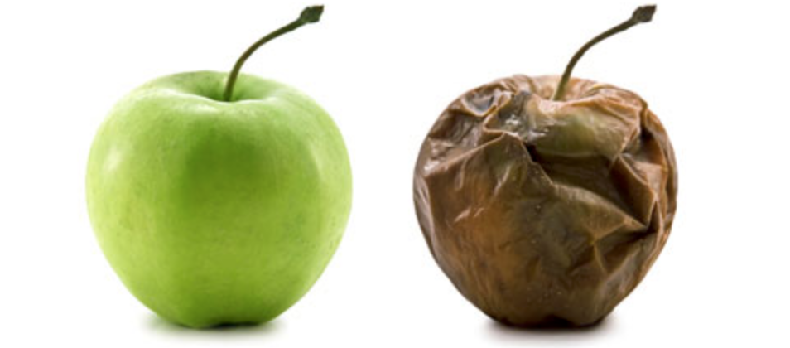
Putrefaction
Putrefactio, onis, f
When the organism begins to decay or rot
Notes:
pūtrefactiō f (genitive pūtrefactiōnis); third declension - rotting

Slide 25
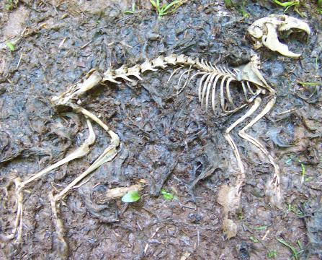
Decomposition
Compositio, onis, f.
The organism begins to break down into simpler organic substances that can be used as nutrients for other organisms
Notes:
compositiō f (genitive compositiōnis); third declension – mixture or union
De- of or from (latin prefix)

Slide 26
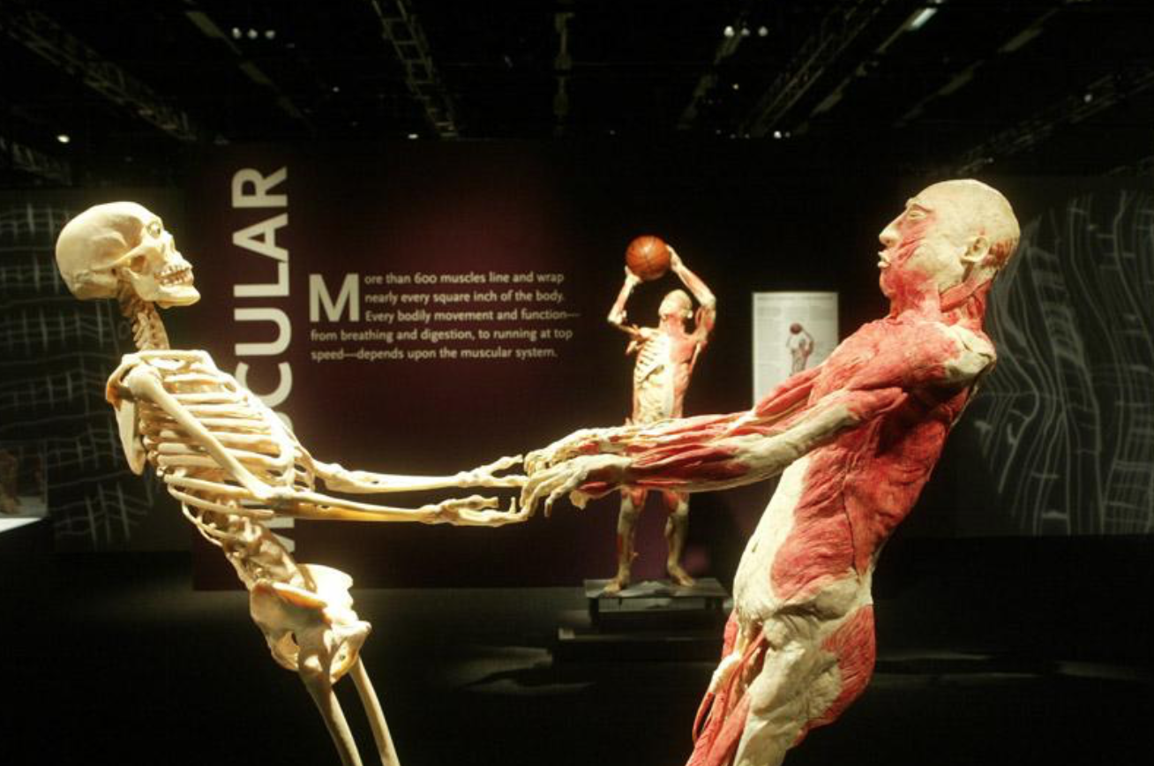
Skeletonization
The remaining tissue of the organism continues to decay until just the skeleton remains

Slide 27
Quiz

Slide 28
What declension is mors and how is it declined?

Slide 29
What is the meaning of rigor mortis?
Notes:
Post mortem muscle stuffness that occures due to the body‘s inability to
Maintain the balance that allows for muscle contraction and relaxation

Slide 30
What is the difference between mors biologica and mors clinica?
Notes:
Biologia is the death of cells due to lack of oxygen (irreversable), as opposed to clinica where the death of hte paitent is revesable (CPR, Difibulator)

Slide 31
Translate this sentence:
Mors subita propter embolum pulmonalem
Notes:
Sudden death due to embolism in the lungs

Slide 32
What does exitus letalis mean?
Notes:
Natural death

Slide 33

Finis, is, m

