Slide 1
Position in medical terminology
By Samer and Mohammad

Slide 2
Last week recap
Incomplete comparison
forms used to describe positions on human body, derived from prepositions, having only comparative and superlative forms
ante anterior, ius
post posterior, ius postremus, a, um
supra superior, ius supremus, a, um
infra inferior, ius infimus/imus, a, um
intra interior, ius intimus, a, um

Slide 3
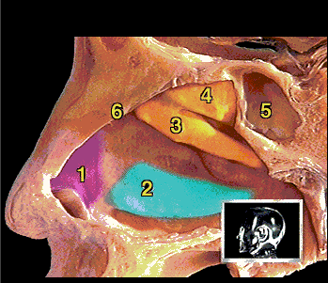
1 cartilago lateralis
2 concha nasalis inferior
3 concha nasalis media
concha nasalis superior
sinus sphenoidalis
septum nasi

Slide 4
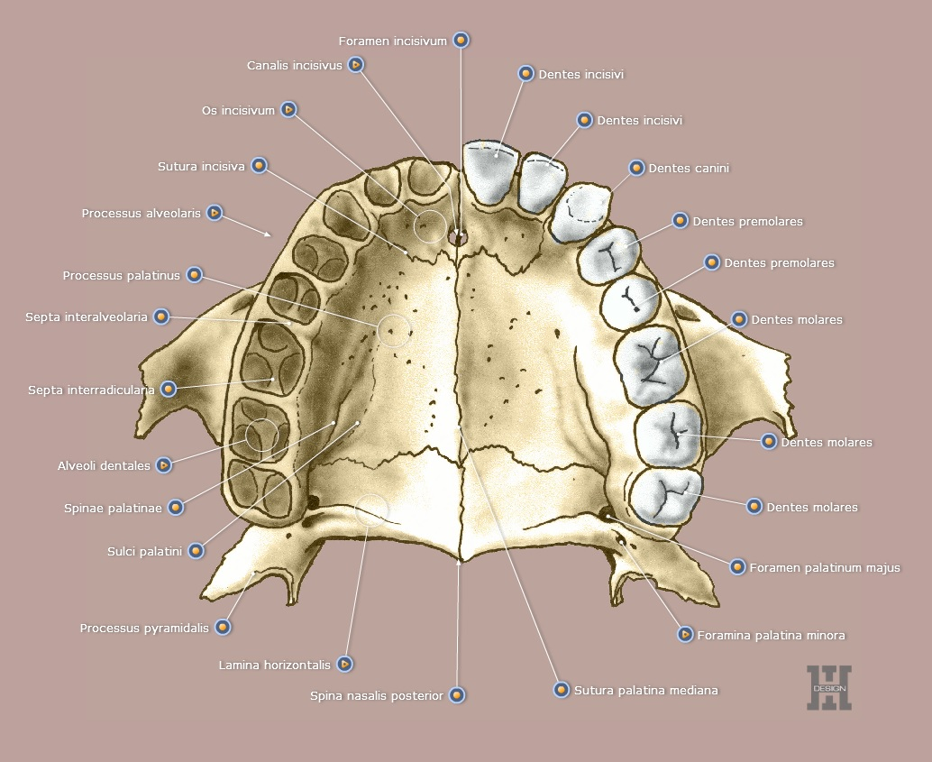

Slide 5
General terms
Place
Locus, I, m / situs, us, m
In situ
Loco typico
Loco cacatricIs
Cicatrix, icis, f
Eodem loco
Localis, e
Positio, onis, f
In the (afore – mentioned place)
In the typical place
In the place of the scar
Scar
In the same place
Local
Position/ location

Slide 6
Lateral position
L.sin
Lateris sinistri
=On the left side, the left one

Slide 7
Lateral position
L.dx
=on the right side, the right one
Lateris dextri

Slide 8
Lateral position
L.utr
=on both sides, both
Lateris utriUsque

Slide 9
Lateral position
later- (L.) *(prefix) = related to side
/bi/lateralis, e = /bi/lateral e.g. decubitus bilaterales
collateralis, e = located on the same side e.g. arteria collateralis
sinistro-/dextropositio = reversal of an organ to the left/right
marginalis, e = marginal e.g. gingivitis marginalis
acralis, e (G.) = referring to extremities e.g. cyanosis acralis

Slide 10
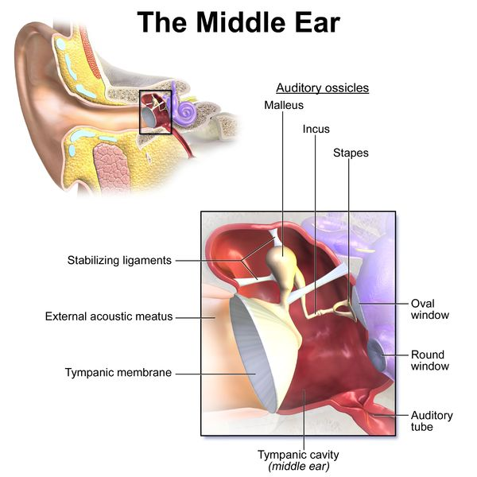
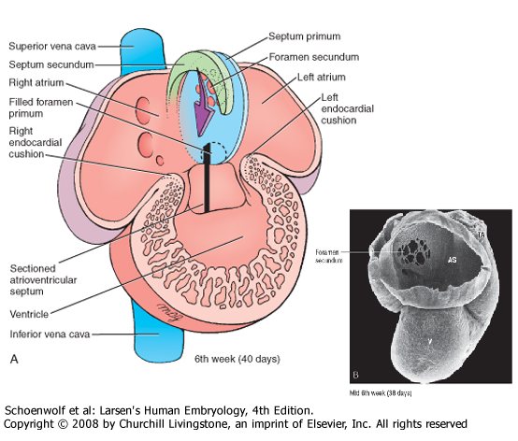
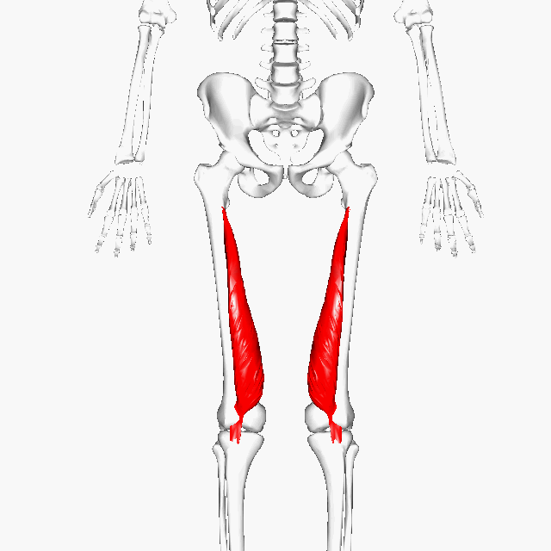
Medial position
Medius, a, um/ medianus, a, um
Medialis,e
Intermedius, a, um
Inter = between
e.g. Auris media
e.g vastus medialis
e.g. Septum intermedium

Slide 11
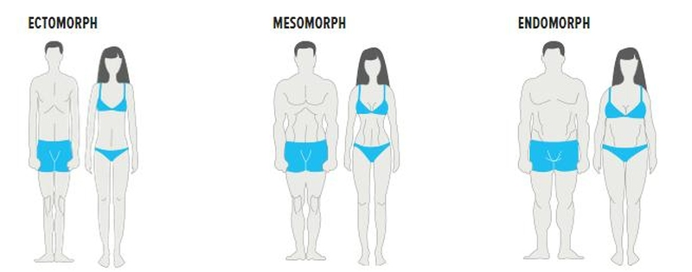
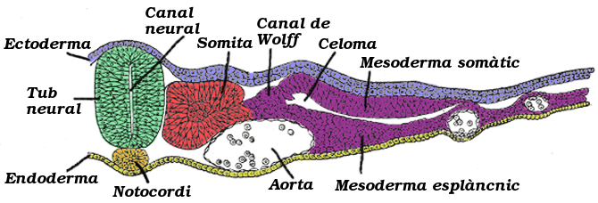
Medial position
Mes-o (prefex)
Meso comes from the greek word mEsos for middle.
e.g. Mesoderma, the middle germ layer in the early embryo.

Slide 12
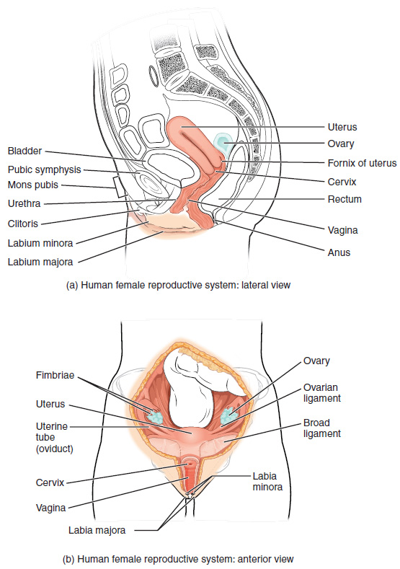
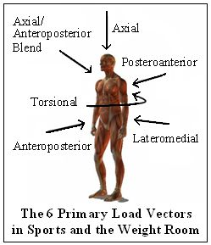
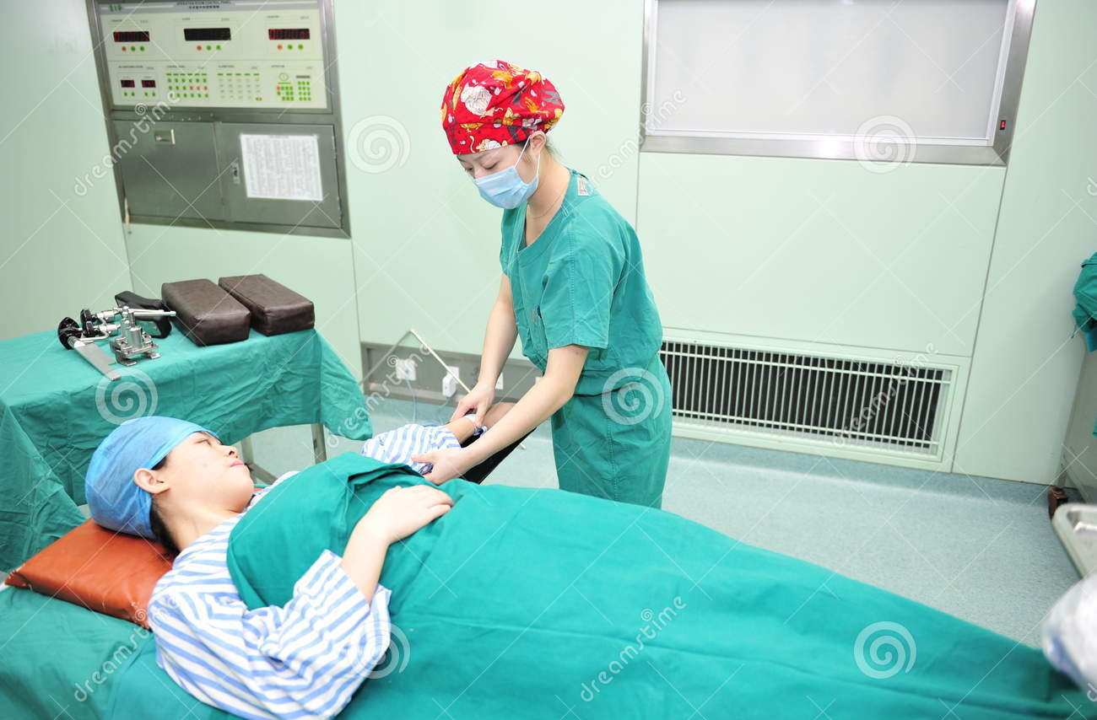
Anterior position/before sth
Antero-
Ante-
Prae-
Pro-
=situated in front, fore
=a variant of pre, “before” , “prior to”
=for
=before
e.g. anteroposterior, anterolateralis, anteroinferior,
e.g. Antepositio uteri
e.g. progeria adultorum, prognathia
e.g. transfusio praeoperativa

Slide 13
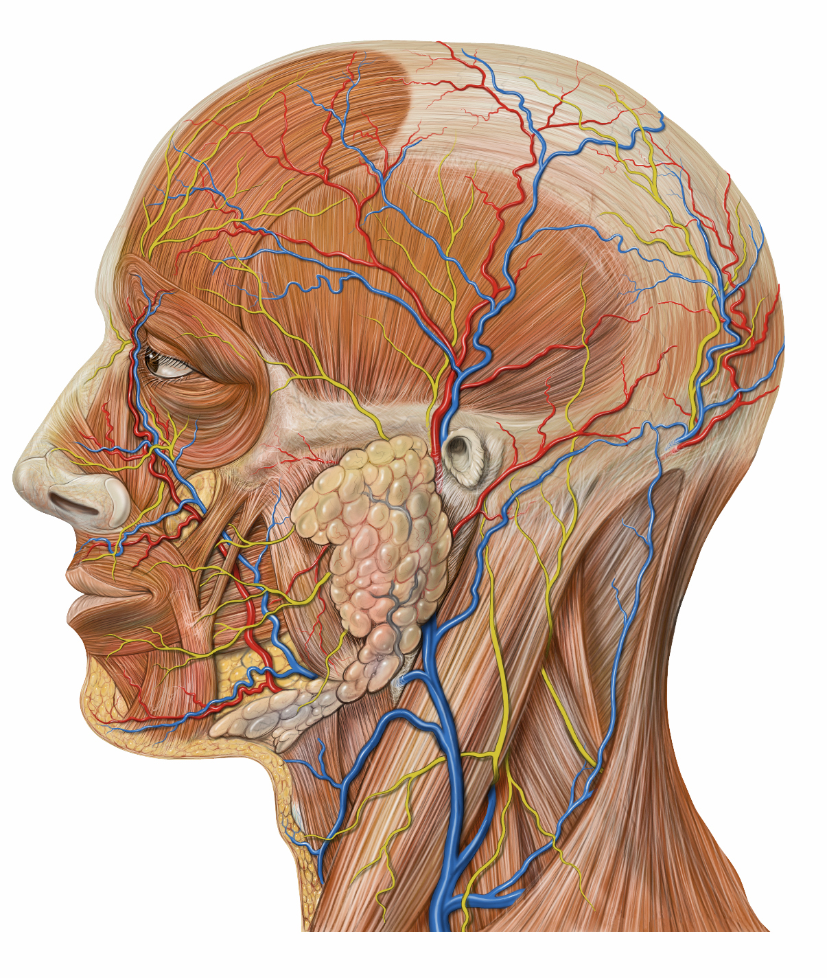
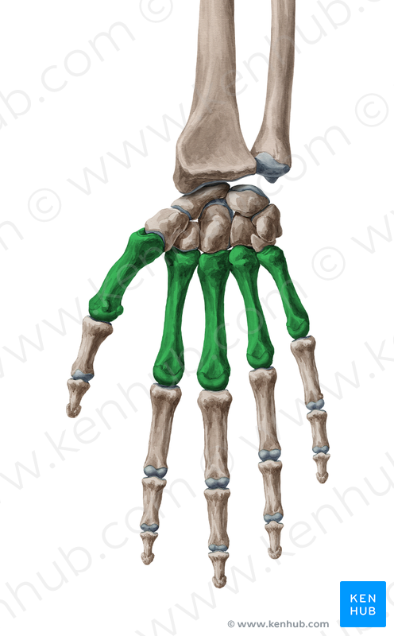
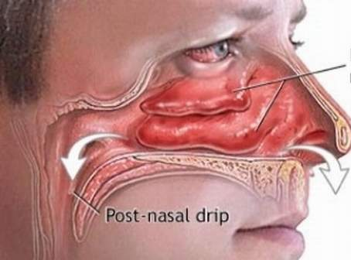
Posterior position/after sth
Postero-
Post-
Retro-
Meta-
=after, along with, beyond, among, behind
= at the back of
=after
=Backward, back, behind
e.g. regio postnasalis, status postabortalis
e.g. Spatium retropharyngeum
e.g. infarctus posterolateralis
e.g. ossa metacarpalia

Slide 14
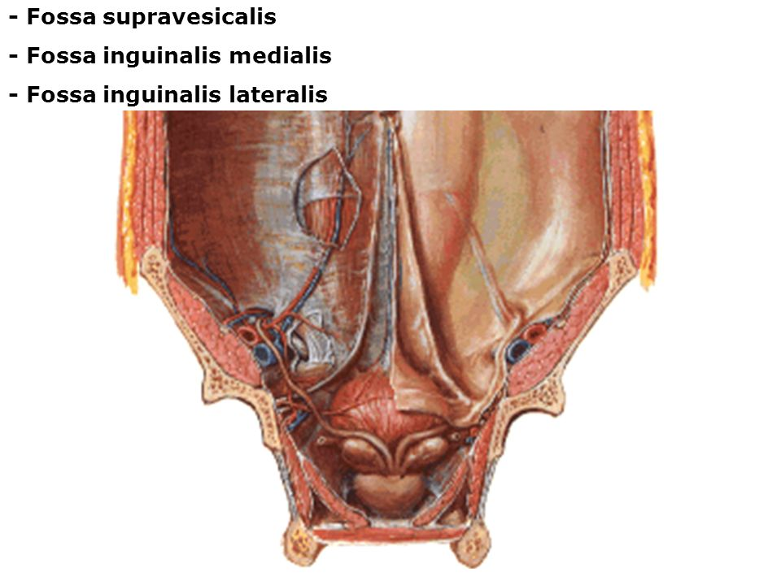
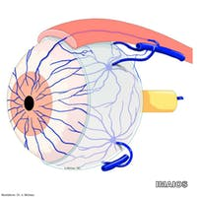
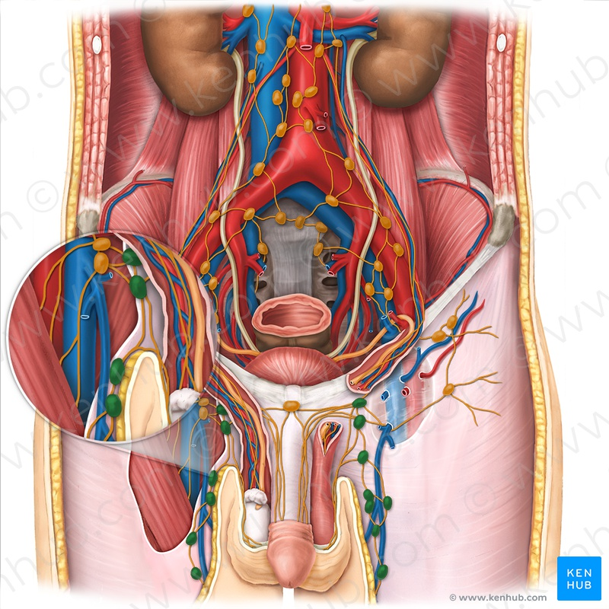
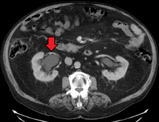
Superior position
Supra/-super-
Epi-
Hyper-
Supero-
=Situated above
=over, usually implying excess or exaggeration
=above
=upon
e.g. nodi lymphatici inguinales superficialis superomedialis
e.g. fossa supravesicalis
e.g. venae episclerales
e.g. hypernephritis

Slide 15
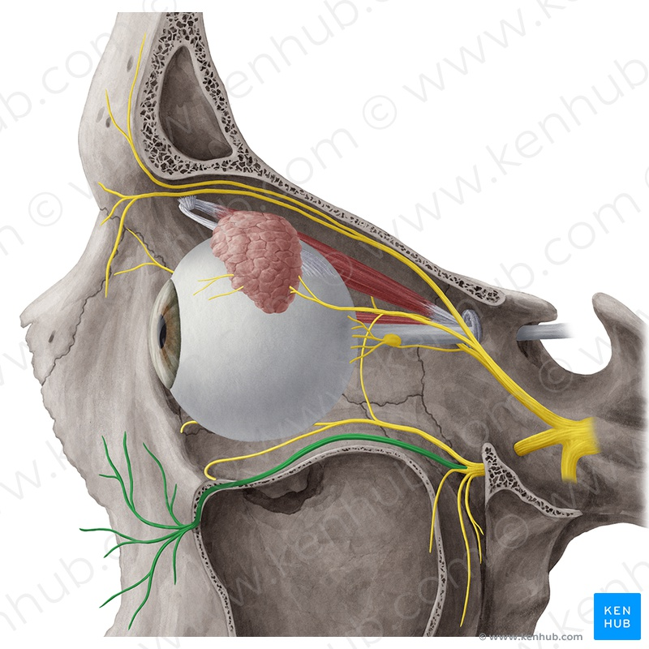
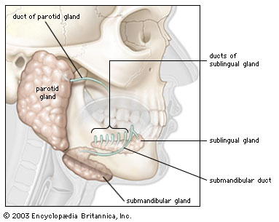
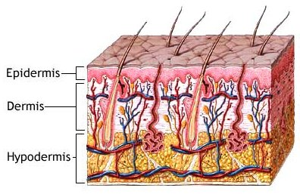
Inferior position
infero-
infra-
sub-
hypo-
=low
=beneath
=beneath/under
=deficient/below normal
e.g. infarctus inferoposterior
e.g. nervus infraorbitalis
e.g. ductus sublingualis major
e.g. hypodermis

Slide 16
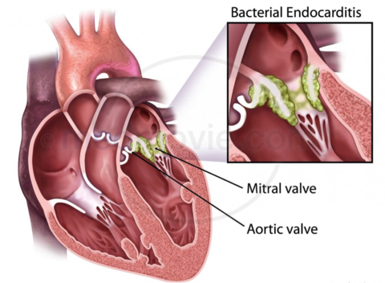
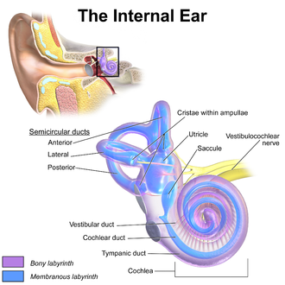
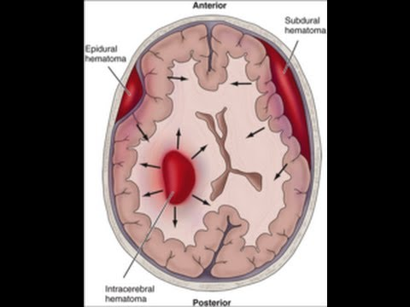
Internal position
Internus, a, um
Intra-
Endo-
=inward, internal
=within
=within
e.g. endocarditis
e.g. auris interna
e.g. haemorrhagia intracranialis

Slide 17
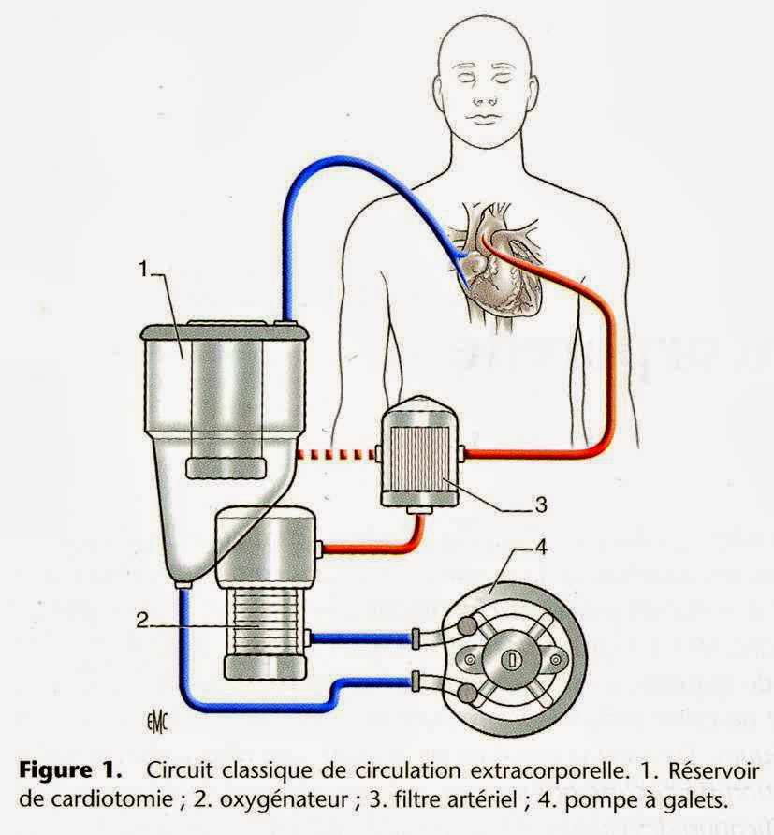
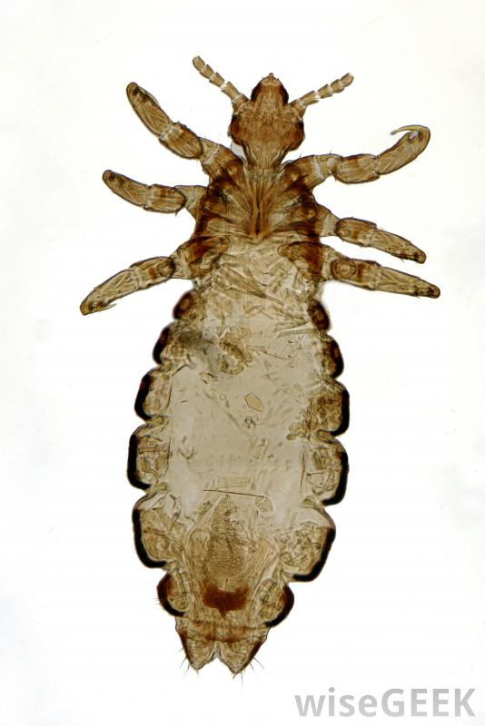
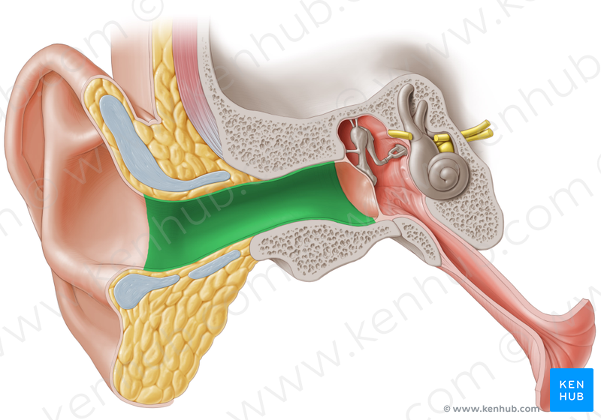
External position
Ecto-/exo-
Externus, a, um
Extra-
=outwards or beyond an area
=outer, outside, external
=outward external
e.g. ectoparasitus; neurosis exogenes
e.g. meatus acusticus externus
e.g. circulatio extracorporallsis

Slide 18
Retrotrachialis space
Fracture of within breastbone
pars retrotrachialis
Antepartus
Hypogastric region
fractura entra-sterni
Antefractura
before giving birth (delivering )
Hypertensio
Pars extravenosa
regio hypogastrica
spina iliaca inferior posterior
before fracture
high blood pressure
Part outwards (or beyond) the vein
Posterior inferior iliac spine
Endocrine system
Systema endocrinum

