Slide 1
CENTRAL REPRESENTATION OF THE TOUCH

Slide 2
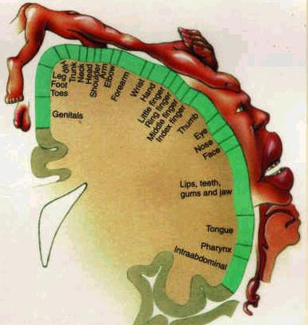
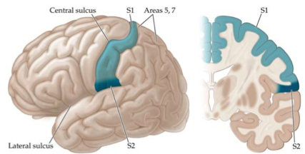
Primary somatosensory (somesthetic)
cortex (SI)

Slide 3
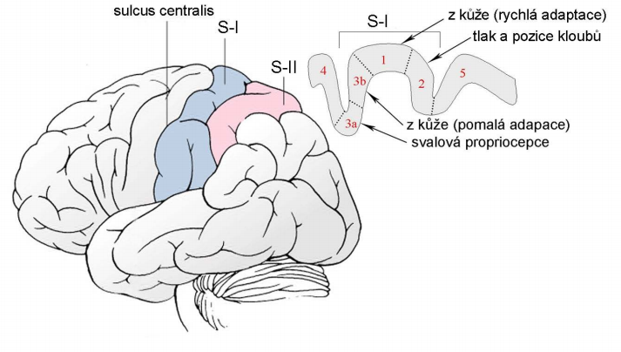
Somatosensory cortex – a. 3,1,2

Slide 4
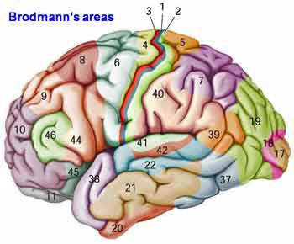
Somatic sensory association area

Slide 5
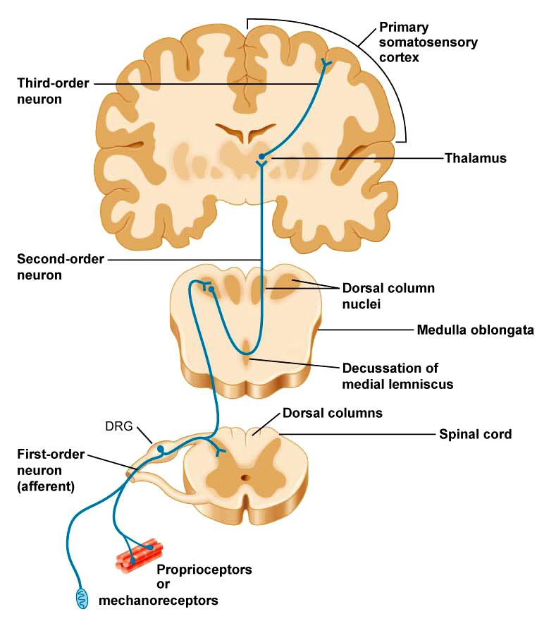

Slide 6

Secondary somatic sensory area (SII)

Slide 7
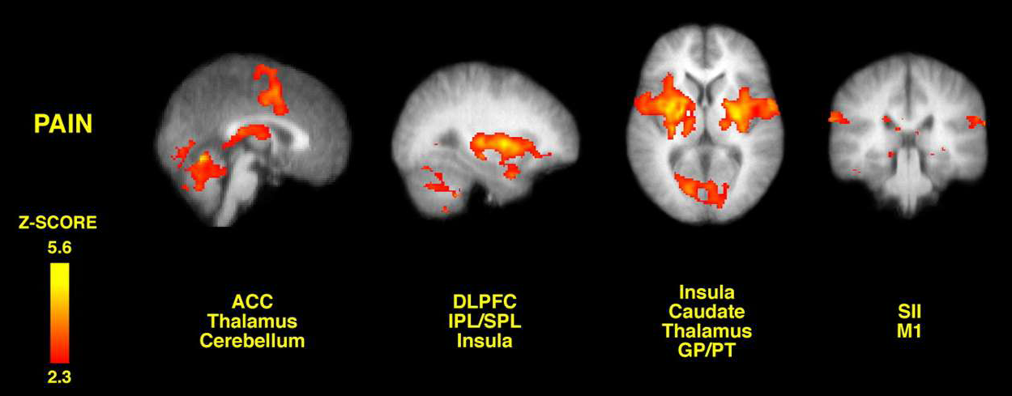

Slide 8
PAIN

Slide 9
PAIN
pain is a protective modality
International Association for the Study of Pain (IASP):
„Pain is an unpleasant sensory and emotional experience
associated with actual or potential tissue damage,
or described in terms of such damage“.
pain threshold: individual and social influences

Slide 10
Nociceptors/nocisensors
nocer – to injure or to hurt in Latin
are activated by noxious mechanical, thermal or chemical
stimuli
detect signals from damaged tissue or the threat of damage
free nerve endings found in the skin, muscles, joints, bones
and viscera

Slide 11
Nociceptors
nociceptors of Aδ fibres (5-40 meters/sec)
Aδ mechanical nociceptors
Aδ thermal nociceptors
nociceptors of C fibres (0.5-2.0 meters/sec)
C polymodal nociceptors – react to thermal, mechanical
and chemical stimuli
silent nociceptors (MIA = mechanically insensitive afferents)
- responsive after inflammation and tissue injury

Slide 12
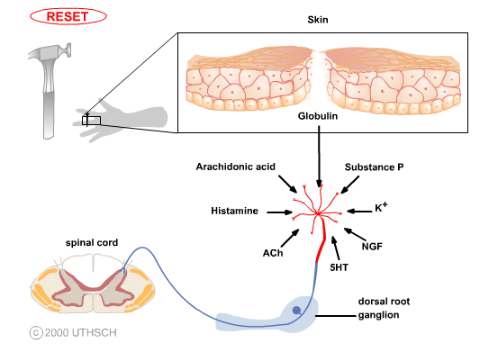

Factors that activate nociceptors

Slide 13
Peripheral sensitization
Central sensitization = activity- or use-dependent
neuronal plasticity in the spinal cord
hyperalgesia - exaggerated or prolonged response
to noxious inputs
allodynia - pain induced by normally innocuous
inputs

Slide 14
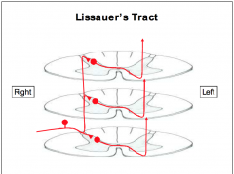
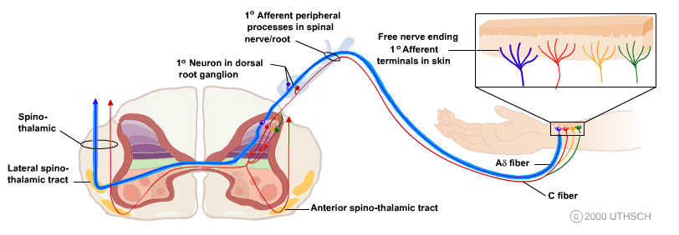
Nociceptive afferents
Aδ fibres – thin myelinated fibres
sharp, localized pain
C non-myelinated fibres
dull, non-localized pain
Spinoreticular tract

Slide 15
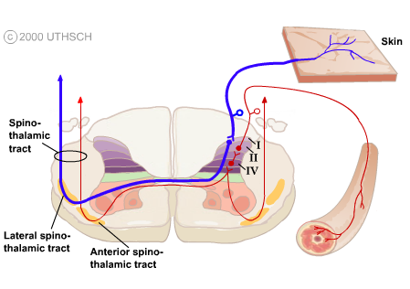
The noxious information from visceral organs and skin
are carried to the CNS in different pathways

Slide 16
Pain pathways from trunk and limbs
PALEOSPINOTHALAMIC
PATHWAY
tr. spino-reticulo-thalamicus
diffuse, non-localized pain
autonomic and reflexive
responses to pain stimuli
emotional and affective
reactions to pain
intralaminar nuclei of the
thalamus
postcentral gyrus,
insula and cingulate gyrus
NEOSPINOTHALAMIC
PATHWAY
tr. spino-thalamicus lat.
sharp, localized pain
ventral posterolateral
(VPL) and posterior
nucleus of the thalamus
postcentral gyrus

Slide 17
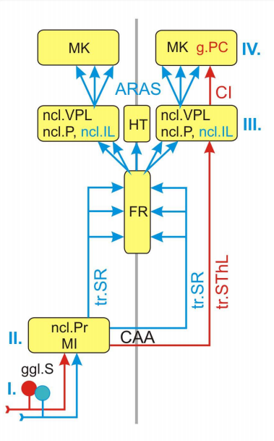
Cortex
Paleospino-
thalamic
pathway
Neospino-
thalamic
pathway
Thalamus
Spinal cord

Slide 18
Pain pathways from head
TRACTUS TRIGEMINO-RETICULO-
THALAMICUS
diffuse, non-localized pain
TRACTUS TRIGEMINO-
THALAMICUS ANTERIOR
sharp, localized pain

Slide 19
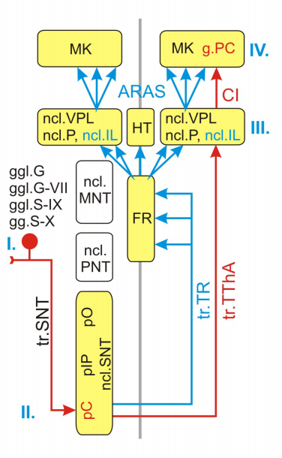
Cortex
Thalamus
Medulla

Slide 20
The phylogenetically old, paleospinothalamic and trigemino-
reticulothalamic, pathways through the RF are concerned with
the arousal and affective (emotional) aspects of somatic sensory
stimuli.
In contrast, the direct, neospinothalamic and anterior
trigeminothalamic, pathways are analytic, encoding
information about modality, intensity, and location.

Slide 21
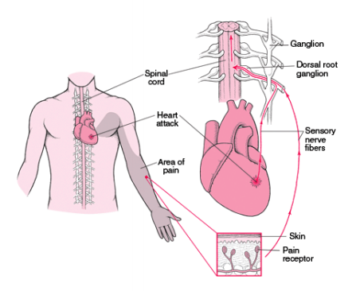
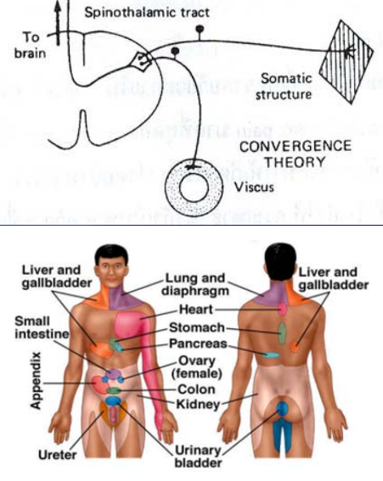
Referred pain

Slide 22
MODULATING SYSTEMS
OF NOCICEPTIVE PATHWAYS
level of modulation of nociceptive pathways
spinal cord (“gate control theory”)
RF of brain stem
periaquaeductal gray matter (PAG)

Slide 23
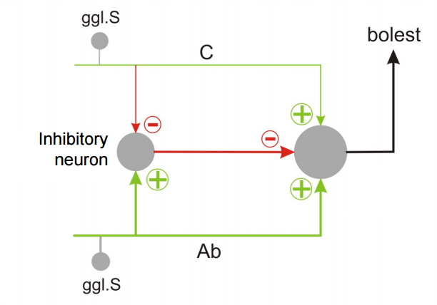
“Gate control theory”

Slide 24
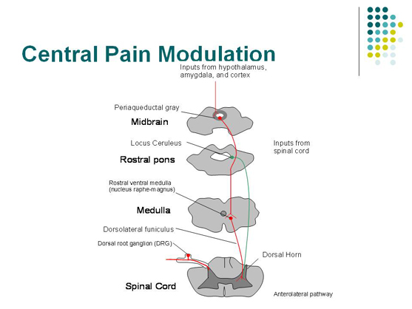

Slide 25
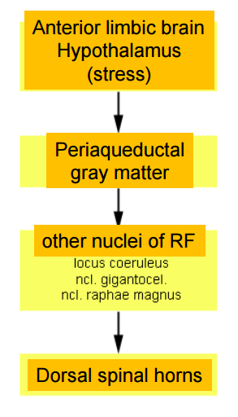
Stress-induced analgesia

Slide 26
SOMATOMOTOR PATHWAYS

Slide 27
Some necessary components of
proper motor control
Volition
Coordination of signals to many muscle groups
Proprioception
Postural adjustments
Sensory feedback
Compensation for the physical characteristics
of the body and muscles
Unconscious processing
Adaptability

Slide 28
Levels of movement regulation
spinal cord
brain stem
cortex
cerebellum
basal ganglia

Slide 29
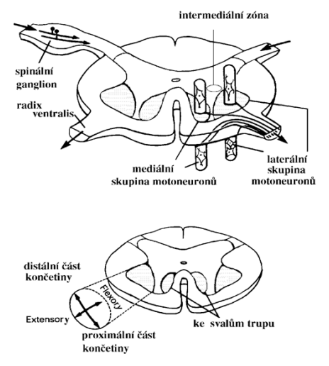
Lower motor neurons – spinal cord
α motoneurons
γ motoneurons
Somatotopic organization
medial column – axial muscles
lateral column – limb muscles
anteriorly – extensors
posteriorly - flexors

Slide 30
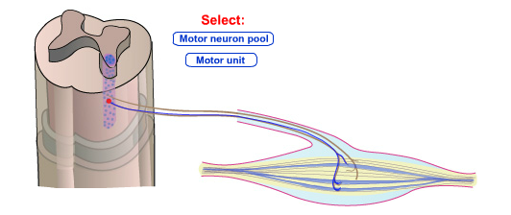

Motor neurons have highly branched, elaborate
dendritic trees, enabling them to integrate the inputs
from large numbers of other neurons and to calculate
proper outputs.
The combination of an individual motor neuron and all
of the muscle fibers that it innervates is called
a motor unit.

Slide 31
size of motor unit
small motor unit – 1 motoneuron innervates several
muscle fibers (extraocular muscles, muscles of hand)
large motor unit – 1 motoneuron innervates
500 – 1000 muscle fibers (back muscles)

Slide 32
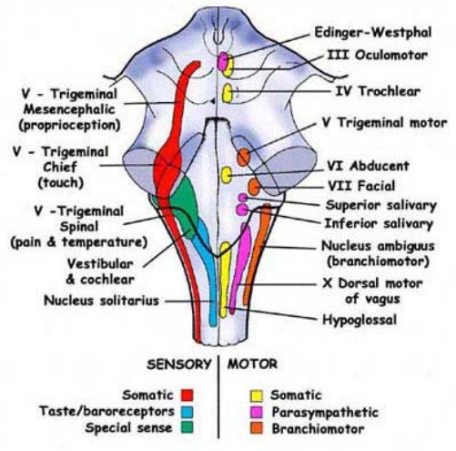
Lower motor neurons – brain stem
Somatomotor nuclei
CN III, IV, VI, XII
Branchiomotor nuclei
CN V, VII, IX, X, XI

Slide 33
Supraspinal system of movement control
Medial system
bilateral
terminates on the interneurons or
the medial column of lower motor neurons
controls maintenance of balance and postural movements
Lateral system
mostly cross the midline and descend contralaterally
terminates on the interneurons or
the lateral column of lower motor neurons
controls fine manipulative movements of the hand and
fingers
The “third” motor system
aminergic pathways of the brain stem

Slide 34
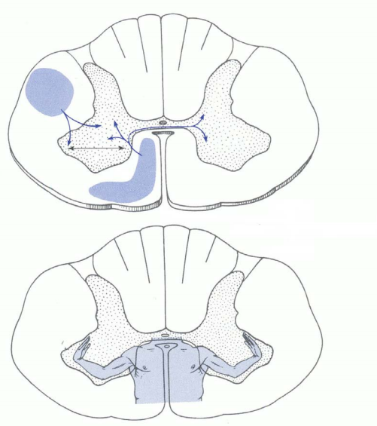

Slide 35
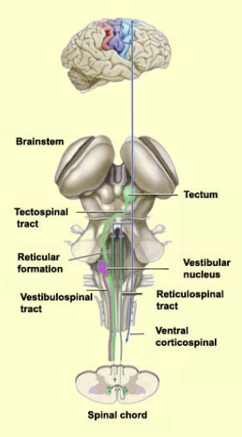
Medial system
Subcortical pathways
Medial and lateral vestibulospinal
tracts - control of balance and
postural movements
Tectospinal tract (sup. colliculus)
– coordination of movements of
the head and eyes during watching
Medial (pontine) and lateral
(medullary) reticulospinal tracts
- control of postural movements
Cortical pathways
Anterior corticospinal tract
- bilateral, medial column of lower motor neurons

Slide 36
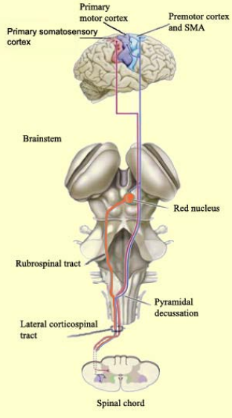
Lateral system
Subcortical pathways
Rubrospinal tract
- contralaterally descends to the
lateral column
Cortical pathways
Lateral corticospinal tract

Slide 37
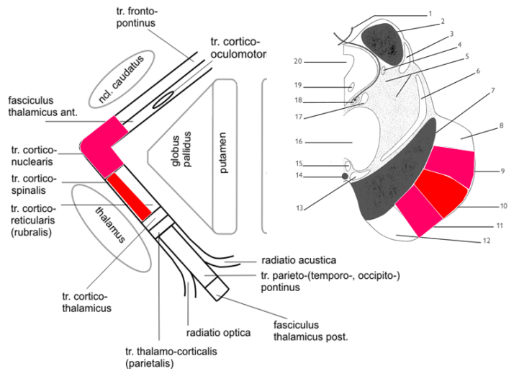
Corticospinal and corticonuclear tracts

Slide 38
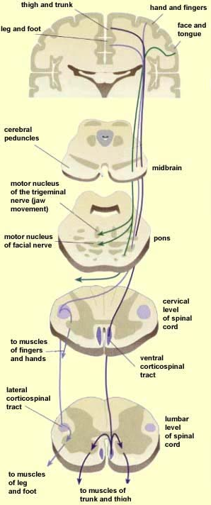

Slide 39
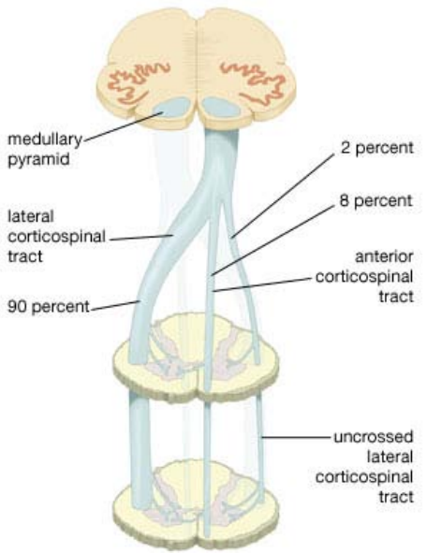

Slide 40
The third system
the oldest one
nuclei of RF – raphespinal and coeruleospinal tracts
control of involuntary emotional movements

Slide 41
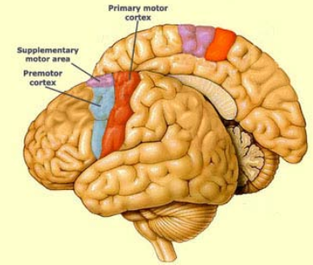
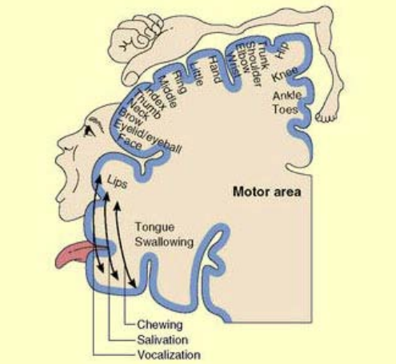
Motor cortex

Slide 42
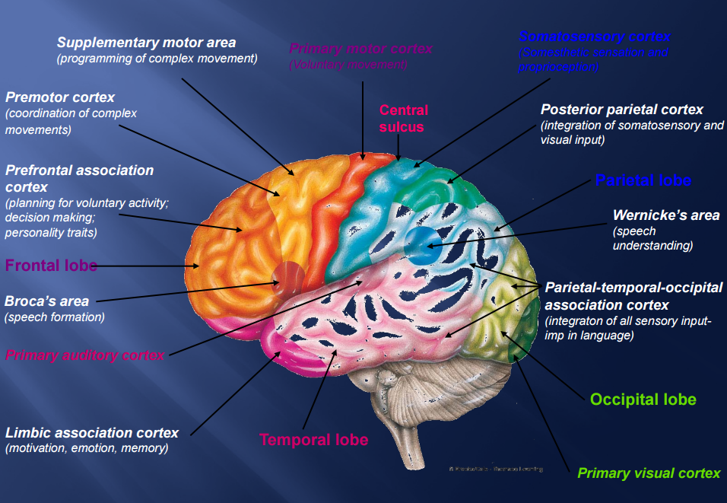

Slide 43
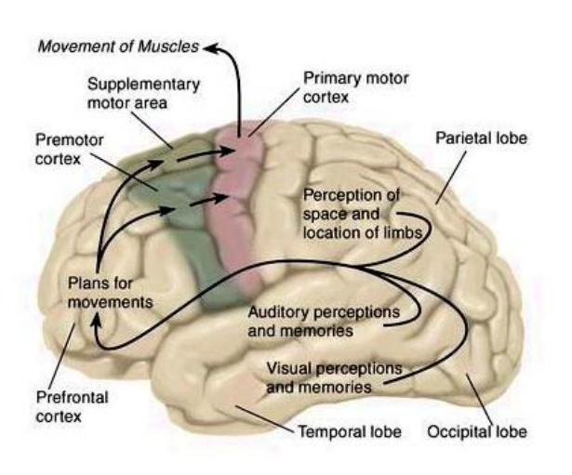
Planning of movements

Slide 44
Illustrations were copied from:
Neuroscience Online, the Open-Access Neuroscience
Electronic Textbook
Department of Neurobiology and Anatomy
University of Texas Medical School at Houston

