Slide 1
ONTOGENETIC DEVELOPMENT OF THE NERVOUS SYSTEM

Slide 2
Ontogenetic development
= individual development of
the organism from the fertilized egg
to its mature form and finally death

Slide 3
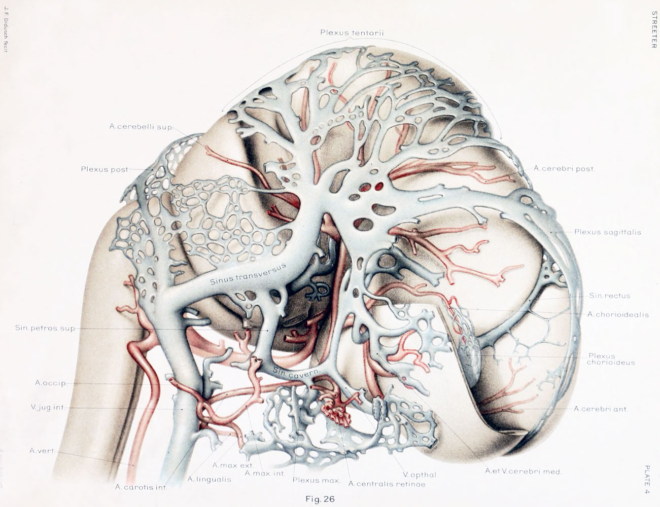
The human heart begins to beat late in the third week after fertilization. Before the heart begins to beat, the nervous system commences to differentiate and change in shape.

Slide 4
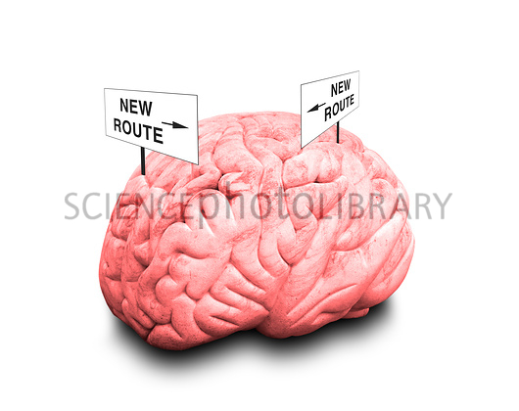
Differentiation and growth continue postnatally throughout life as the nervous system is remodeled through plasticity.

Slide 5
Development of a neuron:
genetic level
a) transciption (DNA → RNA)
b) translation (RNA → polypeptides)
epigenetic level
neurotropic and neurotrophic molecules

Slide 6
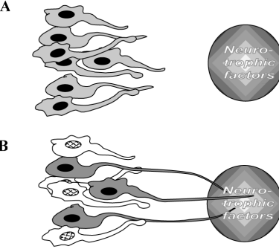
Target field theory
anatomy
Notes:
6

Slide 7
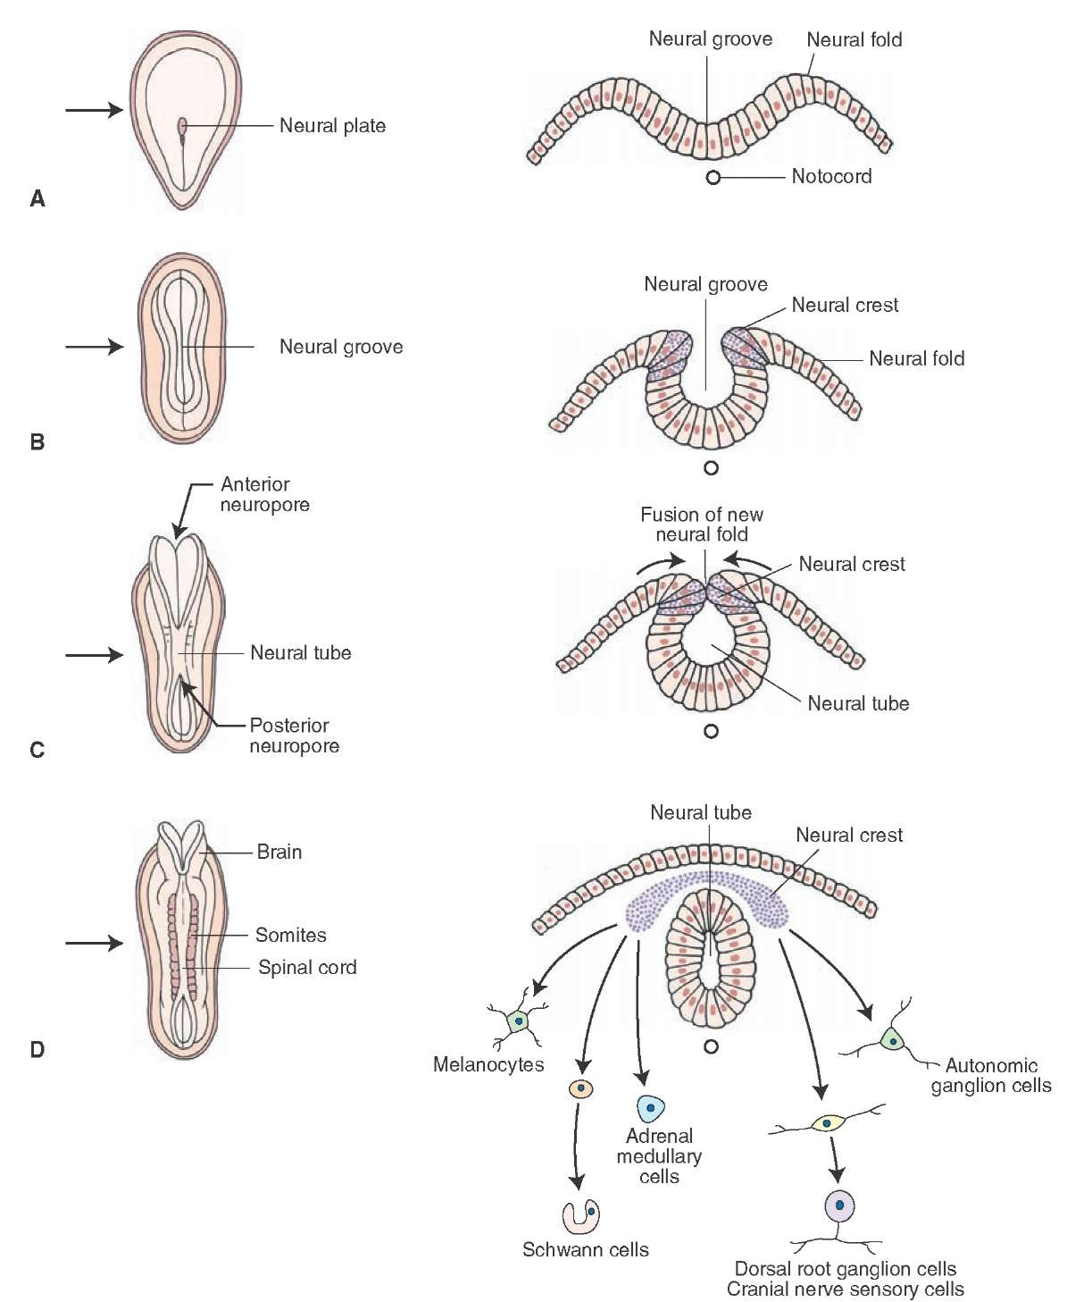
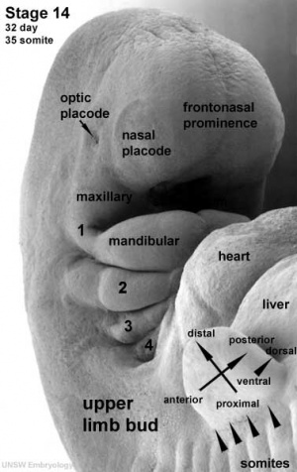
Development of
the NS

Slide 8
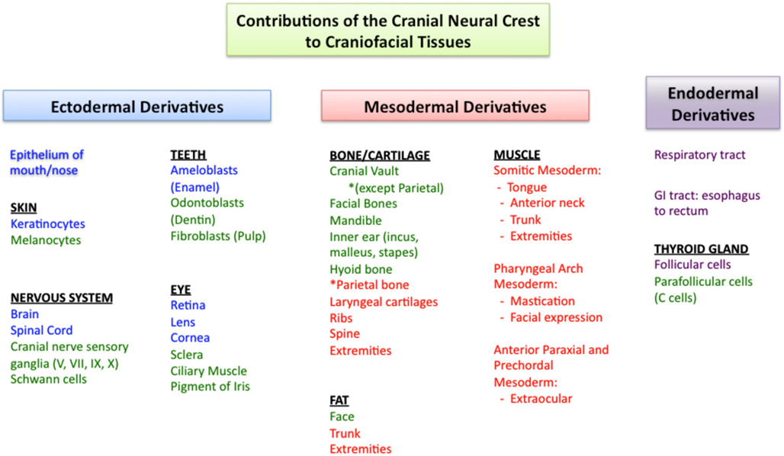

Slide 9
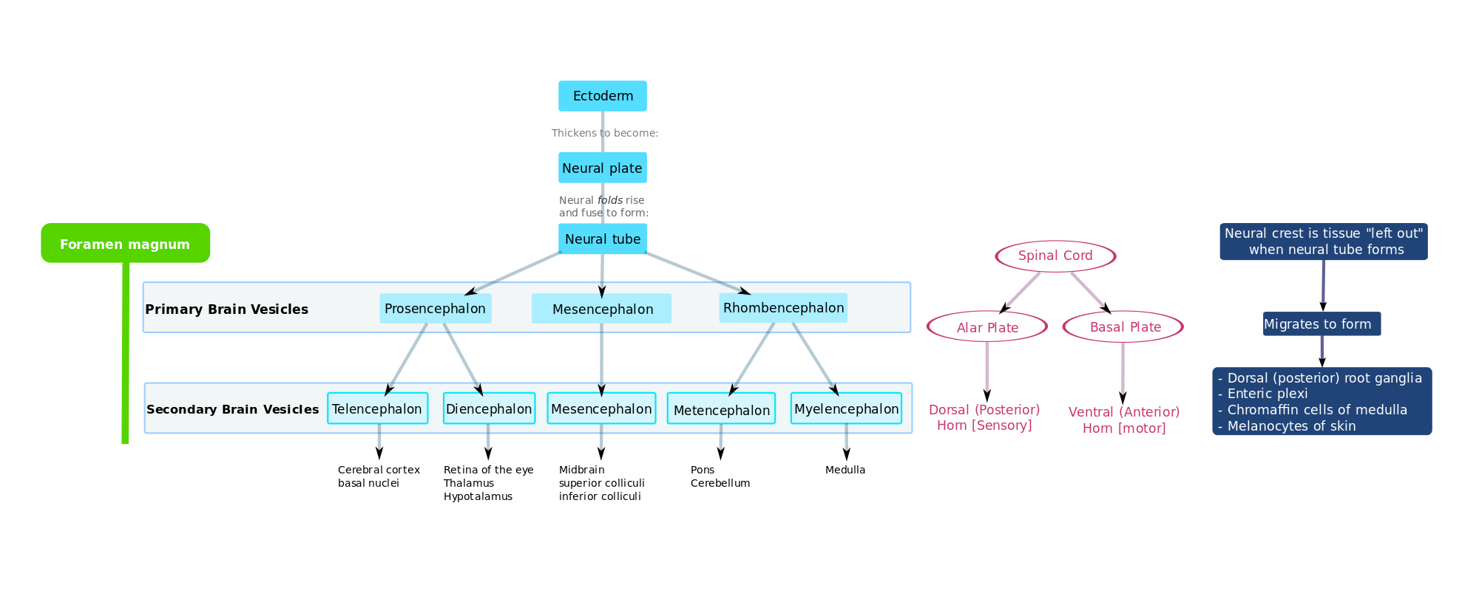
Development of the NS
neurons and glia
of sensory, symp.
and parasymp nerves

Slide 10
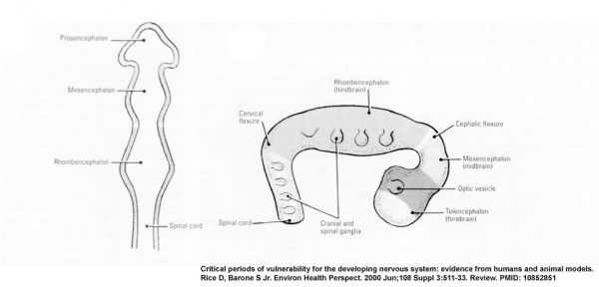
Primary brain vesicles

Slide 11
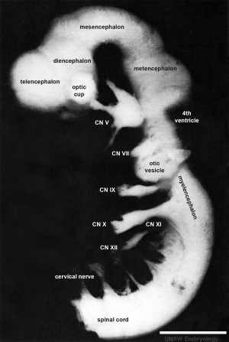
Secondary vesicles
and cranial nerves
1 mm

Slide 12
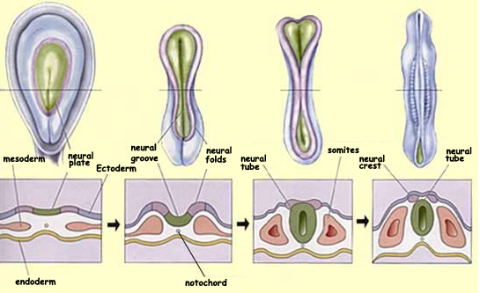
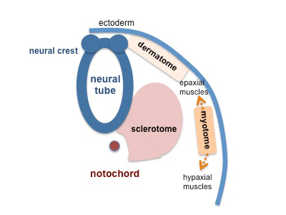
Differentiation of the neural tube in the anterior-posterior
axis pattern (rostrocaudal axis) and dorsal-ventral
axis pattern is linked to different transcription factors.
Each somite and its associated spinal cord segment is
integrated into a structural and functional unit consisting
of a spinal nerve, its sensory dermatomal distribution,
and its myotome.

Slide 13
General principles of the ontogenetic
development of the CNS
segmentation of NS (somitogenesis)
control by genes
fate of neurons (death or survival) based on epigenetic
factors, migration and interaction of neurons –
neurotrophic molecules
neuronal differentiation and survival molecules
navigation of neurons towards the target structures –
neurotropism
end-differentiation of neurons

Slide 14
Trophic relationships in the NS
Neurons have trophic effect on periferal tissues
Periferal tissues have trophic effect on neurons

Slide 15
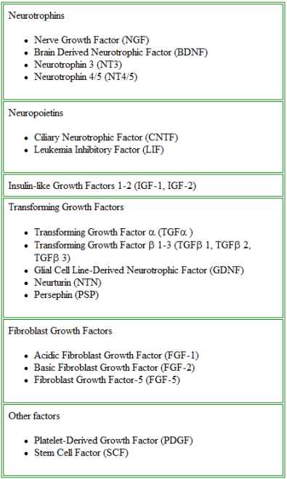
Neurotrophic factor
families

Slide 16
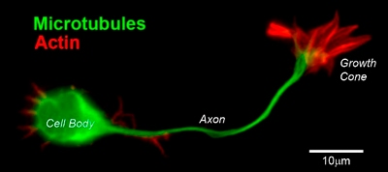
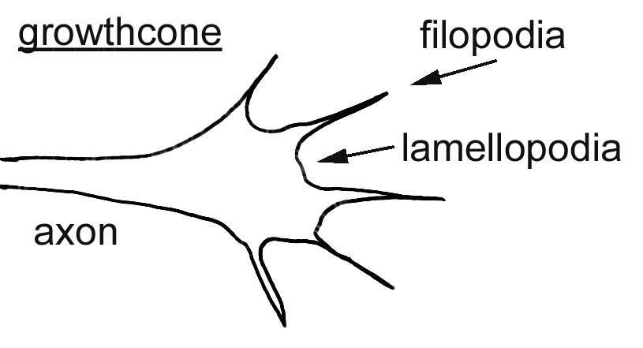
Growth cone

Slide 17
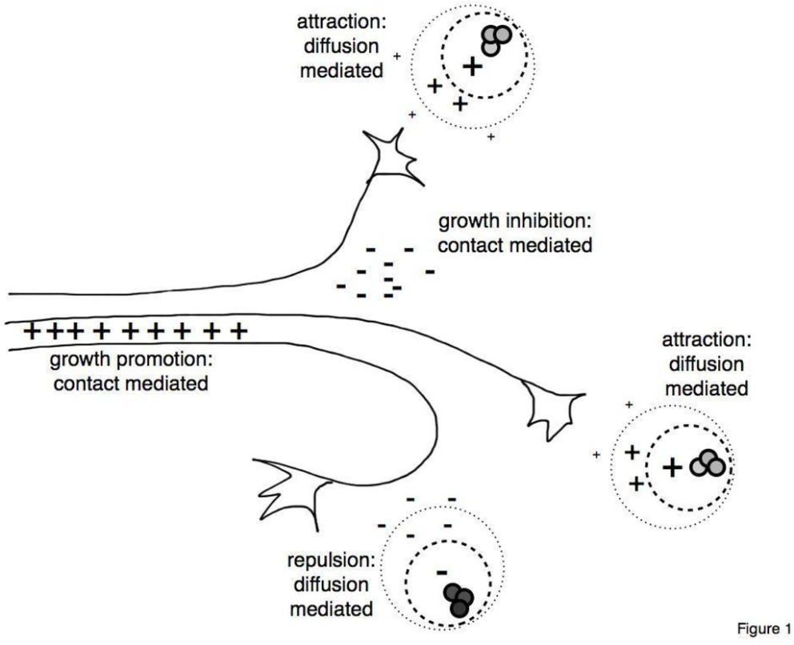
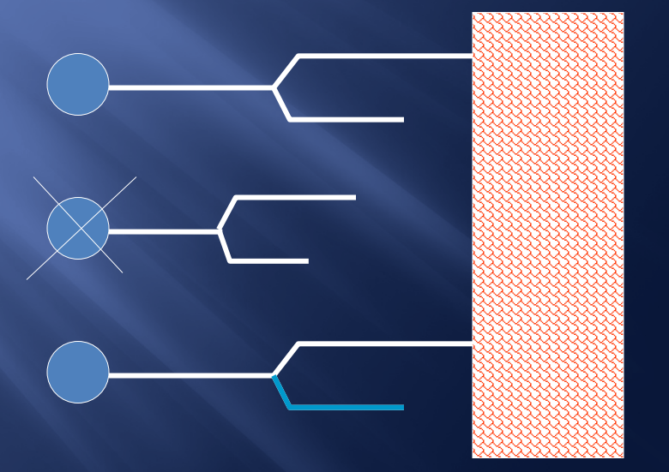
Axon guidance
Reduction of redundant axons

Slide 18
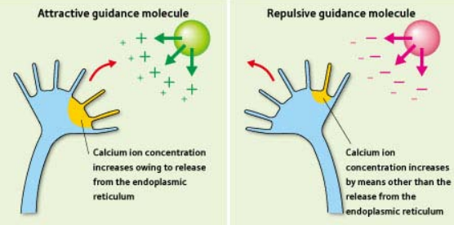
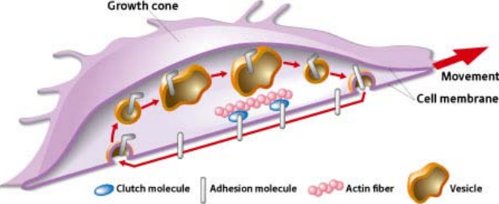
Axon guidance

Slide 19
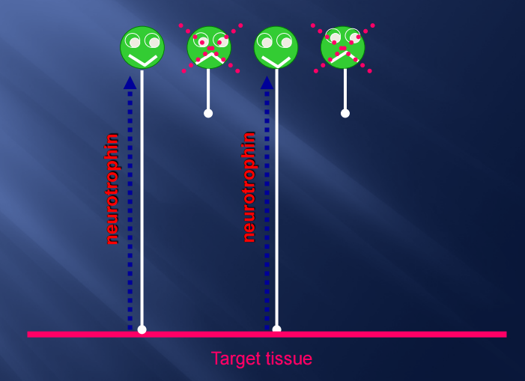
Neurotrophism
Neurotrophic factors

Slide 20
Molecular mechanisms of axonal guidance
contact adhesion
permissive surface (laminin, fibronectin, cell-adhesion
molecules)
contact inhibition
non-permissive surface
fasciculation
chemotropism – attractive molecules

Slide 21
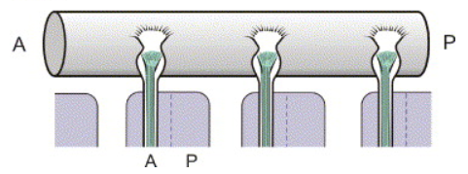
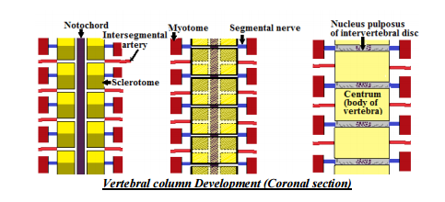
Contact adhesion and inhibition

Slide 22
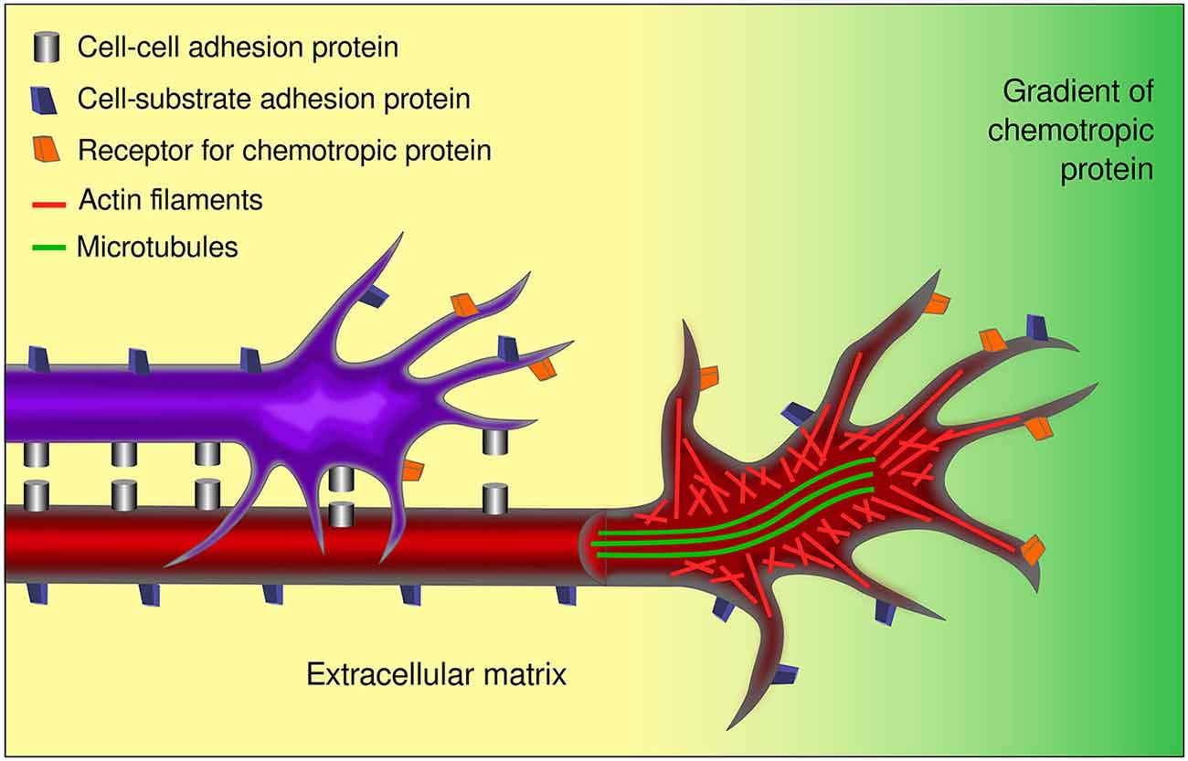
Fasciculation

Slide 23
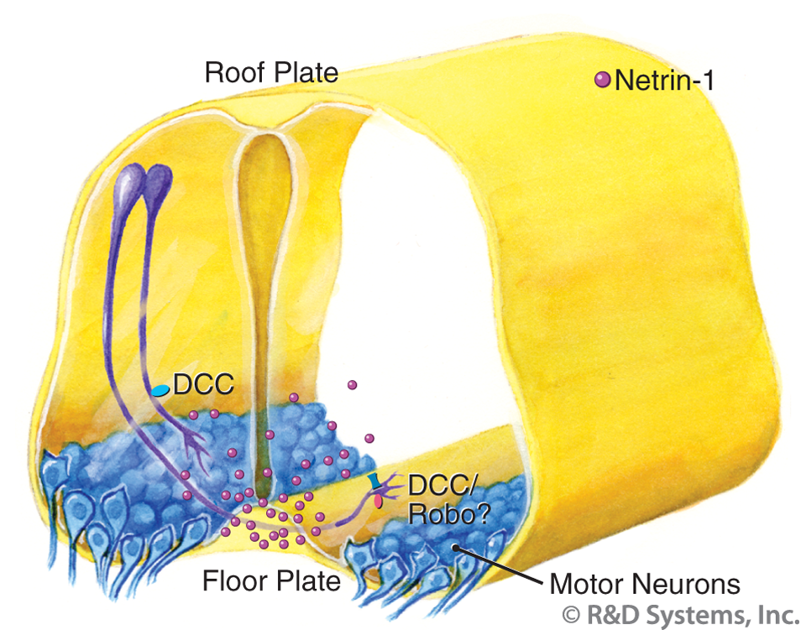
Chemotropism

Slide 24
Neural plasticity
developmental plasticity
neuroanatomical and neurophysiological changes
chemical plasticity
fast or slow turnover
neurotrophic-derived plasticity
neurons are not irrevocably genetically programmed
to produce one transmitter
neuronal plasticity
capability of generating new branches and synapses
synaptic plasticity
strengthening or weakening of synapses

Slide 25
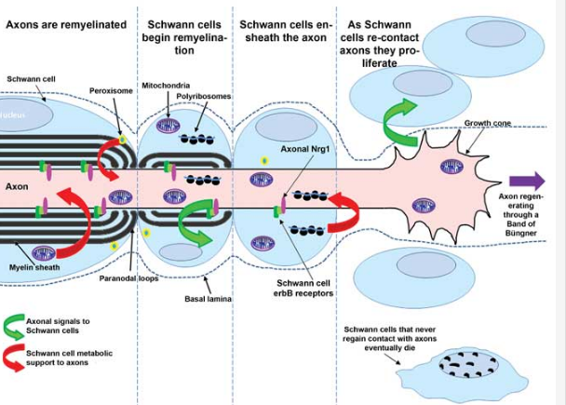
Reciprocal Schwann cell-axon interactions

Slide 26
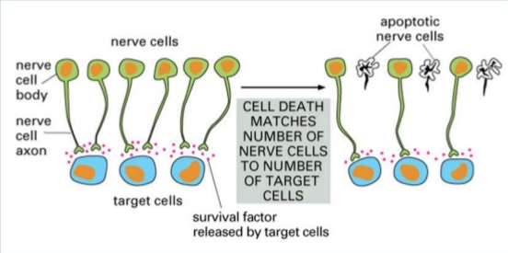
Apoptosis

Slide 27
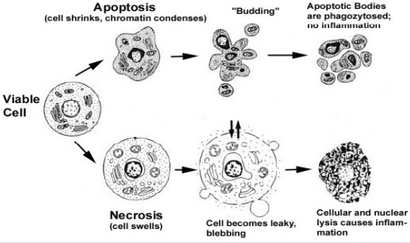

Slide 28
Critical factors and periods in
development of the CNS
critical period in development of the CNS
influence of the proper factors is necessary
for the next development of the structure
genetic factors (initial period of development)
nutritive factors
critical period – the 2nd trimester – 1st year
hormonal factors
factors of afferent pathways

Slide 29
Reaction of neurons to injury
loss of function
influence of duration of the damaging agent
reaction to injury of processes differs in neurons of
CNS and PNS
CNS neurons - atrophy and death due to great decline
of RNA synthesis
PNS neurons – anabolic processes depending on
type of injury
distance of the injury site from the body
age of the organism
localization and function of neurons

Slide 31
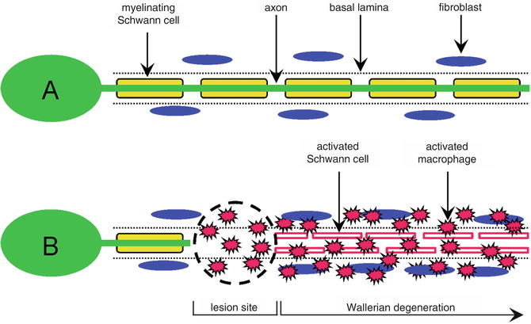
Wallerian degeneration

Slide 32
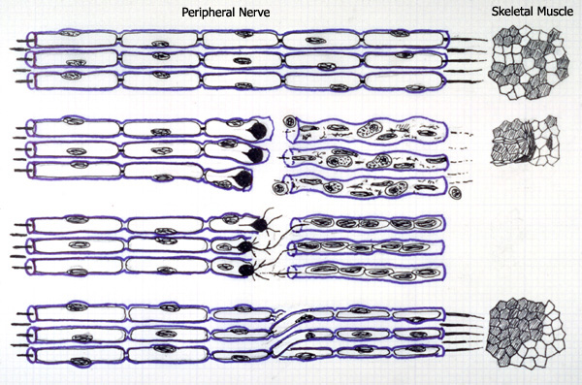
Peripheral nerve transection

Slide 33
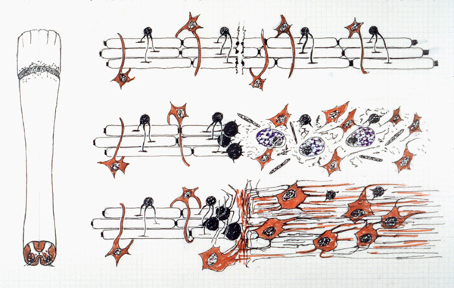
Spinal cord trauma

Slide 34
Illustrations were copied from:
Neuroscience Online, the Open-Access Neuroscience
Electronic Textbook
Department of Neurobiology and Anatomy
University of Texas Medical School at Houston

