Slide 1
SOMATOSENSORY AND VISCEROSENSORY PATHWAYS

Slide 2
SOMATOSENSORY SYSTEMS
inform about objects around us through touch
inform about position and movements of our body parts
(proprioception)
monitor the temperature
inform about painful, itchy and tickling stimuli

Slide 3
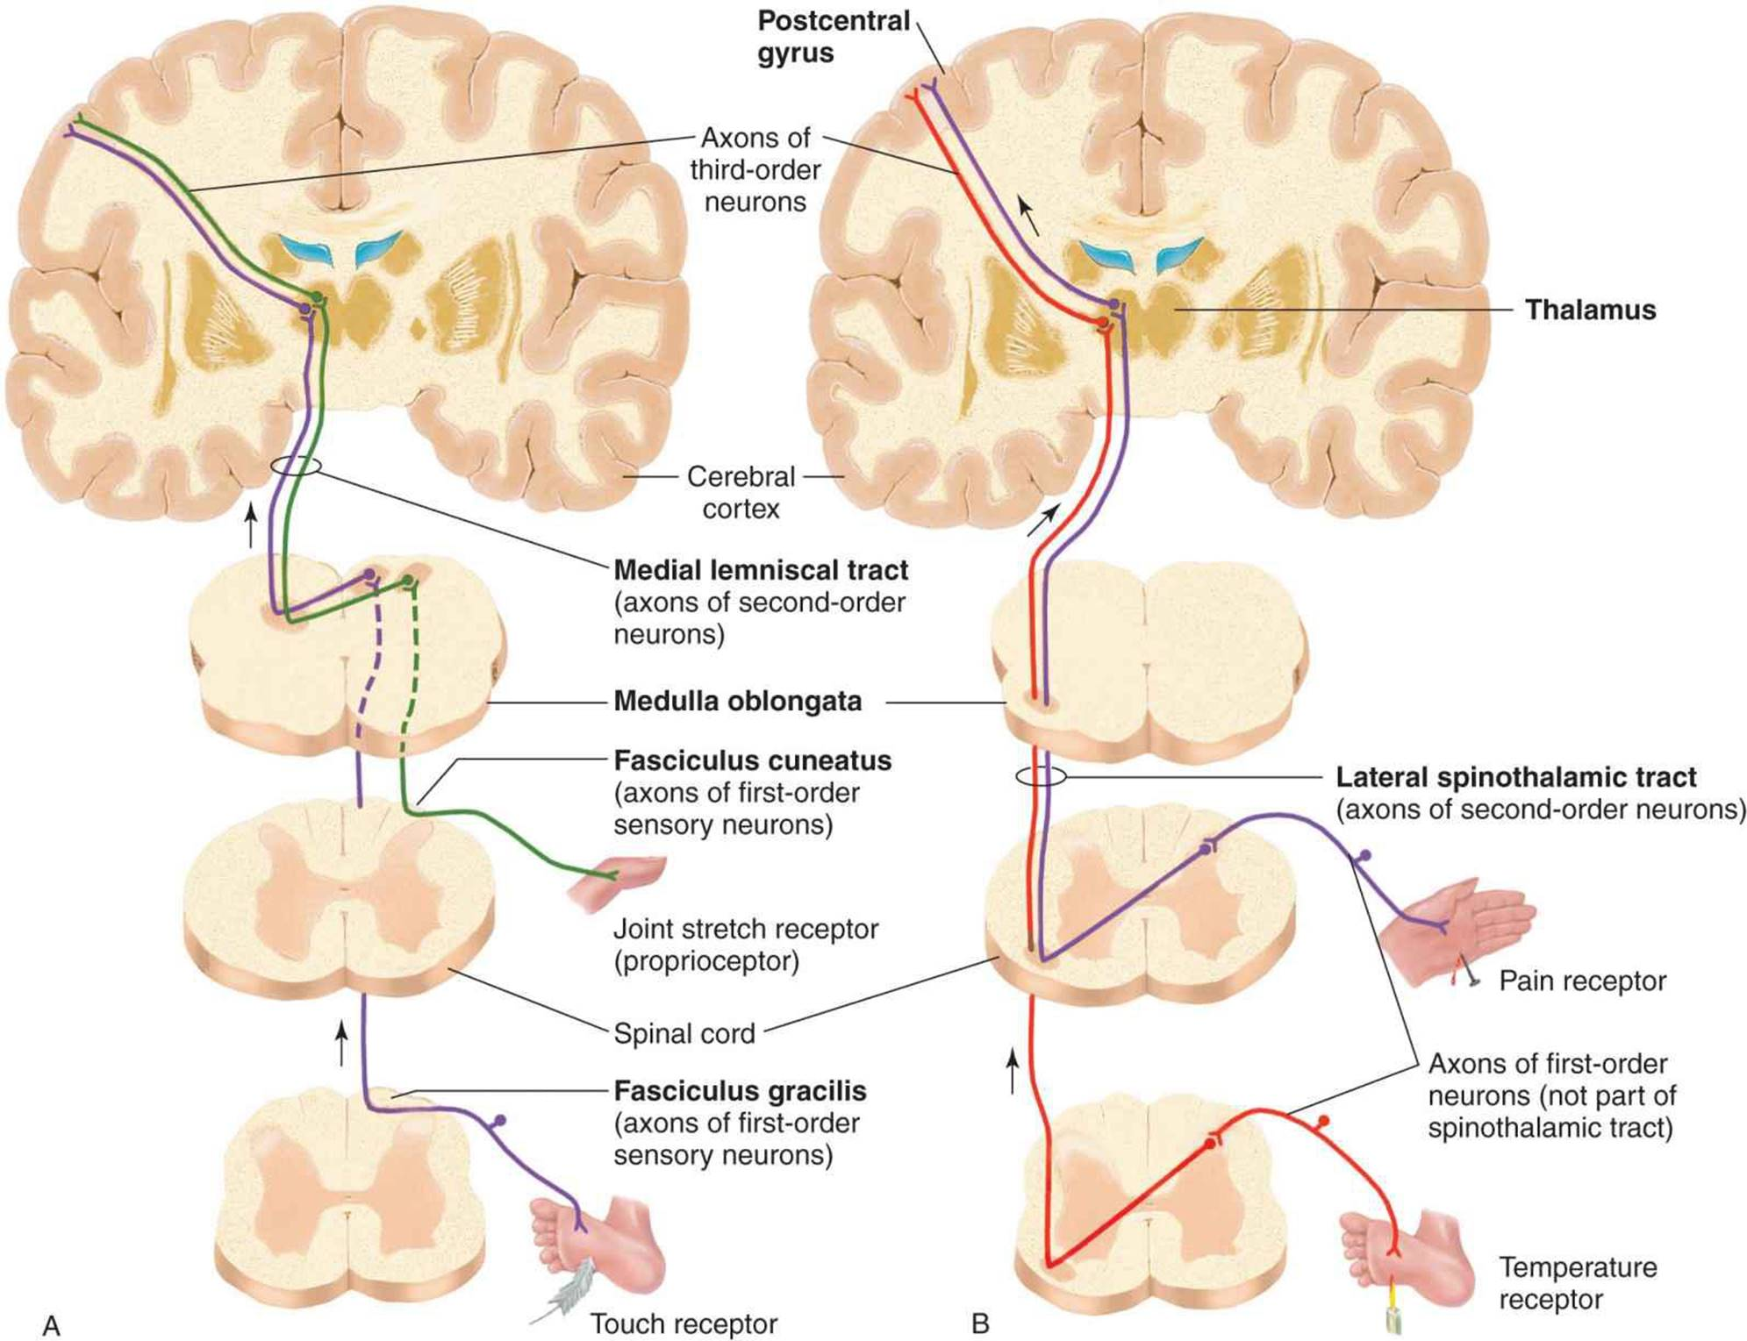
The somatosensory receptor and its central connections determine the modality specificity of the neurons forming a somatosensory pathway.

Slide 4
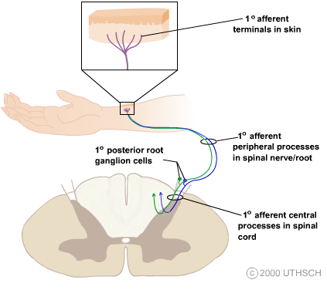
The cell bodies of the first-order somatosensory afferent neurons
are located in dorsal root or cranial root ganglia
All the peripheral terminal branches of a 1° axon form only one
type of somatosensory receptor.

Slide 5
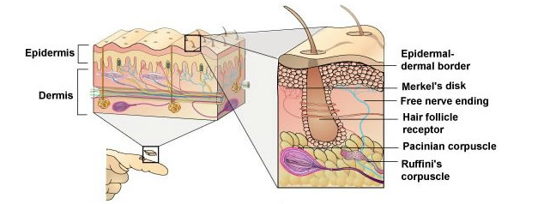
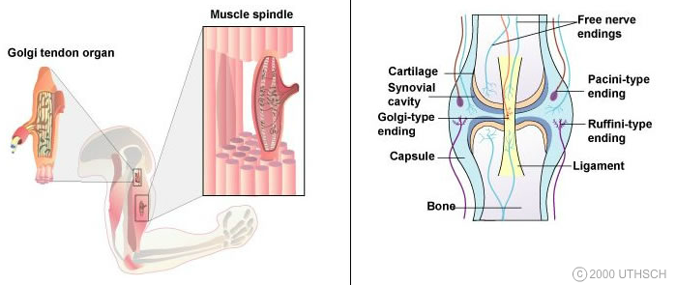
The adequate stimulus: mechanical force, temperature change, tissue damage, chemical action.

Slide 6
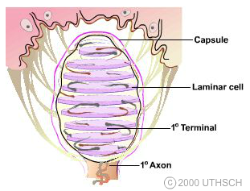
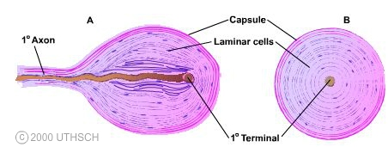
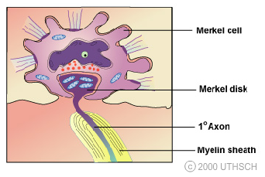
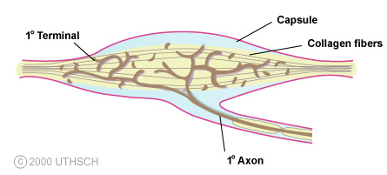
Pacinian corpuscle
Meissner corpuscle
Ruffini corpuscle
Merkel complex

Slide 7
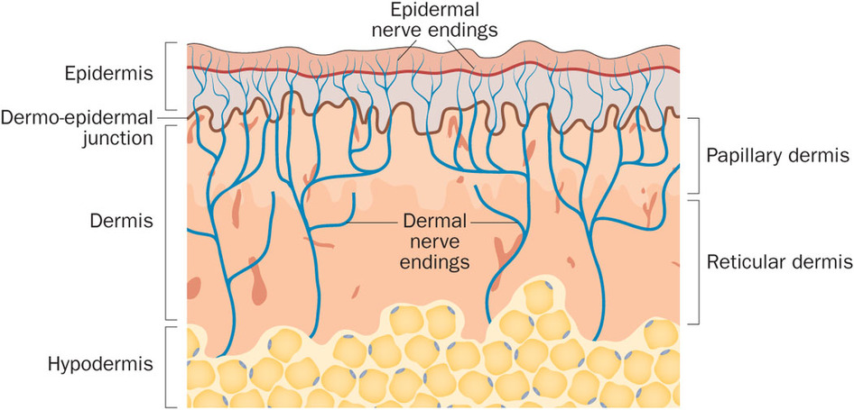
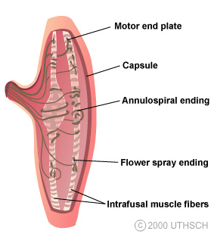
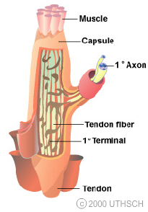
Free nerve endings
Muscle spindle
Golgi tendon organ

Slide 8
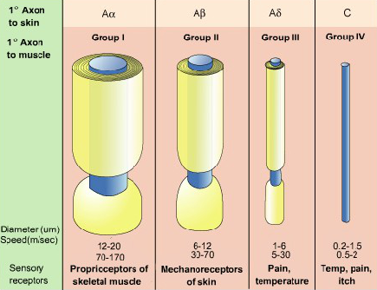
Peripheral Somatosensory Axons

Slide 9
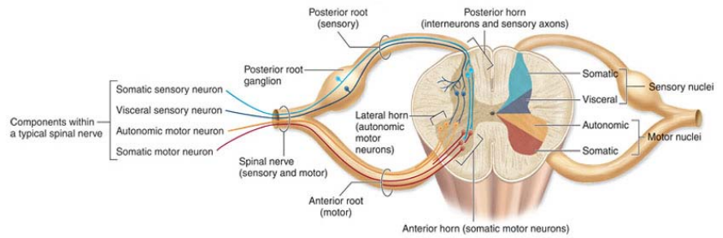
The 1° afferent is a pseudounipolar neuron that has its cell
body located in a peripheral (spinal or cranial) ganglion.

Slide 10
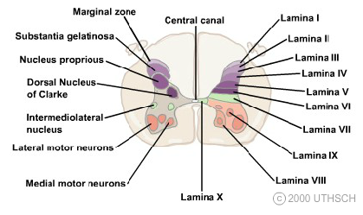
Spinal cord gray matter

Slide 11
lamina (Rexed 1952) | nuclei
I | ncl. apicalis (ncl. posteromarginalis)
II + III | substantia gelatinosa Rollandi
IV + V | ncl. proprius
VI | ncl. thoracicus (Stilling – Clark‘s ncl.) C8-L3
VII | substantia intermedia
VIII | medial group of motoneurons
IX | lateral group of motoneurons
X | zona centralis, the grey substance around the central canal

Slide 12
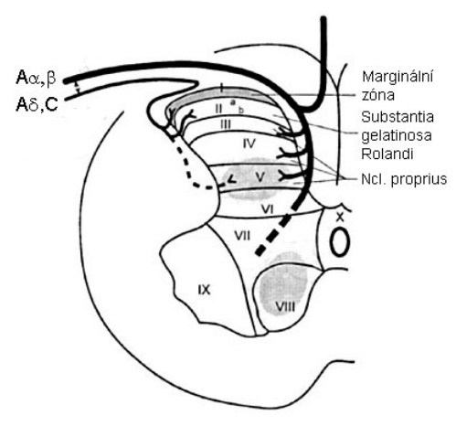
Spinal cord grey matter

Slide 13
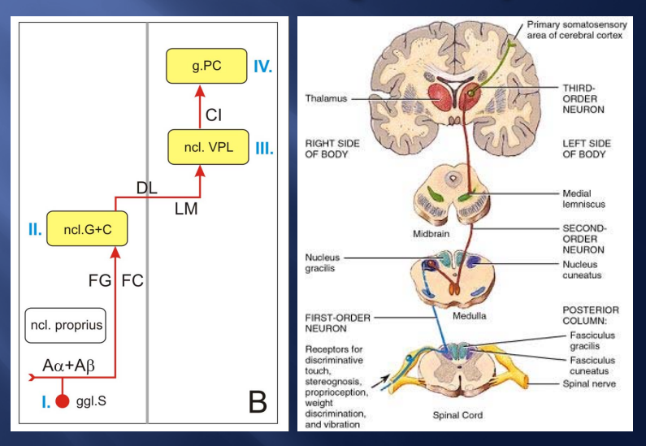
Lemniscal system

Slide 14
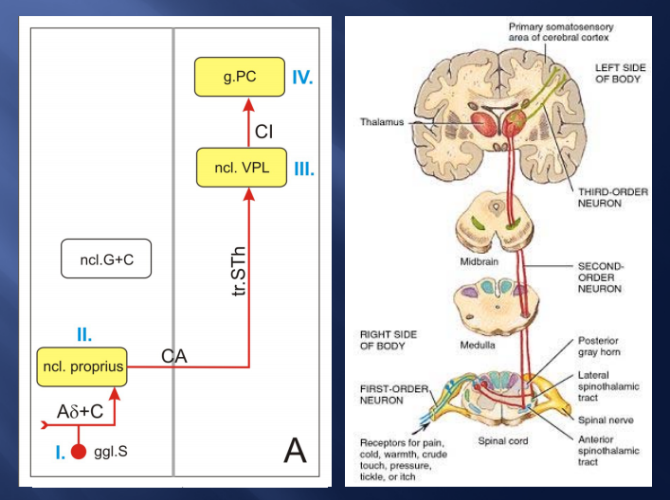
Anterolateral system

Slide 15
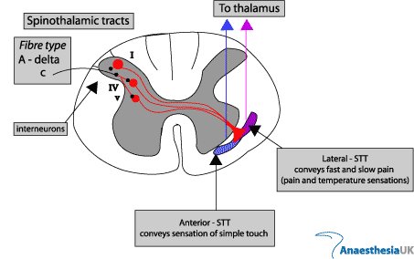
Anterolateral system
Anterior spinothalamic tract
Lateral spinothalamic tract

Slide 16
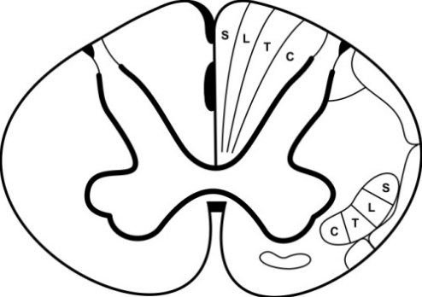
Somatosensory pathways
Lemniscal system
younger
perception with high
discrimination ability
discriminative touch,
proprioception
Anterolateral system
(neospinothalamic pathway)
older
perception with low
discrimination ability
crude touch, pain and
temperature

Slide 17
Spinoreticular tract
(paleospinothalamic pathway)
the oldest
not somatotopically arranged
arouses the cerebral cortex (ARAS)
report to the limbic cortex about the nature
of a stimulus

Slide 18
Proprioception
static component of proprioception
information from UL and LL mediated by one pathway
dynamic (kinesthetic) component of proprioception
information from UL and LL mediated by separate pathways
Spinal cord – reflexes
Cerebellum – coordination of movements
Cerebral cortex – consious proprioception

Slide 19
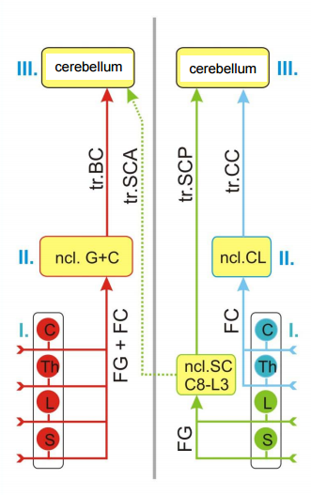
Non-conscious proprioception
static
dynamic
tr. bulbocerebellaris
tr. cuneocerebellaris
tr. spinocerebellaris ant.
tr. spinocerebellaris post.
ncl. gracilis et cuneatus
ncl. cuneatus lateralis
fasciculus gracilis
et cuneatus
fasciculus cuneatus
ncl. Stilling-Clark
fasciculus gracilis

Slide 20
Conscious proprioception
static proprioception
DRG – fasciculus gracilis et cuneatus – gracile and
cuneate (bulbar) nuclei – tr. bulbo-thalamo-corticalis –
SI
dynamic proprioception
LL + caudal part of trunk
tr. spinocerebellaris post – ncl. Z (rostral to gracile ncl.) –
medial lemniscus – ncl. VPL thalami – SI
UL + cranial part of trunk
lateral cuneate ncl. – contralateral medial lemniscus –
ncl. VPL thalami – SI

Slide 21
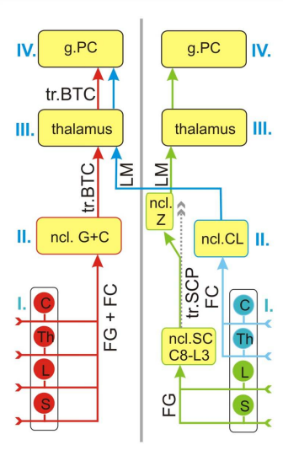
static
dynamic
gyrus postcentralis (SI)
gyrus postcentralis (SI)
tr. thalamocorticalis
tr. bulbothalamicus (lemn. med.)
lemniscus medialis
ncl. gracilis et cuneatus
ncl. cuneatus lateralis
fasciculus cuneatus
tr. spinocerebell. post.
fasciculus gracilis
et cuneatus
ncl. Stilling-Clark
fasciculus gracilis

Slide 22
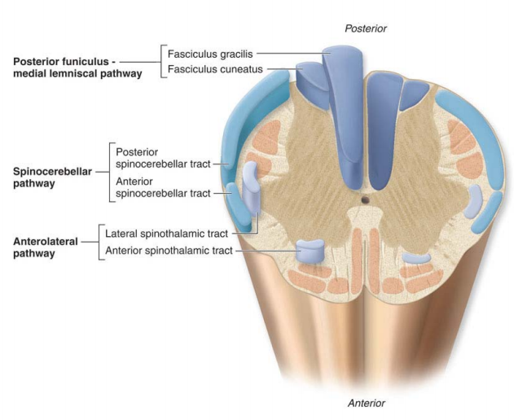

Slide 23
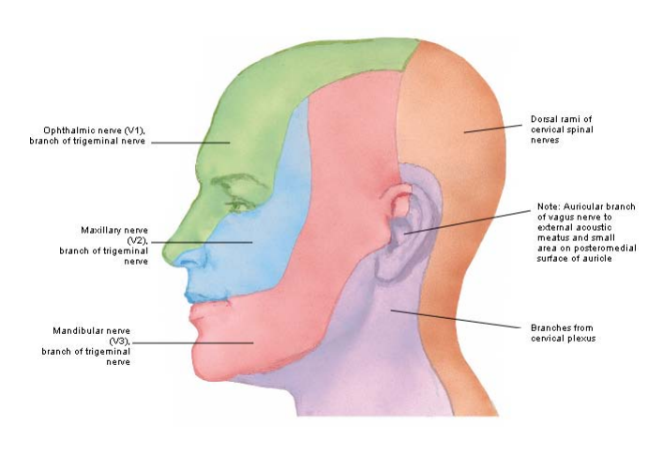
CN V

Slide 24
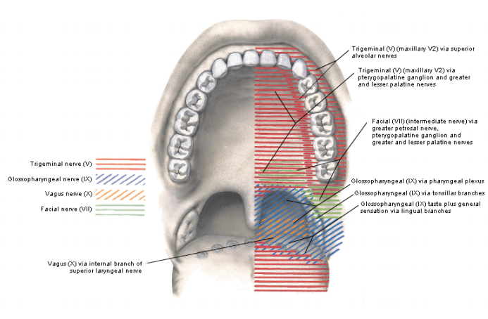
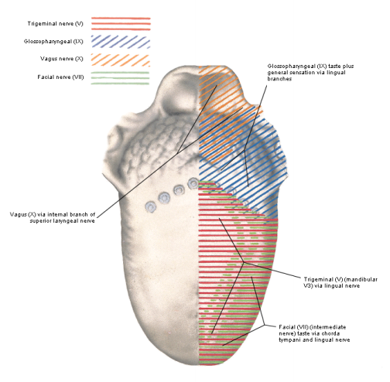
Maxillary nerve
Mandibular nerve

Slide 25
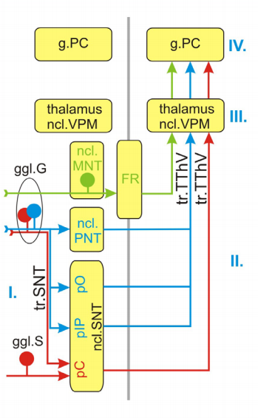
CN V - pathways
touch, pain and temperature
touch (discriminative touch)
proprioception (muscles,
temporomandibular joint,
teeth)

Slide 26
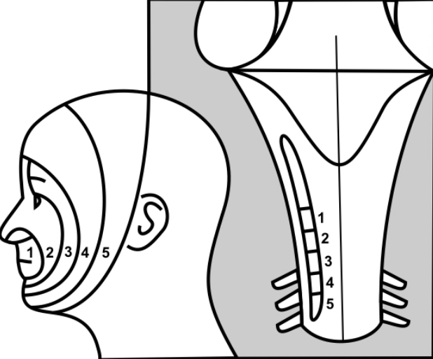
CN V - spinal nucleus

Slide 27
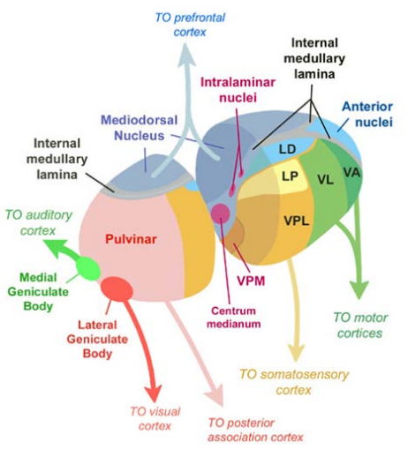

Slide 28
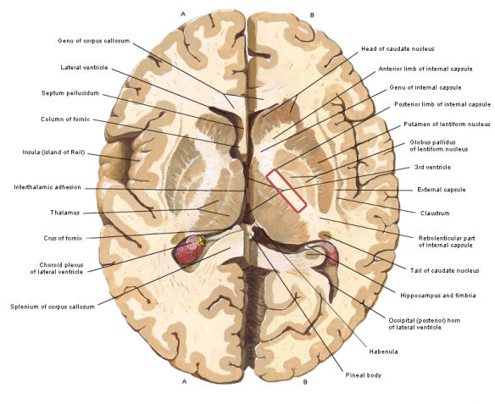

Slide 29
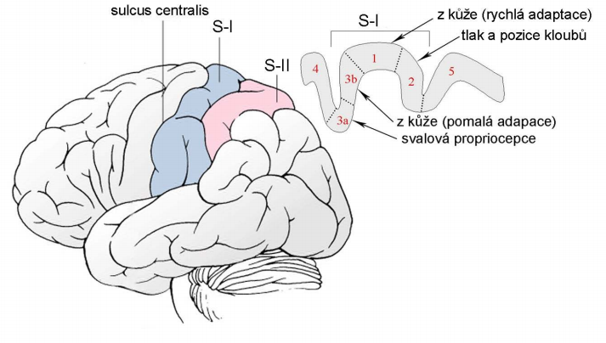
Somatosensory cortex – a. 3,1,2

Slide 30
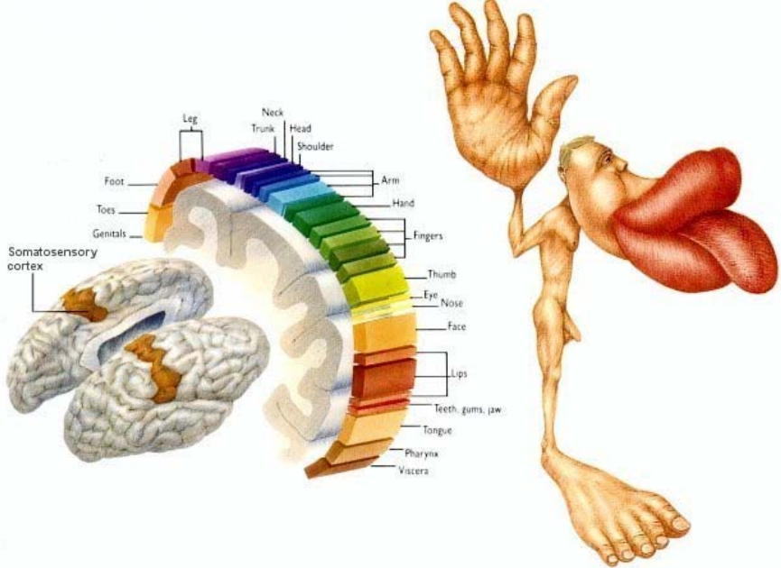

Slide 31
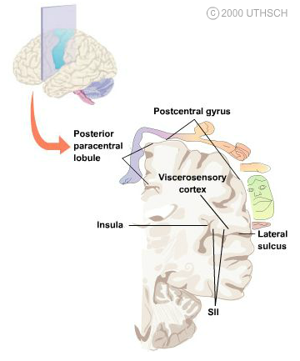
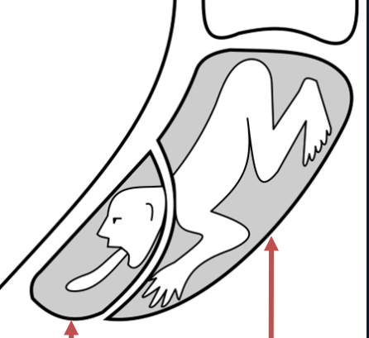
Somatotopic organization
VPM
VPL

Slide 32
VISCEROSENSORY PATHWAYS
carry information from the thoracic, abdominal and
pelvic cavities, and from the cardiovascular system
utilize autonomic pathways to reach the CNS
participate in important reflexes
most of them end in the hypothalamus

Slide 33
VS fibres in the parasympathetic nerves
pseudounipolar neurons in the inferior ganglion of CN IX
mucosa of oropharynx → ncl. commissuralis
(reflex contractions of pharyngeal muscles during swallowing)
carotid sinus (baroreceptor)
carotid body (chemoreceptor) → dorsal respiratory ncl.
pseudounipolar neurons in the inferior ganglion of CN X
heart, respiratory organs and GIT → ncl. commissuralis
information about acidity of gastric juice → lateral
hypothalamus (apestat)
aortic arch (baroreceptor)

Slide 34
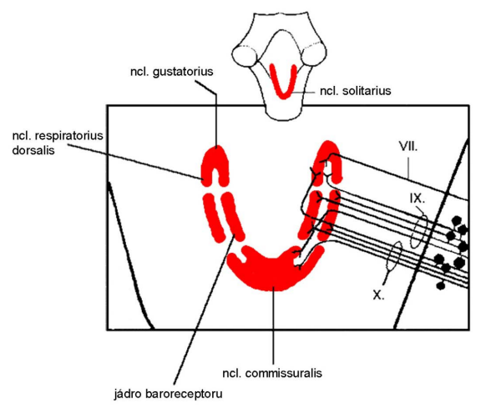
Solitary nucleus (ncl. of solitary tract)

Slide 35
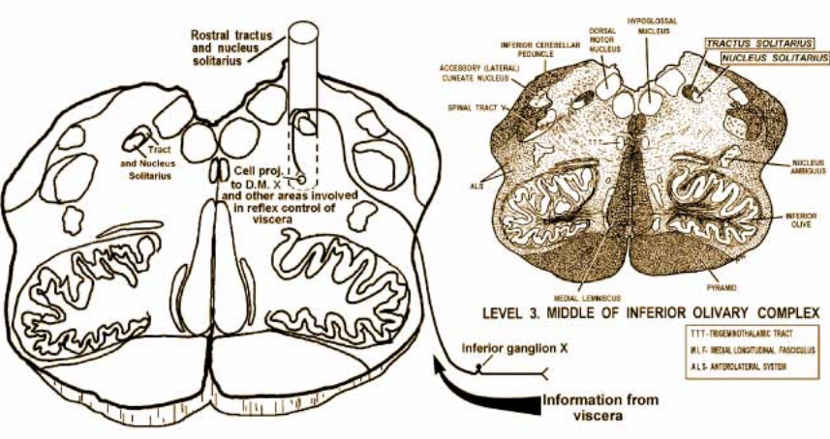

Slide 36
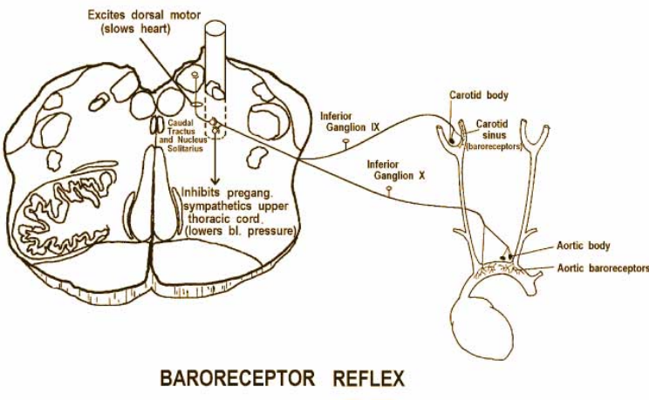

Slide 37
VS fibres in the sympathetic system
information about pressure, vibrations, temperature
and pain from visceral organs
dorsal root ganglion
ncl. proprius
tr. spinothalamicus → ncl. ventralis posterolateralis thalami
→ somesthetic cortex
tr. spinoreticularis

Slide 38
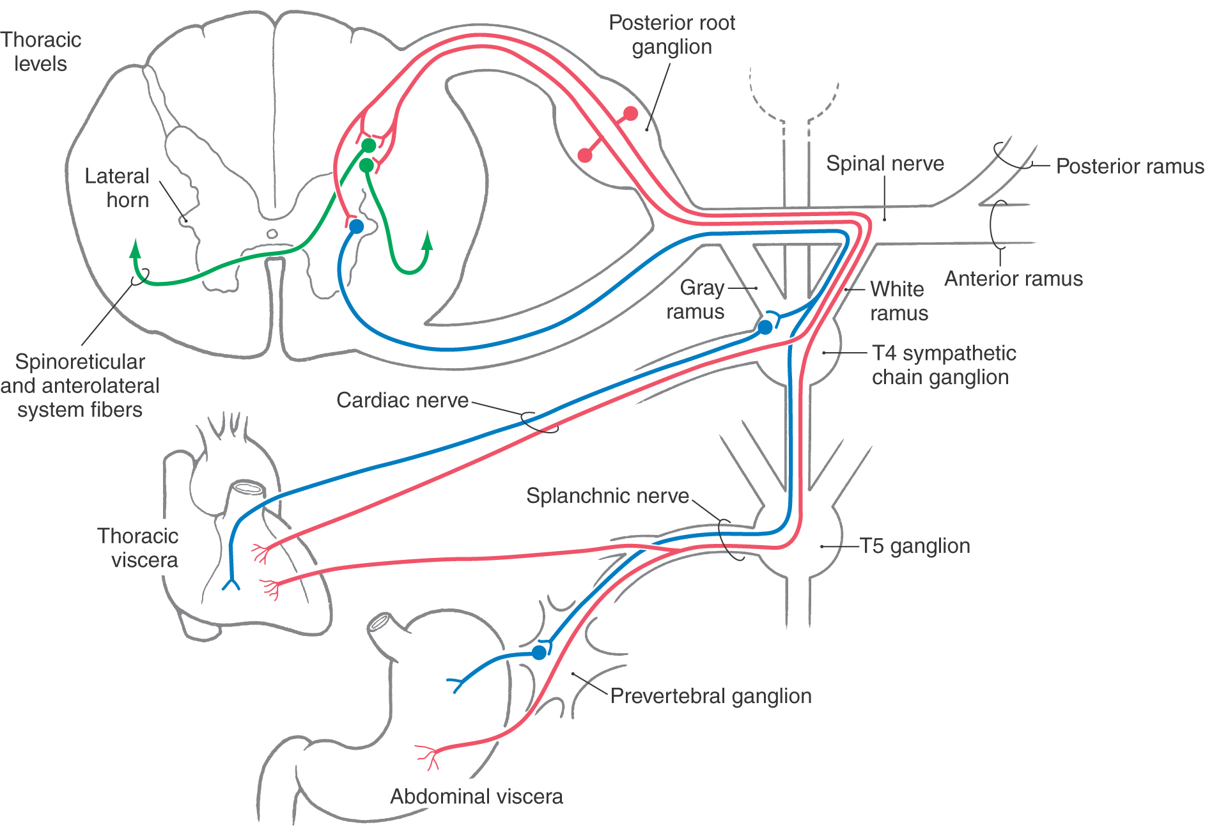

Slide 39
Illustrations were copied from:
Neuroscience Online, the Open-Access Neuroscience
Electronic Textbook
Department of Neurobiology and Anatomy
University of Texas Medical School at Houston

