Slide 1
PATHWAYS OF THE CEREBELLUM AND BASAL GANGLIA

Slide 2
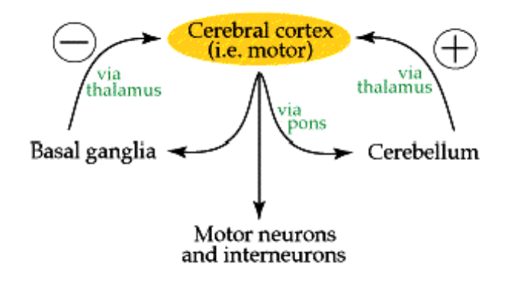

Slide 3
CEREBELLUM
Functions:
Maintenance of balance and posture
Coordination of voluntary movements
Motor learning
Cognitive functions

Slide 4
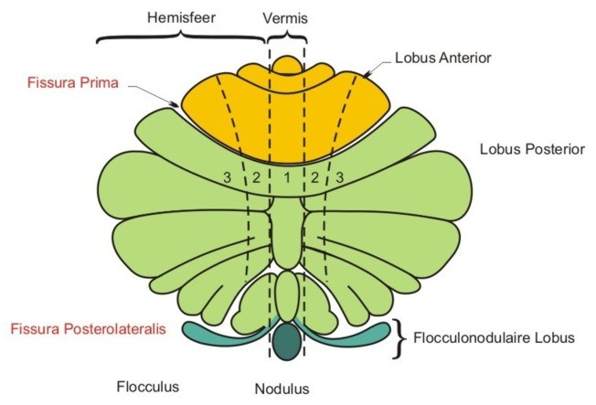
CEREBELLUM
Anatomical division

Slide 5
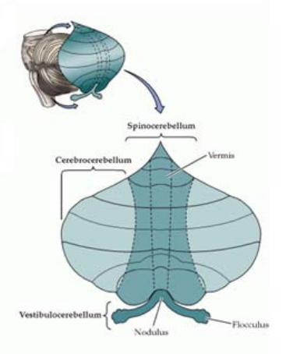
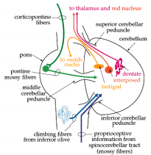
CEREBELLUM
Developmental division
archicerebellum
vestibulocerebellum
paleoocerebellum
spinocerebellum
neocerebellum
cerebro- (ponto-) cerebellum

Slide 6
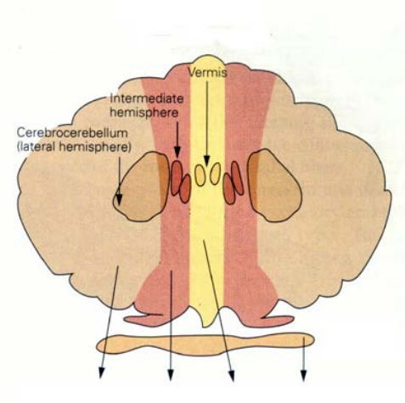
CEREBELLUM
Functional division
VC
flocculonodular lobe
vestibular ncll.
SC - median zone
vermis
ncl. fastigii
SC - paramedian zone
intermediate cortex
ncll. emboliformis et globosus
CC - lateral zone
cortex cerebellar hemispheres
ncl. dentatus

Slide 7
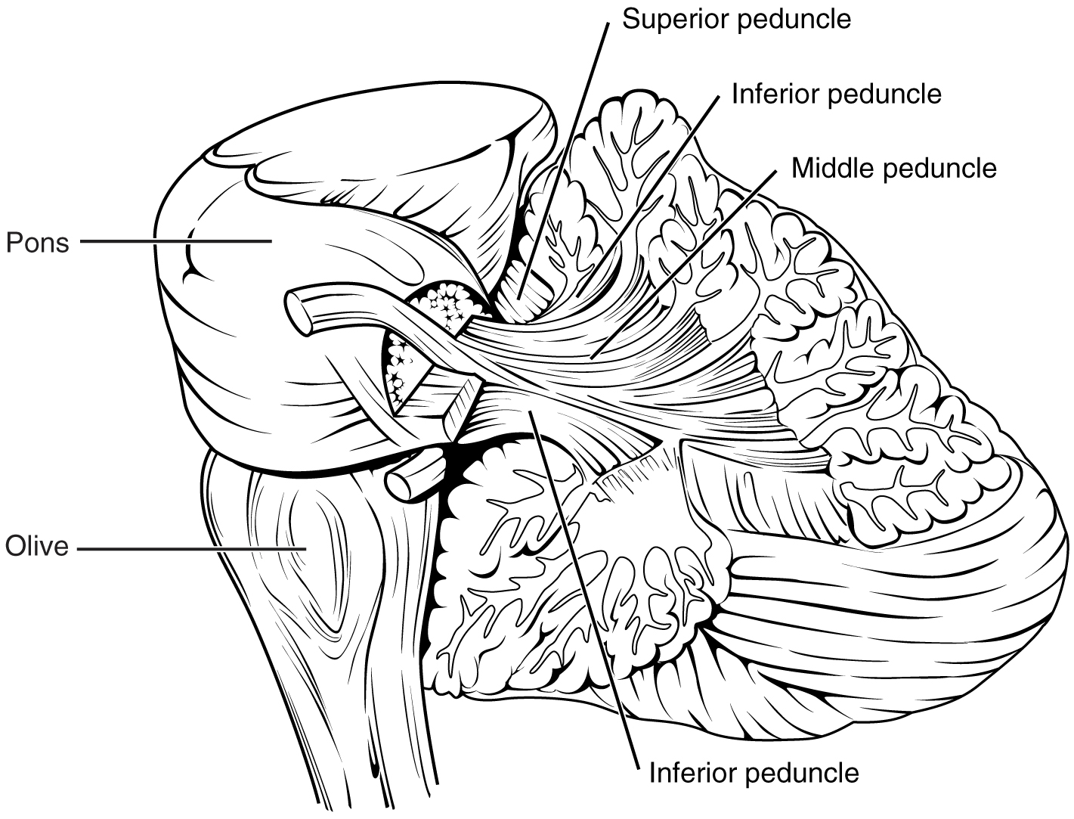

Slide 8
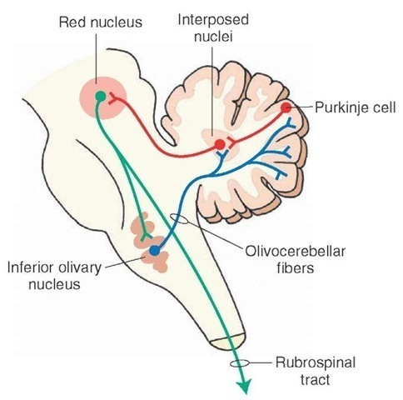
Rubro – olivary tract

Slide 9
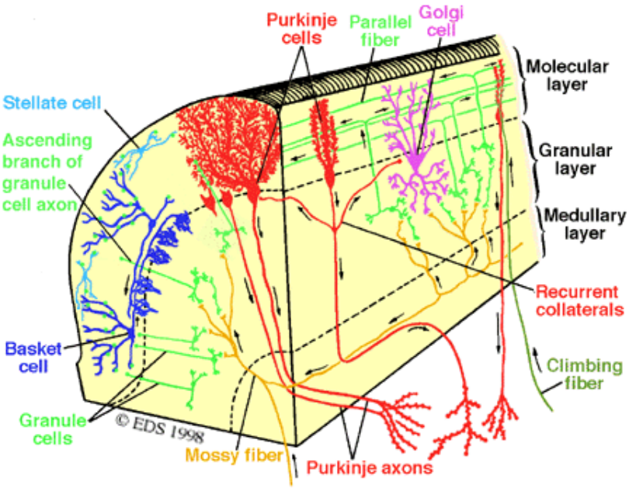
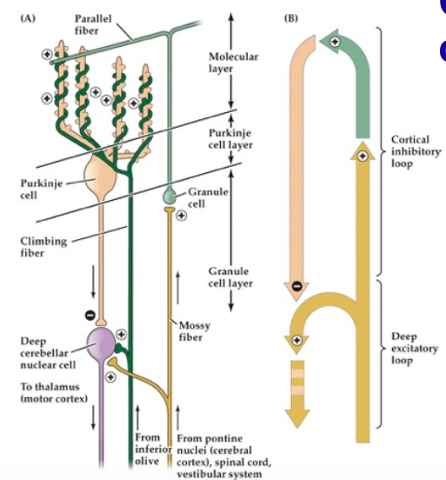
CEREBELLAR CORTEX

Slide 10
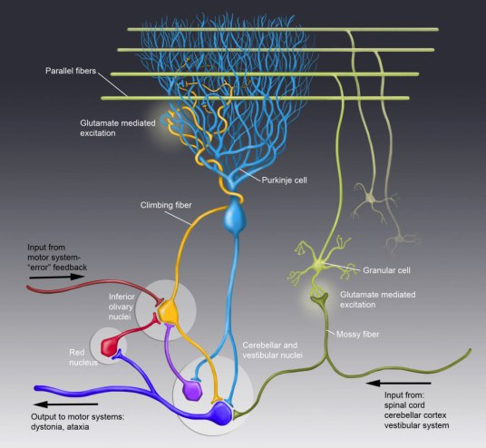

Slide 11
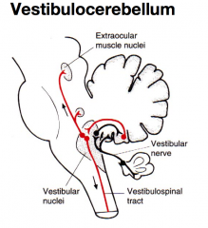
Connections of the
vestibulocerebellum
Flocculonodular lobe
(vestibulocerebellum)
Vestibular ncll.
Vestibulospinal tracts
Pontine ncll.
Vestibulocerebellar tract
Spinal motor neurons
vestibular reflexes
postural maintenance
LGB + Sup.Col. Vestibular system

Slide 12
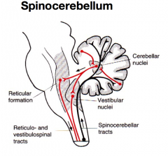
Connections of the
spinocerebellum – median zone
Th. VL
MC
Vermis
(spinocerebellum)
Ncl. fast.
Vestibular ncll.
FR
Ant. corticoospinal tract
Vestibulospinal tracts
Bulbocerebellar tract
Cuneocerebellar tract
Reticulosp. tracts
Spinocerebellar tracts
Spinal motor neurons
control of medial
descending (motor)
system
GN + CN Ncl. thor. (S-C)

Slide 13
Connections of the
spinocerebellum – paramedian zone
Th. VL
MC
Intermediate zone
(spinocerebellum)
Ncll. emb.+ glob.
RN
Lat. corticoospinal tract
Bulbocerebellar tract
Cuneocerebellar tract
Spinocerebellar tracts
Rubrosp. tract
Spinal motor neurons
control of lateral
descending (motor)
system
GN + CN Ncl. thor. (S-C)

Slide 14
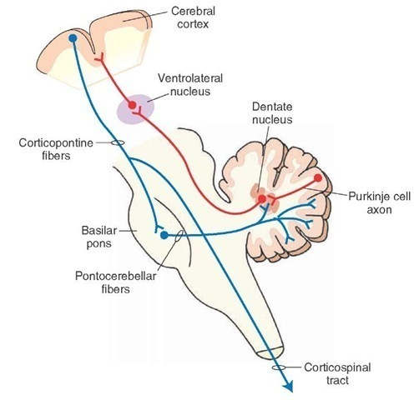
Connections of the
cerebro(ponto)cerebellum – lateral zone
Motor cortex
Corticopontine tract
Lat. corticoospinal tract
Th. VL
Pontine ncll.
planning and timing
of movements
cognitive functions
Ncl. dentatus
Pontocerebellar
tract
Spinal motor neurons
Lateral zone
(pontocerebellum)

Slide 15
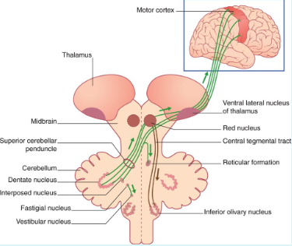

Slide 16
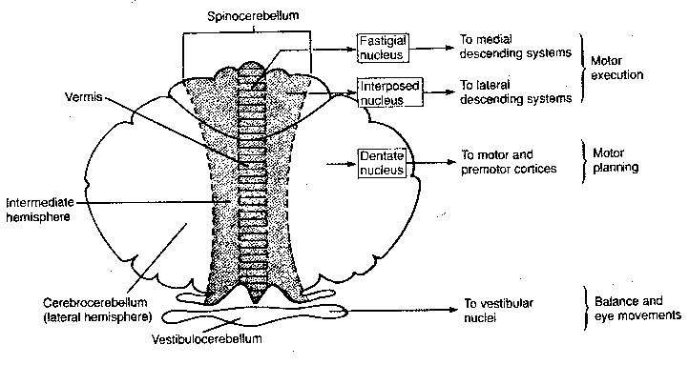

Slide 17
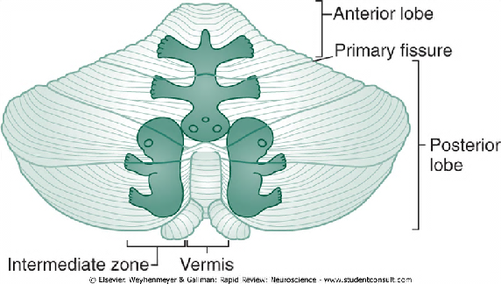
Somatotopic organization
Projection of both spinocerebellar pathways and motor cortex
ipsilateral anterior lobe
bilateral paramedian (intermediate) zone

Slide 18
CEREBELLAR DISORDERS
Ataxia - errors in the force, direction, speed and amplitude of movements
Dysmetria - „overshooting or undershooting“ - the hand may travel past the target
Asynergia - incoordination
Adiadochokinesia - inability to perform rapid alternating movements
Intention tremor - involuntary movement caused by alternating contractions of opposing muscle groups
Notes:
18

Slide 19
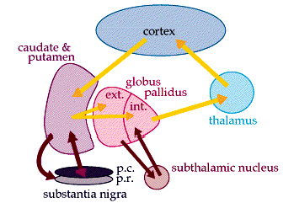
BASAL GANGLIA

Slide 20
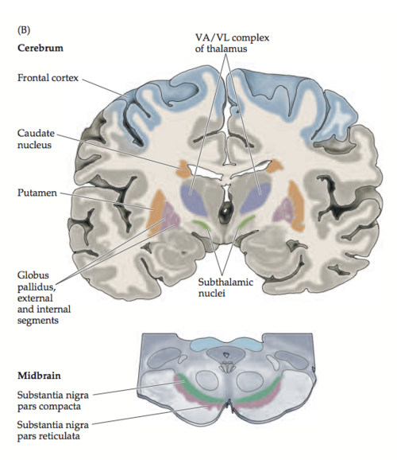
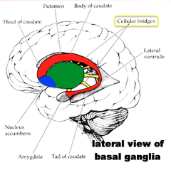
BASAL GANGLIA
Striatum (neostriatum) – ncl. caudatus (D)
- putamen (D)
- ncl. accumbens (V)
Pallidum (paleostriatum) – globus pallidus
ext.s. int.s.
Substantia nigra – pars reticularis
- pars compacta
Ncl. subthalamicus

Slide 21
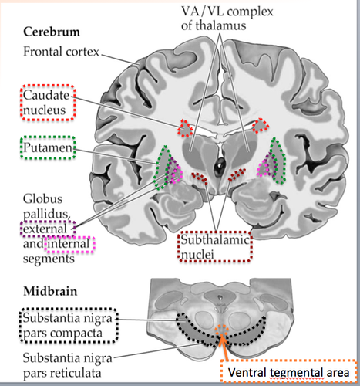

Slide 22
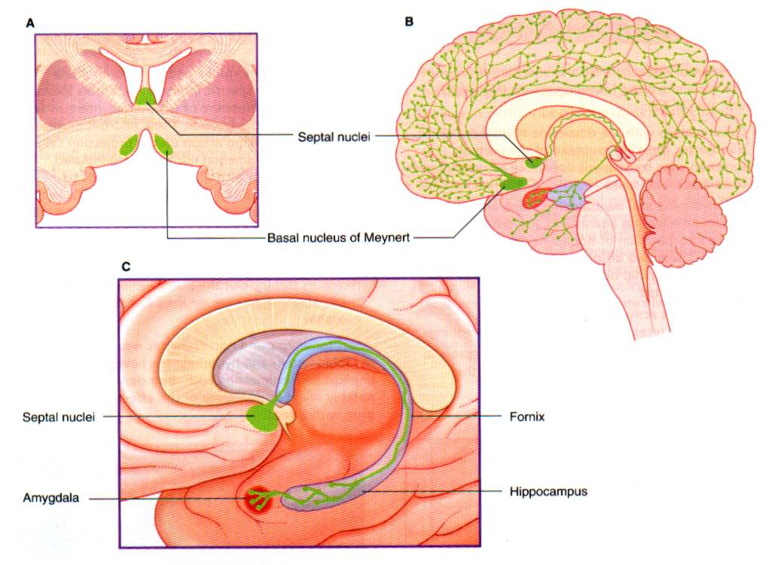

Slide 23
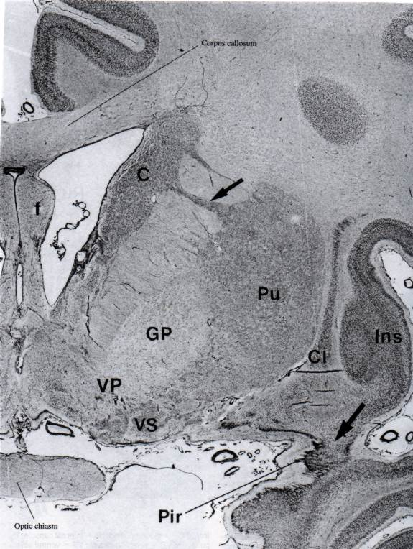
Ncl caudatus + putamen
= dorsal striatum
Globus pallidus
= dorsal pallidum
Substantia innominata:
VS = ventr. striatum
Ncl. accumbens septi
VP = ventral pallidum
Ncl. basalis Meynerti
C
Pu
GP
VP
VS

Slide 24
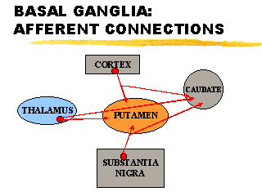
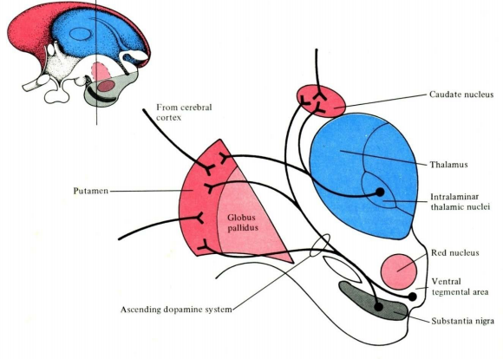
Basal ganglia afferents:
cortex
substantia nigra – pars compacta
intralaminar ncll. of thalamus (CM)

Slide 25
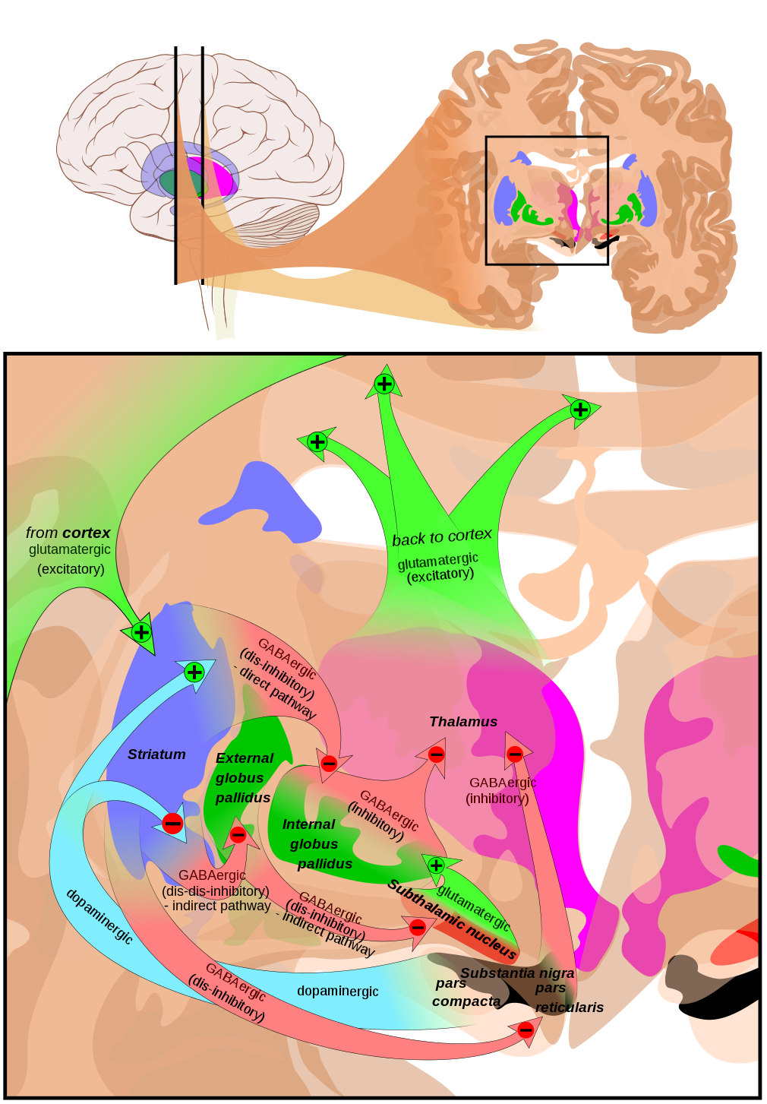
Basal ganglia efferents:
GPi
SN – pars reticularis
Th. VA/VL
Th. CM
(ansa lenticularis +
fasciculus lenticularis →
fasciculus thalamicus)

Slide 26
Basal ganglia intrinsic connections:
Striatopallidal p.
Striatonigral p.
GPe → STN
STN → GP, SNr.
Nigrostriatal p.

Slide 27
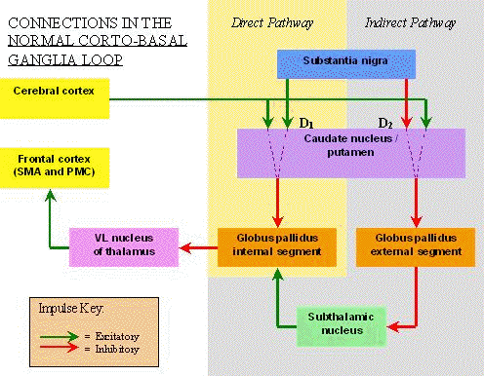
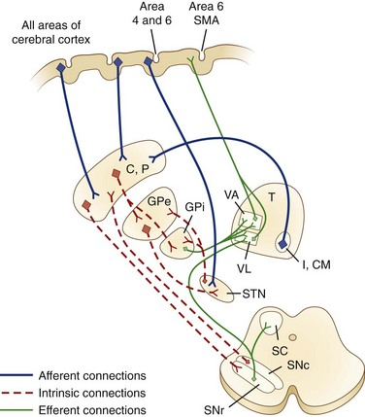
Motor loop

Slide 28
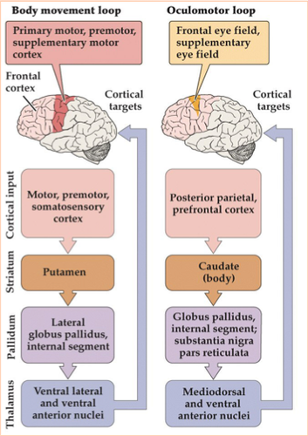
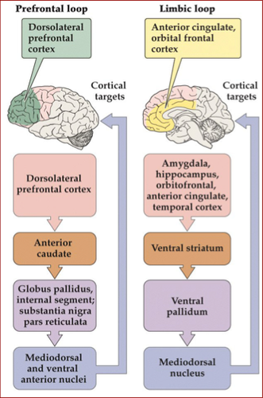

Slide 29
SPINAL MOTOR REFLEXES

Slide 30
SPINAL REFLEXES
type of afferents
somatic spinal reflexes
visceral spinal reflexes
type of somatosensor
proprioceptive reflexes
exteroceptive reflexes
number of involved spinal segments
monosegmental spinal reflexes
polysegmental spinal reflexes
number of synapses
monosynaptic reflexes
disynaptic reflexes
polysynaptic reflexes

Slide 31
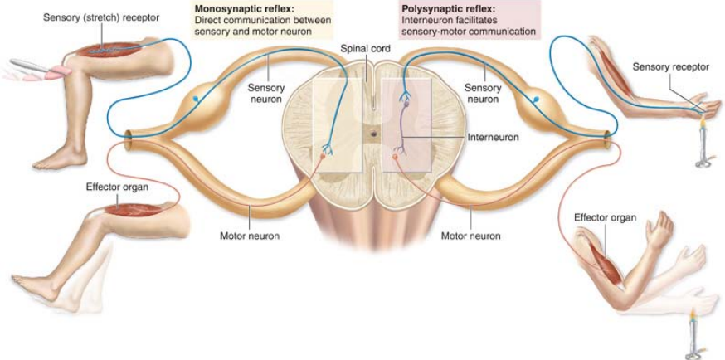
Myotatic reflex
Withdrawal reflex

Slide 32
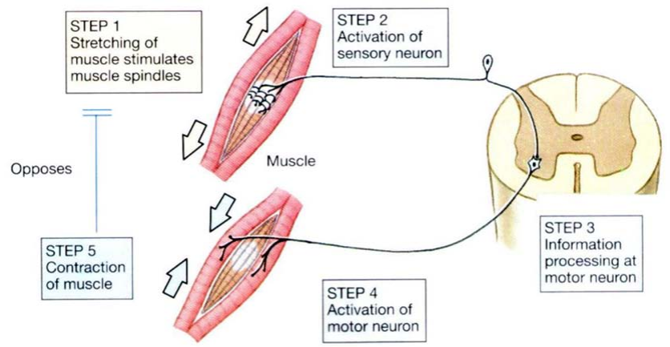
Myotatic (stretch) reflex

Slide 33
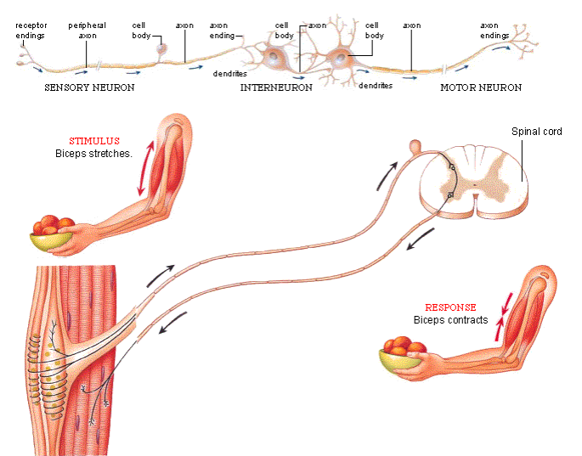
Myotatic (stretch) reflex

Slide 34
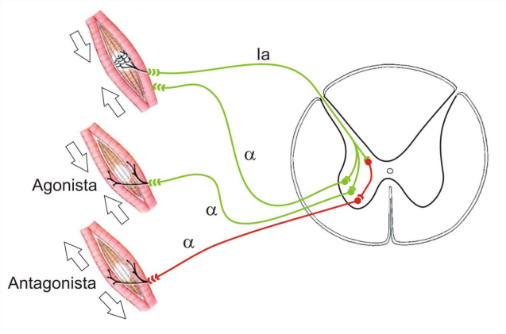
Myotatic (stretch) reflex

Slide 35
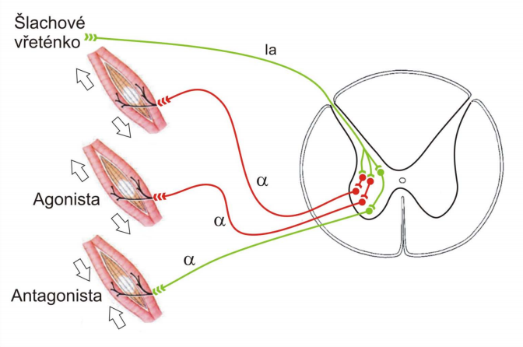
Reflex loop of Golgi tendon organ
(inverse myotatic reflex)
Ib

Slide 36
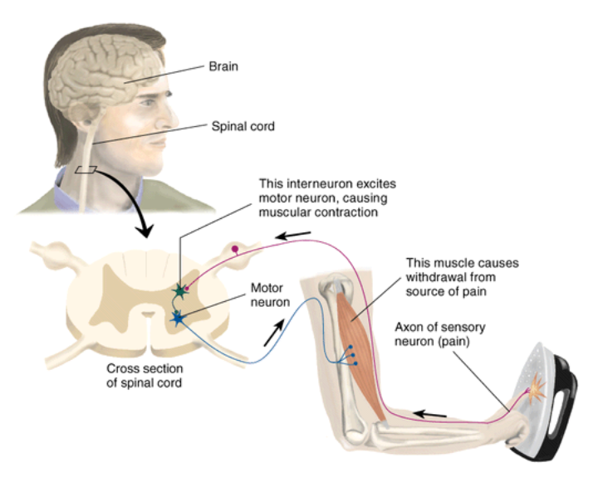
Flexor (withdrawal) reflex

Slide 38
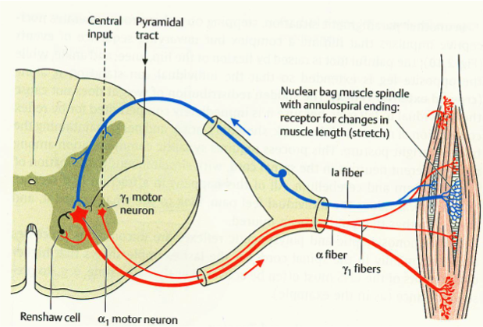
Renshaw cells

Slide 39
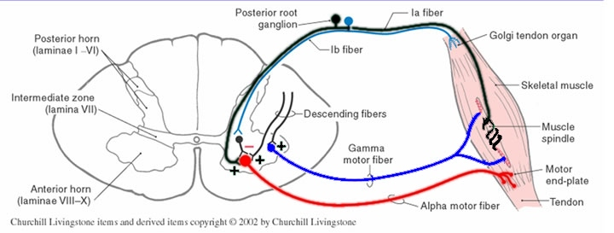
Gamma loop

Slide 40
EYE MOVEMENTS

Slide 41
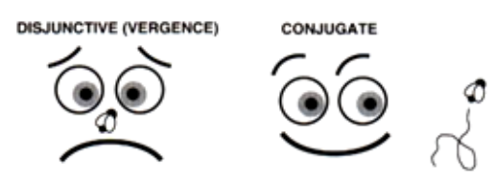
EYE MOVEMENTS
Fovea centralis – area of most acute vision
Coordination of 12 extraocular muscles
Eye movements
conjugated – both eyes in same direction
vergent - during motion of object to and from us
convergent
divergent

Slide 42
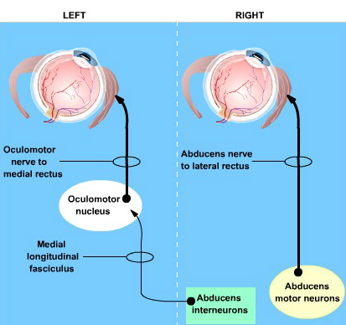

Slide 43
Four basic types of eye movements
Saccades
Smooth pursuit movements
Vergence movements
Vestibulo-ocular movements

Slide 44
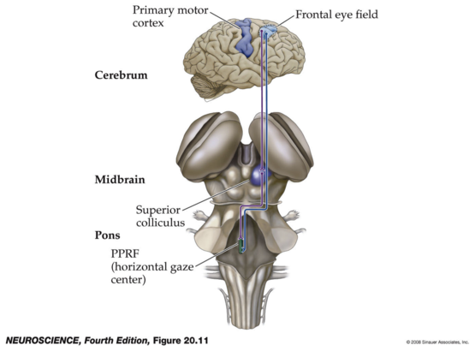
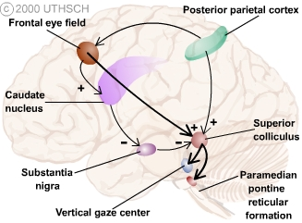
Saccadic eye movements
horizontal gaze center - PPRF
vertical gaze center – RF of the midbrain
superior colliculi – information from FEF, retina, auditory,
and tactile i.

Slide 45
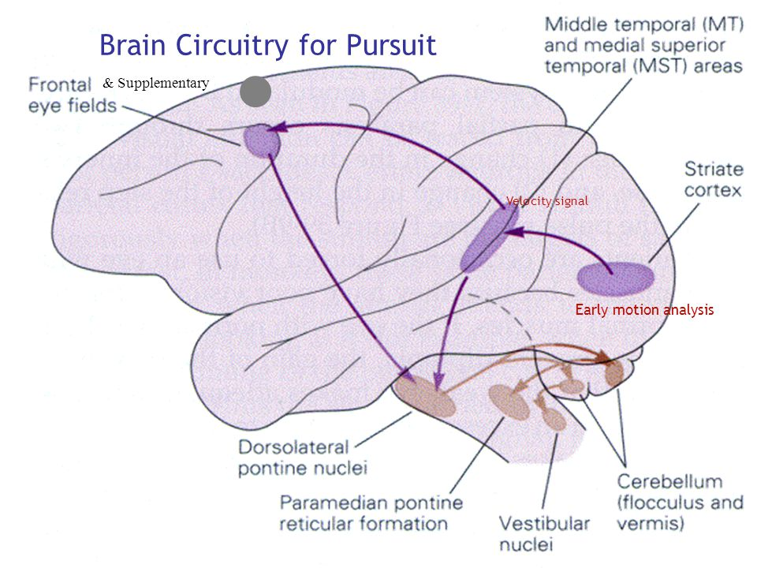
Smooth pursuit movements
elicited by a moving visual target that the eyes follow
voluntarily or under direction
the moving visual target is required to initiate this eye
movement

Slide 46
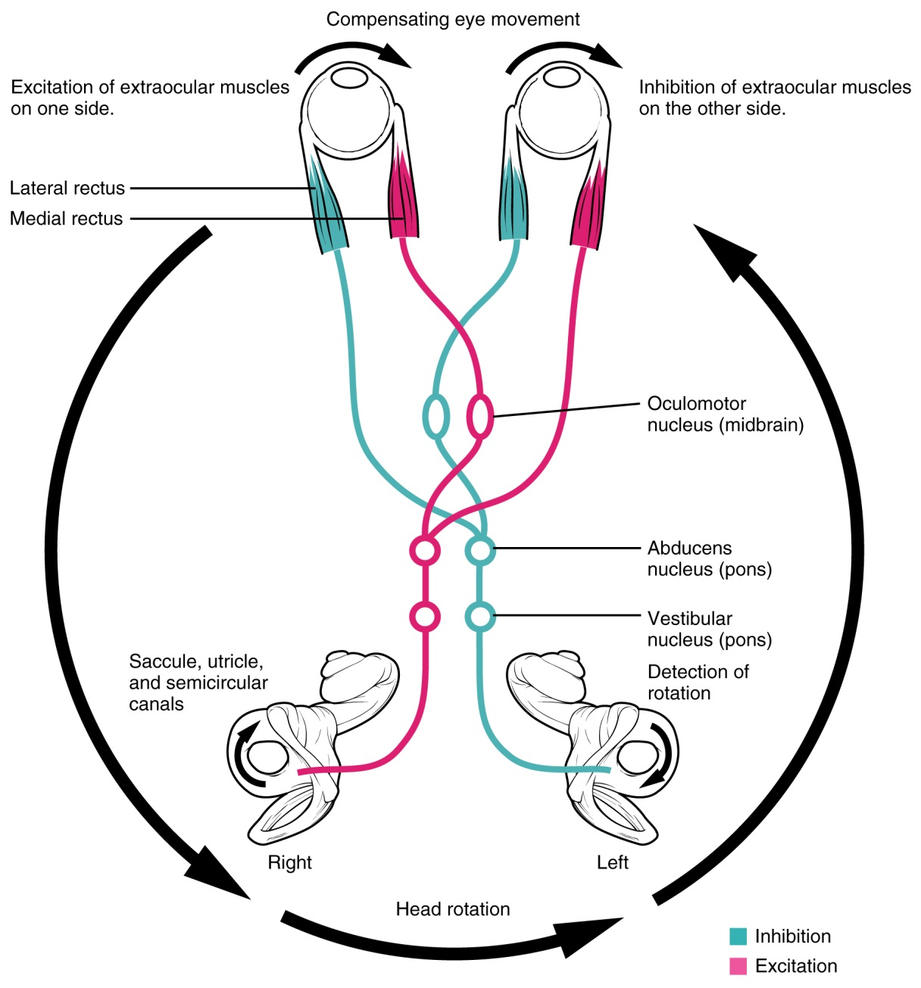
Vestibulo-ocular movements
stabilize the eyes relative
to the external world,
thus compensating for
head movements

Slide 47
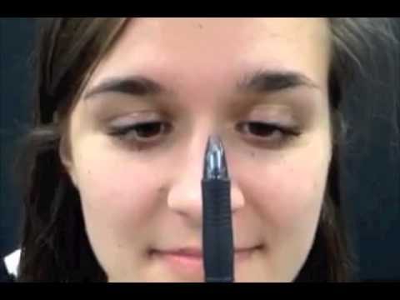
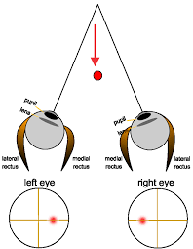
Vergence movements
Near reflex triad: convergence
accommodation of the lens
pupillary constriction

Slide 48
Illustrations were copied from:
Neuroscience Online, the Open-Access Neuroscience
Electronic Textbook
Department of Neurobiology and Anatomy
University of Texas Medical School at Houston

