Slide 1
III.Selected instruments in restorative dentistry

Slide 2
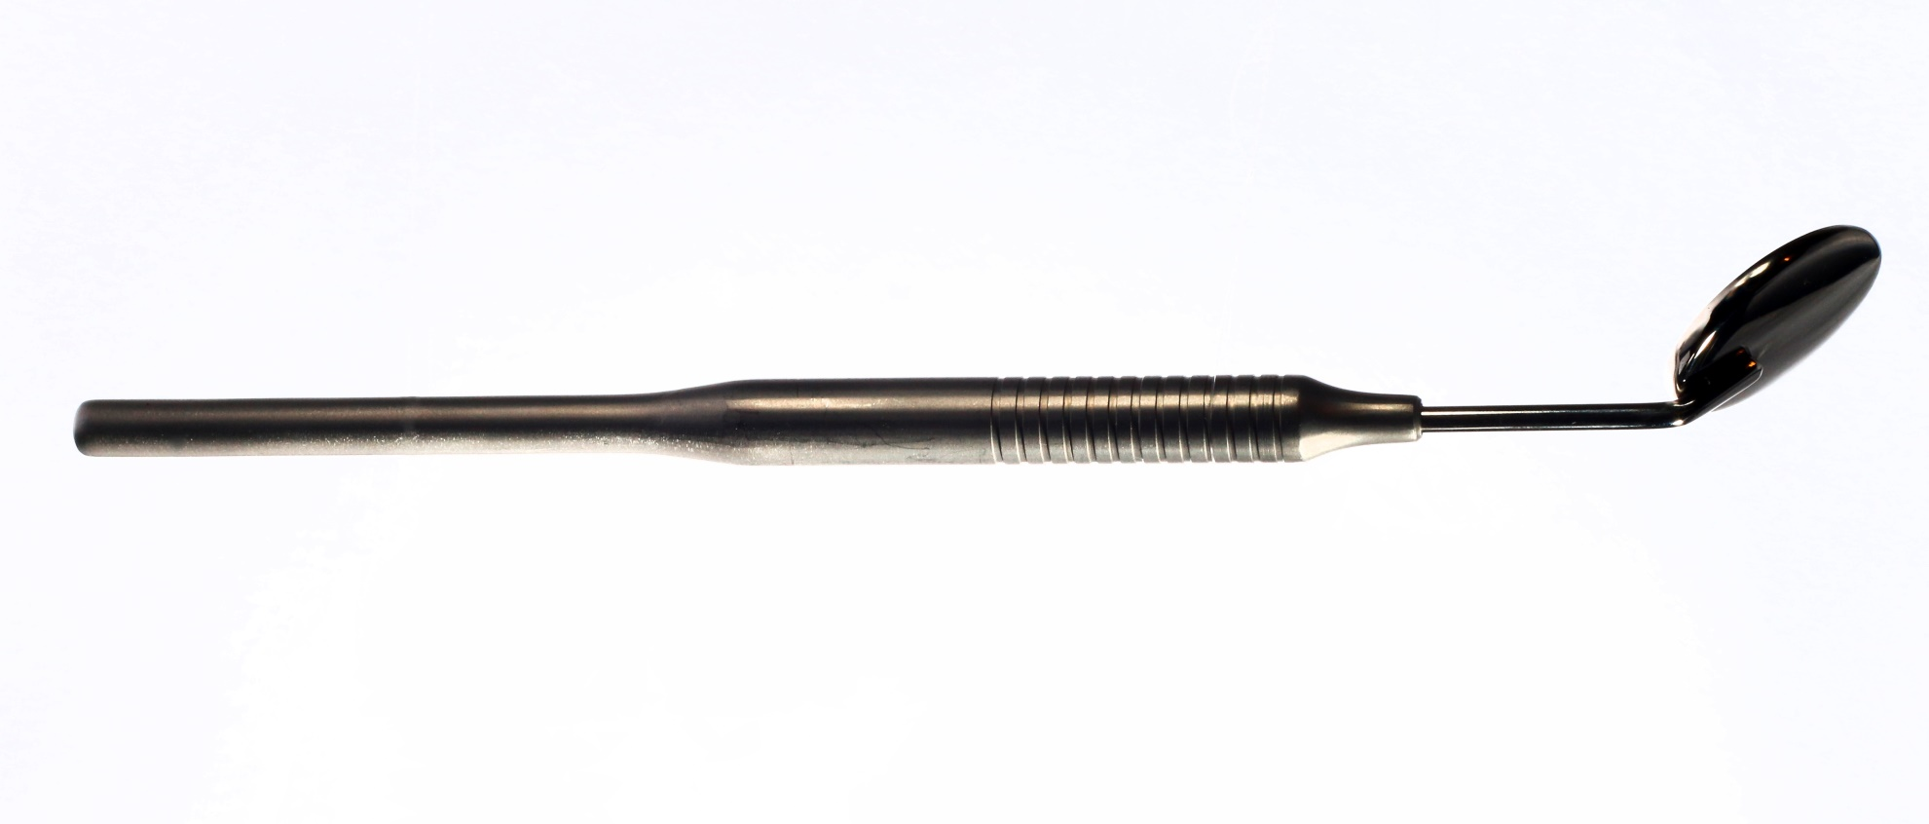
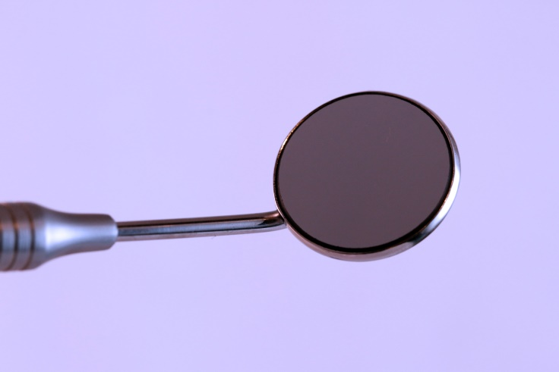
Instruments for investigation
Mirror

Slide 3
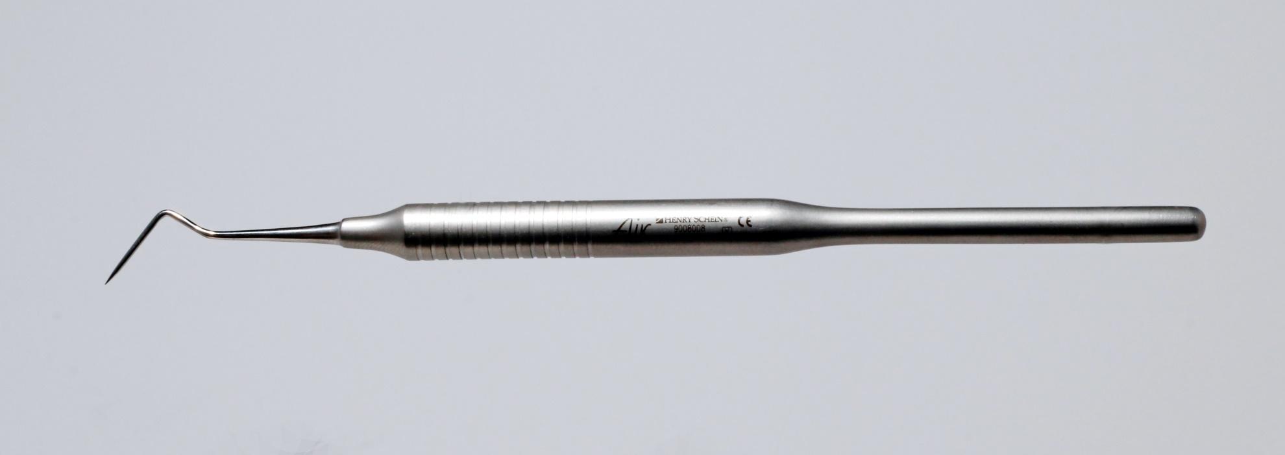
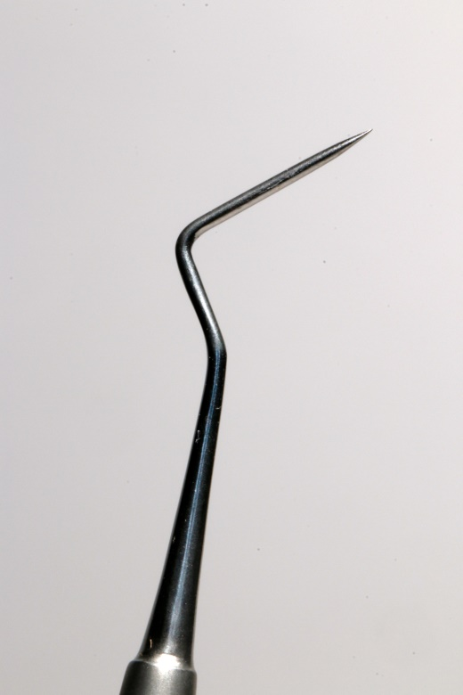
Instruments for investigation
Straight probe

Slide 4
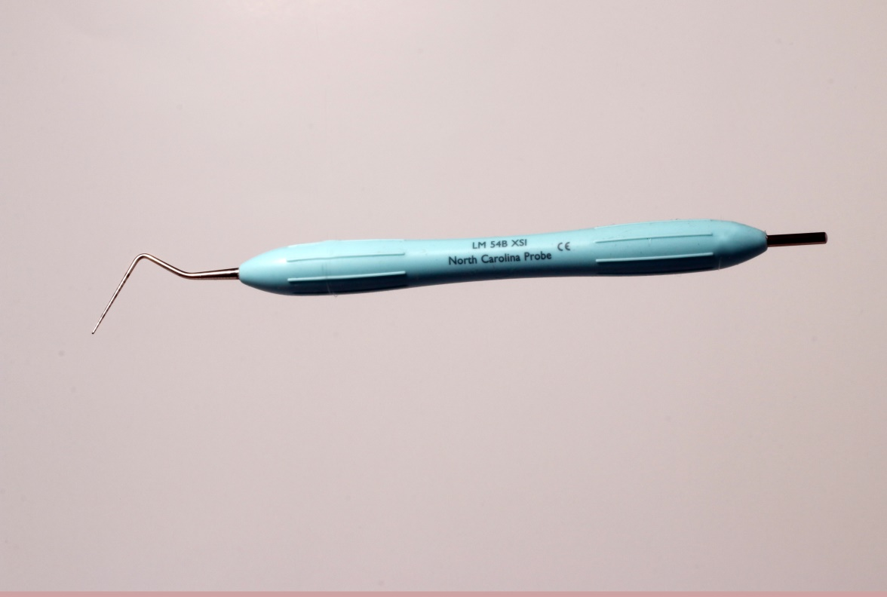
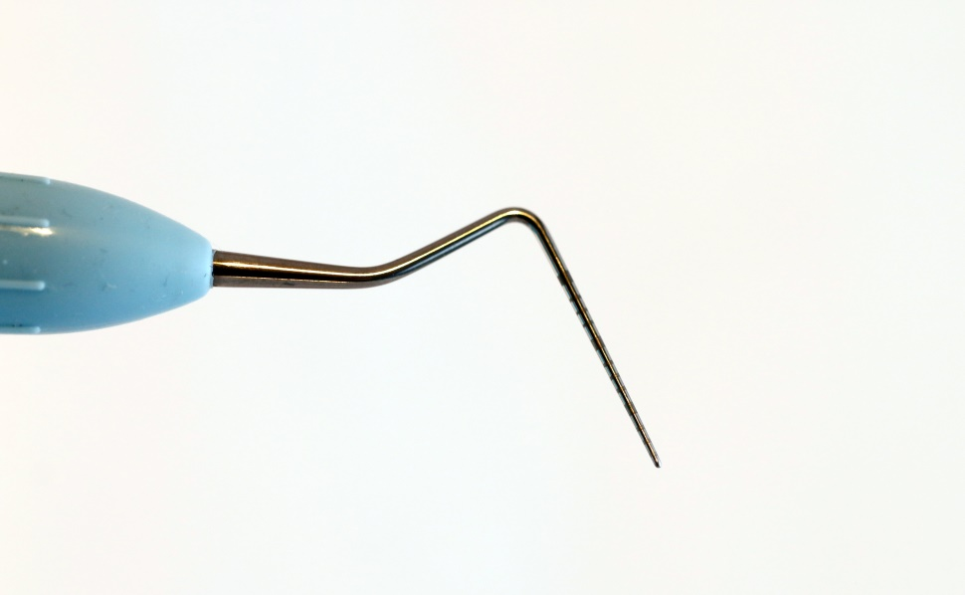
Instruments for investigation
Periodontal probe -calibrated

Slide 5
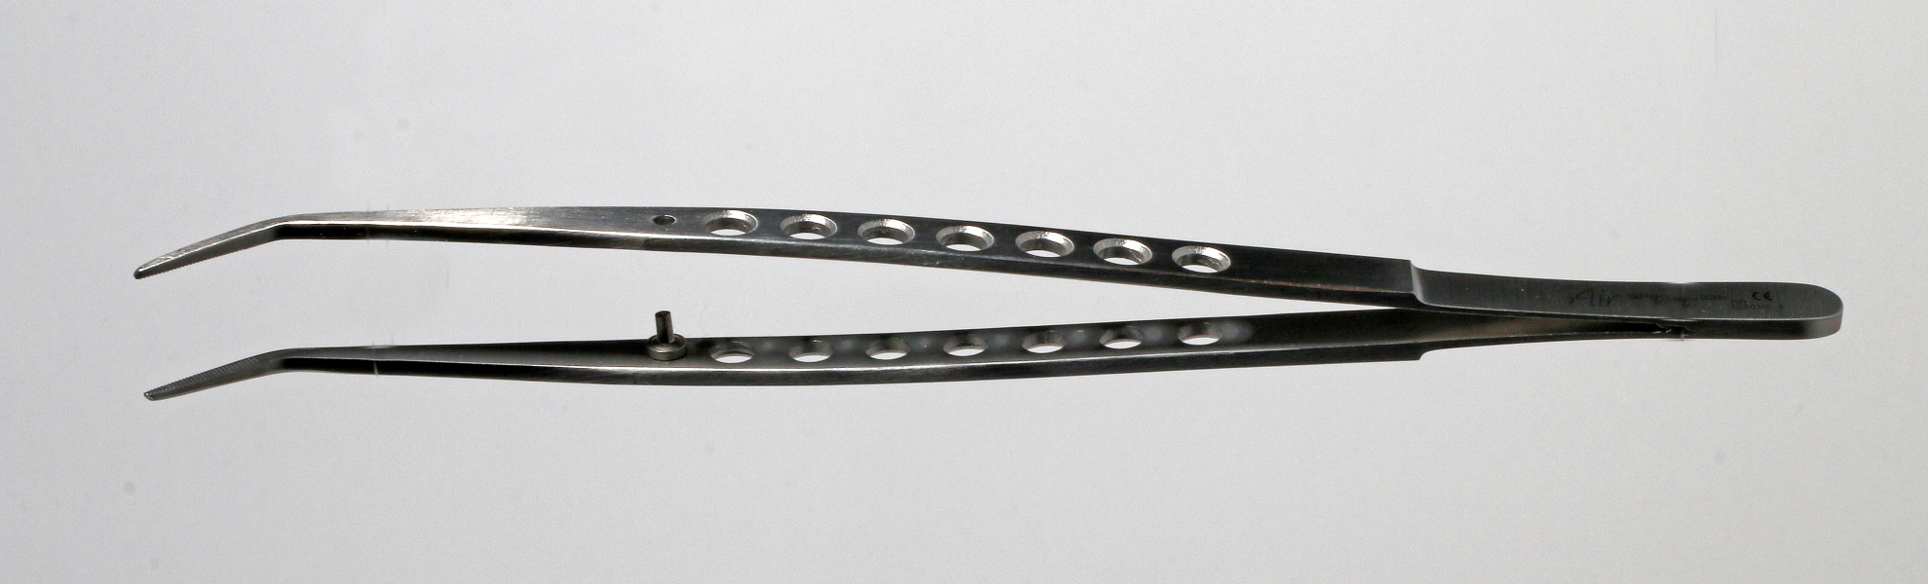
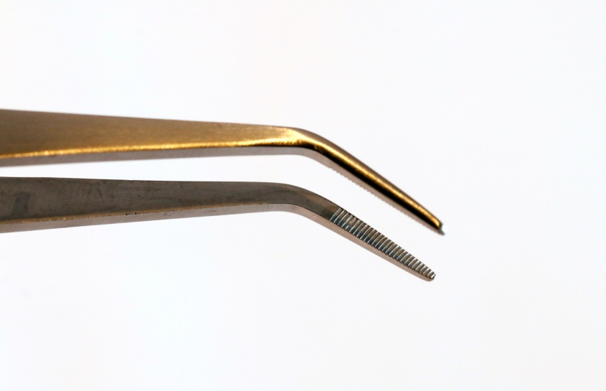
Tweezer

Slide 6
Preparation - techniques
Power driven – mostly rotary
Hand
Less common – laser, ultrasound etc.

Slide 7
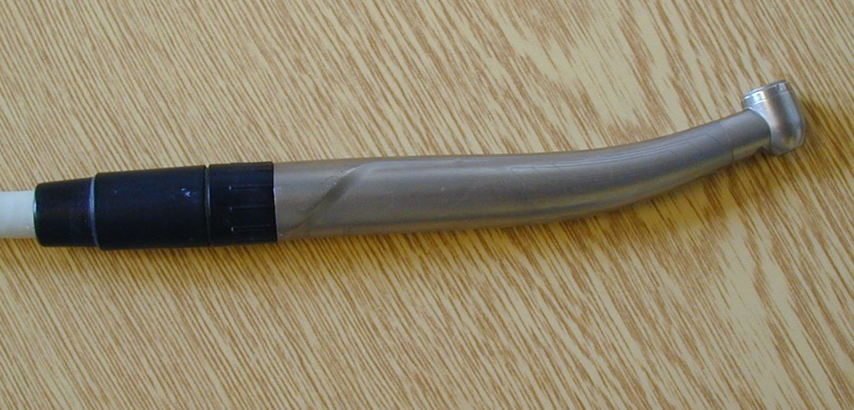
Turbine handpiece
400.000 rpm
Low torque control, vigorous preparation

Slide 8
Electromotor and Air Motor
Electromotor – maximum 40.000 rpm
Air motor – maximum 20.000 rpm
The rpm is possible to modify using hanpieces
with various gear.
High speed
Low speed
Gear 1:1
Oscillation
(rotation is blocked)

Slide 9
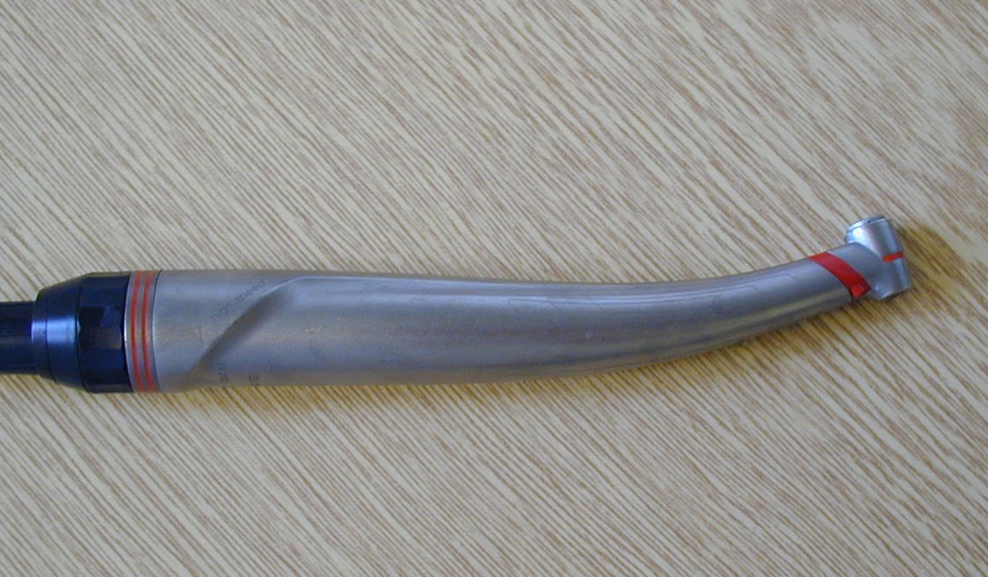
High speed handpiece
Red coded. Better control in comparison with the turbine handpiece

Slide 10
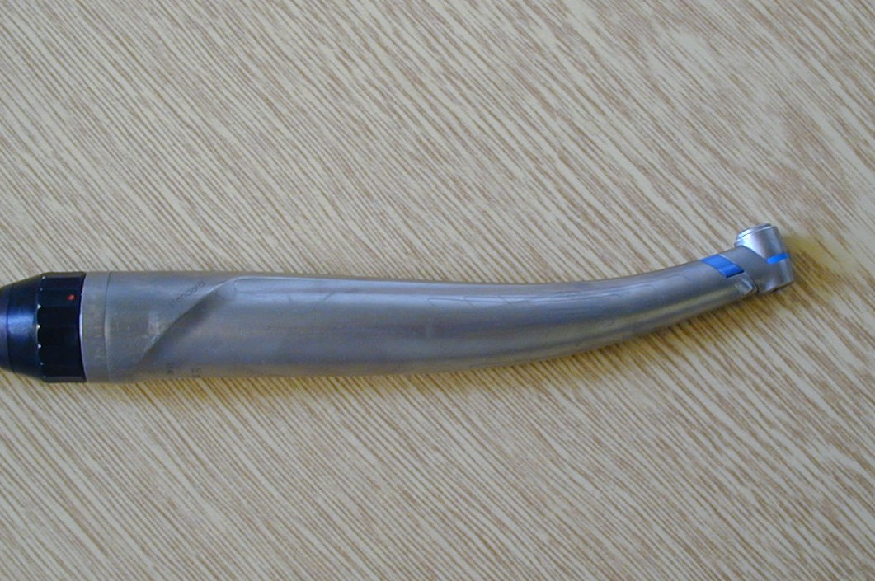
Gear 1:1
Blue coded. Preparation in dentin recommended

Slide 11
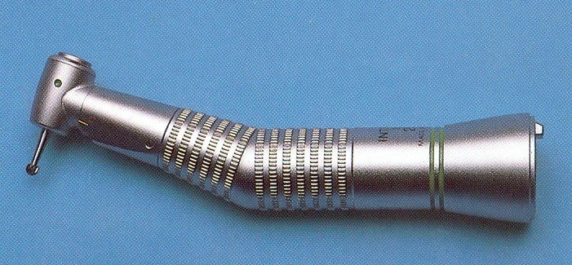
Low speed handpiece
Suitable for slow worh e.g. excavation of carious dentin

Slide 12
Special handpieces
Handpiece for compaction of amalgam
EWA system ( instrument does not rotate, if oscillate only)
Handpieces for endodontology and implantology

Slide 13
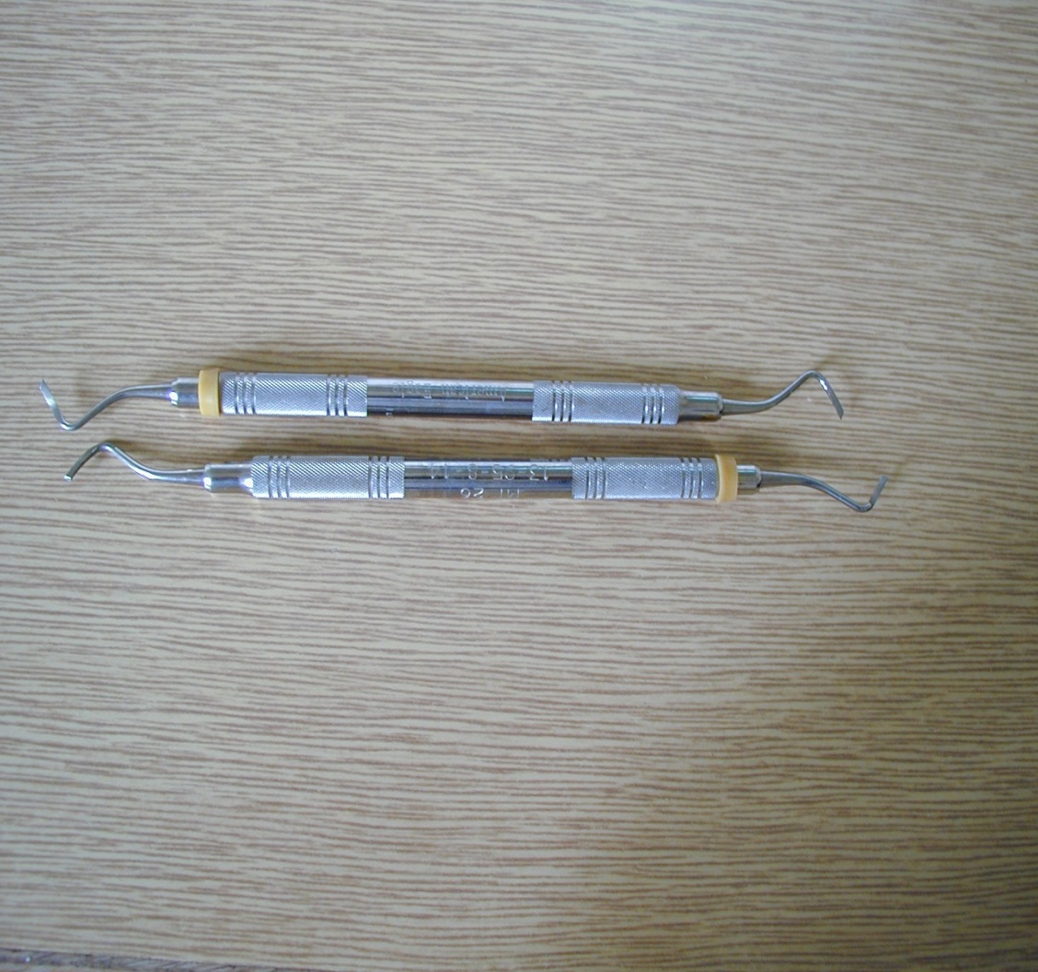
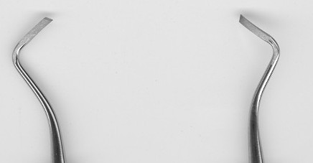
Hand instruments
Chisels
Fopr finishing of gingival wall in class II

Slide 14
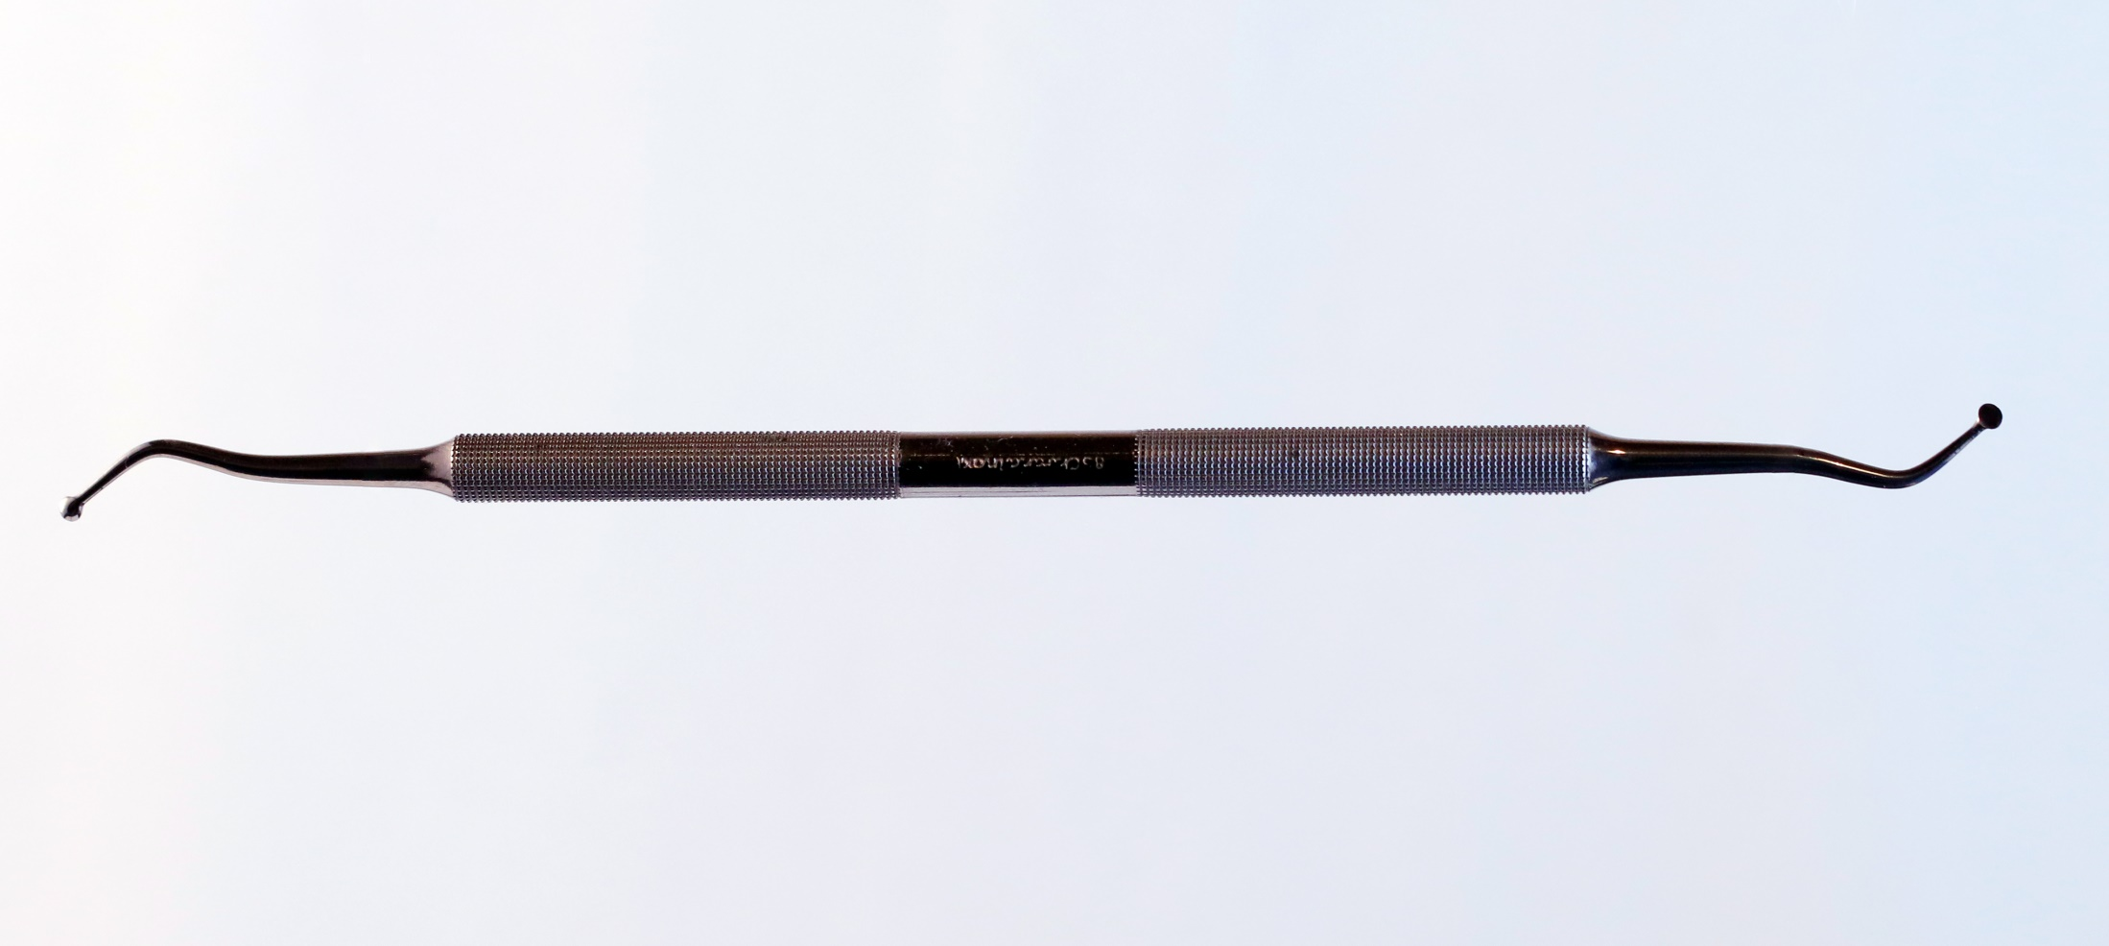
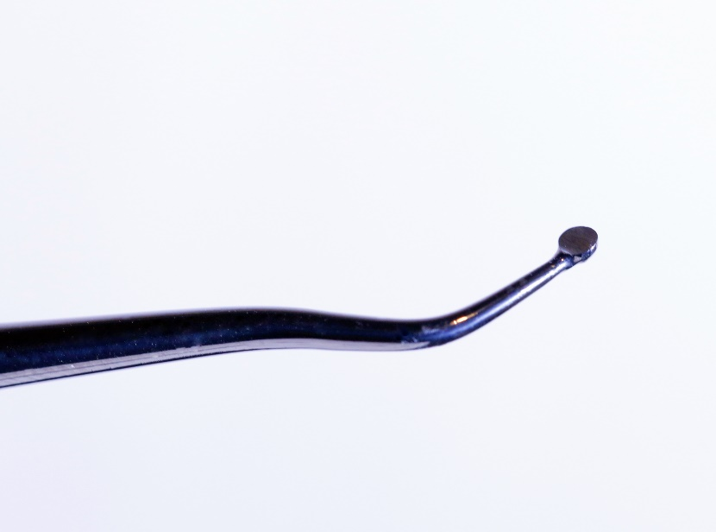
Excavator
Ostrý, lžičce podobný nástroj k odstranění kazivého dentinu.

Slide 15
Rotary instruments
Burs and diamonds.
ISO norm 6360
5 figures A – E
A- material (Stainless steel, tungsten -carbide,diamond)
B,C size and kind of the handpiece (straight handpiece, contraangle, turbine)
D shape of the working part (ball, pear,fissure)
E further characterization ( blades or grit)

Slide 16
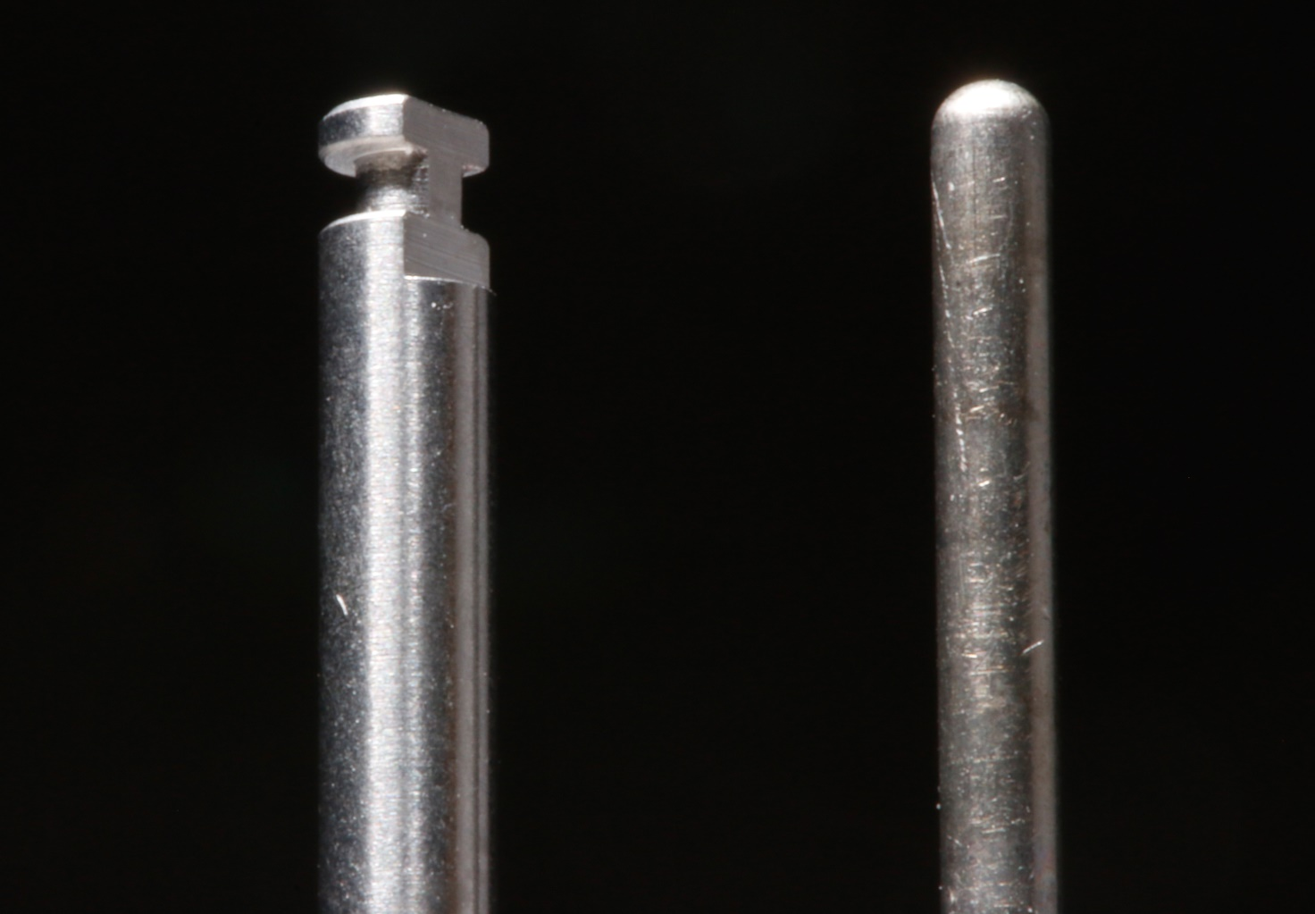
Shape of the shank
Contra angle handpiece Turbine handpiece

Slide 17
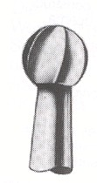

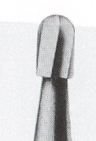

Inverted cone, pear formed bur, fissure bur, round (ball) bur
Notes:
Konu
17

Slide 18
Diamonds
Blue - standard (90 – 120 μm) ISO 524
Universal use

Slide 19
Diamonds
Black extra coarse (150 – 180 μm) ISO 544 – No for cavities, e.g. for cutting old crowns

Slide 20
Diamonds
Green - coarse (125 – 150 μm) ISO 534,
For special purposism no for cavities

Slide 21
Diamonds
Red- fine ( 20 – 40 μm) ISO 514 – finishinf of preparation – smoothen of beveling

Slide 22
Diamonds
Yellow – extra fine (12 – 22μm) ISO 504,
Finishing of composite fillings

Slide 23
Diamonds
White –ultra fine (6-12 μm) ISO 494 –
Polishing of composite fillings

Slide 24
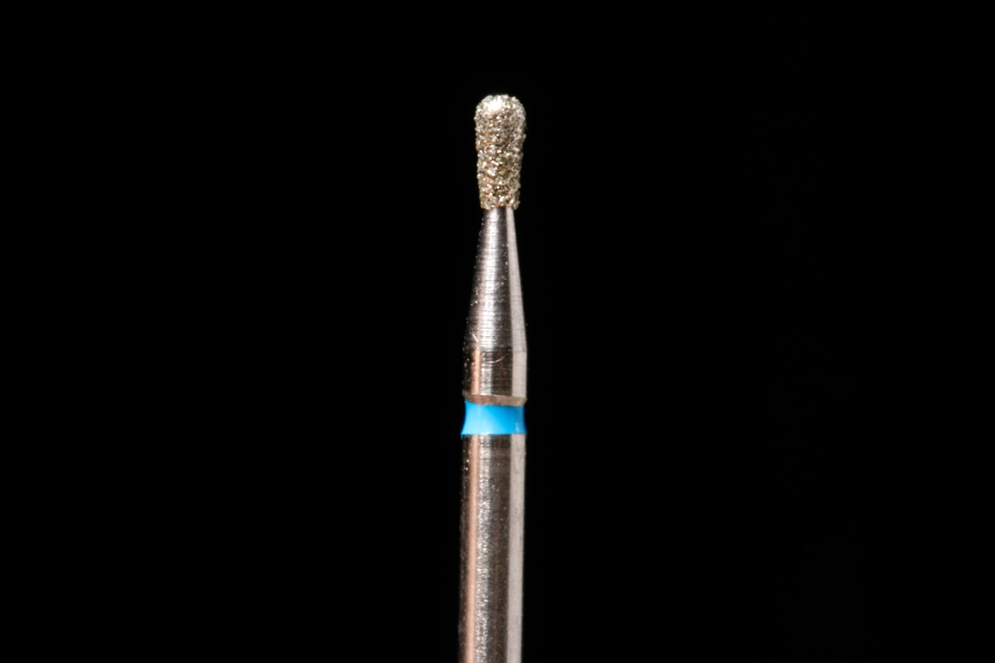
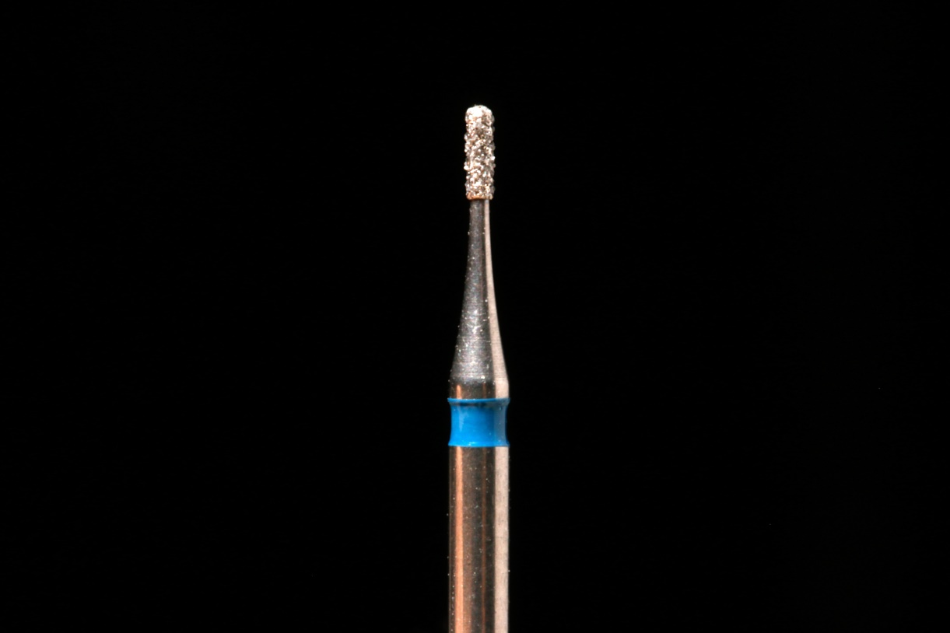
Preparation instruments for cavosurface margin

Slide 25
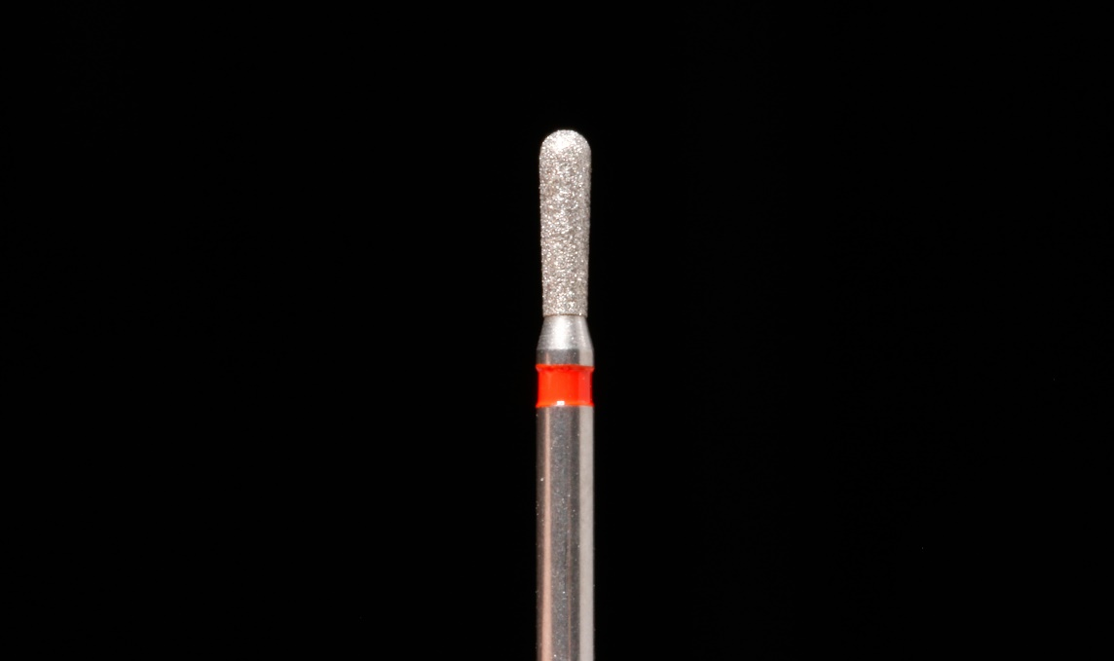
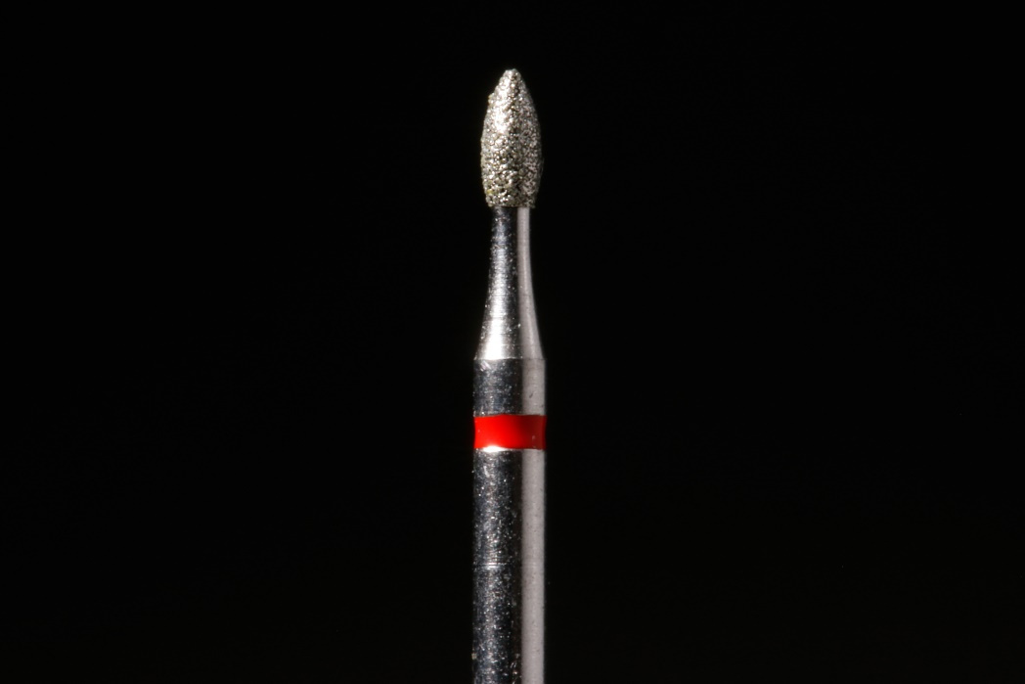
Preparation instruments for finishing of borders

Slide 26
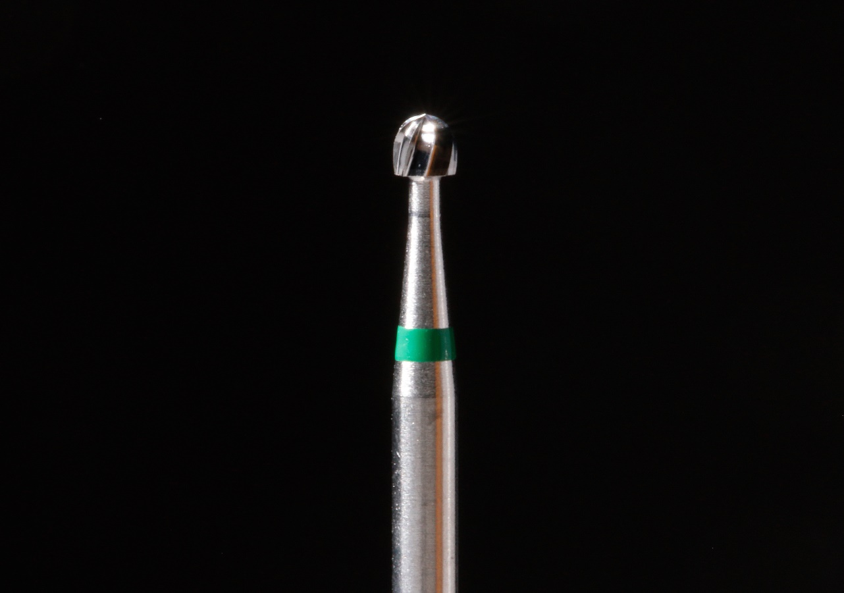
Preparation instruments
Bur for excavation of carious dentin

Slide 27
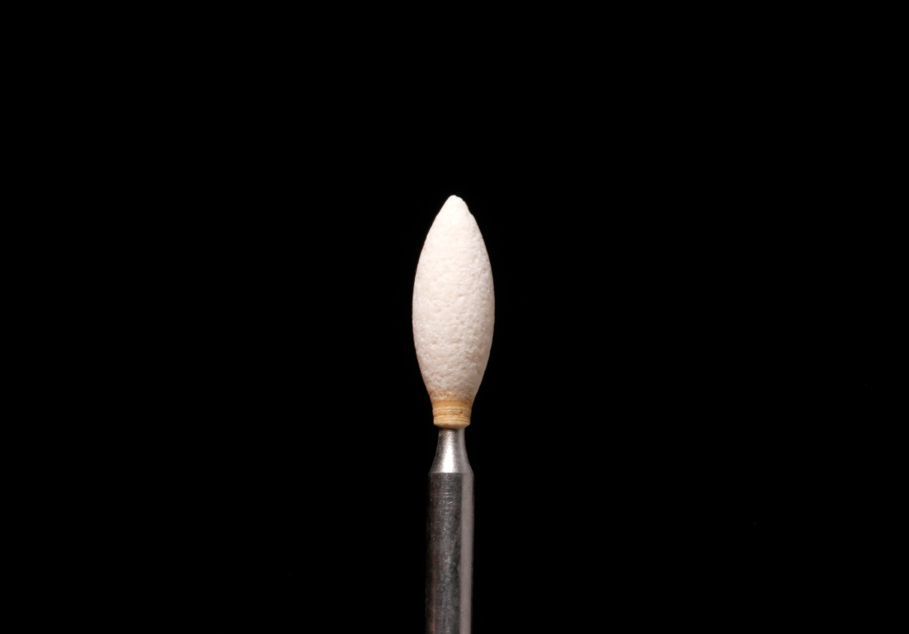
Rotary instruments for polishing of fillings – Arkansas stone

Slide 28
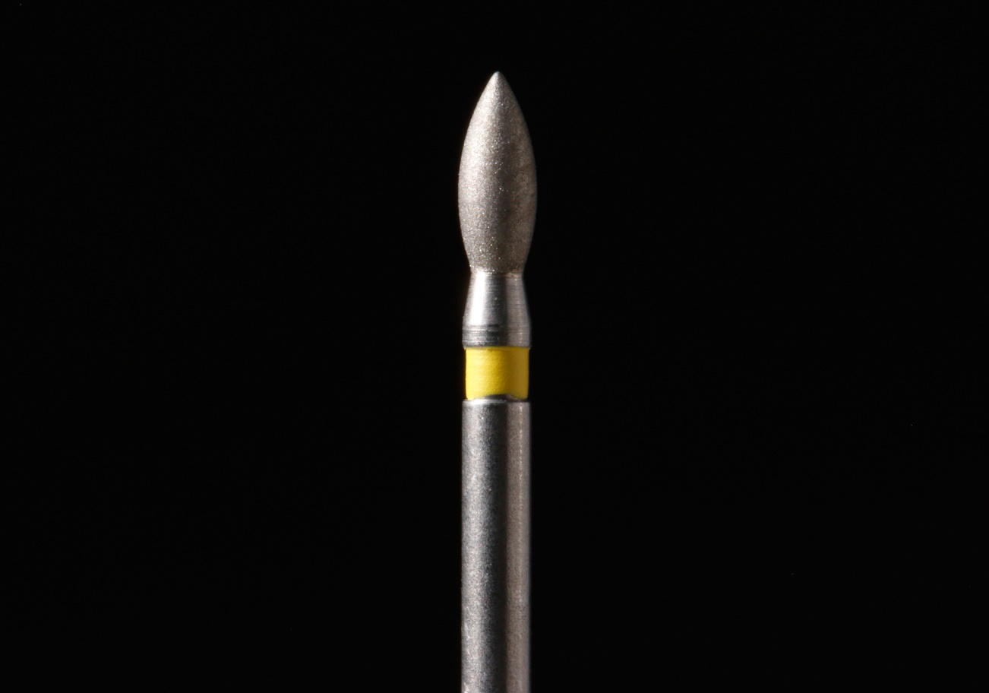
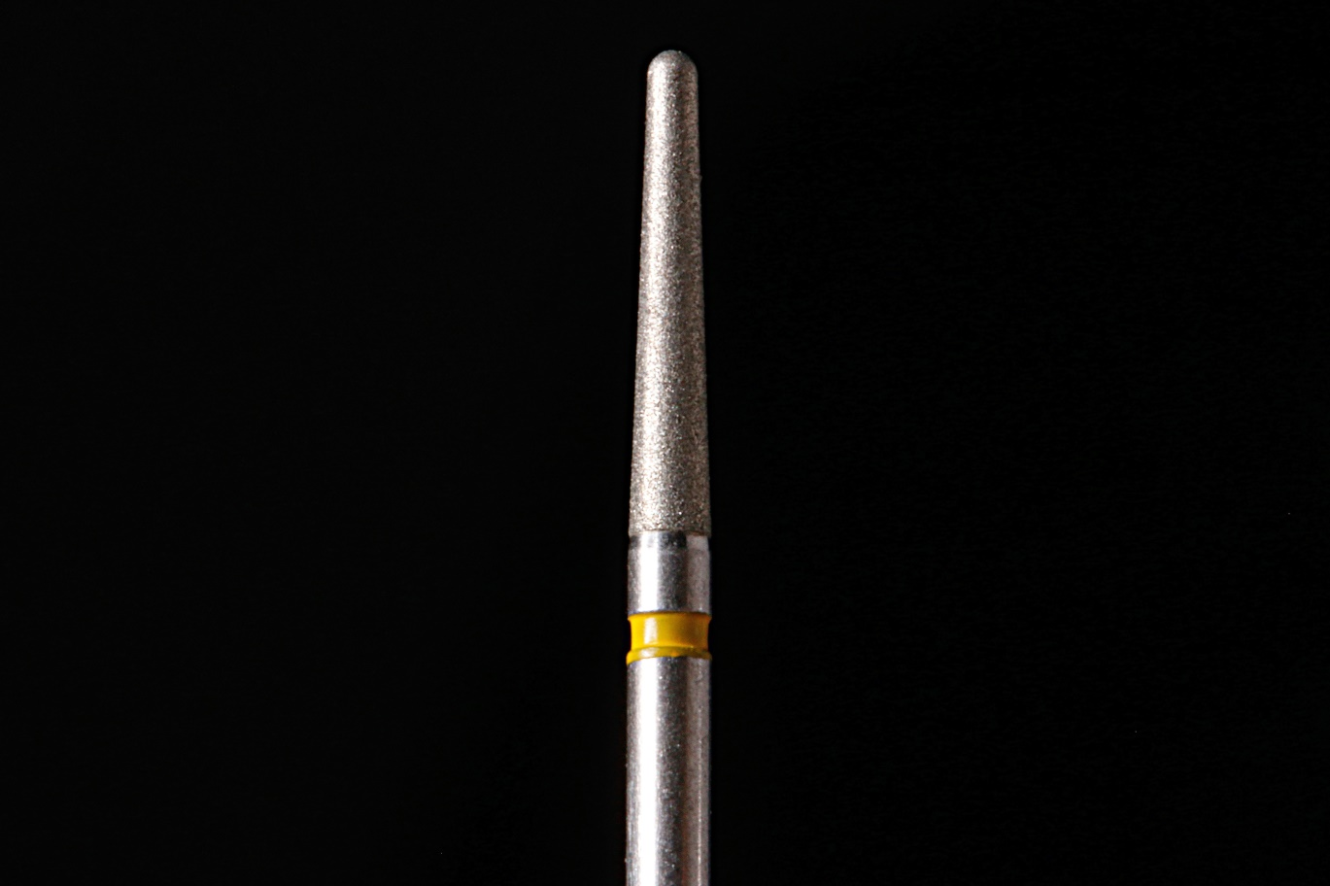
Rotary instruments for finishing extra fine diamonds

Slide 29
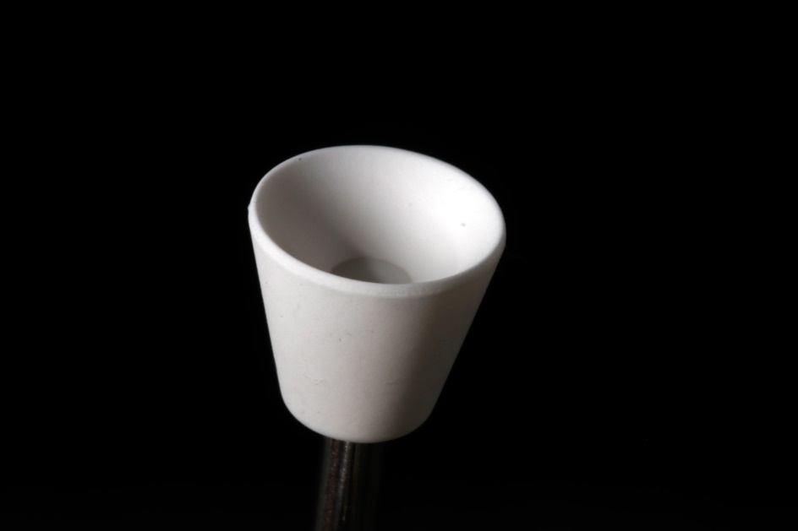
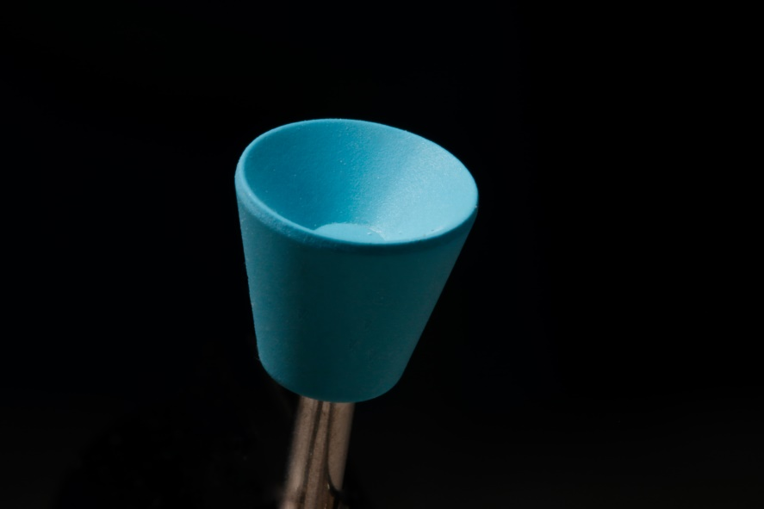
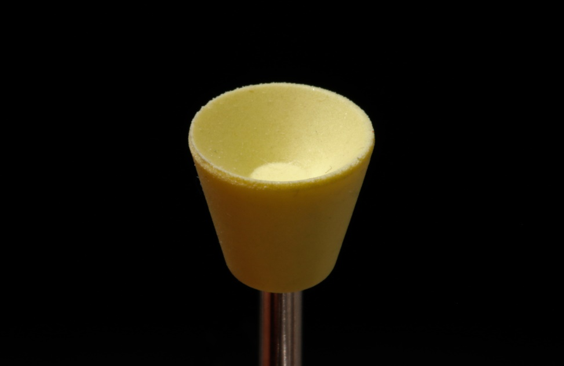
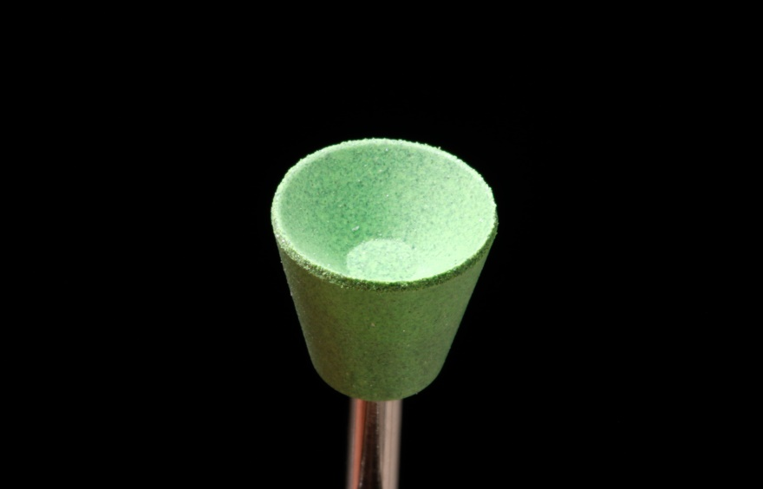
Rubber rotary instruments – for polishing

Slide 30
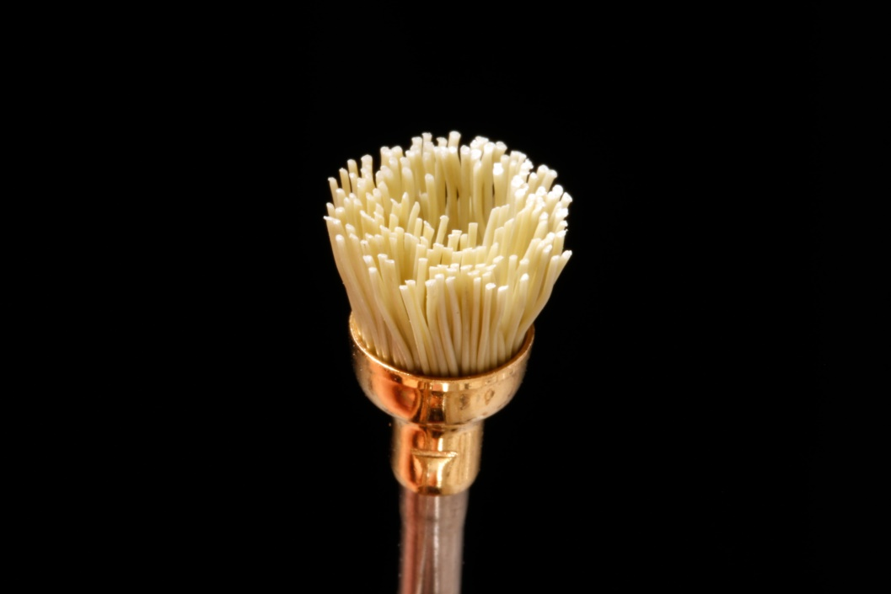
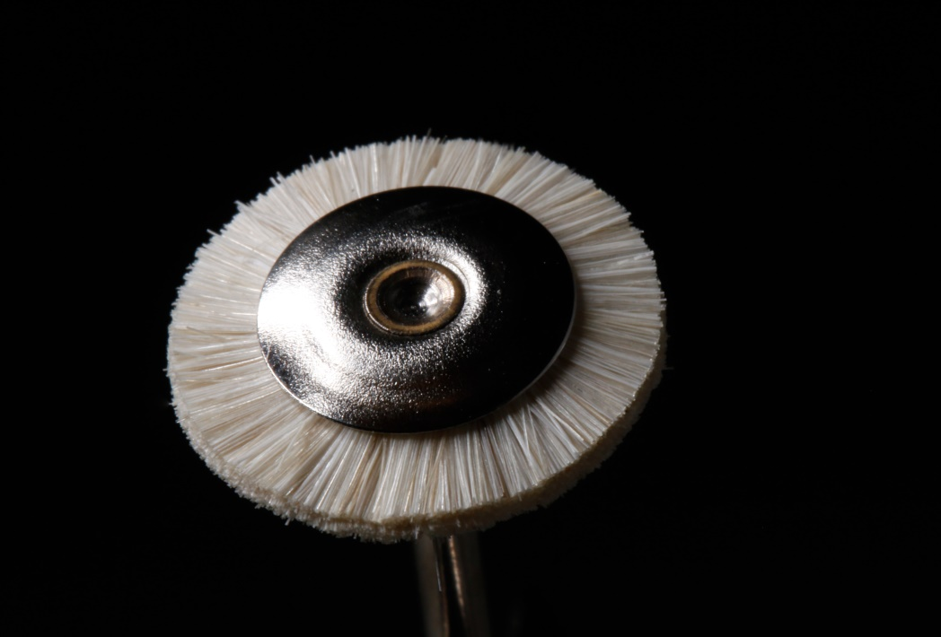
Nástroje k úpravě výplní
Rotační kartáčky

Slide 31
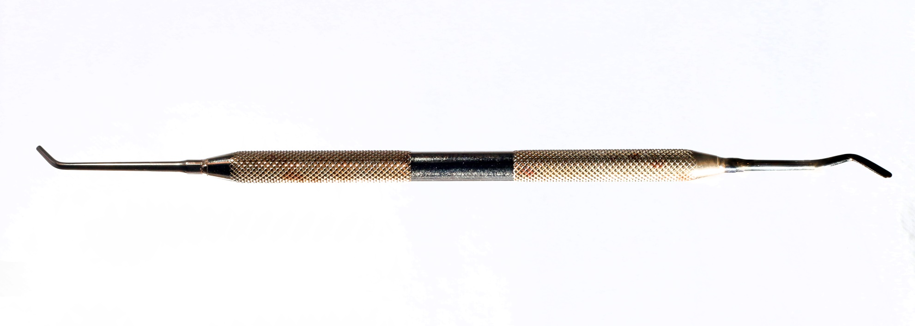
Filling instruments
Spatula + condensor

Slide 32
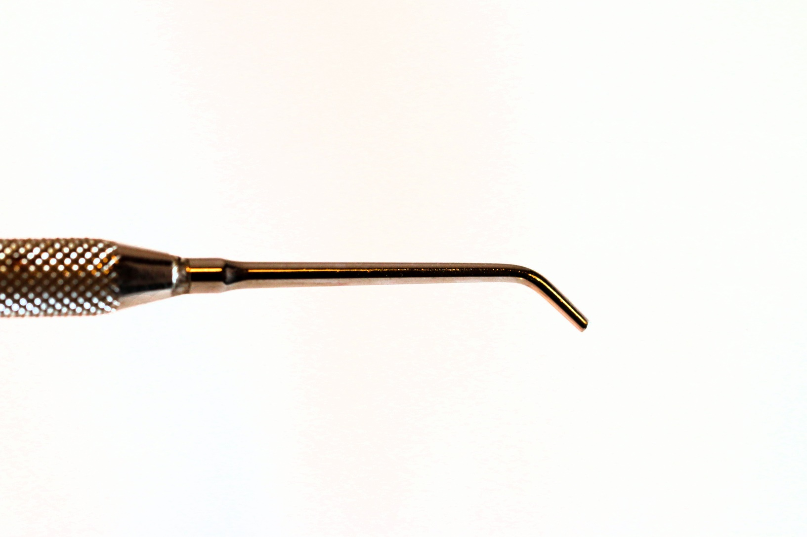
Detail of a condensor

Slide 33
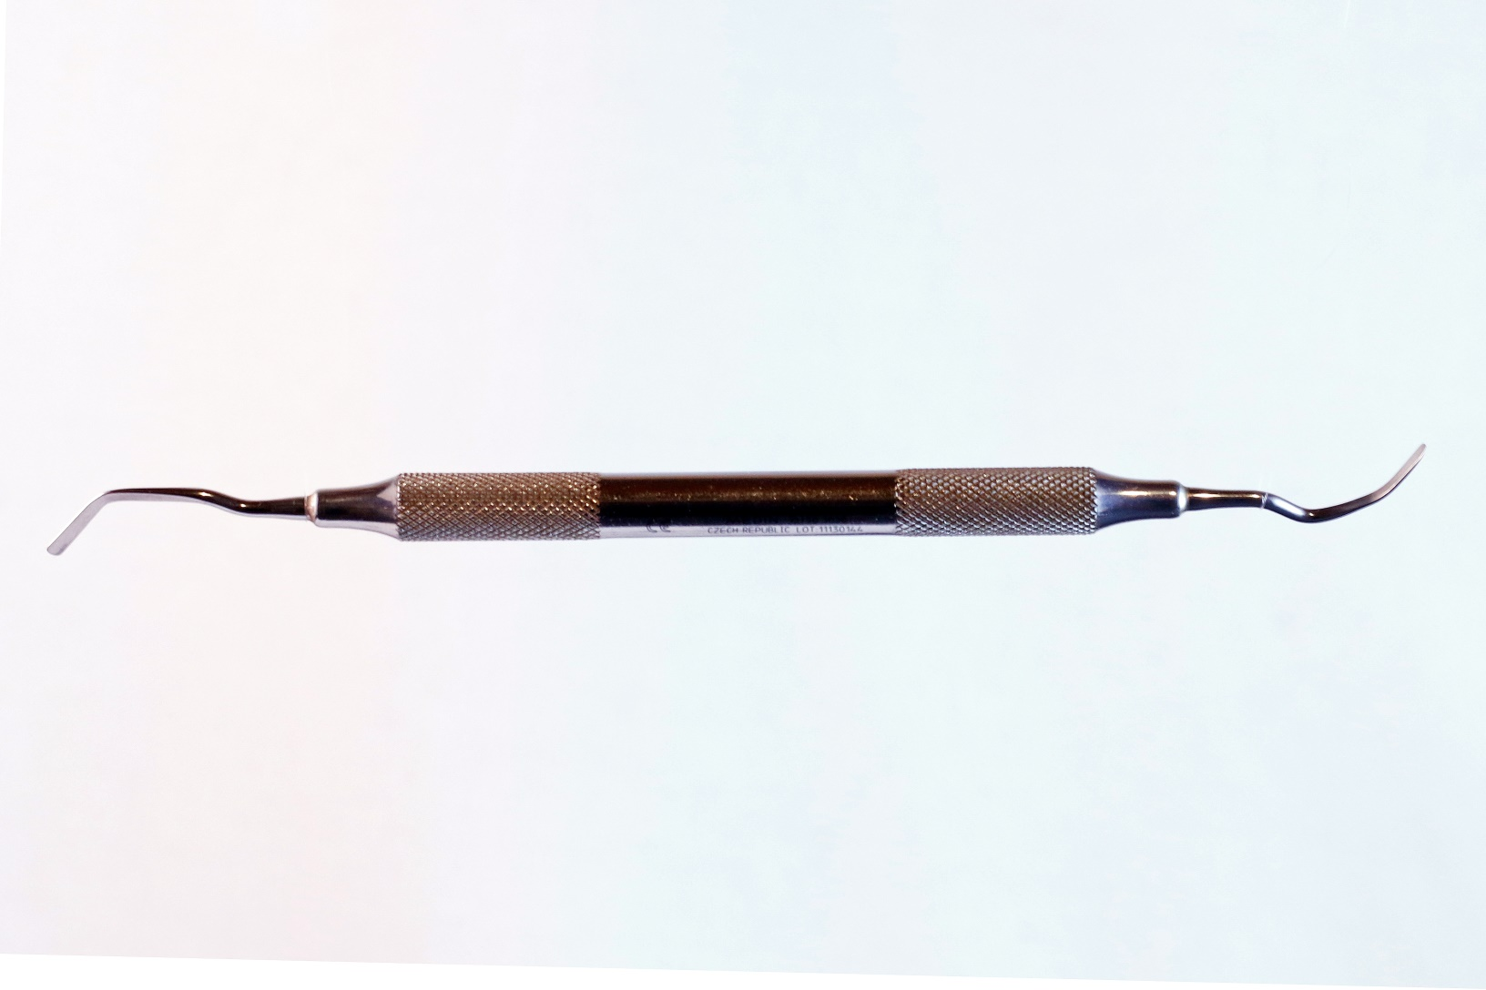
Spatula (3 angled)

Slide 34
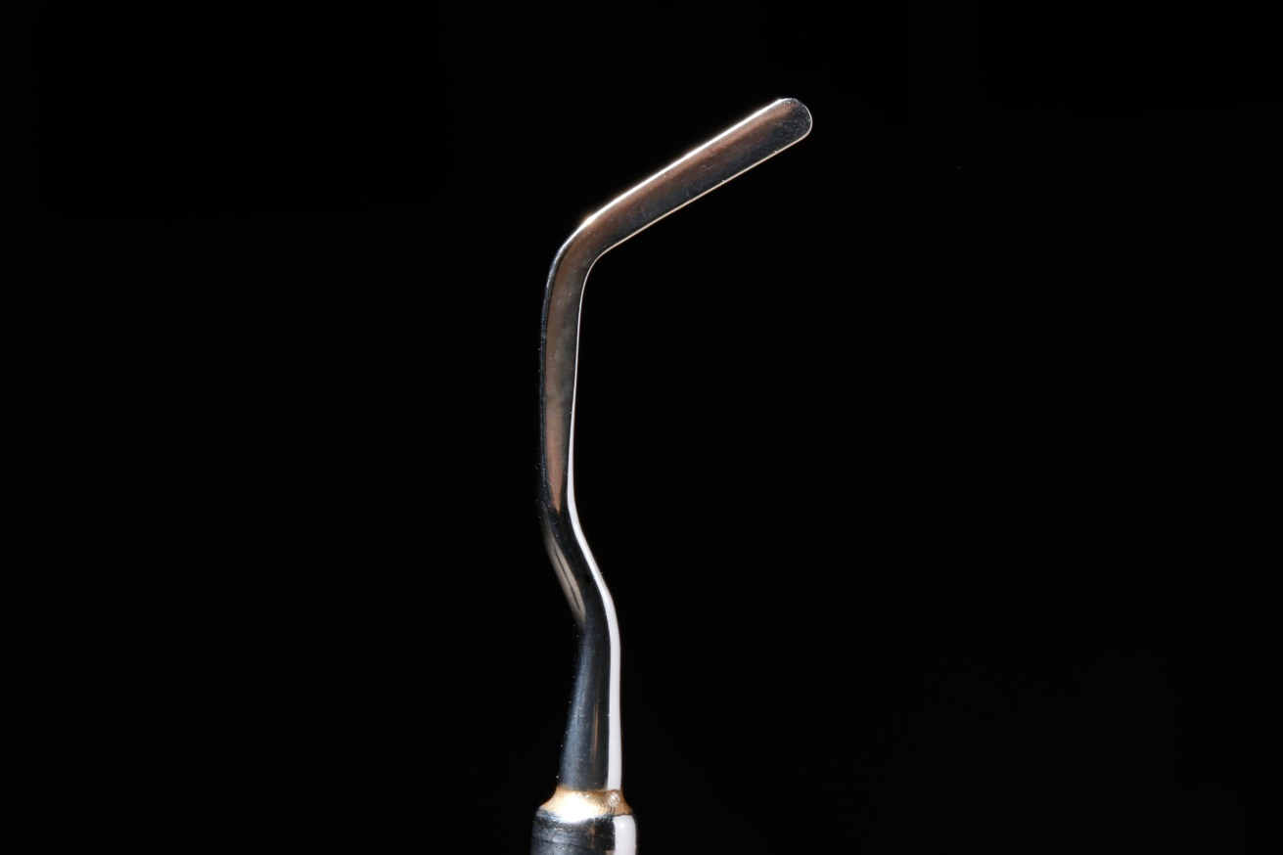
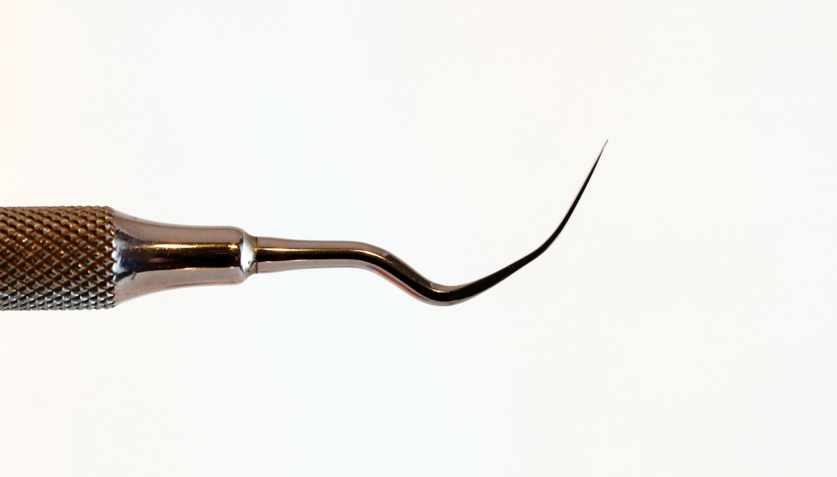
Spatula in detailb(3 angled)

Slide 35
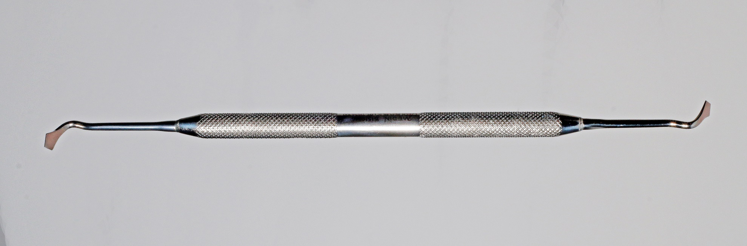
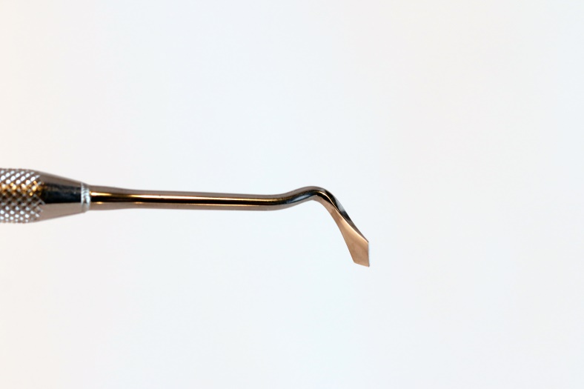
Frahm

Slide 36
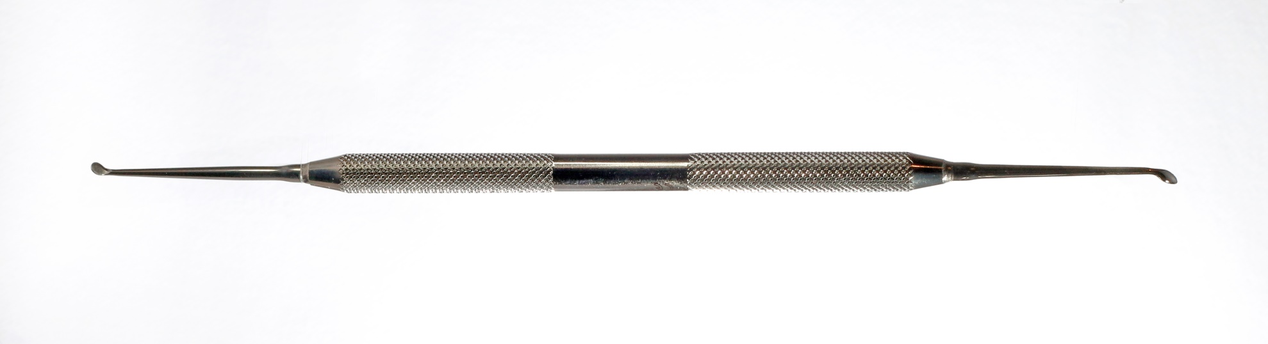
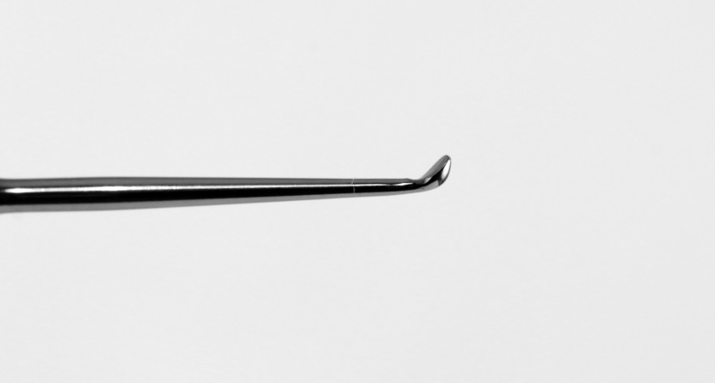
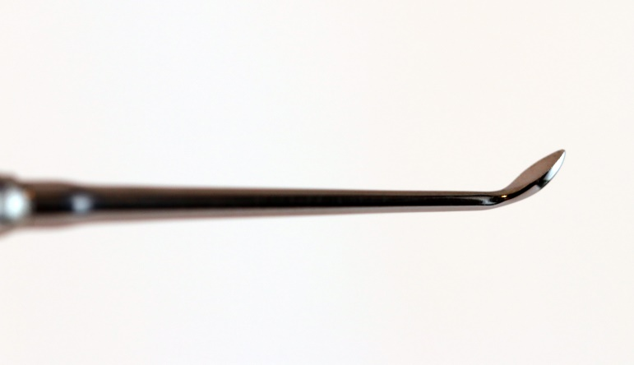
Discoid-cleoid

Slide 37
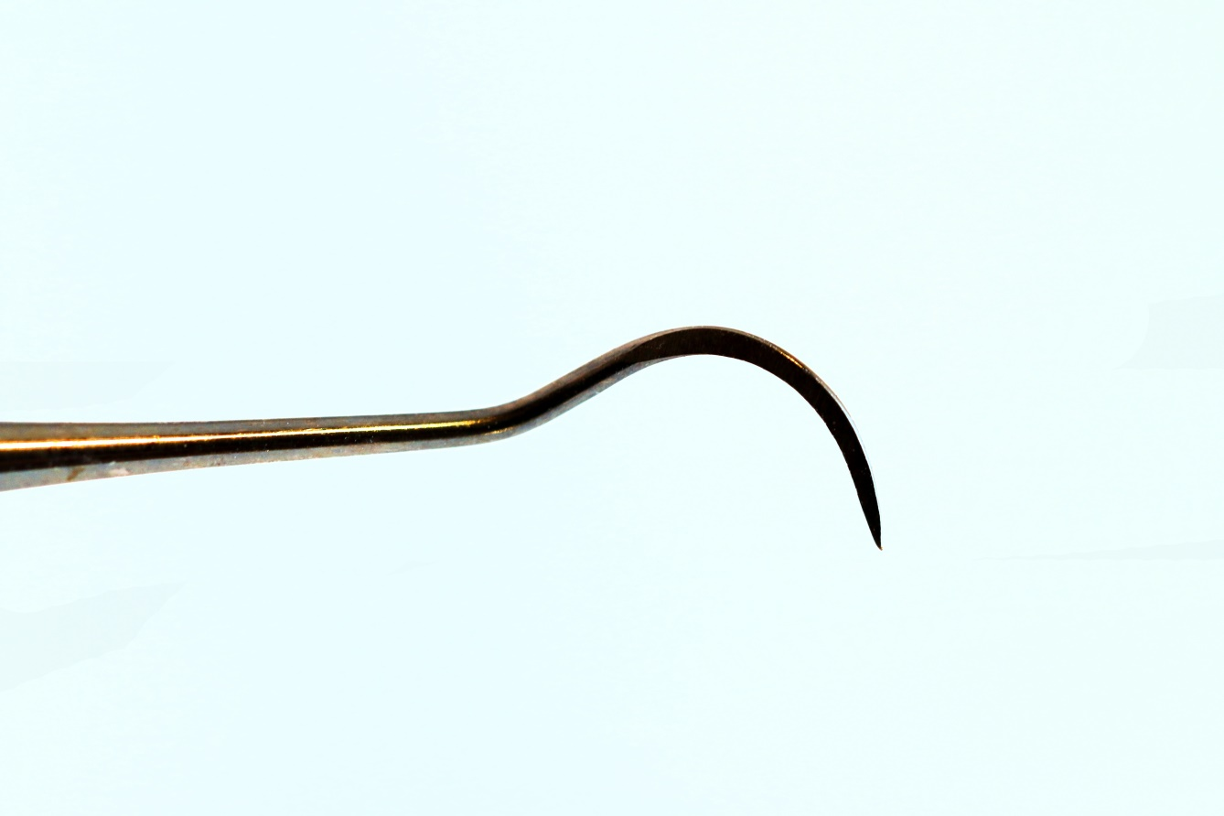
Wiland - carver

Slide 38
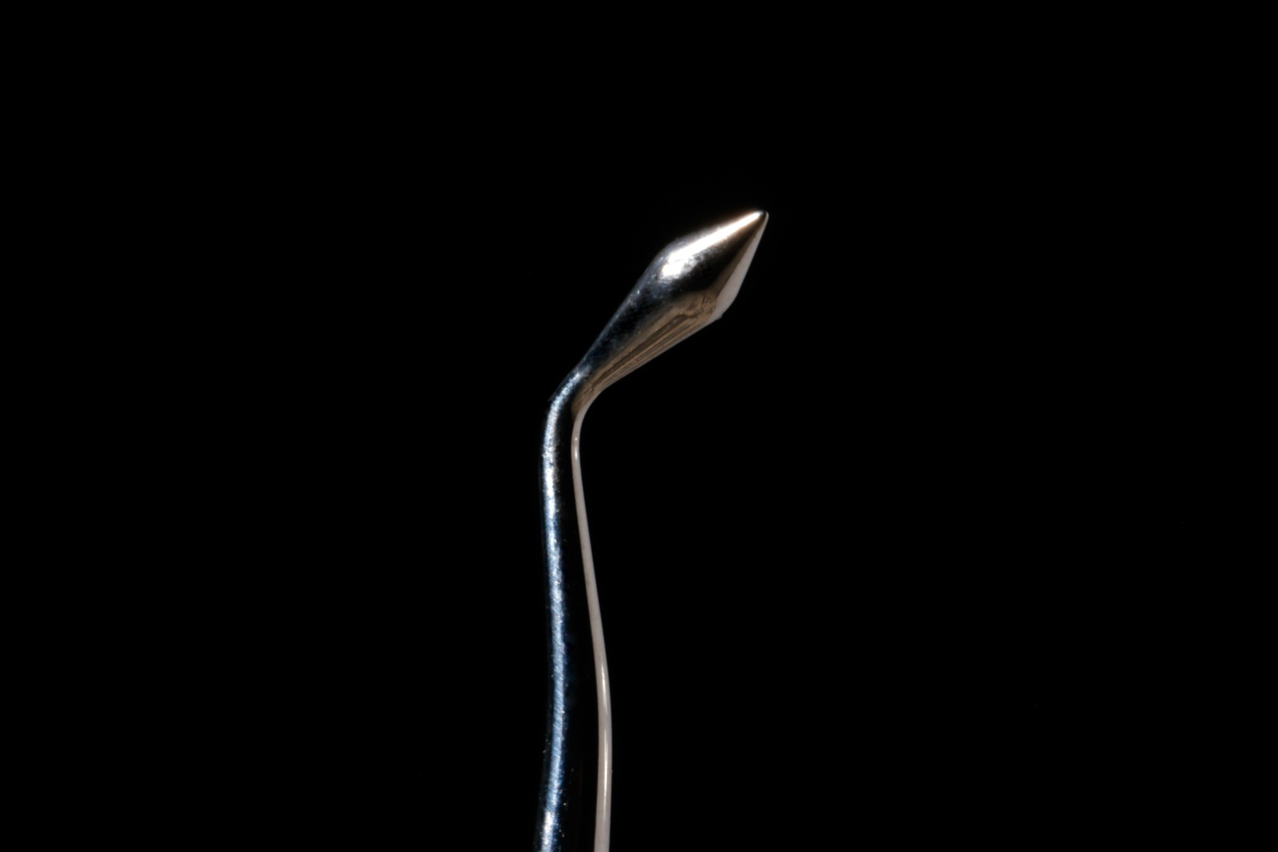
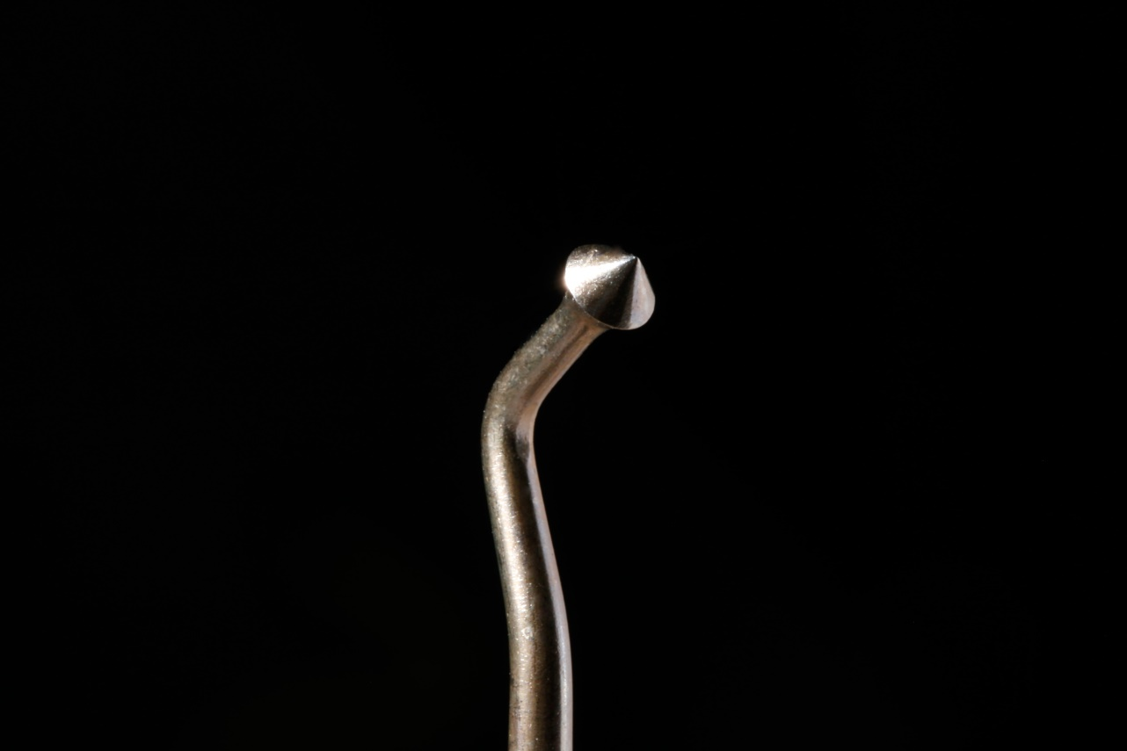
Burnishers

Slide 39
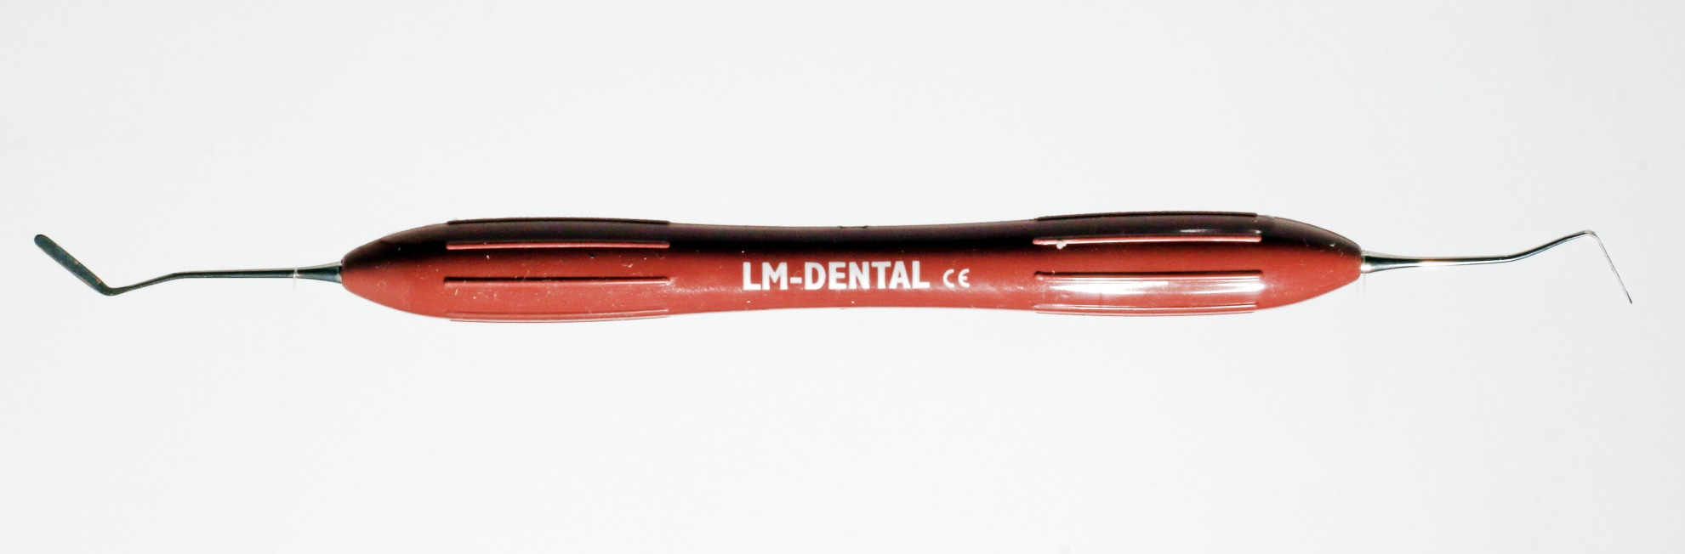
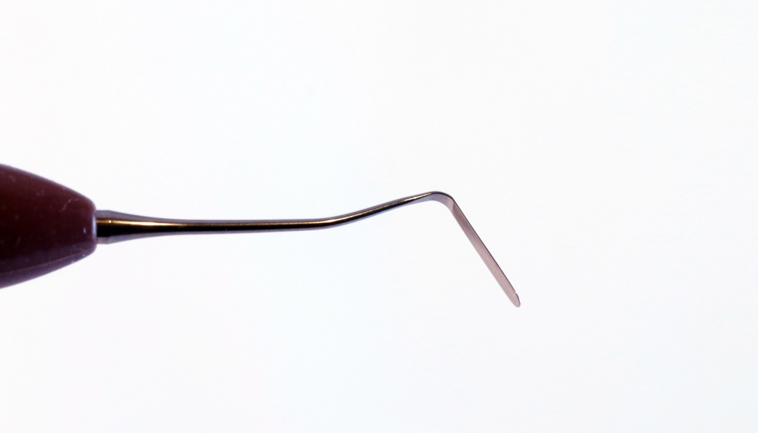
Instrument for composite fillings

Slide 40
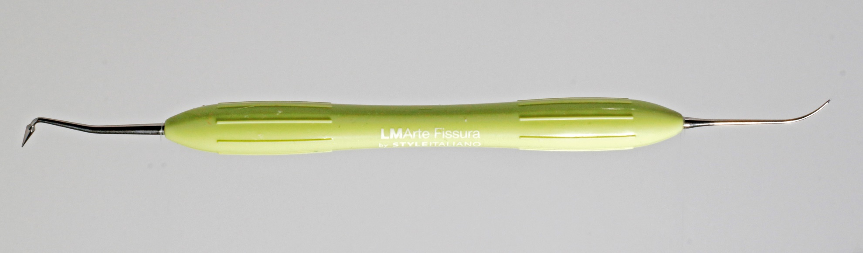
Instrument for composite fillings

Slide 41
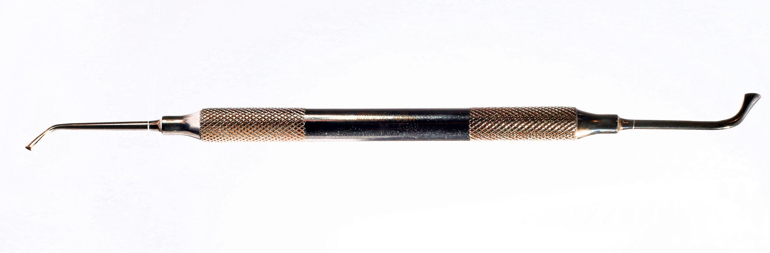

Condensor

