Slide 1
Onemocnění bělimy
Synek S.
KOO

Slide 2
Anatomické poznámky
Episkléra
Skléra
Lamina fusca

Slide 3
Zánětlivá onemocnění skléry
Episkleritis, ložiskové nebo difúzní, často bolestivé na tlak
Skleritis, překrvení – hluboká injekce, bolestivé, u zadní skleritidy pak protruze bulbu, bolesti při pohybech oka
Sklerokeratitidy- zánět přechází na rohovku- herpes viry, tbc, revmatismus, lepra, onchocerkóza

Slide 4
EPISCLERITIS AND SCLERITIS
1. Episcleritis
Simple
Nodular
2. Anterior scleritis
Non-necrotizing diffuse
Non-necrotizing nodular
Necrotizing with inflammation
Necrotizing without inflammation
( scleromalacia perforans )
3. Posterior scleritis

Slide 5
Etiologie
Herpes zoster
Choroby vaziva: rheumatiodní arthritida, lupus erythematodes, polyarteritis nodosa, Wegner` s granulomatosis
Sarcoidosis, tuberculosis

Slide 6
Léčba
Nesteroidní antiflogistika- indomethacin 100 mg for 4 days, celkkově prednisolone 60 / 80 mg, imunosupresiva
Specifická léčba antituberculostatika

Slide 7
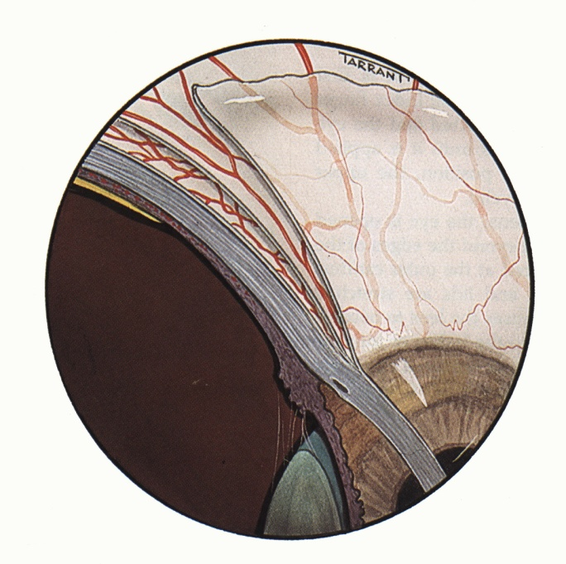
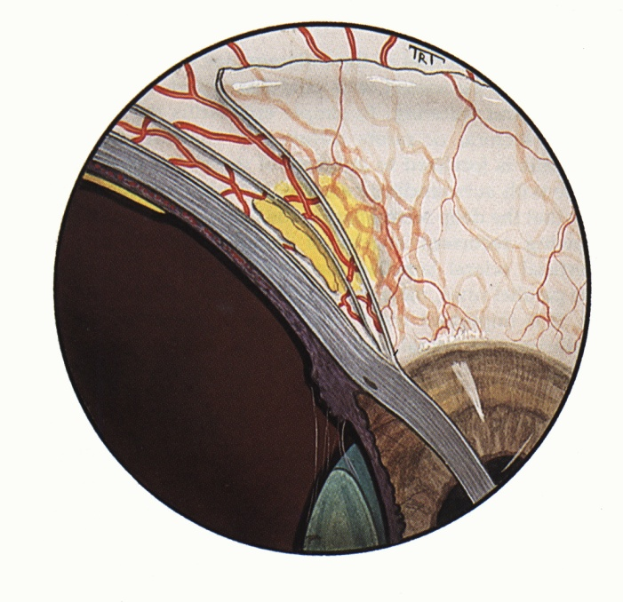
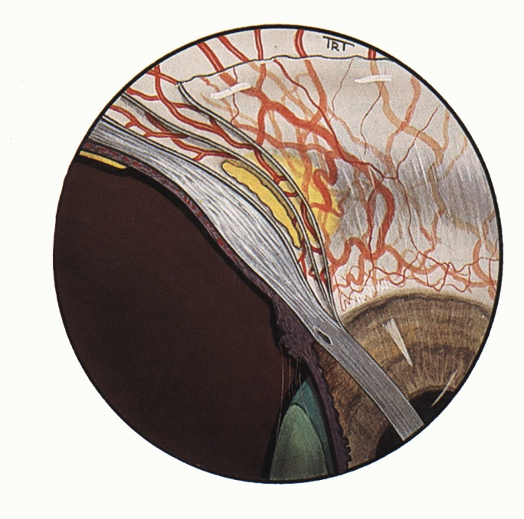
Applied anatomy of vascular coats
Normal
Episcleritis
Scleritis
Radial superficial episcleral
vessels
Maximal congestion
of episcleral vessels
Maximal congestion of
deep vascular plexus
Deep vascular plexus
adjacent to sclera
Slight congestion of
episcleral vessels

Slide 8
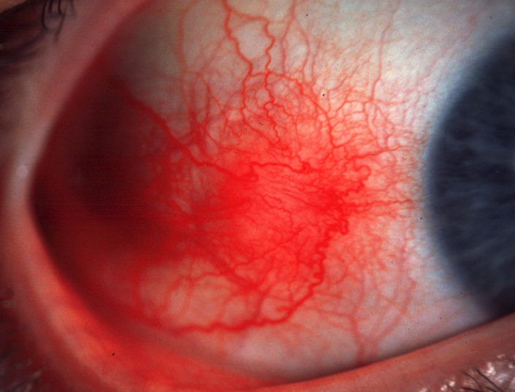
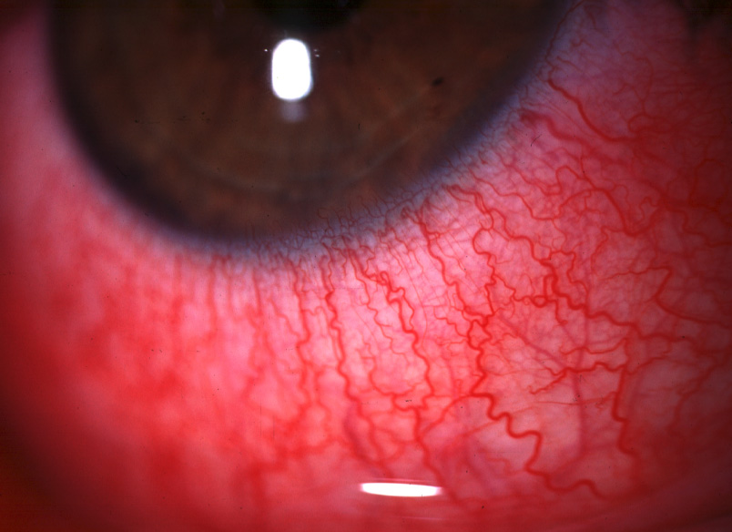
Simple episcleritis
Common, benign, self-limiting but frequently recurrent
Typically affects young adults
Seldom associated with a systemic disorder
Simple sectorial episcleritis
Simple diffuse episcleritis
Treatment
Topical steroids
Systemic flurbiprofen ( 00 mg tid if unresponsive

Slide 9
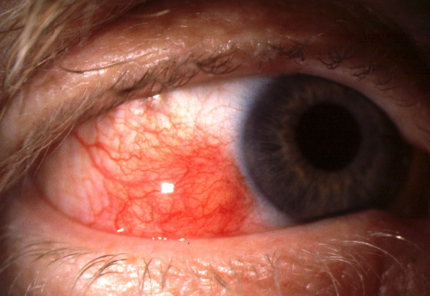
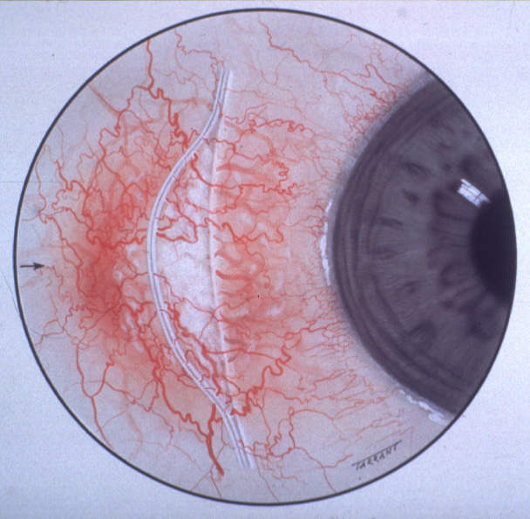
Nodular episcleritis
Less common than simple episcleritis
May take longer to resolve
Treatment - similar to simple episcleritis
Localized nodule which can be moved over sclera
Deep scleral part of slit-beam
not displaced

Slide 10
Causes and Systemic Associations of Scleritis
1. Rheumatoid arthritis
2. Connective tissue disorders
Wegener granulomatosis
Polyteritis nodosa
Systemic lupus erythematosus
3. Miscellaneous
Relapsing polychondritis
Herpes zoster ophthalmicus
Surgically induced

Slide 11
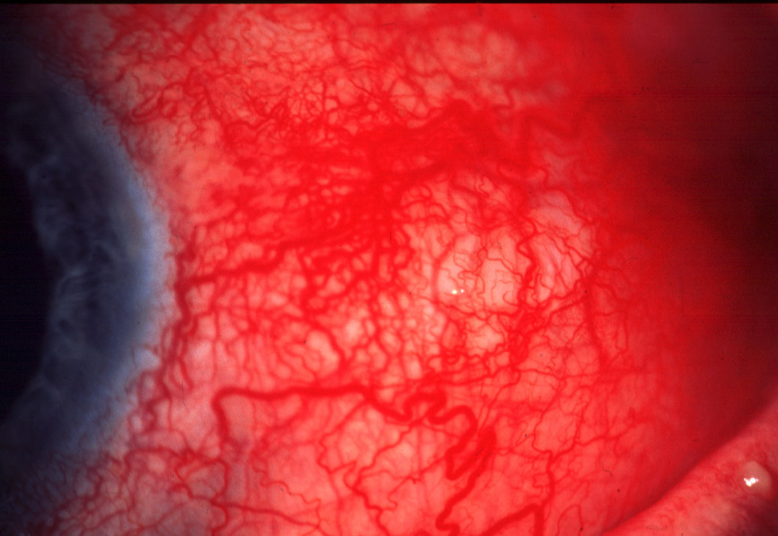
Diffuse anterior non-necrotizing scleritis
Relatively benign - does not progress to necrosis
Widespread scleral and episcleral injection
Treatment
Oral NSAIDs
Oral steroids if unresponsive

Slide 12
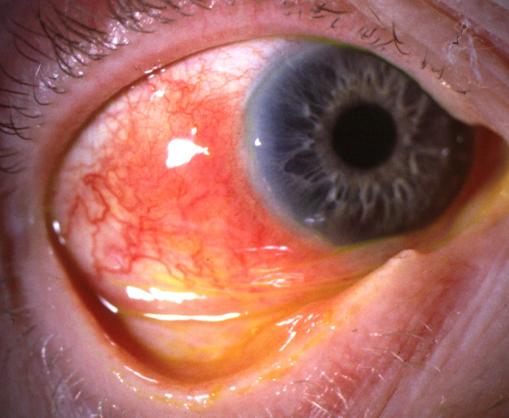
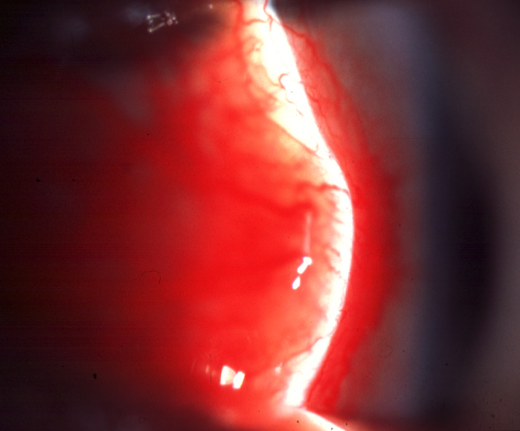
Nodular anterior non-necrotizing scleritis
More serious than diffuse scleritis
On cursory examination resembles
nodular episcleritis
Scleral nodule cannot be moved over
underlying tissue
Treatment - similar to diffuse non-necrotizing scleritis

Slide 13
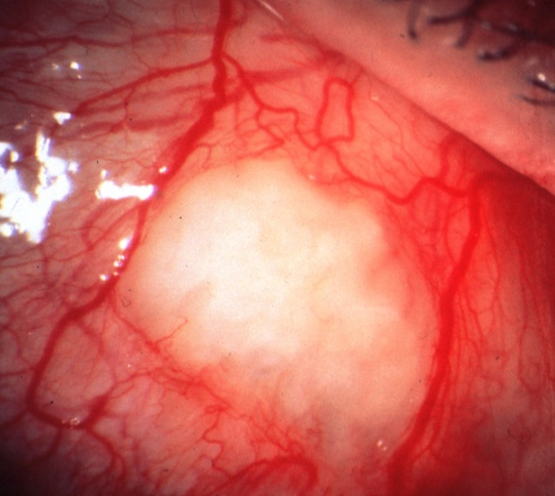
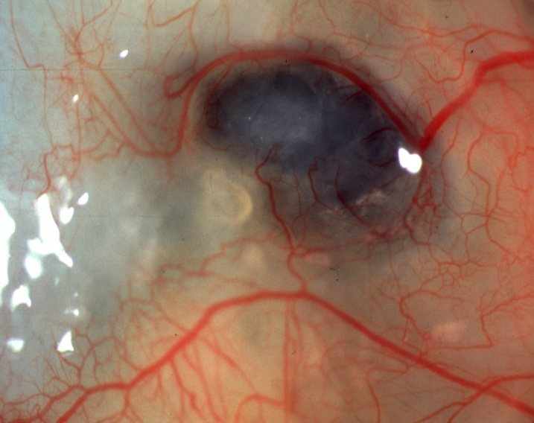
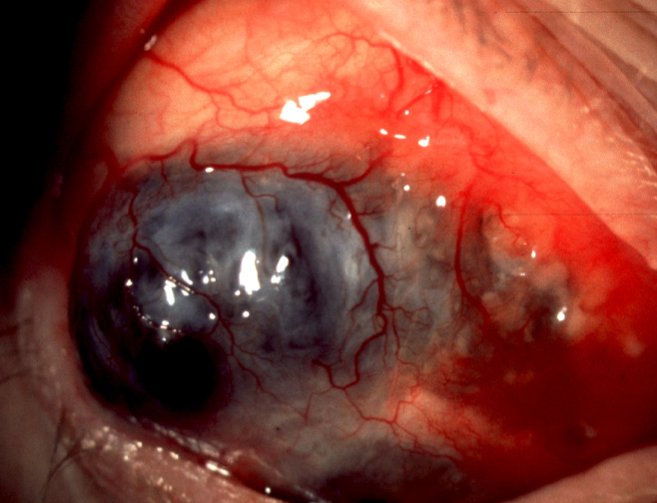
Anterior necrotizing scleritis with inflammation
Painful and most severe type
Complications - uveitis, keratitis, cataract and glaucoma
Progression
Avascular patches
Scleral necrosis and
visibility of uvea
Spread and coalescence
of necrosis
Treatment
Oral steroids
Immunosuppressive agents (cyclophosphamide, azathioprine, cyclosporin)
Combined intravenous steroids and cyclophosphamide if unresponsive

Slide 14
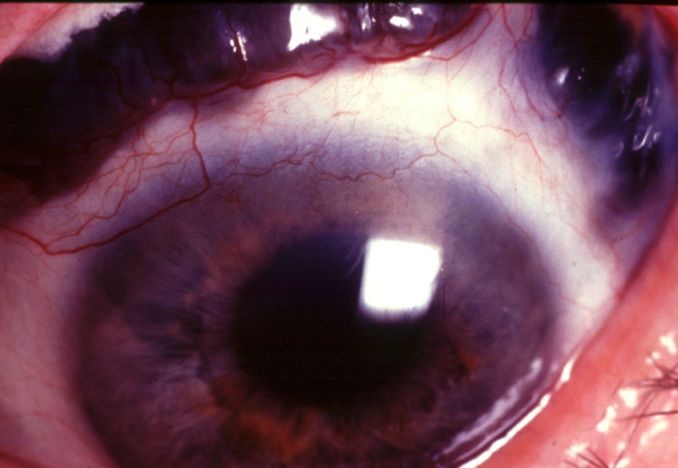
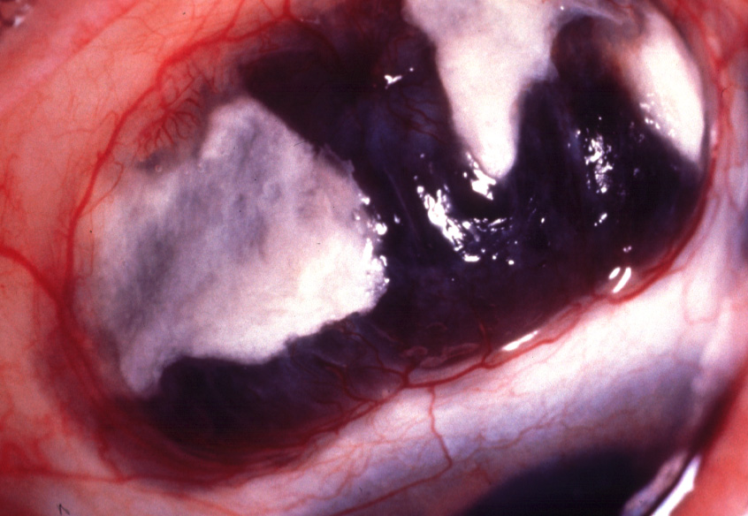
Anterior necrotizing scleritis with inflammation
(scleromalacia perforans)
Associated with rheumatoid arthritis
Asymptomatic and untreatable
Progressive scleral thinning with exposure of underlying uvea

Slide 15
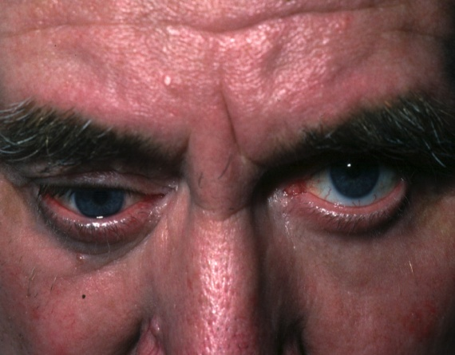
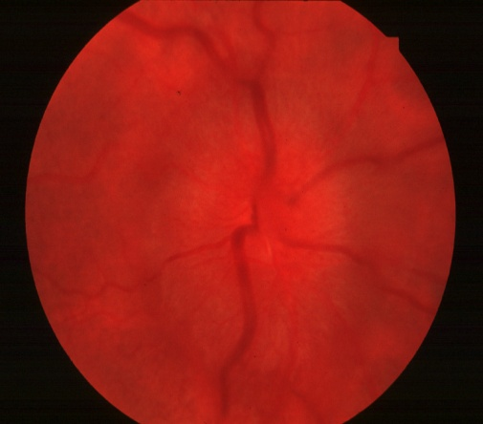
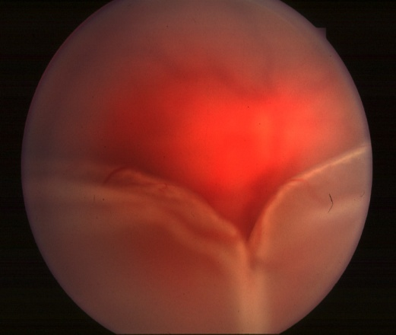
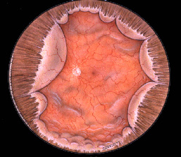
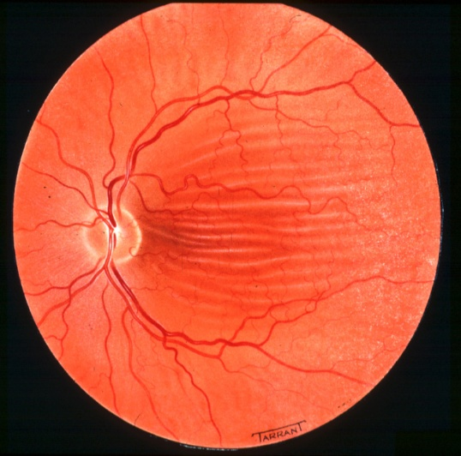
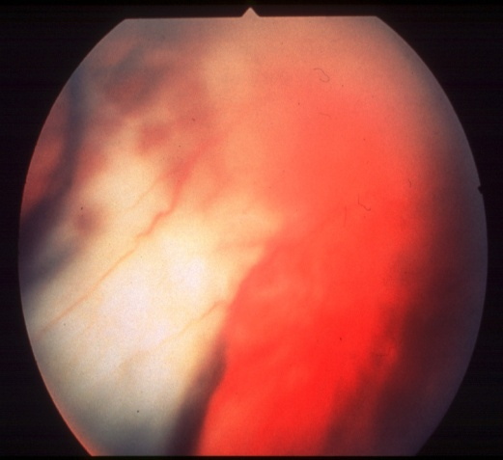
Posterior scleritis
About 20% of all cases of scleritis
About 30% of patients have systemic disease
Treatment similar to necrotizing scleritis with inflammation
Signs
Proptosis and
ophthalmoplegia
Disc swelling
Exudative retinal
detachment
Ring choroidal
detachment
Choroidal folds
Subretinal exudation

Slide 16
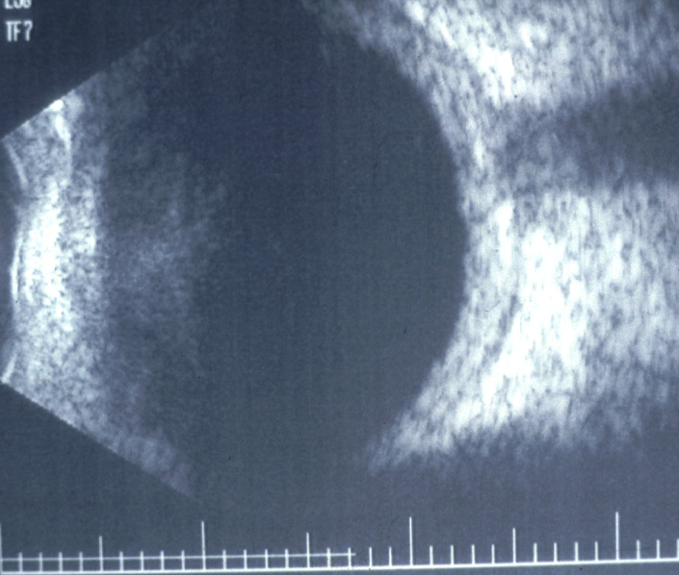
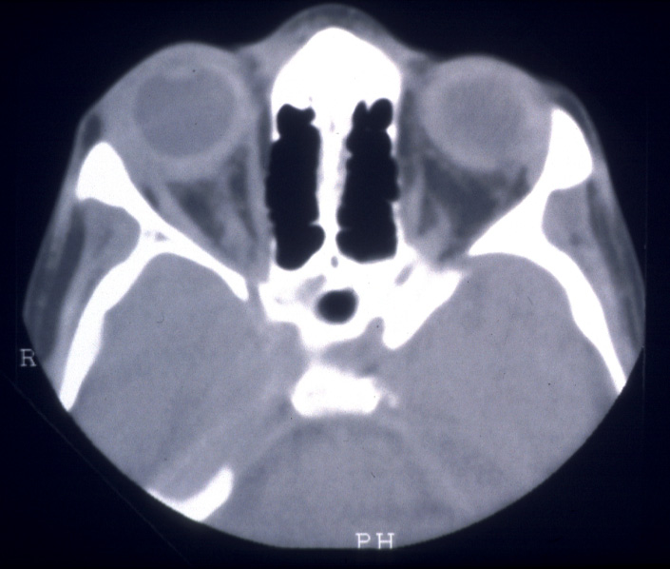
Imaging in posterior scleritis
Ultrasound
Axial CT
a
a
b
a - Thickening of posterior sclera
Posterior scleral thickening
b -Fluid in Tenon space (‘T’ sign)

Slide 17
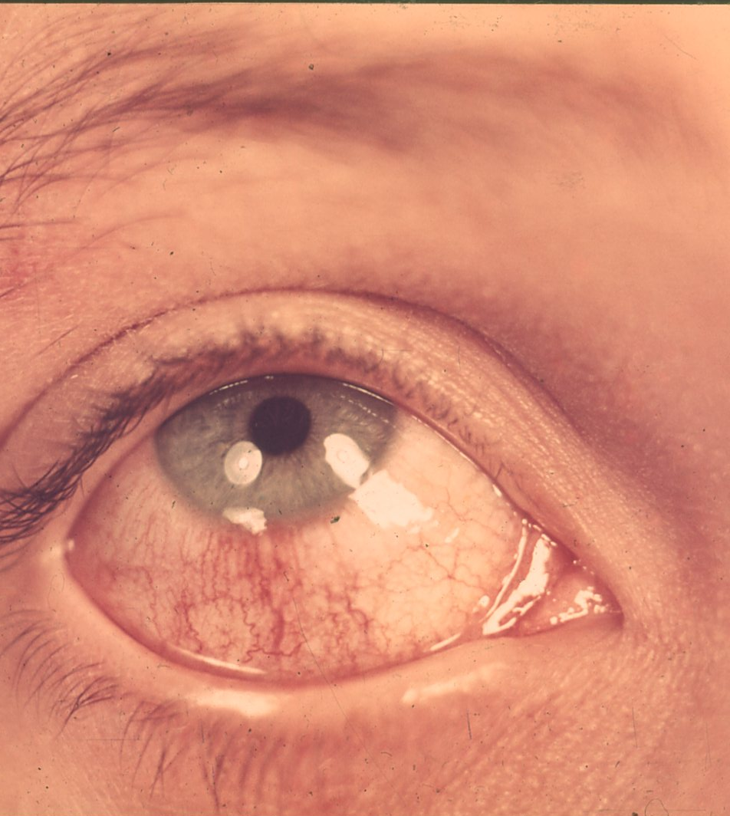
episkleritida

Slide 18
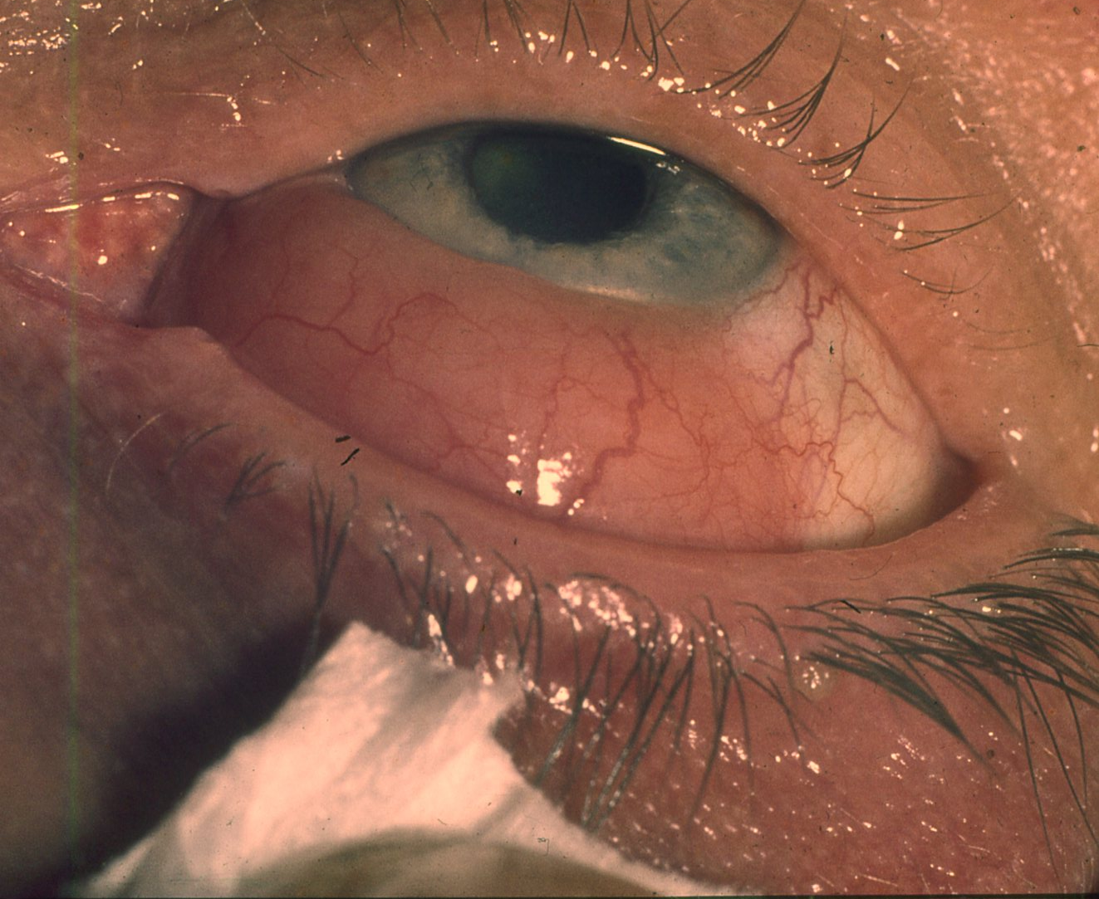
Skleritida

Slide 19
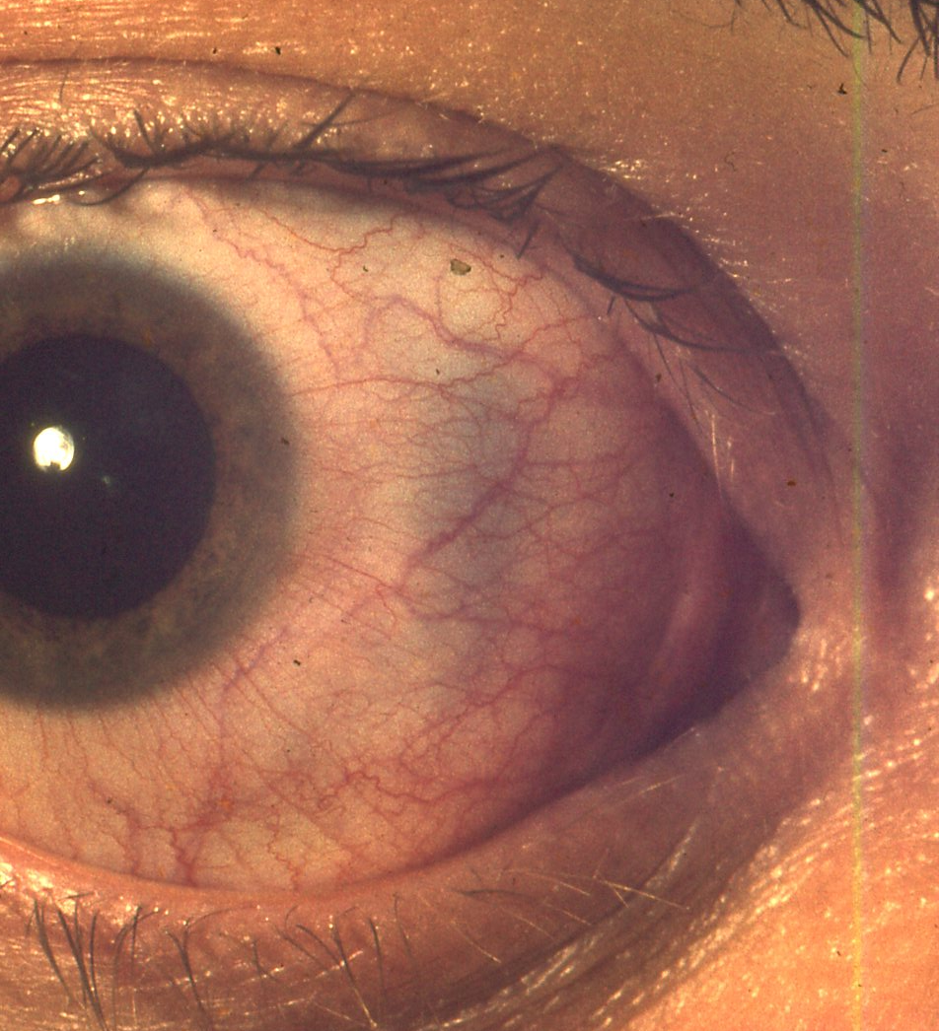
Stafylom

Slide 20
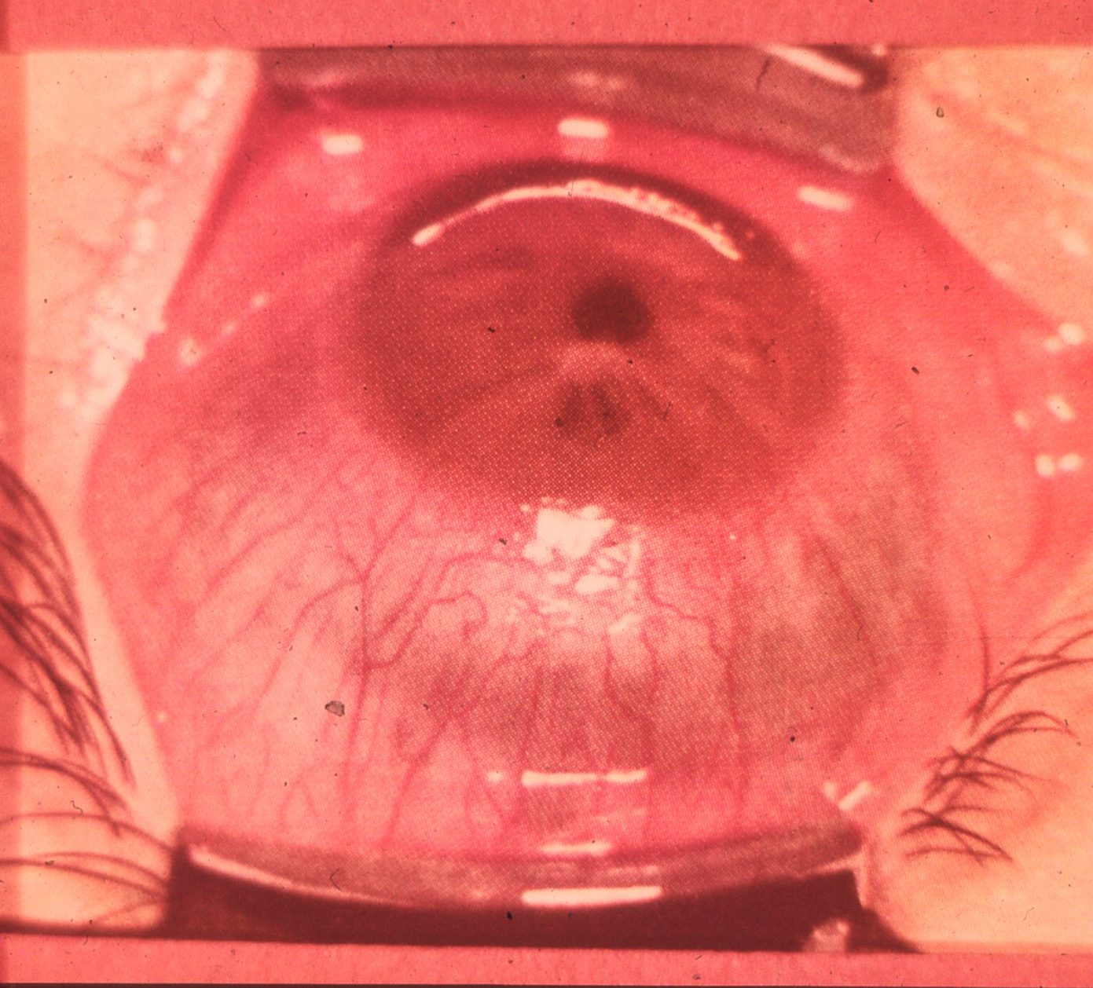
Skleritis

Slide 21
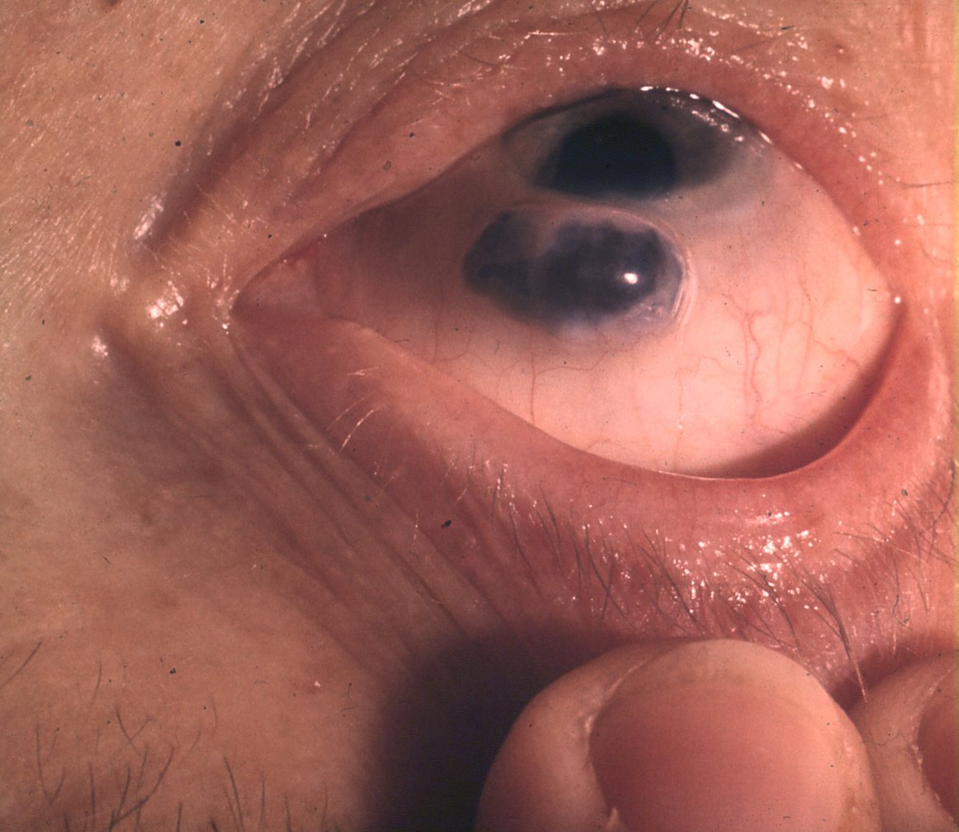
Stafylom

Slide 22
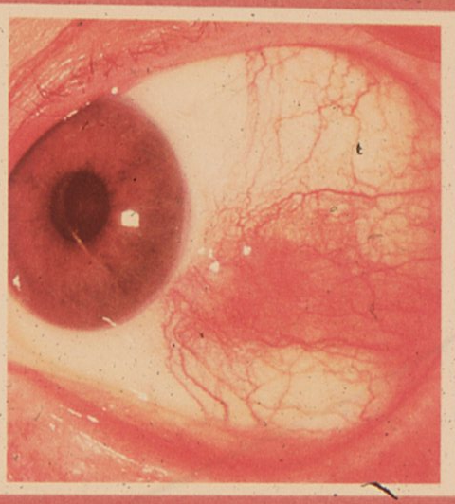
Episkleritida

Slide 23
Děkuji za pozornost

