Slide 1
Respiratory system

Slide 2
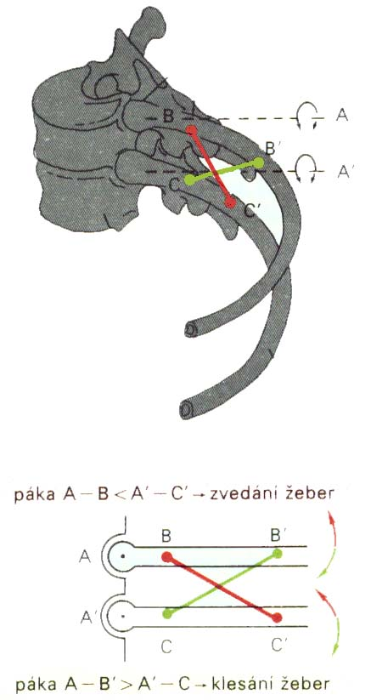
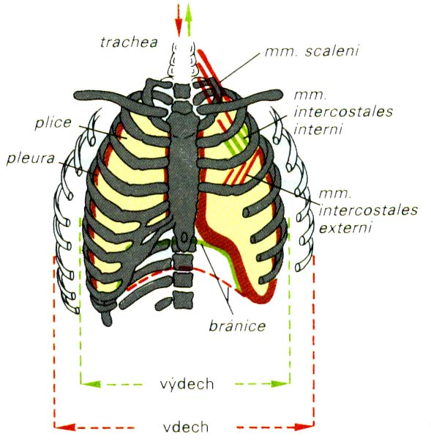
Bucket-handle and water-pump handle effects

Slide 3
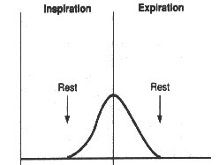
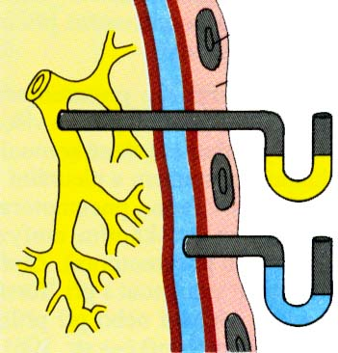
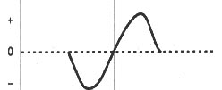
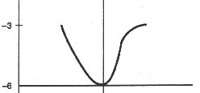
PLEURA
pulmonalis
parietalis

Slide 4
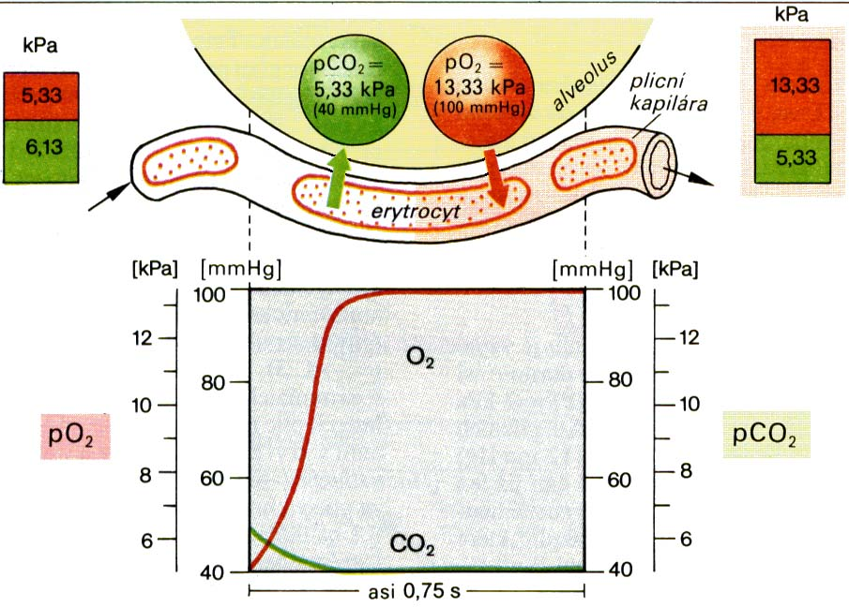
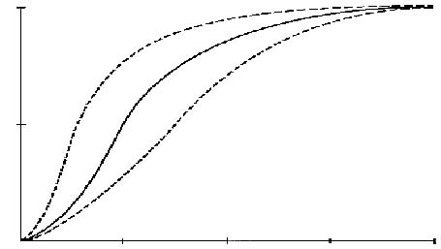
TRANSPORT O₂
↓ temperature
↑ pH
pCO₂
↓ DPG
100%
↑ temperature
↓ pH
↑ pCO₂
↑ DPG
50%
pO₂
25
50
75
100

Slide 5
Regulation of breathing

Slide 6
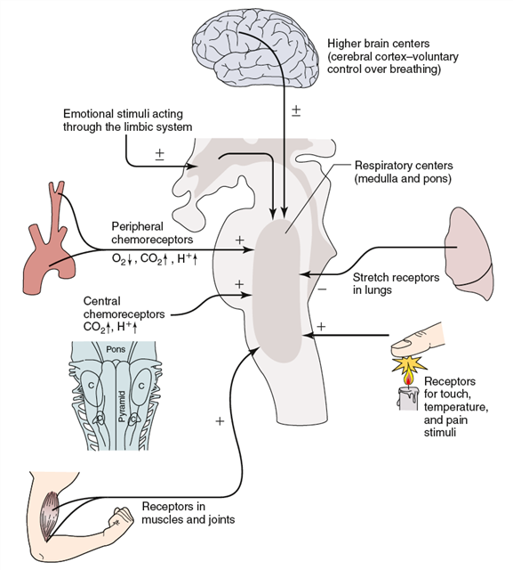
Control of ventilation
https://sleep.sharepoint.com/siteimages/Chapter%203.png

Slide 7
Breathing is an automatic process that takes place unconsciously. Automaticity of breathing comes from regular (rhythmic) activity of groups of neurons anatomically localized in the medulla and its vicinity. They can be divided into three main groups:
  dorsal respiratory group – placed bilaterally on the dorsal side of the medulla oblongata, only inspiratory neurons, sending axons to motoneurons of inspiratory muscles (diaphragm, external intercostal muscles; their activation=inspiration, their relaxation=expiration; participates on inspiration at rest and forced inspiration
  ventral respiratory group - located on the ventrolateral part of the medulla oblongata, the upper part: neurons whose axons of motor neurons activate the main and auxiliary inspiratory muscles; the lower part: expiratory neurons which innervate expiratory muscles (internal intercostal muscles). Neurons in this group operate only during forced inspiration and forced expiration.
  Pontine respiratory group - pneumotaxic center - dorsally placed on top of the pont, contributes to the frequency and depth of breathing; affects the activity of respiratory neurons in the medulla oblongata.

Slide 8
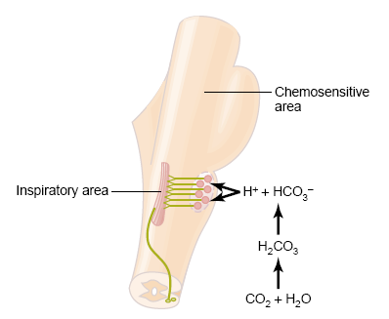
Chemical factors affecting the respiratory center:
Central chemoreceptors
on the front side of the medulla
sensitive only to increase of arterial pCO₂ (by increasing H⁺ )
central chemoreceptor are stimulated by other types of acidosis (lactate acidosis, ketoacidosis)

Slide 9
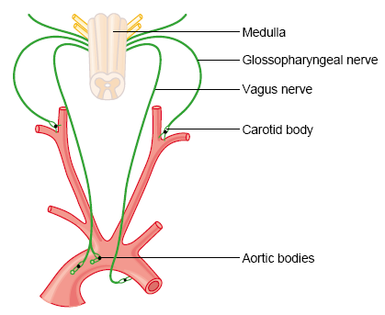
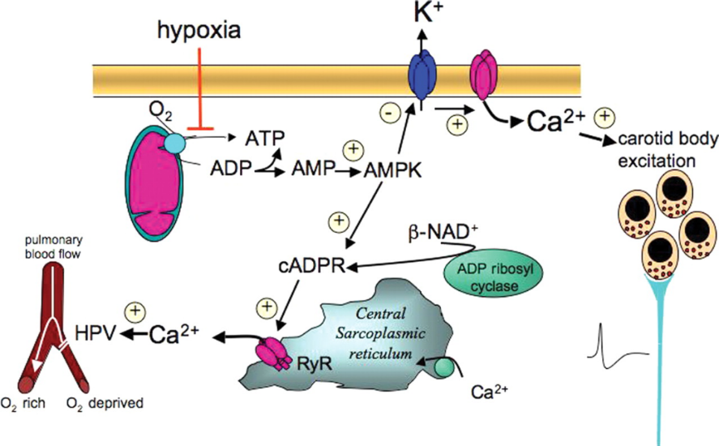
Peripheral chemoreceptors
– located in the aortic and carotid bodies
-primarily sensitive to decrease in arterial pO₂, particularly to decrease of O₂ under 10-13 kPa in the arterial blood.
They convey their sensory information to the medulla via the vagus nerve and glossopharyngeal nerve.
Mechanism of action: Decreased ATP production in mitochondria leads to depolarization of receptors membrane and to excitation of chemoreceptor
http://www.medicine.mcgill.ca/physio/resp-web/sect8.htm,

Slide 10
Non-chemical influences
More types of receptors in respiratory system
Irritants receptors on mucose of respiratory system – quickly adaptated,
Stimulus: chemical substances (histamin, serotonin, cigarette smoke).
Respons: increase mucus secretion, constriction of larynx and brochus
C-receptors (=J receptors)– free nerve ending of n.vagus (type C) in intersticium of bronchus and alveolus;
Mechanical irritans (pulmonary hypertension, pulmonary oedema)
Response: hypopnoe, bronchoconstriction, cough
Stretch receptors slowly adaptation, in smooth muscle trachea and bronchus; its irritants triggered decrese activity of respiratory centre – Hering-Breuer´s reflexes.

Slide 11
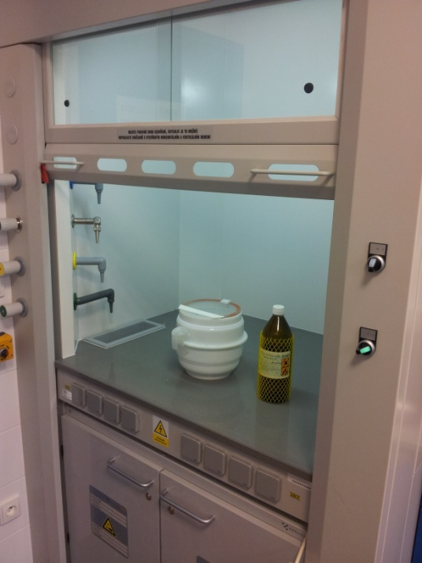
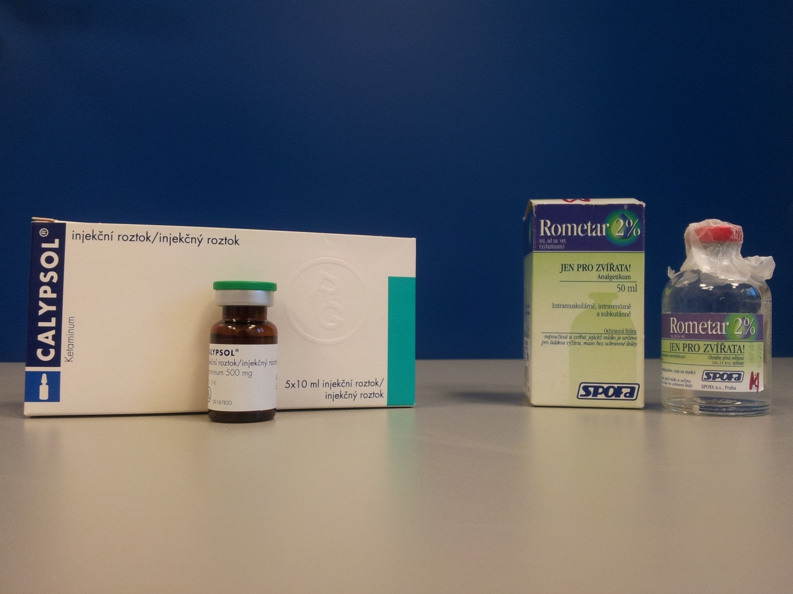
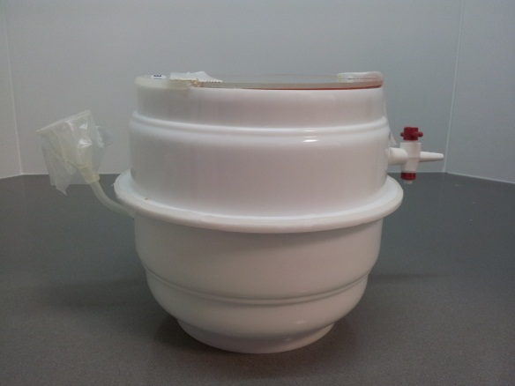
11

Slide 12
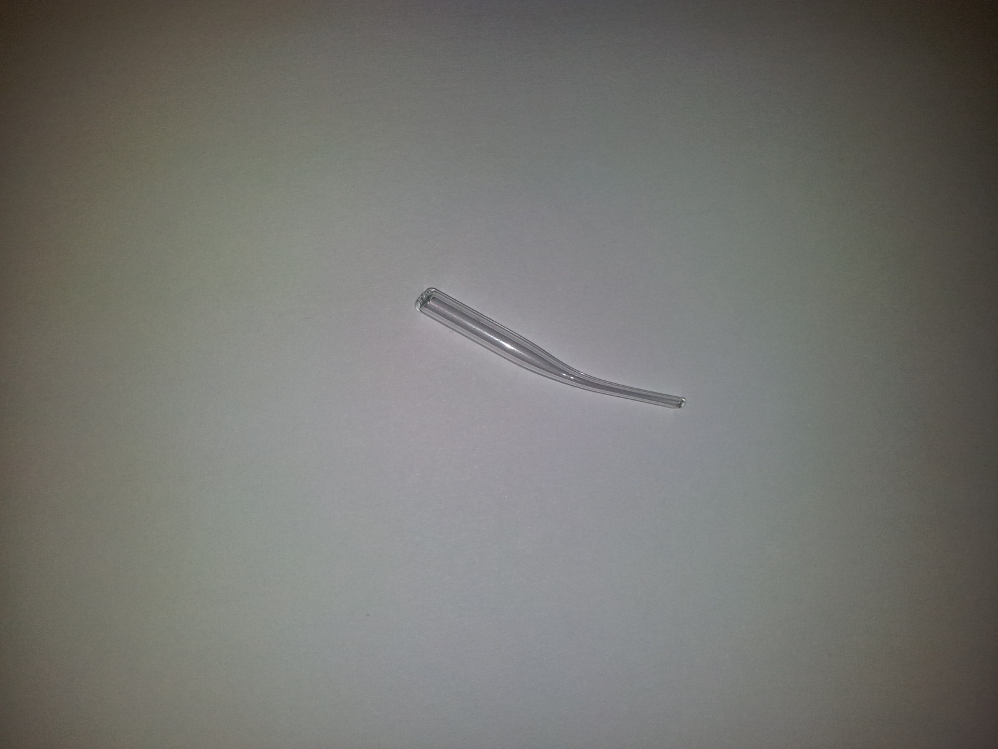
ENDOTRACHEAL CANNULA
TRACHEA
A. CAROTIS
N. VAGUS
12
Upraveno dle: Poopesko Peter a kol. (1990)

Slide 13
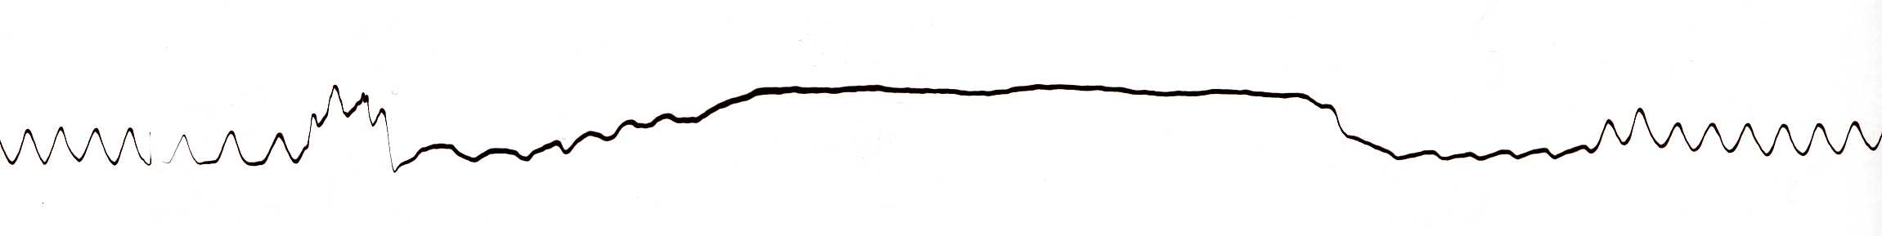
HERING-BREUER REFLEX
Reflex STOP BREATHING
Artefakts
Artefakts
13

Slide 14
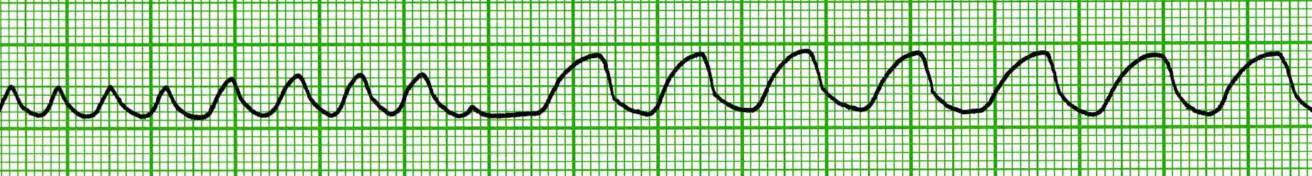
VAGOTOMY
inspirium
exspirium
One-side VAGOTOMY
Both-side VAGOTOMY
14

Slide 15
Baroreceptors – suppresses activity of respiratory centre
Irritants of proprioreceptors of muscles, tendons during active and pasive movements of limbs
Influenced activity of respiratory neurons (increase minute ventilation during work load)
Limbic system, hypothalamus – strong pain, emotion
Tractus corticospinalis =cortex – activated RC during work load
temperature

Slide 16
Periodic breathing
Non regulary, non rhythmic, respirátory coming in „periods“ e.g. – period with respiration folows period without respiration.
CHEYNE-STOKES – e.g. sleeping babies
BIOT‘S – brain injury, encephalitis
„gasping“ – newborn
KUSSMAUL – during coma in diabetic patients (ketoacidosis)

Slide 17
Hypoxia, hypoxemia
Hypoxia is a general name for a lack of oxygen in the body or individual tissues.
Hypoxemia is lack of oxygen in arterial blood.
Complete lack of oxygen is known as anoxia.
The most common types of hypoxia:
Hypoxic - physiological: stay at higher altitudes, pathological: hypoventilation during lung or neuromuscular diseases
Transport (anemic) - reduced transport capacity of blood for oxygen (anemia, blood loss, CO poisoning)
Ischemic (stagnation) - restricted blood flow to tissue (heart failure, shock states, obstruction of an artery)
Histotoxic - cells are unable to utilize oxygen (cyanide poisoning - damage to the respiratory chain)

Slide 18
Hypercapnia
Hypercapnia - increase of concentration of carbon dioxide in the blood or in tissues that is caused by retention of CO₂ in the body
possible causes: total alveolar hypoventilation (decreased respiration or extension of dead space)
mild hypercapnia (5 -7 kPa) causes stimulation of the respiratory center (therapeutic use: pneumoxid = mixture of oxygen + 2-5% CO₂)
hypercapnia around 10 kPa - CO₂ narcosis - respiratory depression (preceded by headache, confusion, disorientation, a feeling of breathlessness)
hypercapnia over 12 kPa - significant respiratory depression - coma and death.

Slide 19
Travelling by aircraft
(On board aicraft is pressure as on 2000 m above see level)
High risk for patients with:
concentration of hemoglobin lower than 60 %
severe step of atherosclerosis
cardial insuficiency
Respiratory insuficiency
non-treated hypertension (BP ower 200/100mmHg)

Slide 20
Toxicity of oxygen
The toxicity seems to be due to the production of the superoxid anion and H₂O₂ + increase pCO2 in body (all hemoglobin is bound with oxygen)
Symptoms are dependent on time of exposure:
Exposure – 8 hours:- respiratory passages became irritated
- Substernal distress
- Nasal congestion
- Sore throat
- Cough
- 24-48 hours:
- damage of lungs – decrease production of surfactant
Recommendation:
100 % - give discontinuosly + together with air

Slide 21
HYPERVENTILATION
Definition: Both, accelerated and deep breathing
  In humans, hyperventilation coming as combination of anxiety and pain
  During hyperventilation is expired CO₂ (hypocapnia) and the increase of pO₂ (hyperoxia) -------------- vasoconstriction of cerebral vessels
  Symptoms: tingling in the ears, feeling light in the head, headache etc.
  Removing symptoms - by increasing pCO₂ in the body – e.g.: by breathing into and out of the bag (re-breathing)

