Slide 1
Pathology of the renal and urologic systems
V. Žampachová
I. PAÚ

Slide 2
Signs and symptoms of renal/urinary tract problems
Urinary frequency / urgency /nocturia
Urinary incontinence
Pain (shoulder, back, flank, pelvis, lower abdomen)
Dysuria (painful urination) – usually uretritis/cystitis
Hematuria – glomerular injury, tumors, trauma
Pyuria - infection
Fever and chills - infection
Thirst, tiredness, weight gain – chronic renal failure
Edema (facial, swollen ankles) – acute/chronic glomerular injury

Slide 3
Signs and symptoms of renal/urinary tract problems
Hypertension – renal ischemia, sodium + fluid retention
Oliguria (diminished amount of urine) – renal failure, obstruction, dehydration
Polyuria (excessive amount of urine) – excessive fluid intake (beer), diabetes mellitus, renal tubular disorder
Renal (ureteric) colic – passage of stone/blood clot
Anaemia - ↓ renal production of erythropoetin
Calcium metabolism problems – metastatic calcifications (arteries, soft tissues, inner organs), bone resorption

Slide 4
Signs and symptoms of renal/urinary tract problems
Urine analysis
  urine production rate
  concentrating power of kidneys
  urinary protein – glomerular / tubular lesions
  urinary casts – hyaline casts (protein)
  granular casts (inflammatory cells)
  red cell casts (severe glomerular damage )

Slide 5
Signs and symptoms of renal/urinary tract problems
Blood analysis (urea, creatinine, electrolytes) – glomerular filtration rate GFR, general integrity of renal function
Imaging methods (X-ray, ultrasound, angiography, contrast urography)
Cystoscopy
Renal biopsy (histology, immunofluorescence, electron microscopy)

Slide 6
Signs and symptoms of renal/urinary tract problems
Asymptomatic hematuria and/or proteinuria – mild glomerular lesion
Polyuria + nocturia + electrolyte disorders – renal tubular defects
Bacteriuria + pyuria – urinary tract infection (UTI)
Renal colic + hematuria - nephrolithiasis

Slide 7
Signs and symptoms of renal/urinary tract problems
Uraemia
Renal insufficiency - GFR 20-50% of normal
Azotemia – increase of blood urea and creatinine due to decreased glomerular filtration (20-30%), or extrarenal cause
Uraemia - azotemia together with several clinical and biochemical abnormities: metabolic, endocrine, … (uremic gastroenteritis, peripheral neuropathy, fibrinous pericarditis)
Renal failure - GFR less than 20-25%, oedema, uraemia; causes: prerenal, postrenal, renal (vascular, glomerular, tubulointerstitial); acute r.f. (oliguria→anuria) chronic r.f.
End-stage renal disease - GFR less than 5% of norm

Slide 8
Signs and symptoms of renal glomerular problems
Nephritic syndrome due to acute glomerular disease; hematuria + mild proteinuria + hypertension
Rapidly progressive glomerulonephritis – very rapid (days-weeks) nephritic syndrome
Nephrotic syndrome: usually chronic glomerular disease, severe proteinuria (>3,5 g/d) + oedema + hyperlipidemia + lipiduria

Slide 9
Inborn disorders
10% of all people
hereditary or acquired developmental defect
decreased volume of renal tissue (e.g. agenesis)
disorders of differentiation (dysplasia)
anatomical abnormalities (ectopy – abnormal site)
metabolic disorders (cystinuria, …)

Slide 10
Cystic renal disease
Hereditary, congenital nonhereditary, acquired
Pathogenesis: primary defect of tubular epithelial cells and their growth, resulting in tubular dilatation
Cavity filled with fluid, epithelial lining
Multiple or solitary
Solitary cyst may simulate a tumor
Affects the whole kidney, or mostly cortex or medulla
Pain, hematuria, hypertension, UTI, stones

Slide 11
Inborn disorders
  Adult polycystic kidney disease
    common congenital disease, ↓of renal function in the 3.- 4. dec., autosomal dominant
    + liver cysts, arterial berry aneurysms.
    ↑risk of renal cancer
    gross: symmetric kidney enlargement – lenght to 30 cm, weight to 8 kg, multiple cysts 0,5-50mm

Slide 12
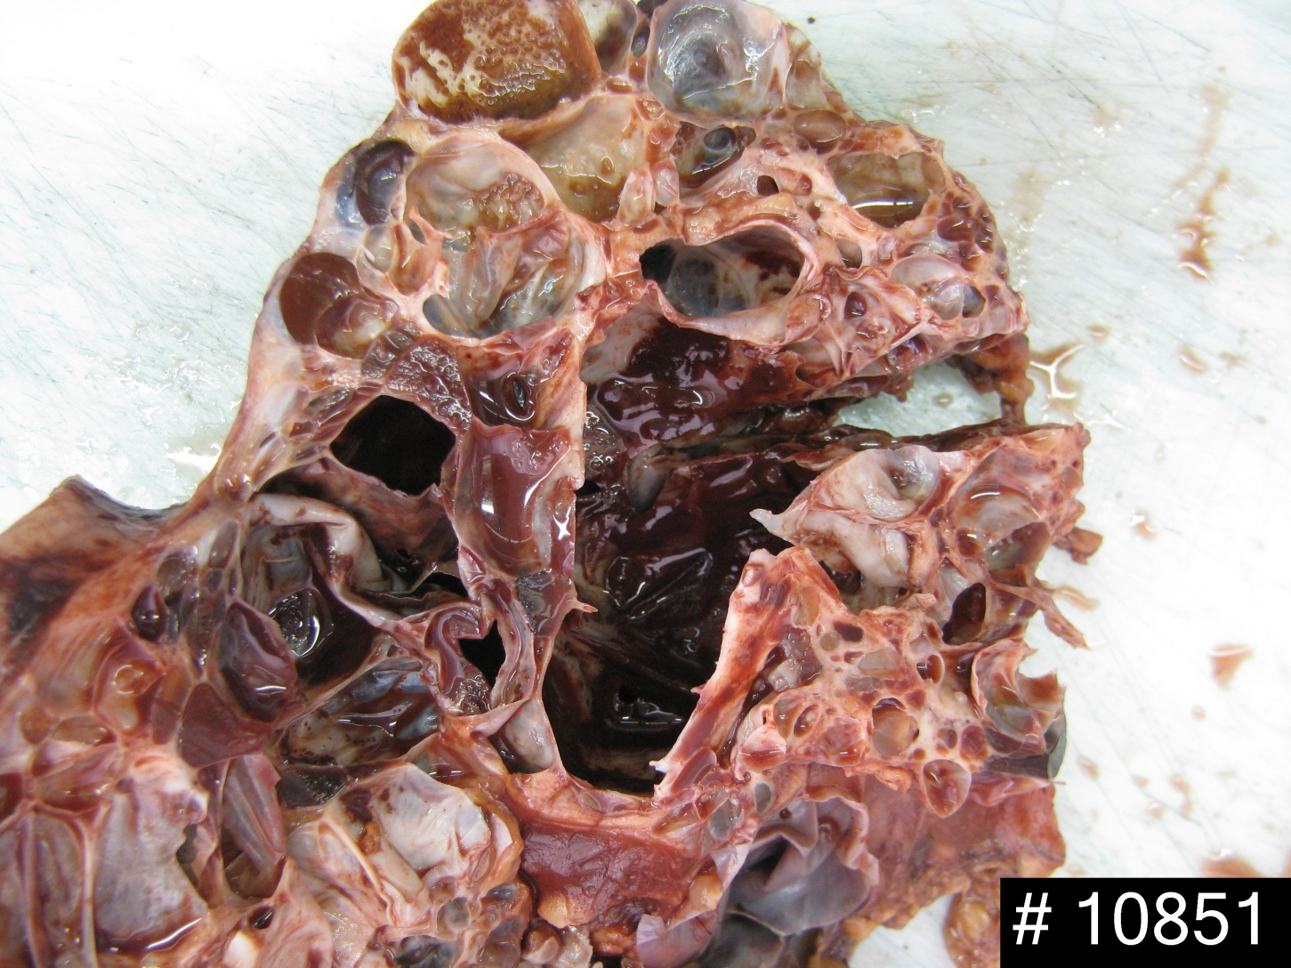
Polycystic kidney

Slide 13
Inborn disorders - implications
Worsening of signs/symptoms of a known disorder
Signs/symptoms suggestive of inborn disorders
Possible kidney enlargement – atypical findings on palpation

Slide 14
Urinary tract obstruction
increased susceptibility to urolithiasis
increased susceptibility to infection
risk of hydronephrosis
Combination of inborn + acquired risk factors

Slide 15
Vesico-ureteric reflux
Incompetence of the vesico-ureteral valve
Combination of congenital defect (short intravesical part of ureter, 1-2% of children)
↓ ureteral contractility in infection
acquired in bladder atony (spinal cord injury)

Slide 16
Obstruction causes
Intrinsic – luminal obstruction (stone, blood clot, necrotic papilla, tumor or its part)
Wall stenosis or dysfunction (inborn, inflammation, postinflammatory, tumor, …)
Extrinsic – external compression, some causes common for both sexes, some different

Slide 17
Obstruction causes
In males: prostatic hyperplasia, prostatic ca, urethral stenosis, phimosis + complications
In females: pregnancy, cervical ca (+ therapy), uterine myoma, ovarian tumor, uterine prolapse
in both: chronic inflammation/fibrosis (retroperitoneal fibrosis), tumor (colorectal ca, LN,...), aortic aneurysm

Slide 18
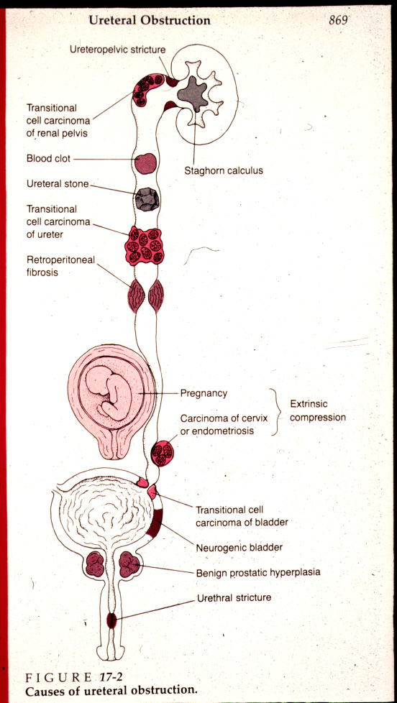

Slide 19
Renal – urinary calculi
5% of adults, recurrence common
Usually of renal origin
Stones > 5 mm cannot pass into ureter
Small stones - ↑ risk of obstruction
Renal colic – pain + spasms during the passage of a stone along the ureter, hematuria
Chronic dull pain lumbal – lower pelvic region
Recurrent infection - possible presentation

Slide 20
Urinary calculi
Calcium containing stones: commonest, laid down in an acid urine.
Complex triple phosphate stones: often associated with urinary infection, in an alkaline urine.
Mixture of uric acid and urate-uric acid stones, 20% of patients with gout, in an acid urine.
Cystine stones: in primary (inborn) cystinuria, important in childhood.

Slide 21
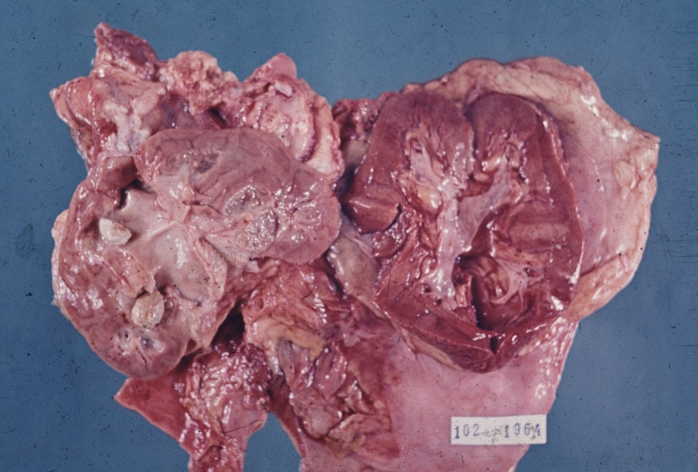
Pyelolithiasis in situ

Slide 22
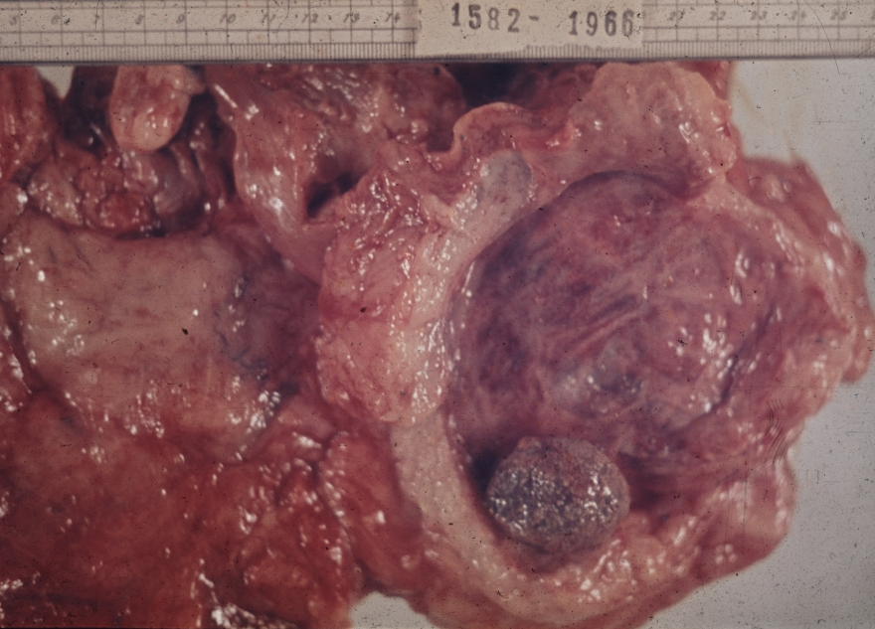
Urocystolithiasis

Slide 23
Renal calculi - implications
Differential diagnosis of less severe/intermittent pain x joint or muscle pain, incl. back pain
Vigilance for signs of concurrent infection (fever, chills, swets) necessary

Slide 24
Urinary tract infections
Most commonly urethritis + cystitis
Risk factors:
  Females (short urethra, proximity to vagina, rectum)
  Immobility /inactivity (impaired bladder emptying)
  Increased sexual aktivity
  Urinary catheter, instrumentation
  Urinary obstruction
  Constipation
  Pregnancy
  Immune deficiency

Slide 25
Urinary tract infections
Mostly ascending infection
Usually of bacterial origin (fecal – E.coli, sexually transmitted)
Less commonly fungal (Candida), parasitic (Schistosoma)

Slide 26
Urinary tract infections
Complicated – more difficult diagnosis/treatment:
  small children (atypical signs)
  elderly adults (less pronounced signs, confusion)
  pregnancy (asymptomatic UTI possible)
  patients in hospitals, long term care
  diabetes and/or other risk factors
  Relapse (due to low-level persisting infection) or recurrence (new infection) common
Uncomplicated – otherwise healthy people

Slide 27
Urinary tract infections
Signs:
  Frequency
  Urgency
  Dysuria
  Nocturia
  Enuresis in children
  Pain (suprapubic, lower abdomen, groin, lumbar)
  Possible cloudy, bloody, foul smelling urine
  Possible systemic signs (fever, malaise, chills)

Slide 28
Acute cystitis
highly common in females (short urethra, perineal connection with anus)
mostly fecal bacteria, mixed flora
risk factors – urine pH, hormonal status, iatrogenic
usually purulent (leucocytes, blood in urine), urging, pain; may have systemic signs
complications – ureteral spread, ulcers, rare phlegmona, pseudomembranous inflammation

Slide 29
Chronic cystitis
in obstruction (prostatic hyperplasia, indwelling catheter)
acute exacerbations, stone formation
may be risk factor for neoplasia
diff. dg. x neoplasia

Slide 30
Acute pyelonephritis
Common purulent renal inflammation, bacterial infection
Ascending infection by urine reflux in urinary tract inflammation
Descending (haematogenous) infection in septicaemia, rare
Systemic signs (abrupt, high fever, chills, malaise, headache, lumbar pain, nauzea, vomiting)
May lead to sepsis+renal failure - urosepsis

Slide 31
Acute pyelonephritis
Facilitated by DM, gout, all causes of obstructive uropathy (e.g. nephrolithiasis, tumors, urinary tract anomalies incl. vesicoureteric and intrarenal reflux)
Instrumental interventions (cathetrization, cystoscopy)
Gross: enlarged kidney, cortical and medullary abscessses

Slide 32
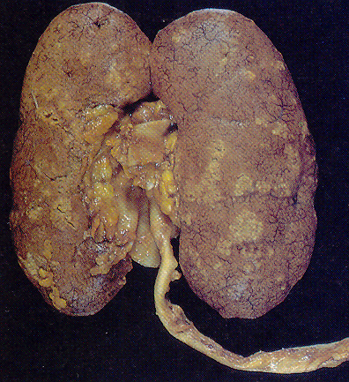
Acute pyelonephritis

Slide 33
Chronic pyelonephritis
Uni- or bilateral chronic renal (tubules + interstitium) inflammation with scarring
Progression to end-stage kidney (renal failure)
Obstructive PN - repeated infections
Reflux nephropathy

Slide 34
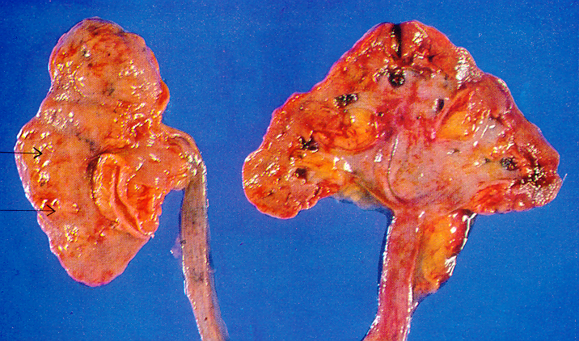
Chronic pyelonephritis
Obstructive

Slide 35
Urinary tract infections - implications
Recognition of early/worsening symptoms – referral to physician – prevention of possible permanent damage
Catheter care – diminishing risk of infections

Slide 36
Chronic kidney diseases (CKD)
Alteration of kidney function/structure for ≥ 3 months
Non-healing acute disorder (i.e. acute glomerulonephritis), or slow progression of chronic lesion
Variable causes, most common:
  Diabetes mellitus
  Hypertension
  Glomerulopathy
  Chronic UTI
  Cystic kidney disorders
  Other systemic disorders (SLE)
  Drugs (NSAIDs) – analgesic nephropathy

Slide 37
Chronic kidney diseases
Common problem
May be asymptomatic initially – incidental finding in laboratory tests
Gradual onset of symptoms common
Slow decrease of glomerular filtration rate
May progress to kidney failure (GFR ˂5%)
Correct diagnosis necessary
In some types treatment possible

Slide 38
Chronic kidney diseases
Uremia: internal intoxication – failure of toxin excretion, maintaining the fluid, pH, electrolyte balance
Loss of important hormone secretion (renin, vitamin D, erythropoetin)

Slide 39
Chronic kidney diseases
Complications + consequences:
Cardiopulmonary:
  Coronary artery disease
  Hypertension
  Pulmonary edema
  Congestive heart failure
  Pericarditis
Hematologic:
  Anemia
  Impaired platelet function

Slide 40
Chronic kidney diseases
Complications + consequences:
GIT
  Nausea and vomiting
  Anorexia
  Bleeding
Central nervous system
  Headache
  Irritability, impaired judgment, inability to concentrate
  Sleep disturbances
  Seizures
  Lethargy/coma

Slide 41
Chronic kidney diseases
Complications + consequences:
Peripheral nervous system
  Loss of deep tendon reflexes
  Impairment of motor nerve conduction velocity
  Burning, tingling sensations
  Tremor
  Muscle cramps, muscle twitching
  weakness
Skin
  Itching + scratching
  Altered skin color (pallor, brownish tint, bruises)

Slide 42
Chronic kidney diseases
Complications + consequences:
Skeletal system
  Bone demineralization
  Joint pain / calcification
  Myopathy

Slide 43
Glomerular diseases
Variable causes (immunological x non-immunological incl. inborn)
Variable clinical / histologic picture – variable classifications according to the changes
Damage to the glomerular permeability → nephrotic syndrome
Glomerular inflammation and necrosis → leakage of blood + protein into urine → nephritic syndrome
Permanent injury → sclerosis, hyalinosis – loss of functional glomeruli, end-stage kidney with renal failure

Slide 44
Glomerular diseases
Glomerulonephritis
Glomerular injury due to abnormal immune responses and/or complement system
May be primary (antibodies against antigenes of glomerulus, SLE), secondary (postinfectious – poststreptococcal, IgA, with deposition of circulating immune complexes in the glomerulus)

Slide 45
Chronic kidney diseases
Diabetes mellitus
Most common cause of end-stage kidney disease in developed countries
Slowly progressive course (15 years) in type I DM, variable in type II DM
Variable combination of changes
Diabetic nephropathy – microvascular changes incl. glomeruli
Accelerated arteriosclerosis
UTI incl. pyelonephritis, papillary necrosis

Slide 46
Chronic glomerulonephritis
End stage of variable glomerular disease
Different rate of progression in different diseases
Focal segmental glomerulosclerosis (commonly the result of hyperfiltration in residual glomeruli due to glomerular/renal tissue loss – nephrectomy; obesity, hypertension; drugs) 50-80%
Rapidly progressive glomerulonephritis ~ 50%
Poststreptococcal 1-2%

Slide 47
Chronic glomerulonephritis
Shrinked kidney with granular surface
Thin cortex
Obliterated glomeruli, arterio- and arteriolosclerosis (hypertension), tubular atrophy

Slide 48
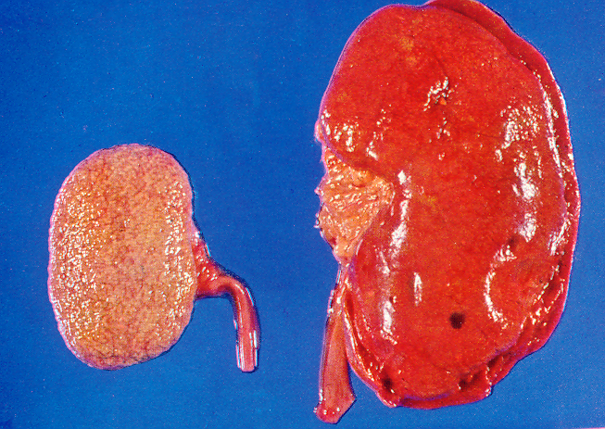
Chronic GN – end-stage kidney

Slide 49
Chronic kidney diseases - implications
Knowledge of association of glomerular diseases with systemic disorders – DM, hypertension, vasculitis, systemic lupus, …
Presence of clinical signs (edema, signs of uremia, …) – referral to a physician
Side effects of therapy (diuretics – fatigue, muscle cramps, weakness, headache, ↑frequency of urination + incontinence, depression

Slide 50
Chronic kidney diseases - implications
Nephrogenic systemic fibrosis
In patients with chronic kidney diseases
Firm erythematous skin plaques, itchy
Fibrosis +/- calcification of soft tissue incl. muscles
Pain in joints, bones
Muscle contracture, loss of function
Massage, joint manipulation, exercise, swimming

Slide 51
Renal failure
Renal replacement therapy necessary
Dialysis
Renal transplantation:
  Cheaper than long-term dialysis
  Limited availability of organ grafts
  Life-long immunosuppression
  Variable complications

Slide 52
Dialysis
Removal/diffusion of waste products, excess fluid + electrolytes
Peritoneal dialysis
  Catheter implanted in the peritoneal cavity
  Sterile dialyzing solution instilled /drained
  Several times daily, possible during sleep
  Independent at home procedure
  Infectious complications, dehydration
Hemodialysis (HD): external machine
  Usually 3x weekly 3-4 hours
  Rapid changes in blood constituents – severe signs possible
  Commonly patients immobile
  Low-intensity exercise program during the first half beneficial

Slide 53
Dialysis – implications for the terapist
↑ susceptibility to infection (!hand hygiene)
Maintaining the dialysis access site (thrombosis)
↑ thirst (limited fluid intake)
Weight gain (fluid retention), but ↓ lean body mass – muscle loss
Alternating hypertension (fluid retention) and dialysis hypotension
Anorexia, ↑ catabolism, ↓ functional capacity (50% in CKD)
Depression common
Individual exercise/treatment plan

Slide 54
Renal cancer
Renal cell carcinoma (RCC): most common adult renal tumor
Transitional cell carcinoma of pelvis, ureter
Benign tumors possible, diff. diagnosis x RCC
Wilms tumor in children
Metastatic cancer (primary in the lungs, breast, skin melanoma, …)

Slide 55
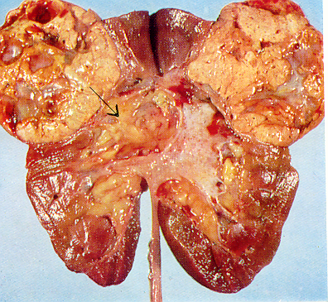
Renal cell carcinoma
Conventional clear cell RCC - Grawitz
80% of renal malignancies
Other RCC types less common (papillary RCC)
Metastasis mosty by hematogenous way

Slide 56
Renal cell carcinoma
More common in males; middle-older age
Risk factors: smoking (25% of RCC), moderate to heavy drinking, obesity (25%), familiar factors incl. cystic disease, industrial pollution, radiation treatment
Incidental finding in imaging methods
Hematuria (50%), may be intermittent and/or microscopic
Flank pain, palpable mass – late sign
Metastasis - late sign, in ¼ of patients; lung, lymph node, bone, liver
Prognosis according to the type and stage

Slide 57
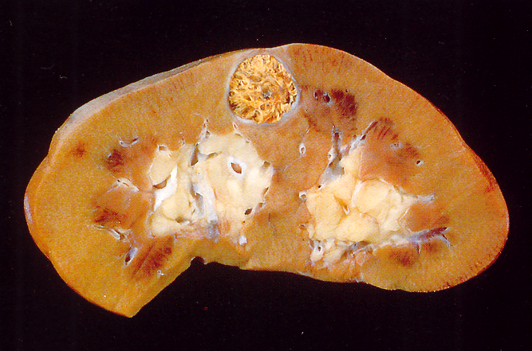
Renal cell carcinoma

Slide 58
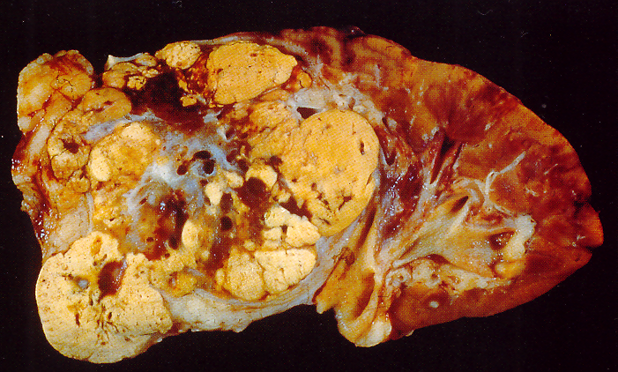
Renal cell carcinoma

Slide 59
Renal cell carcinoma - implications
Mostly in geriatric population
Awareness/questions of possible signs
New onset of unexplained abdominal / back pain
Surgical treatment most important - surgical sites scarring management
Side effects of targeted therapy

Slide 60
Transitional cell carcinoma
Cca 10% of renal carcinoma
Growth in the renal pelvis
Early presentation with hematuria / urinary tract obstruction
Multiple concurrent tumors in pelvis /ureter /bladder possible

Slide 61
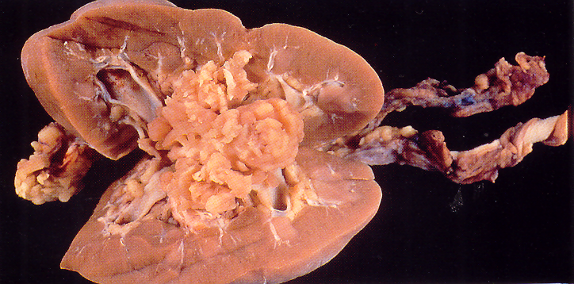
Transitional cell ca of the renal pelvis

Slide 62
Wilms tumor
  3rd most common malignant pediatric tumor
  Diagnosed mostly in the 1st-4th year of age
  Sporadic, or part of some syndromes
  Clinical: large tumor, palpable, complications due to compression of adjacent organs, hematuria
  Prognosis: good, chemotherapy, (radiotherapy carefully, second malignancies possible)

Slide 63
Disorders of the bladder and urethra
Inflammation
  Infections - UTI
  Non-infective: interstitial cystitis / painful bladder syndrome: suprapubic pain related to bladder filling + ↑ urgency/frequency (day+night), without other pathology
    Low back pain, burning, spasm possible
    Commonly ↑ with stress, acid food, sex
    Conservative treatment usual – symptom relief, stress management, relaxation treatment

Slide 64
Disorders of the bladder and urethra – neurogenic bladder
Voiding dysfunction due to neurologic lesions
Pelvic lesions: trauma, surgery
Spinal cord /nerve lesions: diabetes, disc disease, injury
Cerebral lesions
  Stroke
  Trauma
  Dementia
  Parkinson‘s
  Multiple sclerosis
  Tumor

Slide 65
Disorders of the bladder and urethra – neurogenic bladder
  Sensory – efferent nerves dysfunction (diabetes, syphilis, …), no sensation of the fullness
  Motor paralytic – destruction of afferent parasympathetic motor nerves (pelvic surgery, trauma) – problems in starting/maintaining urine stream
  Reflex – spinal cord injury – loss of sensation + motoric problems
  Neurogenic detrusor overactivity – brain tumors, demyelinization, Parkinson – involuntary contractions
  Autonomous – complete separation from upper nervous centres

Slide 66
Disorders of the bladder and urethra – neurogenic bladder
Complications: UTI, renal calculi, hydronephrosis
Differential diagnosis x other lesions (bladder cancer, prostate hyperplasia, …)
Exercise – bladder training
Functional mobility, relaxed sitting

Slide 67
Disorders of the bladder and urethra - cancer
Urothelial (transitional cell) carcinoma most common
Middle to older age
Manifestation: painless hematuria, frequency, dysuria
Commonly recurrences / multiple tumors over years
Important predisposing factors:
  Smoking (about ½ of bladder cancer cases)
  Occupational exposures – dyes, diesel exhaust, rubber industry, …
  Males
  Chronic inflammations, incl. permanent catheter, stones, parazites
  Decreased fluid intake
  Genetic / inborn defects

Slide 68
Disorders of the bladder and urethra - cancer
Flat lesions –
  Carcinoma in situ – confined to the epithelium
  Invasive solid carcinoma, worse prognosis
Mostly exophytic papillary, variable malignant potential
  Tumor of low malignant potential – borderline malignancy, no invasion, no metastasis, good prognosis, but recurrences possible
  Low grade carcinoma (non-invasive, invasive)
  High grade carcinoma (non-invasive, sooner invasive)

Slide 69
Disorders of the bladder and urethra - cancer
Other histologic types possible
Secondary tumors
  Local progression from surrounding organs not uncommon (prostate, rectum, cervix)
  Metastasis rare

Slide 70
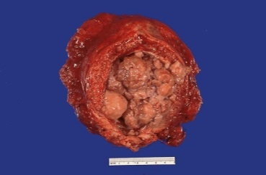
Bladder carcinoma

Slide 71
Disorders of the bladder and urethra – cancer - implications
High incidence of local recurrence – signs!
Risk of late radiation sequelae
Sequelae of surgery (cystectomy) incl. infection, impotence
Retraining of voiding, pelvic floor muscles

Slide 72
Urinary incontinence
Complaints of involuntary urine loss
Variable categories, commonly mixed UI
Urgency urinary incontinence – loss of urine + urgency due to overactive bladder, variable triggers (running water, …)
Stress urinary incontinence – during increased intraabdominal pressure
  On effort / physical exertion – lifting weight, …
  Coughing, sneezing

Slide 73
Urinary incontinence
UI common, more prevalent in women (50%) than males (14%)
In older adults, particularly nursing home
Diagnosis! – not a part of the normal aging process
Consequences:
  depression, social isolation, limited work opportunities
  UTI
  Decreased exercise participation
  Increased fracture risk (incontinence + postural hypotension → fall)

Slide 74
Urinary incontinence – risk factors
Obesity, ↑ BMI
Age
Pregnancy (multiple)
Pelvic surgery (prostate in males, uterus in females)
Diabetes mellitus
Constipation
UTI
Medications
Impaired cognitive function, impaired mobility

Slide 75
Urinary incontinence - implications
Rehabilitation often possible
  Pelvic floor muscles exercises
  Bladder training
  Biofeedback possible
Everyone should be asked about urinary problems
  Esp. peri- postmenopausal women
  Parous women (who have been pregnant)
  People ˃ 60 years
  Person with multiple risk factors

