Slide 1
BLOOD PRESSURE
Blood pressure – the most important parameter in cardiovascular system – „high-profile“ parameter

Slide 2
Blood pressure (BP) – pressure of the blood to the wall of the vessels
Systolic BP, diastolic BP, pulse pressure, mean arterial pressure (MAP)
BP = CO x R CO – cardiac output, R – resistance
CO = SV x HR SV – stroke volume, HR – heart rate

Slide 3
ESH AND ESC GUIDELINES
2013 ESH/ESC Guidelines for the management of arterial hypertension
The Task Force for the management of arterial hypertension of the European Society of Hypertension (ESH) and of the European Society of Cardiology (ESC)
Authors/Task Force Members: Giuseppe Mancia (Chairperson) (Italy) * , Robert Fagard (Chairperson)

Slide 4
Classification BP values
category | Systolic BP | Diastolic BP
 | (mmHg) | (mmHg)
optimal | < 120 | < 80
normal | 120 – 129 | 80 – 84
high normal pressure | 130 – 139 | 85 – 89
Hypertension - mild | 140 – 159 | 90 – 99
Hypertension - moderate | 160 – 179 | 100 – 109
Hypertension - severe | ≥ 180 | ≥ 110
Izolated systolic hypertension | ≥ 140 | < 90
According the Guidelines of European Society of Cardiology 2013

Slide 5
2018 ESC/ESH Guidelines for the management
of arterial hypertension
The Task Force for the management of arterial hypertension of the
European Society of Cardiology (ESC) and the European Society of
Hypertension (ESH)
Authors/Task Force Members: Bryan Williams* (ESC Chairperson) (UK),
Giuseppe Mancia* (ESH Chairperson) (Italy), Wilko Spiering (The Netherlands),
Enrico Agabiti Rosei (Italy), Michel Azizi (France), Michel Burnier (Switzerland),
Denis L. Clement (Belgium), Antonio Coca (Spain), Giovanni de Simone (Italy),
Anna Dominiczak (UK), Thomas Kahan (Sweden), Felix Mahfoud (Germany),
Josep Redon (Spain), Luis Ruilope (Spain), Alberto Zanchetti† (Italy), Mary Kerins
(Ireland), Sverre E. Kjeldsen (Norway), Reinhold Kreutz (Germany),
Stephane Laurent (France), Gregory Y. H. Lip (UK), Richard McManus (UK),
Krzysztof Narkiewicz (Poland), Frank Ruschitzka (Switzerland),
Roland E. Schmieder (Germany), Evgeny Shlyakhto (Russia), Costas Tsioufis
(Greece), Victor Aboyans (France), and Ileana Desormais (France)
European Heart Journal (2018) 39, 3021–3104

Slide 6
Classification of BP
It is recommended that BP be classified as
optimal, normal, high–normal, or grades
1–3 hypertension, according to office BP.

Slide 7
Classification BP values: „officer BP“
category | Systolic BP | Diastolic BP
 | (mmHg) | (mmHg)
optimal | < 120 | < 80
normal | 120 – 129 | 80 – 84
high normal pressure | 130 – 139 | 85 – 89
Hypertension – mild: grade 1 | 140 – 159 | 90 – 99
Hypertension – moderate: grade 2 | 160 – 179 | 100 – 109
Hypertension – severe: grade 3 | ≥ 180 | ≥ 110
Isolated systolic hypertension | ≥ 140 | < 90
According the Guidelines of European Society of Cardiology 2018

Slide 8
BLOOD PRESSURE MEASUREMENT
Direct invasive method
  1726 Stephan Hales – horse
  Today – during catetrisation
  Indirect non-invasive measurement
  palpation method
  Auscultation method
  Oscilometric method

Slide 9
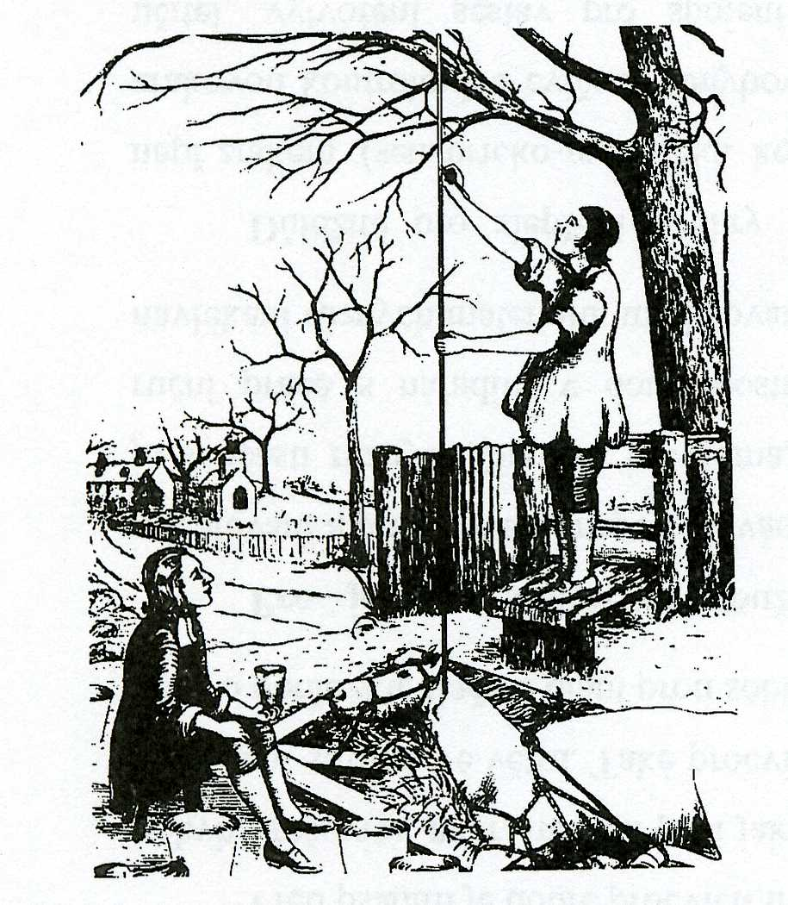

Slide 10
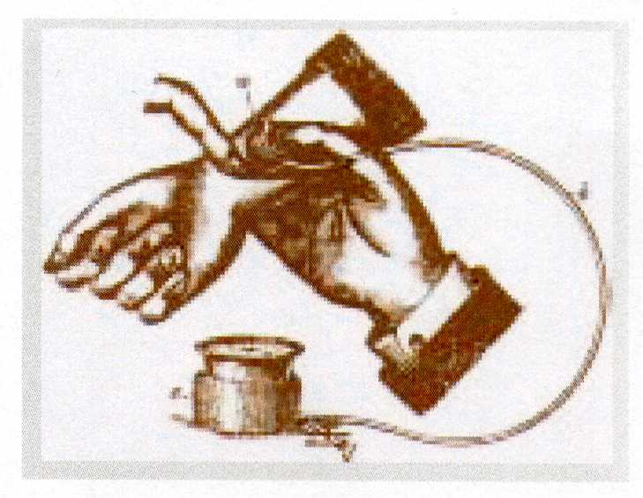
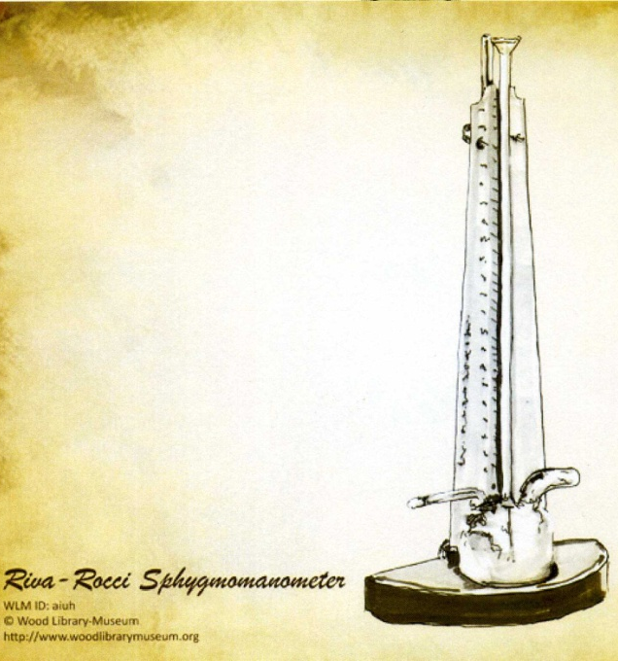
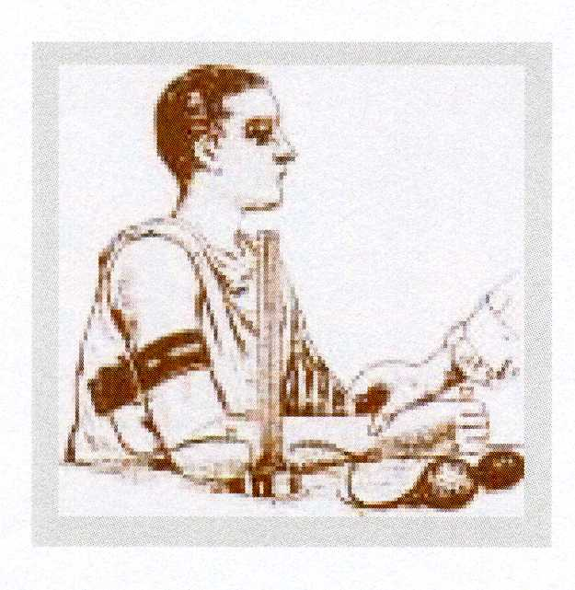
Palpatory methods
An Austrian physician
Von Basch
„aneroid sfygmomanometr“
Balloon in the wrist
1876
Italian physician
Riva Rocci
„mercury sfygmomanometr“
The cuff on the arm
1896

Slide 11
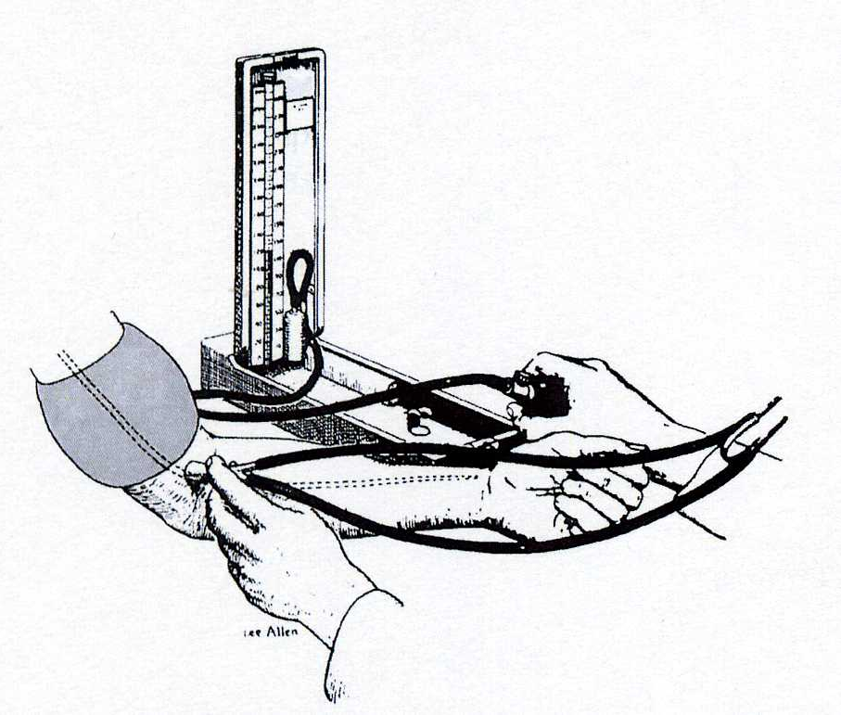
Auskultatory method
A Russian army surgeon
Nikolai Korotkoff
1904
„mercury sfygmomanometr“
The cuff on the arm
Stethoscope at the elbow

Slide 12
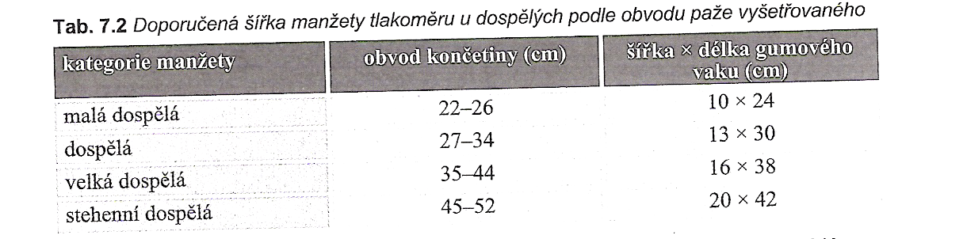
The size of the cuff in adults
Small adult
Adult
Large
Tight cuff
Špinar, J. a kol. Propedeutika a vyšetřovací metody vnitřních nemocí, 2008

Slide 13
Noninvasive continuously beat-to-beat measurement of finger arterial pressure
Prof. Jan Peňáz, MD, PhD
Teacher and researcher on the Department of Physiology, Masaryk university, Brno
Patent 1969

Slide 15
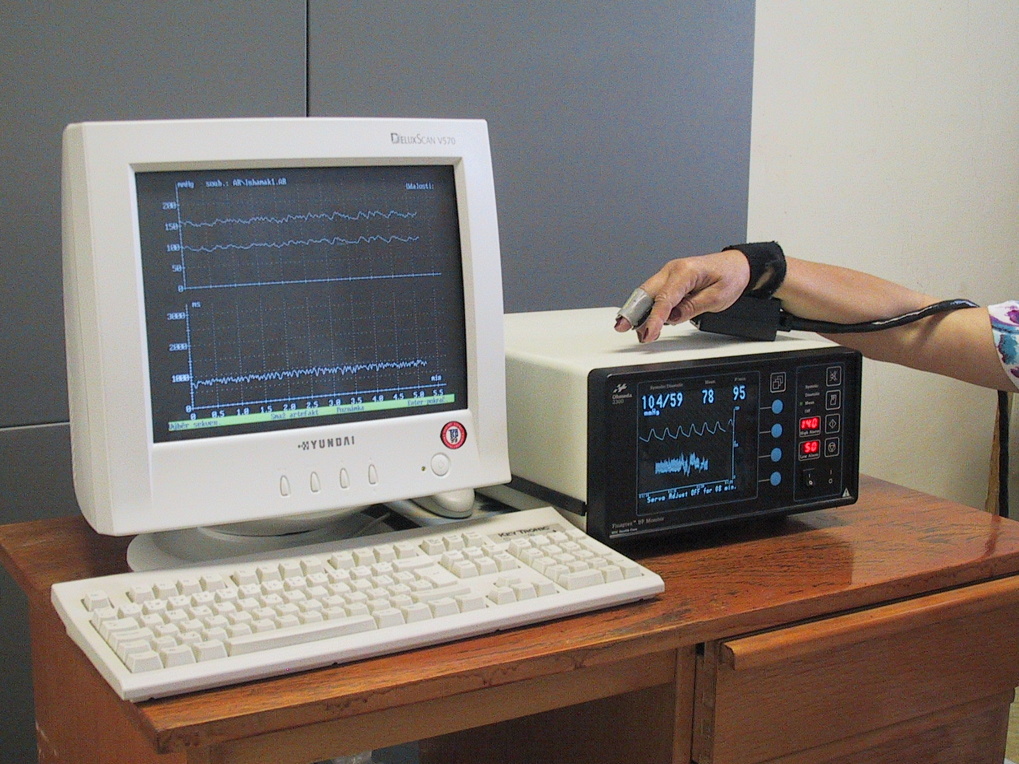
Finapres (Ohmeda, USA)

Slide 16
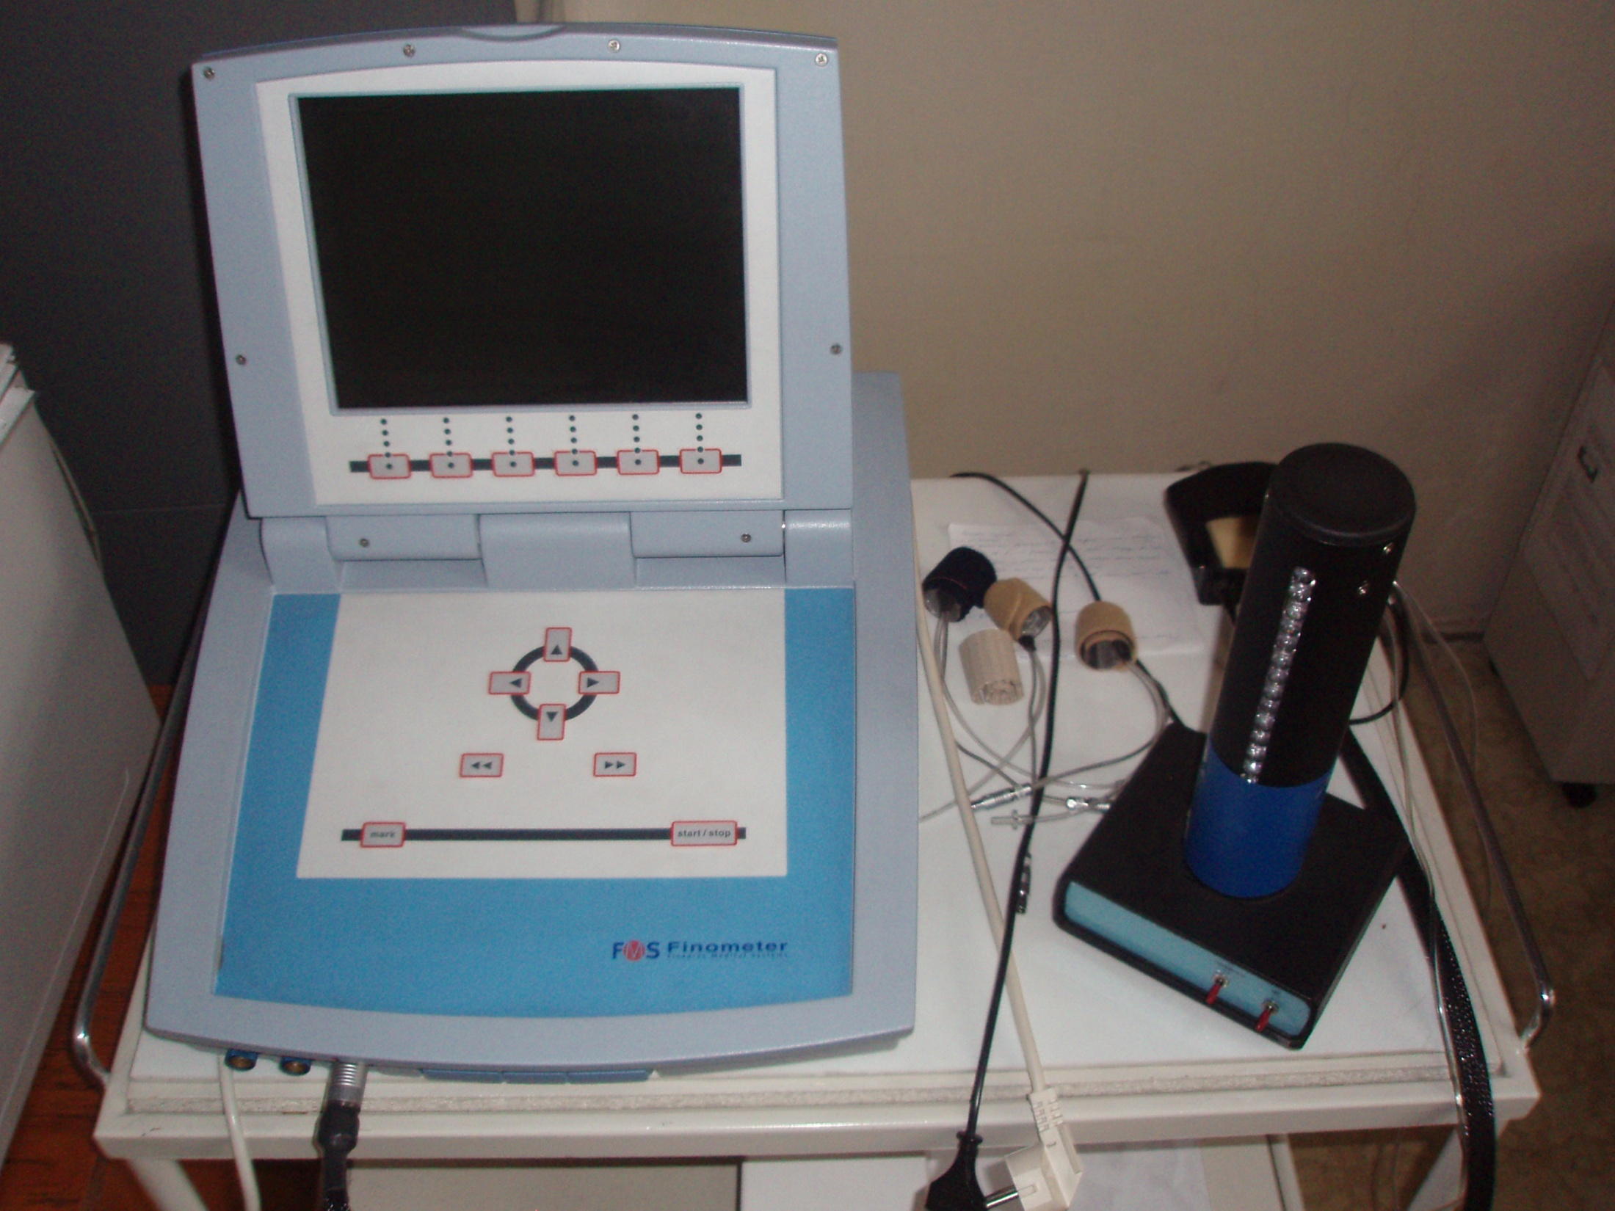
Finometr (FMS, Nizozemí)

Slide 17
We need than pressure in the cuff corresponded to the pressure of the digital artery
Method: photopletysmography
Recorded photoelectric plethysmogram
The new term: Transmural pressure – Pt (the pressure across the wall of the artery)
BP, Pc (pressure in cuff), Pt
We estimated: BP=Pc - - - Pt=0 - - - photoplethysmogram registered the highest amplitude of oscilation --- we measure the MAP
Step by step increase of Pc, in the moment of the highest amplitude – feed-back loop started for obtained(keeping) the constant volume of the finger

Slide 18
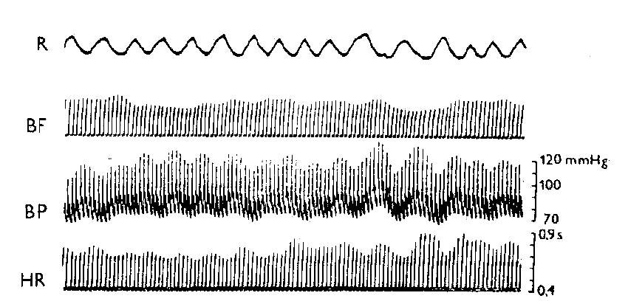
Records of circulatory parameters

