Slide 1

Cardiac action potential and underlying ionic currents
Methods, physiology and selected pathologies
Assoc. Prof. MUDr. Markéta Bébarová, Ph.D.
The presentation was created with the support of the FRMU project „Modernization of teaching of cardiac cellular electrophysiology“, MUNI/FR/1490/2018.

Slide 2
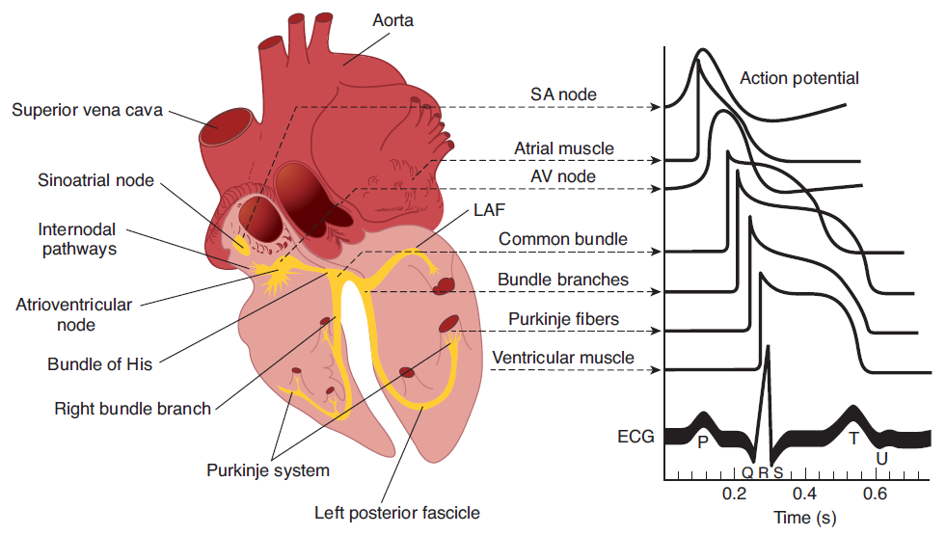
1
1:Ganong´s Review of Medical Physiology, 23rd edition
Notes:
Jak je obecně známo, podkladem fyziologicky probíhající mechanické aktivity srdce je adekvátně utvářená aktivita elektrická. Srdeční svalové buňky jsou jedním z typů vzrušivých tkání. Jsou tedy schopné na stimulaci reagovat vznikem akčního napětí, které se šíří srdeční svalovinou a umožní její následnou kontrakci vedoucí k vypuzení krve ze srdce do krevního oběhu.
Elektrická aktivita srdce vzniká a na pracovní myokard se šíří prostřednictvím srdečního převodního systému. Obrazem elektrické aktivity na úrovni jednotlivé srdeční buňky je akční napětí. Jeho konfigurace se zásadním způsobem liší v buňkách převodního systému a v buňkách pracovní svaloviny srdce a rovněž pak v rámci samotné pracovní svaloviny náležící k různým srdečním oddílům a vrstvám.
Odlišná konfigurace akčního napětí je podmíněna odlišným zastoupením a aktivitou jednotlivých iontových membránových proudů. Pro správné utváření akčního napětí je klíčová dokonalá souhra těchto proudů. Narušení funkce prakticky kteréhokoliv z iontových kanálů a tedy změna kteréhokoliv z iontových proudů pak může vést ke vzniku proarytmogenního stavu.

Slide 3
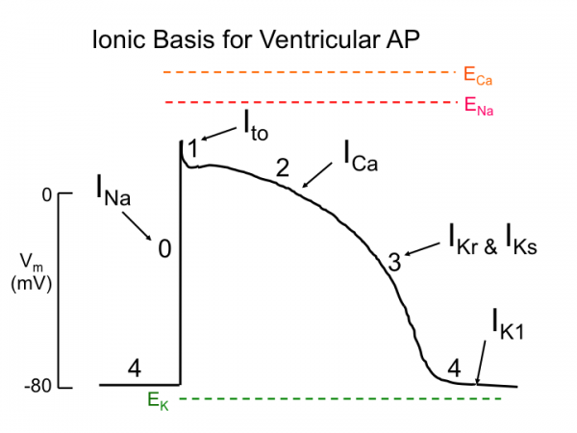
1
1
1: http://tmedweb.tulane.edu/tmedwiki/doku.php/intro_to_the_heart_cardiac_electrophysiology
Notes:
Fáze AN.
Iontový podklad AN. Význam souhry jednotlivých proudů pro správné utváření AN.
Tyto iontové proudy, tedy proudy nesené ionty, které jsou hydrofilními a tedy lipofobními částicemi, tečou přes buněčnou membránu přes speciální proteiny přemosťující buněčnou membránu, tzv. iontové kanály.

Slide 4
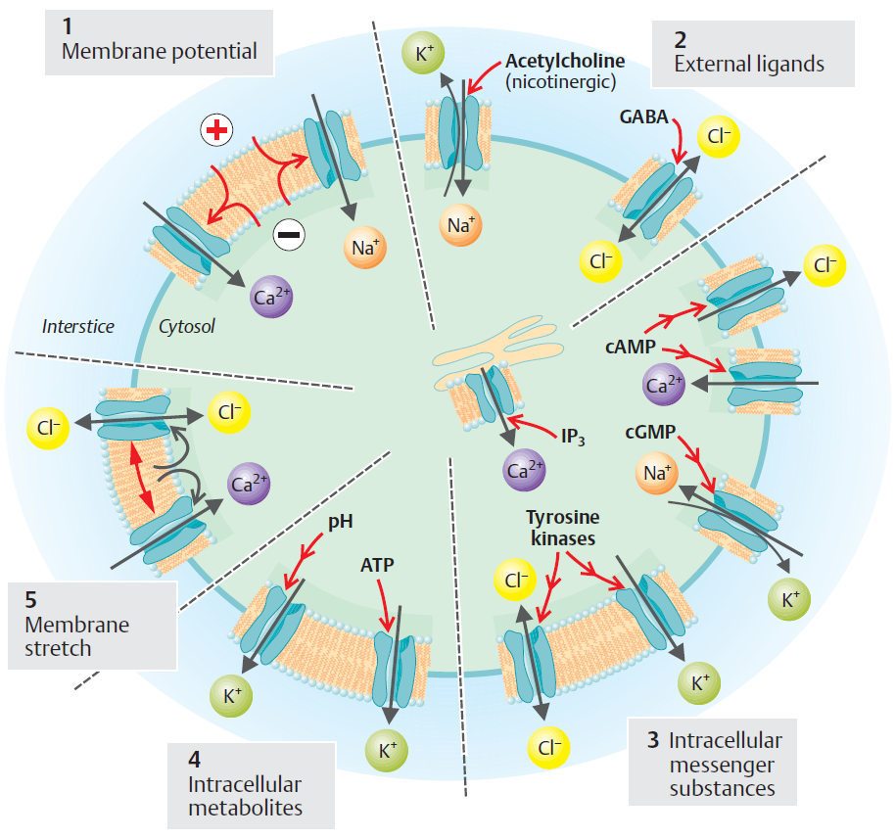
Ionic Channels
1
1
1:Despopoulos, Color Atlas of Physiology, 2003
Notes:
Iontové kanály – typ pasivního transportu, po elektrochemickém gradientu.
Různé typy iontových kanálů. Vrátkování.

Slide 5
Impact of Knowledge on Electrical Properties
of Cardiac Cells for Clinical Medicine
Inherited Arrhythmogenic Syndromes
Acquired Arrhythmogenic Syndromes
On a base of other primary cardiac diseases
Side effects of drugs
Effects of other substances including addictive drugs
Sudden Cardiac Death
Mechanisms of Action of Antiarrhythmic Drugs
1

Slide 6
Electrophysiological Methods in Cardiology
Measurements could be performed:
On the level of whole organism
  Example: ECG
On the level of the heart
  Example: Intracardiac ECG
On the isolated heart
  Example: Langendorff heart perfusion
On the multicellular cardiac samples
On the isolated cardiomyocytes
    Example: Whole cell patch clamp
  On the single membrane channels
    Example: Single channel patch clamp
1
Zipes D. and Jalife J. ; Cardiac Electrophysiology: From Cell To Bedside, 2003

Slide 7
Electrophysiological Methods in Cardiology
Measurements could be performed:
On the level of whole organism
  Example: ECG
On the level of the heart
  Example: Intracardiac ECG
On the isolated heart
  Example: Langendorff heart perfusion
Basic principle of methods:
We measure the potential difference between two points
  of a volume conductor
Measured quantity voltage.
Recorded signals represent a sum of contributions of electrical activities
  of individual cells of the organ during propagation of excitation.
1

Slide 8
Electrophysiological Methods in Cardiology
Measurements could be performed:
On the multicellular cardiac samples
On the isolated cardiomyocytes
    Example: Whole cell patch clamp
  On the single membrane channels
    Example: Single channel patch clamp)
Basic principle of methods:
We measure membrane voltage, which is the difference between
  the extracellular and intracellular medium, or membrane current.
1

Slide 9
Basic principle of measurements
on various levels of organism

Slide 10
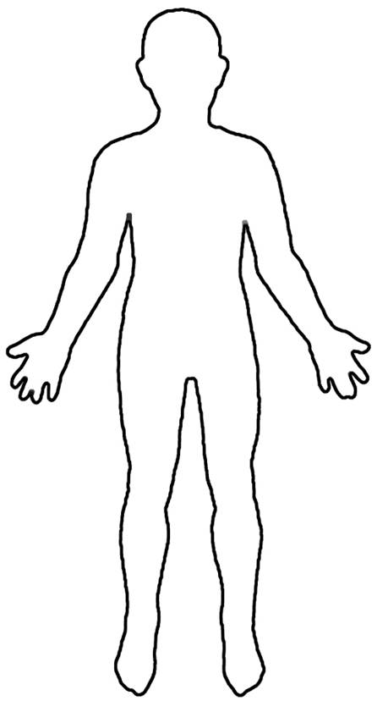
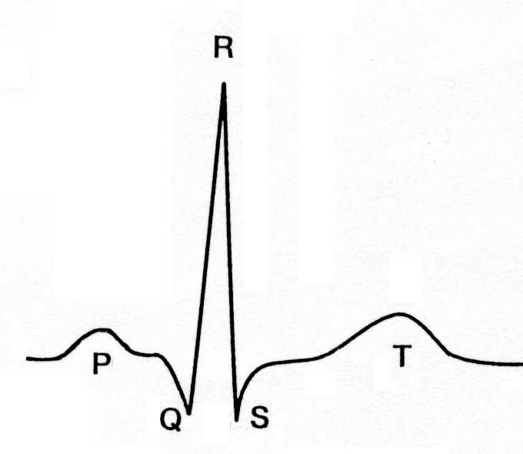
Electrocardiography
We record voltage and
its changes over the time.
EKG
V [mV]
t [s]
1
1
1:http://www.cndajin.com/group/human-figure-outline/#photo_2

Slide 11
Electrocardiography
Mechanism of impulse creation:
1
Adopted from Malmivuo, J., Plonsey, R., 1995. Bioelectromagnetism: principles and applications of bioelectric and biomagnetic fields. Oxford University Press, New York

Slide 12
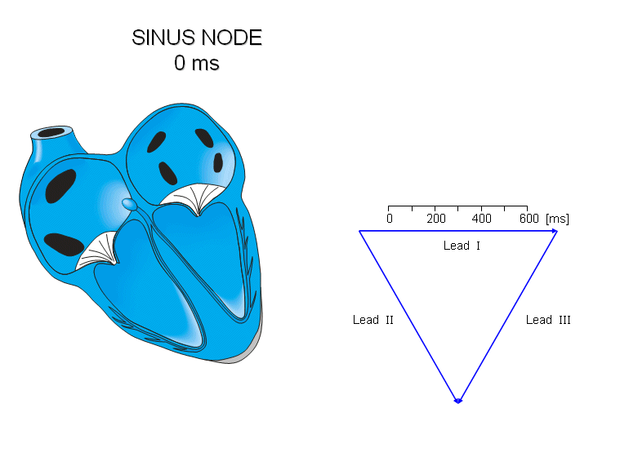
Electrocardiography
Mechanism of impulse creation:
1
Adopted from Malmivuo, J., Plonsey, R., 1995. Bioelectromagnetism: principles and applications of bioelectric and biomagnetic fields. Oxford University Press, New York

Slide 13
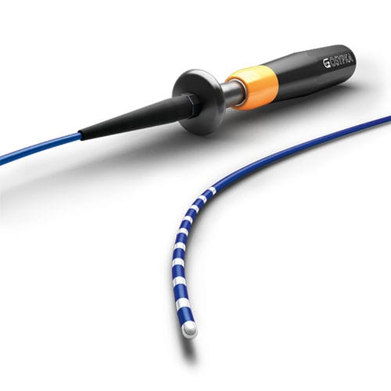
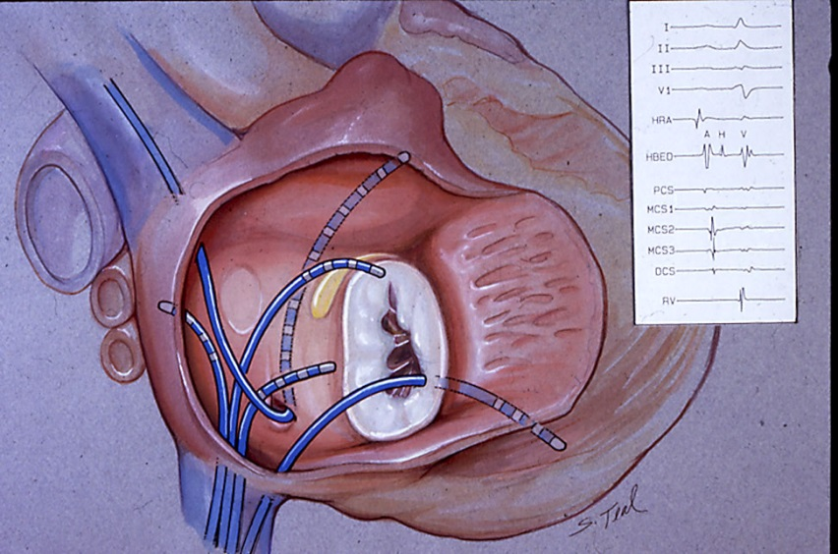
Intracardiac electrocardiography
An invasive method, routinely used in clinical practice
Basic principle:
  A multipolar catheter is inserted into the heart. It is positioned in close proximity
  along the conduction system. The signal is registered from the tip of the catheter.
1
1. Multipolar catheter
2. Intracardial position of the catheter with the example
of recorded signal
1: http://www.medicalexpo.com/prod/osypka/product-111576-879783.html; 2: http://www.drjohnm.dreamhosters.com/wp-content/uploads/2010/12/EPS-Teal_3.jpg

Slide 14
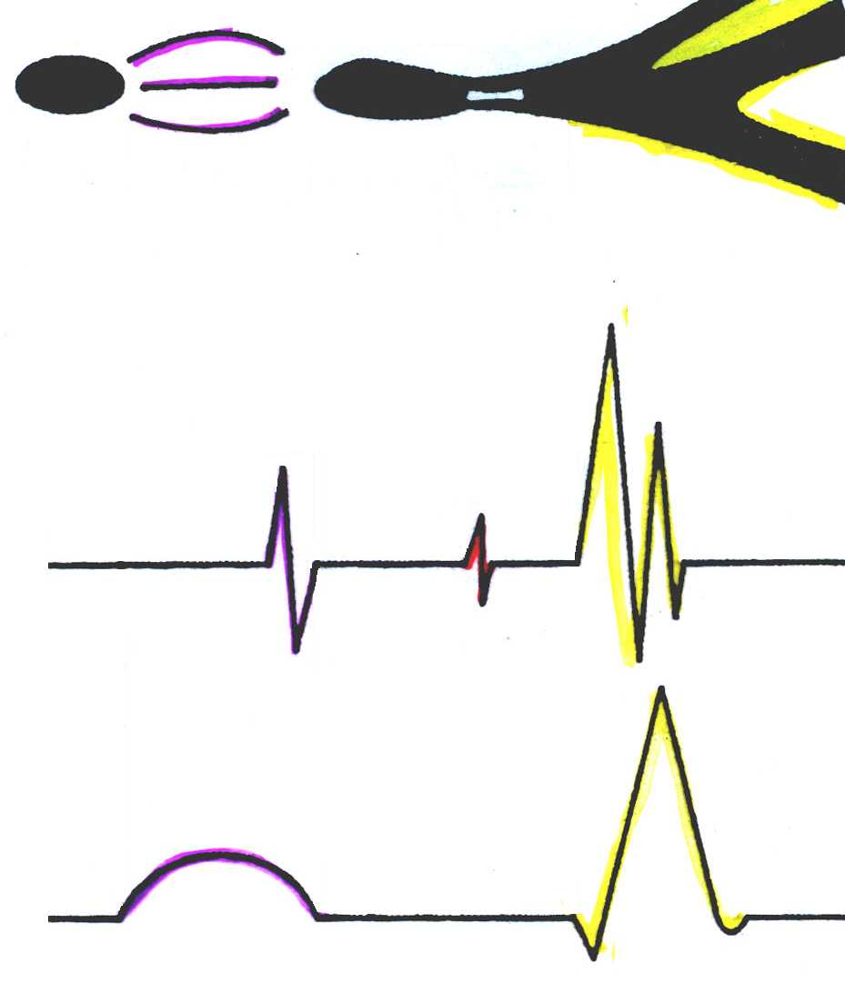
Intracardiac electrocardiography
We can measure:
The interpretation of recorded signal
Function of sinus node
Conduction thorugh the atrial wall
Conduction in atrioventricular node
Conduction through Hiss bundle
Conduction through Purkinje fibers
SA
AV
PA
AH
HV
V
V
A
A
H
V
EHS
H
A
PQ segment
Hiss bundle electrogram
EKG
P
1
PQ
QRS

Slide 15
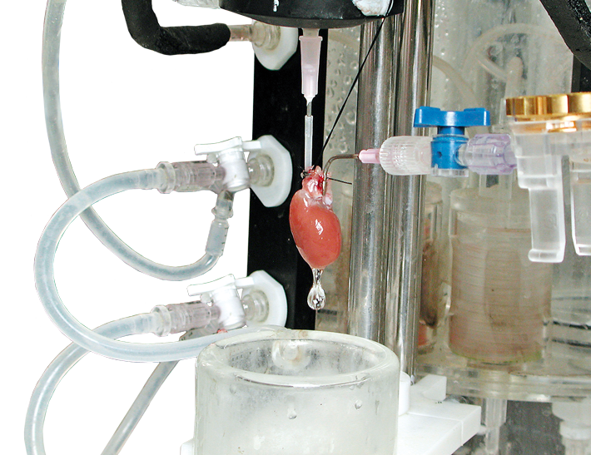
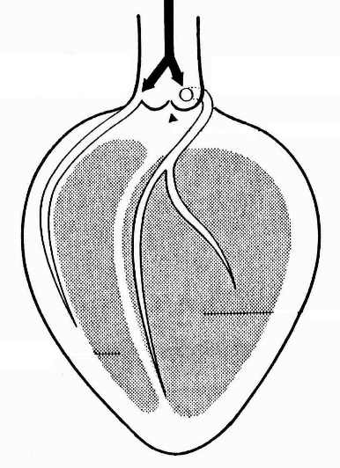
Measuremt on the isolated heart
An experimental methos
The heart is placed in the Langendorff perfusion set:
Principle of the retrogarde perfusion
direction of flow of the solution
aorta →
perfusion through the coronary artery
close aortic valve
LW
RV
empty ventricles
1
1
1: https://www.adinstruments.com/research/animal/cardiovascular/isolated-heart-systems/langendorff

Slide 16
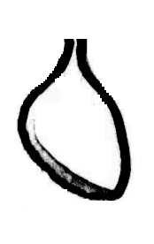
Measuremt on the isolated heart
Measurement is performed by:
electrodes embedded in walls of the bath
Electrogram
reference electrode
[mV]
Epicardial suction electrode
Monophasic action potential

Slide 17
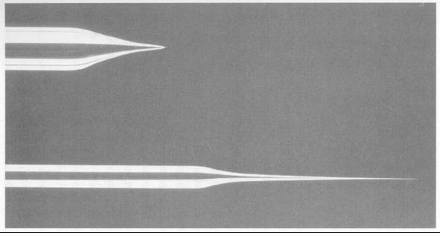

Measurement on multicullular cardiac samples
Set-up
Ag/AgCl electrode
Glass microelectrode
Glass microelectrode
Reference Ag/AgCl electrode

Slide 18
Measurement on multicullular cardiac samples
A stimulation of the sample is needed for the measurement
It could be performed in two modes:
current clamp mode
voltage clamp mode
Stimulation
I_{m}
U_{m}
I_{c}
I_{to}
I_{K}, I_{K1}
I_{m}
Recorded signal
U_{m}
I_{Ca-L}
I_{c}
I_{Na}

Slide 19
Patch-clamp
Both whole cell patch-clamp and single channel patch-clamp require
  an isolated cardiac cells.
By the successful dissociation, we obtain a sufficient fraction of viable,
  funtionally undamaged cells responding to electrical stimulation by:
  Contraction
  Characteristic electrical activity (action potential and membrane currents)

Slide 20
Patch-clamp
Enzymatic isolation of cardiac cells:

Slide 21
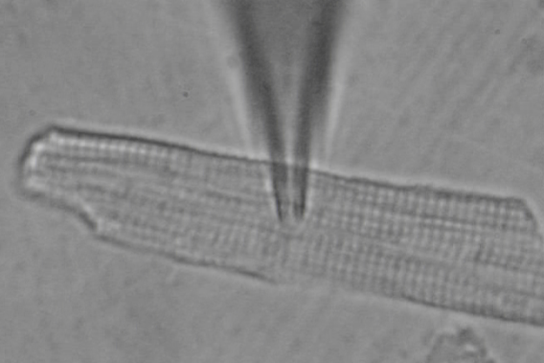
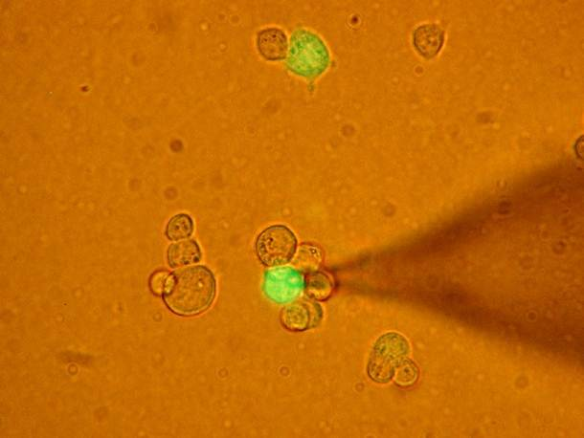
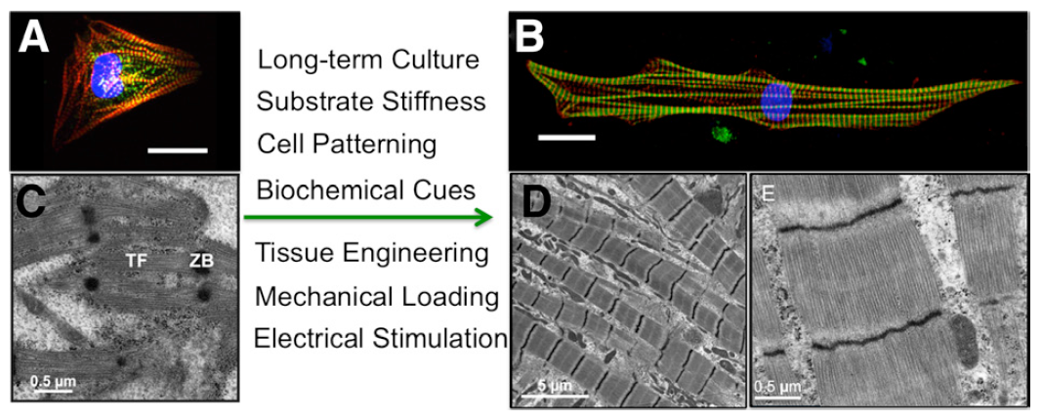
Possibilities of using patch-clamp
Measurements could be performed on:
Isolated cardiac cells
Cell lines transiently expressing
  human ionic channels
Induced pluripotent stem
  cell-derived cardiac cells
  (iPSC-CM)

Slide 22
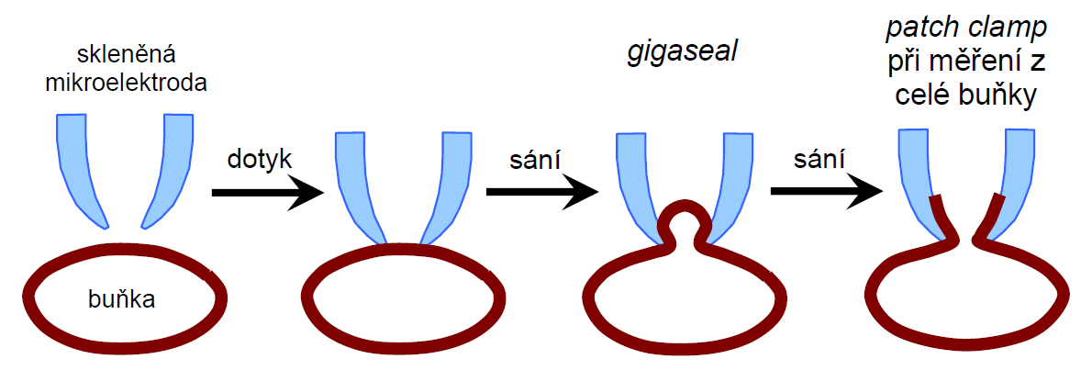
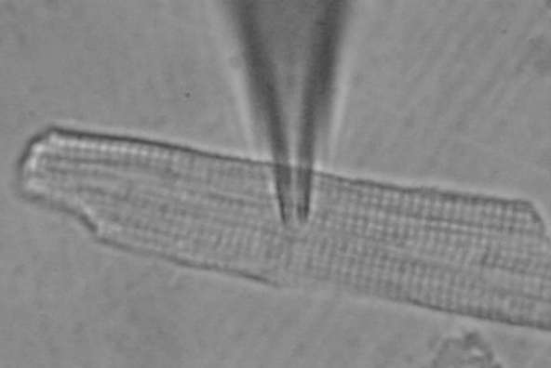
Patch-clamp
Whole cell patch-clamp
Establish a contact with a cell

Slide 23
Patch-clamp
Whole cell patch-clamp
Measurement on a single cell
Two mode of measurement:
Voltage clamp
Current clamp

Slide 24
Patch-clamp
Single channel patch-clamp
[pA]
Current flowing through single channel in response to imposed voltage pulse
Glass microelectrode
Membrane patch with single channel

Slide 25
Patch-clamp
Single channel patch-clamp
5 µM ACh
Glass microelectrode
50 μM ACh
Membrane patch with single channel
Single channel current at -110 mV induced by acetylcholine at rat neuromuscular junction (nicotinic receptors; Mulrine and Ogden)

Slide 26
Possibilities of using patch-clamp
We can analyse:
Ionic channel gating under physiological and pathological conditions
  Example: Changes of cardiac ionic currents in failing heart
Drug effects on ionic channels
  Example: Describing the pro-arrhythmogenic properties of certain drugs, i.e.:
          Effect of antiarrhythmic drug ajmaline on action potential and on I_{K(ATP)}
          Effect of antipsychotic drug perphenazine on I_{Na} and I_{to}
          Effect of ethanol on I_{K1}
          Effect of anidepressant nefazodone on I_{Kr}
Impact of a mutation on drug effects on a channel
Ionic channel dysfunction caused by a mutation
  Example: Analysis of arrhythmogenic syndromes:
          Long QT syndrome
          Brugada syndrome
1

Slide 27
          Example: Effect of antiarrhythmic drug ajmaline on action potential
CONTROL
AJMALINE
WASH-OUT

Slide 28
          Příklad: Vliv antiarytmika ajmalinu na I_{K(ATP)}
Měření I_{K(ATP)}
Voltage
clamp
impulse
240 mV
Control
Recorded current
I_{K(ATP)}
After DNP
aplication
3 nA
50 ms

Slide 29
          Example: Effect of antiarrhythmic drug ajmaline on I_{K(ATP)}
Measurement of I_{K(ATP)}
Voltage
clamp
impulse
240 mV
Kontrola
I_{K(ATP)} in control
Recorded current
Changes after
ajmaline
aplication
I_{K(ATP)} after ajmaline aplication

Slide 30
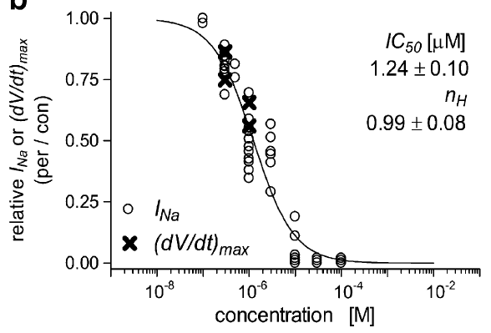
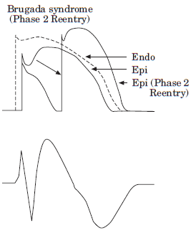
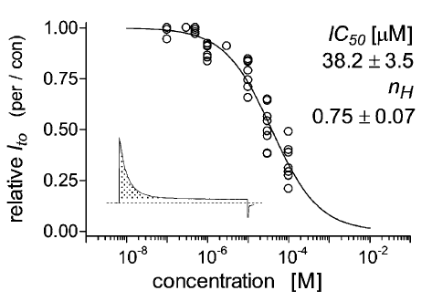
          Example: Effect of antipsychotic drug perphenazine on I_{Na} and I_{to}
1
2
I_{Na}
I_{to}
1:Bébarová et al. (Naunyn Schmied Arch Pharmacol 2009; 380:125-133); 2: http://tmedweb.tulane.edu/tmedwiki/doku.php/intro_to_the_heart_cardiac_electrophysiology

Slide 31
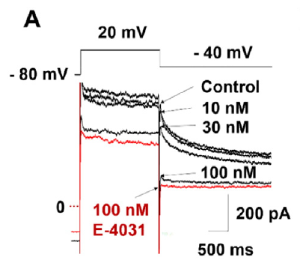
          Example: Effect of antidepressant nefazodone on I_{Kr}
Measurement was performed on
  Induced pluripotent stem cell-derived
  cardiac cells
Inhibition of I_{Kr}
  by nefazodone
1
Work about nefazodonueis from Lee et al., Toxicol Appl Pharmacol 2016; 296: 42-53; 1: Jouni et al., J Am Heart Assoc 2015; 4: e002159
Notes:
Odkaz na TZKM
Možnost modelovat dědičné arytmie
Inhibice Ikr antidepresivem druhé generace nefazodonem (množící se zprávy o jeho proarytmogenní aktivitě)

Slide 32
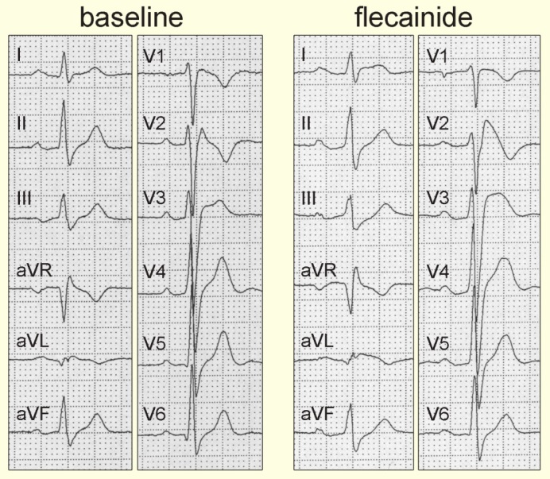
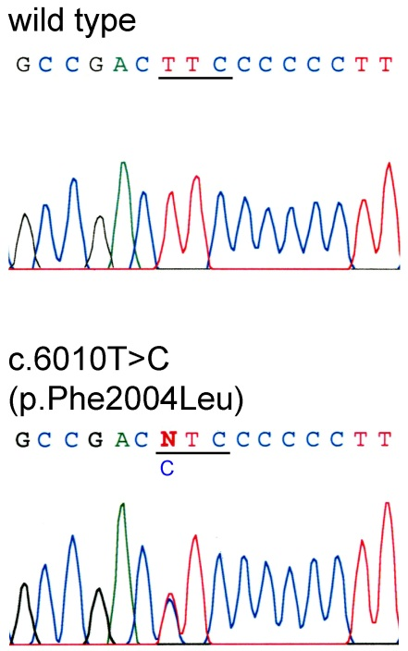
          Example: Brugada syndrome
NH₂
COOH
F2004L
clinical symptoms: syncope
ECG: ST elevation
Missence mutation in C-terminus I_{Na} channel
P wave = 80 ms (120 ms)
QRS complex = 135 ms (100 ms)
QTc interval = 382 ms (440 ms)
AH = 109 ms (160 ms)
HV interval = 56 ms (50 ms)
Adopted from Bébarová et al. , Am J Physiol Heart Circ Physiol 2008; 295:H48-H58

Slide 33
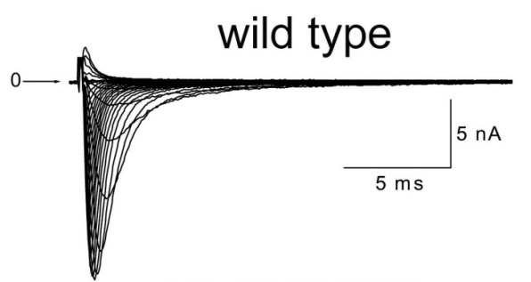
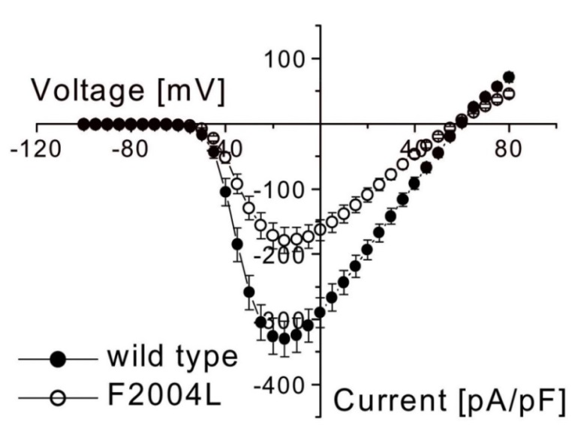

          Example: Brugada syndrome
Measurement was performed on cell line transiently expressing human
  wild-type and mutated (F2004L) I_{Na} channel
Inhibition of I_{Na} in mutated channel
F2004L
Adopted from Bébarová et al. , Am J Physiol Heart Circ Physiol 2008; 295:H48-H58

Slide 34
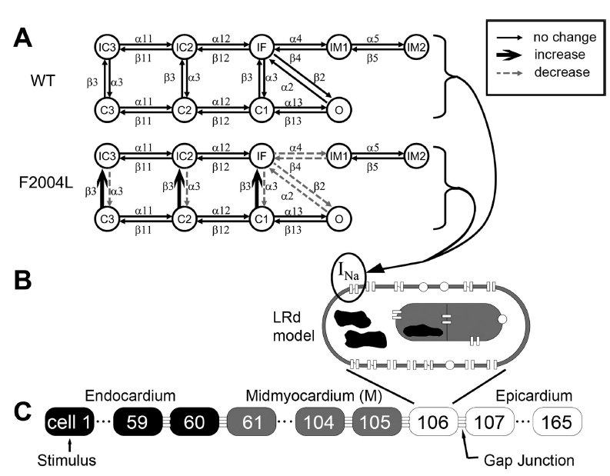
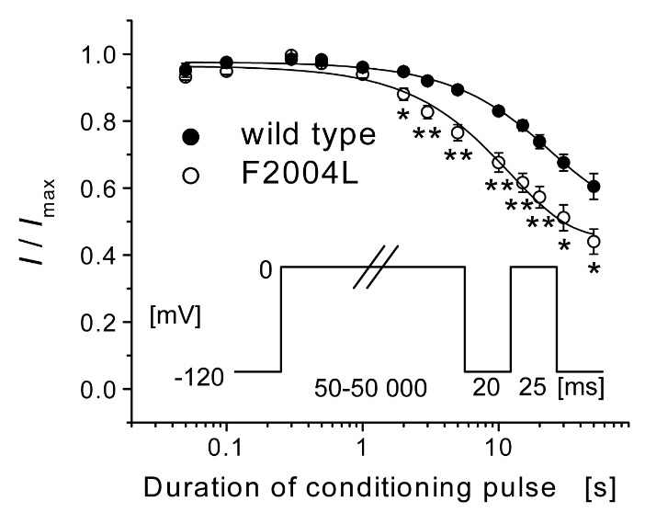
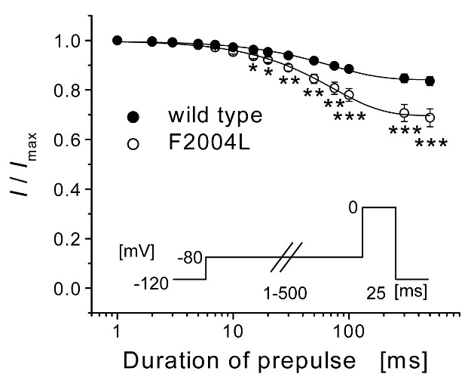
          Example: Brugada syndrome
Kinetic scheme of I_{Na} channel
d
Development of closed state inactivation
Development of slow
inactivation
Adopted from Bébarová et al. , Am J Physiol Heart Circ Physiol 2008; 295:H48-H58

Slide 35
          Example: Brugada syndrome
Schematic model
Adopted from Bébarová et al. , Am J Physiol Heart Circ Physiol 2008; 295:H48-H58

Slide 36
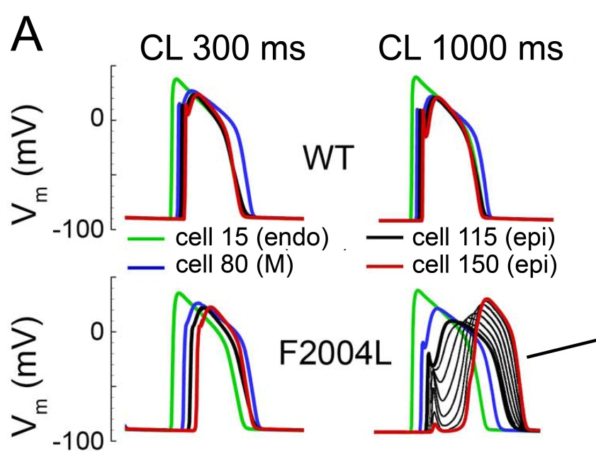
          Example: Brugada syndrome
Schematic model
Adopted from Bébarová et al. , Am J Physiol Heart Circ Physiol 2008; 295:H48-H58

Slide 37
The presentation was created with the support of the FRMU project „Modernization of teaching of cardiac cellular electrophysiology“, MUNI/FR/1490/2018.

