Slide 1
Basic Medical terminology II
Seminar 10-11:
Types of medications
Medical prescription

Slide 2
Basic types of medications
Names of medications = remedium (sg.) / remedia (pl.) + adjective
REMEDIUM (usually omitted)…
Plural forms?
-(I)ENTIA/-ANTIA
-(I)ENS/-ANS
-ICUM/-IVUM
  -LYTICUM?
  CONTRA-/ANTI-?
  HYPO-?
  DE-/DES-?
  AN-?
-ICA/-IVA
ANXIOLYTICUM
CONTRACEPTIVUM / ANTIDOTUM
HYPOTONICUM
DETOXICANS
ANALGETICUM
Notes:
Rem. anxiolyticum = a drug preventing or reducing anxiety; contraceptivum = a drug preventing conception; antidotum = a drug counteracting/neutralizing a poison; hypotonicum = a drug decreasing blood pressure; detoxicans = a drug removing toxins from the body; analgeticum = a drug relieving pain

Slide 3
Change the underlined words into the opposite number (Handout 9.7, task 7)
REMEDIUM ANXIOLYTICUM
VASODILATANTIA PROPTER STENOSIM VASORUM
DOSIS ANTIBIOTICI PRO INFANTE
ANTIPYRETICA PROPTER HYPERPYREXIAM
REMEDIUM MYORELAXANS
REMEDIA PROPHYLACTICA IN GRAVIDITATE
REMEDIA ANXIOLYTICA
VASODILATANS
DOSES ANTIBIOTICORUM PRO INFANTIBUS
ANTIPYRETICUM
REMEDIA MYORELAXANTIA
REMEDIUM PROPHYLACTICUM
Notes:
Rem. anxiolyticum = a drug preventing or reducing anxiety; vasodilatans = a drug causing dilatation of walls of blood vessels; antibioticum = a drug used to treat or prevent bacterial infections; antipyreticum = a drug reducing fever; myorelaxans = a drug reducing muscle contractility; prophylacticum = a drug to prevent a disease or infection

Slide 4
Match the types of medications with appropriate clinical conditions (Handout 9.7, task 8)
CONTRACEPTIVUM | DYSPEPSIA
HYPNOTICUM | FEBRIS
ANTIDOTUM | TUSSIS
ANTIPYRETICUM | INSUFFICIENTIA CORDIS
STOMACHICUM | INSOMNIA
OBSTIPANS | GRAVIDITAS
EXPECTORANS | INTOXICATIO
CARDIOSTIMULANS | DIARRHOEA
Notes:
Rem. contraceptivum = a drug preventing conception; hypnoticum = a drug inducing sleep; antidotum = a drug counteracting/neutralizing a posion; antipyreticum = a drug reducing fever; stomachicum = a drug stimulating gastric digestion and relieving discomfort caused by stomach pain; obstipans = a drug providing relief from diarrhoea; expectorans = a drug facilitating the secretion or expulsion of phlegm or mucus from the respiratory tract; cardiostimulans = a drug stimulating the function of the heart

Slide 5
Match the clinical conditions with appropriate types of medications
OBSTIPATIO
THROMBOSIS
ONYCHOMYCOSIS
CANCER
DILATATIO VASORUM
OLIGURIA
HYPERTENSIO
DOLORES PERMAGNI
DIURETICA
ANTICOAGULANTIA
VASOCONSTRINGENTIA
NARCOTICA
HYPOTONICUM
CHEMOTHERAPEUTICA
LAXATIVA/LAXANTIA
ANTIMYCOTICA
Notes:
Rem. laxativum/laxans = a drug stimulating evacuation of the bowels; anticoagulans = a drug preventing blood clotting; antimycoticum = a drug used to prevent or inhibit the growth of fungi (onychomycosis = a fungal infection of the fingernails or toenails); chemotherapeuticum = a drug that is selectively destructive to malignant cells and tissues; vasoconstringens = a drug that causes narrowing of the walls of blood vessels; diureticum = a drug increasing the formation of urine (olyguria = abnormally small production of urine); emeticum = a drug increasing nausea and vomiting; hypotonicum = a drug decreasing blood pressure; narcoticum = a drug used to relieve pain and induce sleep

Slide 6
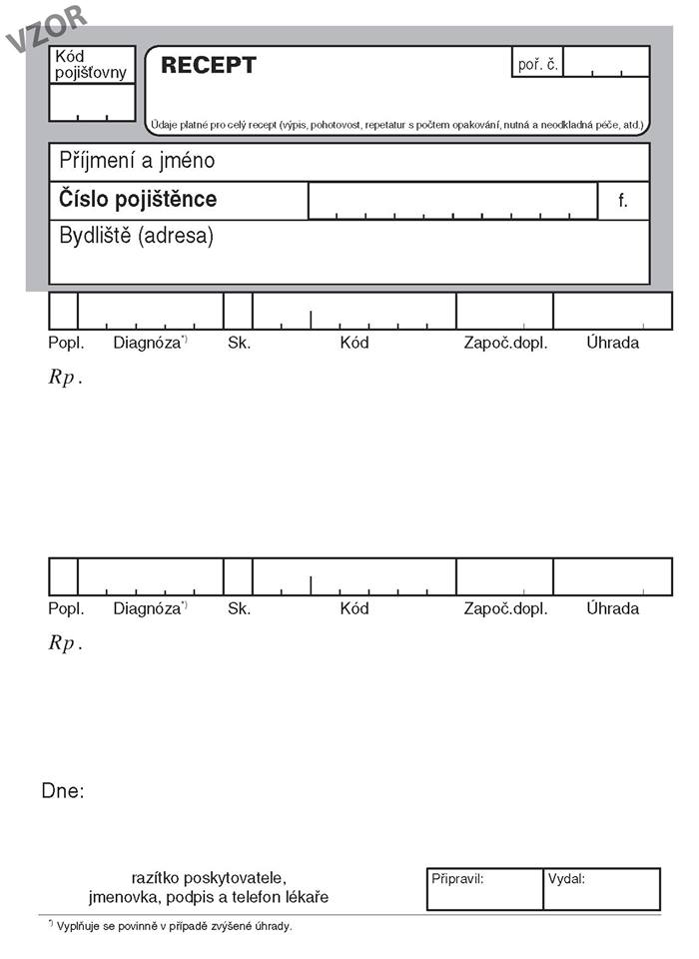
Medical prescription
CZECH

Slide 7
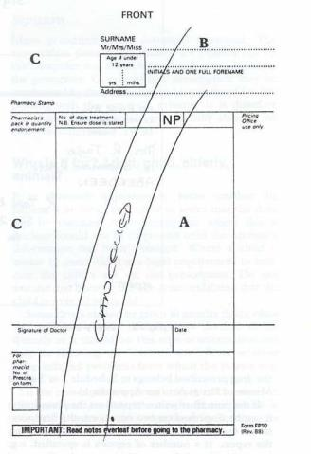
Medical prescription
BRITISH

Slide 8
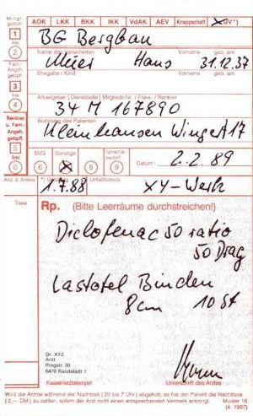
Medical prescription
GERMAN

Slide 9
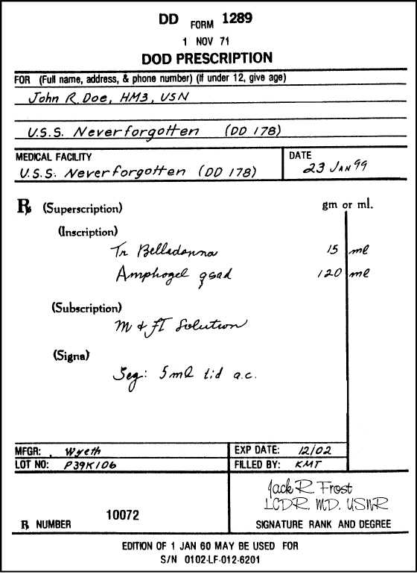
Medical prescription
AMERICAN

Slide 10
CZECH, currently used

Slide 11
Medical prescription: structure
INSCRIPTIO
PERSONALIA AEGROTI
INVOCATIO
Rp. = Recipe = take!
Natrii bromati (bromatis) 6,0
Phenobarbitali 0,6
Sirupi Menthae 60,0
Aquae destillatae ad 300,0
M. f. mixt. = Misce fiat mixtura = Mix (the ingredients) to make
a mixture (literally: so that a mixture is made)
D. S. = Da. Signa. = Give! Sign! Jedna lžička třikrát denně po jídle.
(= One tablespoon 3 times a day after meal).
ORDINATIO:
PRAESCRIPTIO
rem. cardinale
rem. adiuvans
rem. corrigens
rem. constituens
SUBSCRIPTIO
SIGNATURA

Slide 12
Magistraliter
= individually prepared medications
Rp.
Kalii iodidi
Anisi spiritus compositi aa 5,0
Aquae purificatae ad 200,0
M. f. sol.
D. S. 3krát denně jednu lžíci.
RECIPE
ANA (PARTES AEQUALES)
GENITIVES!
(expressing How much OF…)
MISCE FIAT SOLUTIO
DA. SIGNA.
EXPECTORANS
Notes:
Rem. expectorans = a drug promoting or facilitating the secretion or expulsion of phlegm or mucus from the respiratory tract

Slide 13
Specialitates
= ready-made medications
Rp.
Framykoin plv. ads. 1 x 20 gm
Exp. orig. No. II (duas)
D. S. Aplikovat 2krát denně na
postižená místa po dobu 10 dnů.
RECIPE
PULVIS ADSPERSORIUS
EXPEDITIONES ORIGINALES
ACCUSATIVE!
DA. SIGNA.
ANTIBIOTICUM
Notes:
Rem. antibioticum = a drug used to treat or prevent bacterial infections

Slide 14
Medical prescription: revision
What are the introductory and the concluding Latin formulae in a prescription?
Which part of a prescription is not in Latin? Why?
What is the difference between an individually prepared and a ready-made prescription?
Which cases of nouns are used in medical prescriptions? For what reason?
Which Latin abbreviation is used to express the number of original packages of a particular medication?

Slide 15
Put the lines in the correct order and read the prescription (Handout 9.7, task 1)
IMMUNOSTIMULANS
Exp. orig. No. I (unam)
Rp.
Imunor p. o. 4 x 10 mg
D. S. Dle rozpisu.
Notes:
Rem. immunostimulans = a drug that stimulates an immune response
Slidy s oranžovými tabulkami v hodině – cvičení 1 – stejné recepty se objevují znovu v posledním cvičení v handoutu, to bych dala za úkol.

Slide 16
Put the lines in the correct order and read the prescription (Handout 9.7, task 1)
GYNAECOLOGICUM
D. ad scat.
Acidi borici pulv. 100,0
Rp.
S. Jednu lžíci na litr teplé vody
k výplachům.
Notes:
Rem. gynaecologicum = a drug used to treat disorders affecting the female reproductive system
Výplach = lavage

Slide 17
Fill in missing terms and translate
(Handout 9.7, task 2)
HYPNOTICUM
Rp.
Amobarbitali 0,15
Codeinii dihydrogenphosphorici 0,03
Aminophenazoni 0,25
Olei cacao q. _______ ut _______ supp.
D. ________ d. _________ VI (sex)
S. Na noc zavést 1 čípek.
Notes:
Rem. hypnoticum = a drug inducing sleep

Slide 18
Fill in missing terms and translate
(Handout 9.7, task 2)
ANTIDEPRESSIVUM
________
Asentra 50 tbl. p. o. 28 x 50 mg
________ orig. _______ IV (quattuor)
D. ________ 2 tablety denně.
Notes:
Rem. antidepressivum = a drug used to treat depression

Slide 19
Give full forms of the underlined abbreviations and translate the terms (Handout 9.7, task 3)
ANALGETICUM + ANTIPYRETICUM
Rp.
Acidi acetylsalicylici
Paracetamoli aa 0,3
Codeinii dihydrogenphosphorici 0,02
Coffeini cum natrio benzoico 0,1
Magnesii oxydati 0,05
M. f. pulv.
D. t. d. No. XX (viginti) ad caps.
S. 3krát denně 1 prášek.
Notes:
Rem. analgeticum = a drug relieving pain; antipyreticum = a drug reducing fever

Slide 20
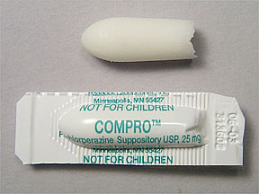
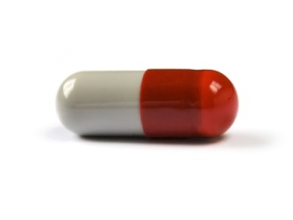
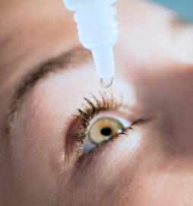
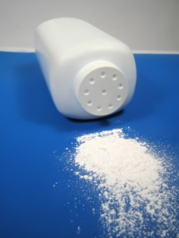
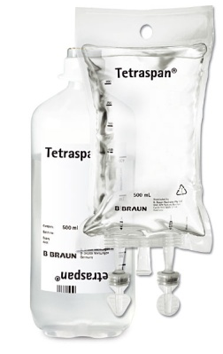
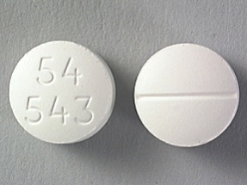
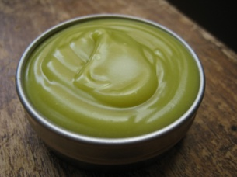
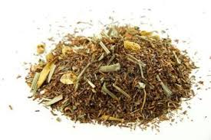
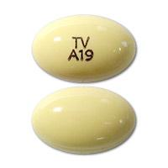
Forms of pharmaceutical preparations and agents (cf. Handout 9.7, task 4)
pulvis (adspersorius) ~ suppositorium ~ guttae ~ unguentum ~
tabuletta ~ infusio ~ species ~ globulus ~ capsula

Slide 21
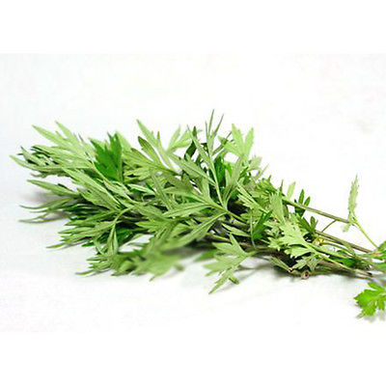
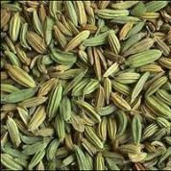
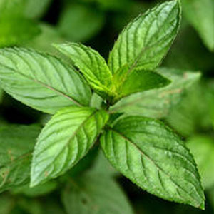
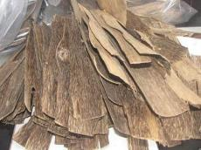
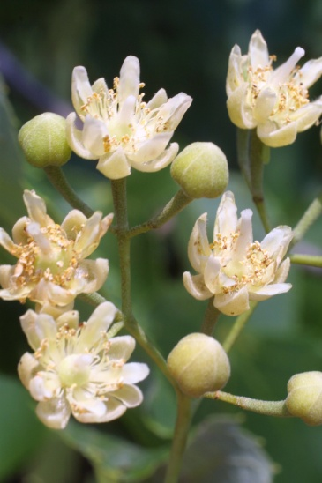
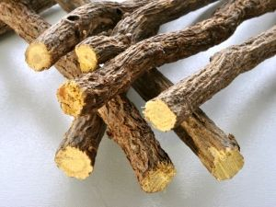
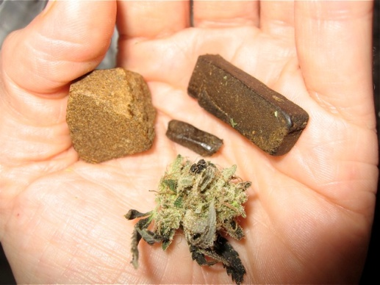
Parts of plants used in pharmacology
folium ~ resina ~ herba ~ flos ~ radix ~ lignum ~ fructus
Notes:
Folium, ii, n. = leaf; resina, ae, f. = resin; herba, ae, f. = the whole plant; flos, floris, m. = flower; radix, radicis, f. = root; lignum, i, n. = wood; fructus, us, m. = fruit

Slide 22
Find mistakes in the terms in red and make abbreviations of them
ANTACIDUM
Rp.
Extracti belladonnae sicci 0,4
Papaverinii chlorati 1,0
Magnesii oxydati 20,0
Misce fiant pulvis
M. f. pulv./plv. = misce fiat pulvis
Divide in doses aequalem numerus XX (viginti) ad capsulos
Div. in dos. aeq. No. XX (viginti) ad caps. = divide in doses aequales numero viginti ad capsulas
D. S. 3krát denně 1 prášek mezi dvěma jídly.
Notes:
Rem. antacidum = a drug counteracting or neutralizing acidity, especially of the stomach

Slide 23
Interpret (Handout 9.7, task 5)
Rp.
Acidi acetylsalicylici
Paracetamoli aa 0,3
Codeinii dihydrogenphosphorici 0,02
Coffeini cum natrio benzoico 0,1
Magnesii oxydati 0,05
M. f. pulv.
D. t. d. No. XX (viginti) ad caps.
S. 3krát denně 1 prášek.
ANALGETICUM +
ANTIPYRETICUM
Rp.
Aminophyllini 1,8
Olei cacao q. s. ut f. supp.
D. t. d. No. VI (sex)
S. 2krát denně zavést 1 čípek do konečníku.
DIURETICUM
Notes:
Rem. analgeticum = a drug relieving pain; antipyreticum = a drug reducing fever; diureticum = a drug increasing the formation of urine

Slide 24
Interpret (Handout 9.7, task 5)
Rp.
Ureae 40,0
Acidi lactici 1,0
Ung. lanalcoli 20,0
Cerae albae 5,0
Vaselini albi ad 100,0
M. f. ung. Týden používat v okluzním obvazu na nehty
před aplikací antimykotik.
ANTIMYCOTICUM
Rp.
Framykoin plv. ads. 1 x 20 gm
Exp. orig. No. II (duas)
D. S. Aplikovat 2krát denně na postižená místa po dobu
10 dnů.
ANTIBIOTICUM
Notes:
Rem. antimycoticum = a drug used to prevent or inhibit the growth of fungi; antibioticum = a drug used to treat or prevent bacterial infections

Slide 25
Change into plural
tuba originalis
remedium expectorans
dosis pro adulto
flos tiliae
solutio physiologica
pars aequalis
suppositorium rectale
pulvis adspersorius
tubae originales
remedia expectorantia
doses pro adultis
flores tiliae
solutiones physiologicae
partes aequales
suppositoria rectalia
pulveres adspersorii
Notes:
Rem. expectorans = a drug facilitating the secretion or expulsion of phlegm or mucus

Slide 26
Write down medical prescriptions
(Handout 9.7, task 8)
2
A fifty-year old woman suffers from chronic bad headache with no reason identified. Prescribe her capsules made of 0,005 g of diazepamum; 0,02 g of phenobarbitalum; 0,1 g of coffeinum; and 0,2 g of paracetamolum. The vehicle is lactose (lactosum) up to 0,5 grams. The pharmacist should make a powder. Make 50 doses in the form of gelatine capsules (gelatinosus, a, um). The patient should take one capsule if needed, max. twice a day. The medication should be marked as poison.
A hard smoker suffers from chronic bronchitis and needs to expectorate the mucus from his bronchial tubes. Prescribe him mucolytics: one package of Mucosolvan drops. The patient should take 30 drops every three hours.
Notes:
Rem. mucolyticum = a drug that is able to break down mucus

Slide 27
a) Rp.
Diazepami 0,005
Phenobarbitali 0,020
Coffeini 0,100
Paracetamoli 0,200
Lactosi ad 0,5
M. f. plv.
D. t. d. No. L (quinquaginta)
D. ad caps. gelat.
D. S. One capsule if needed, max. twice a day. S. s. v.
b) Rp.
Mucosolvan gtt.
Exp. orig. No. I (unam)
D. S. 30 drops every 3 hours.

Slide 28
Write down medical prescriptions
(Handout 9.7, task 8)
3
A five-year old child has been received at the hospital with very high fever caused by acute inflammation of urinary bladder. One of the best ways how to lower the fever of children is via paracetamol suppositories (Suppositoria paracetamoli). These should be made by pharmacist of 10 grams of paracetamol + 30 grams of adipis solidi as adjuvant remedy. 20 of them should be made in equal doses. The instructions for the patient are to take one suppository every 6 hours if the fever reaches 38,5⁰C.
The patient suffers from acute pneumonia, but is allergic to penicilline antibiotics. Therefore, two original packages of klaritromycine antibiotics Klacid 500 mg have to be prescribed in the form of coated tablets. The patient should take one tablet every 12 hours for two-three weeks.

Slide 29
a) Rp.
Paracetamoli 10,0
Adipis solidi 30,0
M. f. supp.
Div. in dos. aeq. No. XX (viginti)
D. S. One suppository every 6 hours if the fever reaches 38.5⁰C.
b) Rp.
Klacid 500 mg tbl. obd.
Exp. orig. No. II (duas)
D. S. One tablet every 12 hours for 2-3 weeks.

Slide 30
Write a prescription
1
A 16-year old boy suffers from severe acne and irritated complexion. Prescribe him an effective suspension made of 85% of zinc oxide (so-called fluid powder – Suspensio zinci oxidi) mixed with talcum and glycerole (talci; glyceroli). The stabilizator is the bentonite magma (bentoniti magma) up to 100 grams. The patient should rub the suspension into his skin three times a day. Shake before using.
A 25-year old woman was received at the emergency with itching urticaria (nettle-rash) on both hands and knees. Prescribe her antihistaminics to relieve her from the symptoms: three packages of Dithiaden tablets. The patient should take half a tablet twice a day.
Notes:
Antihistaminicum = a drug that neutralizes the effects of histamine, used esp. in the treatment of allergies
První udělat spolu jako vzor, ostatní rozdat prázdné předpisy, práce v párech/skupinách.

Slide 31
a) Rp.
Zinci oxidi
Talci
Glyceroli 85%
Bentoniti magmatis ad 100,0
M. f. susp.
D. S. Rub into the skin three times a day. Shake before using.
b) Rp.
Dithiaden tbl.
Exp. orig. No. III (tres)
D. S. Half of the tablet twice a day.

