Slide 1
Basic Medical terminology II
Seminar 10-11:
Revision
Dissection protocol

Slide 2
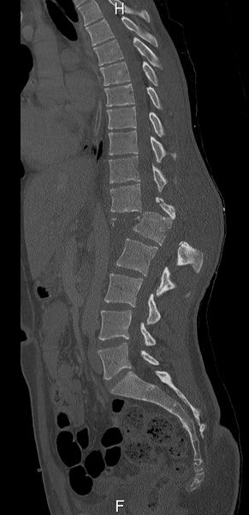
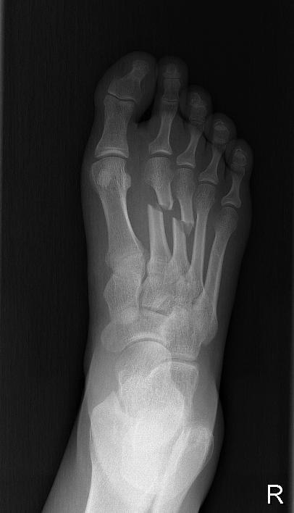
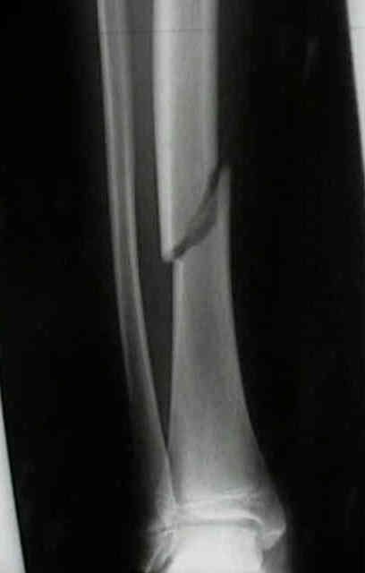
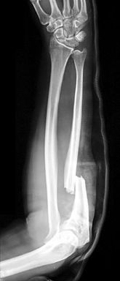
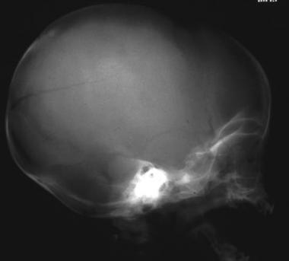
Fill in the given words in grammatically correct forms and match the diagnoses with appropriate x-rays
multiplex — luxatio — trauma — latus — laesio traumatica — male sanatus
multiplices
B
1. Fracturae ossium metatarsalium __________.
2. Embolia propter fracturam colli femoris sinistri sine ________ capitis femoris.
3. Operatio fracturae columnae vertebralis lumbalis cum __________________
nervorum et medullae spinalis.
4. Fractura tibiae obliqua cum dislocatione ad _____.
5. Infractio ossis parietalis dextri post ______ capitis.
6. Reoperatio propter fracturam antebrachii dextri ____________.
luxatione
F
laesione traumatica
A
latus
C
F
trauma
E
male sanatam
D
A
B
C
D
E

Slide 3
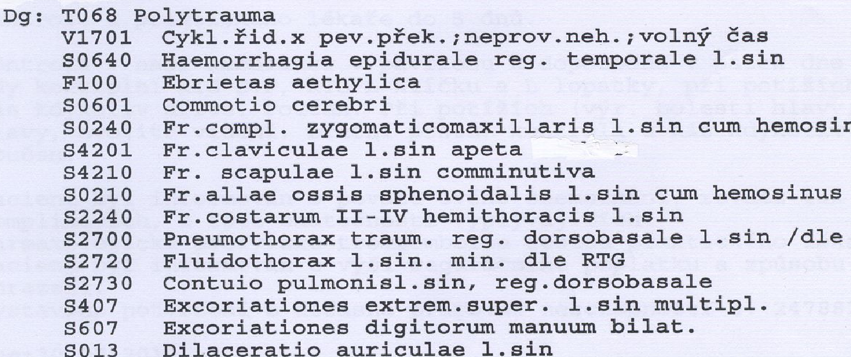
Try to match the circumstances with the described polytraumas. Explain your choices.
A hanging suicide attempt.
A parachute fall.
A cyclist’s collision with a solid obstacle.
A
C
B
A
Which patient was intoxicated
at the moment of the accident?
B
C

Slide 4
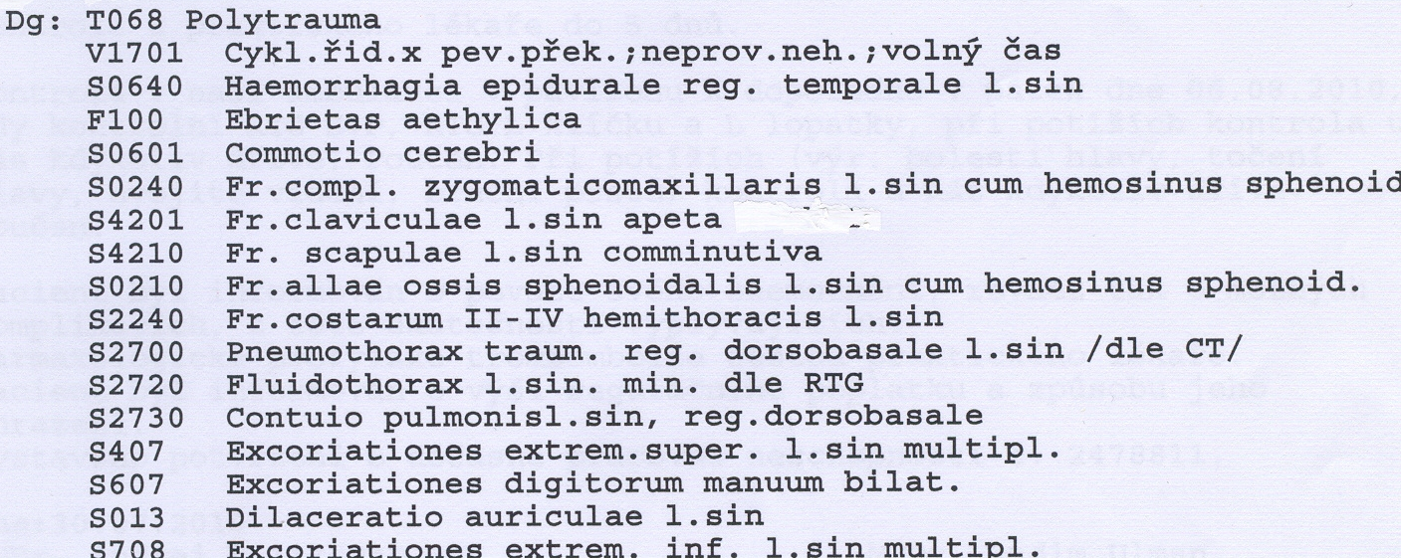
Find grammatical and spelling mistakes

Slide 5
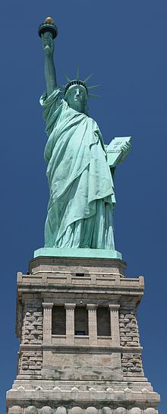
In which position was the child born?
Diagnosis:
Partus spontaneus in grav. hebd. 39 + 5
Praesentatio occipitalis
Manus fetus sinistra elevata
à la Statue of Liberty
à la Superman

Slide 6
Dissection protocol: structure
Pathological-anatomical diagnosis consists of four parts:
I. Morbus principalis
II. Complicationes
III. Causa mortis
IV. Inventus accessorius

Slide 7
Analyze the dissection protocol

Slide 8
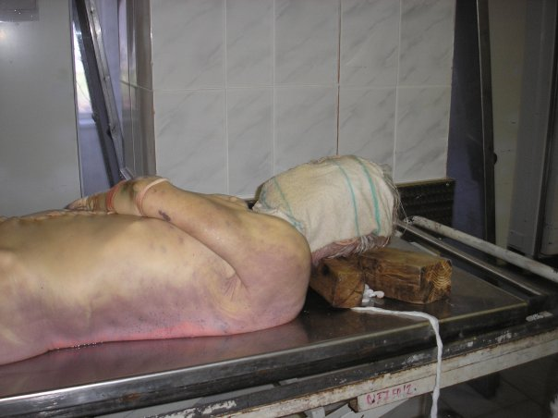
Livores mortis
Hypostasis
= a settling of blood in the lower parts of the body post mortem causing a purplish-red discoloration of the skin
starts within 20-30 minutes after death, not visible until 2 hours after death, maximum lividity is around 8-12 hours after death

Slide 9
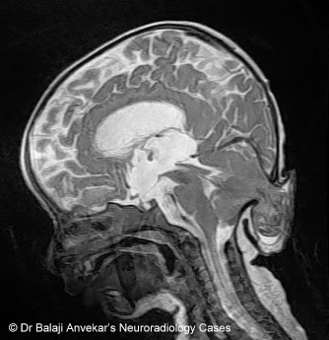
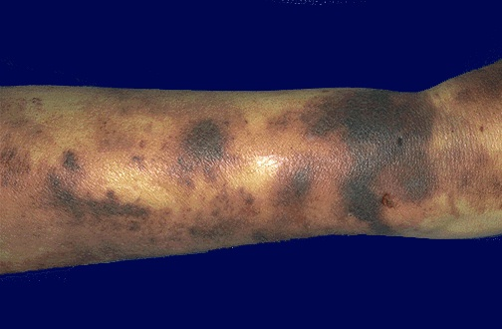
Conus occipitalis Ecchymosis
herniation/compression of the life important brain structures into foramen occipitale magnum; fatal
subcutaneous spots of blood similar to haematoma; however, not caused by trauma but a pathophysiology of cells/vessels

Slide 10
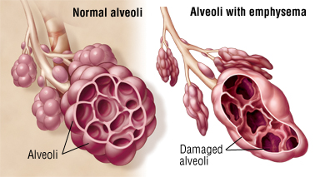
Emphysema pulmonale
a type of COPD (chronic obstructive pulmonary disease) together with e.g. bronchitis
a dilatation of pulmonary ways and destruction of intraalveolar septa, permanent excessive amount of air
in the lungs
Symptoms: shortness of breath, cough, sputum,
gets worse over time
Causes: smoking, air pollution, chronic bronchitis

Slide 11
Hypertrophia trabecularis Cor pulmonale
pathological overgrowth of the trabeculae of heart muscle
pulmonary heart disease; enlargement and failure of the right ventricle due to high blood pressure in lungs or pulmonary stenosis

Slide 12
Match the terms with approriate adjectives and connect with “CUM”
emphysema – fractura – decubitus – pneumothorax
conus – ebrietas – haemosinus
alcoholicus, a, um |  | cum | Sg.
superficialis, e |  |  | Pl.
pulmonalis, e |  |  | Sg.
traumaticus, a, um |  |  | Sg.
sphenoidalis, e |  |  | Sg.
comminutivus, a, um |  |  | Sg.
temporalis, e |  |  | Sg.
Notes:
cum ebrietate alcoholica; cum decubitibus superficialibus; cum emphysemate pulmonali; cum pneumothorace traumatico; cum hemosinu sphenoidali;
cum fractura comminutiva; cum cono temporali

