Slide 1
Basic Medical Terminology II
Seminar 2

Slide 2
Revision of adjectives Connect to make meaningful phrases
partes
processus
sulcus
ruptura
carcinoma
sanatio
caries
bursa
inflammatio
lamina
fractura
therapia
operatio
remedium
columna vertebralis
vertebrae lumbales
nervus radialis
ligamentum teres
colon descendens
herpes simplex
dentes permanentes
musculus biceps brachii
appendix vermiformis
os ethmoidale
ossa nasalia
morbus exacerbans
trauma grave
febris recurrens
columnae vertebralis
vertebrarum lumbalium
nervi radialis
ligamenti teretis
coli descendentis
herpetis simplicis
dentium permanentium
musculi bicipitis brachii
appendicis vermiformis
ossis ethmoidalis
ossium nasalium
morbi exacerbantis
traumatis gravis
febris recurrentis

Slide 3
Comparison of adjectives
Adjectives can express different levels of quality
1st level – POSITIVE
the base form of an adjective
in English: good, small, easy
2nd level – COMPARATIVE
expresses a higher degree of some quality in comparison with
other individuals /objects
in English: better, smaller, easier
3rd level – SUPERLATIVE
expresses the highest degree of some quality in comparison with other individuals /objects
in English: the best, the smallest, the easiest

Slide 4
Types of comparison
In Latin, as well as in English, there exist various ways of comparing adjectives:
regular
comparatives and superlatives are formed using suffixes
in English: small, smaller, the smallest
irregular
comparatives and superlatives have irregular forms
in English: good, better, the best
periphrastic
a multi-word expression having the same role as an inflectional construction, adverbial intensifiers are used
in English: intelligent, more intelligent, the most intelligent
incomplete
no positive form of adjective, only comparatives (and superlatives) exist

Slide 5
Regular comparison - comparative
Positive
LONGUS, A, UM gen. LONG-I, LONG-AE, LONG-I
BREVIS, E gen. BREV-IS
Comparative
genitive stem + comparative suffixes -ior (m.+f.), -ius (n.)
genitive ending for all 3 genders: -ioris
declined like 3rd declension consonant stems,
i.e. DOLOR (m. + f.) and CORPUS (n.)
LONGIOR, LONGIUS, gen. LONGIORIS
BREVIOR, BREVIUS, gen. BREVIORIS

Slide 6
Declining comparatives
 | singular |  | plural
nom. | brevior | brevius | breviores | breviora
gen. | brevioris |  | breviorum
acc. | breviorem | brevius | breviores | breviora
abl. | breviore |  | brevioribus
Comparative forms are declined according to paradigms:
DOLOR (M., F.) and CORPUS (N.).
Genitive ending for all 3 genders: – IORIS.
E.g.:
simplex, simplicis -> simplicior (m., f.), simplicius (n.) -> gen. sg.: simplicioris (m., f., n.)
latus, a, um -> latior (m., f.), latius (n.) -> gen. sg.: latioris (m., f., n.)

Slide 7
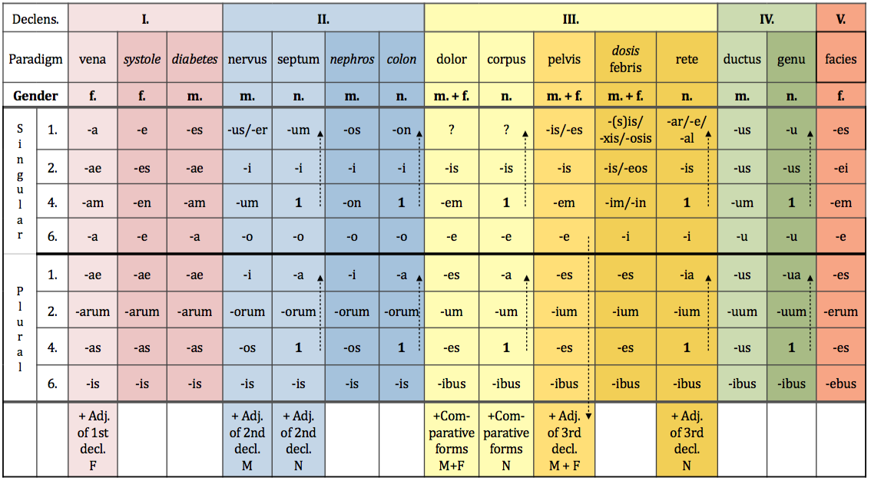
Latin and Greek declensions

Slide 8
Regular comparison - superlative
Positive
LONGUS, A, UM gen. LONG-I, LONG-AE, LONG-I
BREVIS, E gen. BREV-IS
Superlative
genitive stem + superlative suffixes -issimus (m.),
-issima (f.), -issimum (n.)
declined like 1st and 2nd declension adjectives,
i.e. MUSCULUS (m.), VENA (f.), SEPTUM (n.)
LONGISSIMUS, A, UM
BREVISSIMUS, A, UM

Slide 9
Latin and Greek declensions

Slide 10
Irregular and incomplete comparison
Irregular comparison
magnus, a, um major, majus maximus, a, um
parvus, a, um minor, minus minimus, a, um
Incomplete comparison
forms used to describe positions on the human body, derived from prepositions, having only comparative and superlative forms
ante anterior, ius
post posterior, ius postremus, a, um
supra superior, ius supremus, a, um
infra inferior, ius infimus/imus, a, um
intra interior, ius intimus, a, um
All of these forms are regularly declined
according to the paradigms specified above!!!

Slide 11
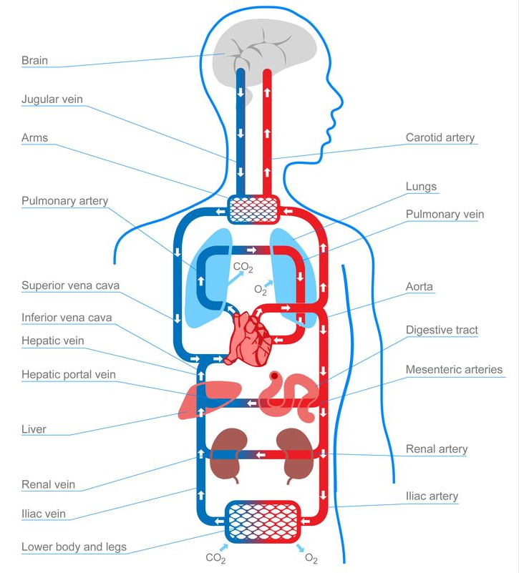
Use of comparatives in anatomy
In anatomical terminology, comparative forms are used to differentiate two structures of the same kind (e.g. by expressing their location):
circulatio sanguinis major / minor
cornu majus / minus ossis hyoidei
vena cava superior / inferior

Slide 12
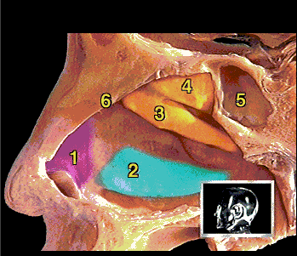
Use of comparatives in anatomy
1 cartilago lateralis
2 concha nasalis inferior
3 concha nasalis media
concha nasalis superior
sinus sphenoidalis
septum nasi

Slide 13
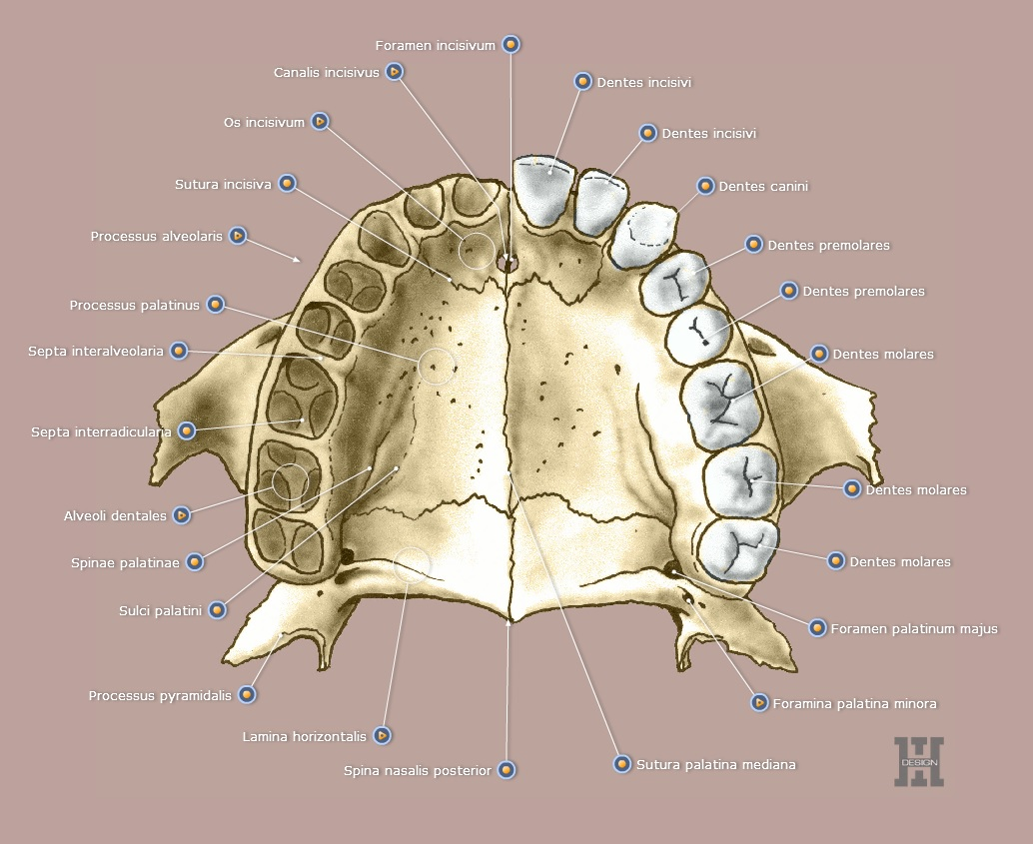
Use of comparatives in anatomy

Slide 14
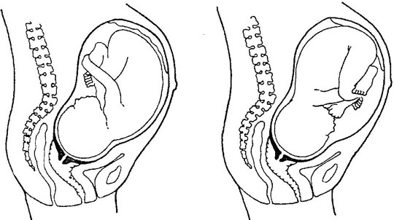
Use of comparatives in anatomy
praesentatio occipitis / occipitalis
anterior posterior

Slide 15
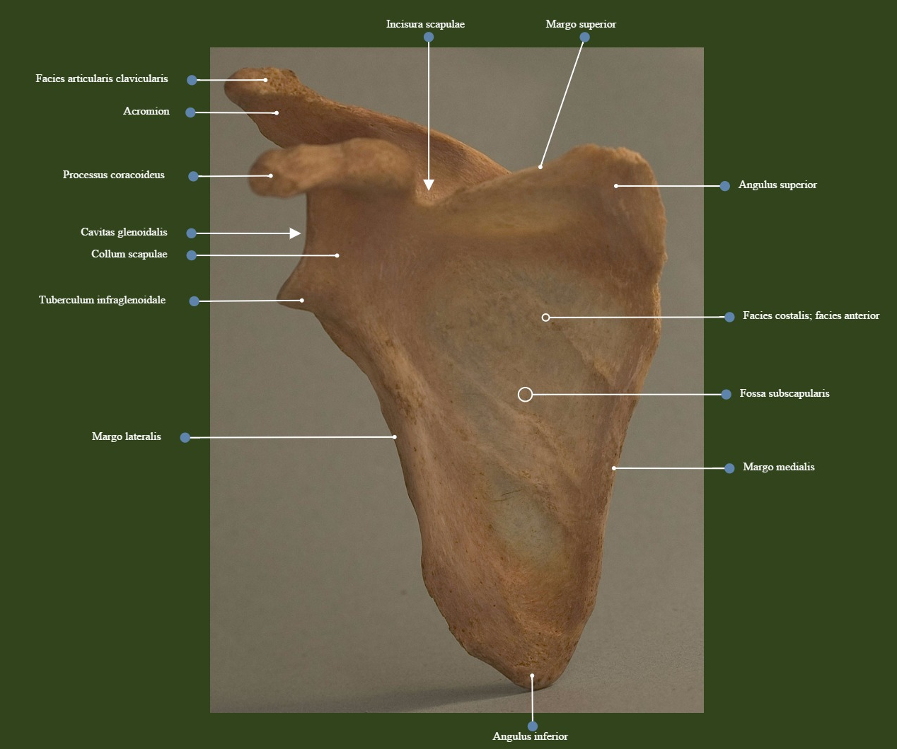
Use of comparatives in anatomy

Slide 16
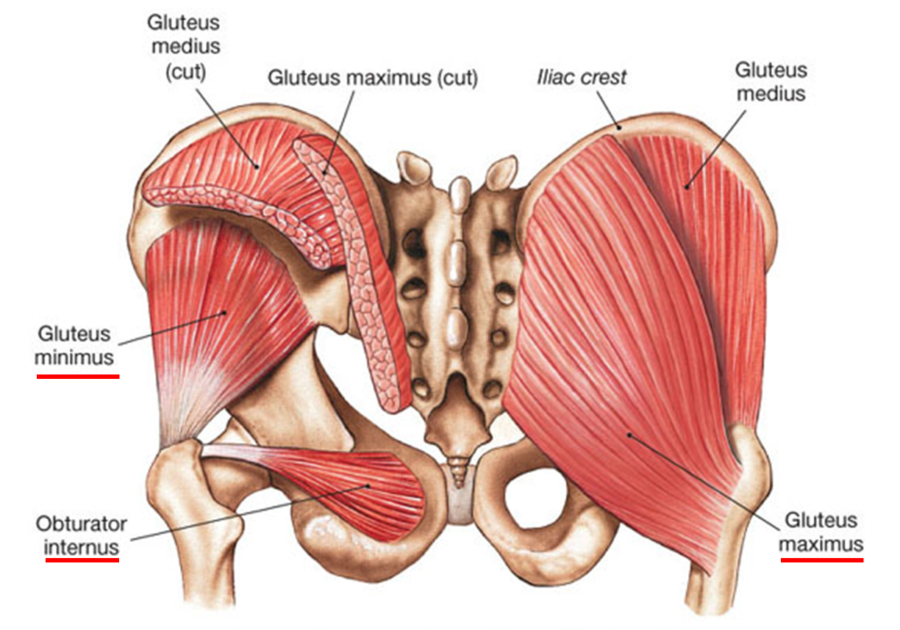
Use of superlatives in anatomy
In anatomical terminology, superlative forms are used to express the highest degree of some quality in one of more than two structures of the same kind.

Slide 17
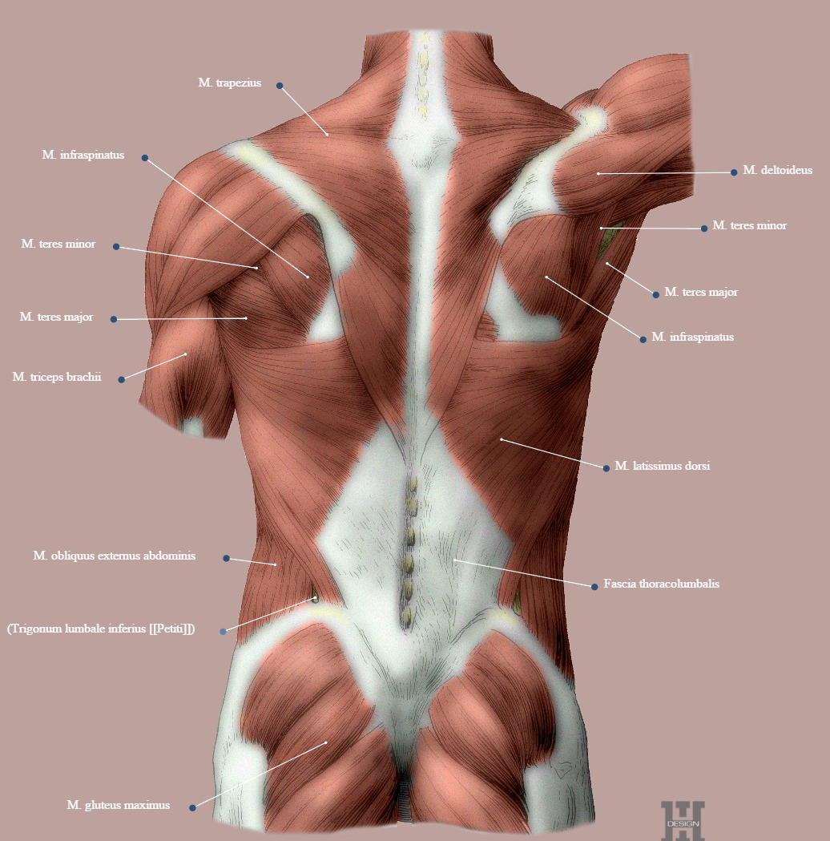
Use of superlatives in anatomy

Slide 18
Use of superlatives in anatomy

Slide 19
Form comparatives and superlatives
POSITIVE | COMPARATIVE | SUPERLATIVE
parvus, a, um
brevis, e
fortis, e
acutus, a, um
magnus, a, um
longus, a,um
gravis, e
profundus, a, um
latus, a, um
minor, minus
minimus, a, um
brevior, ius
brevissimus, a, um
fortior, ius
fortissimus, a, um
acutior, ius
acutissimus, a um
maior, maius
maximus, a, um
longior, ius
longissimus, a, um
gravior, ius
gravissimus, a, um
profundior, ius
profundissimus, a, um
latior, ius
latissimus, a, um

Slide 20
Fill in comparatives and superlatives in correct forms (Handout 2.2, task 3)
minimi
minimus, a, um musculus abductor digiti __________
minor,minus cornu _______ ossis hyoidei
superior, ius defectus arcus dentalis____________
intimus,a,um musculi intercostales___________
inferior,ius amputatio membri ___________
imus, a,um arteriae lumbales __________
anterior, ius peritoneum parietale ___________
latissimus,a,um ruptura musculi ___________ dorsi
posterior, ius arteria temporalis profunda ________
minus
superioris
intimi
inferioris
imae
anterius
latissimi
posterior

Slide 21
Create meaningful diagnoses
pro / dosis / infantibus / maxima
dosis maxima pro infantibus
oris / chronicum / superioris / ulcus / labii
ulcus chronicum labii superioris oris
sepsim / propter / lateris / amputatio / membri / sinistri / inferioris
amputatio membri inferioris lateris sinistri propter sepsim
gastritidis / minoris / suspicio / gradus
suspicio gastritidis gradus minoris
inferioris / dextri / rami / et / ossis / fractura / superioris / pubis / lateris
fractura rami superioris et inferioris ossis pubis lateris dextri

Slide 22
Decide whether the following sentences are true or false (Handout 2.2, task 5)
True False
1. Pelvis feminina levior est.
2. Pelvis masculina latior est.
3. Apertura superior pelvis femininae major est.
4. Cavitas pelvis femininae angustior est.
5. Os sacrum pelvis masculinae brevius est.
6. Os sacrum pelvis femininae latius est.
7. Foramina obturatoria pelvis femininae majora sunt.
8. Acetabula feminina majora sunt.
9. Coccyx feminina brevior est.
10. Angulus alarum ossis ilii masculini minor est.
11. Promontorium femininum minus est.
12. Symphysis pubica feminina longior est.
✓
✓
✓
✓
✓
✓
✓
✓
✓
✓
✓
✓

Slide 23
Translate (Handout 2.2, task 6)
more severe injury
trauma gravius
bigger sublingual duct
ductus sublingualis major
in the upper hollow vein
in vena cava superiore
the longest muscle of the upper limb
musculus longissimus membri superioris
lesser (= smaller) curvature of stomach
curvatura gastrica (ventricularis) minor
posterior deep temporal artery
arteria temporalis profunda posterior

Slide 24
Translate (Handout 2.2, task 6)
fracture of the middle phalanx of the smallest finger
fractura phalangis mediae digiti minimi
the most recent infarction
infarctus recentissimus
the innermost layer of oesophagus
tunica intima oesophagi
amputation of the lower limb due to gangrene caused by diabetes mellitus
amputatio membri inferioris propter ganraenam e diabeta mellito

Slide 25
Give correct Latin anatomical terms

Slide 26
Introduction to word-formation
In medical terminology, the following word-formation processes are used:
1) Derivation
a) Prefix: ante-brachium; ana-lysis
b) Suffix: brachi-alis; nephr-itis
c) Prefix + suffix: ante-brachi-alis; para-nephr-itis
2) Composition: prim-i-para; pneum-o-thorax
3) Derivation + composition:
nas-o-lacrim-alis; haemat-ur-ia
4) Abbreviations: DM; CT; HIV, AIDS
5) Borrowings: shock; stress
6) Eponyms: Alzheimer’s disease (named after Alois Alzheimer)
Notes:
DM = Diabetes mellitus
CT = Computer Tomography
HIV = Human Immunodeficiency Virus
AIDS = Acquired Immune Defficiency Syndrome

Slide 27
Basic terminology: 3 component parts of words
PREFIX
WORD ROOT
SUFFIX
 | PORT
RE | PORT
IM | PORT
SUP | PORT
EX | PORT
TRANS | PORT
 | PORT | ER
 | PORT | ABLE
TRANS | PORT | ABILITY

Slide 28
PREFIXES
ORIGIN: LATIN/GREEK prepositions
ROLE: SPECIFY/RESTRICT/CHANGE/ALTER the meaning of the derived word
ad-ductor vs. ab-ductor
POSITION: AT the BEGINNING of the word
MEANING:
TIME/PLACE
DEGREE
DEVIATION/NORMALITY

Slide 29
SUFFIXES
ROLE: SPECIFY/RESTRICT/CHANGE/ALTER the meaning of the derived word
e.g.: teach vs. teacher
e.g. adductio vs. adductor
e.g. nephrosis, nephritis, nephroma
POSITION: AT the END of the word
MEANING:
NOUN suffixes: STATE, QUALITY, TYPE OF DISEASE,...
ADJECTIVE suffixes: RELATION, POSSIBILITY, ABILITY, SHAPE etc.

Slide 30
Diminutives
Diminutives are words indicating small size:
e.g.: duckling, kitty, sweetie, Maggie,...
In Latin, a diminutive is formed from a noun by the addition
of a suffix to its genitive stem:
-(i)culus, a, um e.g. canaliculus (small canal)
-ulus, a, um e.g. capitulum (small head)
-olus, a, um e.g. alveolus (small cavity or pit)
-illus, a, um e.g. pupilla (pupil; dark circular aperture at the centre of the iris of the eye)
-ellus, a, um e.g. cerebellum (posterior brain mass, “small brain”)
Latin diminutives are always of the same gender as the nouns
they are derived from!!!

Slide 31
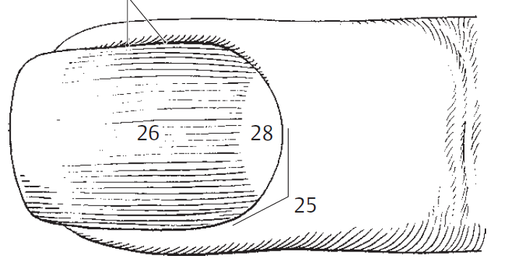
Diminutives in anatomy
caput humeri
x
capitulum humeri
corpusculum renale
glomerulus
capsula glomerularis
cuticula unguis
Notes:
glomus, eris, n.

Slide 32
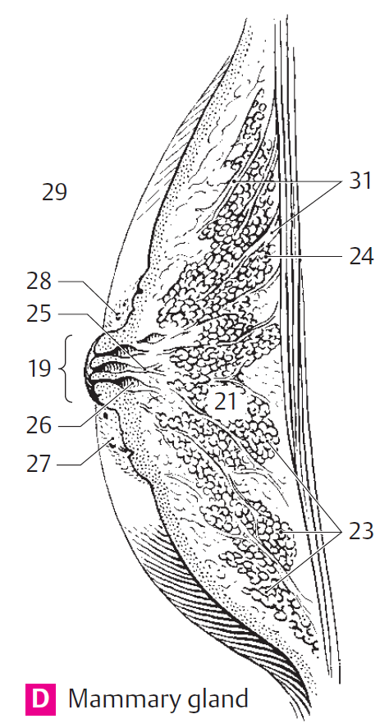
Diminutives in anatomy
papilla mammae 19
lobi glandulae mammariae 23
lobuli glandulae mammariae 24
areola mammae 27
glandulae areolares 28
ligg. suspensoria mammaria 31

Slide 33
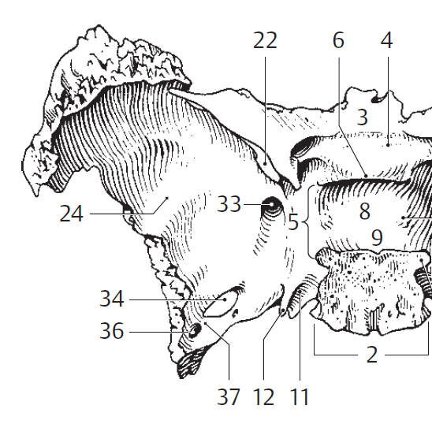
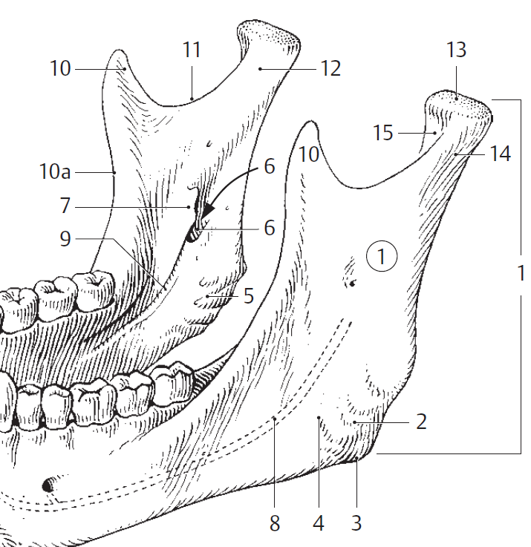
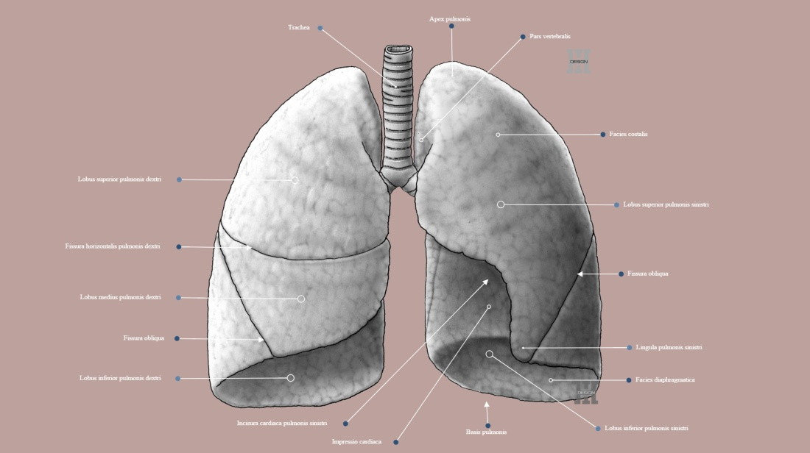
Diminutives in anatomy
lingula (< lingua)
= little projection, process
E.g.: sphenoidalis
pulmonis sinistri
mandibulae

Slide 34
Give nouns from which the following diminutives are derived (Handout 2.4, task 1)
caput, itis, n.
os, ossis, n.
capitulum ........................
nodulus .......................
cerebellum ........................
lingula ........................
cuticula ......................
denticulus ....................
vasculum ....................
ossiculum ....................
venula........................
geniculum ........................
canaliculus........................
arteriola........................
areola ........................
nodus, i, m.
vena, ae, f.
cerebrum, i, n.
genu, us, n.
lingua, ae, f.
canalis, is, m.
cutis, is, f.
arteria, ae, f.
dens, dentis, m.
area, ae, f.
vas, vasis, n.

Slide 35
Form diminutives (Handout 2.4, task 2)
lobus ........................
ductus .......................
anus ........................
frenum ......................
valva .....................
mus ......................
venter.....................
vena....................
fossa........................
glans ........................
tuber ........................
corpus ........................
auris ........................
circus ........................
lobulus
venula
ductulus
fossula
anulus
glandula
frenulum
tuberculum
valvula
corpusculum
musculus
auricula
ventriculus
circulus

Slide 36
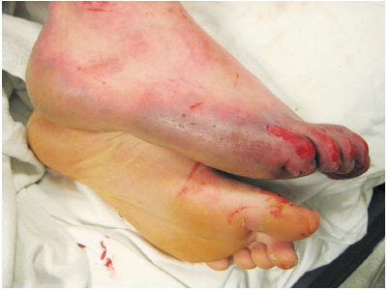
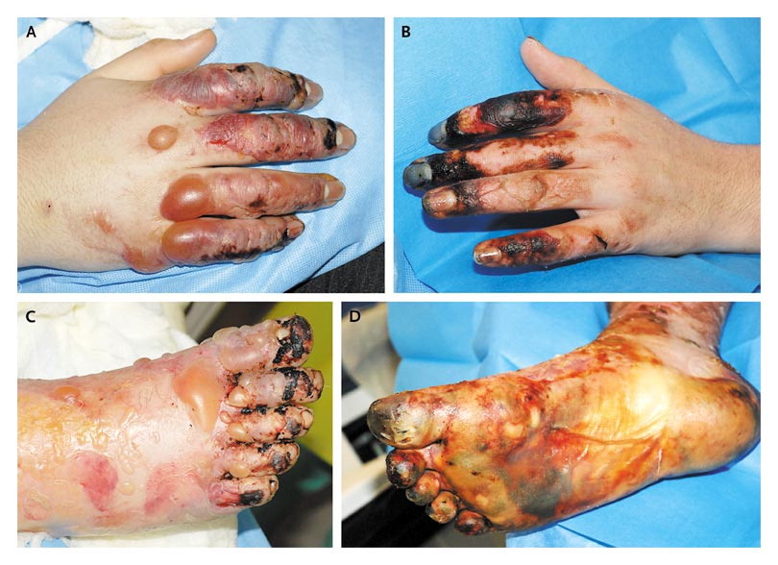
A 16-year-old boy was admitted to the hospital after being found unconscious in a snow bank at 6 a.m. on New Year's Day. He had been well until the night before admission, when he attended a party where alcohol was consumed. He was last seen at approximately 11 p.m. Approximately 2 hours later, his friends and family noticed his absence and notified police; a search was begun. At approximately 6 a.m., he was found unconscious in a snowbank by local firefighters and police officers. The ambient temperature was −15°C (5°F), with a wind-chill factor of approximately −29°C (−20°F). He was partially undressed
with his pants down and his right boot off;
his limbs were buried in the snow, and
a layer of ice surrounded his right foot.
Diagnosis:
Stage 3 hypothermia.
Stage 3 frostbite with diffuse distal
small-vessel thrombosis and impending
partial limb loss.
Notes:
Hypothermia gradus tertii.
Congelatio gradus tertii cum thrombosi vasculorum distali diffusa
Periculum amputationis partialis membri (extremitatis) / amputatio partialis imminens

