Slide 1
Basic Medical Terminology II
Seminar 4:
Numerals
Latin prefixes and suffixes

Slide 2
Revision Change the given terms into sg./pl.
cornu minus
dentes molares superiores
contra dolorem acrem
symptoma morbi latentis
segmenta anteriora bulborum
operatio post trauma gravissimum
fractura membri inferioris
amputationes digitorum minimorum
ala major
ante transfusionem necessariam
cornua minora
dens molaris superior
contra dolores acres
symptomata morborum latentium
segmentum anterius bulbi
operationes post traumata gravissima
fracturae membrorum inferiorum
amputatio digiti minimi
alae majores
ante transfusiones necessarias

Slide 3
Revision Fill in missing endings
Ramus inferior arteri…… glutae…… superior……
Status post traum…… grav……
Infarctus pariet…… anterior…… ventricul…… cord…… sinistr…..
In muscul…… latissim…… dors……
Pulsus frequentissim…… in febr…… acut……
Exitus post collaps…… circulation…… major…...
Laesio muscul…… longissim…… thorac……
Doses medicament…… minim……
Iniectio contra dolor…… magn……
Ulcus peptic…… chronic…… in curvatur…… minor……
ae
ae
is
a
e
is
is
i
is
i
o
o
i
us
i
a
um
is
is
i
i
is
i
ae
em
um
um
um
a
e

Slide 4
Numerals – Introduction
TYPES:
CARDINAL NUMERALS unus, una, unum
ORDINAL NUMERALS secundus, a, um
MULTIPLE NUMERALS triplex, icis
NUMERAL ADVERBS quater

Slide 5
Ordinal numerals
1-10 | 11-12
primus, a, um | undecimus, a, um
secundus, a, um | duodecimus, a, um
tertius, a, um
quartus, a, um
quintus, a, um
sextus, a, um
septimus, a, um
octavus, a, um
nonus, a, um
decimus, a, um
express the order in a sequence
declined like the paradigms nervus, vena, septum
in anatomy, ordinals are used only up to 12
(see the handout Numerals in
anatomical and clinical
terminology)

Slide 6
,Match the numbers and letters, fill in missing endings and read the ordinal numerals
B
Vertebra cervical_ _ C₇
Fractura vertebra_ coccyge_ _ Co₃
Contusio vertebr_ _ _ _ lumbal_ _ _ L₁-L₂
Vertebr_ _ sacral_ _ S₁-S₅
Operatio vertebr_ _ thoracic_ _ Th₈-Th₉
Columna vertebr_ _ _ _
C
A
D
E
F

Slide 7
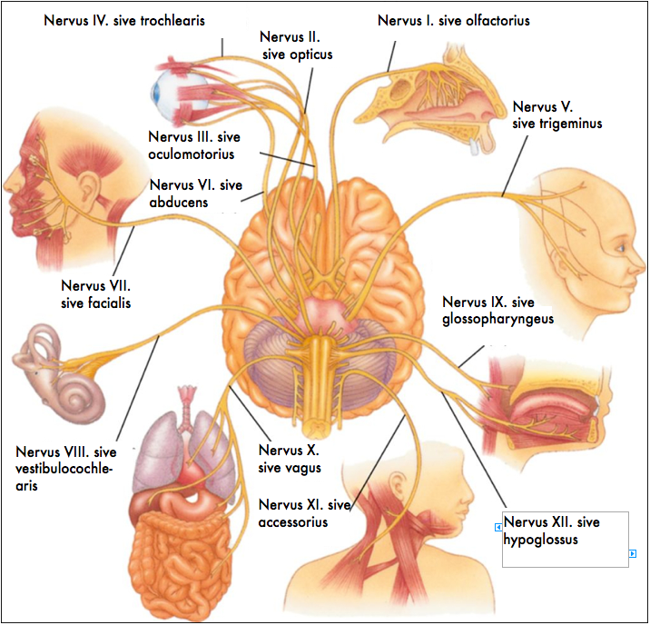
Nervi craniales

Slide 8
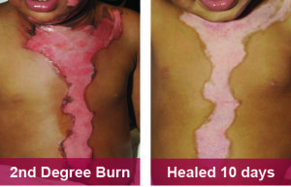
How to express a degree/stage of an injury/illness?
using the noun gradus (us, m.) + ordinal numerals
both the noun and the numeral are always in genitive!
e.g. second degree burn of chest, neck and head
combustio pectoris, colli et capitis gradus secundi

Slide 9
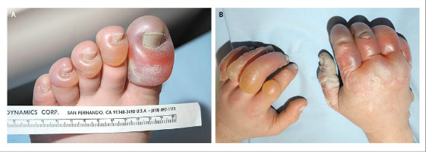
Authentic diagnosis: translate the red parts
A 39-year-old man was found in a snowbank, with the ambient
temperature -34°C. He had been reported missing the previous
evening, after an argument with his girlfriend. The emergency
services crew noticed the odor of alcohol in his breath. Large, clear blisters characteristic of severe frostbite were noted on the hands and feet. Of particular note were the left great toe and right thumb with frostbite of the third grade. Subsequently, the patient’s left great toe was amputated.
blister = bulla, ae, f.
Notes:
bullae latae manuum et pedum; congelationes hallucis sinistri et pollicis dextri gradus tertii; amputatio hallucis sinistri

Slide 10
Multiple numerals
1-3 | many
simplex, cis | multiplex, multiplicis
duplex, cis
triplex, cis
express multiplicity
nom. sg. -plex; gen. sg. -plicis
declined like 3rd declension
adjectives (paradigms pelvis, rete)

Slide 11
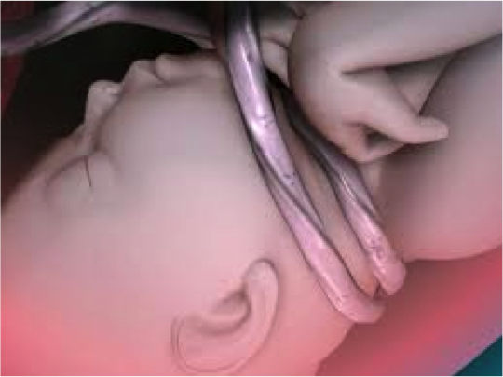
Numeral adverbs
1-4
semel
bis
ter
quater
express frequency
indeclinable !!!
Notes:
Funiculus/chorda umbilicalis = umbilical cord

Slide 12
Compounds with numeral components
ENGLISH | LATIN | Example | GREEK | Example
one | uni- | unilateralis unigravida | mono- | monoplegia
first | primi- | primipara primigravida
two (i.e. twice) | bi- | biceps bilateralis | di- | diplegia
second | secundi- | secundigravida
three | tri- | triceps trigeminus | tri- | tricephalus
four | quadri- | quadriceps | tetra- | tetraplegia
half | semi- | semilunaris | hemi- | hemiplegia
few |  |  | olig-o- | oligodactylia
many | mult-(i)- | multangulus multicellularis | poly- | polydactylia polyarthritis
all, whole |  |  | pan- | panplegia pandemia

Slide 13
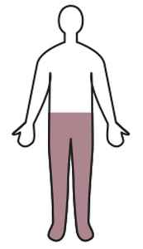
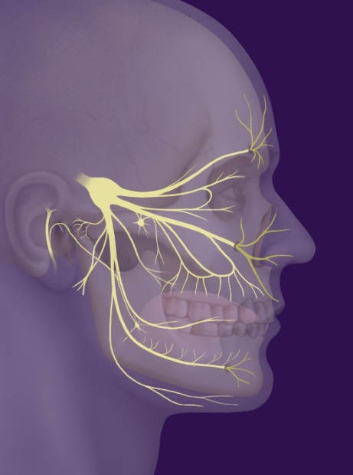
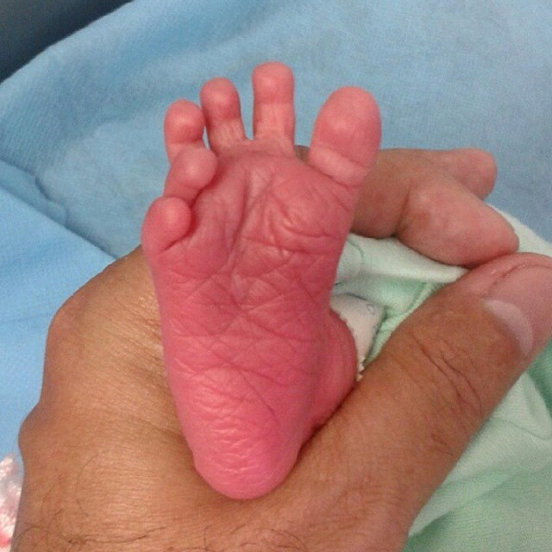
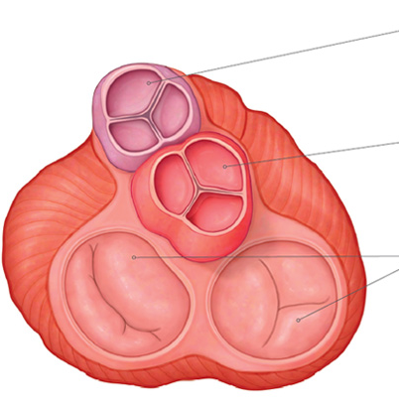
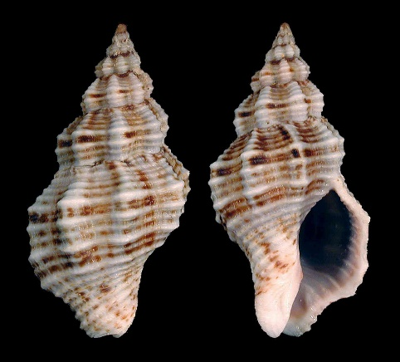
Match the given terms with corresponding pictures
diplegia
multangulus
trigeminus
polydactylia
valvulae semilunares

Slide 14
Match the pictures with the terms given below
1
2
3
4
5
MONOPLEGIA DIPLEGIA TRIPLEGIA
TETRAPLEGIA HEMIPLEGIA QUADRIPLEGIA
Notes:
Tetraplegia / quadriplegia – diplegia – hemiplegia – triplegia – monoplegia

Slide 15
Use the given Greek roots to form terms corresponding to the definitions (Handout 4.2, task 2)
-PARESIS slight, partial paralysis, muscle weakness
-PLEGIA stroke, total paralysis
Partial paralysis of a single limb or one part of the limb
Paralysis of a single extremity
Paralysis of corresponding parts on both sides of the body
Complete paralysis of the lower half of the body including both legs
A slight paralysis or weakness of both legs
Paralysis affecting only one side of the body
Paralysis of an upper and a lower extremity and of the face
Paralysis of all four limbs
Muscular weakness affecting all four extremities
Paralysis of the whole body
Weakness on one side of the body
Notes:
Monoparesis – monoplegia – diplegia – paraplegia – paraparesis – hemiplegia - triplegia – tetraplegia (=quadriplegia, quadruplegia) – tetraparesis – panplegia – hemiparesis
Tetraplegia, also known as quadriplegia, is paralysis caused by illness or injury that results in the partial or total loss of use of all four limbs and torso; paraplegia is similar but does not affect the arms. The loss is usually sensory and motor, which means that both sensation and control are lost. Tetraparesis or quadriparesis, on the other hand, means muscle weakness affecting all four limbs. It may be flaccid or spastic.

Slide 16
Number of pregnancies /childbirths = ordinal numeral + GRAVIDA/PARA
GRAVIDA - number of pregnancies, regardless of result
PARA - number of births after 20 weeks of pregnancy,
regardless of result,
stillbirth counted as 1,
multiple births /twins et al./ counted as 1
ABORTION - miscarriage before 20 weeks of pregnancy
G₈P₅A₃
G₂P₂
G₄P₃A₁

Slide 17
-para and -gravida
0
1
2
3
4
5
6
7
8
9
10
MANY
NULLI-PARA
UNI-/PRIMI-PARA
SECUNDI-PARA
TERTI-PARA
QUARTI-/QUADRI-PARA
QUINTI-PARA
SEXTI-PARA
SEPTI-PARA
OCTI-PARA
NONI-PARA
DECI-PARA
MULTI/PLURI-PARA
NULLI-GRAVIDA
UNI-/PRIMI-GRAVIDA
SECUNDI-GRAVIDA
TERTI-GRAVIDA
QUARTI-GRAVIDA
QUINTI-GRAVIDA
SEXTI-GRAVIDA
SEPTI-GRAVIDA
OCTI-GRAVIDA
NONI-GRAVIDA
DECI-GRAVIDA
MULTI/PLURI-GRAVIDA

Slide 18
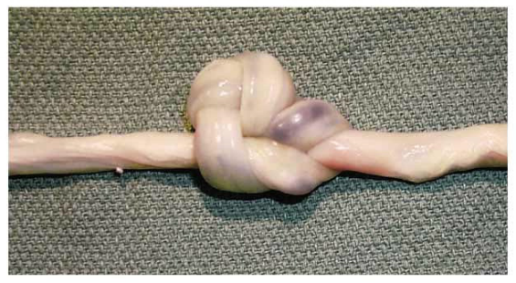
Authentic diagnosis: translate the red parts
A 23-year-old woman (gravida 1, para 0) was admitted at 40+1 weeks gestation and underwent an emergency caesarian section due to imminent hypoxia of the fetus. As revealed during the section the umbilical cord was twisted twice around the neck of the neonate, furthermore the umbilical cord was noted to have a compound knot. Compound knots, as in this case, are rare.
hypoxia, ae, f. = a diminished availability of oxygen to the body tissues
Notes:
sectio caesarea acuta propter hypoxiam fetus imminentem, funiculus umbilicalis circum collum neonati bis, nodus compositus funiculi umbilicalis

Slide 19
Latin and Greek prefixes
LATIN | Example | GREEK | Example
contra- | contraindicatio | ant-, anti- | antibioticum, antipyreticum
cum- (con-, com-, col-, cor) | congenitus commotio | syn-, sym- | symphysis, syndroma
de- (des-) | 1) descendens 2) desinfectio, deformatio | 1) cata- 2) Ø | catarrhus Ø
dis- (dif-, di-) | 1) dislocatio 2) dissimilis | 1) dia-, di-, ana- 2) a-, an- | diagnosis, analysis atrophia, anaesthesia
e-, ex- (ef-) | exsanguinatio | ec- | ectopia
in- (im-, il-, ir-) | immaturus | a-, an- | atrophia, anaesthesia
post- | posttraumaticus | met-, meta- | metastasis, metabolismus
re- | reinfectio | ana- | anamnesis, anabiosis

Slide 20
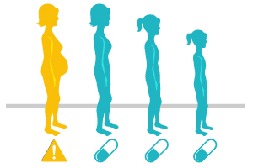
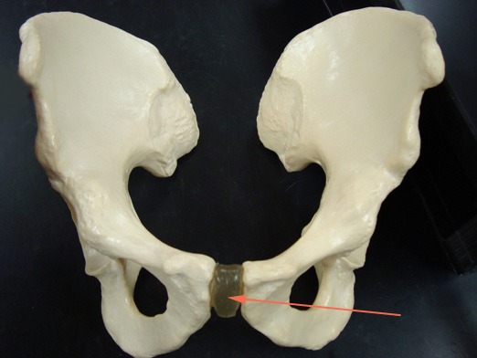
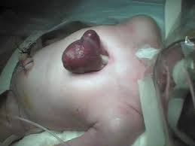
Match the given terms with corresponding pictures
contraindicatio – ectopia – cattarhus – atrophia – anamnesis – symphysis
Notes:
anamnesis - accumulated data concerning a medical or psychiatric patient and the patient's background, including family, previous environment, experiences, and particularly, recollections, for use in analyzing his or her condition

Slide 21
Latin and Greek prefixes
LATIN | Example | GREEK | Example
per- | 1) peracutus, peraciditas 2) perforatus | 1) hyper- 2) dia | hypertonia, hypertrophia diencephalon, diameter
sub- (suc-, suf-, sup-, sus-) | 1) subfebrilis, subluxatio 2) subcutaneus | hyp-, hypo- | hypotrophia, hypotonia hypophysis, hypoglossus
Ø |  | dys- | dystrophia, dyspepsia
Ø |  | eu- | eutrophia, euthanasia

Slide 22
Attach the Greek prefixes to the given root word to form terms corresponding to the definitions
EU- / HYPER- / A- / DYS- / HYPO- + TROPHIA
EU-
state of normal nourishment and growth
progressive changes that may result from defective nutrition of a tissue or organ
general increase in bulk of a part or organ, not due to tumor formation
progressive degeneration of an organ or tissue caused by loss of cells
a wasting away of the body or of an organ or part, as from defective nutrition or nerve damage
DYS-
HYPER-
HYPO-
A-

Slide 23
Latin noun suffixes
Noun ending | Meaning | Example
-io | act, process | commotio, inflammatio, laesio, transfusio
-tor, -sor, -xor | agent | levator, extensor, flexor
-ura | result of an action | sutura, fisura, incisura
-itas | quality, state | obesitas, surditas, mutitas
-mentum | instrument, tool | ligamentum, medicamentum
-itis | inflammation | perinephritis, encephalitis, otitis, nephritis
-osis | degenerative or non-inflammatory disease | arthrosis, hepatosis, sclerosis, stenosis
-oma | tumour | melanoma, adenoma, carcinoma, hepatoma

Slide 24
Latin adjective suffixes
Adjective ending | Meaning | Example
-alis, e; -aris, e; -icus, a, um; -acus, a, um; -eus, a, um; -aneus, a, um; -ivus, a, um; -inus, a, um; -arius, a, um; -itus, a, um | relation | nasalis, cochlearis, hepaticus, cardiacus, pharyngeus, cutaneus, operativus, uterinus, coronarius, mellitus
-osus, a, um | full of | ulcerosus, venosus, periculosus
-atus, a, um | equipped with | dentatus, caudatus
-bilis, e | possibility, ability | operabilis
-oideus, a, um -formis, e | shaped like, resembling | coracoideus, thyroidea, cuneiforme

Slide 25
Name the action performed by the given muscle
Musculus abductor pollicis longus >> abductio, onis, f.
adductio, onis, f.
Musculus adductor hallucis longus
Musculus compressor urethrae
Musculus constrictor pharyngis medius
Musculus depressor anguli oris
Musculus dilatator pupillae
Musculus extensor carpi
Musculus flexor digitorum profundus
Musculus levator glandulae thyr(e)oideae
Musculi rotatores thoracis
Musculus tensor fasciae latae
compressio, onis, f.
constrictio, onis, f.
depressio, onis, f.
dilatatio, onis, f.
extensio, onis, f.
flexio, onis, f.
levatio, onis, f.
rotatio, onis, f.
tensio, onis, f.

Slide 26
Name defects of senses
surdomutitas, atis, f.
caecitas, atis, f.
surditas, atis, f.
mutitas, atis, f.

Slide 27
Derive terms from the given roots (Handout 5.3, task 1)
BASIC WORD | DESCRIPTION | DERIVED TERM
brain | related to brain
 | small brain
 | related to the small brain
 | inflammation of the brain
liver | related to liver
 | inflammation of liver
 | cancerous tumour in liver
 | degenerative disease of liver
thorn | related to the thorn/spine
 | full of thorns
 | provided with thorns
 | found above the thorny processes
cerebralis
cerebrum, i, n.
encephalon, i, n.
cerebellum
cerebellaris
encephalitis
hepaticus
hepar, atis, n.
hepatitis
hepatoma
hepatosis
spinalis
spina, ae, f.
spinosus
spinatus
supraspinatus / supraspinalis

Slide 28
Fill in parallel prefixes and derive required terms (Handout 5.3, task 2)
PARALLEL GREEK / LATIN PREFIX | ENGLISH DESCRIPTION | DERIVED LATIN TERM
pro- ⇨ ante- | forearm | antebrachium
endo- | inside the vein (adj. e.g. injection)
dia- | a process of transferring blood from a donor to a recipient
circum- | a double-wall sac around the heart
epi- | being on the surface, opposite of profound
peri- | located around the mouth
ecto- | outside the uterus
meta- | after the operation (e.g. state, condition)
hyper - | located above the kidney
inter- | sheet of muscle separating the thorax from the abdomen
⇨ intra-
intravenosus
⇨ trans-
transfusio
⇨ peri-
pericardium
⇨ super-
superficialis
⇨ circum-
circumoralis
⇨ extra-
extrauterinus
⇨ post-
postoperativus
⇨ supra-
suprarenalis
⇨ dia-
diaphragma

