Slide 1
Basic Medical Terminology II
Seminar 6-7

Slide 2
Match the Greek and English names of colours
Chrom-o-, chromat-o-
Blue
Chlor-o-
Color
Cyan-o-
Black, dark
Erythr-o-
Green
Leuc-o-
Grey
Xanth-o-
Red
Poli-o-
White, colorless
Melan-o
Yellow

Slide 3
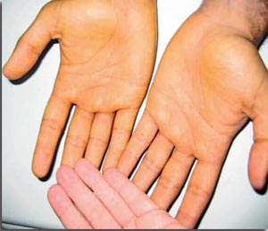
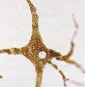
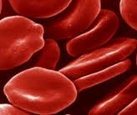
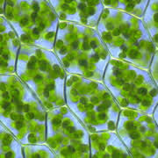
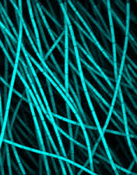
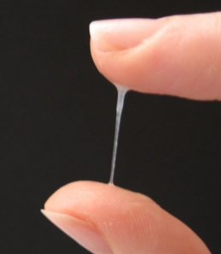
Form compounds using the names of colours
1. A yellowish discoloration of the skin is known as .…….…….derma
2. A cell producing the dark pigment (…………...) is called ……………………cytus
3. A decreased number of red blood cells is ………………..penia
4. The green pigment of plant leaves and algae is ………………phyllum
5. A group of photosynthetic bacteria containing a blue pigment is ………….bacteria
6. An excessive discharge of white (or sometimes yellowish) mucus from the vagina is ………………..rrhoea
Notes:
Xanthoderma – melaninum; melanocytus – erythro(cyto)penia – chlorophyllum (on) - cyanobácteria - leucorrhoea

Slide 4
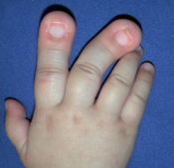
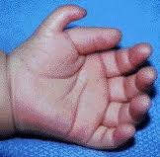
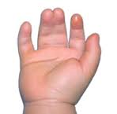
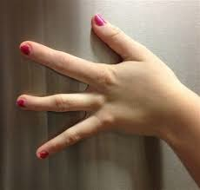
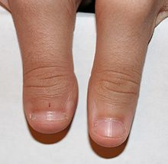
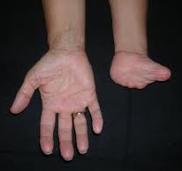
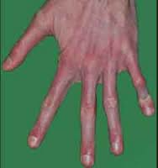
Name the different types of “-dactylia” on the pictures
1
2
3
4
5
6
7
SYNDACTYLIA POLYDACTYLIA MACRODACTYLIA ARACHNODACTYLIA ADACTYLIA
BRACHYDACTYLIA OLIGODACTYLIA

Slide 5
Latin vs. Greek compound words
Latin origin | Greek origin | Hybrids (both compound and derived terms)
⇨ usually 2-root expressions ⇨ connecting vowels: o/i/Ø ⇨ a noun/adjective/numeral on the first place examples: nas-o-lacrim-alis secund-i-grav-ida uni-later-alis mult-angulus cerebr-o-spin-alis (noun) mult-i-cellul-aris (adj.) prim-i-para (numeral) | ⇨ multi-root expressions ⇨ connecting vowels: o/Ø ⇨ a noun/adjective/numeral on the first place examples: thromb-o-cyt-o-penia (= 3 roots) pan-hyster-o-salping-o-oophor-ec-tom-ia (= 5 roots) haemat-o-log-ia haemat-ur-ia tri-pleg-ia py-ur-ia (noun) macr-o-cephal-ia (adj.) mon-o-pleg-ia (numeral) ⇨ the order of the roots makes a difference!!! e.g. haematuria x uraemia | ⇨ multi-root expressions ⇨ connecting vowels: o/Ø examples: ap-pendic-itis L L G hepat-o- ren-alis G L L ovari-ec-tom-ia L G G G cheil-o-gnath-o-palat-o-schisis G G L G

Slide 6
How to identify the components of the derived/compound terms?
Obesitas permagna
ROOT SUFFIX PREFIX ROOT
St. p. cholecystectomiam laparoscopicam
ROOT 1 ROOT2 PREFIX ROOT 3 SUFFIX
ROOT 1 ROOT 2 SUFFIX
CONNECTING VOWEL

Slide 7
PATHOLOGICAL STATES AND DISEASES
MEDICAL INTERVENTIONS AND EXAMINATIONS

Slide 8
Form compounds with the given meaning
-ALGIA /-ODYNIA: “pain, ache, suffering” of a body part or organ
e.g. dorsalgia = dorsodynia = back pain
Pain in the JOINT(S)
Arthr-algia/arthr-odynia
STOMACH pain
Gastr-algia/gastr-odynia/stomach-algia/stomach-odynia
Pain along the course of NERVE(S)
Neur-algia/neur-odynia
TOOTHache
Odont-algia/odont-odynia
Pain in the HIP JOINT
Cox-algia
HEADache
Cephal-algia/cephal-odynia
Hyster-algia/ hyster-odynia/ metr-algia/
metr-odynia / uter-algia/uter-odynia
Pain in the UTERUS
Pain in the BREAST
Mast-algia/mast-odynia/mamm-algia/mamm-odynia
Pain in the SMALL INTESTINE
Enter-algia/enter-odynia
Notes:
+ ODYNIA is synonymic!!!!

Slide 9
Form compounds with the given meaning
-LYSIS : 1) Biochemistry: dissolution, destruction of cells
2) Medicine: gradual subsiding of the symptoms of an
acute disease; relaxation
Pyretolysis
Reduction of fever
Haemolysis
Disintegration of red blood cells
Spondylolysis
Defect in the connection between vertebrae
Spasmolysis
Relaxation of muscle spasms
Dialysis
Separation of smaller and larger molecules
Osteolysis
Dissolution or degeneration of bone tissue
Necrolysis
Disintegration and dissolution of dead tissue
Bacteriolysis
Dissolution or destruction of bacteria

Slide 10
Form compounds or explain their meaning
-PATHIA : pathology (= disease/disorder) of sth
Psychopathia
Mental disorder
Disease of the heart
Cardiopathia
Neuropathia
Disorder of the nervous system
Disease of the cartilage
Chondropathia
Angiopathia
Disease of blood vessels
Disorder of a cell
Cytopathia
Rhinopathia
Disease of the nose
Disease of the tongue
Glossopathia
Myopathia
Disease of muscles

Slide 11
Form compounds or explain their meaning
-PTOSIS : prolapse (= downward displacement) of sth
Prolapse of the uterus
Hysteroptosis/metroptosis/uteroptosis
Blepharoptosis
Drooping of the upper eyelid
Prolapse of the colon
Coloptosis
Nephroptosis
Prolapse of the kidney
Prolapse of the stomach
Gastroptosis
Colpoptosis
Prolapse of the vagina

Slide 12
Form coumpounds with the given meaning
-ECTOMIA : excision, surgical removal of an organ or a part of it
e.g. appendectomia – removal of the vermiform appendix
Removal of a FINGER -
Dactyl-ec-tomia
Removal of the STOMACH -
Gastr-ec-tomia
Removal of the LIVER -
Hepat-ec-tomia
Removal of the LARYNX -
Laryng-ec-tomia
Removal of a LOBE -
Lob-ec-tomia
Removal of the BREAST -
Mast-ec-tomia/mamm-ec-tomia
Removal of the PANCREAS -
Pancreat-ec-tomia
Removal of the PROSTATE -
Prostat-ec-tomia
Removal of theUTERUS-
Hyster-ec-tomia/metr-ec-tomia/
uter-ec-tomia
Notes:
prostata, ae, f.

Slide 13
Form coumpounds with the given meaning
-GRAPHIA : recording, imaging of sth
e.g. hysterographia/metrographia/uterographia
– graphic recording of the strength of uterine contractions
Mamm-o-graphia / mastographia
A breast examination with imaging technology
Angi-o-graphia
An examination of the blood vessels with some type
of viewing/recording device
Radi-o-graphia
Internal organs examination by taking X-ray photographs
Electr-o-cardi-o-graphia
The process of recording electrical impulses of the heart

Slide 14
Explain the meaning of the given compounds
-METRIA : measurement of sth
e.g. pupillometria – measurement of the diameter
of the eye pupil
Crani-o-metria
Measurement of the SKULL
Cephal-o-metria
Measurement of the HEAD (i.e. skull)
Pelvi-metria
Measurement of the PELVIS
Odont-o-metria
Measurement of TEETH
Oste-o-metria
Measurement of BONES
Cyst-o-metria
Measurement of the urinary BLADDER

Slide 15
Form compounds with the given meaning
-SCOPIA : visual examination of the interior of a body organ,
broadly also any inspection of a body part
e.g. endoscopia : examination of the interior of a body
Inspection of the FETUS-
Fet-o-scopia
Inspection of the PHARYNX-
Pharyng-o-scopia
Inspection of the ANUS-
An-o-scopia
Inspection of the ABDOMINAL CAVITY-
Lapar-o-scopia
Inspection of the LARGE INTESTINE-
Col-o(no)-scopia
Inspection of the THORACIC CAVITY-
Thorac-o-scopia
Inspection of the VAGINA-
Colp-o-scopia
Inspection of the EYE-
Ophthalm-o-scopia

Slide 16
Form compounds with the given meaning
-TOMIA : cutting, incision into sth
e.g. herniotomia – a surgical incision to fix hernia
Incision into an ARTERY
Arteri-o-tomia
Incision into a BRONCHUS
Bronch-o-tomia
Incision into the SKULL
Crani-o-tomia
Incision into a LOBE
Lob-o-tomia
Incision into a MUSCLE
My-o-tomia
Incision into the PERICARDIUM
Pericardi-o-tomia
Incision into the PERINEUM (pubic region)
Episi-o-tomia
Incision into a VEIN
Phleb-o-tomia
Incision into the TYMPANUM
Tympan-o-tomia

Slide 17
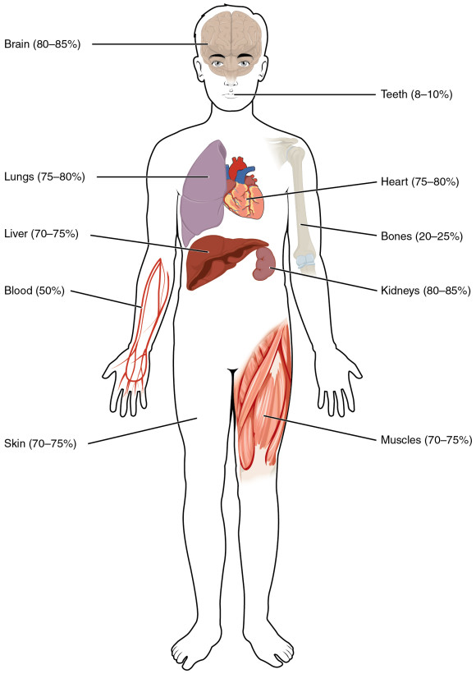
Decide whether the compounds contain Greek components
corresponding to the labelled body parts
Encephalopathia
Somatologia
Thoracographia
Phlebotomia
Cholecystitis
Otoscopia
Adenocarcinoma
Nephrostomia
Podarthritis
Myeloneuritis
Notes:
Myeloneuritis = inflammation of the spinal cord and peripheral nerves

Slide 18
Match definitions with Greek roots and create adequate compounds
The benign tumor made up of newly formed blood vessels is ?
Py-
The burning sensation caused by the return of acidic stomach contents into the oesophagus is called heartburn or ?
Pyr-
Lith-
Condition in which excess cerebrospinal fluid accumulates in the ventricles of the brain is ?
Haem-angi-
The surgical removal of fat beneath the skin is ?
Hydr-
An accumulation of pus in the Fallopian tube is ?
The surgical removal of a kidney stone through an incision into the kidney is ?
Lip-
Ur-
A toxic condition resulting from renal failure in which kidney function is compromised and urea is retained in the blood is ?
Notes:
Haemangioma – pyrosis - hydrocephalus – lipectomia - pyosalpinx – nephrolithectomia – uraemia -

Slide 19
Explain the meaning of medical terms including
the Greek root ODONT- (= tooth) (Handout 7.3, task 5)
toothache
inflammation of the tissues surrounding teeth
hypersensitivity of teeth
the field of medicine dealing with teeth
benign tumour of tooth-tissue origin
tooth development
pathological fear of dental care, dentistry
visual examination of oral cavity
surgical removal of a tooth
ODONTALGIA
PERIODONTITIS
ODONTOHYPERAESTHESIA
ODONTOLOGIA
ODONTOMA
ODONTOGENESIS
ODONTOPHOBIA
ODONTOSCOPIA
ODONTECTOMIA
Notes:
Handout 5 – time to prepare

Slide 20
Form medical terms based on the definitions (Handout 7.3, task 6)
Use the Greek root my-o-/s/- (= muscle)
Benign tumor in a smooth muscle
Inflammation of a muscle
Formation of multiple tumors in a smooth muscle
Heart muscle
Muscular tissue in the uterus
Referring to the heart muscle (adj.)
Recording the strength of a muscle contraction
Medical field studying muscles
Removal of a muscular tissue tumour
Surgical incision to a muscle
Plastic surgery to repair a muscle
MYOMA
MYITIS/MYOSITIS
MYOMATOSIS
MYOCARDIUM
MYOMETRIUM
MYOCARDIACUS
MYOCARDIALIS
MYOGRAPHIA
MYOLOGIA
MYOMECTOMIA
MYOTOMIA
MYOPLASTICA
Notes:
Handout 6

Slide 21
Use the given components to form compounds based on the definitions (Handout 7.3, task 7)
-tomia -ectomia -stomia -graphia -plastica -therapia -anastomosis -scopia -metria
cephalometria
A. ____________: measurement of the dimensions of the head
B. ____________: treatment of a disease by means of ionizing radiation
C. ____________: surgical formation of an opening through
the abdominal wall into the stomach
D. ____________: surgical excision of the gallbladder
E. ____________: endoscopic examination of the colon
F. ____________: surgical repair of a defect of the lip
G. ____________: surgical incision of the appendix
H. Electro- ____________: recording of electrical impulses produced by the brain activity (EEG)
I. ____________ : surgical connection of two parts of the intestine
radiotherapia
gastrostomia
cholecystectomia
colo(no)scopia
cheiloplastica
appendicotomia
encephalographia
enteroanastomosis

Slide 22
Create compounds using the given components
and figure out their meaning
hystera – salpinx – graphia
pan – hystera – salpinx – oophoron – ectome
oligos – erythros – kytos – haima
thrombos – kytos – penia
pneuma (gr. air) – haima – pericardium
kystis – ureter – pyelos – nephros - itis
hepaticus – duodenum – anastomosis
hysterosalpingographia
panhysterosalpingooophorectomia
oligoerythrocythaemia
thrombocytopenia
pneumohaemopericardium
cystoureteropyelonephritis
hepaticoduodenoanastomosis
Notes:
Time to prepare
Radiography of the uterus and Fallopian tubes; surgical removal of the uterus, Fallopian tube and ovary; lower number of erythrocytes in blood; abnormally low number of platelets in blood; presence of blood and air in the pericardium; inflammation of the urinary bladder, ureter, renal pelvis and kidney; formation of a connection between the liver and duodenum

Slide 23
Fill in medical terms with the given meaning
Plastic surgery to repair a blood vessel (e.g. a narrowed artery) is…
An X-ray examination of a vessel using radio-opaque dye so the vessel shows up is…
Referring to the heart and the cardia (part od the stomach close to the oesophagus) (adj.) …
An abbreviation C-PG stands for examination of the heart function and breathing, in Latin it is called…
Surgical operation to make a permanent opening into the pelvis of kidney from the surface is…
Surgery to make an opening between the bladder and the abdominal wall is…
Surgical removal of tongue is...
Plastic surgery of breasts is…
Replacement of the damaged skin by skin taken from a donor is…
Notes:
Time to prepare: Angioplastica; Angiographia; Cardiacus; Cardiopneumographia; Nephrostomia/pyelostomia; Cystostomia; Glossectomia; Mastoplastica; Dermatoplastica

Slide 24
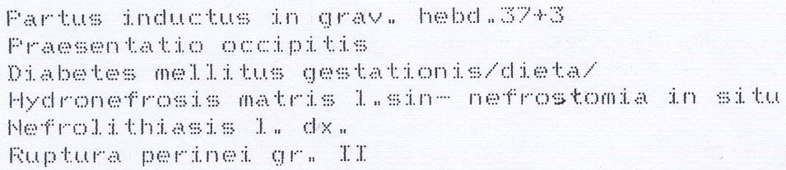
Read the diagnoses and give full forms of the abbreviations used
secundum (prep.!) = according to
Notes:
Gestatio, onis, f. = pregnancy

