Slide 1
BASIC TYPES OF MEDICATIONS
REMEDIUM…
PLURALS?
-ENS/-ANS
-ICUM/-IVUM
  -LYTICUM?
  CONTRA-/ANTI-?
  HYPO-?
  DE-/DES-?
  AN-?
-ENTIA/-ANTIA
-ICA/-IVA
ANXIOLYTICUM
CONTRACEPTIVUM
ANTIDOTUM
HYPOTONICUM
DETOXICANS
ANALGETICUM

Slide 2
CHANGE INTO OPPOSITE NUMBER
REMEDIUM ANXIOLYTICUM
VASODILATANTIA PROPTER STENOSIM VASORUM
DOSIS ANTIBIOTICI PRO INFANTE
ANTIPYRETICA PROPTER HYPERPYREXIAM
REMEDIUM MYORELAXANS
REMEDIA PROPHYLACTICA IN GRAVIDITATE
REMEDIA ANXIOLYTICA
VASODILATANS
DOSES ANTIBIOTICORUM PRO INFANTIBUS
ANTIPYRETICUM
REMEDIA MYORELAXANTIA
REMEDIUM PROPHYLACTICUM

Slide 3
MATCH THE TYPES OF MEDICATIONS WITH THE CONDITIONS
CONTRACEPTIVUM | DYSPEPSIA
HYPNOTICUM | FEBRIS
ANTIDOTUM | TUSSIS
ANTIPYRETICUM | INSUFFICIENTIA CORDIS
STOMACHICUM | INSOMNIA
OBSTIPANS | GRAVIDITAS
EXPECTORANS | INTOXICATIO
CARDIOSTIMULANS | DIARRHOEA
Notes:
Tady se dá znovu zeptat na formu v plurálu.

Slide 4
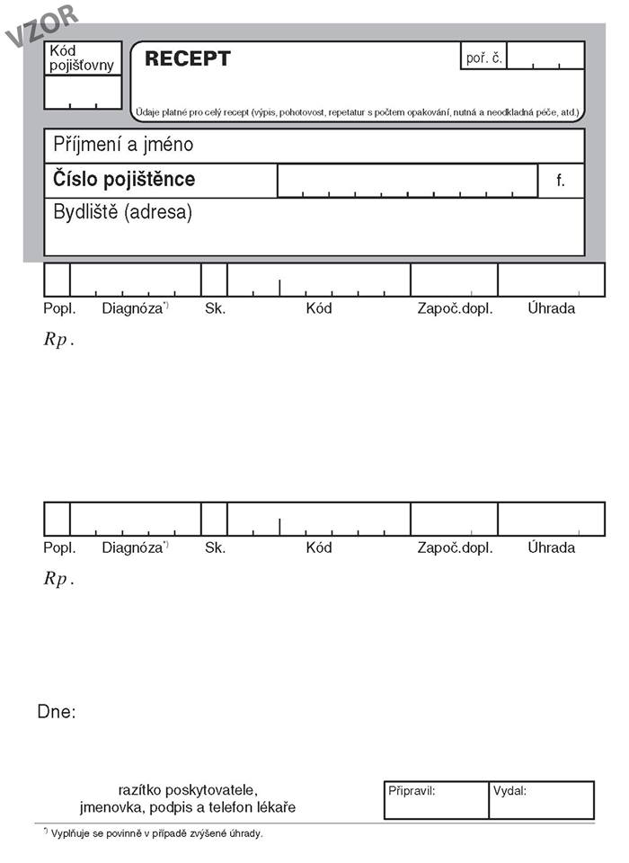
MEDICAL PRESCRIPTION
CZECH

Slide 5
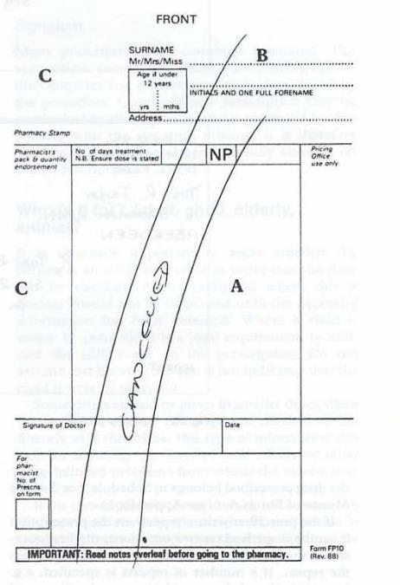
BRITISH

Slide 6
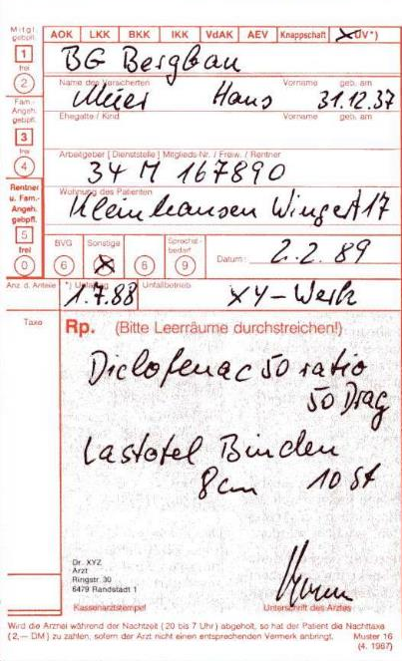
GERMAN

Slide 7
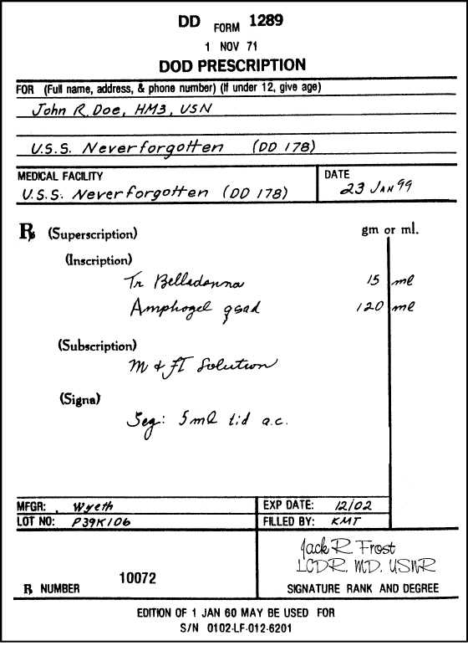
AMERICAN

Slide 8
CZECH, currently used

Slide 9
STRUCTURE
INSCRIPTIO
PERSONALIA AEGROTI
INVOCATIO
Rp. = Recipe = take!
Natrii bromati (bromatis) 6,0
Phenobarbitali 0,6
Sirupi Menthae 60,0
Aquae destillatae ad 300,0
M. f. mixt. = Misce fiat mixtura = Mix (the ingredients)
to make a mixture (lit. so that the mixture is made)
D. S. = Da. Signa. = Give! Sign! Jedna lžička třikrát denně po jídle.
(= One tablespoon 3 times a day after meal).
rem. cardinale
rem. adiuvans
rem. corrigens
rem. constituens
ORDINATIO
SUBSCRIPTIO
SIGNATURA

Slide 10
MAGISTRALITER
Rp.
Kalii iodidi
Anisi spiritus compositi aa 5,0
Aquae purificatae ad 200,0
M. f. sol.
D. S. 3krát denně jednu lžíci.
GENITIVES!
(How much OF…)
ANA (PARTES AEQUALES)
MISCE FIAT SOLUTIO
EXPECTORANS

Slide 11
SPECIALITAS
Rp.
Framykoin plv. ads. 1 x 20 gm
Exp. orig. No. II (duas)
D. S. Aplikovat 2krát denně na postižená místa po dobu 10 dnů.
RECIPE
PULVIS ADSPERSORIUS
EXPEDITIONES ORIGINALES
ACCUSATIVE !
Take…+object!
DA. SIGNA.
ANTIBIOTICUM

Slide 12
PUT THE LINES IN THE CORRECT ORDER
Immunostimulans
Exp. orig. No. I (unam)
Rp.
Imunor p. o. 4 x 10 mg
D. S. Dle rozpisu.
3
1
2
4
Notes:
Slidy s oranžovými tabulkami v hodině – cvičení 1 – stejné recepty se objevují znovu v posledním cvičení v handoutu, to bych dala za úkol.

Slide 13
PUT THE LINES IN THE CORRECT ORDER
Gynaecologicum
D. ad scat.
Acidi borici pulv. 100,0
Rp.
S. Jednu lžíci na litr teplé vody k výplachům.
3
2
1
4
Notes:
Výplach = lavage

Slide 14
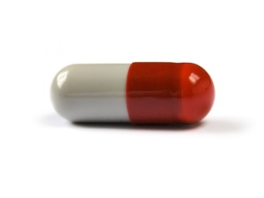
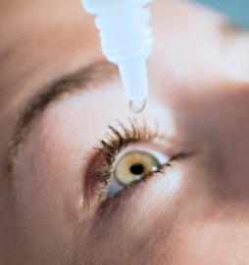
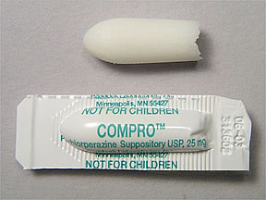
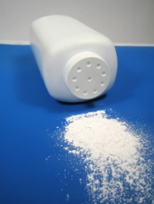
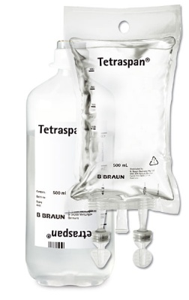
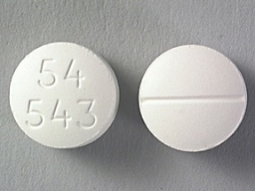
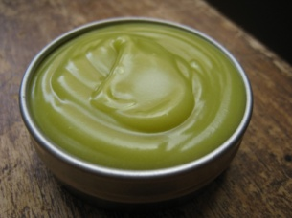
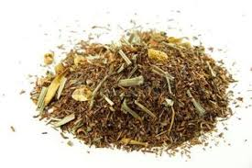
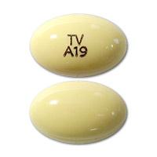
FORMS OF PHARMACEUTICAL PREPARATIONS AND AGENTS
pulvis (adspersorius) ~ suppositorium ~ guttae ~ unguentum ~ tabuletta ~ infusio ~ species ~ globulus ~ capsula

Slide 15
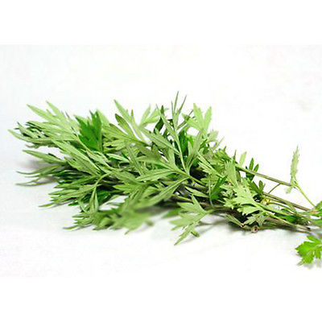
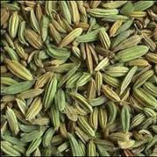
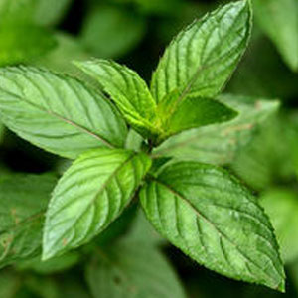
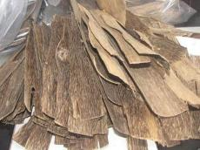
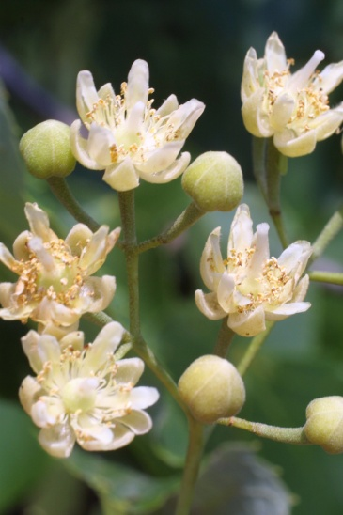
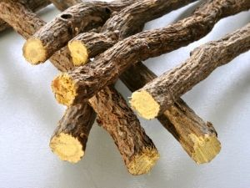
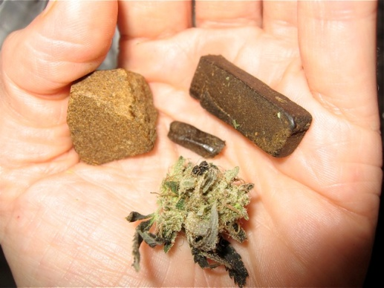
PARTS OF PLANTS USED IN PHARMACOLOGY
folium ~ resina ~ herba ~ flos ~ radix ~ lignum ~ fructus

Slide 16
MAKE A PRESCRIPTION
1
a) A 16-year old boy suffers from severe acne and irritated complexion. Prescribe him an effective suspension made of 85% of zinc oxide (so-called fluid powder – Suspensio zinci oxidi) mixed with talcum and glycerole (talci; glyceroli). The stabilizator is the bentonite magma (bentoniti magma) up to 100 grams. The patient should rub the suspension into his skin three times a day. Shake before using.
b) A 25-year old woman was received at the emergency with itching urticaria (nettle-rash) on both hands and knees. Prescribe her antihistaminics to relieve her from the symptoms: three packages of Dithiaden tablets. The patient should take half a tablet twice a day.
Notes:
První udělat spolu jako vzor, ostatní rozdat prázdné předpisy, práce v párech/skupinách.

Slide 17
a) Rp.
Zinci oxidi
Talci
Glyceroli 85%
Bentoniti magmatis ad 100,0
M. f. susp.
D. S. Rub into the skin three times a day. Shake before using.
b) Rp.
Dithiaden tbl.
Exp. orig. No. III (tres)
D. S. Half of the tablet twice a day.

Slide 18
INTERPRET
Rp.
Acidi acetylsalicylici
Paracetamoli aa 0,3
Codeinii dihydrogenphosphorici 0,02
Coffeini cum natrio benzoico 0,1
Magnesii oxydati 0,05
M. f. pulv.
D. t. d. No. XX (viginti) ad caps.
S. 3krát denně 1 prášek.
Analgeticum +
antipyreticum
painkiller + against fever:
Take the substances given in grams and mix them (the first two in equal amount) into a powder. Then distribute the powder into 20 capsules.
Diureticum
Rp.
Aminophyllini 1,8
Olei cacao q. s. ut f. supp.
D. t. d. No. VI (sex)
S. 2krát denně zavést 1 čípek do konečníku.
to stimulate urination:
Take 1.8 grams of the given substance and mix it with as much cocoa oil as needed to make six suppositories

Slide 19
INTERPRET
Rp.
Ureae 40,0
Acidi lactici 1,0
Ung. lanalcoli 20,0
Cerae albae 5,0
Vaselini albi ad 100,0
M. f. ung. Týden používat v okluzním obvazu na nehty před aplikací antimykotik.
Antimycoticum
against fungal infection:
Mix the first four ingredients with up to 100 grams of white vaseline to make an ointment.
Rp.
Framykoin plv. ads. 1 x 20 gm
Exp. orig. No. II (duas)
D. S. Aplikovat 2krát denně na postižená místa po dobu 10 dnů.
Antibioticum
pre-made antibiotics:
Two packages of the medication should be given in the form of dusting powder .

Slide 20
CHANGE TO PLURAL
tuba originalis
remedium expectorans
dosis pro adulto
flos tiliae
solutio physiologica
pars aequalis
suppositorium rectale
pulvis adspersorius
tubae originales
remedia expectorantia
doses pro adultis
flores tiliae
solutiones physiologicae
partes aequales
suppositoria rectalia
pulveres adspersorii

Slide 21
oculoguttae ~ pasta ~ pulvis ~ vaselinum ~ herba ~ globulus ~ capsula ~ species ~ filum ~ tabuletta ~ cremor ~ infusio
Fill in missing terms from the box in correct form:
1. GLOBULI vaginales No. II
2. SPECIES urologicae propter urocystitidem
3. acidi borici OCULOGUTTAE propter ophthalmiam
4. CAPSULA enterosolvens pro infante
5. PASTA dentifricia
6. FILUM sterile
7. INFUSIO Natrii chloridi
8. VASELINUM flavum q.s.
9. CREMOR refrigerans contra pedes oedematosos
10. PULVIS adspersorius
11. TABULETTAE obductae p.o.
12. HERBA absynthii pro speciebus

Slide 22
MATCH THE PROBLEMS WITH THE APPROPRIATE MEDICATION GROUPS:
OBSTIPATIO
THROMBOSIS
ONYCHOMYCOSIS
CANCER
DILATATIO VASORUM
OLIGURIA
INTOXICATIO
DOLORES PERMAGNI
DIURETICA
ANTICOAGULANTIA
VASOCONSTRINGENTIA
NARCOTICA
EMETICA / ANTIDOTUM
CHEMOTHERAPEUTICA
LAXATIVA
ANTIMYCOTICA

Slide 23
FILL IN MISSING TERMS hypnoticum
Rp.
Amobarbitali 0,15
Codeinii dihydrogenphosphorici 0,03
Aminophenazoni 0,25
Olei cacao q. _______ ut _______ supp.
D. ________ d. _________ VI (sex)
S. Na noc zavést 1 čípek.
= quantum satis ut fiat suppositorium
s.
f.
= dentur tales doses numero
t.
No.

Slide 24
FILL IN MISSING TERMS
Antidepressivum
________
Asentra 50 tbl. p. o. 28 x 50 mg
________ orig. _______ IV (quattuor)
D. ________ 2 tablety denně.
Rp.
= recipe!
= expeditiones originales numero
Exp.
No.
= Da! Signa!
S.

Slide 25
Give full forms of the underlined abbreviated terms: analgeticum + antipyreticum
Rp.
Acidi acetylsalicylici
Paracetamoli aa 0,3
Codeinii dihydrogenphosphorici 0,02
Coffeini cum natrio benzoico 0,1
Magnesii oxydati 0,05
M. f. pulv.
D. t. d. No. XX (viginti) ad caps.
S. 3krát denně 1 prášek.
= ana partes aequales
= misce fiat pulvis
= dentur tales doses numero
ad capsulas
= Signa!

Slide 26
INTERPRET diureticum
Rp.
Aminophyllini 1,8
Olei cacao q. s. ut f. supp.
D. t. d. No. VI (sex)
S. 2krát denně zavést 1 čípek do konečníku.
Take 1.8 grams of aminophyllinum and mix it with as much cocoa oil as needed to make six suppositories.

Slide 27
Find mistakes in the terms in red; then make the abbreviations of them
Antacidum
Rp.
Extracti belladonnae sicci 0,4
Papaverinii chlorati 1,0
Magnesii oxydati 20,0
Misce fiant pulvis
Divide in doses aequalem numerus XX (viginti) ad capsulos
D. S. 3krát denně 1 prášek mezi dvěma jídly.
;
fiat > M. f. pulv.
aequales numero… capsulas > Div. in dos. aeq. No. XX (viginti) ad caps.

Slide 28
MAKE A PRESCRIPTION
2
a)A fifty-year old woman suffers from chronic bad headache with no reason identified. Prescribe her capsules made of 0,005 g of Diazepamum; 0,02 g of Phenobarbitalum; 0,1 g of coffeinum; and 0,2 g of paracetamolum. The vehicle is lactose (lactosum) up to 0,5 grams. The pharmacist should make a powder. Make 50 doses in the form of gelatine capsules (gelatinosus, a, um). The patient should take one capsule if needed, max. twice a day. The medication should be marked as poison.
b) A hard smoker suffers from chronic bronchitis and needs to expectorate the mucus from his bronchial tubes. Prescribe him mucolytics: one package of Mucosolvan drops. The patient should take 30 drops every three hours.

Slide 29
a) Rp.
Ergotamini tartratis 0,001
Diazepami 0,005
Phenobarbitali 0,020
Coffeini 0,100
Paracetamoli 0,200
Lactosi ad 0,5
M.f. plv.
D. t. d. No. L (quinquaginta)
D. ad caps. gelat.
D. S. One capsule if needed, max. twice a day. S. s. v.
b) Rp.
Mucosolvan gtt.
Exp. orig. No. I (unam)
D. S. 30 drops every 3 hours.

Slide 30
MAKE A PRESCRIPTION
3
a) A five-year old child has been received at the hospital with very high fever caused by acute inflammation of urinary bladder. One of the best ways how to lower the fever of children is via paracetamol suppositories (Suppositoria paracetamoli). These should be made by pharmacist of 10 grams of paracetamol + 30 grams of Adipis solidi as adjuvant remedy. 20 of them should be made in equal doses. The instructions for the patient are to take one suppository every 6 hours if the fever reaches 38,5⁰C.
b) The patient suffers from acute pnemonia, but is allergic to penicilline antibiotics. Therefore, two original packages of klaritromycine antibiotics Klacid 500 mg have to be prescribed in the form of coated tablets. The patient should take one tablet every 12 hours for two-three weeks.

Slide 31
a) Rp.
Paracetamoli 10,0
Adipis solidi 30,0
M. f. supp.
Div. in d. aeq. No. XX (viginti)
D. S. One suppository every 6 hours if the fever reaches 38,5⁰C.
b) Rp.
Klacid 500 mg tbl. obd.
Exp. orig. No. II (duas)
D. S. One tablet every 12 hours for 2-3 weeks.

