Slide 1
Dissection Protocol
Week 11

Slide 2
STRUCTURE
Pathological-anatomical diagnosis consists of four parts:
I. Morbus principalis
II. Complicationes
III. Causa mortis
IV. Inventus accesorius

Slide 3
ANALYZE THE DISSECTION PROTOCOL

Slide 4
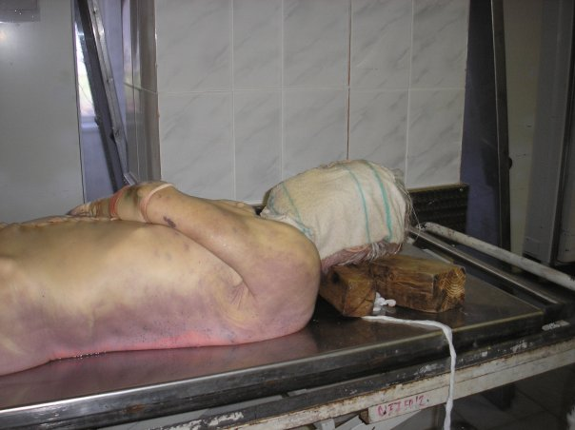
LIVORES MORTIS
Hypostasis; a settling of blood in the lower parts of body post mortem, which causes a purplish red discoloration of the skin
start 20-30 min after death, visible 2 hours after death, maximum extent 8-12 hours after death

Slide 5
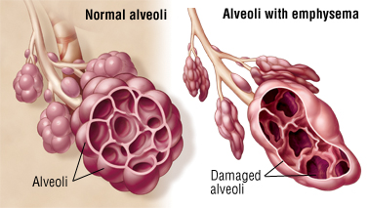
Emphysema pulmonale
a type of COPD (chronic obstructive pulmonary disease) together with e.g. bronchitis;
a dilatation of pulmonary ways and destruction of intraalveolar septa, permanent excessive amount of air in lungs
Symptoms: shortness of breath, cough, sputum, gets worse over time
Causes: smoking, air pollution, chronic bronchitis

Slide 6
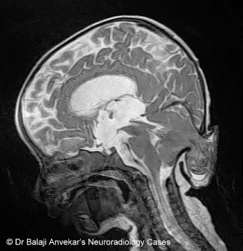
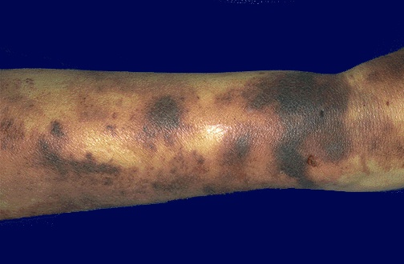
conus occipitalis
herniation/compression of the life important brain structures into foramen occipitale magnum; fatal
ecchymoses
subcutaneous spots of blood similar to haematoma; however, not caused by trauma but a pathophysiology of cells / vessels

Slide 7
hypertrophia trabecularis
pathological overgrowth of the trabeculae of heart muscle
cor pulmonale
pulmonary heart disease; enlargement and failure of the right ventricle due to high blood pressure in lungs or pulmonary stenosis

Slide 8
MATCH THE TERMS WITH APPROPRIATE ADJECTIVES AND CONNECT WITH „CUM“:
emphysema – fractura – decubitus (pl.) – pneumothorax
conus – ebrietas – haemosinus
ebrietas alcoholica
ebrietate a-a
alcoholicus, a, um |  | cum
superficialis, e
pulmonalis, e
traumaticus, a, um
sphenoidalis, e
comminutivus, a, um
temporalis, e
decubitus superficiales
decubitibus p-is
emphysema pulmonale
emphysemate p-i
pneumothorax traumaticus
pneumothorace t-o
conus temporalis
cono s-i
fractura comminutiva
fractura c-a
haemosinus temporalis
haemosinu t-i
Notes:
cum ebrietate alcoholica; cum decubitibus superficialis; cum emphysemate pulmonali; cum pneumothorace traumatico; cum hemosinu sphenoidali;
cum fractura comminutiva; cum cono temporali

Slide 9
Melanoblastoma dorsi reg. subscapularis l. dx.
Metastases multiplices cerebri lat. utr., cerebelli lat utr., et ad pulmones.
Oedema cerebri.
Decubitus reg. sacralis superficialis parvus. Hypertrophia lienis.
Arteriosclerosis universalis. Bronchopneumonia hypostatica microfocalis l.dx.
Thromboembolia ramorum arteriae pulmonalis l. dx. multifocalis. Dilatatio ventriculi cordis dextri acuta.
Defectus dentium partialis reg. mandibulae l. sin. Atrophia fusca myocardii et hepatis.
Adenoma lobi sinistri glandulae thyroideae. Stp. HYE et adnexectomiam bilateralem. Striae cutis reg. abdominis. Degeneratio cuspidum valvae mitralis. Cystes serosae corticis renum. Urocystitis catarrhalis.
Notes:
Odpovědi jsou v poznámce pod následujícím slidem
Co je příčinou smrti?
Jak se nazývají jednotlivé části epikrízy (shrnutí pitvy)?
Jedná se o muže, či ženu?
Co znamená zkratka HYE?
Najděte všechny záněty.

Slide 10
MAN / WOMAN ?
CAUSE OF DEATH ?
INFLAMMATIONS ?
TUMOURS ?

