Slide 1
Types of prevention Risk assessment
Mgr. A. Peřina, Ph.D.
Dept. of Public Health
Faculty of Medicine, Masaryk University

Slide 2
Health
A state of complete physical, mental and social well-being and not merely the absence of disease or infirmity (WHO, 1948).
Health is neither born nor cultivated in hospitals but it arises and developes wherever people live, play and work, relax and grow old.
Pillars of health care:
Health education
Disease prevention
Health protection + health promotion

Slide 3
Health protection and promotion
Health protection: summary of activities and measures focused on creation and protection healthy living and working conditions aimed at the prevention of infectious and non-infectious diseases
Health promotion: summary of activities helping people to strengthen and improve their health and control their determinants of disease
Sectors involved: health care, environmental sciences , food production and agriculture, technologies, industry, trade, social care, transport, culture, state defense forces, schools, sport facilities…

Slide 4
Prevention
Type of prevention | Tasks | Responsibility
Primary | Influencing disease determinants and reducing health risks | Health and Social care services, Environment. sci., , Food prod. & Agriculture, Education etc.
Secondary | Preventive examinations, screening programs | Health care services
Tertiary | Treatment of diseases and mitigation of their consequences | Health and social care services, M. of Social Affairs
Quarterly | Mitigate the effects of unnecessary or excessive treatment interventions | Health care services

Slide 5
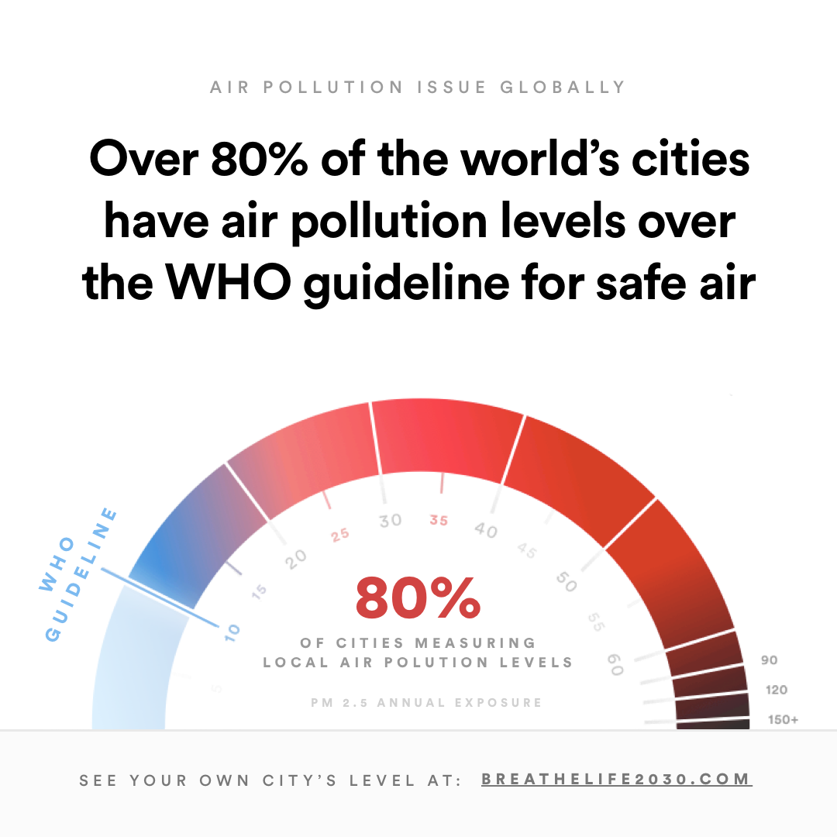
Selected campaigns of WHO
BreatheLife mobilizes cities and individuals to protect people’s and Planet health from the effect of air pollution.
Predominant type of prevention: primary

Slide 6
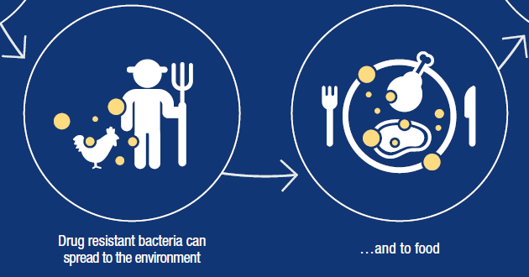
Selected campaigns of WHO
Antibiotic resistance: new WHO recommendations are trying to help maintaining the effectiveness of antibiotics used in human medicine by limiting the unnecessary use in animals.
Predominant type of prevention: primary & tertiary

Slide 7
Selected campaigns of WHO
„Global Hearts" is an initiative to averting the global threat of cardiovascular disease, the world's leading causes of death.
Predominant type of prevention: primary & secondary

Slide 8
Selected campaigns of WHO
"WHO's Global School Health Initiative", also known as "Health Promotion School": An initiative to promote health and education at local, national, regional and global level. The aim is to improve the health of students, school staff, families and other community members through schools.
Predominant type of prevention: primary

Slide 9
Selected campaigns of WHO
Global Action Plan „Healthy enterprise“ addresses all aspects of workers’ health: primary prevention of occupational hazards, protection and promotion of health at work, working conditions and health services for employees of enterprises.
Predominant type of prevention: primary

Slide 10
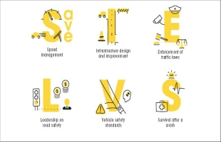
Selected campaigns of WHO
SaveLIVES: road safety package, evidence-based inventory focusing on speed limits, transport infrastructure, vehicle safety, traffic law and regulations and actions increasing the chance of survival after a traffic accident.
Predominant type of prevention: primary

Slide 11
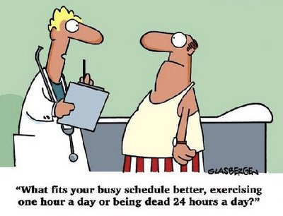
The preventive and therapeutic components of medicine are complementary to one another.

Slide 12
Why to prevent diseases when we can cure them?
Effective prevention reduces the incidence and prevalence of serious diseases.
In most cases, treatment has side effects that can be avoided by effective prevention.
Consistently healthy people are economically active.
Consistently healthy people are less sensitive to social, cultural and other differentiation.
Satisfactory environment fulfills well the functions of production, recreation and regeneration.
The zero option means the growing cost of medical technology, the possibilities of which can be (once) exhausted (eg. antibiotics and current resistance, organ transplants and ethical issues etc.).

Slide 13
Health risks assessment

Slide 14
Hazard vs Risk
Hazard
Characterizes properties of agents
Pathogenicity, toxicity...
Risk
chance of harmful effects to health
It is a mathematical function of hazard.
P = 0 … 1
P = 0 % … 100 %
… It may, it could…
Notes:
Pravděpodobností a emoční vnímání rizika.

Slide 15
Probability
Meaning in conversation
Relative frequency of the phenomenon
The result can be predicted on the basis of a statistical analysis of a large number of iterations.
However:
the life expectancy in the population does not indicate the length of an particular person
the likelihood of genetic diseases do not indicate the occurrence of this disease in particular newborns

Slide 16
Pifalls in risk assessment
Risk assessment (among others) = hazard analysis + emotions
the public knows very little about probability and overestimates its importance
experts (mostly) know very little about emotions; experts must be fully aware of the fact, that
emotions are measurable, as well as the probability is
emotions can be affected as well as the probability
emotions are a legitimate part of the risk

Slide 17
Prioritization of health risks
Why?
There are a lot of risks that occur in the human environment, but only some of them have a direct impact on human health.

Slide 18
Risk Assessment
Attention focuses on human!
Hazard identification: can the agent (specific active factor) harm health?
Dose – response relationship: what is the numerical relationship between the exposure and the effect on health?
Exposure assessment: how important is the contact of the individual / population with the agent?
Risk characterization: can the assumption of an adverse effect on health be confirmed?

Slide 19
Types of hazard (will be discussed in more detail in specific seminars)
Biological agents
Pathogenic microorganisms (see epidemiological seminars)
Non-pathogenic microorganisms related to health
Toxins as by-products of decomposing and primarily non-pathogenic microflora (fungi and aflatoxins)
Chemicals
Irritating, toxic, mutagenic, teratogenic and carcinogenic effects
Physical factors
Noise, vibration
Nonionizing and ionizing radiation: Special features of therapeutic use: benefit / risk ratio
Microclimate, unilateral strain of muscle groups

Slide 20
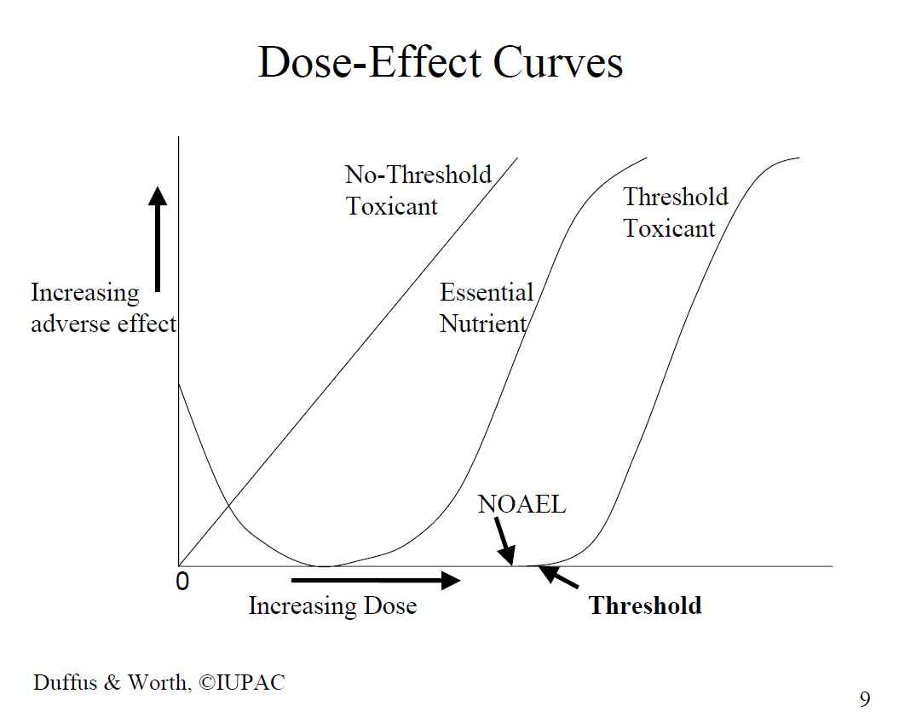
Types of dose-response relationship
Agents with threshold effect
Existence of a safe dose defined as
No Observed Adverse Effect Level
Agents with no threshold effect
Non-existence of a safe dose, but we can estimate the probability of an adverse health effect
„ (Cancer) Slope factor" defined as the size of the inclination angle of no-threshold line (see the figure); often assotiated with cancer

Slide 21
Exposure assessment
Potential dose
It corresponds to the concentration of the agent in the environment (i. e. in air, water, food, soil), converted to a unit of mass, volume or area of the matrix.
Applied dose
It depends on the speed of diffusion and capacity of receptor.
Ingestion, inhalation, contact with skin or mucous membranes
Comment: besides the concentration, the duration of exposure can also determine the size of the effect.
Effective dose
Defined by the concentration of agents in the target organ

Slide 22
Exposure assessment – methods
Indirect methods
Environmental monitoring: The amount of agent in the matrix multiplied by the average matrix intake by the exposed person:
Average lung volume (22 m3/person/day)
Average water consumption per person (1,9 liter/day)
Amount of food consumed per person (e.g. Food pyramid)
The average length of stay in the swimming pool
Inaccuracy! Interindividual differences are significant!
Exposure scenario or questionnaire survey: A rough estimation of the exposure can be specified, most often in a well defined population group (typically school pupils, members of the army ...)

Slide 23
Estimation of individual exposure based on the food pyramid may be difficult.

Slide 24
Exposure assessment – methods II.
Direct methods
are preferred but are generally less accessible.
Personal monitoring:
24 hrs recall, double portion method…
Personal dosimetry - healthcare workers
Biological monitoring
Biomarkers of exposure (DNA adduct in tests of genotoxicity)
Biomarkers of effect (measurable pathophysiological changes in organs)
Biomarkers of sensitivity (measurable susceptibility to health impairment)

Slide 25
Risk characterization
Harmful to health has not been confirmed
Exposure to harmful factor reduces the level of well-being (health in a broader sense)
Example: The source of environmental noise has forced the use of space (more demanding activities are moved to a quieter part of the building).
Exposure to a harmful factor poses a threat to health in the longer term, with the factor being considered at most as one of several disease factors (long-term and multifactorial health effects)
Exposure to harmful agents poses an immediate threat to human health or lives
(See the Czech “methanol affair“ in 2012.)

Slide 26
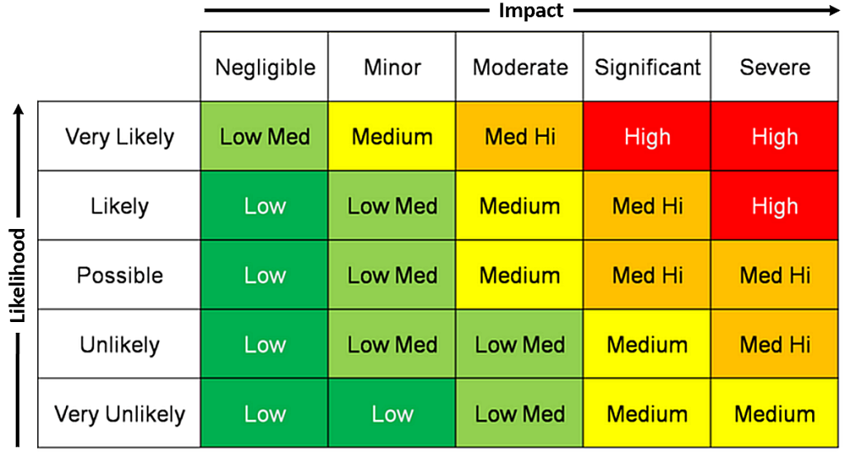
Risk matrix
Graphic tool for expressing the risk according to the probability of exposure and the size of the effect.

Slide 27
Uncertainty in health risk assessment
Errors in exposure assesment
Most common
Due to the complexity of the presence of the agent in the matrix (water, soil, air, food, occupational exposure)
The size of individual effective dose in the target organ of the individual
Interspecies extrapolation
In many cases, toxicological data exists only on animal or tissue models
Can be eliminated with the development of epidemiological methods of work

Slide 28
Epidemiology
Method of work used to study the distribution of determinants of diseases in the population.
Epi demios (Greek) = Among the people
Descriptive, analytical, experimental and interventional epidemiology use statistical methods; a separate field of biostatistics is being developed.
Focus on the study of infectious and (later) non-infectious diseases.

Slide 29
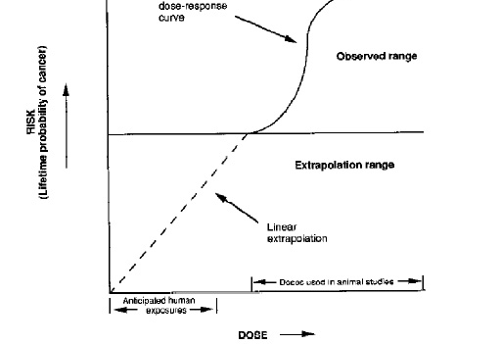
Epidemiology in health risk assessment
Benefits
fundamental role in the scientific concept of protecting public health
no need to perform interspecies extrapolation
exposure to the harmful agent may be studied in context
no need to extrapolate experimental data to the low dose range

Slide 30
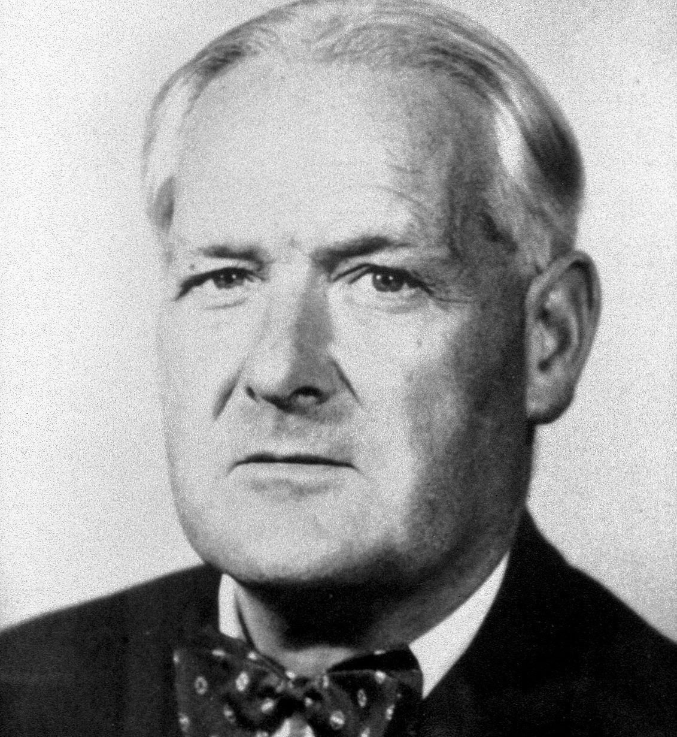
Epidemiology in health risk assessment
Problems: transferability of results
Internal validity of epidemiological studies
Hill's criteria of causality (Sir Austin Bradford Hill, 1897 – 1991)
Strength of association: Even a weak association does not rule out causality if it is weakened by unrecognized confounders
Consistency: Inconsistency with other epidemiological studies does not exclude causality, the effect may only occur under special circumstances
The causality does not assume the specificity of the effect
The temporality (time sequence) of exposure and effect is a prerequisite!

Slide 31
Epidemiology in health risk assessment II.
Hill's criteria of causality ….continuation
Biological gradient: its absence does not exclude causality, many dependencies can be J-shaped
Biological plausibility: the inability of pathophysiological explanation of the phenomenon may be just the result of the current scientific knowledge
Coherence: Incompatibility with "established" theories does not exclude causality
Experimental evidence: its absence does not exclude causality, as the experiment can also be prevented by ethical reasons
Analogy: its absence can only be a manifestation of a lack of scientific imagination

Slide 32
Epidemiology in health risk assessment III.
Bias in epidemiological studies
an error in estimating the effect being studied as a result of poor planning or execution of epidemiological studies. It may cause the distortion of the results in terms of both positive or negative.
Basic types of bias in epidemiological studies
Selective bias: e.g. respondents willing to collaborate are not a representative sample of the population
Information bias is a sign of poor classification in a statistical survey
Confounding bias is a manifestation of the interfering "third" factor of the disease.

Slide 33
Health risk assessment in doctor’s everyday practice
Not only in prevention, but also in the diagnosis and treatment of diseases, doctors should ask the following questions (according to the US EPA):
What symptoms can be causal in terms of exposure to environmental or occupational hazards?
Is there a safe exposure level for the selected agent?
Is there a possibility that some people will be exposed to significantly different exposure doses?
Is it an exposure of an increasingly vulnerable (susceptible) population group (such as children, pregnant women, sick people, the elderly, people with occupational exposure)?

Slide 34
Public Health and qualitative research
Qualitative research always just as a complement to epidemiological methods of work
It enables us to understand the social, cultural, economic and behavioral aspects of public health
Epidemiological methods: “How many? How much?”
Calculation of frequency, confidence intervals, the probability of the estimation error (magic “p-value“)
Qualitative research: how and why?
From the Latin word “Qualis” (= How? What?)
Verbal analysis of relationships and contexts

Slide 36
Conclusions
Lost health can be restored medically.
But:
Creation of health, health protection and health promotion in some ways exceeds the capacity of clinical medicine.
The basis for the protection and promotion of health is a health risk assessment process built on a scientific basis.
Principles of health risk assessment are very useful in clinical practice.

