Slide 1
Drug Interactions
Lenka Součková

Slide 2
Agenda
Drug interactions (DDI)
  Definition
  Significance
Pharmacokinetic DI - examples
Pharmacodynamic DI - examples
Pharmaceutical DI - examples
Drug interactions with food, beverages, herbs
Drug interactions among smokers
Recommendation
Summary

Slide 3
Definitions and Terms
Drug Interactions:“ The pharmacologic or clinical response to the administration of a drug combination different from that anticipated from the known effects of the two agents when given alone ”
1Tatro DS (Ed.) Drug Interaction Facts. J.B. Lippincott Co. St. Louis 1992.
Negative?
Positive ?
Clinically relevant!

Slide 4
Classifying drug interactions
Interrelationship 2 or more drugs at the level of:
    Pharmaceuticals - physico-chemical and chemical interactions of the components
    Pharmacokinetics – Involves absorption, distribution, metabolism and excretion, all of them being associated with both treatment failure or toxicity
    Pharmacodynamics - interaction of active ingredients at the level
      direct effect at receptor function,
      interference with a biological or physiological control process and
      additive/opposed pharmacological effect..

Slide 5
Drug interactions - classification
Pharmacological
Pharmacodynamics
Pharmacokinetics
Pharmaceutical
Incompatibilities
Absorption
Metabolisms
Excretion
Distribution
Notes:
O lékové interakci mluvíme tehdy, když při současném podávání dvou nebo více léků dojde ke změně účinku některého z nich.
Farmaceutické lékové interakce - dochází ještě před podáním pacientovi (např. v infuzní láhvi). Jedná se vlastně o farmaceutickou inkompatibilitu a ne o pravou lékovou interakci
Farmakodynamické - Jedná se o interakce, kdy účinek jednoho léku je změněn přítomností dalšího v místě jeho účinku buď přímo na receptorech nebo nepřímo interferuje s fyziologickým mechanismem

Slide 6
Drug interactions - classification
Drug interaction
Drug
Food and beverage
Alcohol
Nutritional supplements
Smoking
Change of expected drug properties caused by

Slide 7
Classifying drug interactions
Grade | Relevance
1 – A | Nonrelevant
2 – B | Minor
3 – C | Moderate
4 – D | Major
5 – X | Contraindicated (?)

Slide 8
Significance of drug interactions
Desirable (beneficial for the patient)
drug combination potentiating drug effect and decreasing the toxicity
  combination of:
        cytostatics
        analgesics
        antihypertensives
        ATBs
        drugs for asthma

Slide 9
Significance of drug interactions
toxic substance | Antidote
amanita phalloides | Silibin, N-acetylcystein
opiates | naloxon
atropine | fysostigmin
benzodiazepines | flumazenil
digitalis | antidigitalisová globulin
glycoles | ethanol, fomepizol
carbamates | atropine
kumarini | vitamin K
cyanides | amylium nitrosum, hydroxycobalamin,
aniline | methylene blue
lead | EDTA, DMSA
organophosphate | atropine, oximy
paracetamol | N-acetylcystein
Desirable (beneficial for the patient)
combination of the active substance suppressing/inhibiting the effect of another drug
in the treatment of intoxication/poisoning organism

Slide 10
Significance of drug interactions
Undesirable (for the patient harmful, potentially dangerous)
    Major - life threatening
    Moderate - clinically significant
    Minor
This may result in:
      increase or decrease (loss) effect
      increasing or reducing the incidence of side effects
      other changes in effect
      injury or even death
clinically insignificant

Slide 11
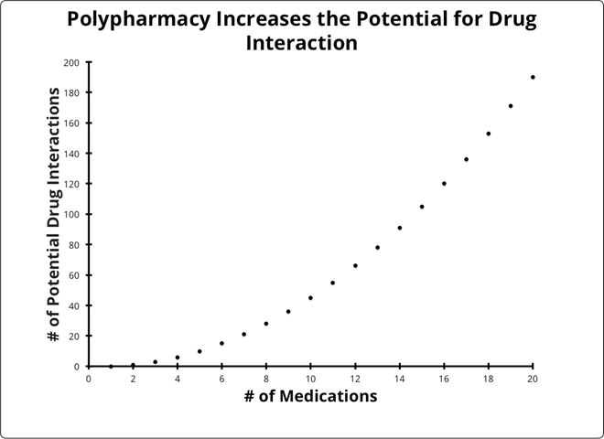
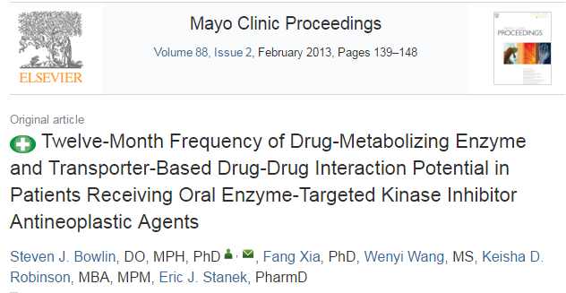
Why are the drug interactions so important?
are one of the commonest causes of ADRs
particularly in the elderly due to polypharmacy
with a prevalence of 20-40% in population
75 % are preventable
ADR are 4th most frequent cause of death
Leape LL et al. JAMA 1995;274(1):35–43.
Raschetti R et al. Eur J Clin Pharmacol 1999;54(12):959–963.

Slide 12
DDI risk factors
Poly pharmacy
Multiple prescribers
Multiple pharmacies
Genetic
Specific population like elderly, obese, critically ill patient
Specific illness e.g. Hepatic disease,
Renal dysfunction…
Narrow therapeutic index drugs
Digoxin, Warfarin, Insulin, Antidepressant, Lithium

Slide 13
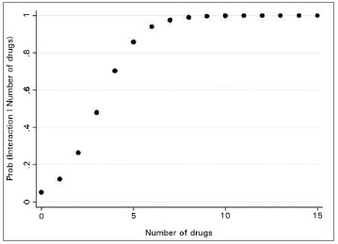
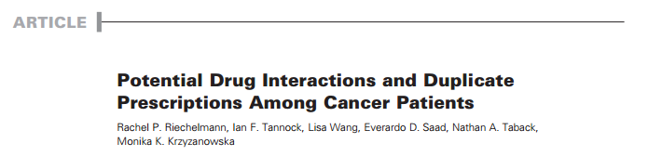
The risk of polypharmacy
prescribing cascade - which occurs when an ADR is misunderstood and new potentially unnecessary drugs are administered; therefore the patient is at risk to develop further ADRs
May F.E., Stewart R.B., Cluff L.E.: Drug interactions and multiple drug administration.
Clin.Pharmac.Ther. 1977, 22:322

Slide 14
Consequences of drug interactions
Loss of therapeutic effect
Toxicity
Unexpected increase in pharmacological activity
Beneficial effects e.g additive & potentiation (intended) or antagonism (unintended).
Chemical or physical interaction e.g I.V incompatibility in fluid or syringes mixture

Slide 15
Pharmacokinetics drug interactions

Slide 16
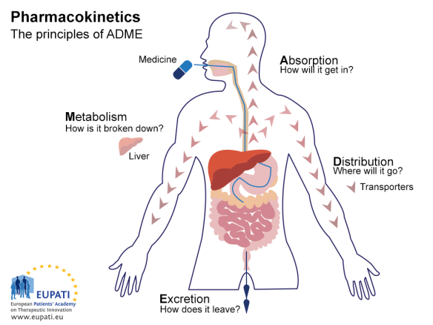
Pharmacokinetics drug interactions

Slide 17
Pharmacokinetics drug interactions
are often considered on the basis of knowledge of each drug and are identified by controlling the patient's clinical manifestations as well as the changes in serum drug concentrations.
They involved all the processes from absorption up to excretion.

Slide 18
Pharmacokinetic interactions
- Absorption
altered pH
altered bacterial flora
formation of drug chelates or complexes
drug induced mucosal damage
altered GIT motility

Slide 19
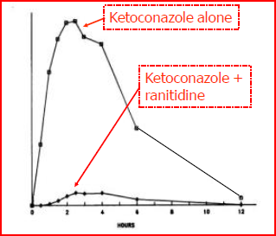
Altered pH
The non-ionized form of a drug is more lipid soluble and more readily absorbed from GIT than the ionized form does.
Antacids
Decrease the tablet dissolution
of Ketoconazole (acidic)
PPI
H2 antagonists
Therefore, these drugs must be separated by at least 2h in the time of administration of both.
https://www.ncbi.nlm.nih.gov/pmc/articles/PMC245265/?page=2

Slide 20
They Can Occur in the GI Tract
Block absorption
of quinolones, tetracycline, and azithromycin
Reduce absorption
of ketoconazole, delavirdine
Reduces ketoconazole absorption
Binds raloxifene,
thyroid hormone, and digoxin
Sucralfate, some milk products, antacids, and oral iron preparations
Omeprazole, lansoprazole,
H2-antagonists
Didanosine (given
as a buffered tablet)
Cholestyramine

Slide 21
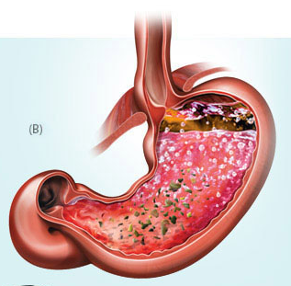
Tyrosinkinase inhibitors/azole antimycotics
And drugs lowering gastric pH
TKI/azole
antimycotics
Gefitinib
Sorafenib
Bosutinib
imatinib
Drugs lowering gastric pH
ranitidin
Antacids
Decreased absorption and availability of TKI/azole antimycotics
omeprazol
sunitinib
Voriconazole
Fluconazole
pantoprazol
famotidin

Slide 22
Altered intestinal bacterial flora
40% or more of the administered digoxin dose is metabolised by the intestinal flora.
Antibiotics kill a large number of the normal flora of the intestine
Increase digoxin conc.
and increase its toxicity

Slide 23
Complexation or chelation
Tetracyclines, Quinolones interact with iron, calcium, magnesium, aluminium preparations
or
Milk (Ca²⁺ )
Unabsorpable complex
Antacid (aluminum or magnesium) hydroxide
Decrease absorption of
ciprofloxacin by 85%
due to chelation
carbo medicinalis (coal), diosmectin – readsorption of other drugs

Slide 24
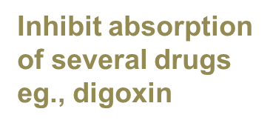
Drug-induced mucosal damage
Antineoplastic agents
cyclophosphamide, vincristine, procarbazine

Slide 25
Altered motility
Increased motility
  Diarrhea - reduce absorption
  Prokinetic drugs - metoclopramide, domperidone, itopride
Decreased motility
  Ileus, constipation - increase in AUC of drugs, toxicity
  Opioids, diphenoxylate, loperamide

Slide 26
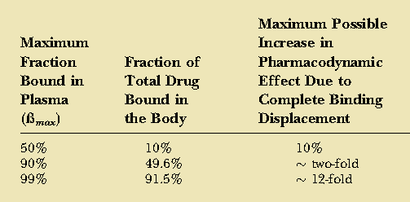
Pharmacokinetic interactions
- Distribution
The major plasma proteins to which most drugs bind are albumin and a1-acid glycoprotein; the former typically binds acidic, anionic drugs whereas the latter typically favors basic drugs
Competitive protein binding by another drug will result in increase concentration of free drug, and that will yield more drug response

Slide 27
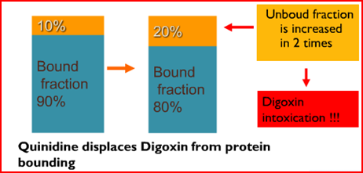
Displaced protein binding
It depends on the affinity of the drug to plasma protein. The most likely bound drugs is capable to displace others.
It is clinically important if displaced drug is highly PP binding , with LONG T ½, small Vd, narrow therapeutic range.
The free drug is increased by displacement by another drug with higher affinity.
Aspirin, Phenylbutazone, Clofibrate
  Displace:
    Oral Anti-coagulants (Dicumarol, Warfarin)
      Bleeding
    Oral Hypoglycemics (Tolbutamide)
      Hypoglycemia
    Bilirubin in Neonate
      Jaundice & Kernictrus.
    Phenytoin

Slide 28
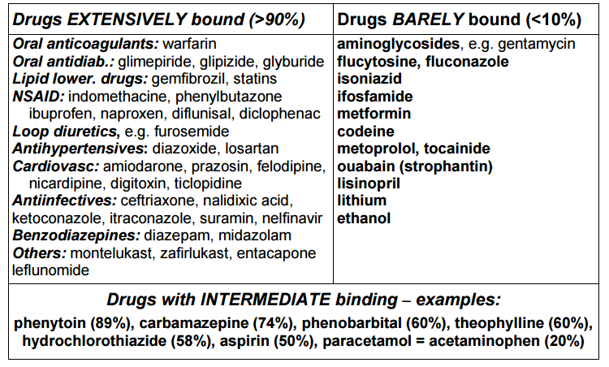
Drugs binding to protein

Slide 29
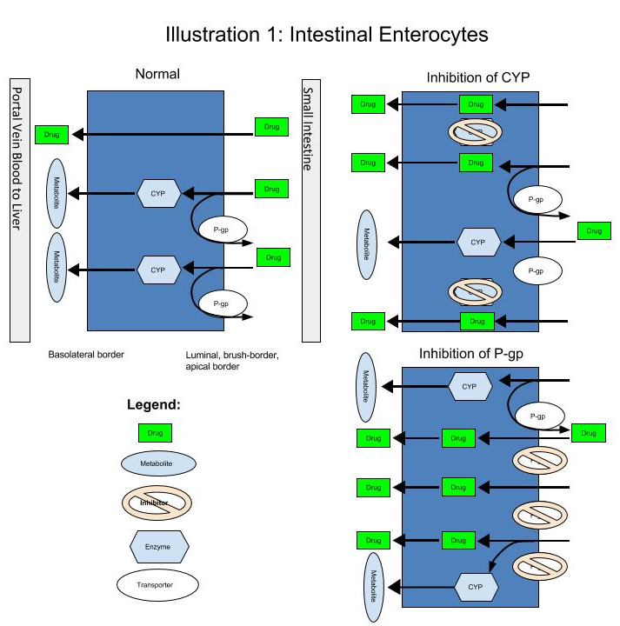

Slide 30
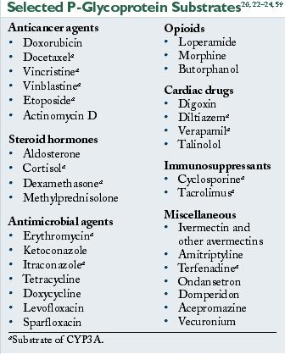
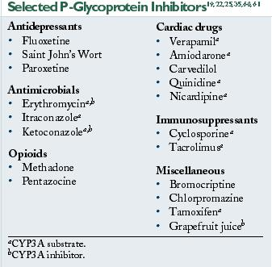
http://www.vetfolio.com/pharmacology/adverse-drug-reactions-in-herding-breed-dogs-the-role-of-p-glycoprotein

Slide 31
Pharmacokinetic interactions - Metabolism
The effect of one drug on the metabolism of the other is well documented. The liver is the major site of drug metabolism but other organs can also do e.g., WBC, skin, lung, and GIT.
CYP450 family is the major metabolizing enzyme in phase I (oxidation process).
Therefore, the effect of drugs on the rate of metabolism of others can involve the following examples

Slide 32
Polymorphism of enzymes
slow metabolizer - all defective alleles
medium metabolizer - an intact allele
rapid metabolizer - all intact allele (wild type)
ultrarapid metabolizer - multiplication of a gene or a higher enzyme activity

Slide 33
CYP P450
a key enzyme in the metabolism of xenobiotics
mainly responsible for Phase I biotransformation processes
occurring in the liver, lungs, kidneys, brain, skin, small intestine and other organs
Substrates P450
    drug metabolizing by this enzyme
Inhibitors of cytochrome P450
    accumulation of the drug in the body
    increased plasma levels
    Increased toxicity
Inducers of Cytochrome P450
    increased degradation of the drug from the organism
    subtherapeutic plasma levels of the drug
    reduce the effect of drugs

Slide 34
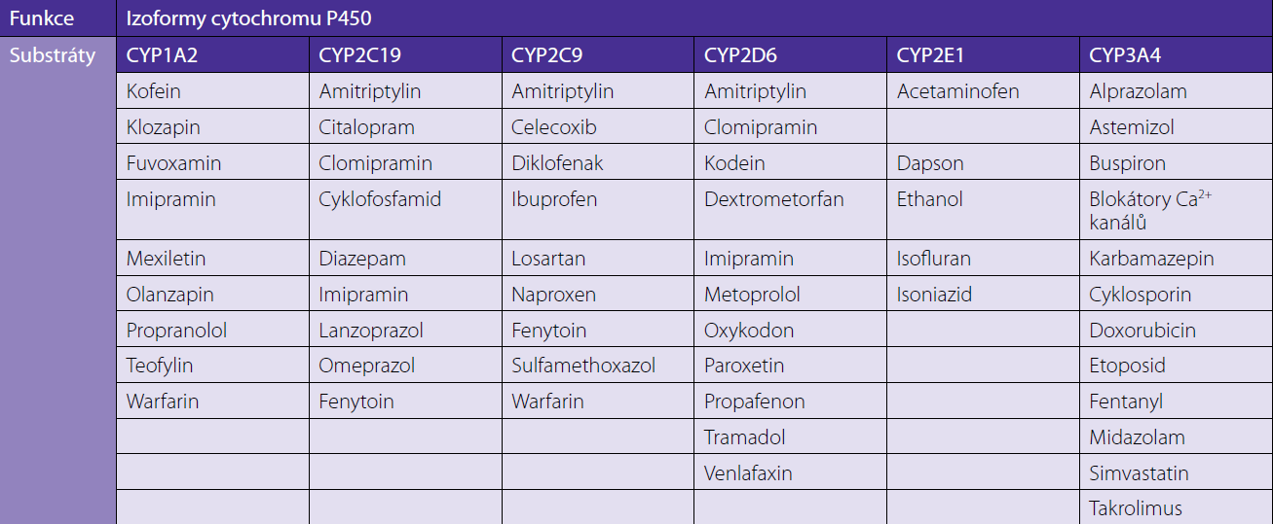
Substrates
high interindividual variability
high interindividual variability
high interindividual variability

Slide 35
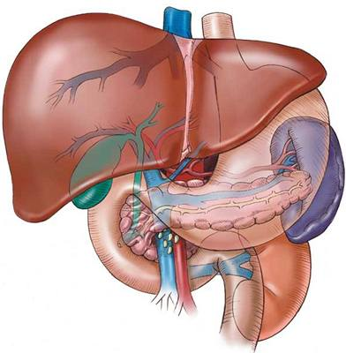
Basic mechanisms - inhibition
10
1
time
inhibition
10
1
exposure
time

Slide 36
Significant drug interactions - inhibition

Slide 37
Different inhibiting ability of drugs from the same ATC

Slide 38
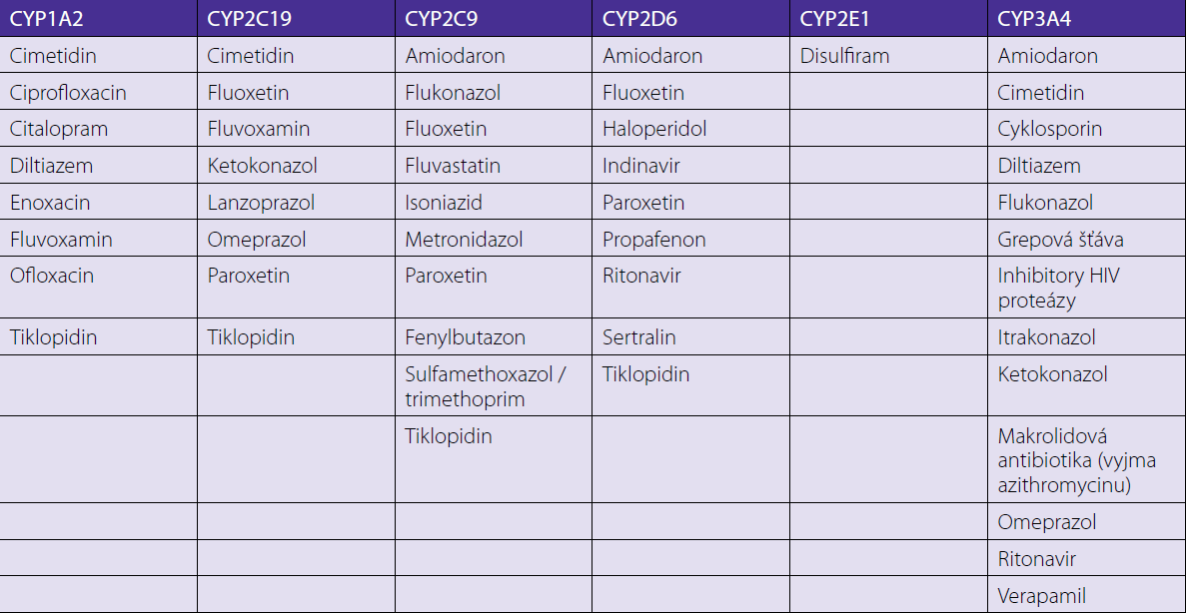
Inhibitors

Slide 39
Basic mechanisms - induction
10
1
čas
induction
10
expozice
1
čas

Slide 40
Drug interactions - induction
AUC (%)

Slide 41
Drug interactions – slow onset of induction
AUC (%)

Slide 42
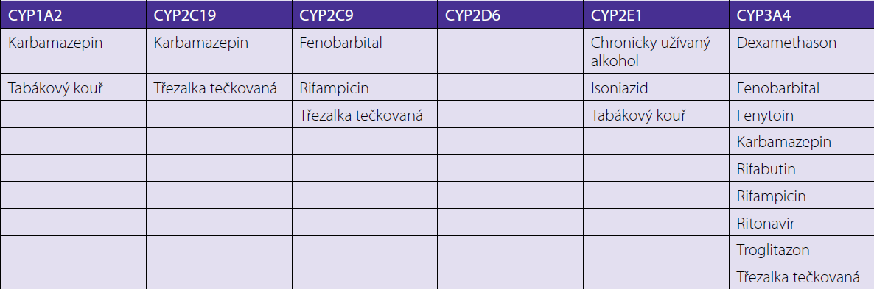
Inductors
It may be seconds up to weeks for example in case of enzyme induction, it needs weeks for protein synthesis, while enzyme inhibition occurs rapidly.

Slide 43
Pharmacodynamics drug interactions

Slide 44
Pharmacodynamics drug interactions
It means alteration of the dug action without change in its serum concentration by pharmacokinetic factors.
Additive effect : 1 + 1 =2
Synergistic effect : 1 +1 > 2
Potentiation effect : 1 + 0 =2
Antagonism : 1-1 = 0

Slide 45
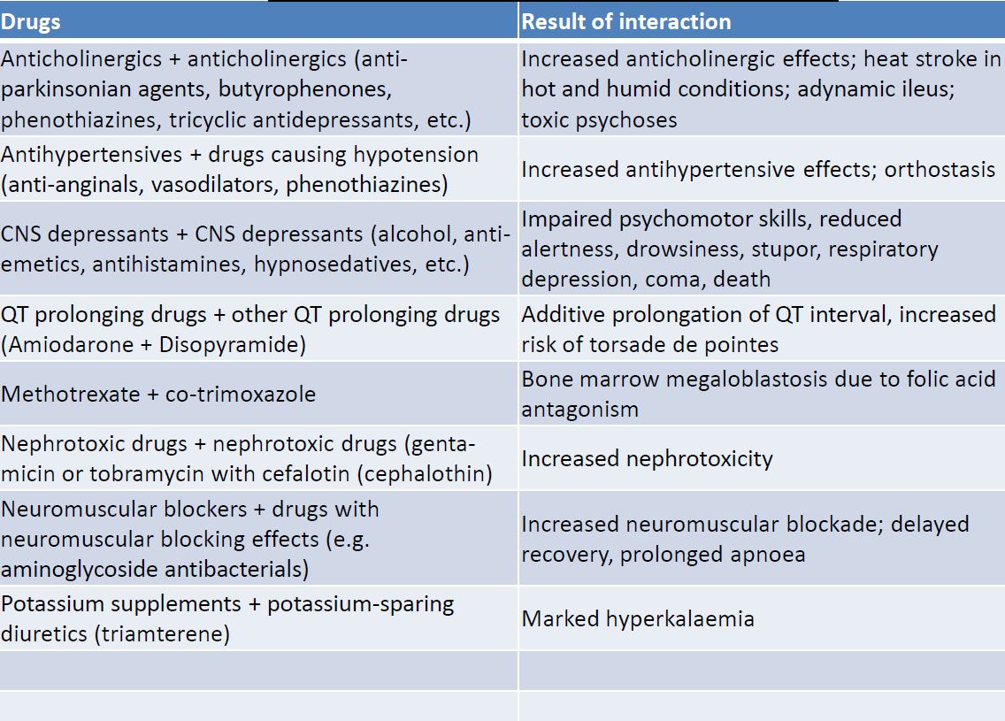
Pharmacodynamics drug interactions - examples

Slide 46
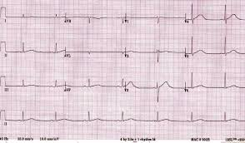
QT interval prolongation
TKI
Deterioration of ADRs on the heart, including QT prolongation and torsades de pointes
Sorafenib
Sunitinib
Pazopanib
Dasatinib
Nilotinib
CYP 3A4
Inhibitors
claritromycin
ciprofloxacin
amiodaron
sotalol
ondansetron
propafenon
chlorpromazine
haloperidol
cisapride
domperidon
pimozide

Slide 47
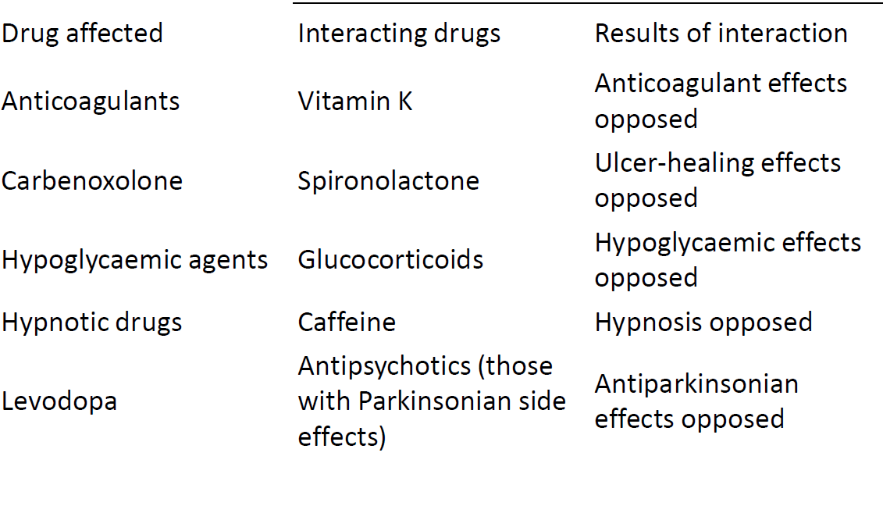
Opposing or antagonistic interactions

Slide 48
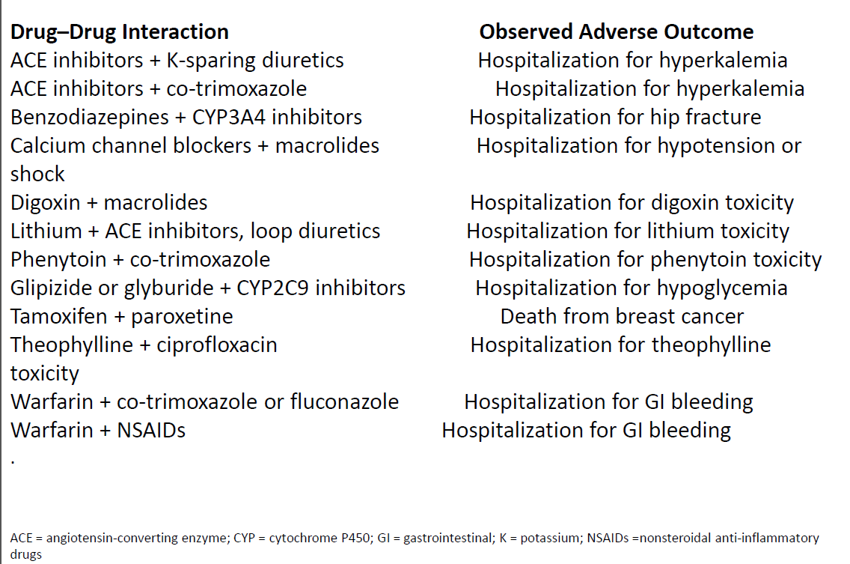
Important Drug Interactions in the Elderly

Slide 49
Drug interactions with food, drinks, herbs

Slide 50
Drugs in which food reduces bioavailability
AUC (%)

Slide 51
Furosemide before or after a meal?
Furon® does not mentioned in SPC
Furorese® fasting
Slovakofarma® furosemide after meal
Food in healthy volunteers (n = 18) resulted in a 45% reduction in the furosemide (40 mg) curve, a 78% reduction in peak plasma concentrations and a reduction in absolute bioavailability from 76% to 43% and a decrease in diuretic effect.
Furosemide should be administered one hour before or 2 hours after a meal.

Slide 52
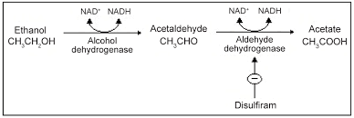
Inhibition of alcohol metabolism
Disulfiram reaction:
facial flushing associated with nausea, palpitations and hot flashes, collapse, arrhythmia, syncope, unconsciousness, convulsions
disulfiram
griseofulvin
metronidazole
co-trimoxazole (Biseptol®)
cephalosporins (eg cefamandole, cefmenoxime, cefoperazone, cefotetan)
ketoconazole
tolbutamide
furazolidone
levamisol

Slide 53
Coca-Cola® phenomenon
ACU (%)

Slide 54
Foods as CYP modulators
St John's wort
CYP3A4 inducer
CYP2C19 inducer
CYP2C9 inducer
P-glycoprotein inducer
affecting (reducing to loss) the effect of many drugs that are substrates of CYP3A4 or P-glycoprotein

Slide 55
St John's wort

Slide 56
Foods as CYP modulators
Garlic
CYP3A4 inducer
CYP2C9 inhibitor
P-glycoprotein inducer
increase in bleeding after warfarin
Paprica, cauliflower

Slide 57
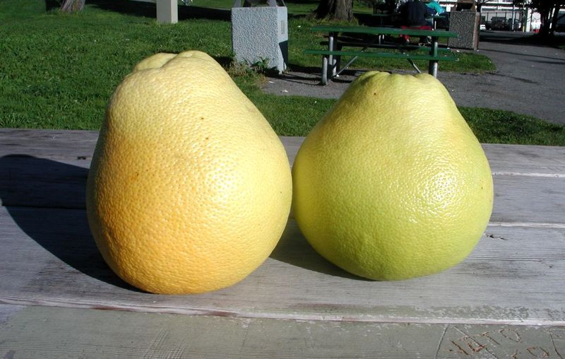
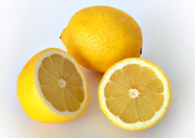
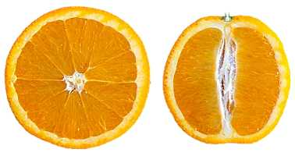

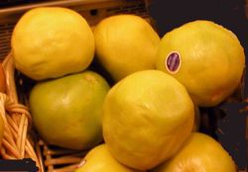
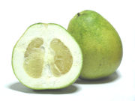
nárůst závažnosti změn

Slide 58
Citrus juice + felodipine
AUC (%)

Slide 59
Drug interactions in smokers

Slide 60
Influencing the effect of drugs by smoking
Pharmacodynamic
mainly nicotine in the CNS and periphery, has sympathomimetic effects (cardiovascular system, reduces insulin sensitivity)
Pharmacokinetic
in the absorption phase - nicotine, other products
in the metabolic phase - especially polycyclic hydrocarbons

Slide 61
Pharmacodynamic interactions of nicotine
Beta-blockers
Less decrease in BP and Heart rate
Benzodiazepines
Less sedative effect
Discontinuation of smoking on prolonged use of benzodiazepines may cause depression
Opioids
Reduction of analgesia
Oral Contraceptives
smoking increases the risk of complications p.o. contraception
in women over 35 who smoke more than 15 cigarettes a day the risk of death is 19: 100,000 vs. 3: 100,000

Slide 62
Effect of smoking on CYP1A2 induction
Smokers have 1.5 x increased CYP1A activity compared to non-smokers
Polycyclic aromatic hydrocarbons cause metabolic induction
Induction already occurs when smoking 10 cigarettes/day
Typically, higher dosages of some drugs are required for smokers
After smoking discontinuation, the enzyme activity is reduced to 7.3x per week
Interrupting smoking requires doses to reduce
High risk NÚL after smoking interruption (extrapyramidal symptoms, cramps…)

Slide 63
Increased CYP450 activity in smoking
CYP1A2 amitriptylin, kofein, clozapin, duloxetin, fluvoxamin, haloperidol, imipramin, olanzapin, ondansetron, paracetamol, propranolol, teofylin, warfarin (R-isomer)
CYP2B6 bupropion, clopidogrel, cyclophosphamid, ifosfamid, methadon, nevirapin

Slide 64
Pharmaceutical drug interactions

Slide 65
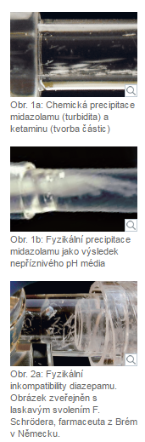
Incompatibility
The incompatibility occurs outside the body, inside the infusion bottles, bags, syringe, or infusion tubes, sometimes visible to the eye.
Physical Reaction
  In the event of physical reactions to the bath, it is usually a separation or precipitation (eg, dilution of alcoholic solutions) due to a change in the relationship between ionization, non-ionization and solubility.
Chemical reaction
  Chemical incompatibility means that it is chemically degraded by oxidation, reduction, hydrolysis or decomposition. Chemical reactions can be manifested by turbidity, precipitation, and color changes.
The result is a reduction in the amount of the medicinal agent or the formation of toxic by-products

Slide 66
Incompatibility
Amiodarone diluted in 5% glucose solution meets NE reconstituted in FR - precipitation of amiodarone
Management - dilute NA to 5% glucose solution
Octreotide meets in one lumen with parenteral nutrition, octreotide is inactivated Management - Separate pathways for parenteral nutrition and octreotide
Administration of aminoglycosides and beta-lactams meeting in one of the lumens - inactivation of the free -NH2 in the free aminoglycosides and -COOH in beta-lactams
Management - do not mix in one fluid, split the route of administration, do not give in t
the same hour

Slide 67
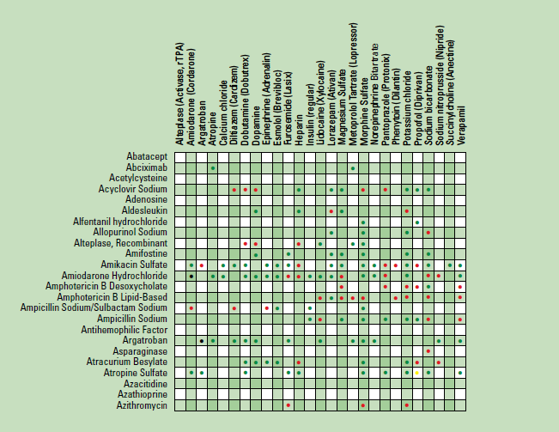
IV Drug Compatibility Chart

Slide 68
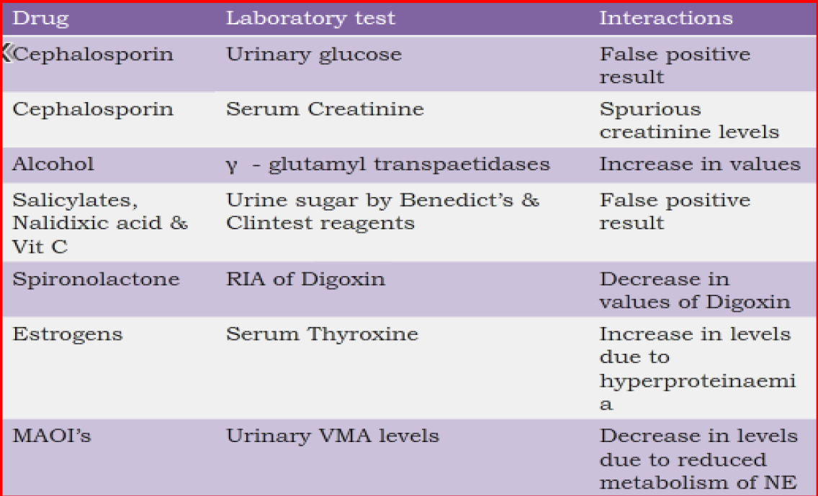
In-vitro: 1-Drug-laboratory tests interaction:

Slide 69
Recommended links
https://www.drugs.com/drug_interactions.html
https://www.webmd.com/interaction-checker/default.htm
https://reference.medscape.com/drug-interactionchecker
www.arizonacert.org (drug interactions)
www.drug-interactions.com
(P450-mediated drug interactions)
http://www.drugwatch.com/drug-interactions/
http://drugagency.cz/lekove-interakce.php?id=9
http://www.uspharmacist.com
www.QTdrugs.org (drug-induced arrhythmia)
www.C-Path.org (drug development)

Slide 70
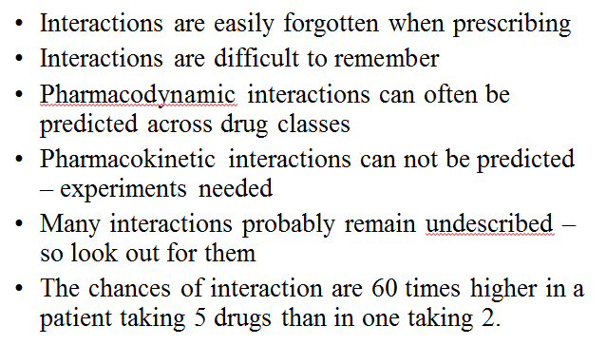
Things to remember

Slide 71
Thank you for attention

