Slide 1
XXXIV.-XXXVII. Accommodation, Scheiner´s experiment, visual field, blind spot, color vision, astigmatism

Slide 2
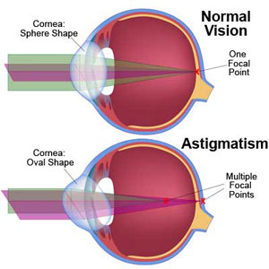
Astigmatism Theoretical background
Astigmatism
is an optical defect, in which vision is blurred due to the inability of the optics of the eye to focus a point object into a sharp focused image on the retina.
astigmatism may be asymptomatic, higher degrees of an astigmatism may cause symptoms such as a blurry vision, squinting, eye strain, fatigue, or headaches.
Types:
Regular astigmatism
principal meridians are perpendicular.
Simple astigmatism - first focal line is on retina, while the second is located behind the retina. Or, first focal line is in front of the retina, while the second is on the retina.
Compound astigmatism - both focal lines are located behind or before the retina.
Mixed astigmatism - focal lines are on both sides of the retina (straddling the retina).
Irregular astigmatism
principal meridians are not perpendicular. This type cannot be fixed by the lens.

Slide 3
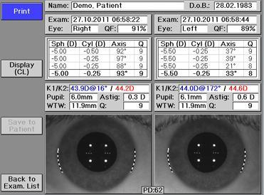
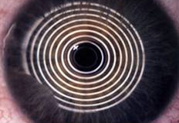
Astigmatism Experimental design
Tests:
Objective
Refractometer, autorefractometer
Placido keratoscope - Placido keratoscope consists of a handle and a circular part with a hole in the middle. Hole with a magnifying glass is viewed from a distance of 10-15 cm to a patient's cornea. Up to 200 mm wide circular portion is concentric alternating black and white circles. They reflect the patient's cornea. In case of astigmatism deformation appears at the corresponding location.
Sciascope
Ophthalmometry
Subjective
Fuchs keratoscope – Tool for evaluating astigmatism. Examinee stands up against the pattern of a circular shape (circulars or stripe rectangles) and fixes the center of the pattern with one eye open. Examinee himself monitors whether its image appears evenly or is somewhere distorted.
Ophtalmometer
Placido keratoscope
Fuchs keratoscope

Slide 4
Color vision Theoretical background
Colour vision deficiency
The collective name for the inability to distinguish colours correctly called colour blindness
Types:
Monochromacy – colour blindness
Rods monochromacy (achromatopsia) - inability to distinguish any colours as a result of absent or nonfunctioning all retinal cones
Cones monochromacy – absence or nonfunctioning of at least two retinal cones
Dichromacy (Daltonismus)
Protanopia - cones are less sensitive to red light
Deuteranopia – cones are less sensitive to green light
Tritanopia – cones are less sensitive to blue light
Anomalous trichromacy - is a common type of inherited colour vision deficiency, occurring when one of the three cone pigments is altered in its spectral sensitivity.
Protanomaly – is a mild colour vision defect in which an altered spectral sensitivity of red retinal receptors (closer to green receptor response) results in a poor red–green hue discrimination.
Deuternomaly – is caused by a similar shift in the green retinal receptors. It is by far the most common type of a colour vision deficiency.
Tritanomaly – is a rare, hereditary colour vision deficiency affecting blue–green and yellow–red/pink hue discrimination.
Trichromacy
Protanopia
Deuteranopia
Tritanopia
Monochromacy

Slide 5
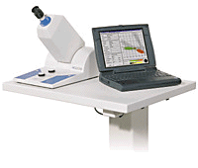
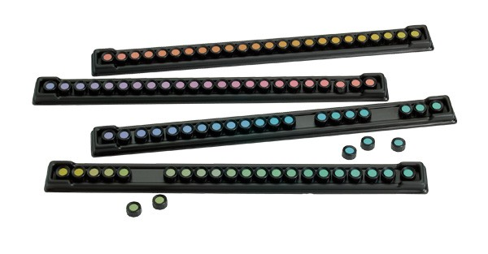
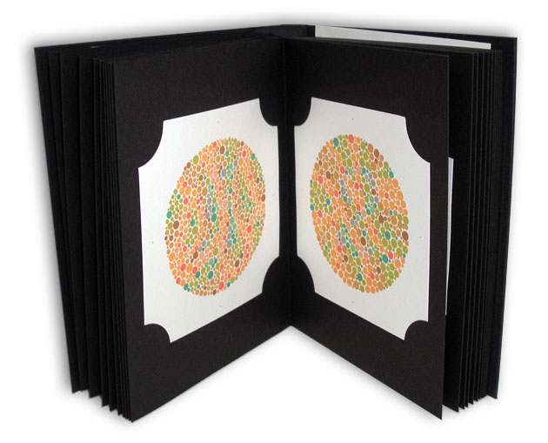
Color vision Theoretical background
Tests
Anomalous trichromacy, dichromacy, monochromacy, decreased sensitivity to hue
Farnsworth – Munsel 100 hue test - Test contains four distinct rows of similar colour hues, each containing 25 distinct variations of each hue. Each colour hue at the polar end of a row is fixed in a position, to serve as an anchor. Each hue tile between the anchors can be adjusted as the observer sees the fit. The final arrangement of the hue tiles represents the aptitude of the visual system in discerning differences in the colour hue.
Monochomacy, Dichromacy, Anomalous trichromacy
Nagel anomaloscope - is based on a colour match. Two different light sources have to be matched to the same colour. On one side you have a yellow colour which can be adjusted in the brightness. The other side consists of a red and a green light whereas the proportion of mixture is variable.
Dichromacy, Monochromacy
Ishihara test – The test consists of a number of coloured plates. Each of them contains a circle of dots appearing randomized in a colour and size. Within the pattern are dots which form a number or shape clearly visible to those with normal colour vision, and invisible, or difficult to see, to those with a red-green colour vision defect, or the other way around.
Holgrem test – The patient has to match one piece of wool to the samples in the box in this colour blindness test. There are light and dark shades to confuse the patient. This helps detect the problems.
Farnsworth- Munsel hue test
Anomaloskop
Holgrem test
Ishihara test

Slide 6
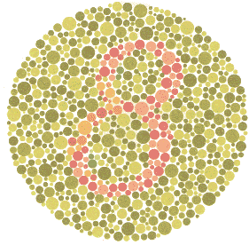
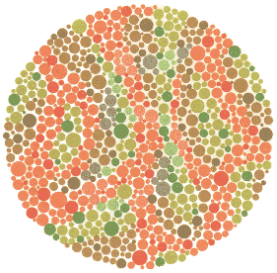
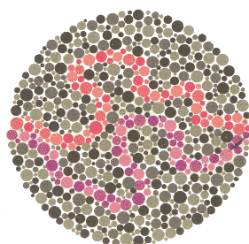
Color vision Experimental design
Numbers
Picture
Finding path
“8” | Trichromacy
“3” | Red-green blindness -Protanopy, deuteranopy, protanomaly
nothing | Monochromacy
nothing | Trichromacy
“5” | Red-green blindness-Protanopy, deuteranopy, protanomaly
Those with a normal colour vision should be able to trace along both the purple and red lines. Those with Protanopia (red colourblind) should be able to trace the purple line, those with protanomaly (weak red vision) may be able to trace the red line, with increased difficulty. Those with Deuteranopia (green colour blind) should be able to trace the red line, those with Deuteranomaly (weak green vision) may be able to trace the purple line, with increased difficulty.

Slide 7
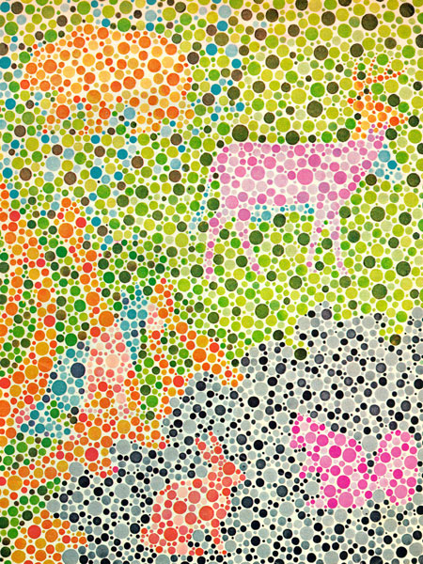
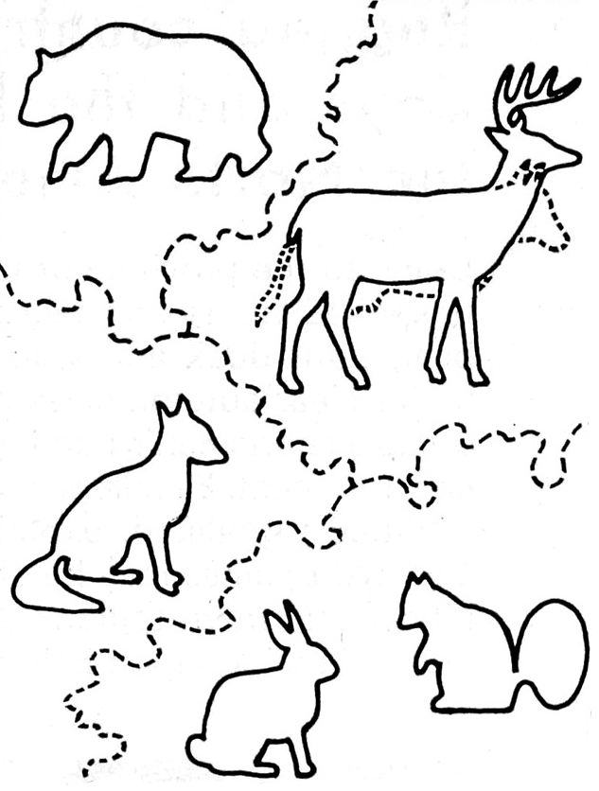
Color vision Experimental design
Children´s pseudo-isochromatic plates

Slide 8
Accommodation Theoretical background
Accommodation
Accommodation is the process by which the vertebrate eye changes optical power to maintain a clear image or focus on an object as its distance varies.
Ability to focus is influenced by two factors:
The ability of the lens to change its shape and strength of the ciliary muscle .
Actual physical deformation of the lens, which is measured in diopters, is called physical accommodation. Physiological accommodation expresses the contractile force of the ciliary muscle, which is necessary to change the refractive state of the eye by 1D .
Accommodation at the near point:
In the process of the accommodation to the near point, there is a contraction of the circular fibers of the ciliary muscle (Muller's muscle) and relaxes the zonulas, but lens, thanks to its elasticity, protrudes. Lens after releasing the contraction of zonulaes changes the radius of the curvature of anterior and posterior refracting surface, due to its high elasticity.
Innervation of the ciliary muscle to the accommodation at the near point provides parasympathetic pathway.
Accommodation at the distant point:
Accommodation on a distant point is also an active action. Meridional ciliary muscle fibers (Brücker´s muscle) are contracting. The fibers are arranged so that the pulling on the lens toward the periphery, there is a flattening of the lens.
Innervation of the meridional muscle to accommodation at the distant point provides sympathetic pathway.

Slide 9
Accommodation Theoretical background
Far point R
Punctum remotum is a point lying on the optical axis that is displayed on the retina at the minimum accommodation.
Far point of a healthy eye is at the infinity.
Hypermetropic eye has a far point at a finite distance behind the eye. Major hyperopia causes that the far point is moved closer to the final distance to the bulb of the eye.
Myopic eye has a far point at a finite distance in front of the eye. The distance of the far point from the subject of the major plane of the eye is called aR and it is measured in meters. The reciprocal value of this distance is called an axial refraction aR. Using this data, the current refractive state of the eye is defined.
Near point P
Punctum proximum is a point lying on the optical axis that appears on the retina at the maximum accommodation. The distance from the subject nearby point the main plane of the eye called the AP and it also measured in meters.
Middle Point is of fundamental importance in assessing the performance of the accommodation of the eye. Along with distant point encloses accommodative area.
Accommodative area
Is the area between the far point and the near point; therefore indicates the range in which we see the individual dots sharply. It is measured in meters.

Slide 10
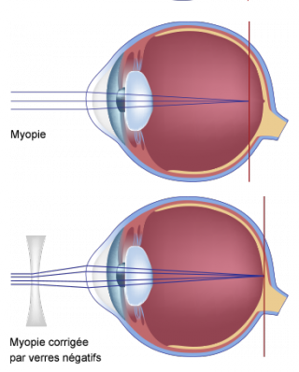
Accommodation Theoretical background
Defects
Myopia
is a condition of the eye where the light that comes in does not directly focus on the retina but in front of it, causing the image that one sees when looking at a distant object to be out of focus. It does not affect focus when looking at a close object.
When used colloquially, 'myopia' can also refer to a view on or way of thinking about something which is - by extension of the medical definition - hyper-focused and fails to include a larger context beyond the focus.
Myopia is most commonly corrected through the use of corrective lenses, such as glasses or contact lenses. It may also be corrected by a refractive surgery, though there are cases of associated side effects. The corrective lenses have a negative optical power (i.e. have a net concave effect) which compensates for the excessive positive diopters of the myopic eye. Negative diopters are generally used to describe the severity of the myopia, as this is the value of the lens to correct the eye. High-degree myopia, or severe myopia, is defined as -6 diopters or worse.
Hyperopia
commonly known as a farsightednesss is a defect of vision caused by an imperfection in the eye (often when the eyeball is too short or the lens cannot become round enough), causing the eye to have insufficient power to see in the distance, causing the eye to have to accommodative, by having to make the lens of the eye more convex, or plus.
For near objects, the eye has to accommodate even more. Depending on the amount of hyperopia and the age of the person which directly relates to the eye's accommodative ability, the symptoms can be different.
People with hyperopia can experience blurred vision, asthenopia, accommodative dysfunction, binocular dysfunction, amblyopia, and strabismus. The causes of hyperopia are typically genetic and involve an eye that is too short or a cornea that is too flat, so that images focus at a point behind the retina.
Presbyopia
is a condition associated with aging in which the eye exhibits a progressively diminished ability to focus on near objects. Presbyopia’s exact mechanisms are not fully understood; research evidence most strongly supports a loss of elasticity of the crystalline lens, although changes in the lens’s curvature from continual growth and loss of power of the ciliary muscles (the muscles that bend and straighten the lens) have also been postulated as its cause.
Myopia
Correction
Hyperopia
Correction

Slide 11
Accommodation Experimental design
1. Examinee looks through a thin window at a pin. At the maximum distance of the optometer examinee reports if he sees or does not see the pin out of focus. Healthy eye has the punctum remotum in 5 meters, unfocused pin in the distance of 1 meter sees only the myopic eye.
2. The examinating person moves progressively the pin closer to the eye and examinee reports if he/she sees a sharp pin or not.
Scheme of the optometer - as viewed of the eye, which tracks optometer through the slot (double vision)
3. Punctum proximum in healthy eye is about 25 cm. At this point, the healthy eye should not be able to have already seen a sharp pin. For hyperopic eye, this point depending on the size of the defect is closer to 30-35 cm and in myopic eye depending on the size of defect is punctum proximum closer to the eye to 10-15 cm.
Scheme of the optometer – a top view
Scheme of the optometer – a side view

Slide 12
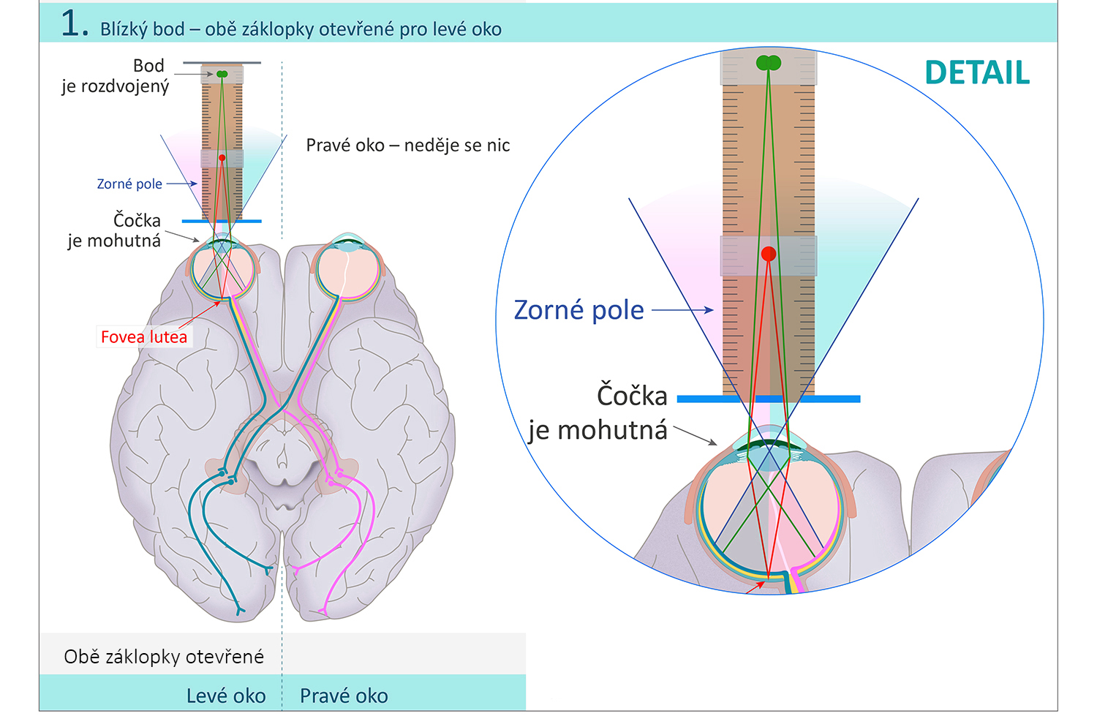
Scheiner´s experiment Theoretical background
Scheiner´s experiment
The aim of the experiment is to understand the connection between the refraction at the interface of two media (depending as curvature of the lens) and the way of perception of the image. I.e. it depends on the lens, which side of retina will handle the beam and how the resulting image will appear. Scheiner´s attempt is an essential part of a refractometer.
Basic theory:
While watching the two objects at different spatial depth (red and green pin) through the clips, which allows the examinee to watch a limited number of incident rays. When examinee looks at the closer pin, it is seen sharp and the distant pin is seen blurred - eye accommodates at the near point so that the beams converge on the fovea centralis. Rays going from a distant point can not be sharp.
Blurring of the pin depends on the imaging field of view - right side of the retina processes the left side of the visual field and vice versa (regardless on the left and right eye). It also means that if one beam from one place falls to the right side and the other on the other side of the retina, the resulting image - composed of both sides of the retina - is blurred.
Near point – both clips are opened ( left eye)
Blurred point
Right eye - nothing
Visual field
Fovea lutea
Visual field
Both clips are opened
Left eye
Right eye

Slide 13
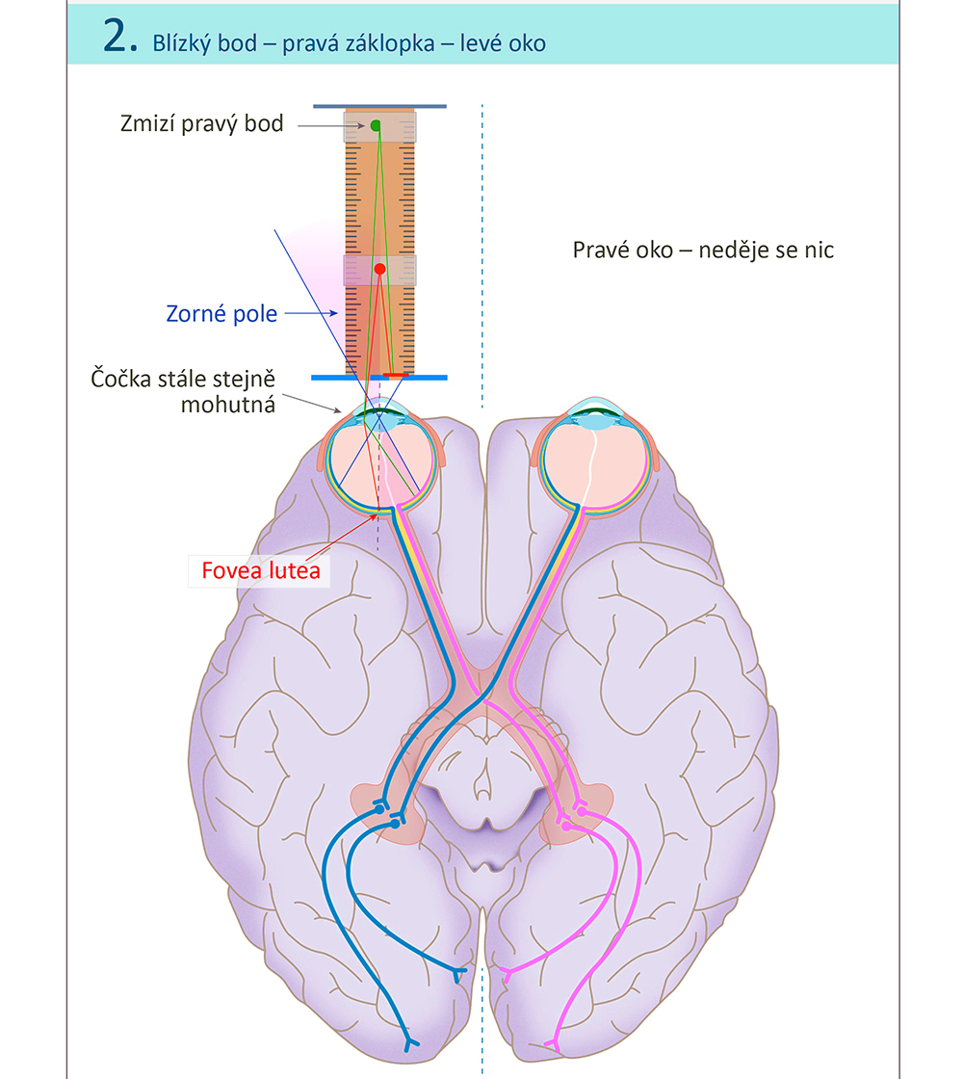
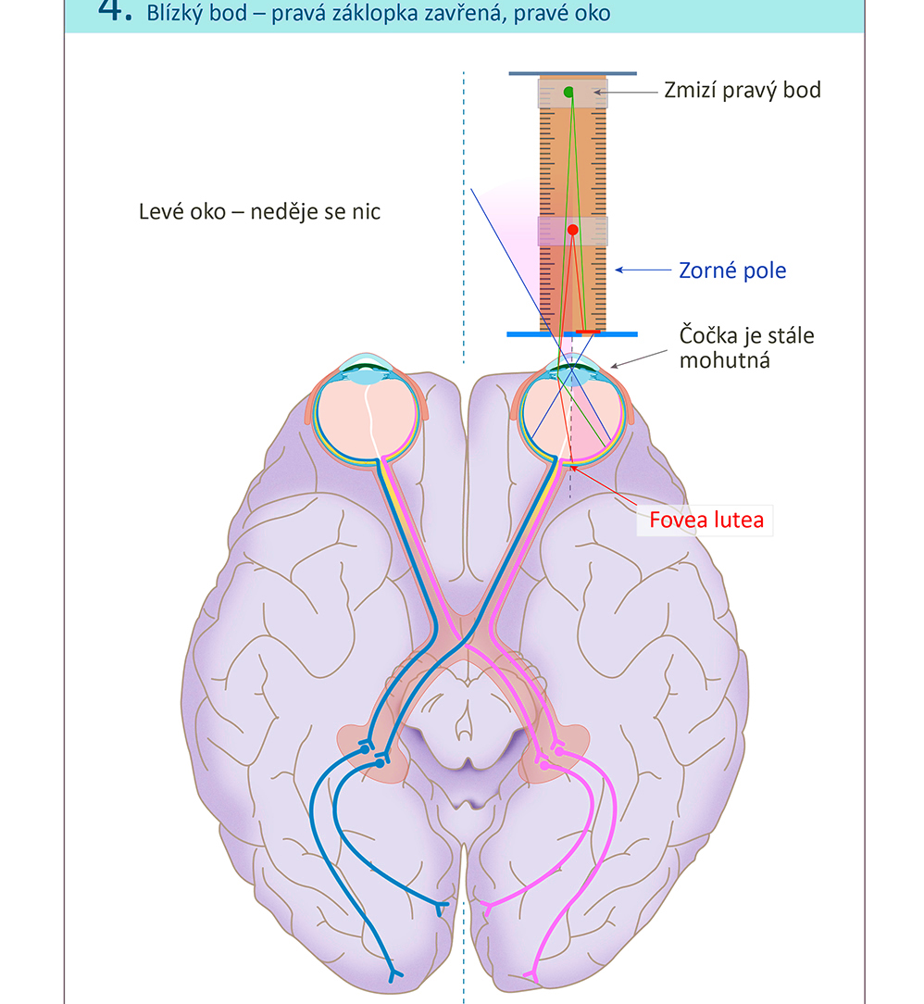
Scheiner´s experiment Experimental design
Near point – right clip is closed (left eye)
Near point – right clip is closed (right eye)
Right side of blurred point disappeared
Right side of blurred point disappeared
Right eye - nothing
Left eye - nothing
Visual field
Visual field
Fovea lutea
Fovea lutea

Slide 14
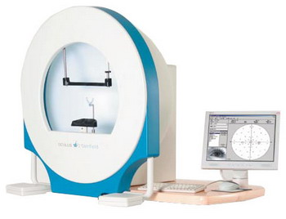
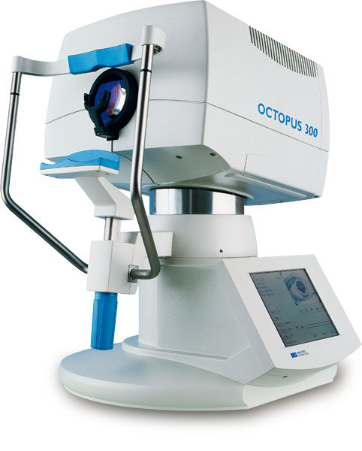
Visual field Theoretical background
Perimetry
Kinetic perimeter:
Examination is performed on a rotating perimeter with moving targets. The task of examinee is in reporting the changes in visibility of the target or colour.
The method is less accurate than the static perimetry.
Static perimeter:
Examinee is focused on a point located in the middle of a screen as soon as elsewhere appears light point and investigated it registers, all confirm by pressing a button.
Static perimetry is more sensitive than kinetic.
Kinetic perimeter
Static perimeter

Slide 15
Visual field Experimental design
Kinetic perimeter - a test of one color for the right eye
1. 0°
3. 60°
Left - schematic drawing of the perimeter lying against the face of the patient, which looks with one eye on the white dot in the center. Examinating person moves by a dot of one colour first from one side to the middle and then from the other side. Right side of the picture - Result movement and colour is entered on opposite angular sides (here, 0 and 180 °, where 0 ° is the left side of the eye and the right side 180 of the eye) on the perimeter.
Do the same for 60° and others to fill the whole circle.
Movement
Colour
Colour
Movement
Colour
Colour and movement
Movement
2. 30°
4. Result
Do the same for 30°
Connect points for colour and movement. Movement should have a greater range than the colour.
Movement
Colour
Movement
Colour
Colour and movement

Slide 16
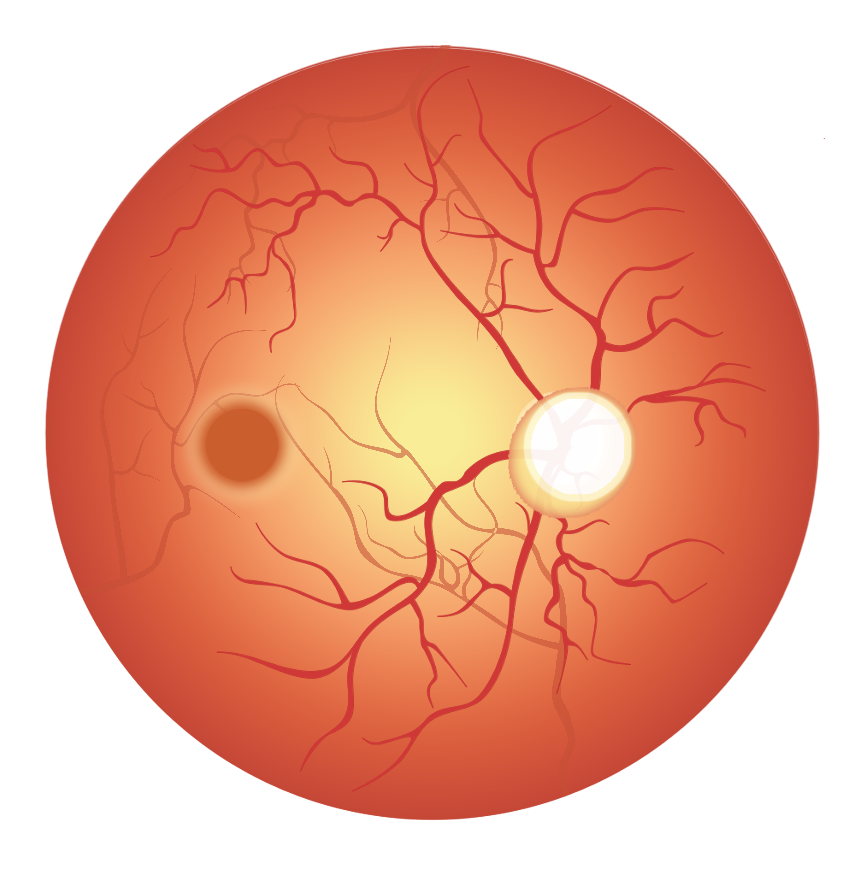
Blind spot Theoretical background
Blind spot
- is a small area on the retina, where the optic nerve protrudes. It is a space which does not contain sensitive cells, i.e. rods or cones.
Ophthalmoscopic examination :
An objective examination of the ocular fundus - accurate measuring of the size and changes on the background of the retina.
Perimetry:
Using perimetry, physiological scotoma can be captured in 18-20 °.
Marriot´s attempt:
Evidence of blind spots - basic subjective method for the detection of blind spot using Marriot´s image (paper with a point on one side and with a cross on the other). Fixing eye on a point avoids saccadic movements and allows that cross at some distance gets into such an angle that falls in the blind spot.
The approximate shape and size of blind spot - on the principle of proportional triangles and principles of Marriot´s attempt, can roughly display the shape of blind spot.
Blind spot
Optical disc
Central optical arteria
and vein
Fovea
Optical disc
Examination the ocular fundus

Slide 17
Blind spot Experimental design
Temporal side
Nasal side
Result:
D- Border of blind spot
CD– Distance between lens and retina
E - Border of blind spot
C - Lens
Calculation:
Distance between the lens and retina is 17 mm.
Distance between the lens and point on paper is 30 mm
CD/BC=DE/AB
DE= AB*(CD/BC)=AB*17/30
AC/BC – Distance between lens and point on paper
A – Point of seeing the pen
B – Point where the pen disappears

