Slide 1
Facial Expressions

Slide 2
Facies, ei, f.
Face
Expression, countenance (typical of a certain disease or state)

Slide 3
Terms referring to healthy or pathological state:

Slide 4
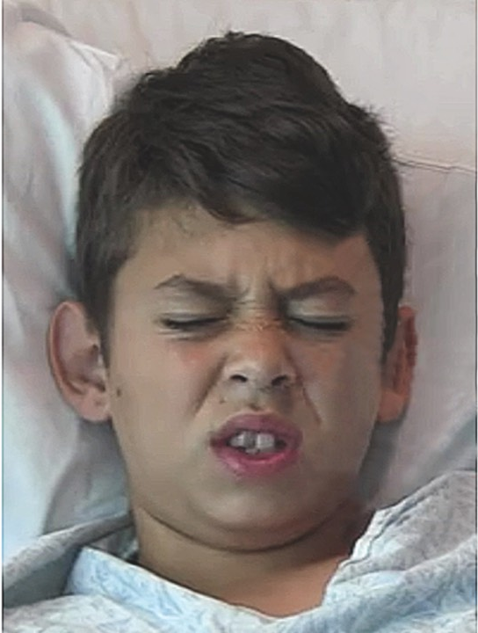
Facies Dolorosa
furrowed brows
Closed eyes
Wrinkled nose
Lifted lip

Slide 5
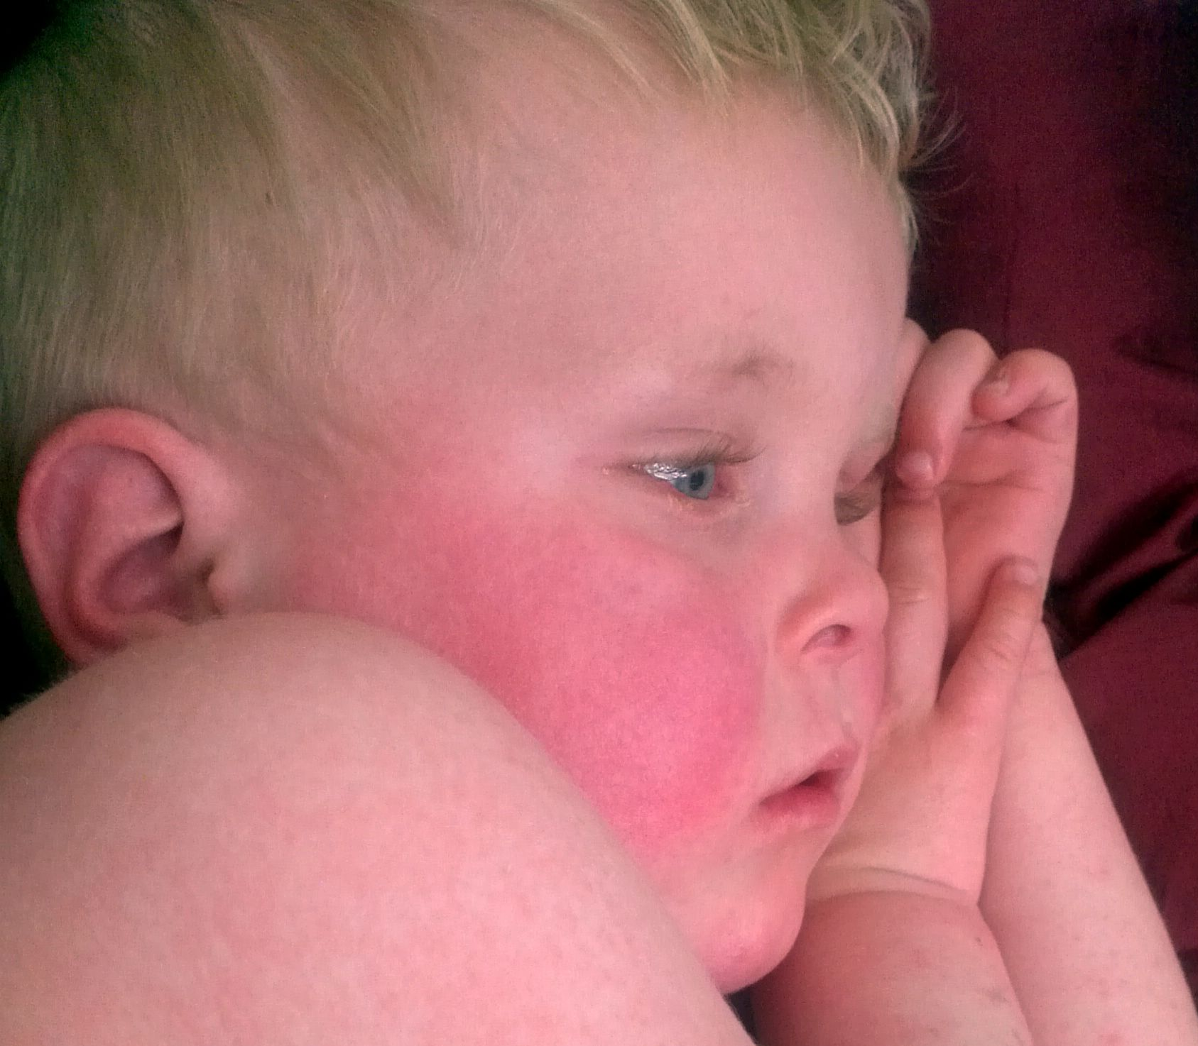
Facies Febrilis
Shiny eyes
Red face
Discomposed face

Slide 6
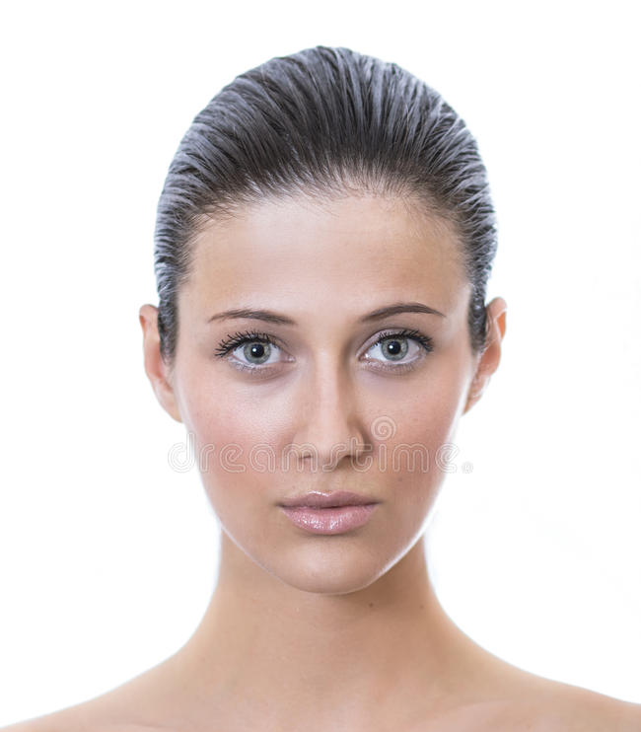
Facies composita
Just kidding…

Slide 7
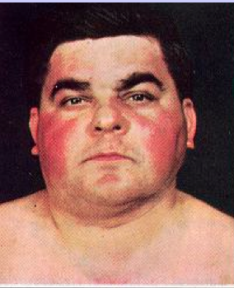
Facies Plethorica
Florid complexion
Hyperemic face

Slide 8
Terms referring to a certain disease/dysfunction of a certain organ:

Slide 9
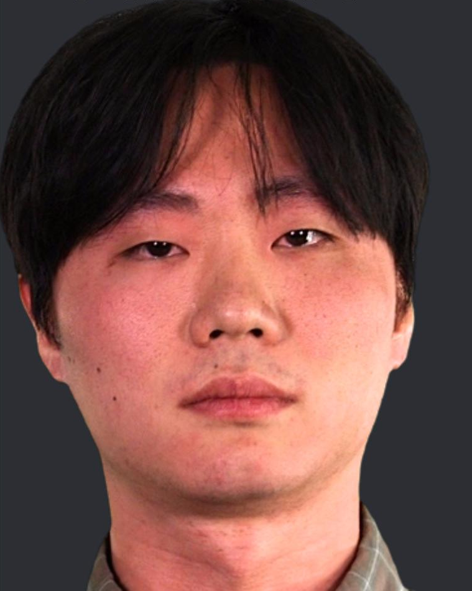
Facies alcoholica / aethylica
Red face
bloated

Slide 10
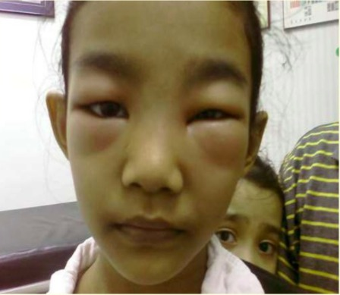
Facies Nephritica
Swelling around eyes
Oedematic & pale

Slide 11
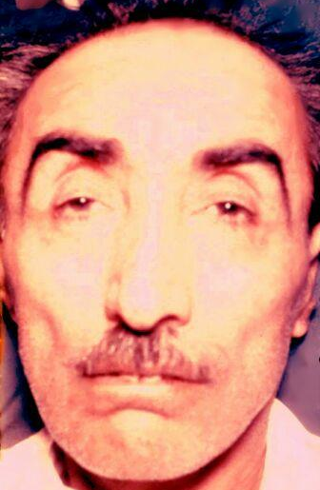
Facies Cardiaca
Cyanotic hue
Oedematic face
Pale and yellowish face
Half open mouth, cyanotic lips

Slide 12
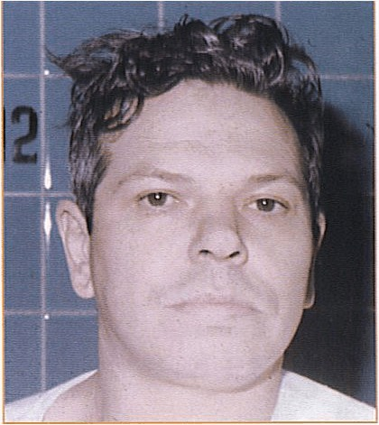
Facies Anaemica
Greenish tint
Very pale face

Slide 13
Facies Mitralis
Cyanotic tip of nose
Blush on cheeks
Cyanotic ears
Cyanotic lips

Slide 14

Facies Gastrica
Furrowed brows
Deep nasolabial fold
Holding stomach

Slide 15
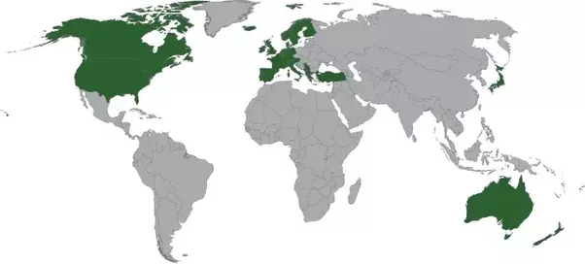
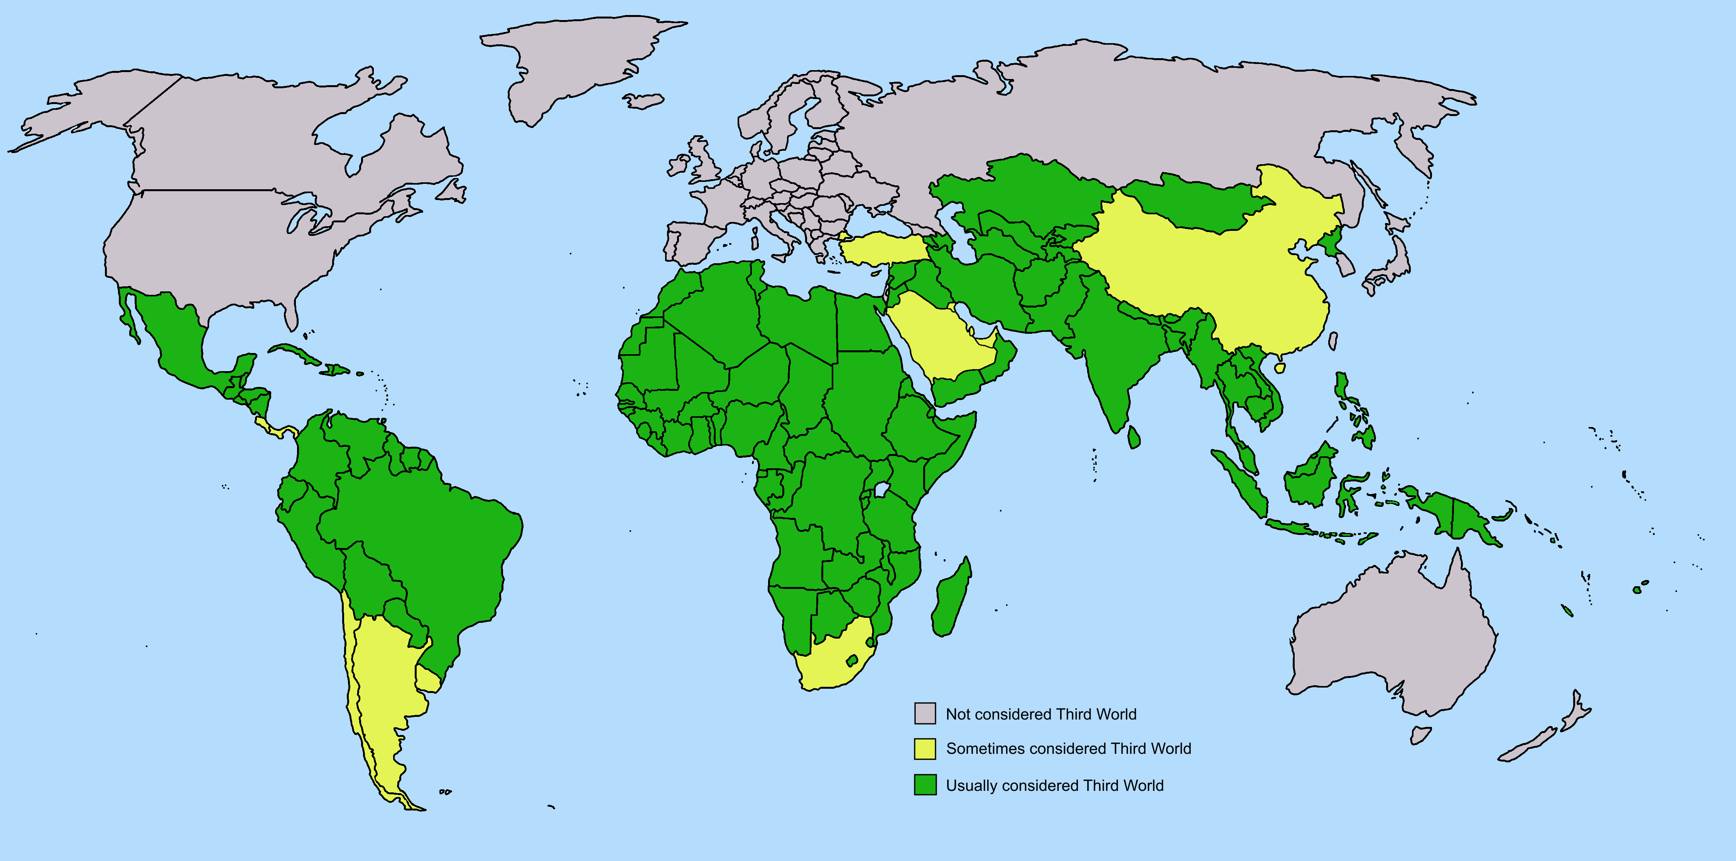
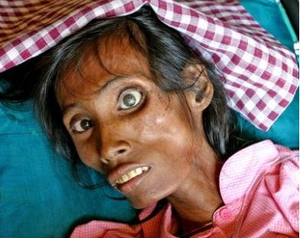


Facies Tuberculosa / Hectica
”burning eyes”
Exhausted, pale face
Dry lips
Open mouth

Slide 16
Facies Morbillosa
Red eyes
Unhappy facial expression
rash

Slide 17
Facies Syphilica
Melancholic facial expression
abscesses
Saddle nose deformation

Slide 18
Facies Tetanica / Risus sardonicus
Forehead expressing grief
Tonic spasm of mimic muscles
lockjaw
Stiffness of neck

Slide 19
Facies Leontina
Skin lesions
Tissue loss
lion-like facial appearance

Slide 20
Eponyms:

Slide 21
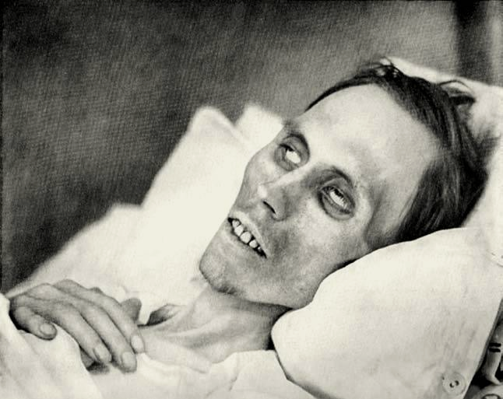
Facies Hippocratica (Abdominalis)
deadly livid skin
sunken eyes
pinched nose
scrawny

Slide 22
Facies Parkinsonica / Oleosa
oily skin of face
A-mimic face
Characteristic stare
sometimes drooling occurs
the patient seems to lean forward to the observer

Slide 23
And now …

