Slide 1
Vascular trauma
Tomáš Novotný
II. chirurgická klinika LF MU a FN u sv. Anny

Slide 2
Vascular trauma
most vascular diseases may be observed and treated during prolonged periods
Vascular trauma is the opposite
very short time intervals for diagnosis and intervention
often incomplete and imperfect information

Slide 3
Vascular trauma an its evolution
The advances and developments are related to major conflicts or war
vascular trauma is associated with hemorrhage
surgical practice evolved around the control of bleeding
Ligation of both arterial and venous injuries
the standard of care through World War II
World War I - repair attempted in 3.2 % of injuries
World War II - repair attempted in 5 % of injuries

Slide 4
Vascular trauma an its evolution
Korean War
88 % of injuries undergoing a vascular repair attempt
Vietnam War
repair attempted in 93% of injuries
Iraq and Afghanistan
high rate of extremity injury (53 %)
decreased rate of major truncal injury (15 %)
devastating nature of the extremity injuries and the inclusion of distal arterial injuries probably explain the increase in vascular ligations (35 %)

Slide 5
Vascular trauma in the civilian setting
historically relatively rare
the development of machinery and motorized vehicles
the increase in urban violence and weaponry
increased incidence of civilian vascular trauma
incidence 1-4% of all injuries (likely an underestimate)
does not include patients who die at the trauma scene or before or immediately after hospital arrival
The majority of immediate deaths from vessel disruption are due to aortic injury (55%)
78% leading to death within 15 minutes of injury

Slide 6
Current Epidemiology of Vascular Injury
trauma as a cause of death (USA 2010)
63% of patients aged 1 – 24 years
42 % of patients aged 25 – 44 years
incidence of vascular injury
1.6 % for adults
0.6 % for children
60 – 90 % due to penetrating mechanisms (mainly guns)
blunt vascular injuries are uncommon
iatrogenic injuries
percutaneous endovascular procedures
laparoscopy

Slide 7
Current Epidemiology of Vascular Injury
Epidemiologic trends
The average age of all trauma patients is increasing
“young and healthy” trauma patient replaced with elderly patients with a preexisting vascular disease
more severely injured patients with major vascular injury reaching a hospital alive
damage control surgery
endovascular techniques

Slide 8
Mechanism of Injury
Direct
penetrating injury (sharp)
blunt injury
Indirect
traction injury
deceleration injury

Slide 9
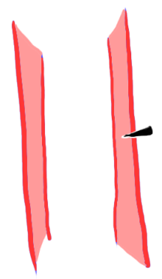
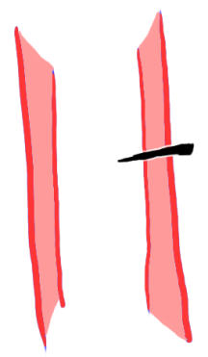
Penetrating injury (sharp)
grade I
no bleeding
no peripheral ischemia
aneurysm might develop
grade II
bleeding
pseudoaneurysm formation
with or without peripheral ischemia
grade III
bleeding
peripheral ischemia

Slide 10
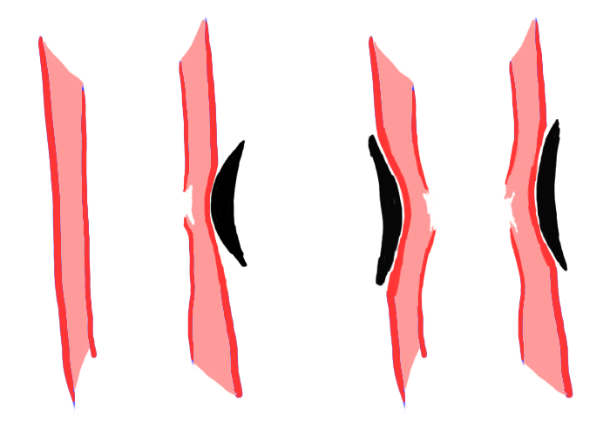
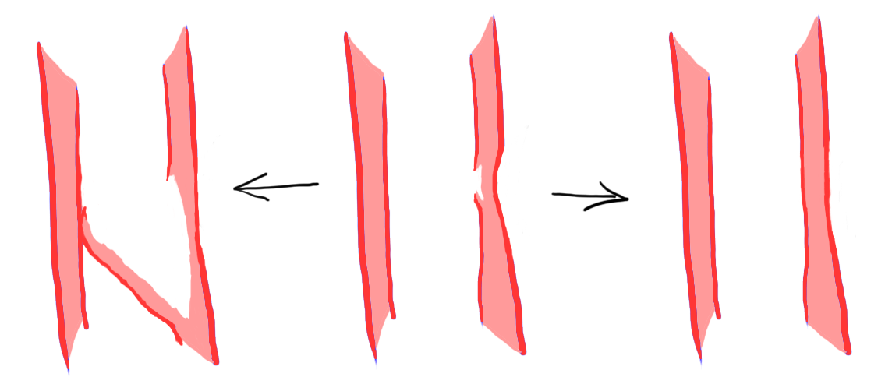
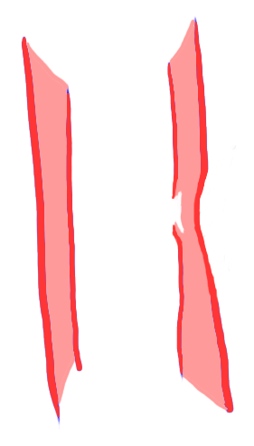
Blunt injury
contusion
compression/strangulation

Slide 11
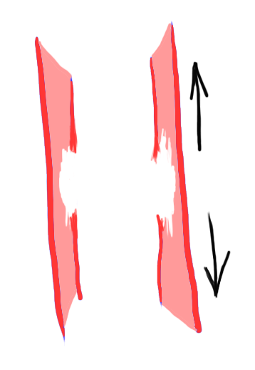
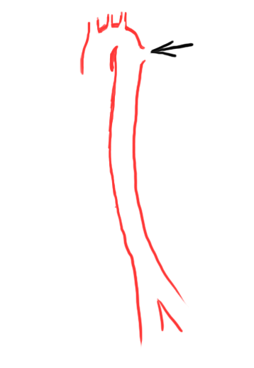
Indirect injury
traction injury
deceleration injury

Slide 12
Vascular Injury Classification and Scoring
has yet to be developed
Three-tier system
tier 1 (peripheral or extremity)
distal to axillary of common femoral vessels
tier 2 (proximal groin or axillary wounds)
junctional wounds
tier 3 (intracavitary wounds)
thorax, abdomen, pelvis

Slide 13
Clinical presentation
highly variable
hard signs of vascular injury
arterial bleeding
pulsatile hematoma
absence of pulses or limb ischemia
bruit or thrill indicative of arteriovenous fistula
soft signs
non-pulsatile hematoma
decreased pulses or pressure index
unexplained anemia or hypotension
injury to closely associated structures (typically nerves)
injury close to the vessel

Slide 14
Clinical presentation
hard signs of vascular injury
100 % specific, particularly with penetrating limb trauma
nearly 100 % specific in penetrating neck trauma but present in only 20 % of patients
much less applicable in intracavitary vascular injury
hypotension will be the primary indicator
are present in less than 10 % of vascular injuries
majority will have soft signs, delayed presentation or be asymptomatic

Slide 15
Clinical presentation
Head
intracranial injury is typically a combination of vessel and brain parenchyma injury
Face
penetrating injuries to branches of external carotid artery
blunt trauma associated with major facial fractures
usually obvious with external or intraoral/intranasal bleeding

Slide 16
Clinical presentation - neck
Vascular injury incidence is
20 % in penetrating trauma
clinical examination is very reliable
missed injury rate 0.7 %
1 % in blunt trauma
usually no hard signs
immediate neurological deficits (up to 28 %)
delayed neurological deficits (up to 78%)
entirely asymptomatic (up to 40 %)
CT angiography is study of choice

Slide 17
Clinical presentation - torso
Noncompressible truncal hemorrhage (NCTH)
high associated mortality
Critical concepts for NCTH
minimize delays in transfer to operating room
permissive hypotension until vascular control
balanced resuscitation with early use of plasma
use of procoagulant drugs
use of damage control surgery

Slide 18
Clinical presentation
Extremities
vascular injury is common in penetrating or blunt mechanism
incidence is 1 – 2 % of all trauma patients
more common on lower (66 %) vs. upper (34 %) extremities
clinical examination is very reliable in penetrating injuries
missed injury rate is of 0.7 %
blunt trauma
hard signs in 66 % of patients; mainly absent distal pulses / limb ischemia
in 95 % associated bone fracture or dislocation
CT angiography is study of choice

Slide 19
Clinical assessment
History
mechanism of trauma
time interval
vascular symptoms
prior vascular injury
anticoagulation therapy
Physical findings
hard and soft signs of vascular injury
ankle-brachial index
Imaging
none
CT angiography
duplex ultrasound

Slide 20
Treatment
Conservative (observation + surveillance)
Vessel repair
suture
patch repair
interposition graft / bypass
endovascular repair

Slide 21
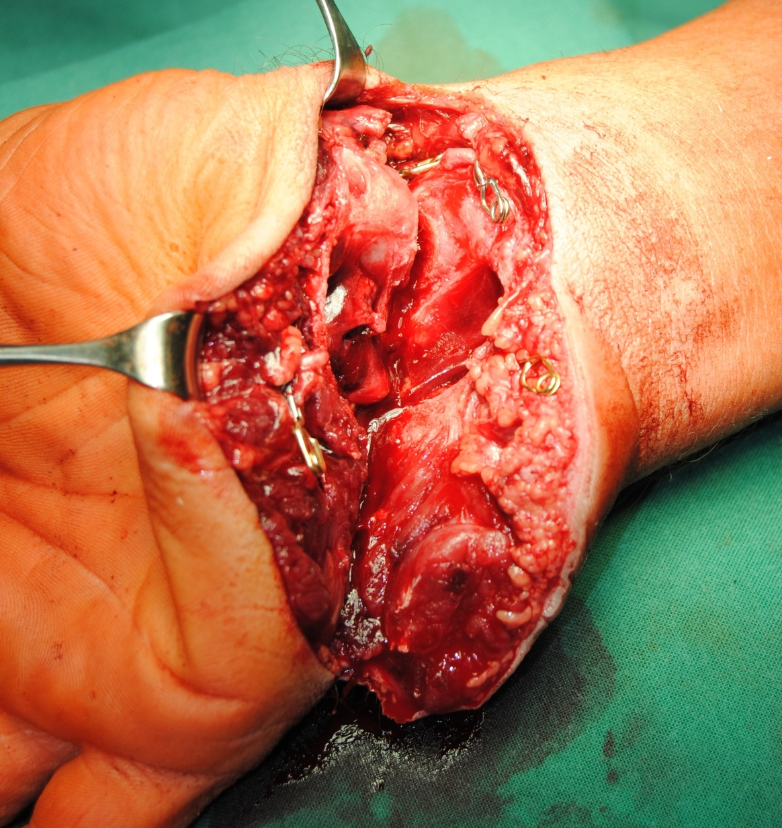
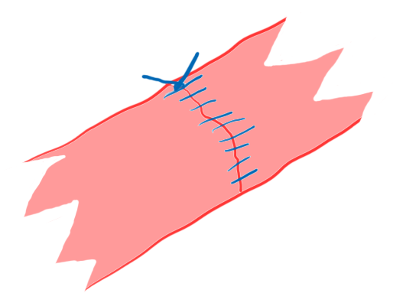
Vessel repair
suture

Slide 22
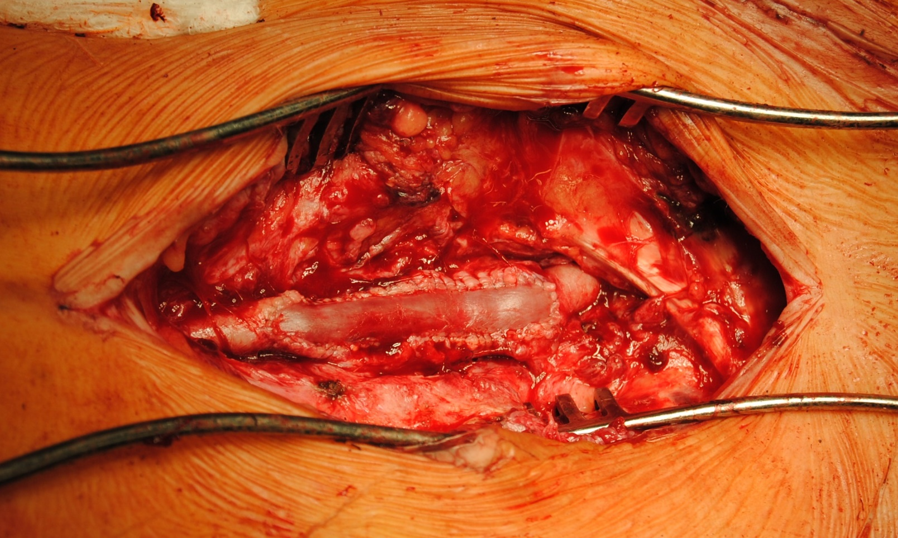
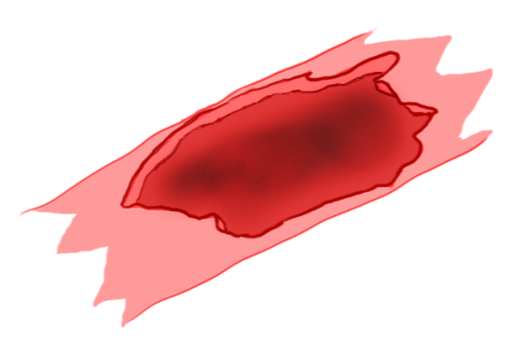
Vessel repair
vein patch angioplasty

Slide 23
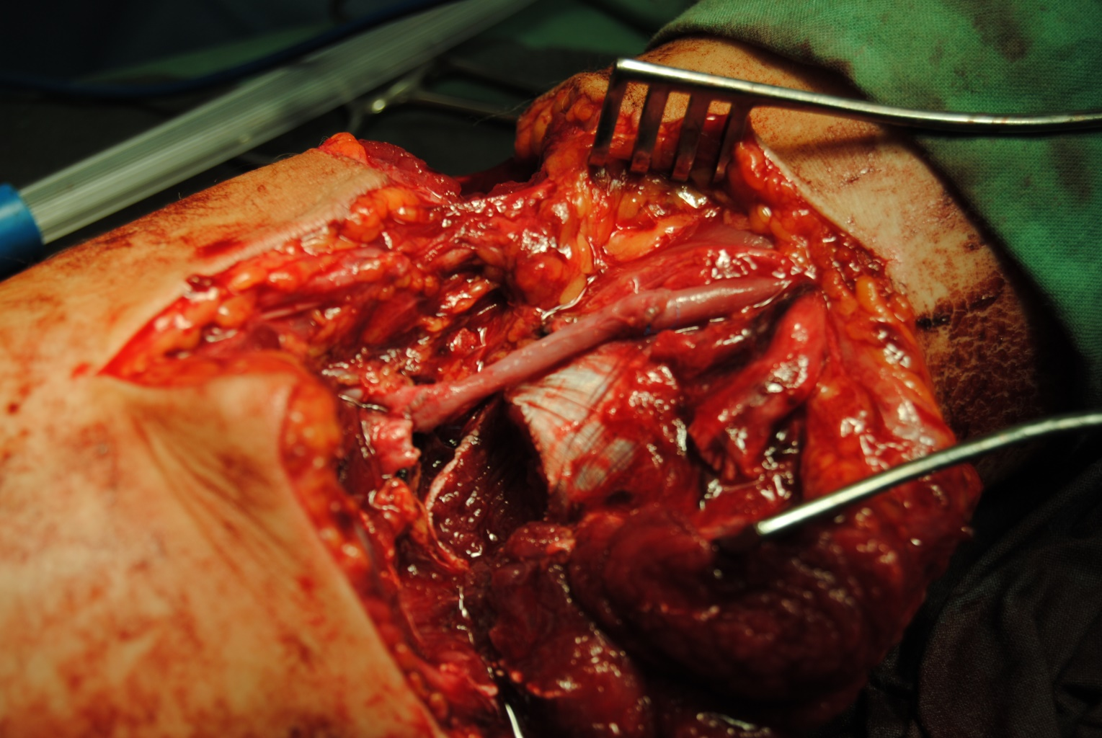
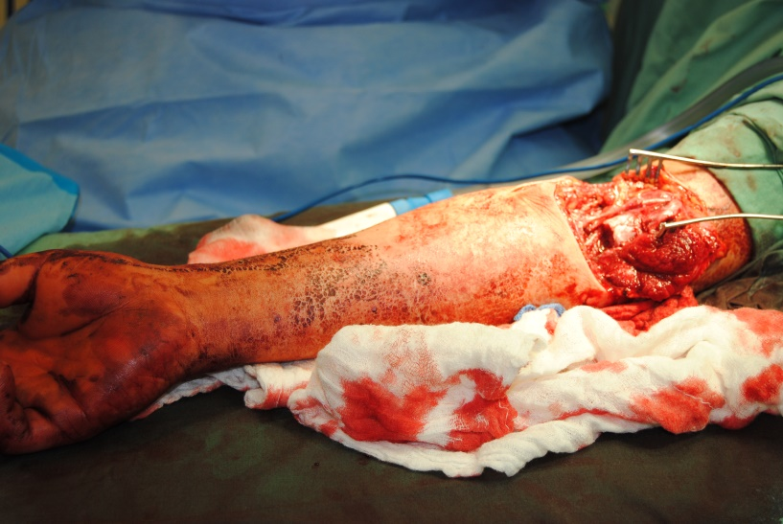
Vessel repair
interposition graft

Slide 24
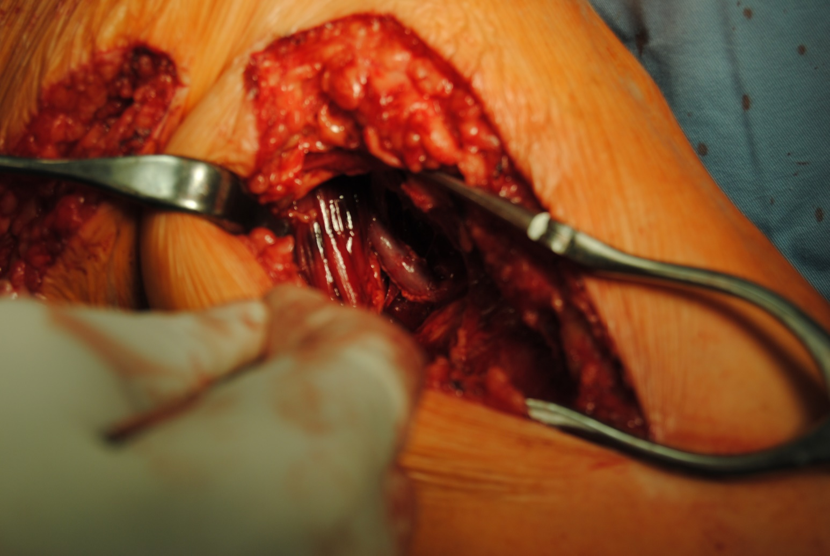
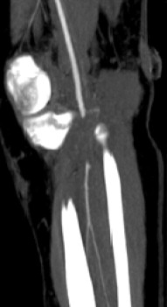
Vessel repair
bypass

Slide 25
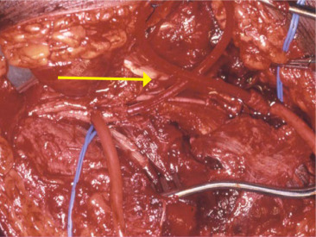
Vessel repair
temporary shunting
Source: Cristián Salas, D. Trauma vascular, visión del cirujano vascular. https://doi.org/10.1016/S0716-8640(11)70481-3

Slide 26
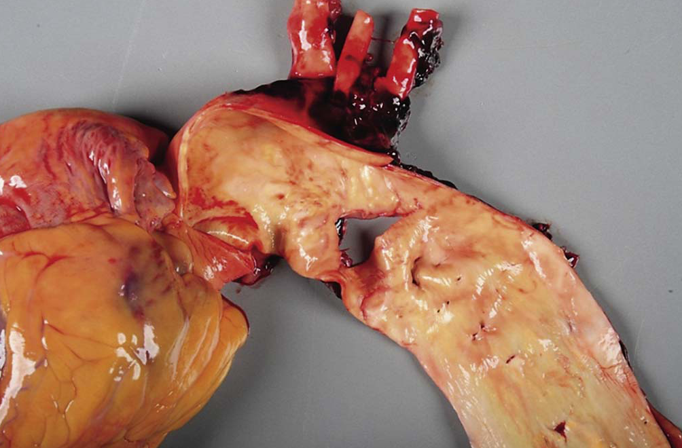
Vessel repair
endovascular repair
Source: Ruhterford‘s Vascular Surgery 8th Edition

Slide 27
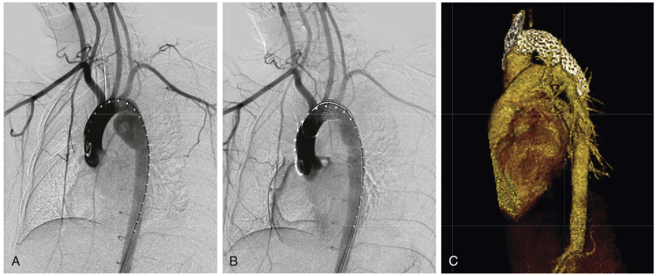
Vessel repair
endovascular repair
Source: Ruhterford‘s Vascular Surgery 8th Edition

Slide 28
Treatment
Conservative (observation)
Vessel repair
direct arterial repair (suture)
patch repair
interposition graft repair
bypass repair
endovascular repair
Vessel ligation
Amputation

Slide 29
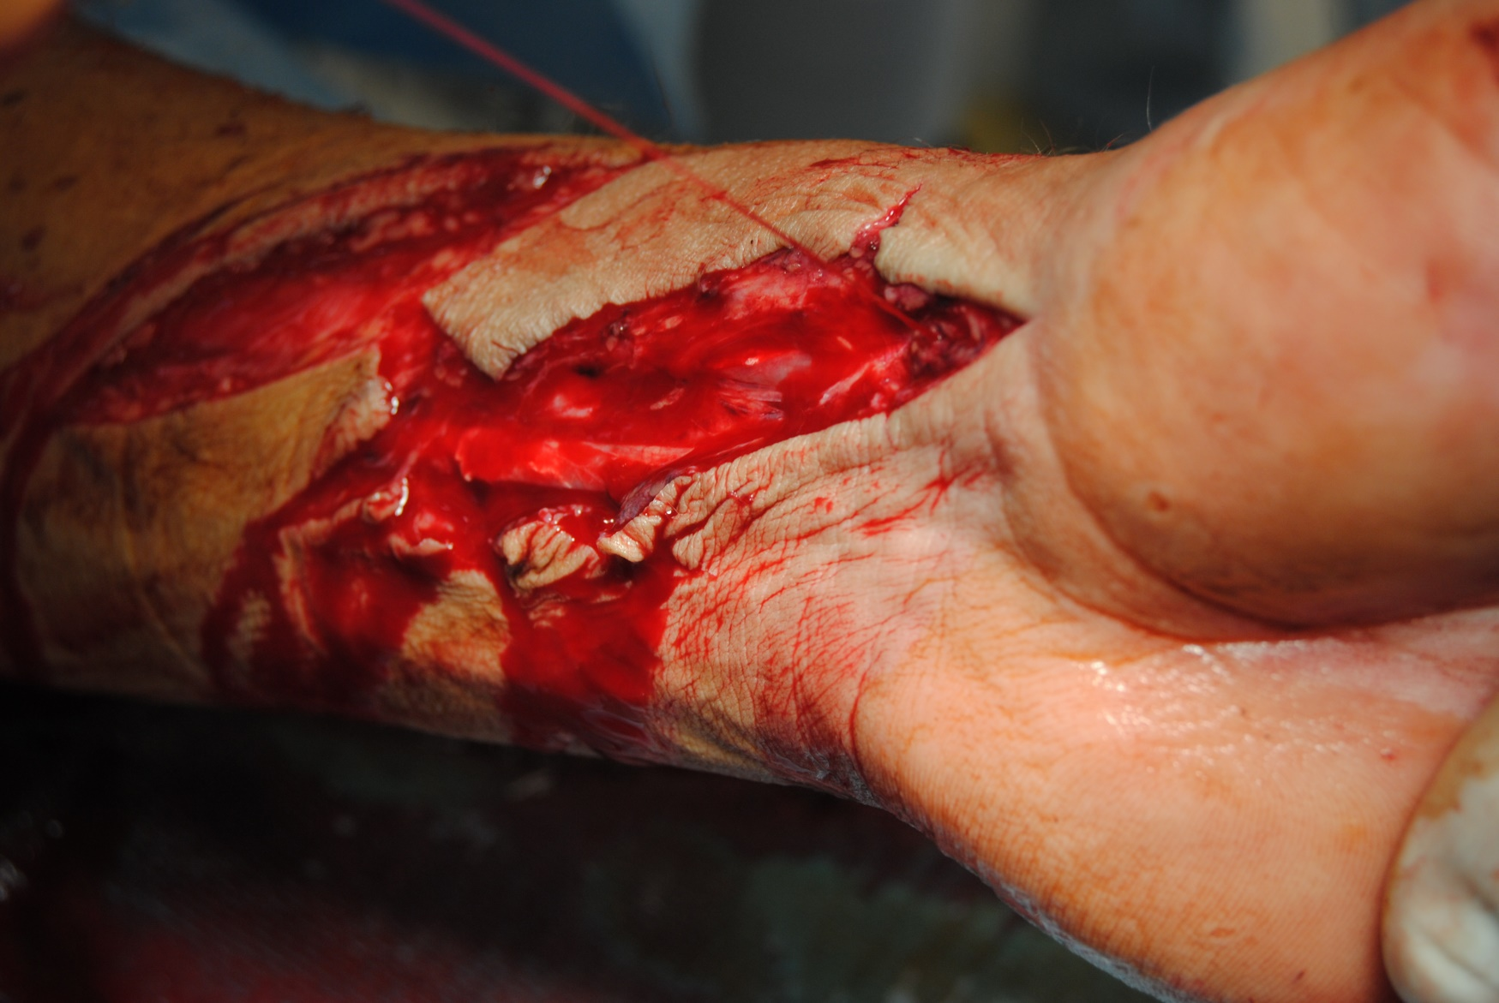
Thank you for your attention!

