Slide 1
Traumatology of lower limb I. Hip joint, femur, patella

Slide 2
Hip joint - anatomy

Slide 3
Blood supply of proximal femur

Slide 4
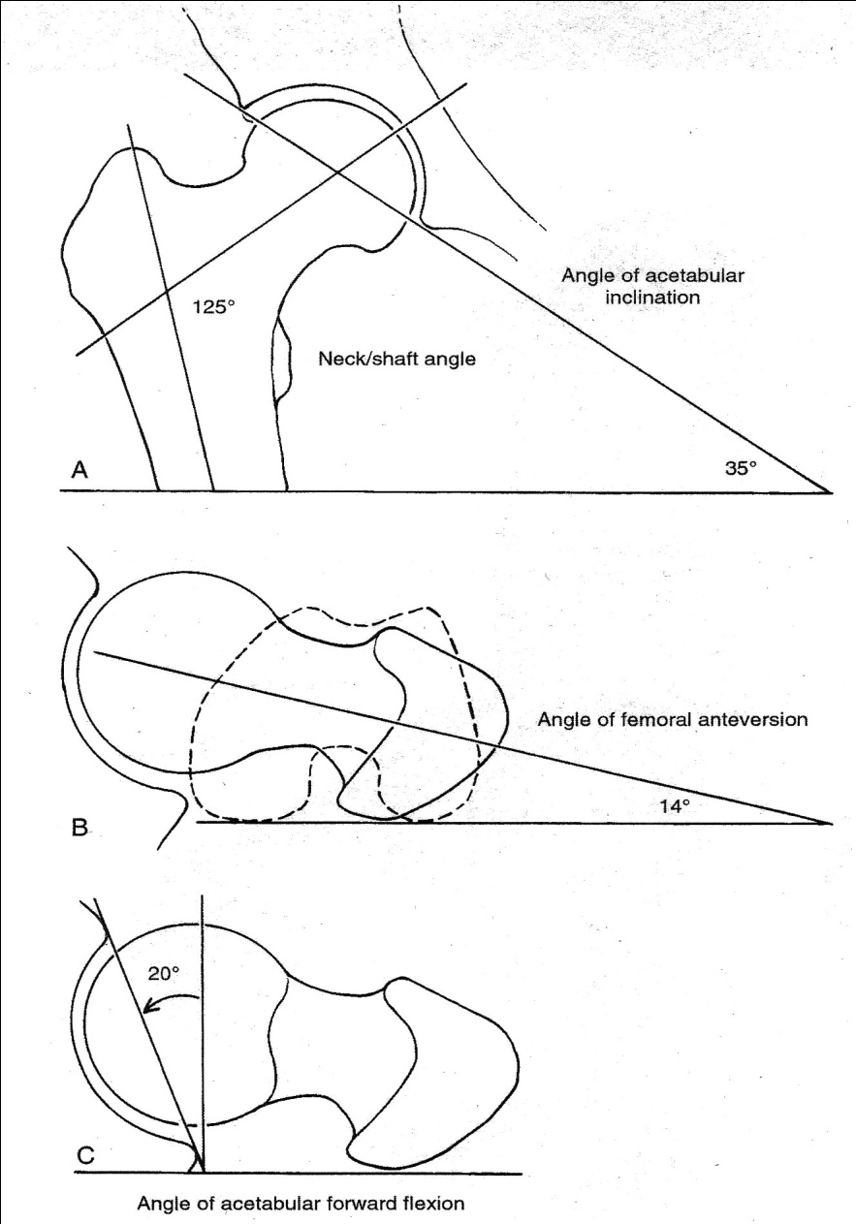
Geometry of acetabulum and femur

Slide 5
Luxatio femoris – hip dislocation
Mechanism – high energy trauma, extensive indirect force – car accidents /dash board injury/, falls
Very often with fracture of acetabulum or femur
Dg – intense pain, springy resistance, limb possition depending on luxation type,
x-ray – both hips, beware undisplaced femoral neck fr., CT.
Risks
- posterior dislocation - n.ischiadicus,
- anterior dislocation - n.femoralis and a.femoralis.
- all cases – vitality of femoral head /avascular necrosis – 20%, after 12hours of dislocation – above 50%/

Slide 6
Hip dislocations
Posterior – more frequent /90%/, mechanism - adduction, limb in internal rotation, shorter
– upper – luxatio iliaca
- lower – luxatio ischiadica
Anterior – /10%/ -mechanism - abduction, limb in external rotation, normal lenght or longer
– upper – luxatio pubica /iliopectinea/
- lower – luxatio obturatoria
„central dislocation“ - fracture of acetabular centr

Slide 7
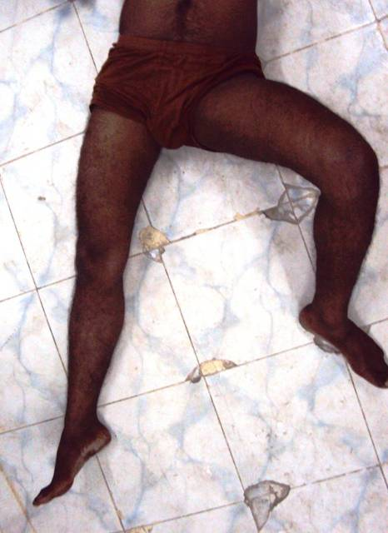
Anterior hip dislocation

Slide 8
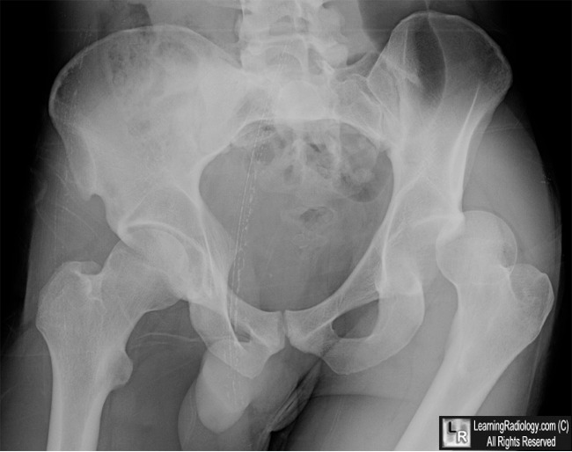
Posterior hip dislocation

Slide 9
Therapy
Reduction
- urgent, under general anesthesia with muscle relaxation,
- x-ray control
- CT – before or after reduction
- neurovascular status – check and document pre and post
Operating treatment – unstabile or nonreducible fractures – advantage – early mobilization, disadvantage – difficult aproach.

Slide 10
Posterior disloc.- reduction - flexion in the knee at 90°, pull, hip flexed, abduction and external rotation, CT in all cases post-reduction

Slide 11
Anterior disloc.- reduction - extension, internal rotation, adduction

Slide 12
After reduction
Pure dislocations - 54% - 2 weeks rest in a bad, progressive mobilization without weight, after 6 weeks step by step weight
With fracture of acetabulum /except central dislocation/ 36%, the most frequently fr. of posterior wall – osteosyntesis, or traction 2-3w, gradual weight with crutches after 8-12w.
With fracture of femur -10% - depends on type of fracture

Slide 13
Prognosis
Threat of avascular necrosis of femoral head - 20%, after 12h 50%
Risk of posttraumatic coxartrosis
Paraarticular calcifications, osifications.
Risk of injury of n.ischiadicus and n.femoralis.

Slide 14
Fractures of proximal femur
Head fractures
Neck fractures
-mediocervical (subcapital - intracapsular)
-laterocervical (basicervical - extracapsular)
Trochanteric /pertrochanteric, intertrochanteric/ fractures
Subtrochanteric fractures
Isolated fractures of trochanters

Slide 15
Head fractures
Separate group of prox. femor. fr.
Tangencial – flake-fracture, with posterior hip dislocation, without dislocation rare.
Pipkin – 4 types /„Pipkin‘s fracture“/ - location.
DG – x-ray, CT.

Slide 16
Pipkin‘s classification Type I—femoral head fracture caudad to fovea capitis. Type II—femoral head fracture cephalad to fovea capitis. Type III—type I or II fracture with associated femoral neck fracture. Type IV—type I, II, or II fracture with associated acetabular fracture.

Slide 17
Therapy
aim – anatomical restoration of joint surface
1. closed reduction of femur dislocation
2. operation th. – depending on large of fragment /1cm2/ and location of defect
- fragment removal /open or artroscopy/,
- osteosyntesis /reduction and fixation of fragment/ using absorbable screws or glue,
- THA can be implanted in case of elderly.

Slide 18
Proximal femoral fractures – neck, per/intertrochanteric, subtrochanteric
Osteoporosis, pathological, minimal injury
Clin. – pain – hip /knee, hip possition – antalg. - external rotation, anteflexion, contraction,
Check neurovascular status
X ray – pelvis - whole /fr. Pelvis, other hip/,
- whole femur incl. Knee,
- CT ?

Slide 19
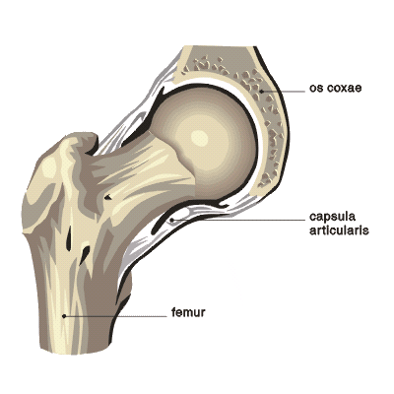
Fractures of femoral neck
mediocervical (subcapital - intracapsular) – vitality of femoral head – interruption of vessels, compression – hematom, dislocation.
laterocervical (basicervical - extracapsular)

Slide 20
Femoral neck fractures - – classifications
Pauwels - I. – less than 30st., II. 30-70st, III. More than 70st.
- mechanické poměry - abdukční – valgozní 10%, addukční - 90%
Garden – vitality of head

Slide 21
Treatment of mediocervical fractures
Conservative - Garden I – valgus impacted
Osteosyntesis - DHS, spongios screws, alternativly – PF – young /50y/ all types, older Garden II.
Alloplastic – Garden III. a IV., depending on age total hip replacement - THA or hemiartroplasty - CKP /lifetime TEP 15y, CKP 5y/
Osteosyntesis – optimal time 6 - 12h /releasing of vessels – reduction, decompression of intracapsular haematoma/ Practice?
- Risk of head necrosis - up to 30%

Slide 22
Hemiartroplasty
THA

Slide 23
Treatment of laterocervical – basicervical fractures
Extracapsular fr.– minimal risk of head necrosis, like per/intertrochatneric fractures
Osteosyntesis - PFN, DHS, rarely THA.

Slide 24
Inter-trochanteric fractures
Stabil X instabil - the most important is thick medial cortex (Adams‘s arch)

Slide 25
Treatment of per/intertrochanteric fractures
PFN
Gama nail
DHS – compresion hip screw
Blade plates (95 st., 130 st.)
Enders rods /rarely/
-corect reduction
-restoration of lenth and axis of limb
-reduction of external rotation deformity
-stabile osteosyntesis and early mobility of patient

Slide 26
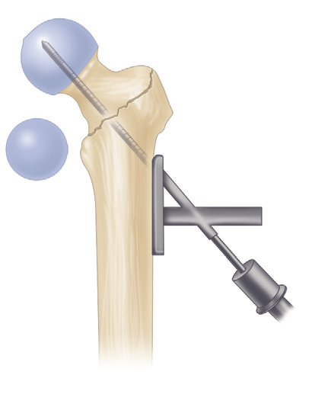
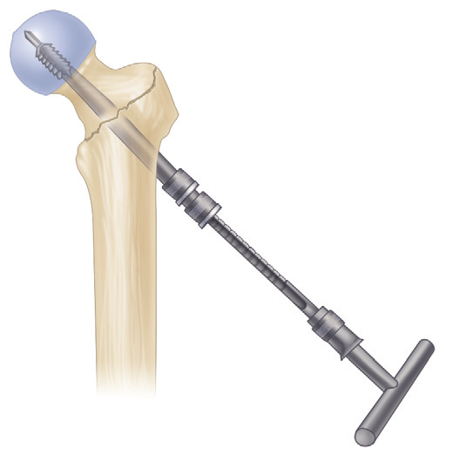
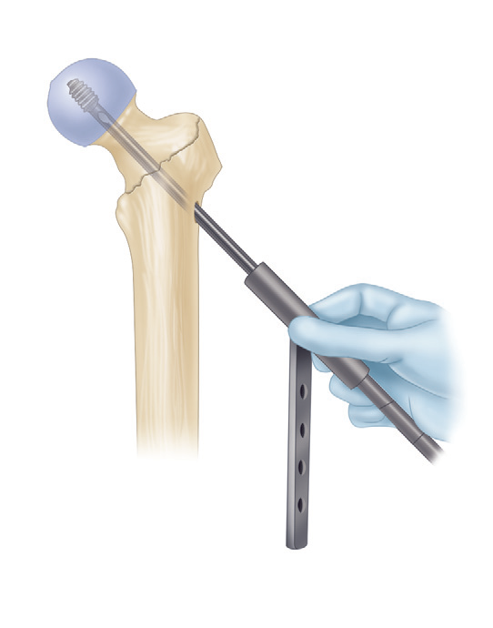
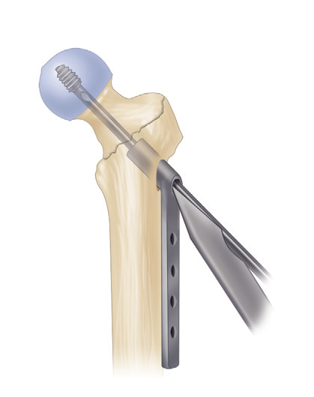
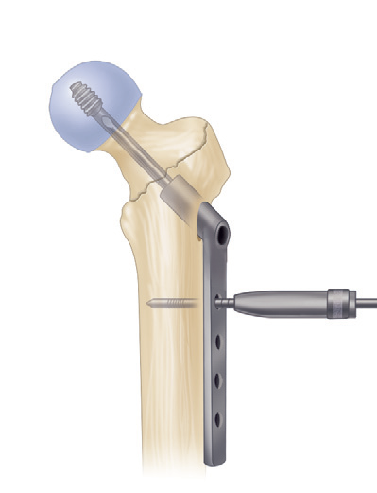
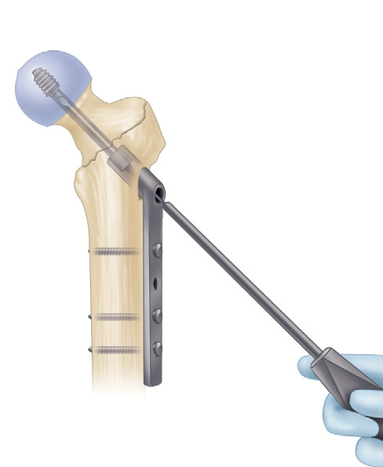
Fixation of intertrochanteric fracture with Dynamic (compression) Hip Screw

Slide 27
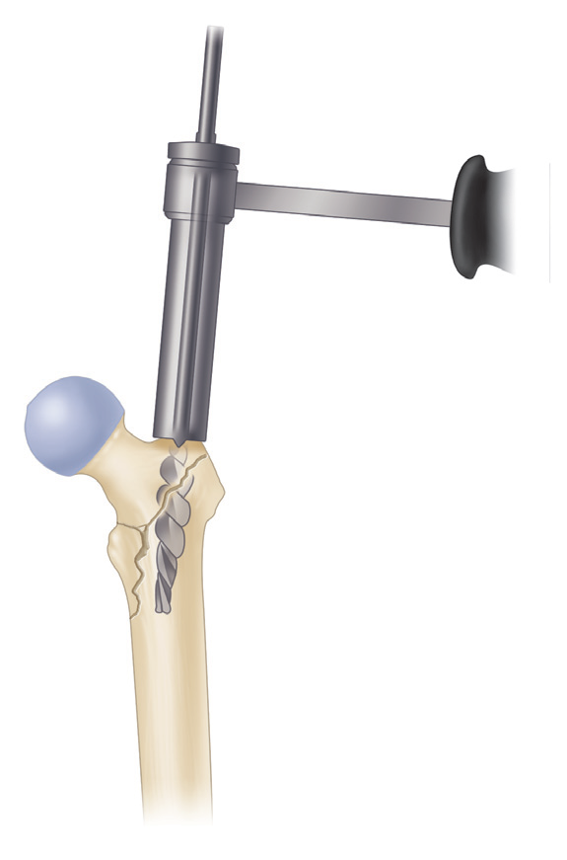
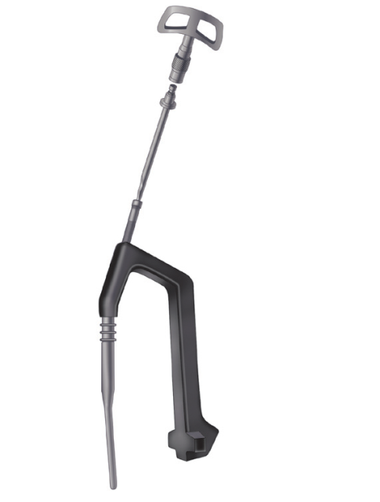
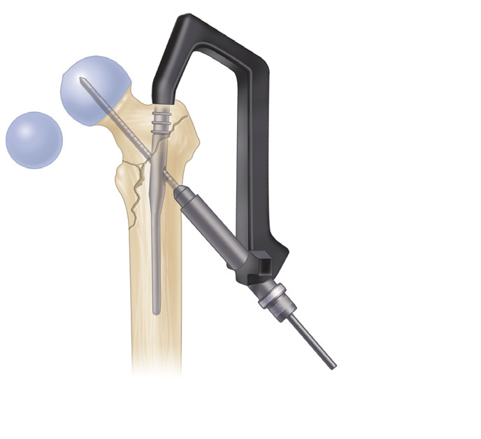
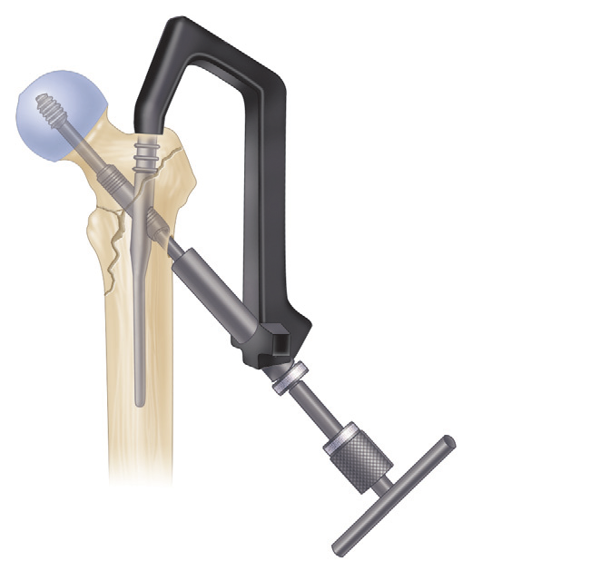
Fixation of introchanteric fracture with PFN / Gamma nail

Slide 28
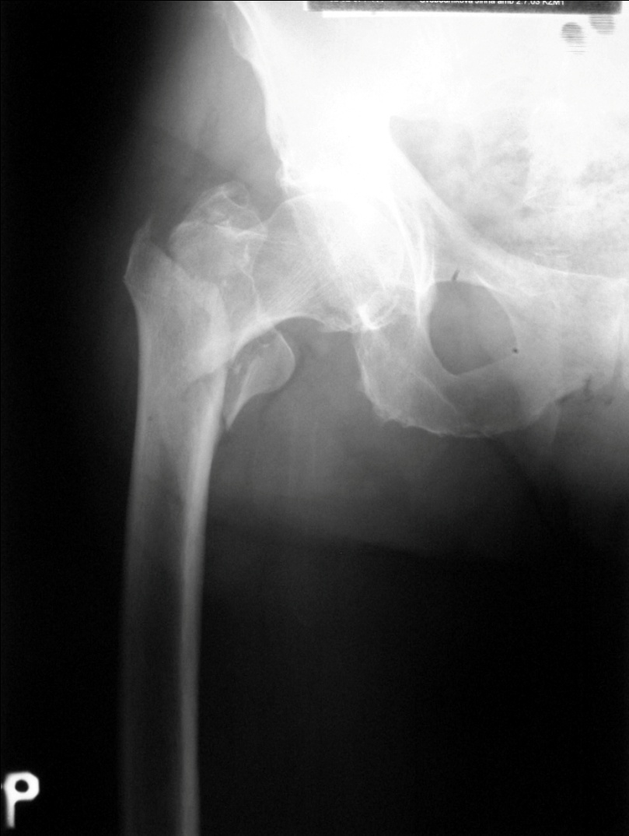
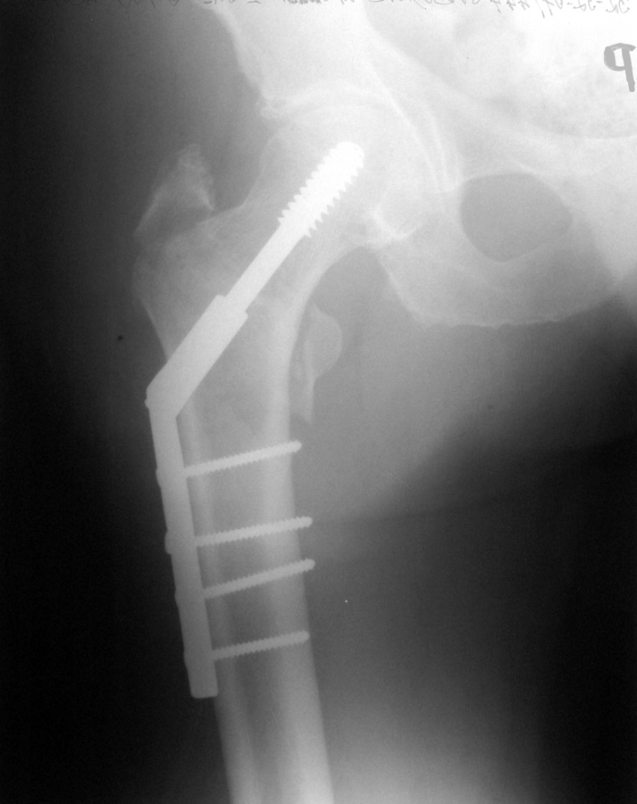
DHS osteosyntesis of pertrochanteric fracture

Slide 29
Subtrochanteric fractures
Between the lesser trochanter and isthmus of the femoral canal
within 5 cm of the distal extent of the lesser trochanter
difficult reduction
Plating – open reduction, DHS, DCS
Nailing – more stabile, closed/open reduction,
- PFN
- gama nail
- antegrade nail proximaly locked in reconstruction mode (Reconstruction nail)

Slide 30
Nailing / Plating

Slide 31
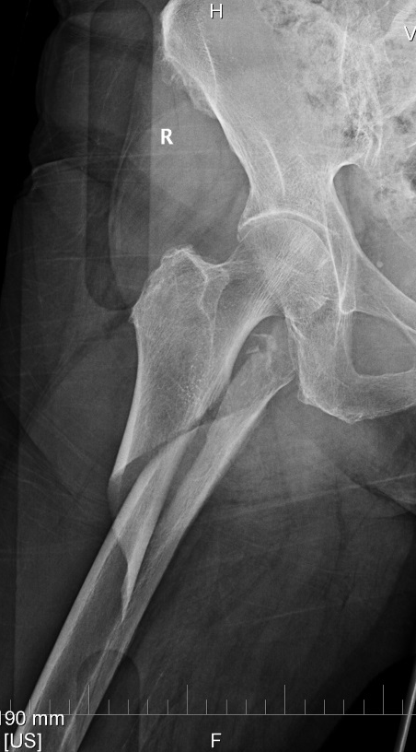
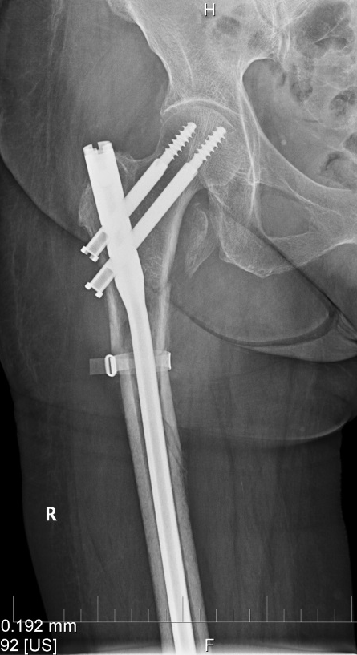
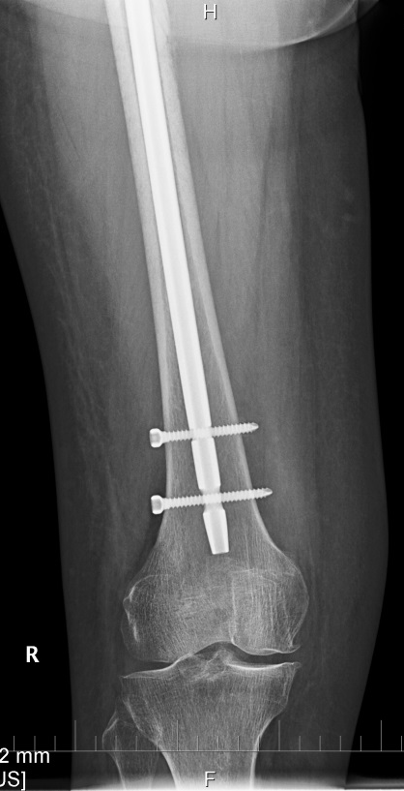
Open reduction and nailing

Slide 32
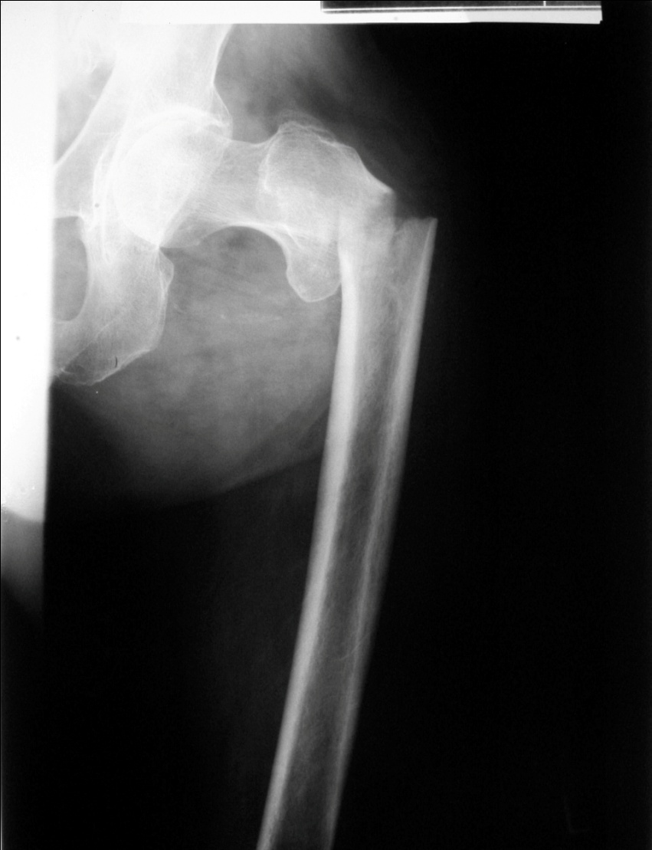
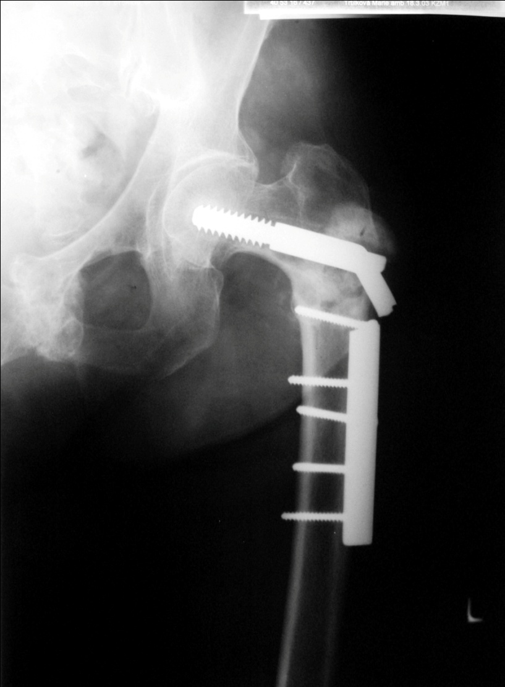
Failure of DHS plate

Slide 33
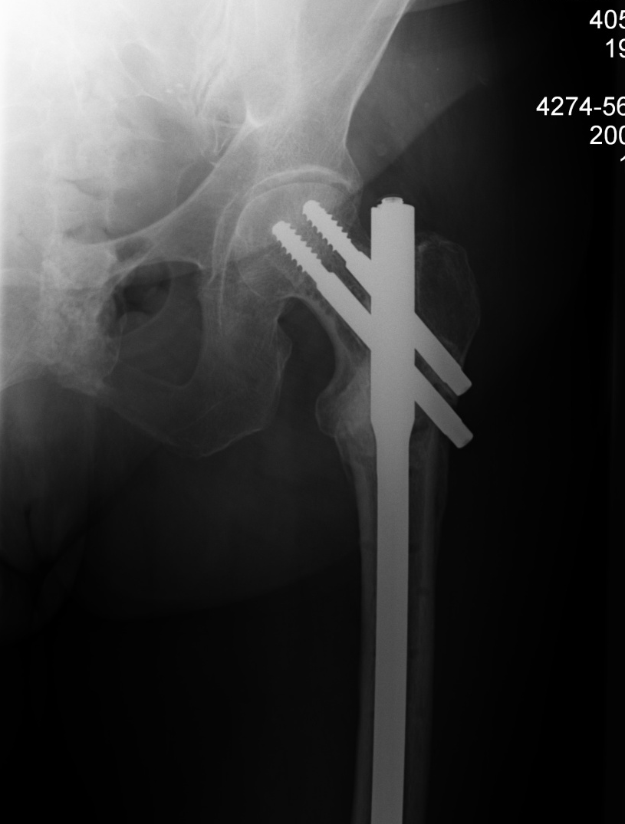
After change of DHS osteosynthesis to nail

Slide 34
Proximal femoral fractures
Reduction (traction) - analgezie, prevent of head ischemie,
prevention of thrombembolism
Acute operation /„vital indication“/
Antibiotic profylaxis (one dose/24h)
Physiotherapy from 1st pooperative day

Slide 35
Femoral shaft fracture
Usually are associated with considerable soft-tissue damage.
Blood loss of 2 to 3 units /1000-2000ml/
high incidence of associated injury in the same extremity - fractures of the femoral neck, posterior fracture-dislocations of the hip, tears of the collateral ligaments of the knee, and osteochondral fractures involving the distal femur or patella and fractures of the tibia.

Slide 36
X – ray – to view the joint above and the joint below the fracture
Treatment – operative - closed antegrade interlocking nailing - with or without reaming of the canal using flexible reamers
- plates (LCP), external fixator

Slide 37
Temporary immobilization
Notes:
37

Slide 38
Nailing

Slide 39
Complications
Associated vascular and nerve damage, especially a transient peroneal or pudendal nerve palsy, is not uncommon - generally associated with excessive or prolonged traction.
Shortening and malrotation of the extremity frequently occur , even with intramedullary nailing. Slight shortening is associated with earlier fracture union, and shortening up to 0.5 inch should be accepted without hesitation.
Skin breakdown over bony prominences and pin track infections are complications of traction.
Infection is extremely rare with the closed nailing technique .
Nonunion occurs in approximately 1% of fractures treated with nailing. This problem is easily managed with nail removal, reaming, and repeat nailing. Healing complications are more common when small-diameter nails are used.
Rotational malunion occurs in 10% to 20% of patients; the deformity is generally external rotation .
Weakness of the abductor muscles and hip pain can occur in one third of patients.
Knee injuries are common after femoral shaft fractures .

Slide 40
Distal femoral fractures
about 7% of all femur fractures.
If hip fractures are excluded, one-third of femur fractures involve the distal portion.
high incidence in young adults from high-energy trauma, in the elderly from minor falls.
In 5% to 10% - Open fractures

Slide 41
Distal femoral fracture
Associated with osteoporosis
Dislocation - dorsal angulation – m.triceps surae
Sharp bony spike
Vascular damage 2%

Slide 42
Distal femoral fractures

Slide 43
Examine
Clin. – neurovascular status, skin and soft tissues
X – ray
CT

Slide 44
Nonoperative treatment
rarely
nondisplaced or incomplete fractures, impacted stable fractures in elderly patients – fixation
displaced - 6- to 12-week period of skeletal traction followed by bracing – risk
of varus and internal rotation deformity, knee stiffness, long bed rest

Slide 45
Operative treatment
Screws
DCS plate
Distal femoral nail
LCP – LISS
External fixation

Slide 46
Osteosyntesis LCP LISS

Slide 47
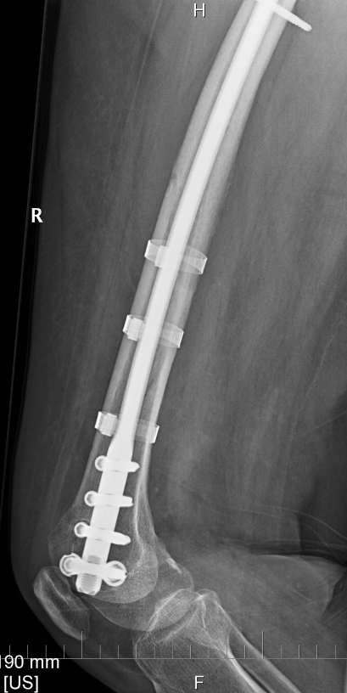
Retrograde nailing – Open Reduction Internal Fixation /ORIF/

Slide 48
DFN – periprostetic fr., after 6m

Slide 49
Open fracture of distal femur, external fixation

Slide 50
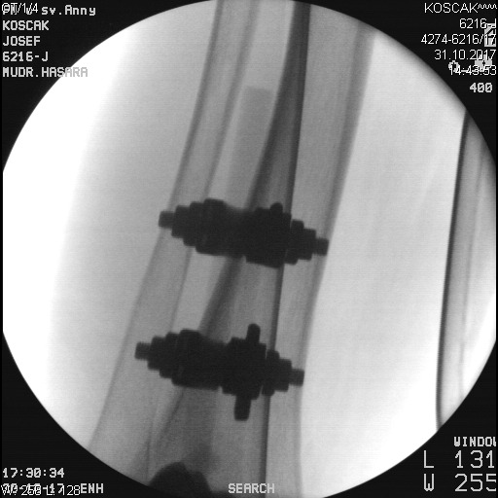
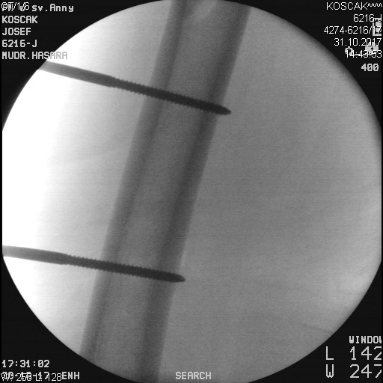
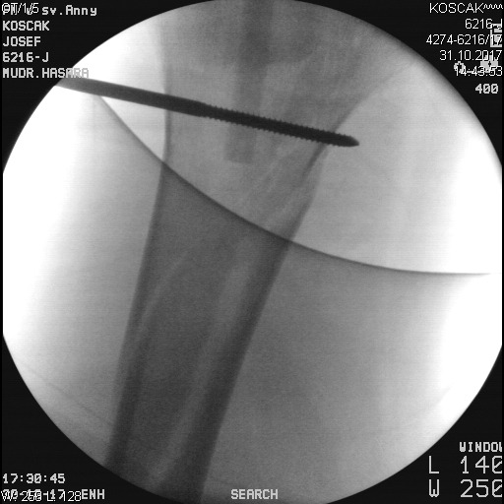
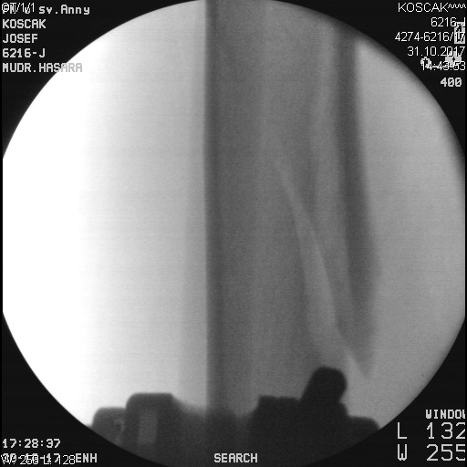
Notes:
50

Slide 51
Distal femoral fracture Associated Vascular Injury
The incidence about 2%.
If arterial reconstruction is necessary, it should be done before definitive skeletal stabilization.
Reduction of the fracture and temporary fixation with an external fixator or femoral distractor before vascular repair should be considered.
Definitive fracture management can proceed after the vascular procedure if the patients condition allows.
Fasciotomy of the lower leg should be performed in all cases.

Slide 52
Patellar fractures

Slide 53
Mechanism of injury
Direct: Displacement is typically minimal - preservation of the medial and lateral retinacular expansions. Abrasions or open injuries are common. Active knee extension may be preserved.
Indirect (most common): This is secondary to forcible quadriceps contraction while the knee is in a semiflexed position The degree of displacement of the fragments suggests the degree of retinacular disruption. Active knee extension is usually lost.
Combined direct/indirect mechanisms: These may be caused by trauma in which the patient experiences direct and indirect trauma to the knee, such as in a fall from a height.

Slide 54
Clinical evaluation
Active knee extension should be evaluated to determine injury to the retinacular expansions. This may be aided by decompression of hemarthrosis or intraarticular lidocaine injection.
Associated lower extremity injuries may be present in the setting of high-energy trauma. The physician must carefully evaluate the ipsilateral hip, femur, tibia, and ankle, with appropriate radiographic evaluation, if indicated.

Slide 55
Nonoperative treatment
Nondisplaced or minimally displaced (2- to 3-mm) fractures with minimal articular disruption (1 to 2 mm). This requires an intact extensor mechanism.
A cylinder cast or knee immobilizer is used for 4 to 6 weeks. Early straight leg raising and isometric quadriceps strengthening exercises should be started within a few days. Weight bearing after 3-4 weeks, active flexion 4+w /x-ray/

Slide 56
Operative treatment
ORIF - open reduction and internal fixation include >2-mm articular incongruity, >3-mm fragment displacement, or open fracture.
There are multiple methods of operative fixation, including tension banding (using parallel longitudinal Kirschner wires or cannulated screws) as well as circumferential cerclage wiring. Retinacular disruption should be repaired at the time of surgery.
Postoperatively, the patient should be placed in a splint for 3 to 6 days until skin healing, with early institution of knee motion. The patient should perform active assisted range-of-motion exercises, progressing to partial and full weight bearing by 6 weeks.
Severely comminuted or marginally repaired fractures, particularly in older individuals, may necessitate immobilization for 3 to 6 weeks.
Patellectomy – partial / total - comminutive fractures, Reattachment of the quadriceps or patellar tendon, Repair of medial and lateral retinacular injuries , long leg cast at 10 degrees of flexion for 3 to 6 weeks.

Slide 57
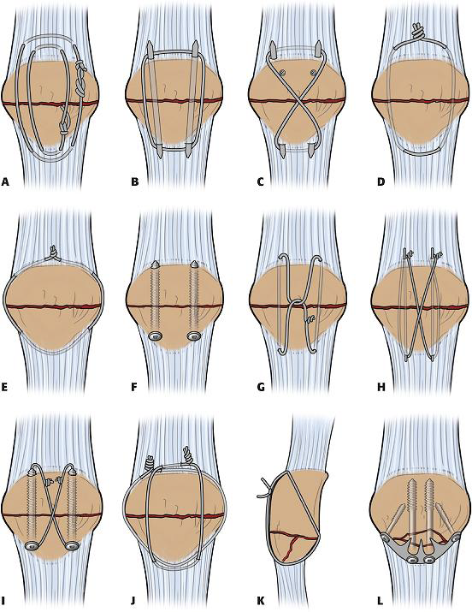
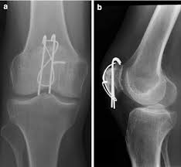
Osteosynthesis of patellar fracture
Types of oteosynthesis
Dynamic tension band – produces increased compression with motion

Slide 58
Děkuji za pozornost

