Slide 1
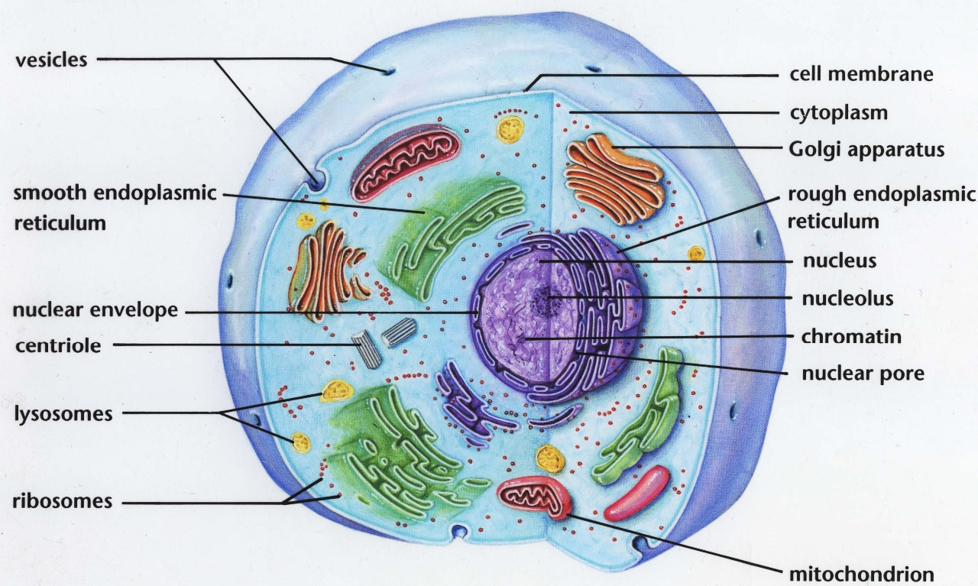
The cell

Slide 2
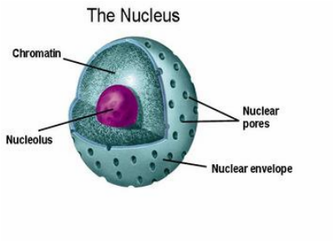
Nucleus
1 or 2 (rarely more)
diameter: 4 – 10 μm
shape – spherical, oval, lobated, segmented
contains chromosomes with DNA and proteins (genetic informations), chromosomes are visible only during cell division (mitosis, meiosis); during interphase (= period between cell divisions) chromosomes are decondensed and form fine, granular chromatin
NUCLEAR COMPONENTS:
chromatin (decondensed chromosomes)
nucleolus
nuclear envelope – inner + outer membrane
nuclear skeleton

Slide 3
Nuclear envelope
The nucleus is enveloped by a pair of membranes (inner + outer) enclosing a perinuclear space that is continuous with rough endoplasmic reticulum and ribosomes can be attached to the external surface of outer membrane. The inner membrane is stabilized by a meshwork of intermediate filament proteins called lamins.
is perforated by nuclear pores that control the passage of molecules in and out
nuclear pores are constructed from a number different proteins called nucleoporins.

Slide 4
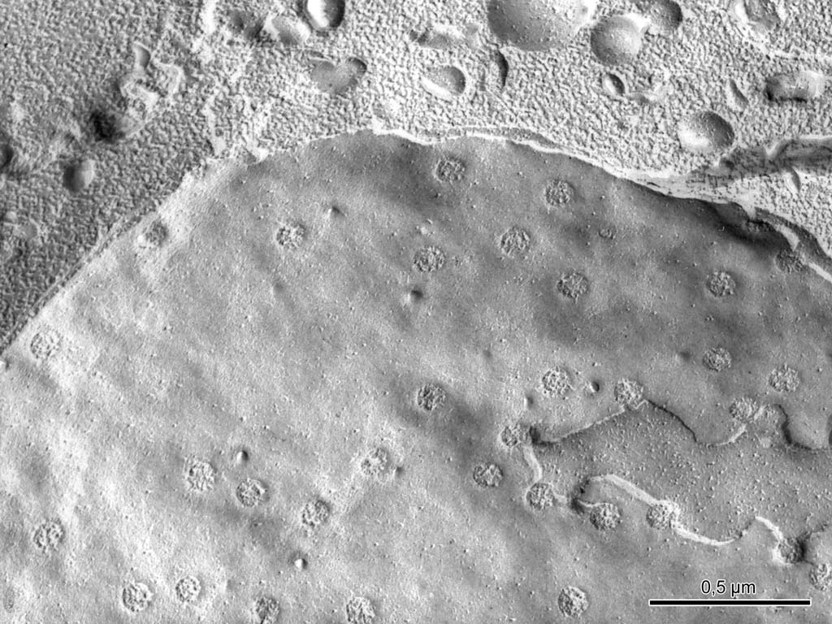
Notes:
Buněčné jádro, mrazový lom, TEM
Jaderné póry
Vnitřní a zevní jaderná membrána

Slide 5
Chromatin
- Decondensed chromosomes during interphase of cell division
2 types of chromatin :
- euchromatin – light in EM, completely decondensed chromosomes, intensly active RNA synthesis
heterochromatin – dark in EM, partly decondensed chromosomes, inactive,
according to localization in nucleus 3 types of heterochromatin are recognised:
marginal heterochromatin (attached to inner membrane)
perinucleolar heterochromatin (around nucleolus)
karyosomes (within euchromatin)

Slide 6
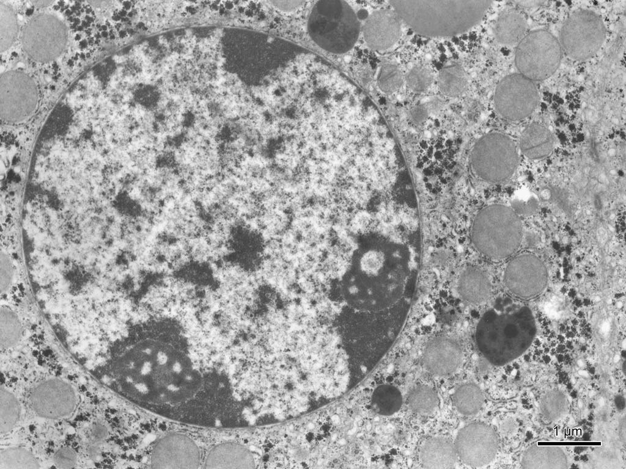
Notes:
Jádro hepatocytu, TEM
Heterochromatin
Euchromatin
Jadérko

Slide 7
Nucleolus
Nucleolus
1 – 2 – more nucleoli in nucleus during the period between cell divisions (interphase)
1 – 3 μm ∅
is not separated by any membrane
contain: RNA, DNA, proteins
structure in EM: pars fibrosa (with fibrilar form of RNA), pars granulosa (with granular form of RNA), fibrilar center(s) with DNA

Slide 8
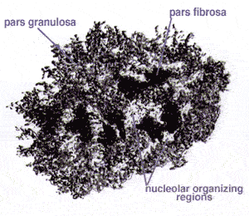
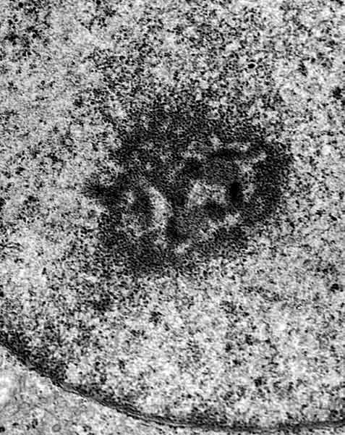
Types of nucleoli: reticular, ring-shaped, compact
function: synthesis of preribosomal RNA which is connected with proteins forming together ribosomal subunits, these are transported into the cytoplasm through pores in nuclear envelope.

Slide 9
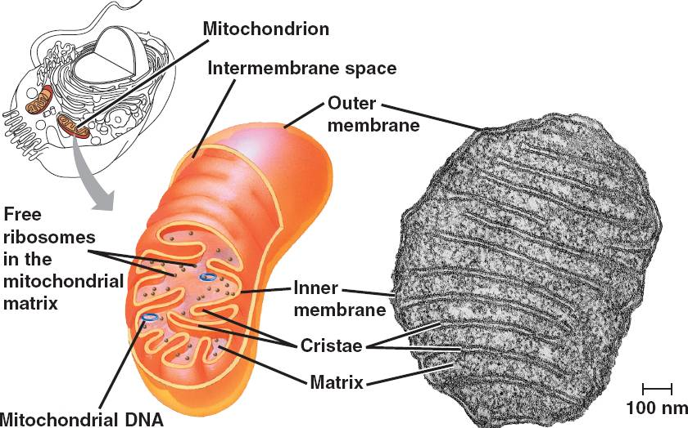
Mitochondrion
spherical or oval or elongated bodies
0.5 μm ∅, length of elongated mitochondria 1-10 μm
volume density of mitochondria in the cytoplasm depends on the metabolic activity of the cell
function: oxydative phosphorylation (transformation of energy of chemical compound into energy of macroergic bounds
ATP - the universal energy currency of the cell).

Slide 10
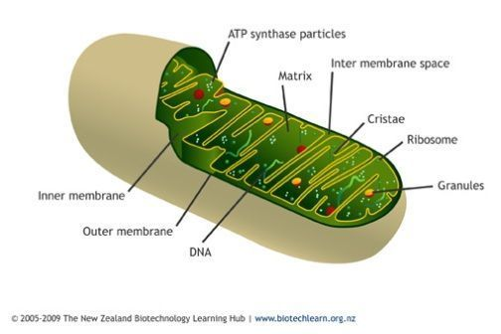
Mitochondrion
Structure:
outer mitochondrial membrane – smooth; with transporting channels
inner mitochondrial membrane – forms flattened (rarely tubular) invaginations into the inner matrix called cristae (there are ATP synthase enzyme molecules, which produce ATP)
intermembrane space between the membranes contains enzyme cytochrome C
mitochondrial matrix – finely granulated, contains enzymes of Krebs' cycle (citric acid cycle), ADP, ATP, DNA, RNA, ribosomes, proteins, ribosomes and granules (with ions Ca, Mg mainly)
mitochondria are partly autonomous (semiautonomous) structures: they contain DNA and their own ribosomes and produce own proteins
they are able divide themselves (replication)

Slide 11
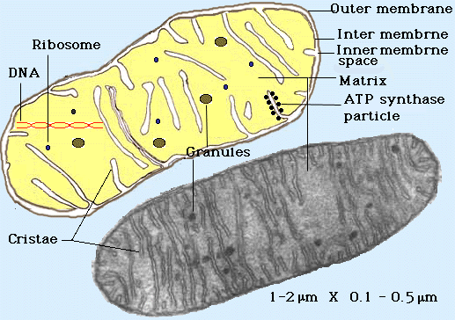
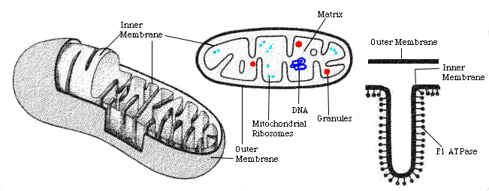
Mitochondrion

Slide 12
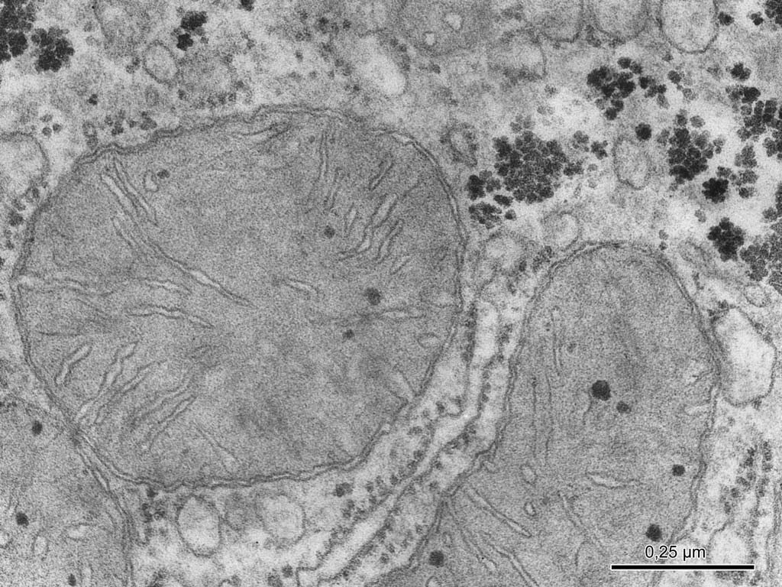
Notes:
Mitochondrie v jaterní buňce, TEM
Kristy, matrix, mitochondriální tělíska

Slide 13
Ribosomes
small particles (below recognizing ability of LM)
in EM they appear as granules sized 20 – 25 nm
chemical composition: several types of RNA with associated proteins (cells containing large amount of ribosomes show basophilia of cytoplasm because ribosomes are acid structures in the cell)
Forms of ribosomes:
free ribosomes
polysomes
connected with membrane of rough endoplasmic reticulum

Slide 14
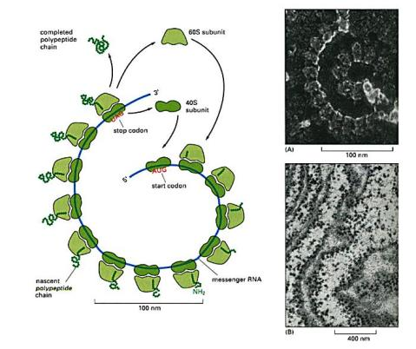
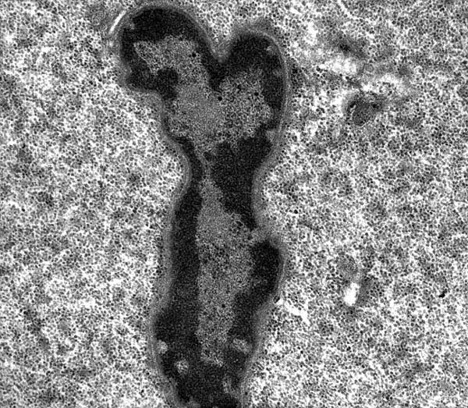
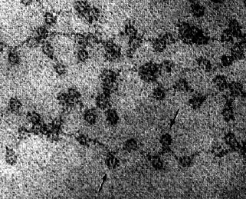
Ribosomes

Slide 15
Ribosomes
Function of ribosomes:
synthesis of proteins (polypeptides) for “export” (are released externally from cell cytoplasm) by rough endoplasmic reticulum
synthesis of proteins used by cell by free ribosomes and polysomes (stem cells need proteins to grow intensly – examples: “young” cells involved in embryogenesis, “young” blood cells – precursors of mature blood cells)

Slide 16
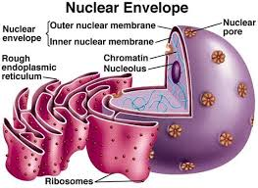
GER
3D system of communicating flattened cisternae with membrane covered with ribosomes
binding of ribosomes to GER is reversible, they can be released from membrane.
function of GER – protein synthesis for export. GER is the site of translation and folding of and transport of proteins that are to become part of the cell membrane (e.g., transmembrane receptors and other integral membrane proteins) as well as proteins that are to be secreted or "exocytosed" from the secretory cell (e.g., digestive enzymes).

Slide 17
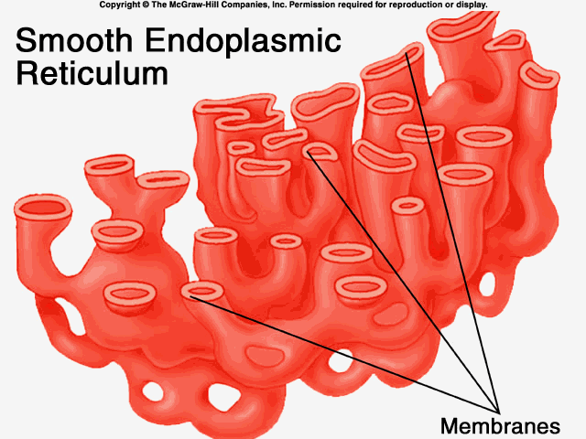
AER
3D system of communicating short tubules and small vesicles with smooth membrane without ribosomes
Function of AER – numerous: - participatin in detoxicating processes in the cells (liver and some kidney cells) - participation in steroid hormones production - participation in glycogen metabolism (liver cells) - reservoir of Ca ions (sarcoplasmic reticulum in muscle cells) - etc.

Slide 18
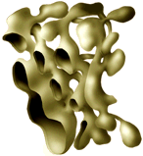
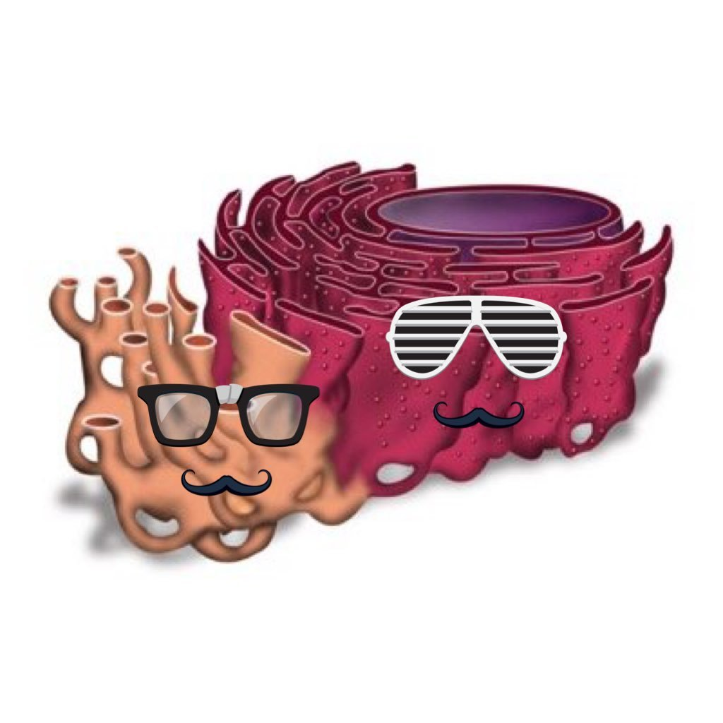
Endoplasmic reticulum
2 forms: rough (granular) – GER, and smooth (agranular) – AER

Slide 19
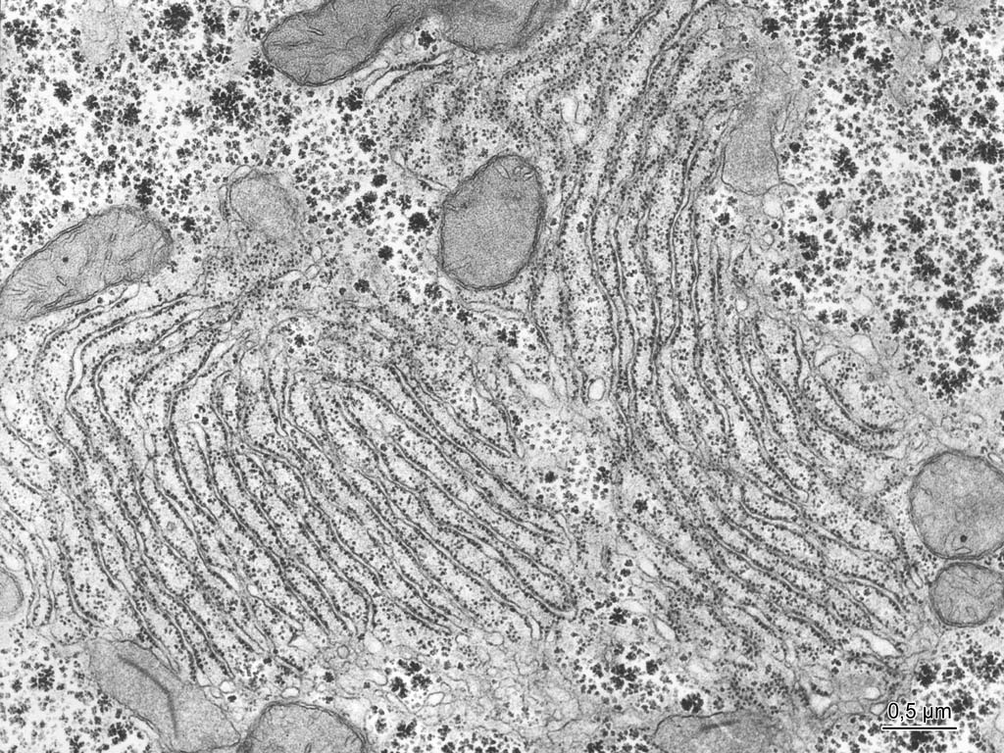
Notes:
Endoplazmatické retikulum v jaterní buňce, TEM
Cisterny granulárního ER
Tubuly a váčky hladkého ER

Slide 20
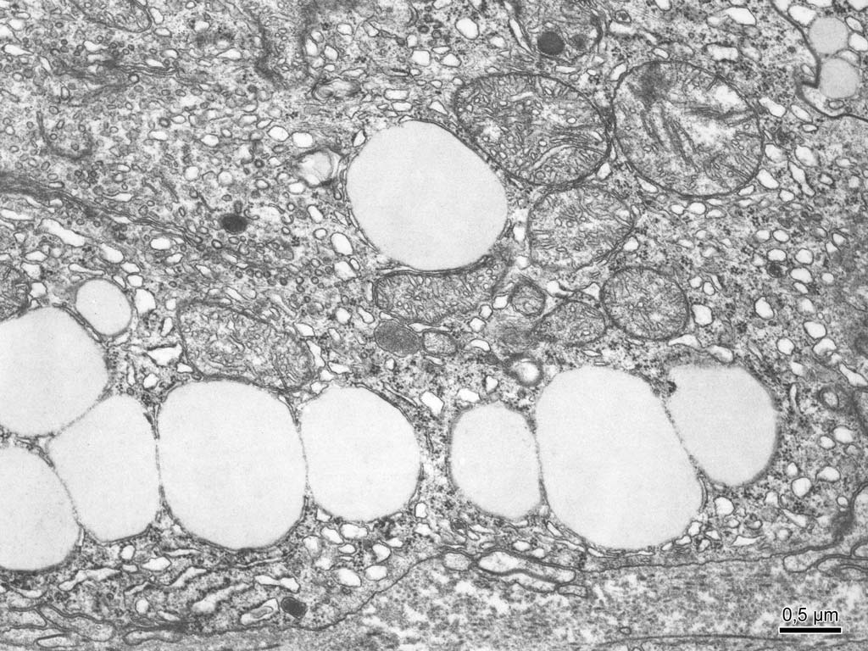
Notes:
Lipidové kapky ve steroidogenní buňce, TEM
Mitochondrie s tubulózními kristami
Váčky hladkého endoplazmatického retikula
Tukové kapky

Slide 21
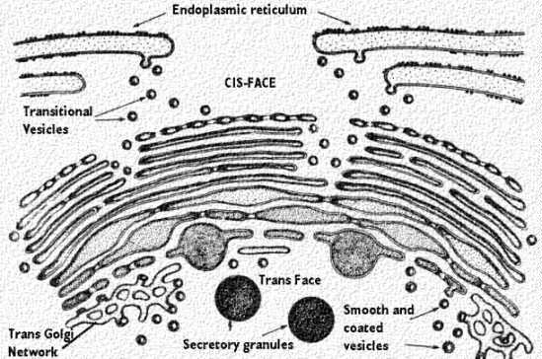
Golgi apparatus
usually near the nucleus; several GA in some region of cytoplasm = Golgi field
3 components: - paralell flat cisternae (3 – 10) – they are curved like horse-shoe and polarized: cis–face (forming face) and trans–face (maturing face) are distinguished - small vesicles (numerous) - large vacuoles (several)

Slide 22
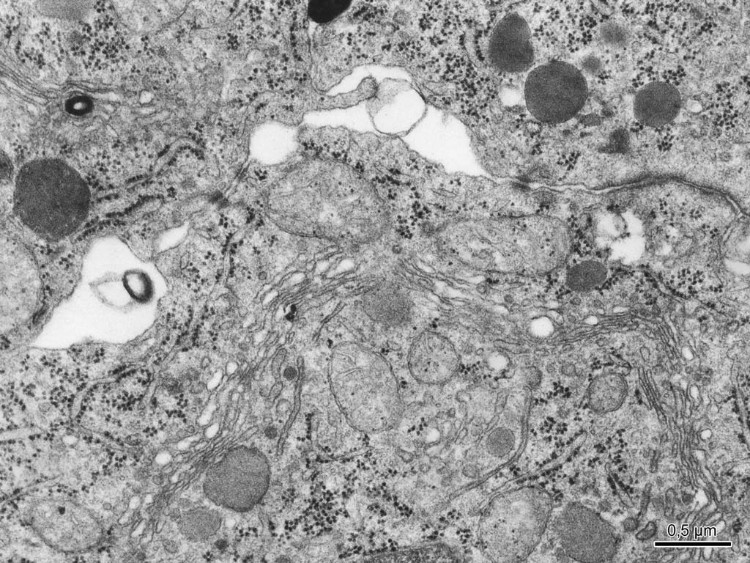
Notes:
Golgiho aparát ve žlázové buňce
Cisterny
Granulární ER s transportními váčky
Nezralá sekreční granula

Slide 23
Golgi apparatus
Function : GER + GA cooperate together, functionally connected system of 3D network of cisternae, vesicles and vacuoles with metabolic, proteosynthetic and secretory functions:
ribosomes on GER – produce polypeptides and release them into cisternae of GER
contant of GER cisternae is transported through them and small transporting vesicles with proteins are detached
transporting vesicles migrate to cis–cisterna of GA and fuse together, protein is released into GA, pass through all cisternae into GA trans–cisterna; proteins are processed in GA (finalization of product into hormones, enzymes and other substances)
- vesicles and vacuoles with final product are detached from trans–cisterna; their contant is condensed and vacuoles are transformed into secretory granules, lysosomes, smooth and coated vesicles for exocytosis

Slide 24
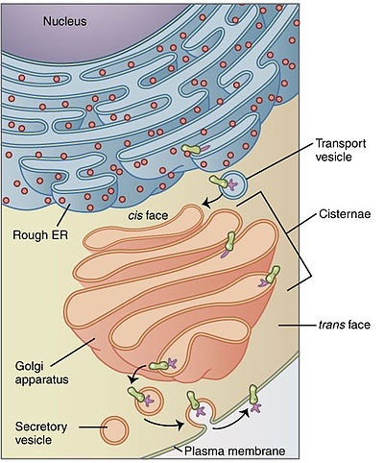
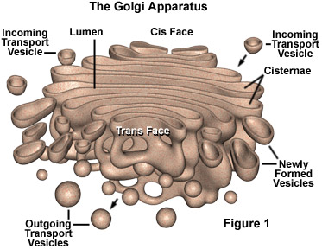
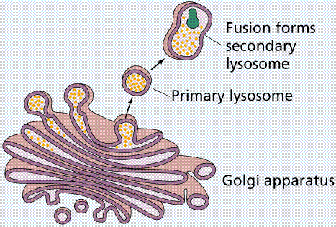
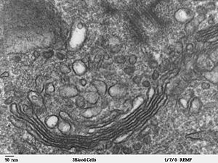

Slide 25
Lysomes
lysosomes – heterogenous group of spherical bodies (0.05 -0.5 μm ∅) containing hydrolytic enzymes - primary lysosomes – small vesicles with intact enzyme contant - secondary lysosomes – after fusion with material for digestion; according to origin of this material they are divided into fagosomes (extracellular origin) and autophagic vacuoles (intracellular origin) - residual bodies – inactive lysosomes with indigestible material (rest)

Slide 26
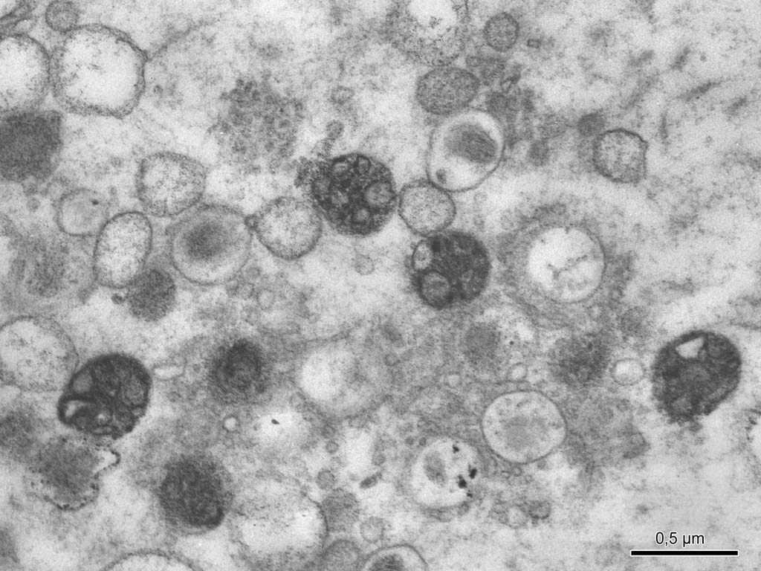
Notes:
Lysozomy, průkaz kyselé fosfatázy, TEM
Sekundární lysozomy, v některých prokázána kyselá fosfatáza

Slide 27
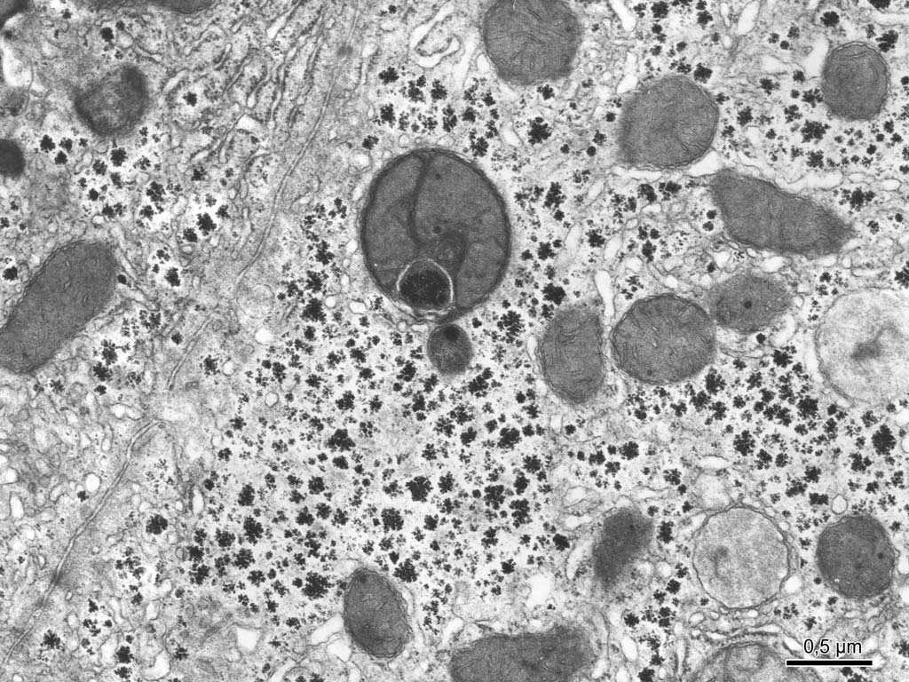
Notes:
Autofagická vakuola v jaterní buňce, TEM
autofagická vakuola,
Alfa-granula glykogenu

Slide 28
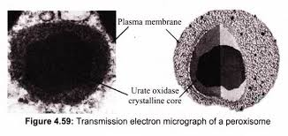
Peroxisomes
spherical vesicles
∅ 0.5 μm
surrounded by single membrane
nucleoid
enzymes: uricase, oxidase (oxidation of long and very long chain fatty acids) , catalase (splits H₂O₂ - detoxication)
in nearly all eukaryotic cells, mainly in liver cells (hepatocytes) and in epithelial cells of proximal tubule of kidney
function: participation in anabolic (bile acid, cholesterol or phospholipids synthesis) and catabolic processes

Slide 29
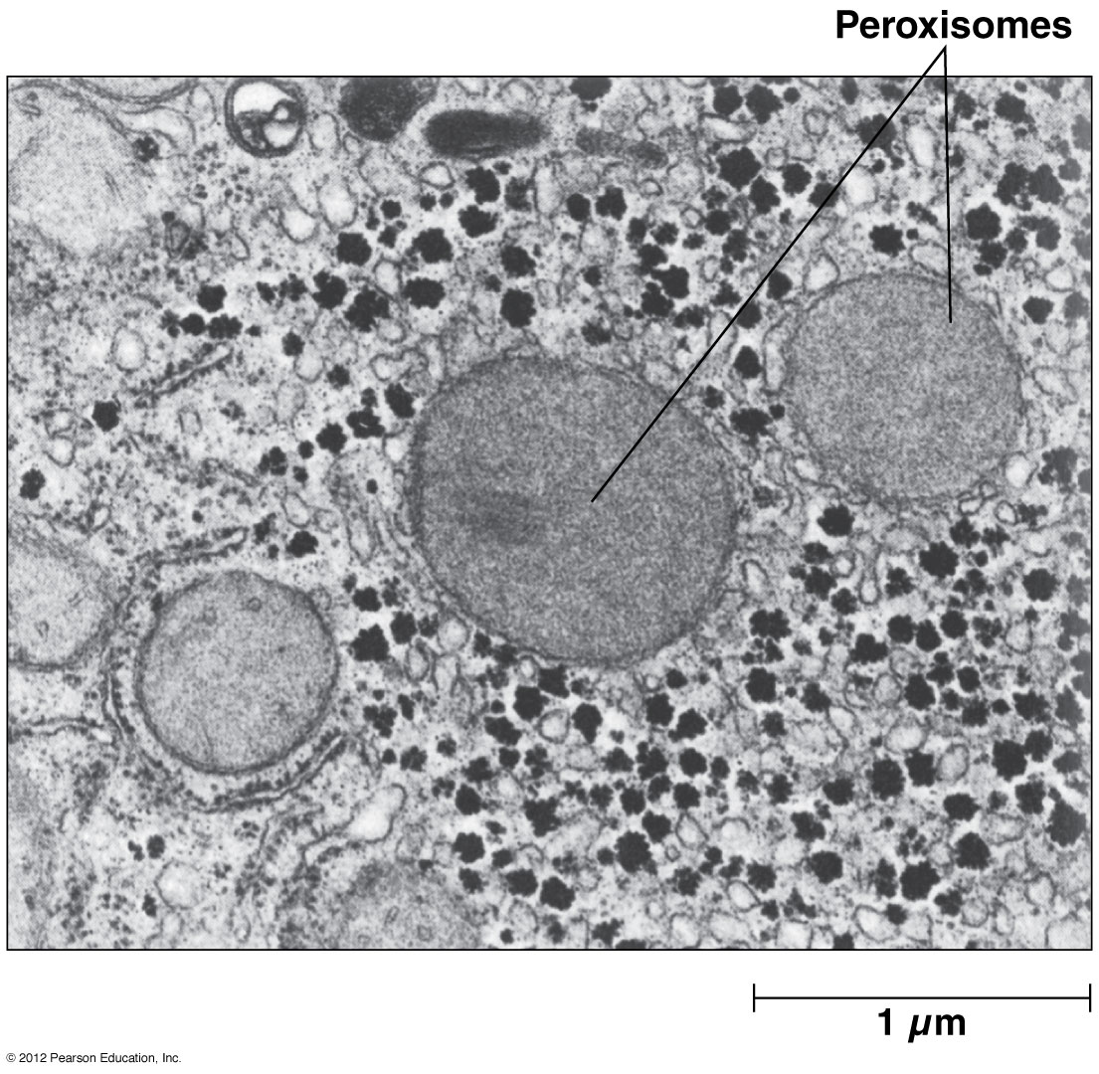
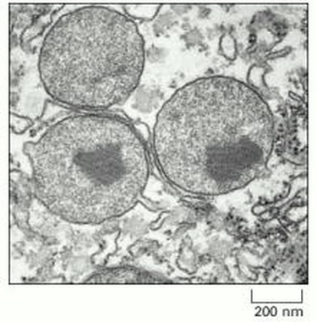
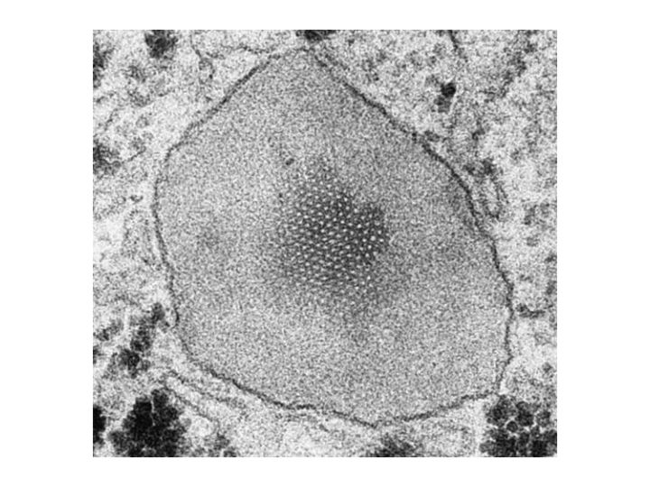

Slide 30
Cytoskeleton
Cells contain protein fibers that serve such functions as:
establishing cell shape
providing mechanical strength
locomotion
chromosome separation during cell division
intracellular transport of organelles
The cytoskeleton is made up of three kinds of protein filaments:
microtubules
microfilaments
intermediate filaments

Slide 31
Microtubules
are straight, hollow cylinders
have a diameter of about 25 nm
are variable in length but can grow 1000 times as long as they are thick (grow at each end by the polymerization of tubulin dimers and shrink at at each end by the release of tubulin dimers (depolymerization)
are built by the assembly of dimers of alpha and beta tubulin.
Microtubules participate in a wide variety of cell activities. Most involve motion. The motion is provided by protein "motors" that use the energy of ATP to move along the microtubule.
Microtubule motors - there are two major groups of microtubule motors
kinesins (most of these move toward the plus end of the microtubules) and
dyneins (which move toward the minus end).

Slide 32
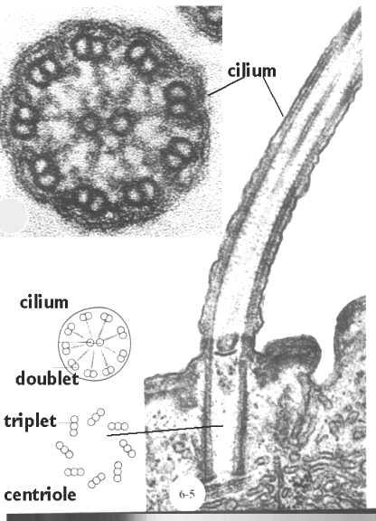
Microtubules
Kinocilia
Cilium – 9 doublets + 1
Basal body = centriol – 9 triplets (kinetic center of cilium)

Slide 33
Microfilaments
Monomers of the protein actin polymerize to form long, thin fibers. These are about 8 nm in diameter and, being the thinnest of the cytoskeletal filaments, are also called microfilaments. (In skeletal muscle fibers they are called „thin“ filaments, while „thick“ filaments are composed of protein myosin). Some functions of actin filaments:
form a band just beneath the plasma membrane that
provides mechanical strength to the cell
links transmembrane proteins (e.g., cell surface receptors) to cytoplasmic proteins
anchors the centrosomes at opposite poles of the cell during mitosis
pinches dividing animal cells apart during cytokinesis
generate cytoplasmic streaming in some cells
generate locomotion in cells such as white blood cells and the amoeba
interact with myosin filaments in skeletal muscle fibers to provide the force of muscular contraction

Slide 34
Intermediate filaments
These cytoplasmic fibers average 10 nm in diameter (and thus are "intermediate" in size between actin filaments (8 nm) and microtubules (25 nm)
There are several types of intermediate filament, each constructed from one or more proteins characteristic of it.
Type of filament | Cells where they are found
cytokeratins | epithelial cells, and also form hair and nails
vimentin | cells of mesenchymal origin – smooth muslce cells, some endothelial and connective tissue cells
desmin | muscle cells
neurofilaments | strenthen the long axons of neurons
glial fibrilary acid protein | supporting neuroglial cells in nerve system
Despite their chemical diversity, intermediate filaments play similar roles in the cell: providing a supporting framework within the cell.
Detection of type of intermediate filaments in tumor cells is used for estimation of tumor origin.

Slide 35
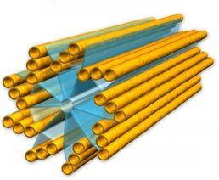
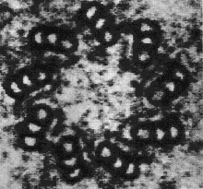
Centriole
oval body
∅ 0.2 μm and 0.2 – 0.5 μm in the length
9 triplets of microtubules
paired organelle: one centriol is organized at right angle to the other
in centrosome = centrosphere (region of cytoplasm near the nucleus)

Slide 36
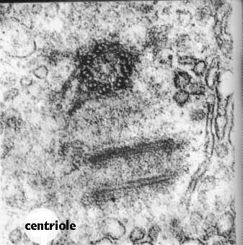
Centriole
oval body, ∅ 0.2 μm and 0.2 – 0.5 μm in the length
9 triplets of microtubules
paired organelle: one centriol is organized at right angle to the other
in centrosome = centrosphere (region of cytoplasm near the nucleus)

Slide 37
Centriole
Function:
after duplication or multiplication
centrioles organize the microtubules of mitotic spindle apparatus at the beginning of mitosis
are also needed to make cilia (ciliogenesis) and flagella – these project from cell surface and centriols as basal bodies of cilia or flagella are present in the cytoplasm bellow them.

Slide 38
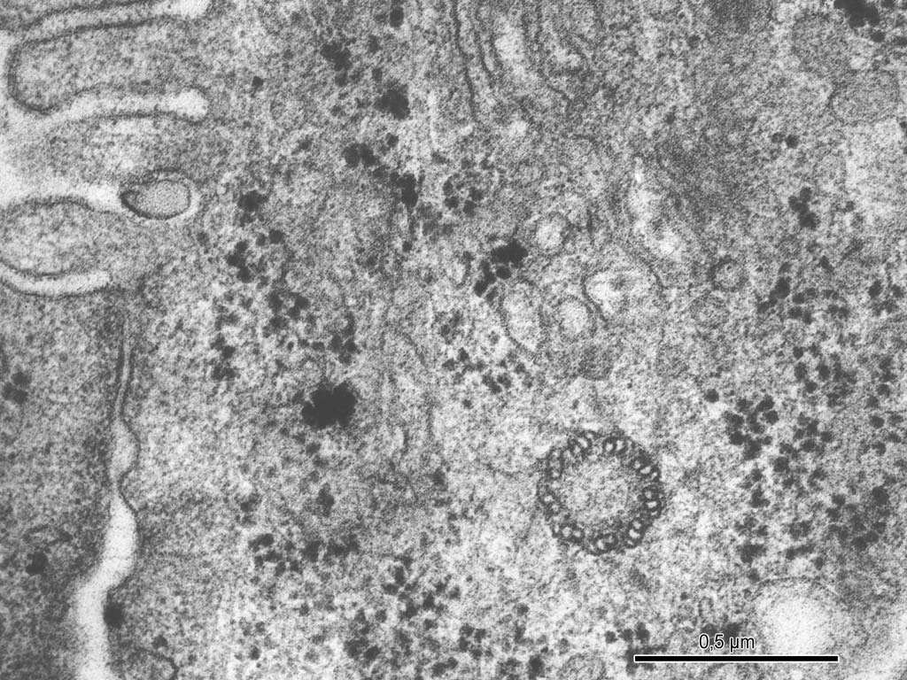
Notes:
Centriol v jaterní buňce – příčný řez, TEM

Slide 39
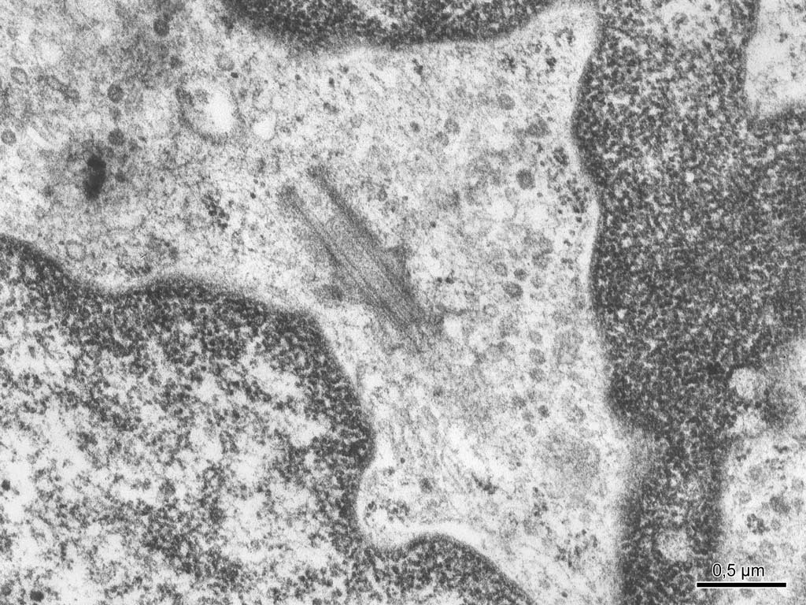
Notes:
Centriol ve fibroblastu – podélný řez, TEM
Mikrotubulus
Satelitní struktury

Slide 40
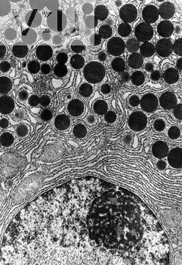
Inclusions
are cytoplasmic structures of transitional character arrising by accumulution of unsoluble metabolits of storing materials or they are of exogenous origin and enter the cell via phagocytosis.
Secretory granules
membranous vesicles with protein or glycoprotein contant in glandular cells
they are released from the cell

Slide 41
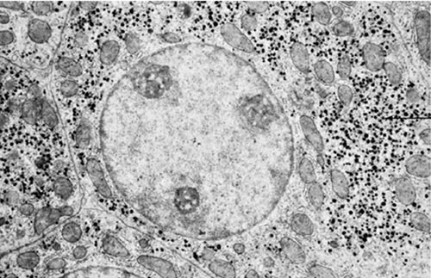
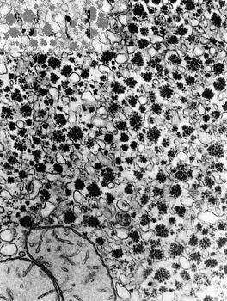
Inclusions
Reserve materials: Glycogen
β – granules (sized 20 nm) or α – granules (clusters of β – granules, sized 500 nm)

Slide 43
Inclusions
Lipid droplets
- non-membranous, round particles (∅ 100 nm – 10 μm)
Kristals
Pigments:
- colored inclusions are divieded into
autogenous – synthetized from precursors inside of cell and having specific function (melanin)
hematogenous – arrise by break-down of hemoglobin (hemosiderin, biliverdin  bilirubin)
- exogenous – from extracellular medium (carotens, dust particles, arteficial dyes – tattoo)

Slide 44
Notes:
Lipidové kapky ve steroidogenní buňce, TEM
Mitochondrie s tubulózními kristami
Váčky hladkého endoplazmatického retikula
Tukové kapky

